Slide 1
Office of Acquisition & Agreements Management
Director: Cecelia Royster
Grants Management Division

Slide 2
Why Robin Likes Grants?
Great service tool
An opportunity for everyone to explore new ideas,
further science, support our economy, and improve
our quality of life
Grants touch nearly all programs at NIST
Good way to see the synergy across NIST
Get to work with really great people!
And it’s FUN!

Slide 3
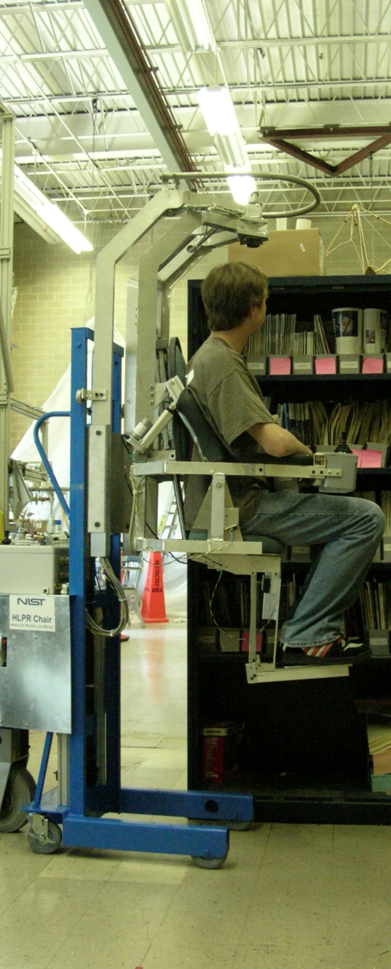
Many Faces of Financial Assistance Agreements
"Assistance" refers to the transfer of money, property, services, or
anything of value, the principal purpose of which is to accomplish
public purpose of support or stimulation authorized by Federal statute.
1
Grants
Cooperative Agreements
Loans
Scholarships
Counseling
Statistical, and other expert information
Service activities of regulatory agencies
2
2
1 From CFDA.Gov
2 Financial assistance agreements offered by NIST

Slide 4
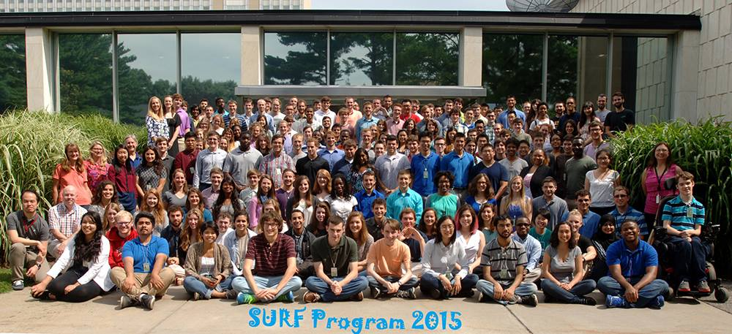
NIST Federal Financial Assistance Programs

Slide 5
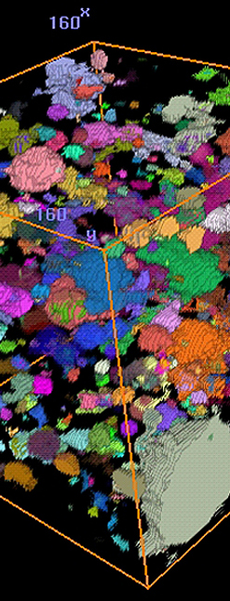
How to Search for Opportunities
Grants.gov:
Site which posts all the financial assistance funding
opportunities across 26 federal agencies
Catalog of Federal Domestic Assistance (CFDA.Gov)
NIST Specific Opportunities
See the Grants booth for more info on NIST grant opportunities
http://www.nist.gov/director/grants/grants.cfm

Slide 6
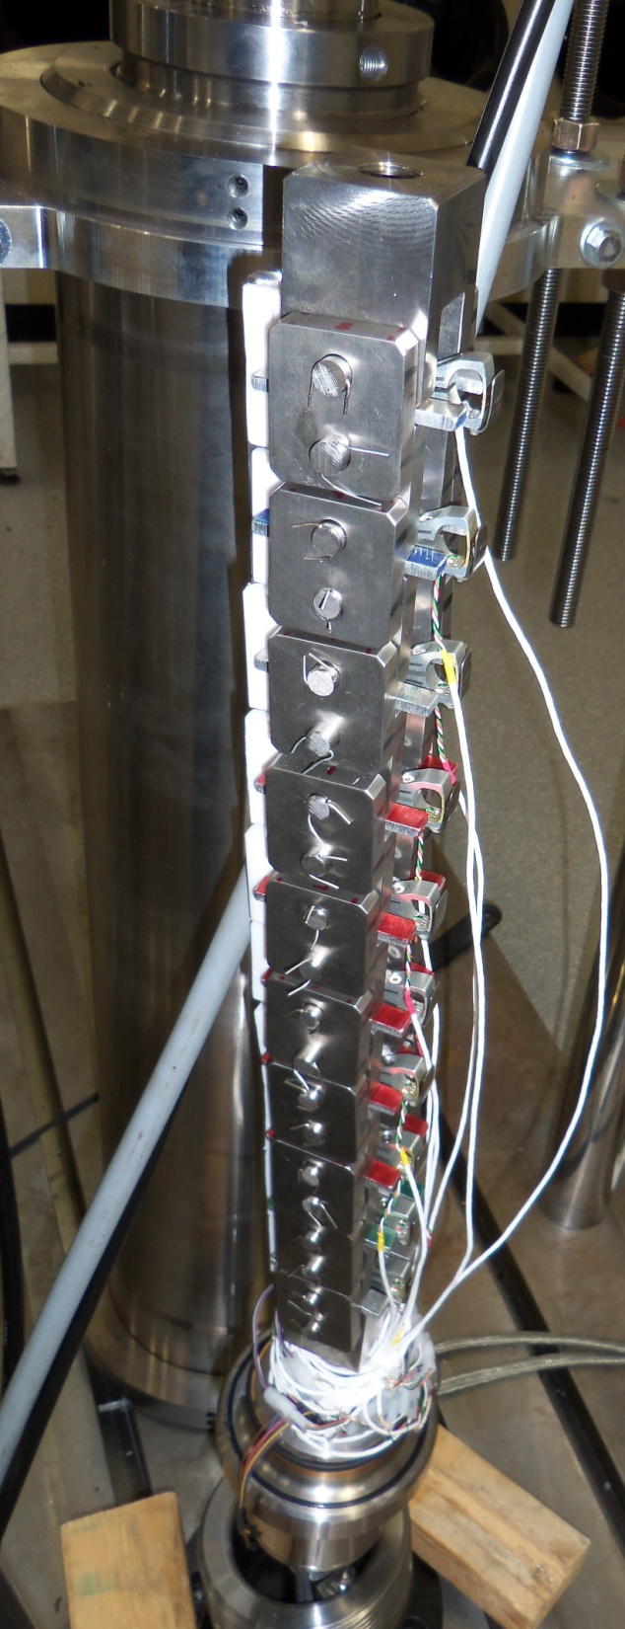
Overview of Application Process
NIST posts announcements to grants.gov
You apply for the grant
Your application is reviewed by a panel and scored
You are notified by NIST if your application will
receive a grant
And that’s it!

Slide 7
Take Home Points
Grants are among the most important
tools the Federal Government uses to
accomplish its objectives
You are needed to further science,
promote U.S. innovation and enhance
industrial competitiveness
NIST also administers contracts
(See Procurement booth)

Slide 8
