Slide 1
BD Flow Cytometry Software: Standardization and Interoperability Aspects
Josef Spidlen, Ph.D.
Senior Director, R&D
Informatics BD Life Sciences
josef.spidlen@bd.com
Presentation @
November 18, 2021
Views expressed here are solely my own and may not express the views or opinions of my employer.

Slide 2
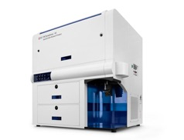
Raw FCS Data
Why do we need standards?
Raw FCS Data
Compensated FCS Data
Data Quality Assessed
Data Quality Assessed
Interoperability
Interpretability
Best practices
Transformed Data
Transformed Data
Normalized Data
Normalized Data
Cell Populations Scored
[Biomarkers]
Cell Populations Identified
[Gated Data]
Cell Populations Scored
[Biomarkers]
Cell Populations Identified
[Gated Data]
Where do we have standards supported by BD?
Cell Populations Labelled
Cell Populations Labelled
Diagnosis
Diagnosis
Visualization ++
Visualization ++
Discovery
Discovery
Adapted from Figure 207 in Cossarizza A et al. Guidelines for the use of flow cytometry and cell sorting in immunological studies (second edition). Eur. J. Immunol. 2019. 49: 1457–1973. DOI: 10.1002/eji.201970107

Slide 3
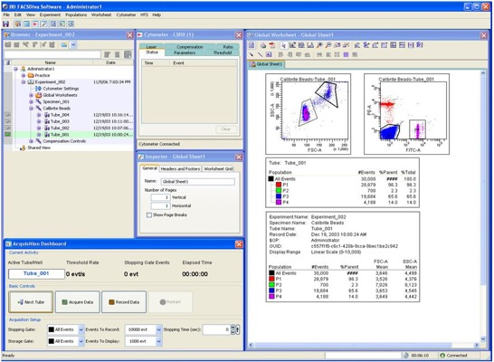
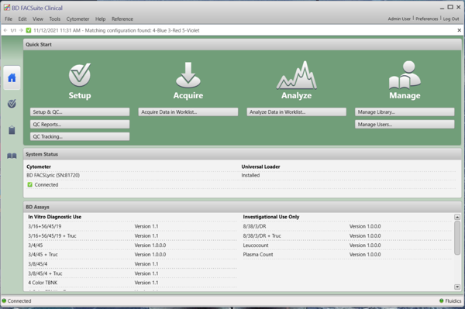
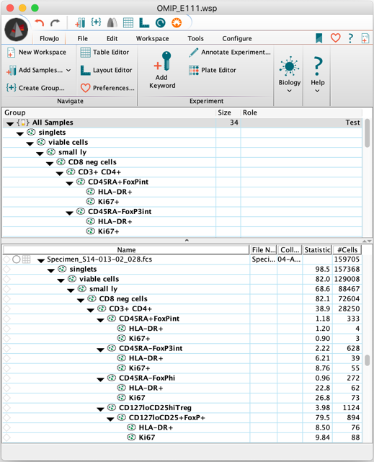
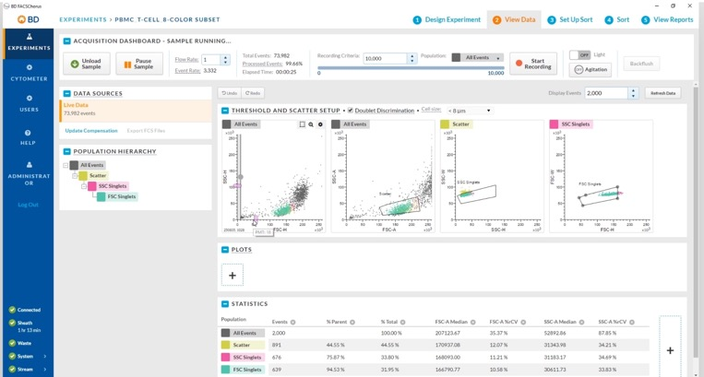
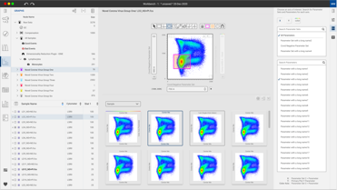
Data acquisition
Data analysis
RUO / Clinical
Not discussing today:
Panel design
Data management solutions
Other kinds of software

Slide 4
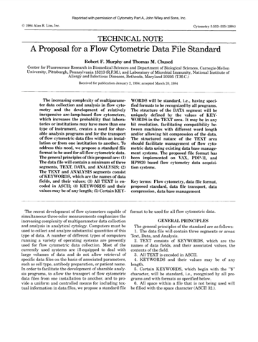
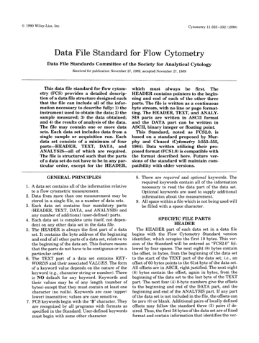
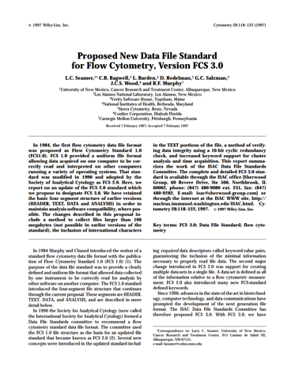
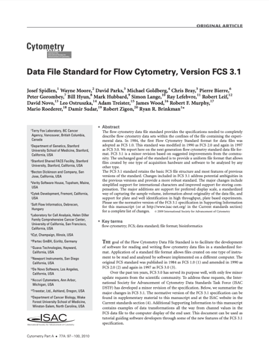
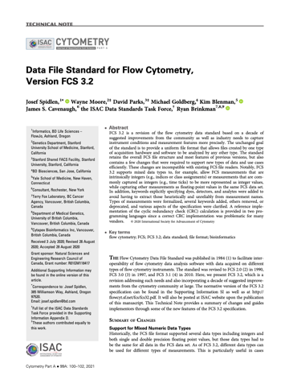
FCS – Flow Cytometry Standard
1984
FCS 1.0
1990
FCS 2.0
1997
FCS 3.0
2010
FCS 3.1
2021
FCS 3.2

Slide 5
FCS – Flow Cytometry Standard
Supported by all BD instruments and all BD software
Data interoperability has been largely addressed

Slide 6
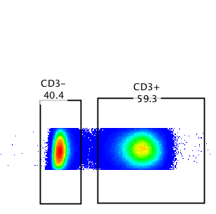
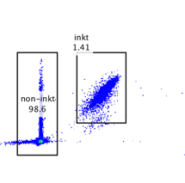
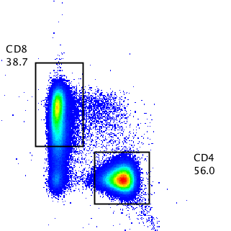
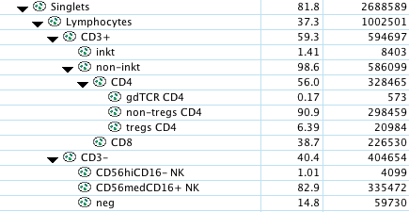
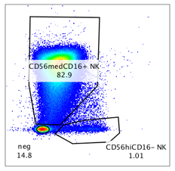
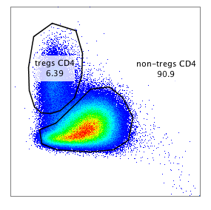
Data Analysis Interoperability
What else is needed?
Comp-VIOLET A-A :: BV7856 CD56
x
Comp-VIOLET C-A :: BV605 CD16
Comp-UV B-A :: BUV737 CD127
x
Comp-UV C-A :: BUV395 CD25

Slide 7
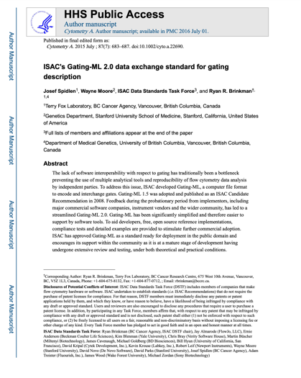
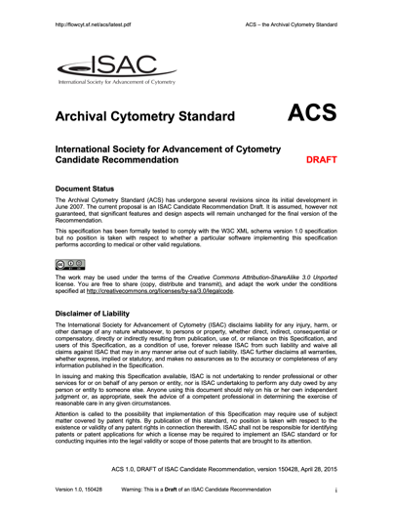
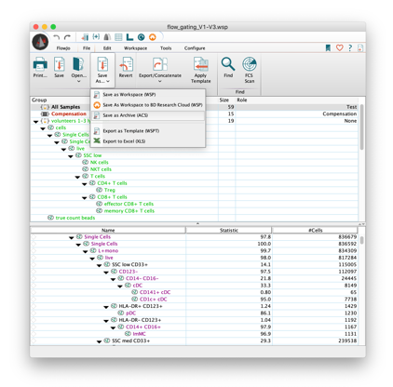
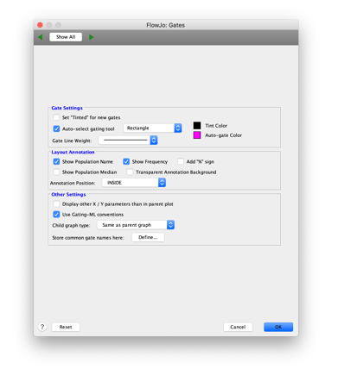
Data Analysis Interoperability
What else is needed?
Gates and gating hierarchies
Data transformations
Compensation
Reasonably supported by FlowJo
Associate data with analysis
Reasonably supported by FlowJo

Slide 8
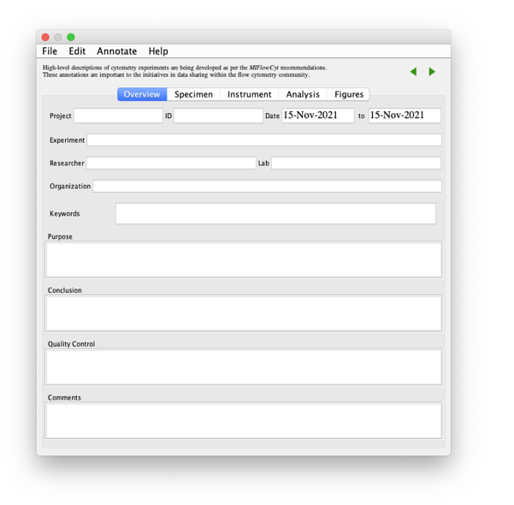
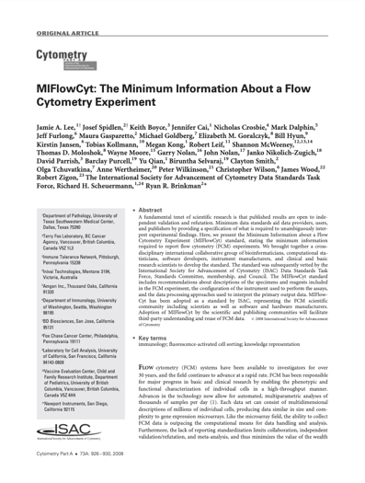
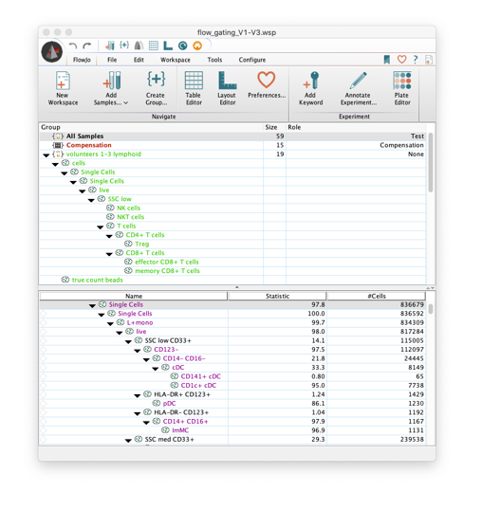
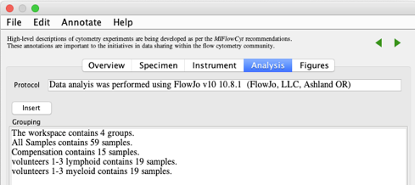
Experiment Interpretability
What else is needed?
MIFlowCyt
Supported by FlowJo

Slide 9
Volunteers to gate this manually?

Slide 10
Computational Analysis
Flow Cytometry
scOmics
CLR
Interchange results of some computational analysis
Does NOT cover methodology
Supported by FlowJo (e.g., drag & drop a CLR file onto a sample in FlowJo)
Automated gating and clustering
Dimensionality reduction
Classification
Trajectory inference

Slide 11
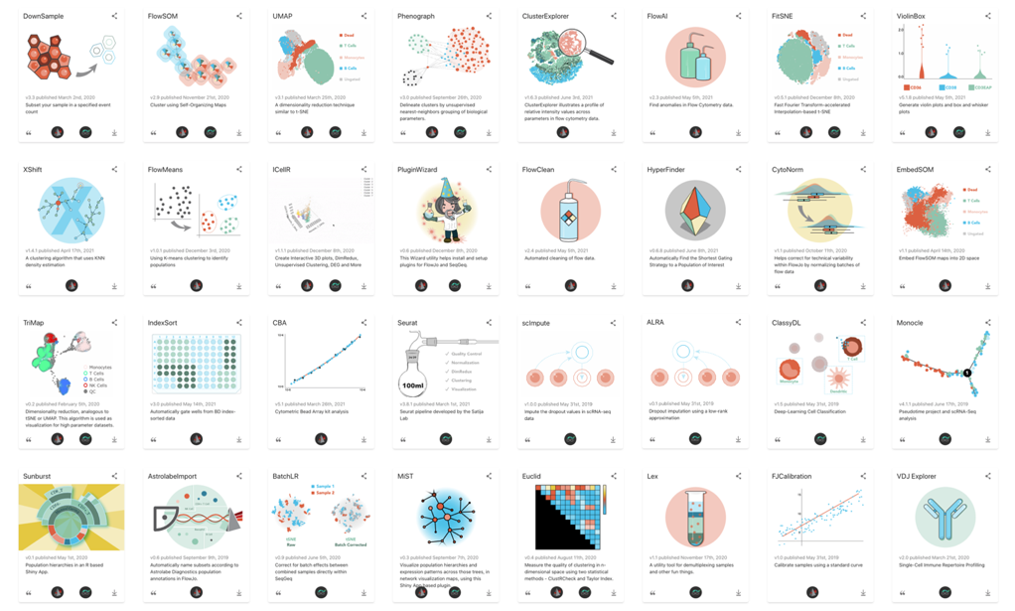
Computational Analysis
Even if standards are missing, enable and leverage the community
We try to do that when we reasonably can
Examples
BD-funded Bioinformatics Initiatives
FlowJo plugins with public APIs
R/BioConductor (CytoML, flowFlowJo)
Notes:
Standards are a great way to do so.
Even if relevant standards don’t exist, make it easy for others to work with you.

Slide 12
Conclusions
ISAC has historically driven a lot of the flow cytometry standardization efforts (THANK YOU)
Data standardization has been largely successful
Meta-data standardization has been somewhat successful
Complexity, cost of development, cost of adoption
Standards are not cheap, but standards
Facilitate progress in the field
Enable scientific discoveries
Help ensure quality
No.1 BD Value: “We do what is right.”
Supporting standards where reasonable aligns with our values, purpose and commitments

