Slide 1
Development of ESPEI: free energy minimization, phase diagram calculations for multicomponent systems
Richard Otis and Zi-Kui Liu
Penn State University
May 14, 2015

Slide 2
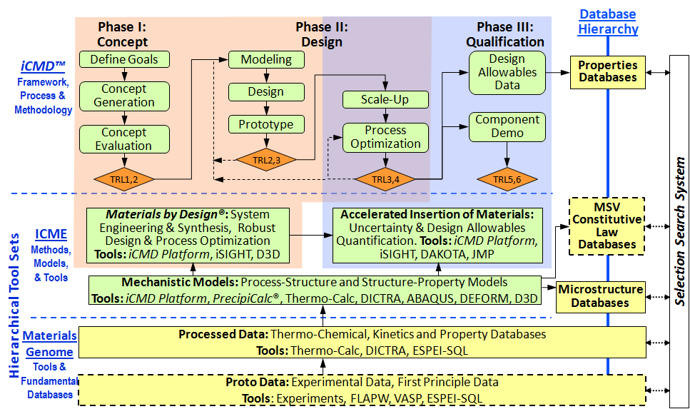
Focus for workshop (phase-based property data needed to build
Composition, temperature, pressure dependent CALPHAD-base databases
G. B. Olson, 2013

Slide 3
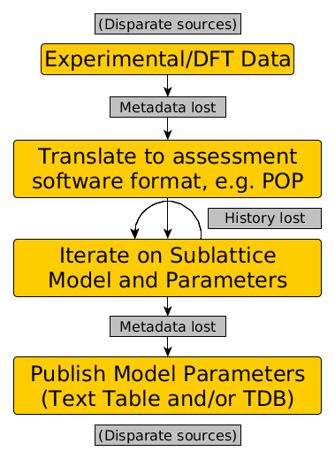
CALPHAD Data Challenges
Data fragmentation
Data standards
Workflow tools
Uncertainty quantification
Reproducibility

Slide 4
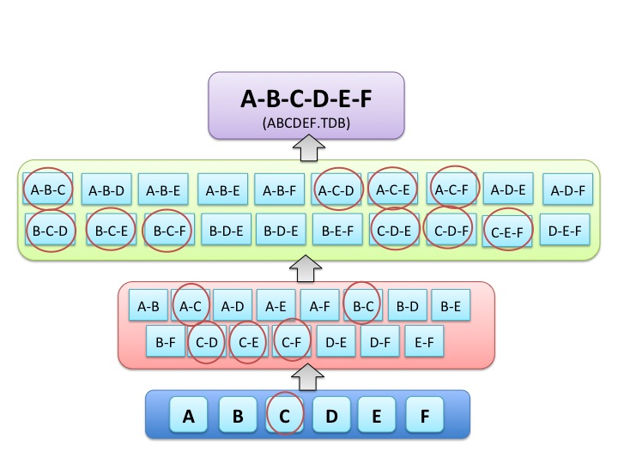
Maintaining CALPHAD Databases
C. E. Campbell, U. R. Kattner and Z. K. Liu, "The development of phase-based property data using the CALPHAD method and infrastructure needs,“ Integrating Materials and Manufacturing Innovation, Vol.3, 2014, 12.

Slide 5
Goals of ESPEI
Workflow tools for CALPHAD modeling, including integration with FP calculations
Online APIs for accessing structured CALPHAD data and metadata
Open-source (MIT license) implementations of all core routines for CALPHAD, including
Phase/property diagrams
Fitting experimental data (CALPHAD modeling)

Slide 6
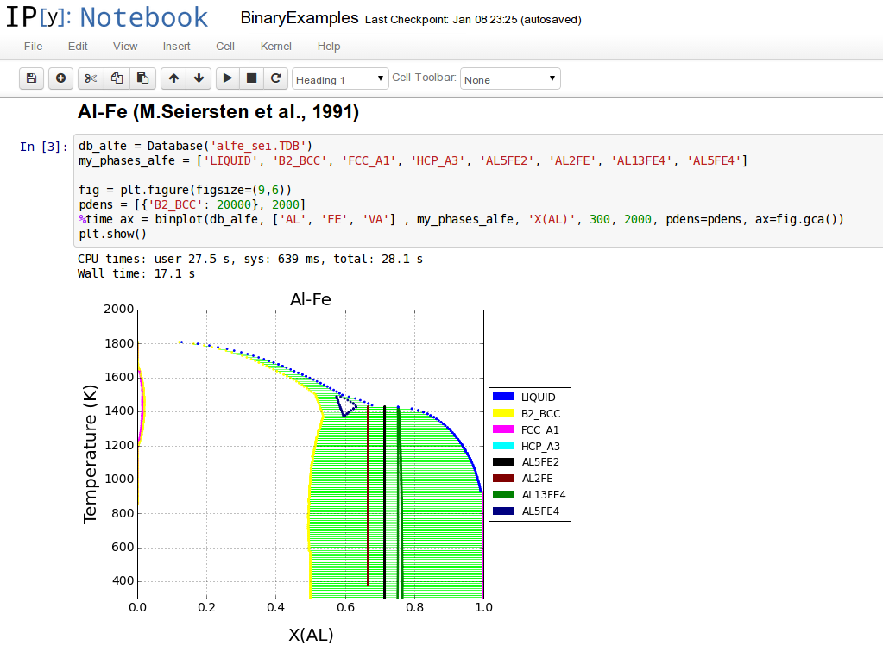
pycalphad
First public release April 2015
5000 lines of code
800 code commits in 2 years
Interactive (shown) and non-interactive modes

Slide 7
pycalphad
Up to 32 degrees of freedom per phase
TDB file support
Plotting: binary diagrams work best for now
Experimental ternary support
All standard alloy models (R-K-M polynomials, IHJ magnetic, order-disorder)
Available on Python Package Index and GitHub https://github.com/richardotis/pycalphad

Slide 8
Reproducible CALPHAD Assessments
Jupyter/IPython Notebook
Free and open-source software for interactive computing, based on Python
Browser-based interface but can run locally
Number-crunching power of MATLAB (NumPy) and symbolic math power of Mathematica (SymPy)
Shen, H. (2014). Interactive notebooks: Sharing the code. Nature, 515(7525), 151–2. doi:10.1038/515151a

Slide 9
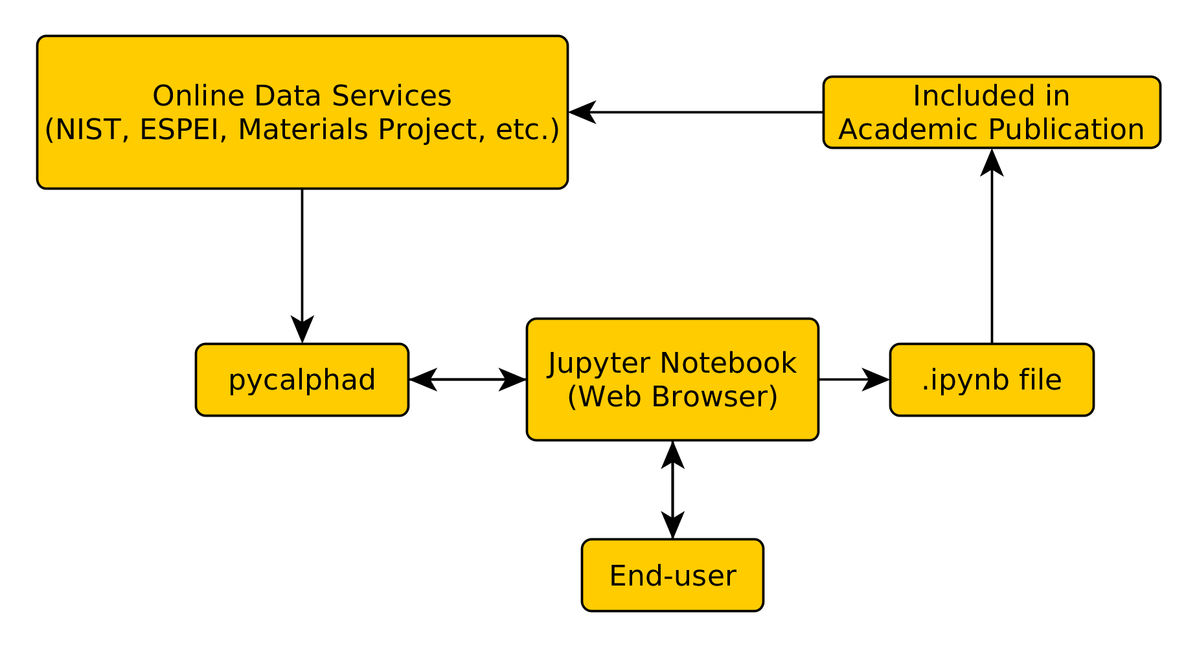
Reproducible CALPHAD Assessments

Slide 10
Demo
Al-Zn and Al-Mg assessment
Uncertainty quantification of parameters
Towards Al-Mg-Zn automated assessment

Slide 11
Advantages of Python Approach
Notebook files are just text files
Can be stored in version-control software
Better than a macro file: figures and text embedded in notebook
Supplementary material in journal articles
Acts as interactive manuscript outline
Others can easily reproduce your work

Slide 12
Conclusion and Future Work
pycalphad 0.2 is coming soon
New equilibrium engine, better fitting routines
Online CALPHAD Data API (Materials Genome, Inc.)

Slide 13
Thank You
rao140@psu.edu
https://github.com/richardotis/pycalphad
This work is sponsored by a NASA Space Technology Research Fellowship under grant number NNX14AL43H.

Slide 14
Open-source CALPHAD codes
OpenCalphad v2
pycalphad 0.2-pre
Written in Fortran
GPL license
Interactive: TC-style macros
Non-interactive: TQ API
Very fast
Modeling module planned
Written in Python
MIT license
Interactive: Python
Non-interactive: Python
Very flexible
Experimental modeling support

