Slide 1
Properties of Light
John F. Lesoine
NIST Biophysics Group
3-20-2012

Slide 2
My Background
Moravian College 1999-2003
BS with Honors in Physics
2002 REU The College of William and Mary
Research material properties using the rotation of the polarization of light
University of Rochester 2003-2010
Institute of Optics
PhD in Optical Physics
Research in Single Molecule Flourescence
Built a nanofluidic tracking device
Statistical optics

Slide 3
My Background at NIST
NIST 2010-Present
National Research Council Associate
A peer review process, involving multiple scientists or engineers, was used to score my research proposal, my ability to perform the proposed research and the suitability of the laboratory to host the proposed research project.
Research interests, cell membrane biology, enhanced optical imaging using the properties of light, statistical optics and computational imaging
Future opportunities: Government Lab research, industrial research and product development, business opportunities,
Biotechnology, defense, semiconductor, telecommunications

Slide 4
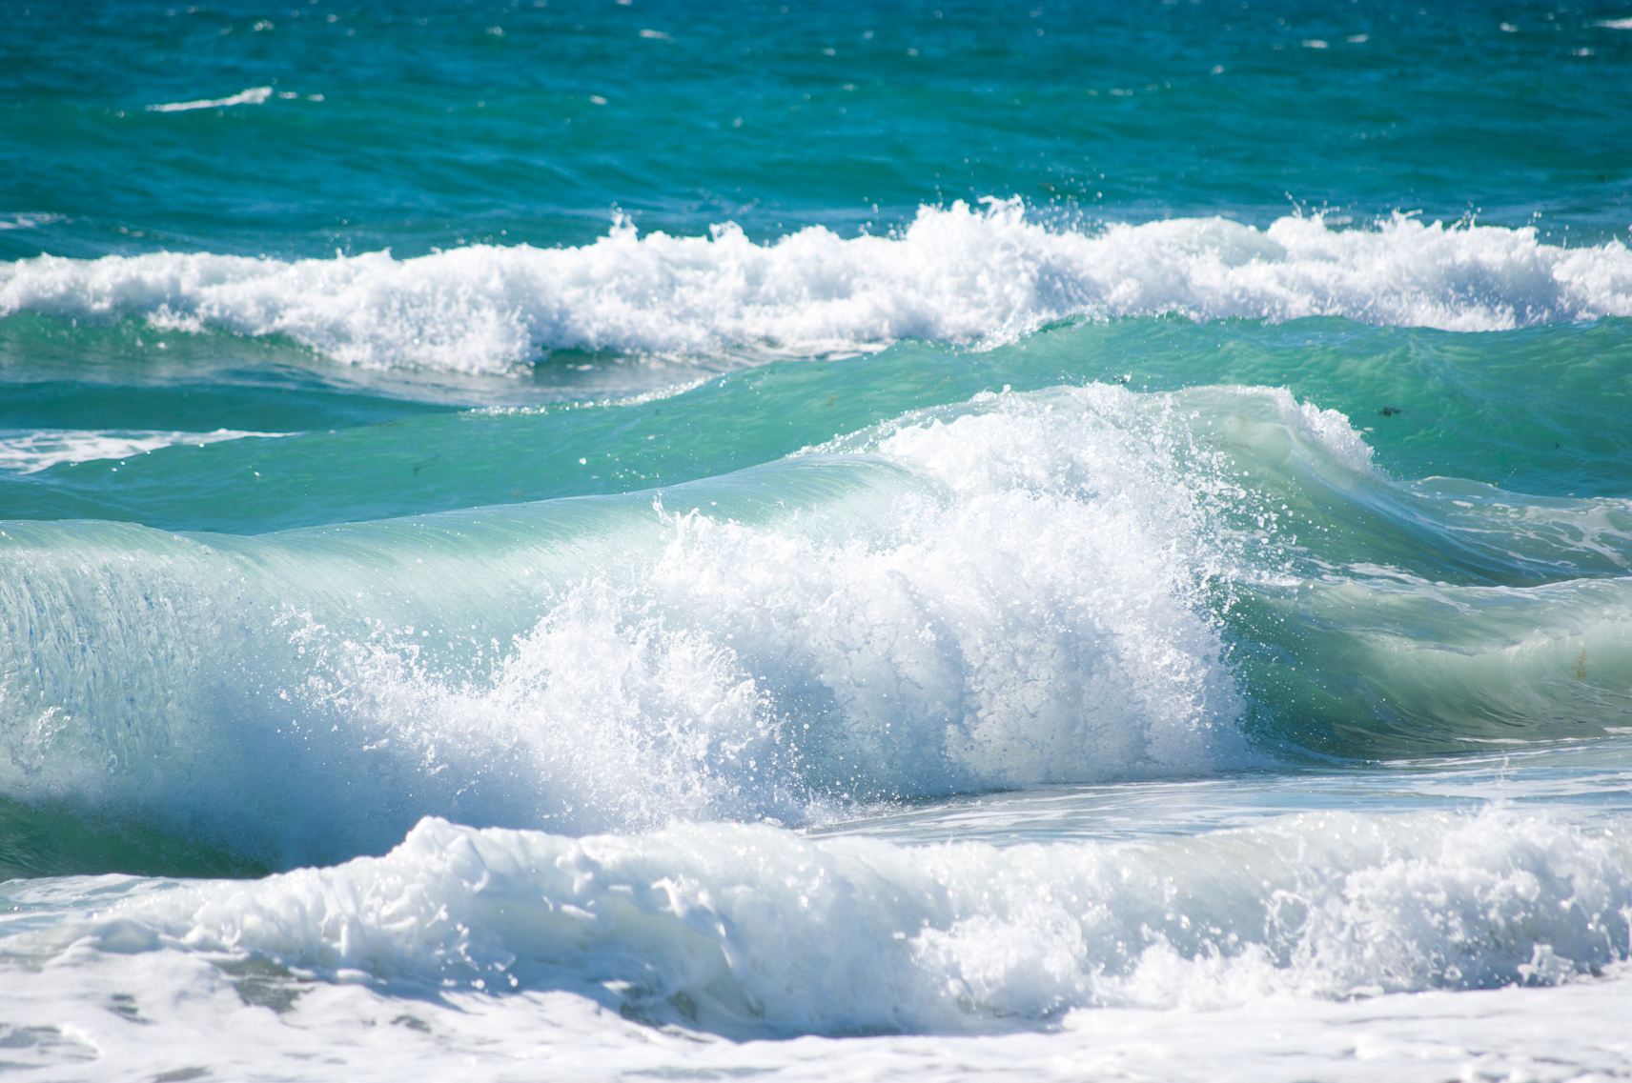
What are waves and what do they do?
Waves are disturbances
Ocean waves
Pebble dropped into water
Sound waves
Visible light and other electromagnetic radiation
Slinky
Waves carry energy from one point to another
Kinetic energy, electromagnetic
Waves have amplitude (intensity), propagation direction etc

Slide 5
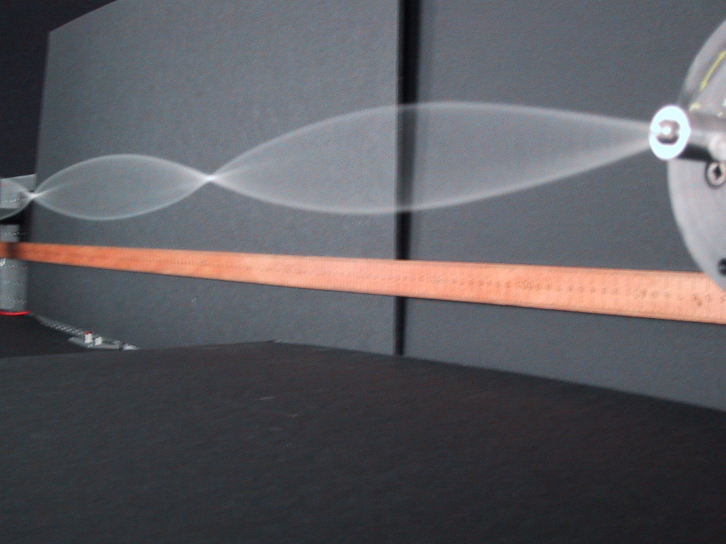
Wavelength and Reflection
Waves possess a physical length
Waves have a vibration frequency
Waves pass through each other unperturbed
Why can we create standing waves on a rope?
How do we make multiple nodes?
How does shortening or lengthening the rope affect the creation of a standing wave?

Slide 6
Wave Exploration
With a partner, try to create a standing wave
Have one person try to hold their hand still. What happens?
Try to create one node, two nodes.
Try shortening or lengthening the rope. What happens?
Are these waves transverse or longitudinal?
Transverse is perpendicular to the travel direction.
Longitudinal is parallel to the travel direction.

Slide 7
Waves continued
What directions can you make the standing waves oscillate in?
How many directions can you make a longitudinal wave oscillate in?
How many directions can you make a transverse wave oscillate in?
Meter is delineated (not defined) by a fixed number of wavelengths of the red HeNe laser

Slide 8
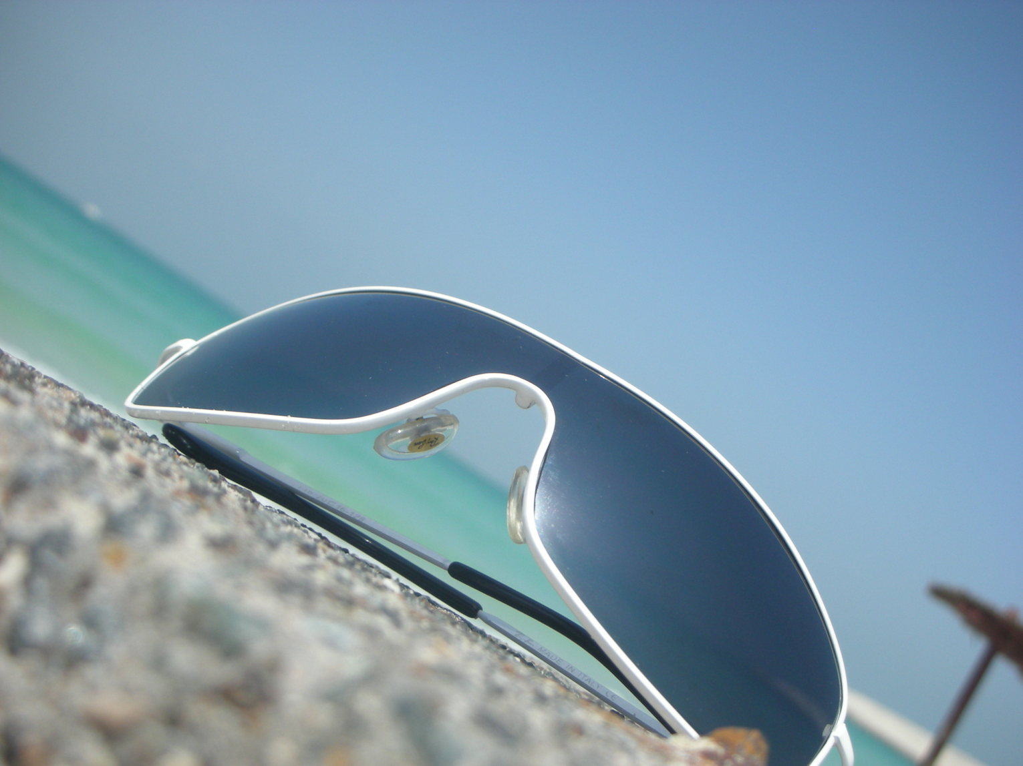
Polarization
Direction of oscillation perpendicular to the direction of travel

Slide 9
Polarization Exploration
Polarization kit
Build polariscope
Polarized sunglasses reduce glare
Polarizers used in photography (Why?)
You can learn to see polarized light with the naked eye
You can see the direction of polarization
Haidinger's Brush, http://www.polarization.com/haidinger/haidinger.html

Slide 10
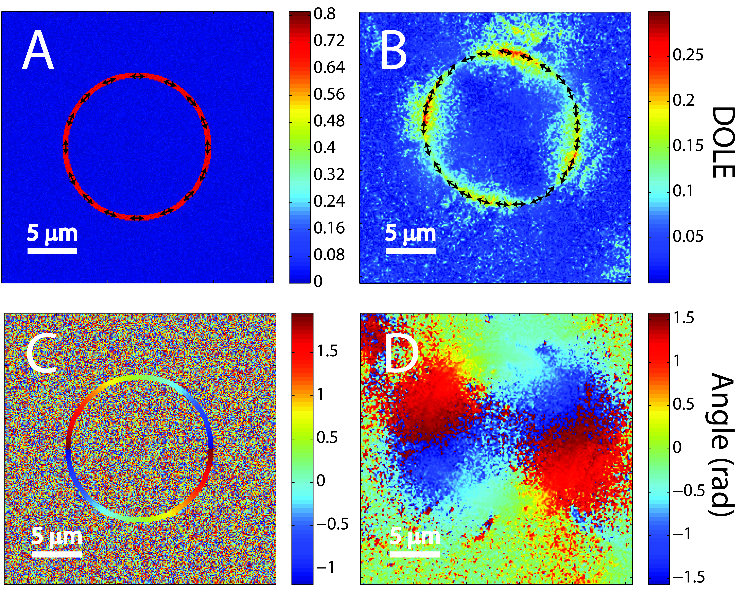
My NIST Polarization Work Enhanced Optical Imaging
The cell membrane’s orientations is probed with polarized light.
Theory
Lymphoma Cell

Slide 11
Polarized light and polarizers can be used
To detect cancers
To probe the structure and orientation of molecules
To investigate the amount of orderedness versus randomness
To reduce glare from reflected surfaces
To make beautiful photographs

Slide 12
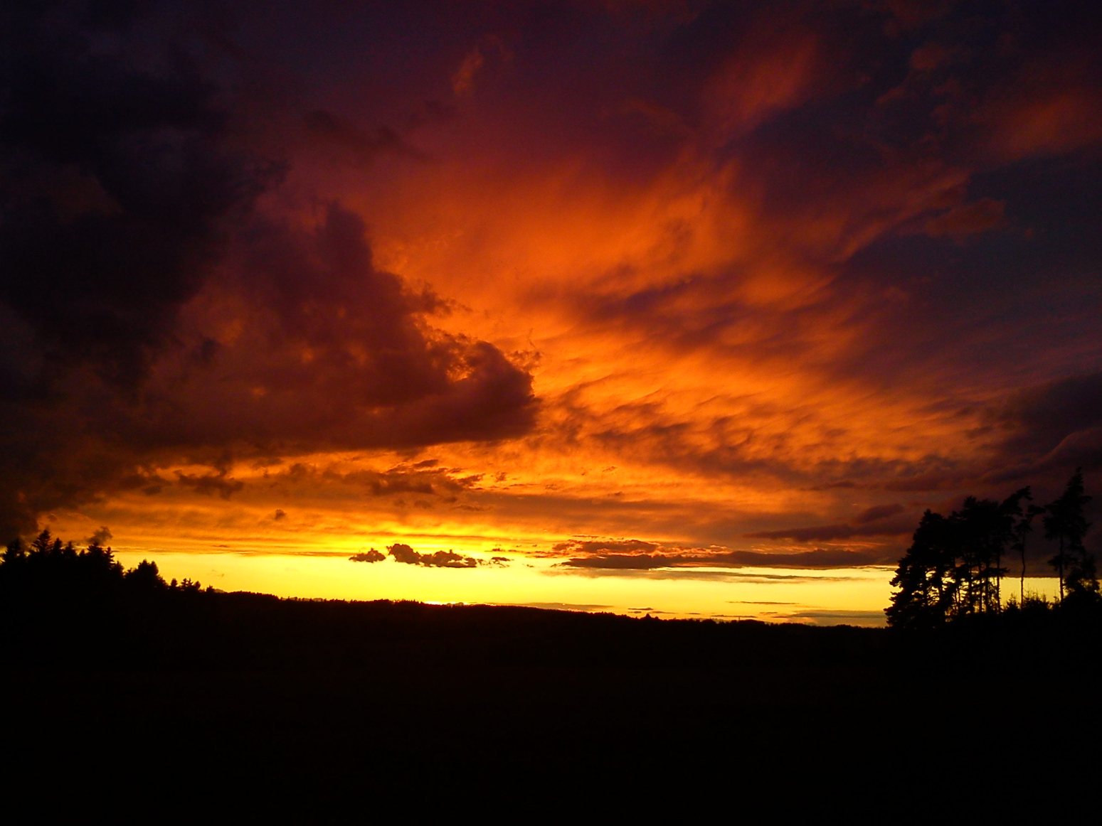
Scattering of Light

Slide 13
Exploration: Sunset in a glass
Why is milk white?
Is the light polarized or unpolarized?
Why are sunsets red?
Why contributes to the sky being blue?

Slide 14
Scattering (and diffuse reflection) at NIST
Measure roughness of surfaces
Combined with polarization
Measure structural properties of molecules
Detection of small particles (in air and water/ environmental health and safety)
Optical Coherence Tomography- 3D imaging of skin and retinas using diffuse reflectance, penetration depth limited by multiple scattering

Slide 15
Color Dependence of Scattering
Longer wavelengths have lower probability of scattering
Red light transmits farther than bluer light before scattering
Why are clouds white?
Why are some clouds dark (gray or black)?
Why is the sunset red
Why is some sunlight polarized?
Combining scattering data with color identification can be used to identify the shapes of objects like biological cells.
Some butterflies wings are colored because of scattered light, (absorption of light would burn the wings)
How would you design a camera that could see through a sand storm?

Slide 16
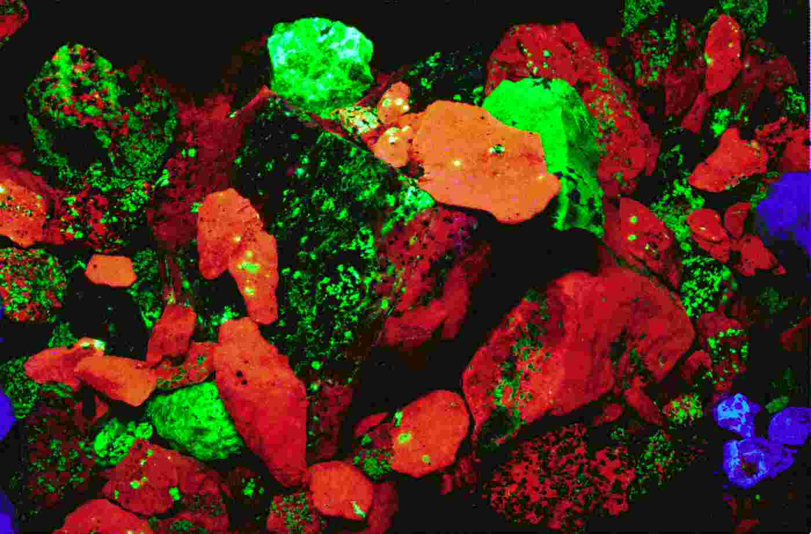
Invisible Light
Visible light possesses wavelengths that fall between 400 nm and 700 nm.
Electromagnetic radiation that is blue shifted, shorter wavelength, is invisible starting with UV, X-Rays, Gamma Rays
Longer wavelengths are red shifted, infrared light (thermal and heat signatures), microwaves, radiowaves
Here high energy UV light is absorbed by minerals, energy is lost due to thermal vibrations and is reemitted as lower energy visible light
Energy is proportional to the frequency of oscillation, shorter wavelength higher energy

Slide 17
UV Beads Exploration
Test various sources of UV light
Can you come up with an idea to make a UV meter using the beads?
Is there UV light in the shade?
Should you wear sunglasses when its cloudy or when you are in the shade?

Slide 18
UV Light Scatters a lot!
UV light has a wavelength much shorter than visible light
UV light produces vitamin D
UV light can damage DNA
Too much can causes mutations that lead to cancer
Correct dose can lead to a long lasting tan

Slide 19
UV light uses
Forensic scientists use UV light to detect blood or saliva at crime scenes
Many fruits and flowers stand out more strongly in UV light
Many insects like bees, and birds and reptiles can see near UV light
Some bird plumage stands out more vibrantly in UV light

Slide 20
More UV light
UV light can be used to purify water and air
DNA absorbs certain UV wavelengths, so bacteria or viruses can be destroyed easily
Irradiation of food is performed with UV light to kill bacteria on the surface
UV light is used to fortify milk with vitamin D
UV light is used to produce microprocessors for computers using UV lithography

Slide 21
Summary of Properties of Light
Intensity, color (wavelength), frequency (number of oscillations per second), direction of propagation, polarization
The properties of light can be used to measure a wide variety of things in a variety of industries.
Chemicals structure, chemical composition, concentrations, sugar content (alcohol content), communication, computing, remote sensing, many experiments, CD players and Blu Rays etc

