Slide 1
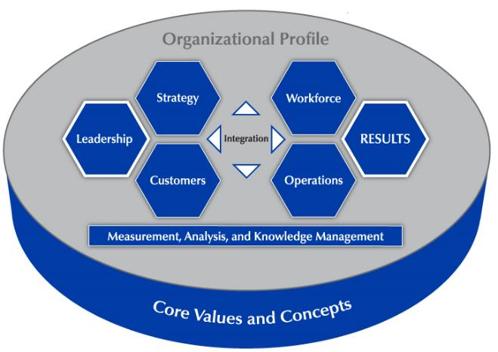

Baldrige Performance Excellence Program | 2018
Introduction to the
Baldrige Excellence Framework
A systems approach to improving your organization
Baldrige Performance Excellence Program | www.nist.gov/baldrige
Notes:
Introduction to the Baldrige Excellence Framework: A systems approach to improving your organization. Baldrige Performance Excellence Program 2018.

Slide 2
  It amazes me that U.S. businesses spend so much money on “how-to” books and course work to teach leaders how to build successful organizations.
  My recommendation: implement the Baldrige-based Criteria in your business. No other single document can help build a long-term successful organization.
  —Jerry Rose, Vice President, Cargill, Inc.
Notes:
Other quotations:
I see the Baldrige process as a powerful set of mechanisms for disciplined people engaged in disciplined thought and taking disciplined action to create great organizations that produce exceptional results.
— Jim Collins, author of Good to Great: Why Some Companies Make the Leap ... and Others Don’t
The use of the Baldrige framework boosted our ability to deliver better care to our patients. And, in the end, that is the most important thing.
—Nancy Schlichting, CEO, Baldrige Award winner Henry Ford Health System
We’ve seen student achievement go up . . . . We’ve become more efficient and more effective . . . . And in the process, we’ve become an innovative force in education. For those pondering whether or not to pursue [Baldrige], I say boldly, “Why wouldn’t you?”
—JoAnn Sternke, Superintendent, Pewaukee School District

Slide 3
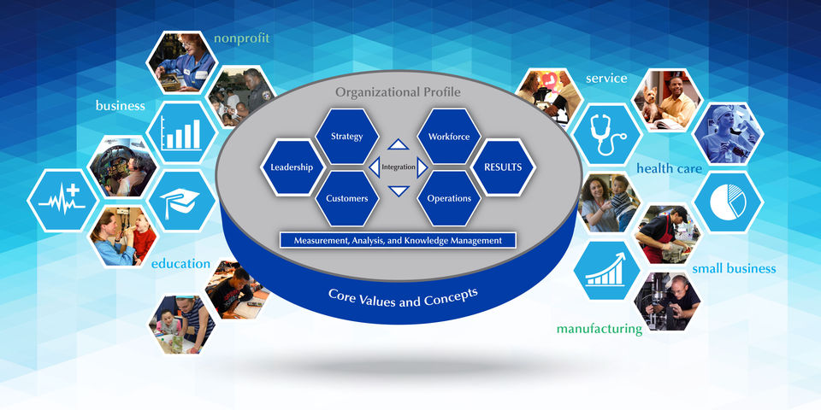
  For 30 years:
  Defining performance excellence: the leading edge of validated leadership and performance practice
  Sharing best practices
  Helping organizations improve
Notes:
The purpose of the Baldrige Excellence Framework is simply to help your organization improve—no matter its size, sector, or industry
For 30 years, organizations around the world have used the Baldrige Excellence Framework and its Criteria for Performance Excellence to improve and get sustainable results. Those recognized as U.S. role models receive the Malcolm Baldrige National Quality Award, a Presidential award. The recipients broadly share their best practices with others. Through that sharing, many thousands of organizations have improved their operations and results, and thus their contributions to the U.S. and global economy.
The Baldrige Excellence Framework is available in three versions: Business/Nonprofit (for manufacturing, service, nonprofit, and government organizations), Education, and Health Care.
The most important words here are “leading edge” and “validated.” The Baldrige Criteria have always been based on role-model practices successfully implemented by businesses and other organizations. They are the practices that lead to ongoing success. They are practices that are equally valid for small organizations and large, multinational corporations.
The Criteria were created in 1987 with significant input from a diverse group of experts and practitioners. The development process included a review of state-of-the-art practices within private- and public-sector organizations that were working on continuous improvement and organizational excellence.
In 1995, legislation was authorized to add Criteria for education and health care organizations. In 2006, with similar legislation passed and an appropriation in place, the Criteria were revised to include nonprofit organizations.
The Criteria are updated every other year with input from business and industry literature and from organizations in all sectors. Contributors include all participants in the Baldrige Program: current and former members of the Board of Examiners, award applicants and recipients, and members of the Panel of Judges and the Board of Overseers.

Slide 4
A Focus on Improvement
Consistently effective processes
Approaches that address your organization’s needs
Results
Organizational learning, innovation, and improvement
Notes:
The Baldrige Excellence Framework helps you understand how well you are achieving your goals and objectives:
• Are your processes consistently effective?
• Do your approaches address your organization’s needs?
• How good are your results?
• Is your organization learning, innovating, and improving?

Slide 5
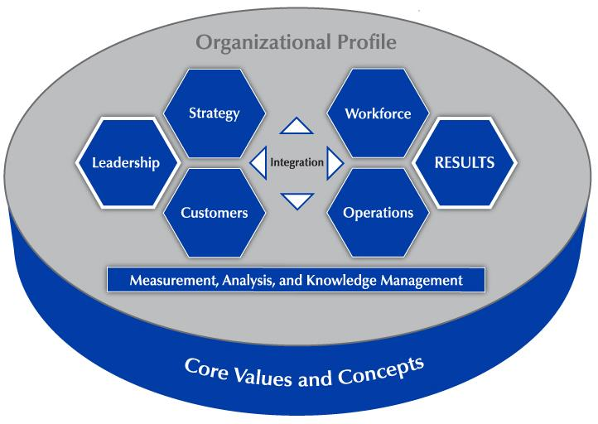
A Systems Perspective
Managing all the parts of your organization as a unified whole
Ensuring that plans, processes, measures, and actions are consistent
Ensuring that the individual parts work together beneficially
Notes:
To manage your organization’s performance successfully, you need to see your organization as a system with interdependent parts.
A systems perspective—the first Baldrige core value—means managing all the parts of your organization as a unified whole to achieve your mission.
It means ensuring that your plans, processes, measures, and actions are consistent.
And it means ensuring that the individual parts of your organization’s management system work together in a fully interconnected, unified, and mutually beneficial manner.

Slide 6
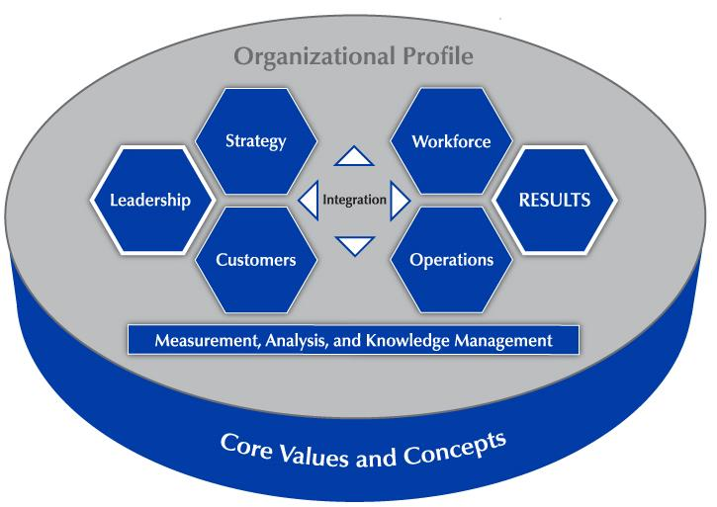
Notes:
This overview of the Criteria for Performance Excellence helps shows what we mean by a systems perspective.
As noted, the foundation of the Criteria is a set of core values and concepts that are embedded in high-performing organizations
The Criteria are a set of questions in key areas affecting your organization—shown in the blue hexagons and rectangle.
The background for all these areas is the Organizational Profile, where you describe your organization and its strategic situation. Baldrige does not prescribe how you should structure your organization or its operations or what your mission and goals should be. Instead, in the Organizational Profile, you define what is most relevant and important to your organization’s mission and performance.
The Criteria include seven categories:
The leadership triad, on the left, includes the Leadership, Strategy, and Customers categories. This emphasizes the importance of a leadership focus on strategy and customers.
The results triad, on the right, includes your workforce-focused processes, your key operational processes, and the performance results they yield.
The system foundation is Measurement, Analysis, and Knowledge Management. This is the “brain center” for the aligning your operations with your objectives. It is the main point the key information you need to effectively measure, analyze, and improve your organization’s performance.
The word “integration” at the center of the figure shows that all the elements of the system are interrelated.

Slide 7
The Baldrige Excellence Framework includes . . .
Core values and concepts
Criteria for Performance Excellence
Scoring system
Notes:
The system’s building blocks are the core values and concepts, the Baldrige Criteria for Performance Excellence, and the scoring system.
As you answer the questions in the Baldrige Criteria for Performance Excellence and evaluate your responses, you will identify your organization’s strengths and its opportunities for improvement. Then, as you build on your strengths and address your opportunities, you create cycles of improvement within your organization.
Let’s look at each of these building blocks in turn.

Slide 8
Core Values and Concepts
Customer-focused excellence
Valuing people
Organizational learning and agility
Focus on success
Managing for innovation
Management by fact
Societal responsibility
Systems perspective
Visionary leadership
Ethics and transparency
Delivering value and results
Notes:
The Baldrige Criteria are built on these interrelated core values and concepts. They represent beliefs and behaviors that are found in high-performing organizations
First and foremost, Baldrige provides a systems perspective that requires visionary leadership—the first two core values.
The next seven core values are the hows of an effective system: customer-focused excellence, valuing people, organizational learning and agility, focus on success, managing for innovation, management by fact, and societal responsibility.
The final two core values, ethics and transparency and delivering value and results, are the outcome of using Baldrige as a guide.

Slide 9
Scoring System
Scoring guidelines
Importance to your organization
Two dimensions: process and results
Notes:
Once you have answered the questions in the Criteria for Performance Excellence, the scoring guidelines allow you (in a self-assessment) or outside assessors (such as Baldrige examiners) to evaluate your processes and your results and gauge your organizational maturity.
In doing this evaluation, a major consideration is what is important to your organization, as described in the Organizational Profile.
In a Baldrige assessment, your organization is evaluated on two dimensions: process and results.

Slide 10
Evaluating Processes
Approach
Deployment
Learning
Integration
How do you accomplish your organization’s work? How systematic are your key processes?
How consistently are your key processes used?
How well have you evaluated and improved your key processes? How well have improvements been shared?
How well do your processes address organizational needs?
Notes:
Your processes are evaluated based on these four factors:
Approach: How do you accomplish the work of your organization? How systematic are the key processes you use?
Deployment: How consistently are your key processes used throughout your organization?
Learning: How well have you evaluated and improved your key processes? How well have improvements been shared within your organization?
Integration: How do your processes address your current and future organizational needs?

Slide 11
Evaluating Results
Levels
Trends
Comparisons
Integration
What is your current performance?
Are the results improving, staying the same, or getting worse?
How does your performance compare with others?
Are you tracking important results? Are you using the results in decision making?
Notes:
Your results are evaluated based on these four factors:
Levels: What is your current performance?
Trends: Are the results improving, staying the same, or getting worse?
Comparisons: How does your performance compare with that of other organizations and competitors, or with benchmarks?
Integration: Are you tracking results that are important to your organization? Are you using the results in organizational decision making?

Slide 12
What Can the Baldrige Framework Do for Your Organization?
Jump-start change initiatives
Energize improvement initiatives
Enable a focus on common goals
Assess performance against the competition
Align resources with strategic objectives
Notes:
You can realize one or more of these benefits when your organization uses Baldrige as a management framework, conducts a self-assessment, or has an external assessment: jump-start change initiatives, energize improvement initiatives, enable a focus on common goals, assess performance against the competition, and align resources with strategic objectives.

Slide 13
Baldrige and Other Performance Management Systems and Tools
ISO
Health care accreditation, such as the
Joint Commission
Education accreditation
Improvement tools (e.g., PDCA, PDSA, Lean Six Sigma)
Notes:
Should your organization use Baldrige or pursue other performance management systems or tools? Baldrige is compatible with these systems and tools. In fact, recent iterations of many standards and accreditations have become more similar to Baldrige. Some now include a systems perspective, self-assessment, process management, a focus on results, and expanding procedures to become more performance-based and systematic in evaluations.
— ISO’s (International Organization for Standardization’s) purpose is to facilitate international trade by providing a single set of conformity standards.
— The Joint Commission certifies health care providers’ processes.
— Accreditation organizations conduct evaluations of K-12 school districts and higher education institutions for accreditation purposes.
Some organizations may believe that, to become more competitive, they must complete ISO registration or implement Lean and Six Sigma, as well as implementing Baldrige.
Many organizations use Baldrige as an overall management and leadership framework to identify and evaluate what is important to them. After they identify strengths and opportunities for improvement with Baldrige, they use ISO, Lean, and Six Sigma, and other improvement tools to build on their strengths and make improvements.

Slide 14
How Is Baldrige Different?
Excellence
Overall systems approach
Results in all areas
Success now and in the future—a strategic view
Organizational learning, learning by the workforce, and knowledge sharing
Corporate governance, ethics, societal responsibility
Notes:
The basic difference between a Baldrige assessment and these other evaluation systems is that Baldrige focuses on achieving performance excellence rather than on achieving required performance levels. Baldrige feedback focuses on key challenges for the future and opportunities for improvement; accreditation feedback focuses on deficiencies.
Baldrige provides a systems approach to improving the entire organization. ISO focuses on product/service conformity systems and Six Sigma concentrates on product quality and process engineering, for example.
Baldrige asks you to identify and track key results in all areas that are important to your organization: product and process results, customer-focused results, workforce-focused results, leadership and governance results, and financial and market results.
One of the Baldrige core values is a focus on success now and in the future. This requires an understanding of the short- and longer-term factors that affect your organization.
Baldrige also emphasizes the importance of organizational learning, learning by workforce members, and knowledge sharing, which includes continuous improvement as well as adaptation to change, best-practice sharing, benchmarking, and investments in the workforce’s personal learning and growth. Therefore, learning is directed not only toward better products but also toward being more responsive, adaptive, and efficient.
Baldrige includes a focus on governance, societal responsibility, ethics, and strategy―issues not addressed by ISO, Lean, or Six Sigma.

Slide 15
Baldrige and Joint Commission Similarities
Continuous improvement focus
Core values
Self-assessment
Notes:
The Joint Commission standards and the Baldrige Criteria for Performance Excellence do not compete or conflict with one another.
Both
—focus on continuous improvement
—are based on a set of core values
—offer a means for self-assessment

Slide 16
Baldrige and Joint Commission Differences
Joint
Commission
Baldrige
Minimum standards for accreditation
Individual factors
Overall organizational focus, including patients
Role-model performance
Individual factors and strategic challenges and advantages
Patient care
Notes:
How are they different?
The Joint Commission’s focus is on the care of patients. The Baldrige focus is more comprehensive, including a focus on organizational systems, management, the workforce, and other stakeholders, but it doesn’t include the specific patient safety requirements spelled out by the Joint Commission.
The Joint Commission’s qualifications for institutions are intended to be inclusive, allowing all acceptable institutions to qualify. Baldrige encourages organizations to achieve excellence and recognizes leading-edge practices and world-class, role-model levels of performance.
The Joint Commission’s review process looks for the same things in every institution, serving as an audit. The Joint Commission considers some individual factors. However, in a Baldrige assessment, examiners review award applicants’ processes and results relative to each applicant’s key environmental and organizational factors and strategic challenges and advantages.

Slide 17

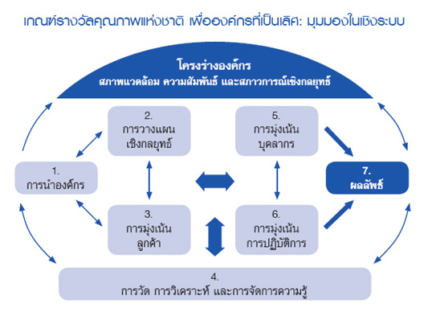
The Baldrige Framework Is the
Basis for . . .
  State, local, and sector-based performance excellence programs
  Many of the nearly 100 performance excellence programs around the globe
Notes:
More than 30 active state, regional, and local performance excellence programs (covering most of the 50 states as well as U.S. territories) throughout the country base their programs and awards on the Baldrige Excellence Framework and the Criteria for Performance Excellence.
About 100 countries have business excellence programs based on Baldrige.

Slide 18
Start Improving Your Organization
Purchase the Baldrige Excellence Framework or download free content.
Become a Baldrige examiner, or
attend examiner training.
Attend a national or regional Baldrige conference.
Do a Baldrige self-assessment.
Notes:
You can take a number of steps to start using Baldrige to improve your organization’s performance.
Visit the Baldrige website for Baldrige Excellence Framework booklets and free content.
Become an examiner. Examiners at both the state/local and the national levels receive valuable training and experience in understanding and applying the Baldrige framework, and they strengthen their ability to use the Baldrige framework within their own organizations. For a fee, you can also attend examiner training without serving as an examiner.
Attend a conference. Annually, Baldrige sponsors The Quest for Excellence® conference in Washington, D.C., every spring, as well as regional conferences, to showcase the award recipients. Conferences give you an opportunity to learn about recipients’ best practices and to network with other organizations.
Consider self-assessing your organization against the Baldrige Criteria. See the Baldrige website for tools and information.

Slide 19
Start Improving Your Organization
Contact your state or local Baldrige-based program.
Consider the Baldrige Executive Fellows Program for a senior leader.
Contact a Baldrige Award recipient.
Apply for a Baldrige-based award, or
consider a Baldrige Collaborative Assessment.
Notes:
Contact your state or local Baldrige-based program. These programs’ training, assessment, and coaching offerings are a good way to begin learning about the Baldrige framework. Information on these programs is linked from the Baldrige website.
Ask your CEO or another senior leader to consider the Baldrige Executive Fellows Program. This executive development program centers on forming relationships with and learning from Baldrige Award recipients and their senior executives.
Most Baldrige Award recipients offer events focused on sharing role-model practices with other U.S. organizations. See the Baldrige website for contact information.
Consider applying for a Baldrige-based award. If you are not ready to apply at the national level, consider contacting your state or local program. Or consider a Baldrige Collaborative Assessment, in which team of Baldrige examiners works with your staff to assess your organization.

Slide 20
For more information
https://www.nist.gov/baldrige
301-975-2036
baldrige@nist.gov
Baldrige Performance Excellence Program | www.nist.gov/baldrige
Notes:
For more information: https://www.nist.gov/baldrige, 301-975-2036; or baldrige@nist.gov.

