Slide 1

Baldrige Performance Excellence Program | 2016
Baldrige Program Impacts
Baldrige Performance Excellence Program | www.nist.gov/baldrige

Slide 2
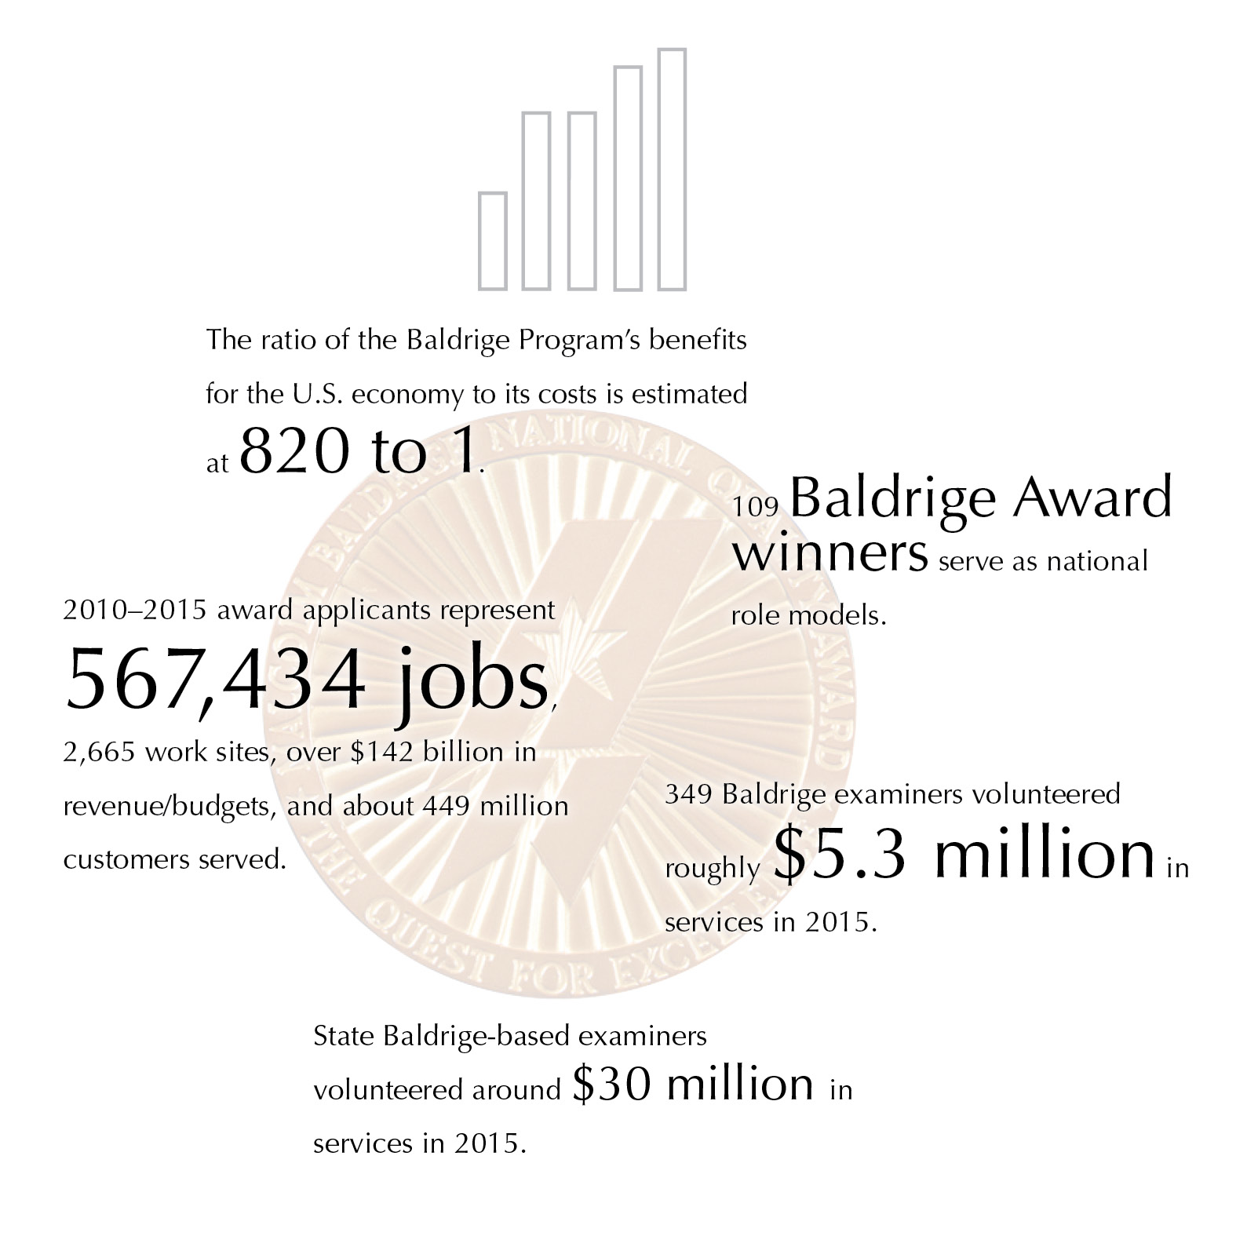

Baldrige Performance Excellence Program | www.nist.gov/baldrige
Notes:
The ratio of the Baldrige Program’s benefits for the U.S. economy to its costs is estimated at 820 to 1.
109 Baldrige Award winners serve as national role models.
2010-–2015 award applicants represent 567,434 jobs, 2,665 work sites, over $142 billion in revenue/budgets, and about 449 million customers served.
349 Baldrige examiners volunteered roughly $5.3 million in services in 2015.
State Baldrige-based examiners volunteered around $30 million in services in 2015.

Slide 3
Nationwide
  Improve organizational practices, capabilities, and results
  Communicate and share best practices (Baldrige Award recipients)
  Tool for understanding and managing organizational performance
Notes:
Since 1987, the Baldrige Excellence Framework and its Criteria for Performance Excellence have played three roles in strengthening U.S. competitiveness:
They help improve organizational performance practices, capabilities, and results.
As the basis of the Baldrige Award, which recognizes the achievements of role-model organizations, they facilitate communication and sharing of best practices among U.S. organizations.
They also serve as a working tool for understanding and managing organizational performance, for guiding your strategic plan, and for providing opportunities to learn.

Slide 4
820:1
Ratio of Baldrige Program benefits for the U.S. economy to program costs
Source: Albert N. Link and John T. Scott, Economic Evaluation of the Baldrige Performance Excellence Program, December 2011, http://www.nist.gov/baldrige/publications/economic_evaluation_2011.cfm.
Notes:
Source for 820-to-1 ratio: Albert N. Link and John T. Scott, Economic Evaluation of the Baldrige Performance Excellence Program, December 2011, http://www.nist.gov/baldrige/publications/economic_evaluation_2011.cfm.
To arrive at this ratio, they compared the benefits received by the 273 Baldrige Award applicants from 2007 to 2010 with the cost of operating the Baldrige Program.
The 820-to-1 ratio represents only the benefits for the surveyed applicants, but it represents all of the Baldrige Program's social costs. Link and Scott note that the benefit-to-cost ratio would be much higher if program costs were compared with the benefits for the entire U.S. economy.
Three types of social benefit were measured:
the applicants’ cost savings from using the Baldrige Criteria instead of a higher-priced alternative
gains to U.S. consumers, who had greater satisfaction with higher-quality products
gains to the U.S. economy from saving scarce resources, since the Baldrige Criteria were used instead of a higher-cost alternative

Slide 5
Impact of Baldrige Framework Use
Notes:
For data on the impact of using Baldrige within an organization, we looked at organizations that we know were using the Criteria for at least a 5-year period: the seven two-time Baldrige Award winners. These growth rates are for the period between awards. Comparative data on job growth are from the U.S. Bureau of Economic Analysis and U.S. Bureau of Labor Statistics.

Slide 6
Reach and Impact of Baldrige
Baldrige Program NIST
10,000+ Baldrige Examiners
~100 Business Excellence Programs Worldwide
Baldrige Executive Fellows
30+ Regional/ Sector Baldrige-Based Programs
Corporate Baldrige-Based Excellence Programs
Federal Baldrige-Based Programs
Baldrige Performance Excellence Groups
Commun-ities of Excellence
99 Baldrige Award Recipients
Association Baldrige-Based Programs
College/
University Business Courses
Baldrige-Based Accredita-tions
1,600+ Baldrige Award Applicants
Rated #1 Leadership Development Program
50,000+ presentations
Improved: operations, engagement, outcomes;
820:1
10,000 applications
20,000 examiners
40,000 conference attendees

Slide 7
Widespread U.S. Participation
Large and small organizations
Internal business excellence programs
College and university courses
Accreditation
Consultants
Private-sector support
Notes:
Organizations of all sizes and types use the Baldrige framework for improvement and self-assessment, including large and small manufacturers; banks and other service providers; small businesses from consulting firms to fast-food restaurants; K–12 school systems, universities, and other education organizations; hospitals, long-term care facilities, and other health care organizations; nonprofit organizations, and local, state, and federal government agencies.
Several large national and international organizations, such as Tata Industries and Infosys, base their internal performance excellence programs on the Baldrige Criteria.
Colleges and universities, such as Ferris State University, Loyola University of New Orleans, and the College of Engineering at the University of Missouri, offer MBA programs, certificates, or courses on the Baldrige framework.
The North Central Association’s Commission on Accreditation and School Improvement has adopted Baldrige-compatible criteria as the basis of its district and school accreditation frameworks. The Accreditation Council for Business Schools and Programs bases its accreditations on the Baldrige Criteria. And the National Housing Quality Award (NHQA) for home builders is modeled after the Malcolm Baldrige National Quality Award.
An informal community of Baldrige-based consultants helps organizations learn about and use the Baldrige framework.
Before 2011, over 90% of program support, including in-kind contributions, came from the private sector. This includes the volunteer time of members of the Board of Examiners. (Currently, the Baldrige Program is funded partly through a gift from the private Baldrige Foundation and partly through product and service fees.)
63 small business development centers, with a total of 1,100 offices in the United States, have adopted aspects of the Baldrige Competitiveness Program begun by the Puerto Rico Small Business Technology and Development Center, which, since 2011, has trained more than 125 businesses, including 250 top-management executives, on Baldrige principles. The Puerto Rico small business graduates have seen improvements in the areas of leadership, sales, metrics, operations, human resources, workplace environment, financial results, and client satisfaction. In addition, SBDCs in Central America, including El Salvador, have begun adopting Baldrige.

Slide 8
Lower Health Care Costs,
Improved Quality
Baldrige hospitals:
Faster five-year performance improvement than peers
83% more likely to be among Thomson Reuters’ 100 Top Hospitals®
Outperformed non-Baldrige hospitals on 6 of 7
100 Top Hospitals measures
Source: Foster, D. A., and Chenoweth, J. 2011, October. Comparison of Baldrige Award Applicants and Recipients with Peer Hospitals on a National Balanced Scorecard. Thomson Reuters. http://www.nist.gov/baldrige/upload/baldrige-hospital-research-paper.pdf.
Notes:
An independent study has documented that use of the Baldrige Health Care Criteria for Performance Excellence has a direct impact on both reducing health care costs and improving quality. The study was completed by Thomson Reuters in October 2011. Key findings include the following:
Baldrige hospitals (award winners and those that received a site visit) demonstrated faster five-year performance improvement than their peers.
Baldrige hospitals, as a group, were about 83% more likely than non-Baldrige hospitals to be awarded Thomson Reuters 100 Top Hospitals® national recognition for excellence in organization-wide performance.
Baldrige hospitals outperformed non-Baldrige hospitals on six of seven individual measures of performance used in the 100 Top Hospitals composite score, including the Centers for Medicare and Medicaid Services’ (CMS) Core Measures and adjusted operating profit margin.
Foster, D. A., and Chenoweth, J. 2011, October. Comparison of Baldrige Award Applicants and Recipients with Peer Hospitals on a National Balanced Scorecard. Thomson Reuters. http://www.nist.gov/baldrige/upload/baldrige-hospital-research-paper.pdf.

Slide 9
Higher Health Care Quality,
Better Patient Experience
34 Baldrige Award winners
Matched or exceeded geographic competitors on 23 health care process measures and 6 outcome measures
Exceeded these competitors on 10 measures of patient experience
Source: R. C. Schulingkamp and J. R. Latham. Healthcare Performance Excellence: A Comparison of Baldrige Award Recipients and Competitors. Quality Management Journal, Vol. 22, No. 3 (2015).
Notes:
A 2015 study compared 34 U.S. health care organizations that received the Baldrige Award with their 153 geographically closest competitors. The study found that the award recipients matched or exceeded their competitors’ measures of health care quality and outperformed them in measures of favorable patient experience.
The authors examined results data for 39 measures that U.S. hospitals publicly report to the Centers for Medicare and Medicaid Services (CMS). The 39 measures included 23 for health care processes, 10 for patient experience, and 6 for health care outcomes. The patient-experience results data come from Hospital Consumer Assessment of Healthcare Providers and Services (HCAHPS) surveys of patients.
The study included all organizations in the health care sector that received the Baldrige Award, the nation’s highest honor recognizing organizational performance excellence and innovation, between 2002 and 2011. The study’s comparison group included all competing hospitals within a 25- to 50-mile radius of the Baldrige Award winners.
Hospitals that used the Baldrige Health Care Criteria had higher means and lower standard deviations [indicating a measurable positive patient experience] than those that didn’t in all 10 measures. The differences were statistically significant for 9 of those 10 measures, showing that there is a definite positive impact on patient experience with use of the Criteria.

Slide 10
Health Care:
Adoption of Baldrige Practices
100 Top Hospitals winners extensively use Baldrige practices (80%)
Highest formal use: Teaching hospitals
(nearly 70%)
Source: Shook, J., and Chenoweth, J. 2012, October. 100 Top Hospitals CEO Insights: Adoption Rates of Select Baldrige Award Practices and Processes. Truven Health Analytics. http://www.nist.gov/baldrige/upload/100-Top-Hosp-CEO-Insights-RB-final.pdf.
Notes:
Another study looked at the current adoption of Baldrige practices among Top 100 Hospitals winners. The study conducted by Truven Health Analytics (formerly known as the health care business of Thomson Reuters) was completed in October 2012.
Overall, the 100 Top Hospitals winners have extensively adopted Baldrige practices, even though 63% reported they did not intentionally use the Baldrige Criteria to develop organizational goals and/or process improvement initiatives. More than 80% of the respondents agreed or strongly agreed that they have implemented the Baldrige practices listed on the survey, with the exception of alignment of results across all areas (68%).
Teaching hospitals reported the highest formal use of the Baldrige Criteria. Nearly 70% of these hospitals noted that their teams have used the Criteria to develop organizational goals and process improvement initiatives.
Shook, J., and Chenoweth, J. 2012, October. 100 Top Hospitals CEO Insights: Adoption Rates of Select Baldrige Award Practices and Processes. Truven Health Analytics. http://www.nist.gov/baldrige/upload/100-Top-Hosp-CEO-Insights-RB-final.pdf

Slide 11
Health Care:
Adoption of Baldrige Criteria
By 2018, hospitals likely to
Use the Baldrige Criteria for improvement or assessment: 65%
Apply for the Baldrige Award or a state-level Baldrige-based award: 41%
Source: Futurescan 2013: Healthcare Trends and Implications 2013-2018. American Hospital Association, Society for Healthcare Strategy & Market Development. http://www.nist.gov/baldrige/upload/Futurescan-2013-p44-2.pdf.
Notes:
Another study asked about the use of the Baldrige Health Care Criteria. This study was based on a survey of CEO members of the American College of Health Care Executives and senior, provider-based members of the Society for Healthcare Strategy and Market Development, as part of Futurescan 2013. Key findings include these:
65% of hospitals are likely to “use the Baldrige Criteria for Performance Excellence as a systematic framework for performance improvement or as an internal assessment tool” by 2018.
41% are likely to submit an application for the Baldrige Award or a state-level Baldrige-based award by 2018.
Futurescan 2013: Healthcare Trends and Implications 2013-2018. American Hospital Association, Society for Healthcare Strategy & Market Development. http://www.nist.gov/baldrige/upload/Futurescan-2013-p44-2.pdf.

Slide 12
“What frameworks or process improvement approaches are being used by hospitals and health systems to transform their organizations and maximize positive outcomes?”
“The Baldrige Performance Excellence Program provides organizations with one such framework to identify improvement opportunities, develop best practices, and attain and sustain top performance."
Source: Frontiers of Health Services Management, Fall 2015 (a publication of the American College of Healthcare Executives).
Notes:
The Fall 2015 issue of Frontiers of Health Services Management, a publication of the American College of Healthcare Executives (ACHE), featured accounts and commentary by leaders of several U.S. health care organizations that had received the Baldrige Award in recent years.
An editorial placed the Baldrige coverage in the context of "healthcare reform’s directives that hospitals and health systems develop more effective and efficient ways of delivering care."

Slide 13
Baldrige Training:
Top-Tier Leadership Development
Update in Feb.
Among government/military leadership development programs:
No. 1 in 2014
Top-10 ranking 5 times since 2010
—Leadership Excellence magazine
Notes:
Leadership Excellence magazine has consistently ranked the Baldrige Program among the best government/military leadership programs in the United States, ranking it ?? In 2015, 1st in 2014 and in the top 10 in 5 of the past 6 years.
The ranking is based on survey responses, interviews, and site visits around seven criteria: vision/mission, involvement/participation, accountability/measurement, design/content/curriculum, presenters/presentations/delivery, take-home value, and outreach.

Slide 14
Factors behind the Impact
Acceptance of the Baldrige framework nationally and globally
Program participants
Notes:
The Baldrige Program and the Baldrige Award have successfully promoted performance excellence across the country and around the world. The program’s success can be attributed to a number of factors, including these:
the network of state, regional, and sector-specific Baldrige-based award programs
the growth of international interest in the Baldrige Program
the efforts of award recipients and other program participants

Slide 15
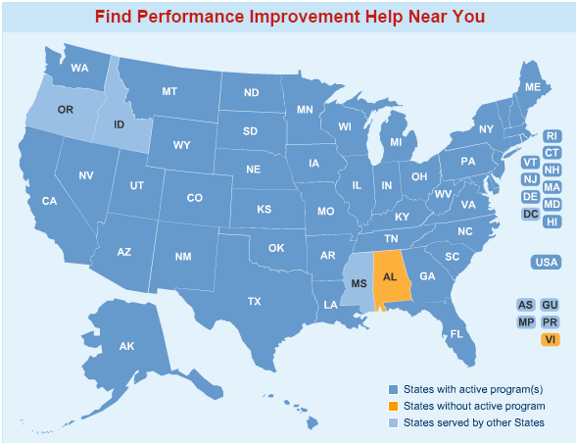
Alliance for Performance Excellence
A National Network
www.baldrigepe.org/alliance
Notes:
The Alliance for Performance Excellence, a nonprofit network, serves as an umbrella organization for local, state, regional, and industry Baldrige-based programs. Around 30 state, regional, local, and industry-based performance excellence programs throughout the country base their programs and awards on the Baldrige Excellence Framework, which has extended the reach of the national program and the Baldrige framework. These programs offer tools, resources, and expertise to assist organizations in improving their performance. They also serve as a feeder system for the national Baldrige Award.
The number of state and local, regional, and sector-specific Baldrige-based award programs has grown from 8 in 1991 to around 30 today. These programs cover nearly all U.S. states and territories.
Other Baldrige-based programs cover the Department of Veterans Affairs, long-term care and assisted living organizations, and Army National Guard units, for example.
The Alliance for Performance Excellence noted the following for 2014:
1,210 application reports were received.
2,152 examiners were trained.
Over the past 19 years, state and local programs have trained more than 30,000 examiners.

Slide 16
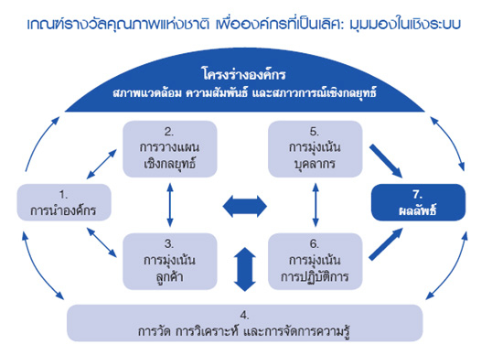

International Adoption
  About 100 performance excellence programs worldwide
Notes:
The Baldrige framework and the Criteria are a globally recognized model of performance excellence. Of the approximately 100 performance or business excellence programs around the world, most use the Baldrige Criteria or criteria similar to Baldrige as their performance excellence models.

Slide 17
Baldrige Award Participants
102 Baldrige Award recipients
(109 awards)
1,639 award applications
More than 9,700 examiners trained
Notes:
Baldrige Program participants include a wide variety of individuals and organizations, such as Baldrige framework-using organizations; Baldrige Award applicants and recipients; and members of the Board of Examiners, who evaluate the award applications and prepare feedback reports.
From the program’s inception through 2015, 109 of the more than 1,600 applications have resulted in a Baldrige Award: 31 in manufacturing, 16 in service, 24 in small business, 11 in education, 20 in health care, and 7 in the nonprofit sector. Seven organizations (MEDRAD; MESA; MidwayUSA; The Ritz-Carlton Hotel Company, L.L.C.; Solectron; Cargill Kitchen Solutions [formerly Sunny Fresh Foods, Inc.]; and Texas Nameplate, Inc.) have received the award twice, making the total number of award recipients 102.
Through 2015, the Baldrige Performance Excellence Program had trained more than 9,700 examiners in the Baldrige framework and processes. State and regional programs that are members of the nonprofit Alliance for Performance Excellence, which serves as a feeder system for the national Baldrige Award, have trained more than 30,000 examiners over the past 20 years. Examiners often take knowledge from the program to their own organizations and teach others about the Baldrige process.
There have been examiners and award recipients in nearly every state and the District of Columbia.

Slide 18

Baldrige Award Recipients
Presentations to all sectors
Quest for Excellence® and regional conferences
Influence on customers/suppliers
Seminars and workshops
Articles
Notes:
Through the sharing of best practices and knowledge of the Baldrige framework , award recipients have helped increase the competitiveness of U.S. organizations. For example, award recipients often host seminars and workshops to help other organizations understand and use the Criteria.
Collectively, Baldrige Award recipients have given thousands of presentations. Audiences have included businesses, education and health care organizations, and government agencies and other nonprofit groups.
Award recipients also share best practices at the annual Quest for Excellence Conference® and at regional conferences. Regional conferences are held at various U.S. locations each year.
The use of the Baldrige framework by award recipients has had a positive influence in several ways on these organizations’ customers and suppliers. First, the use of the Baldrige framework has helped the organizations improve their processes related to customers and suppliers and their relationships with these groups. In addition, some organizations, through such mechanisms as Baldrige-based awards for their suppliers, have encouraged their supplier organizations to use the Baldrige framework .
Many award recipients have also written and published articles on the Baldrige framework and the Baldrige Program.

Slide 19
The Bottom Line: Results
Improved outcomes for products, services, and processes
Notes:
Besides results such as increased self-knowledge, more workforce participation, and integrated operations, the Baldrige framework has helped organizations to improve bottom-line results and competitiveness. Following are some examples:
Lockheed Martin Missiles and Fire Control (MFC) has attained a leading market share and sustained growth over the past four years: return on investment, a strategic measure for MFC, has grown at a 23% compound annual rate, faster than the industry-best competitor at 13.7%; operating margin has had a compound annual growth rate of 6.2% over 11 years, better than the Standard & Poor’s (S&P) 500 Capital Goods Manufacturing Index at 1.5% and the industry-best competitor at 0.2%; from 2006 to 2011, annual orders from repeat customers increased by 32%, and international orders increased by almost 400%; and time reductions as a result of process and performance improvement programs yielded an estimated saving of $225 million annually.
Since 2006, MESA more than doubled in size while transforming itself from a manufacturing company to a full-service provider of corrosion control and integrity solutions to the pipeline industry. MESA's growth rate during this period exceeded its closest competitor by almost 40%; MESA's entry into new markets, including expansion into the asset integrity market for pipelines, has created more than $26 million of annual revenue over a nine-year period; profitability as a percentage of revenue has increased from 5% in 2006 to greater than 10% projected for 2012; customer retention rates consistently exceeded 95% in both materials and service between 2006 and 2011, and revenue from existing customers increased over the same period; and the customer satisfaction increased from 87% in 2006 to over 90% since 2009; these levels are consistently better than competitors (ranging from 72 to 83%) and the American Customer Satisfaction Index (ranging from 72 to 76%).
North Mississippi Health Services’ (NMHS’) outpatient management of diabetes has met or exceeded the National Committee for Quality Assurance (NCQA) top-decile benchmark since 2008; colorectal cancer screenings have increased since 2009 and consistently exceed the standard set by the state’s Medicare quality improvement organization; for 2012, the system’s flagship hospital performed at the 100% level for Joint Commission-accredited hospitals in 26 of 30 Surgical Care Improvement Project core measures; a strong focus on patient safety has led to no central line-associated blood stream infections in the intensive care unit for two years; employee retention has been at or above 90% since fiscal year 2007, exceeding the Bureau of Labor Statistics’ benchmark for health care organizations by 10%; and NMHS leads its primary competitor in market share by 13% and all other hospitals combined by 8%.
The City of Irving is one of five cities in the state and 89 in the nation with a AAA rating from both Standard and Poor’s and Moody’s—ratings that it has maintained since 2007; the tax rate is the second lowest in the Dallas-Fort Worth Metropolitan area. Since 2007, its overall cost of service has been better than four comparable cities in the area; the rating for overall quality of service in Irving (74%) is higher than the state of Texas (46%), county government (37%), and the U.S. government (38%); since 2006, the%age of residents rating many of the city’s key services—including police, code enforcement, libraries, and recreational—as good or excellent has increased by double digits; and Irving’s focus on process efficiency has resulted in more than $44 million in cost savings and efficiencies since 2008.
Montgomery County Public Schools (2010 Baldrige Award recipient) elementary school students’ reading performance used to determine Adequate Yearly Progress (AYP) increased for all subgroups, including improvements of 10.2 percentage points for Limited English Proficient students, 8.3 percentage points for students receiving free and reduced-priced meals, 7.1 percentage points for African Americans, and 7.6 percentage points for Hispanics..
Advocate Good Samaritan Hospital (2010 Baldrige Award recipient) demonstrates high levels of performance in many process measures for clinical outcomes. For example, risk-adjusted mortality (overall mortality divided by expected mortality where 1 is the standard) decreased from 0.55 in 2007 to 0.42 in 2010, exceeding the six-county top-decile level as measured by Thomson Reuters.
Lean manufacturing concepts have helped MESA Products, Inc. (2006 Baldrige Award recipient) achieve cycle time and productivity improvements. For example, throughput time in the magnesium assembly area improved by 82%, output in the instrumentation equipment assembly area increased by 60%, lead time for the sales-order-entry process decreased by 30%, and error rates dropped 50%. In addition, on-time shipments improved to 97.2%.
Hurricane Katrina caused DynMcDermott Petroleum Operations Company (2005 Baldrige Award recipient) to relocate operations from New Orleans, Louisiana, to Beaumont, Texas. Within five days, the Strategic Petroleum Reserve, which DynMcDermott manages as a contractor for the U.S. Department of Energy, began delivering oil to refineries in the Gulf Coast region that normally get oil from the Gulf of Mexico.

Slide 20
Returns on Investment in
Performance Excellence:
2015 Baldrige Award Recipients
Notes:
The following slides show some of the achievements of the current award recipients.

Slide 21

MidwayUSA
90% customer approval ratings
43.8% average annual net income growth since 2004
21.3% average annual gross sales growth since 2004
Leader in waste recovery and resource management
Notes:
MidwayUSA is an Internet retailer offering “Just About Everything”® for shooting, hunting, and the outdoors. It is a world leader in its market sector, offering more than 110,000 products from more than 800 suppliers to 1.2 million active customers. Since first adopting the Baldrige Criteria for Performance Excellence in 2006, MidwayUSA has pursued its vision to be “the best-run, most respected business in America, for the benefit of our Customers.”
This is the second Baldrige Award for MidwayUSA, as the company was honored in the same category in 2009.
Selected results:
As a result of MidwayUSA’s focus on customer satisfaction and the integration of customer satisfaction data into MidwayUSA’s Performance Improvement System, customer approval ratings have topped 90% since 2006 and has exceeded the performance of its primary Internet retailing competitor for the past two years.
Since 2004, MidwayUSA has sustained a 43.8% average annual growth rate in net income and a 21.3% average annual growth rate in gross sales, making it one of the fastest-growing companies in its industry.
MidwayUSA improved its employee satisfaction and engagement rate from 76% in 2004 to 83% in 2015.
MidwayUSA is a community leader in waste recovery and resource management, recycling paper, plastic, cardboard, pallets, and metal. In 2008, the company replaced Styrofoam packing peanuts with inflatable air pillows made of recycled plastic. MidwayUSA is virtually paperless; most marketing and business transactions are done electronically and no “snail mail” orders are accepted.

Slide 22

Charter School of San Diego
Nearly 100% student and parent satisfaction
2.4% dropout (better than the county and state)
80–90% instructional staff retention
Positive end-of-year fund balances
Notes:
The Charter School of San Diego (CSSD), authorized by the public San Diego Unified School District, “is committed to the development of a personalized instructional program with intensive parental involvement that demonstrates positive outcomes for each student.” CSSD is specifically aimed at students whose futures are at risk because they were not successful at conventional schooling. Students who enroll at CSSD are seeking an alternative educational environment or fall into several at-risk categories. CSSD provides free, individualized education in Grades 7-12 to engage, graduate, or redirect these students.
Selected results:
CSSD maintained overall student and parent satisfaction levels of close to 100 percent from 2010 to 2015. 95 percent of enrolled students for the past six years would recommend CSSD to others, and 97 percent of students’ parents would recommend the school to a friend or family member.
CSSD’s overall dropout rate of 2.4 percent in 2013-2014 outperformed the county rate of 2.7 percent and the statewide rate of 3.1 percent, even though CSSD students are on average two to three grade levels behind peers in language arts and three to four grade levels behind peers in math achievement when they enroll.
CSSD has retained between 80–90 percent of its instructional staff for the past six years. For four years, CSSD has maintained a greater percentage of teachers with advanced degrees than two of its charter school competitors and most recently outperformed its county school system on this measure in the 2013-2014 academic year.
Despite a combined decrease of 43.14 percent in state funding in recent years, CSSD’s positive end-of-year fund balances have increased for the last six years. Additionally, CSSD’s innovative approach in evaluating the financial performance of each resource center demonstrates that the number of resource centers with deficits fell over the past three years from seven of 20 in FY 2012-2013, to six in FY 2013-2014, and most recently, to three in FY 2014-2015.

Slide 23

Charleston Area Medical Center Health System
Top 5% for quality inpatient service by Healthgrades
Top 10% nationally for outpatient satisfaction
West Virginia’s largest provider of uncompensated care
Notes:
The Charleston Area Medical Center Health System in Charleston, W.Va., operates four hospitals within the Charleston Area Medical Center (CAMC). The system also includes the CAMC Foundation; the CAMC Health and Education Research Institute; document, cancer, weight loss, and physical therapy centers; and the physician clinics of Integrated Health Care Providers, Inc. Services at CAMC include a Level 1 Trauma Center, top-level neonatal intensive care unit and pediatric intensive care, West Virginia’s only kidney transplant center, and subspecialists in every service line. CAMCHS operates with a revenue of $956 million and a workforce of just under 7,000 employees (including nearly 800 physicians) and more than 300 volunteers.
Selected results:
For the past two years, the Charleston Area Medical Center Health System has ranked in the top 5 percent for quality inpatient service by Healthgrades, a national service that rates the performance of physicians, hospitals and health care providers, and received the group’s Distinguished Hospital Award.
CAMC ranks in the top 10 percent nationally for outpatient satisfaction in all areas, including wait times, communication, staff courtesy and respect, doctor time with patient, and information given to patients for self-care.
CAMC’s Sepsis Performance Improvement Team saved 1,798 lives from 2011 to 2014 through increased awareness and early identification, better than the national top 10 percent level since 2012.
As West Virginia’s largest provider of uncompensated care, CAMC exceeds local and national benchmarks for such activity, reflecting its mission to provide the best health care to every patient, every day. CAMCHS's commitment to improving the health of its neighbors is demonstrated by community benefit expenditures that exceed the national average by 76 percent and total over $115 million annually.

Slide 24

Mid-America Transplant Services
Decrease in cost per donor for in-house cases from approximately $7,000 to under $4,000
Named “top workplace” by the St. Louis Post-Dispatch
Nearly 90% employee retention
Close to zero customer complaints per case
Notes:
Mid-America Transplant Services (MTS) is a private, nonprofit organ procurement organization and eye and tissue bank serving a designated service area (DSA) of 84 counties in eastern Missouri, southern Illinois, and northeastern Arkansas. MTS works with its partner hospitals to procure donated organs and tissues and then provide them to transplant centers and tissue processors, both in the DSA and across the country. MTS also operates three stations at Department of Motor Vehicles offices in the Greater St. Louis, Mo., area that support its mission by making it easy for motorists to register as donors while renewing drivers’ licenses or automobile registrations. A unique concept is the MTS Family House, which provides short- and intermediate-term housing for transplant patients and their families from outside the St. Louis area and gives MTS leaders and staff the opportunity to interact with them.Selected results:
To facilitate organ and tissue donations, MTS staff members are in residence at the organization’s key partner hospitals. This innovation has resulted in a 0.08 percent rate of missed organ referrals since 2012, outperforming the reported best-in-class industry benchmark of 2 percent.
In 2001, MTS built the nation’s first stand-alone organ recovery facility, a system that has significantly reduced the expense of procuring organs compared to the cost of in-hospital organ procurement. Since 2012, the cost-per-donor for in-house cases has decreased from approximately $7,000 to under $4,000, compared to approximately $20,000 when completed in the hospital.
In 2015, MTS was selected as a “top workplace” by the St. Louis Post-Dispatchnewspaper. The overall employee retention rate approaches 90 percent and has exceeded the Association of Organ Procurement Organizations industry average since 2012.
MTS uses customer data to determine their satisfaction with the donation process. Customer complaints per case have been close to zero since 2013 for eye and tissue donations and declined from approximately 7 percent in 2013 to approximately 3 percent in 2015 for organ donations.

Slide 25
For more information
Baldrige framework booklets and free content
Self-assessment tools
Organizational assessments
Training, conferences, and executive education
Award recipient profiles
Case studies
Connections to the Baldrige community
www.nist.gov/baldrige
baldrige@nist.gov
(301) 975-2036
Baldrige Performance Excellence Program | www.nist.gov/baldrige

