Slide 1
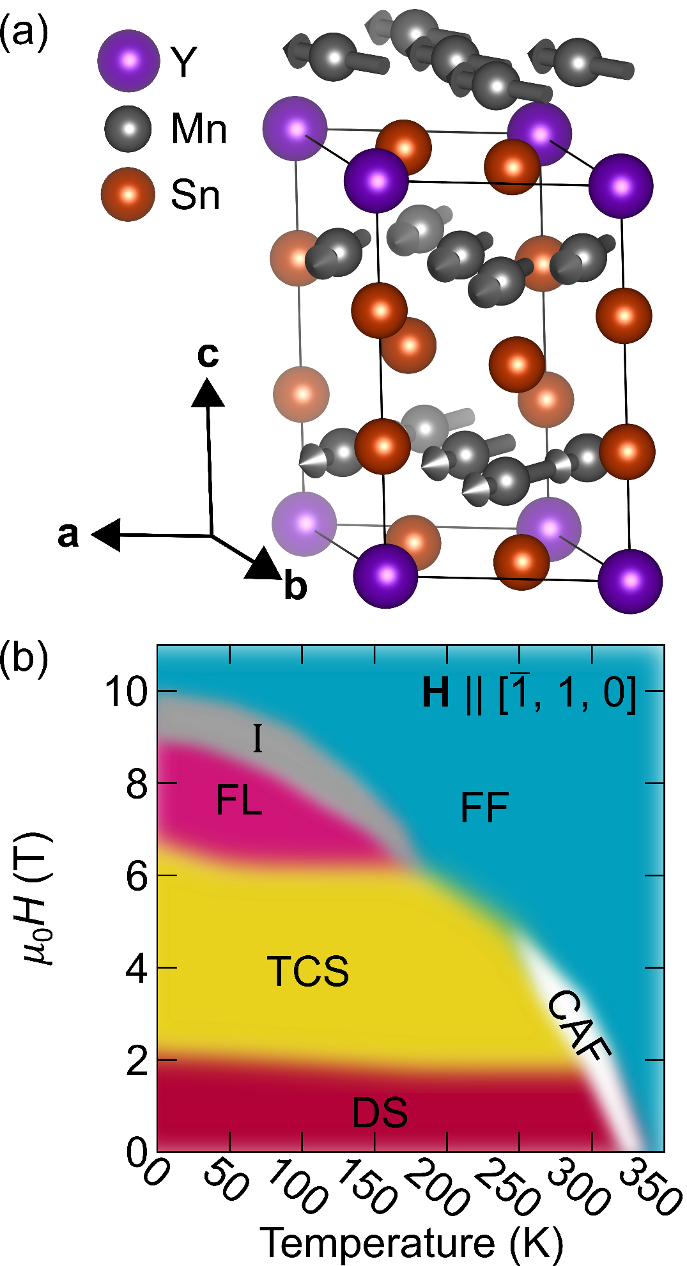

Neutron diffraction studies on the topologically non-trivial kagome helimagnet YMn₆Sn₆
Rebecca L. Dally
NCNR, BT7 Instrument Scientist
CHRNS Summer School on Neutron Scattering
October 17 – 21, 2022
NATIONAL INSTITUTE of STANDARDS and TECHNOLOGY ● NIST CENTER for NEUTRON RESEARCH

Slide 2
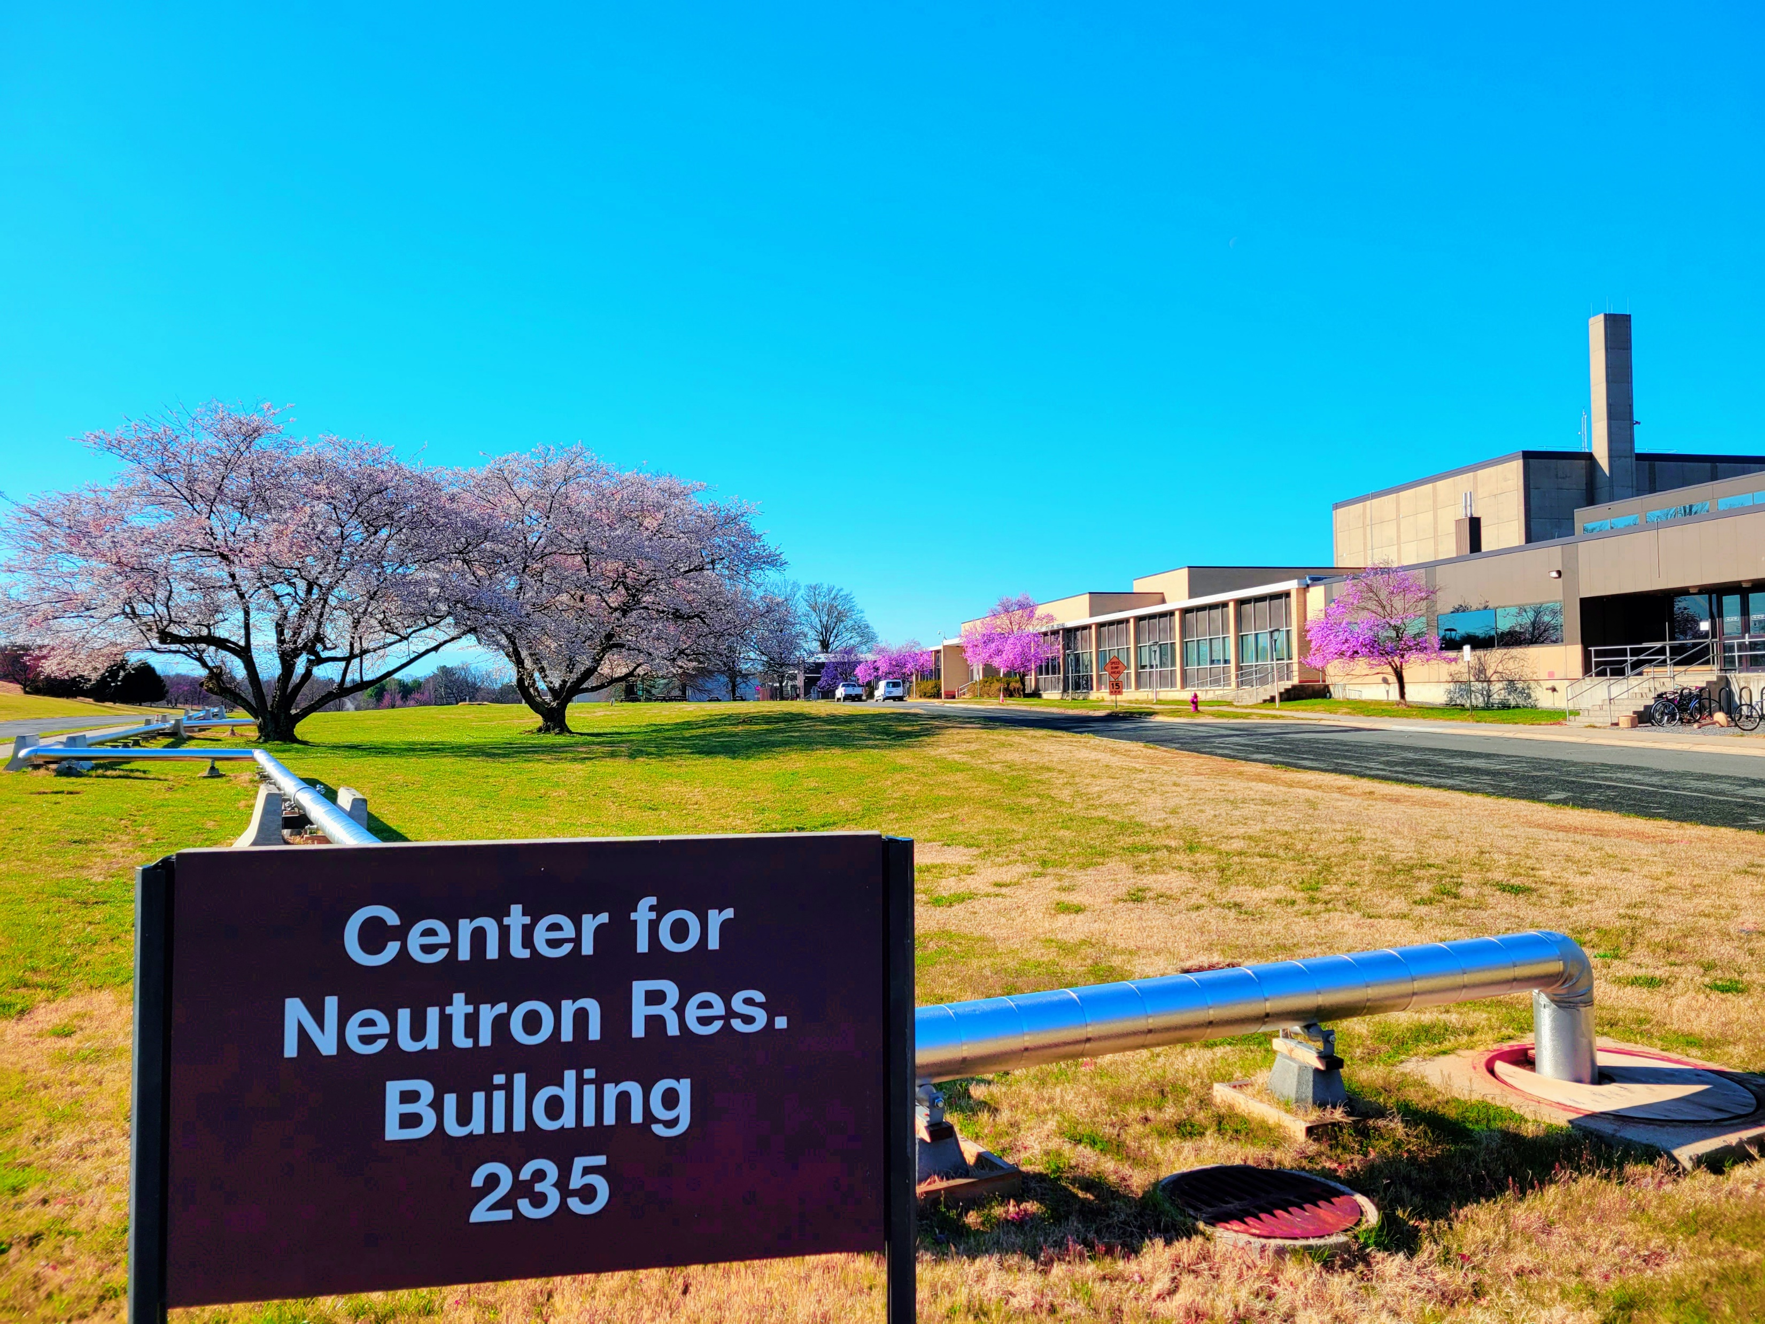
Synthesis, extensive bulk electronic and magnetic characterization (Ghimire lab @GMU,
M. A. McGuire @ORNL,
J.F. Mitchell & J. S. Jiang @Argonne)
Theory
(I. I. Mazin @GMU; M.P. Ghimire @Tribhuvan U.)
Neutron diffraction: SANS, triple-axis, & triple-axis polarized
(R.L. Dally, L. Poudel, M. Bleuel, J.W. Lynn @NCNR, K. Rule @ANSTO)
Acknowledgements
N. J. Ghimire et al, Sci. Adv. 6, eabe2680 (2020)
R. L. Dally et al, Phys. Rev. B 103, 094413 (2021)
P. E. Siegfried et al, Comm. Phys. 5, 58 (2022)
NATIONAL INSTITUTE of STANDARDS and TECHNOLOGY ● NIST CENTER for NEUTRON RESEARCH

Slide 3
Why study Kagome lattice materials?
The RMn₆Sn₆ (HfFe₆Ge₆ structure) family and magnetic structures
YMn₆Sn₆ history and the B-T phase diagram
Topological Hall effect and the transverse conical spiral (TCS) magnetic phase
Polarized neutron results
Recent results: magnetoresistance and Ge-doped YMn₆Sn₆
NATIONAL INSTITUTE of STANDARDS and TECHNOLOGY ● NIST CENTER for NEUTRON RESEARCH

Slide 4
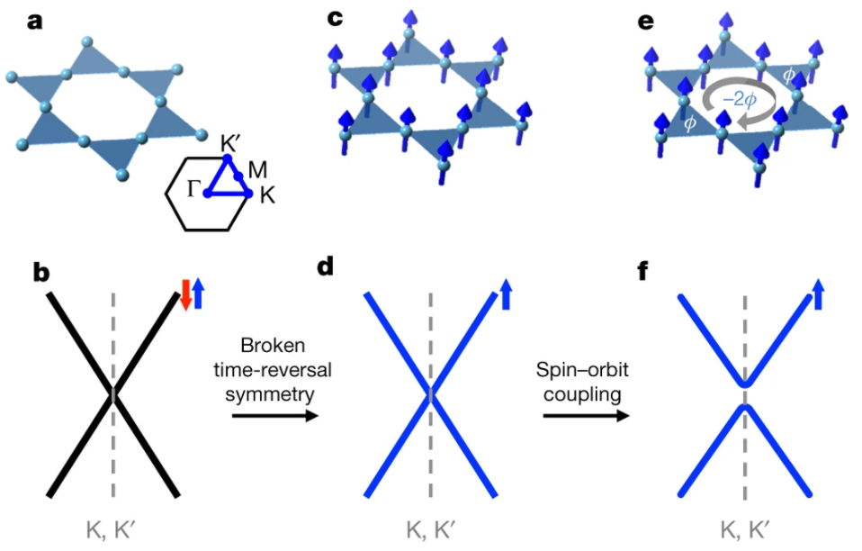
Where to look for interesting physics in Kagome lattice materials
L Ye et al. Massive Dirac fermions in a ferromagnetic kagome metal. Nature 555, 638–642 (2018) doi:10.1038/nature25987
NATIONAL INSTITUTE of STANDARDS and TECHNOLOGY ● NIST CENTER for NEUTRON RESEARCH

Slide 5
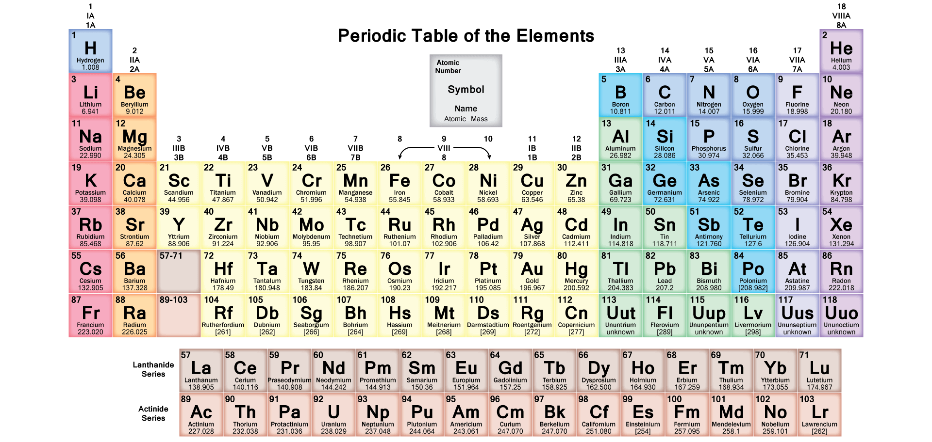
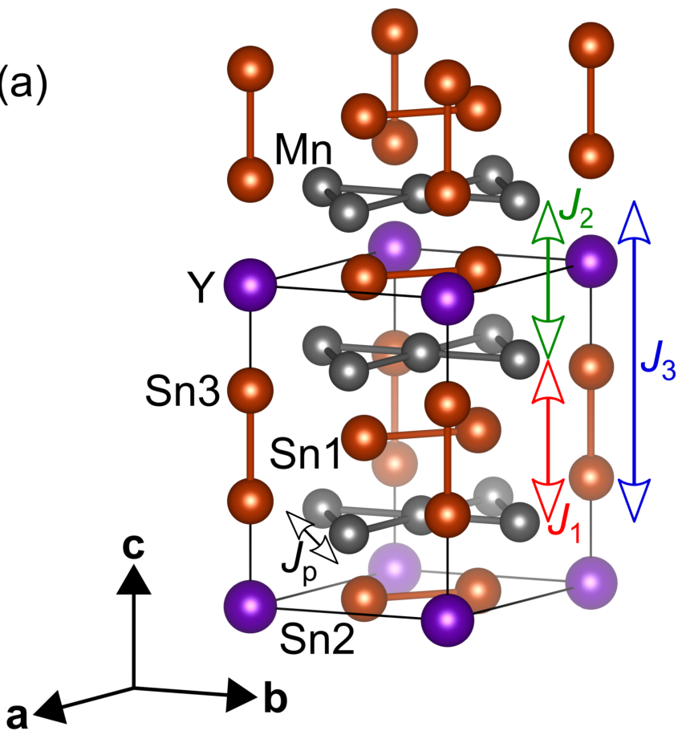
The RMn₆Sn₆ (HfFe₆Ge₆ structure) family contains many magnetic structures
HoFe₆Ge₆ structure (Immm)
NATIONAL INSTITUTE of STANDARDS and TECHNOLOGY ● NIST CENTER for NEUTRON RESEARCH

Slide 6
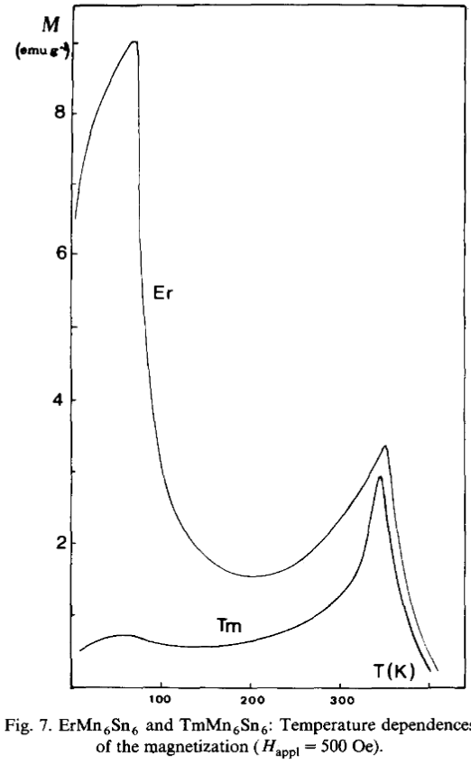
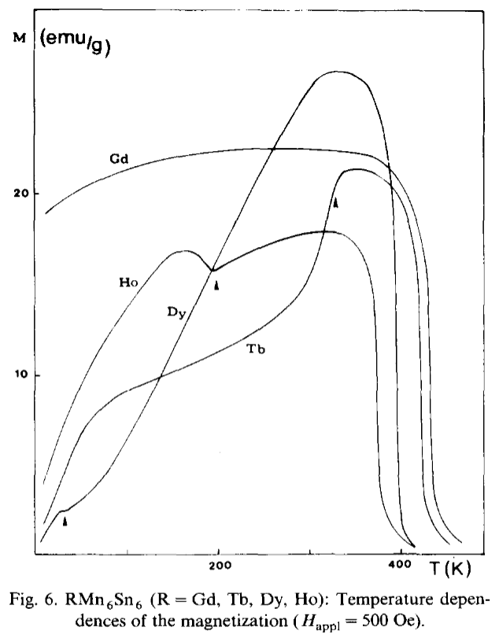
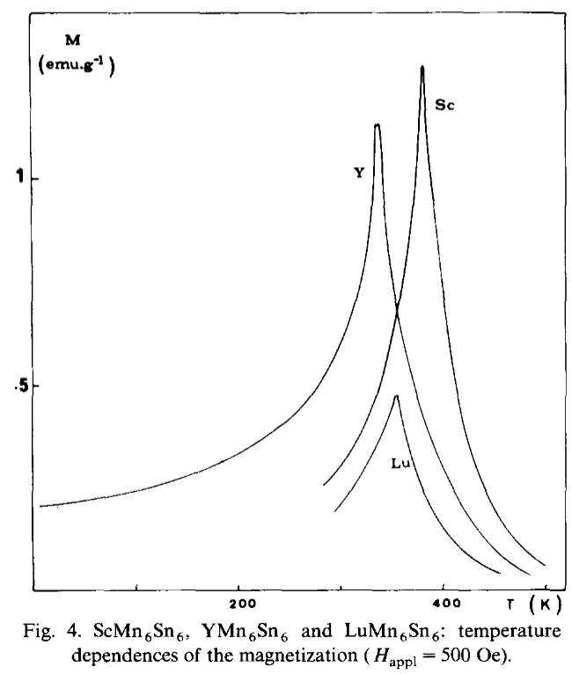
The RMn₆Sn₆ (HfFe₆Ge₆ structure) family contains many magnetic structures
G. Venturini et al. J. Magn. Magn. Mater. 94(1–2), 35-42 (1991). https://doi.org/10.1016/0304-8853(91)90108-M
NATIONAL INSTITUTE of STANDARDS and TECHNOLOGY ● NIST CENTER for NEUTRON RESEARCH

Slide 7
Timeline of key YMn₆Sn₆ research
1988
ternary stannide synthesis first reported for RMn₆Sn₆ (R = Sc, Y, Sm, Gd-Tm, Lu)
B. Malaman et al. Mater. Res. Bull. 23(11), 1629-1633 (1988). https://doi.org/10.1016/0025-5408(88)90252-8
1991
Crystal synthesis and bulk magnetic characterization revealing diversity of magnetic structures in RMn₆Sn₆ family
G. Venturini et al. J. Magn. Magn. Mater. 94(1–2), 35-42 (1991). https://doi.org/10.1016/0304-8853(91)90108-M
1996
Neutron diffraction revealed the (unusual) incommensurate antiferromagnetic spiral ground state of RMn₆Sn₆ (R = Sc, Y, Lu)
G. Venturini et al. J. Alloy Compd. 236(1–2), 102-110 (1996). https://doi.org/10.1016/0925-8388(95)01998-7
NATIONAL INSTITUTE of STANDARDS and TECHNOLOGY ● NIST CENTER for NEUTRON RESEARCH

Slide 8
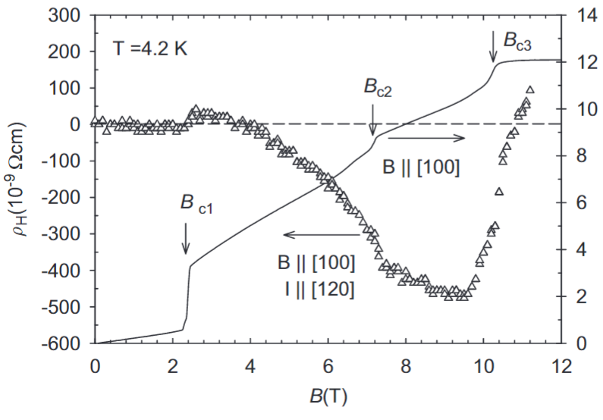
Timeline of key YMn₆Sn₆ research
2007
Bulk magnetic measurements with B ⟂ c published along with Hall data at 4.2 K
K. Uhlířová, et al. J. Magn. Magn. Mater. 310(2), 1747-1749 (2007). https://doi.org/10.1016/j.jmmm.2006.10.577
2020
Topological Hall effect (THE) found in transverse conical spiral magnetic phase. New THE mechansim proposed.
N. J. Ghimire et al, Sci. Adv. 6, eabe2680 (2020). https://doi.org/10.1126/sciadv.abe2680
NATIONAL INSTITUTE of STANDARDS and TECHNOLOGY ● NIST CENTER for NEUTRON RESEARCH

Slide 9
Zero-field magnetic structure is an antiferromagnet with incommensurate spiral order as the magnetic ground state
Centrosymmetric (P6/mmm)
Mn atoms form layers of kagome lattices with easy-plane anisotropy
Mn layer above not the same distance as layer below
  need J₁-J₂-J₃ interlayer exchange interaction model
  J_{p}<0, J₁<0, J₂>0, J₃<0
  frustrated magnet
NATIONAL INSTITUTE of STANDARDS and TECHNOLOGY ● NIST CENTER for NEUTRON RESEARCH

Slide 10
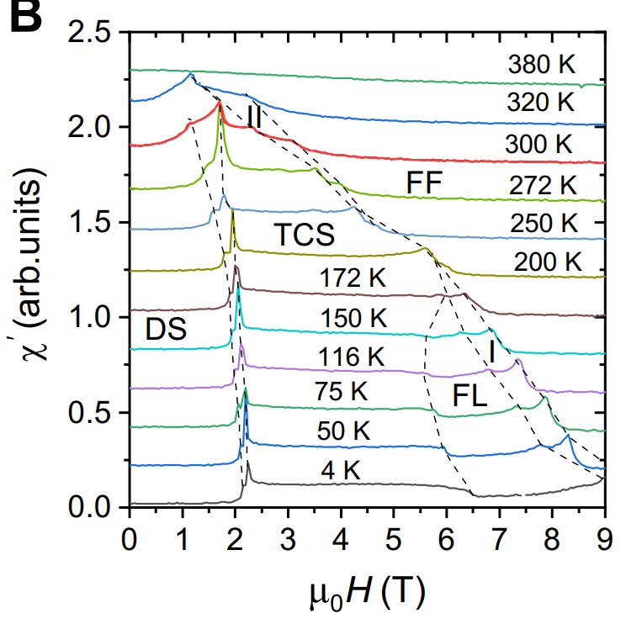
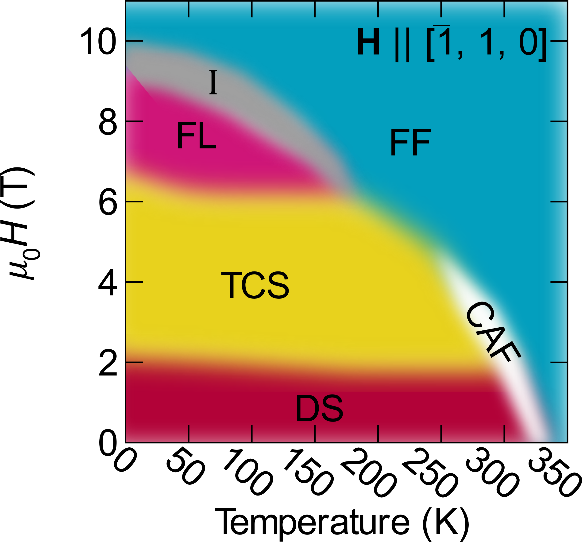
Magnetic structures in the in-plane B-T phase diagram
NATIONAL INSTITUTE of STANDARDS and TECHNOLOGY ● NIST CENTER for NEUTRON RESEARCH

Slide 11
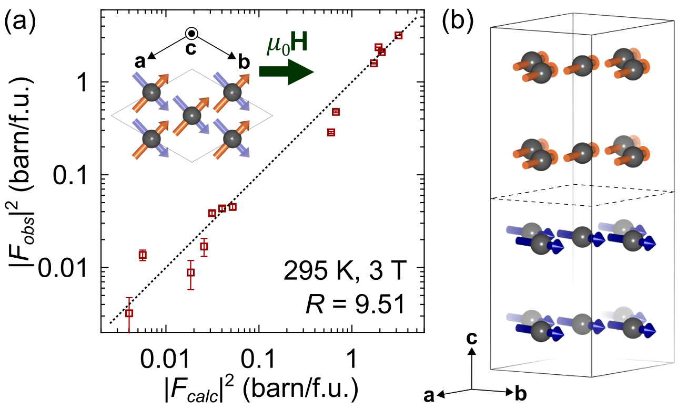
Magnetic structures in the in-plane B-T phase diagram
k₁ = (0, 0, 0), k₂ = (0, 0, 0.5)
γ = 52(2)◦, µ = 1.13(4)µ_{B}
NATIONAL INSTITUTE of STANDARDS and TECHNOLOGY ● NIST CENTER for NEUTRON RESEARCH

Slide 12
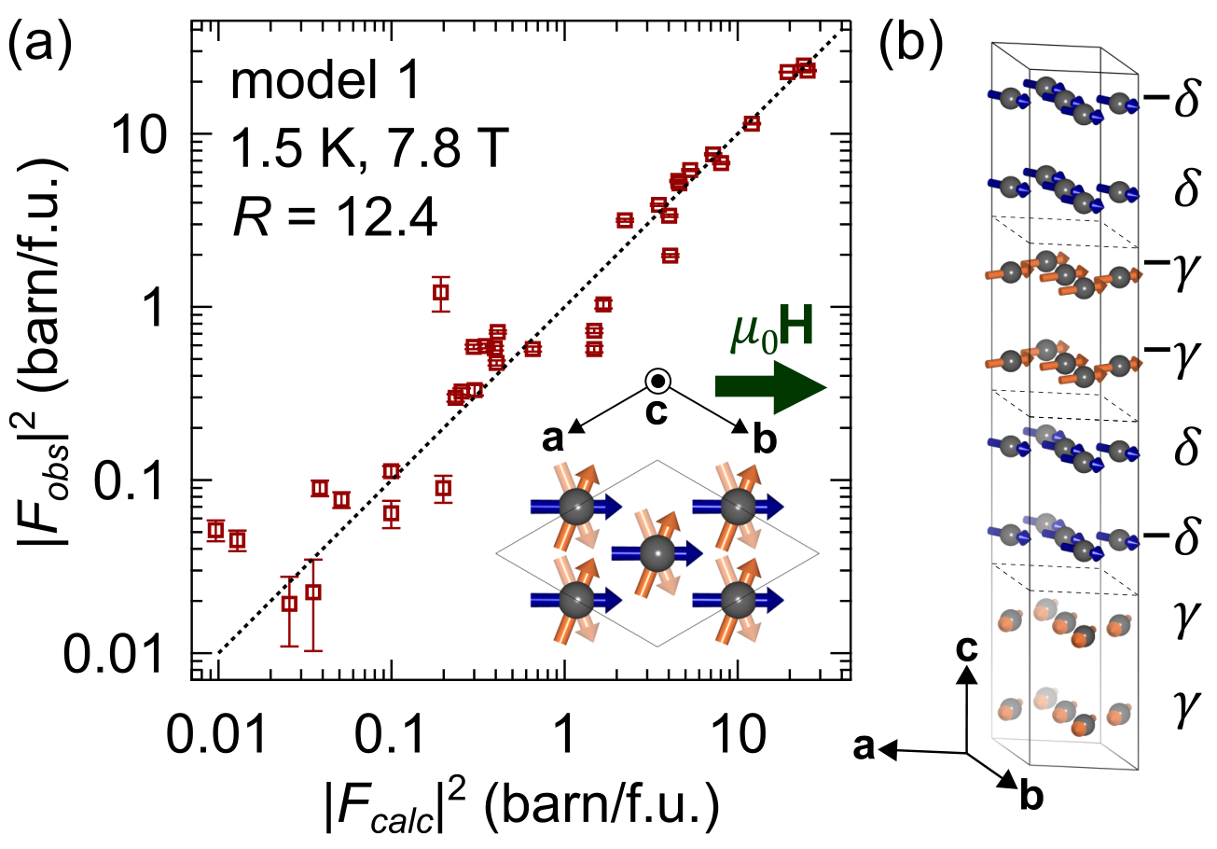
Magnetic structures in the in-plane B-T phase diagram
k₁ = (0, 0, 0), k₂ = (0, 0, 0.25), k₃ = (0, 0, 0.5)
γ = 68(2)◦ , δ = 0(1)◦ , µ = 1.95(5)µ_{B}
NATIONAL INSTITUTE of STANDARDS and TECHNOLOGY ● NIST CENTER for NEUTRON RESEARCH

Slide 13
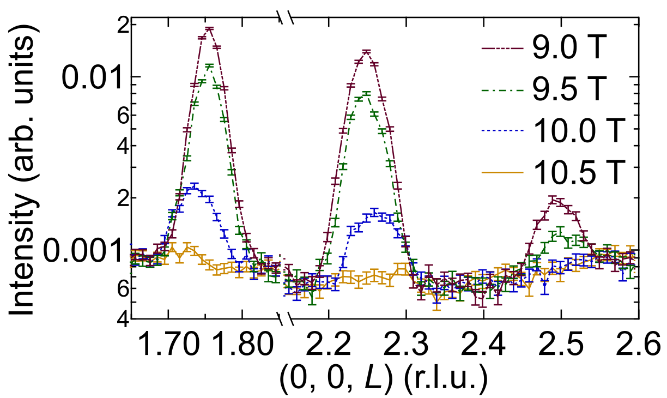
Magnetic structures in the in-plane B-T phase diagram
“Phase I” incommensurate
k₁ = (0, 0, k_{z}), k₂ = (0, 0, 0)
NATIONAL INSTITUTE of STANDARDS and TECHNOLOGY ● NIST CENTER for NEUTRON RESEARCH

Slide 14
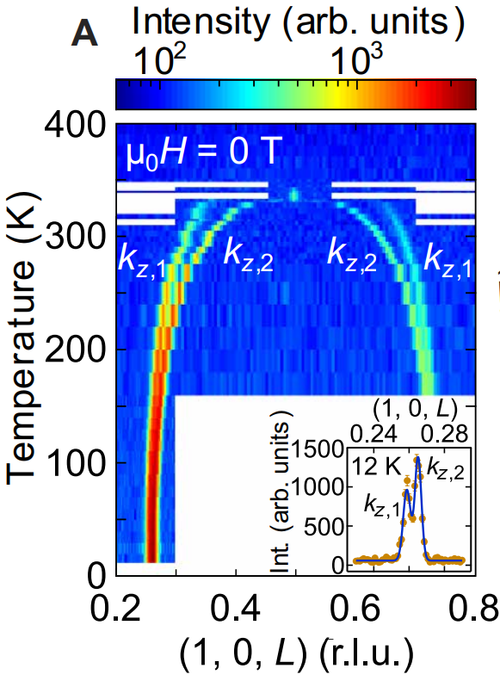
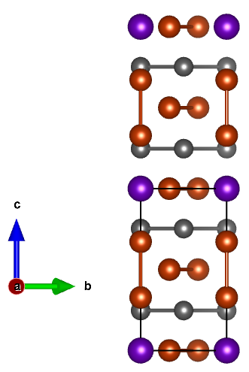
The zero-field magnetic structure is a commensurate AFM at T_{N} and quickly transforms to an incommensurate double-flat-spiral
T_{N} ~ 340 K, k = (0, 0, 0.5)
Sn₂Y
Sn₃
NATIONAL INSTITUTE of STANDARDS and TECHNOLOGY ● NIST CENTER for NEUTRON RESEARCH

Slide 15
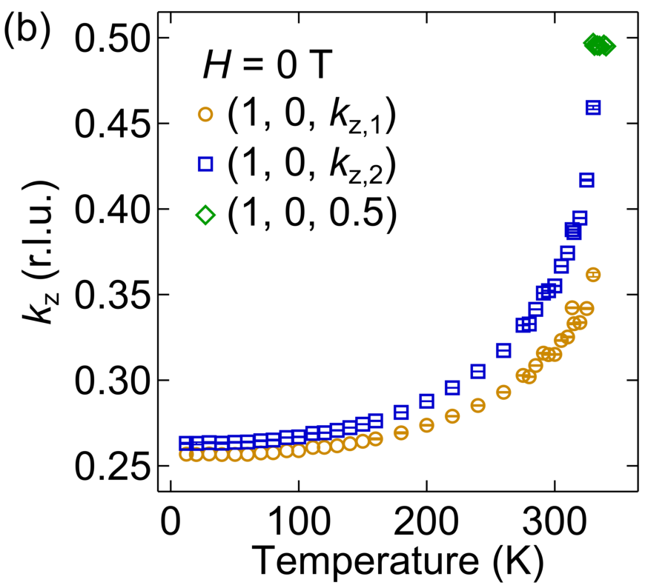
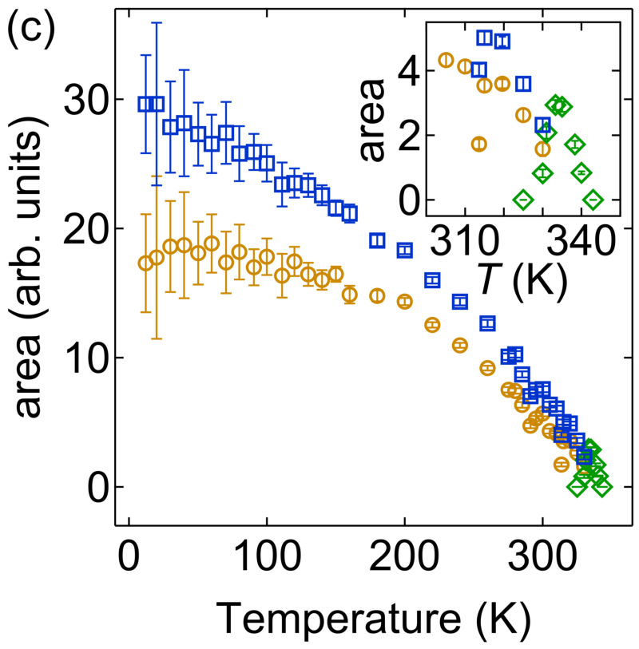
The zero-field magnetic structure is a commensurate AFM at T_{N} and quickly transforms to an incommensurate double-flat-spiral
T_{IC} ~ 330 K, k = (0, 0, k_{z})
actually k₁ = (0, 0, k_{z,1}) and k₂ = (0, 0, k_{z,2})
NATIONAL INSTITUTE of STANDARDS and TECHNOLOGY ● NIST CENTER for NEUTRON RESEARCH

Slide 16
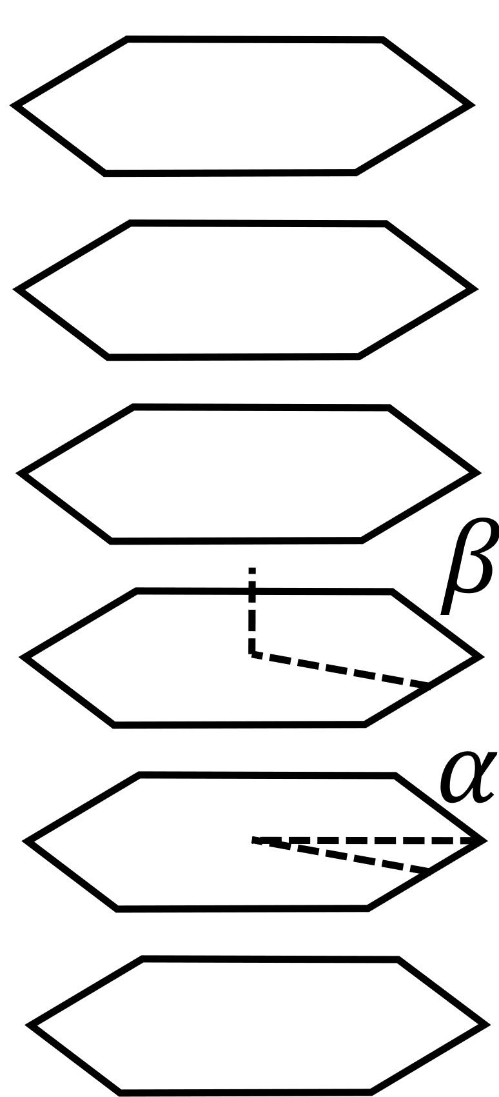


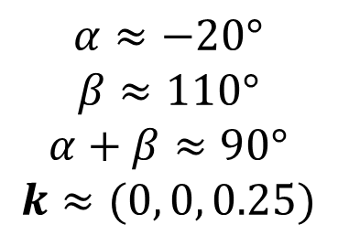
Magnetic ground state structure in zero field is the incommensurate double spiral structure [Venturini, et al. J Alloy Compd 236(1-2), 102-110 (1996).]
6
5
4
$$α≈−20°$$
$$β≈110°$$
$$α+β≈90°$$
$$k≈(0, 0, 0.25)$$
3
2
1
NATIONAL INSTITUTE of STANDARDS and TECHNOLOGY ● NIST CENTER for NEUTRON RESEARCH

Slide 17









$$F_{M}^{±}$$
Unpolarized neutrons cannot distinguish chirality
Two chiral domains possible
$${I_{obs}^{mag}∝\left|F_{M⟂}\right|}^{2}$$
$$F_{M}\left(Q=H+k\right)=p\sum_{v}{f_{v}\left(Q\right)m_{v,k}e^{iQ{∙r}_{v}}}$$
$$F_{M}^{±}\left(Q=H+k\right)=p\sum_{v}{f_{v}\left(Q\right)\left[\frac{μ_{1v}∙\hat{x}±iμ_{2v}∙\hat{y}}{2}\right]e^{−iΦ_{v}}e^{iQ{∙r}_{v}}}$$
$$F_{M}^{±}\left(Q=H+k\right)=\frac{pf\left(Q\right)μ_{1}}{2}\left(\hat{x}±i\hat{y}\right)\sum_{v}{e^{i(Q{∙r}_{v}−Φ_{v})}}$$
Example: $F_{M⟂}^{±}\left(\left(0,0,L\right)+k\right)=F_{M}^{±}\left(\left(0,0,L\right)+k\right)$
${\left|F_{M⟂}^{+}\right|}^{2}={\left|F_{M⟂}^{−}\right|}^{2}$ because ${\left|\hat{x}+i\hat{y}\right|}^{2}={\left|\hat{x}−i\hat{y}\right|}^{2}$
$$+k$$
$$+k$$
$$μ_{1v}=μ_{2v}$$
$$μ_{1v}={−μ}_{2v}$$
$$F_{M}^{+}$$
$$F_{M}^{−}$$
NATIONAL INSTITUTE of STANDARDS and TECHNOLOGY ● NIST CENTER for NEUTRON RESEARCH

Slide 18

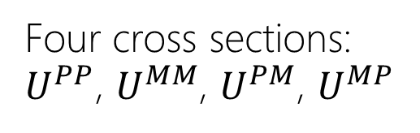


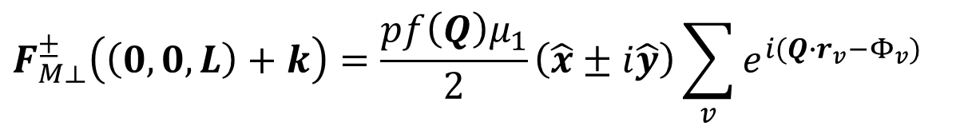


$$F_{M}^{±}$$
Polarized neutrons can distinguish chirality: scattering amplitude modified to consider initial and final spin states of neutron
$$F_{M⟂}^{±}\left(\left(0,0,L\right)+k\right)=\frac{pf\left(Q\right)μ_{1}}{2}\left(\hat{x}±i\hat{y}\right)\sum_{v}{e^{i(Q{∙r}_{v}−Φ_{v})}}$$
$$+k$$
$$+k$$
$$P$$
$$M$$
sample
$$P$$
$$M$$
Four cross sections: $U^{PP}$, $U^{MM}$, $U^{PM}$, $U^{MP}$
$$μ_{1v}=μ_{2v}$$
$$μ_{1v}={−μ}_{2v}$$
$$F_{M}^{+}$$
$$F_{M}^{−}$$
$${I_{obs}^{mag}∝\left|U\right|}^{2}$$
NATIONAL INSTITUTE of STANDARDS and TECHNOLOGY ● NIST CENTER for NEUTRON RESEARCH

Slide 19
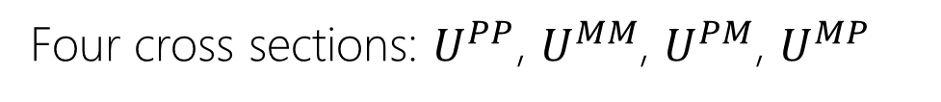
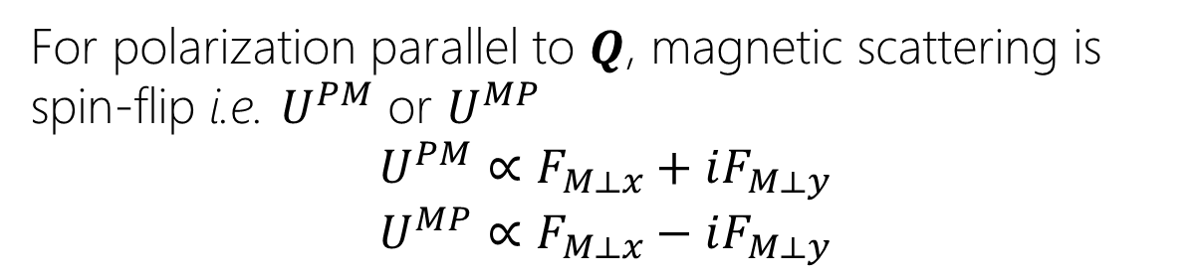
$$F_{M}^{±}$$
Polarized neutrons can distinguish chirality: scattering amplitude modified to consider initial and final spin states of neutron
$$F_{M⟂}^{±}\left(\left(0,0,L\right)+k\right)=\frac{pf\left(Q\right)μ_{1}}{2}\left(\hat{x}±i\hat{y}\right)\sum_{v}{e^{i(Q{∙r}_{v}−Φ_{v})}}$$
$$+k$$
$$+k$$
Four cross sections: $U^{PP}$, $U^{MM}$, $U^{PM}$, $U^{MP}$
For polarization parallel to $Q$, magnetic scattering is spin-flip i.e. $U^{PM}$ or $U^{MP}$
$$U^{PM}∝F_{M⟂x}+iF_{M⟂y}$$
$$U^{MP}∝F_{M⟂x}−iF_{M⟂y}$$
$$μ_{1v}=μ_{2v}$$
$$μ_{1v}={−μ}_{2v}$$
$$F_{M}^{+}$$
$$F_{M}^{−}$$
NATIONAL INSTITUTE of STANDARDS and TECHNOLOGY ● NIST CENTER for NEUTRON RESEARCH

Slide 20
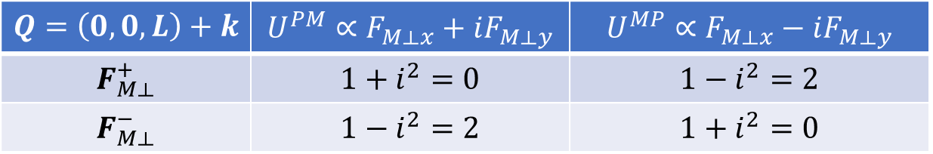
$$F_{M}^{±}$$
Polarized neutrons can distinguish chirality: scattering amplitude modified to consider initial and final spin states of neutron
$$F_{M⟂}^{±}\left(\left(0,0,L\right)+k\right)=\frac{pf\left(Q\right)μ_{1}}{2}\left(\hat{x}±i\hat{y}\right)\sum_{v}{e^{i(Q{∙r}_{v}−Φ_{v})}}$$
$$+k$$
$$+k$$
Four cross sections: $U^{PP}$, $U^{MM}$, $U^{PM}$, $U^{MP}$
For polarization parallel to $Q$, magnetic scattering is spin-flip i.e. $U^{PM}$ or $U^{MP}$
$$U^{PM}∝F_{M⟂x}+iF_{M⟂y}$$
$$U^{MP}∝F_{M⟂x}−iF_{M⟂y}$$
$$μ_{1v}=μ_{2v}$$
$$μ_{1v}={−μ}_{2v}$$
$$Q=\left(0,0,L\right)+k$$ | $$U^{PM}∝F_{M⟂x}+iF_{M⟂y}$$ | $$U^{MP}∝F_{M⟂x}−iF_{M⟂y}$$
$$F_{M⟂}^{+}$$ | $$1+i^{2}=0$$ | $$1−i^{2}=2$$
$$F_{M⟂}^{−}$$ | $$1−i^{2}=2$$ | $$1+i^{2}=0$$
$$F_{M}^{+}$$
$$F_{M}^{−}$$
NATIONAL INSTITUTE of STANDARDS and TECHNOLOGY ● NIST CENTER for NEUTRON RESEARCH

Slide 21



$$F_{M}^{±}$$
Polarized neutrons can distinguish chirality: scattering amplitude modified to consider initial and final spin states of neutron
$$+k$$
$$+k$$
$$PM$$
$$MP$$
Intensity
$$\left(0,0,L\right)+k$$
$$μ_{1v}=μ_{2v}$$
$$μ_{1v}={−μ}_{2v}$$
$$Q=\left(0,0,L\right)+k$$ | $$U^{PM}∝F_{M⟂x}+iF_{M⟂y}$$ | $$U^{MP}∝F_{M⟂x}−iF_{M⟂y}$$
$$F_{M⟂}^{+}$$ | $$1+i^{2}=0$$ | $$1−i^{2}=2$$
$$F_{M⟂}^{−}$$ | $$1−i^{2}=2$$ | $$1+i^{2}=0$$
$$F_{M}^{+}$$
$$F_{M}^{−}$$
NATIONAL INSTITUTE of STANDARDS and TECHNOLOGY ● NIST CENTER for NEUTRON RESEARCH

Slide 22



$$F_{M}^{±}$$
Polarized neutrons can distinguish chirality: scattering amplitude modified to consider initial and final spin states of neutron
$$+k$$
$$+k$$
$$PM$$
$$PM$$
$$MP$$
$$MP$$
Intensity
Intensity
$$\left(0,0,L\right)+k$$
$$\left(0,0,L\right)+k$$
$$μ_{1v}=μ_{2v}$$
$$μ_{1v}={−μ}_{2v}$$
$$Q=\left(0,0,L\right)+k$$ | $$U^{PM}∝F_{M⟂x}+iF_{M⟂y}$$ | $$U^{MP}∝F_{M⟂x}−iF_{M⟂y}$$
$$F_{M⟂}^{+}$$ | $$1+i^{2}=0$$ | $$1−i^{2}=2$$
$$F_{M⟂}^{−}$$ | $$1−i^{2}=2$$ | $$1+i^{2}=0$$
$$F_{M}^{+}$$
$$F_{M}^{−}$$
NATIONAL INSTITUTE of STANDARDS and TECHNOLOGY ● NIST CENTER for NEUTRON RESEARCH

Slide 23







$$F_{M}^{±}$$
Polarized neutrons can distinguish chirality: scattering amplitude modified to consider initial and final spin states of neutron
$$+k$$
$$+k$$
$$PM$$
$$PM$$
$$MP$$
$$MP$$
$$+$$
Intensity
Intensity
$$\left(0,0,L\right)+k$$
$$\left(0,0,L\right)+k$$
$$μ_{1v}=μ_{2v}$$
$$μ_{1v}={−μ}_{2v}$$
$$Q=\left(0,0,L\right)+k$$ | $$U^{PM}∝F_{M⟂x}+iF_{M⟂y}$$ | $$U^{MP}∝F_{M⟂x}−iF_{M⟂y}$$
$$F_{M⟂}^{+}$$ | $$1+i^{2}=0$$ | $$1−i^{2}=2$$
$$F_{M⟂}^{−}$$ | $$1−i^{2}=2$$ | $$1+i^{2}=0$$
$$F_{M}^{+}$$
$$F_{M}^{−}$$
NATIONAL INSTITUTE of STANDARDS and TECHNOLOGY ● NIST CENTER for NEUTRON RESEARCH

Slide 24
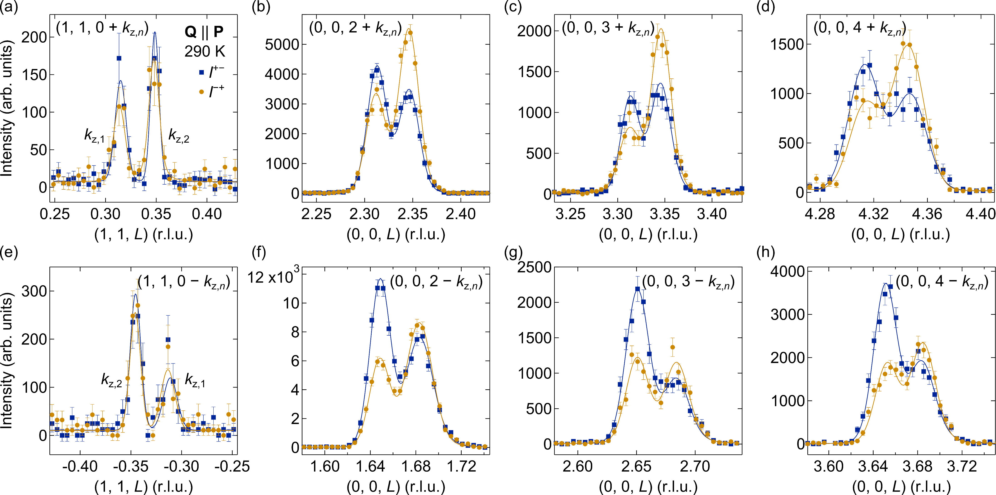
$$F_{M}^{±}$$
Polarized neutron diffraction data show an imbalance of the positive vs negative chiral domains despite centrosymmetric structure
NATIONAL INSTITUTE of STANDARDS and TECHNOLOGY ● NIST CENTER for NEUTRON RESEARCH

Slide 25
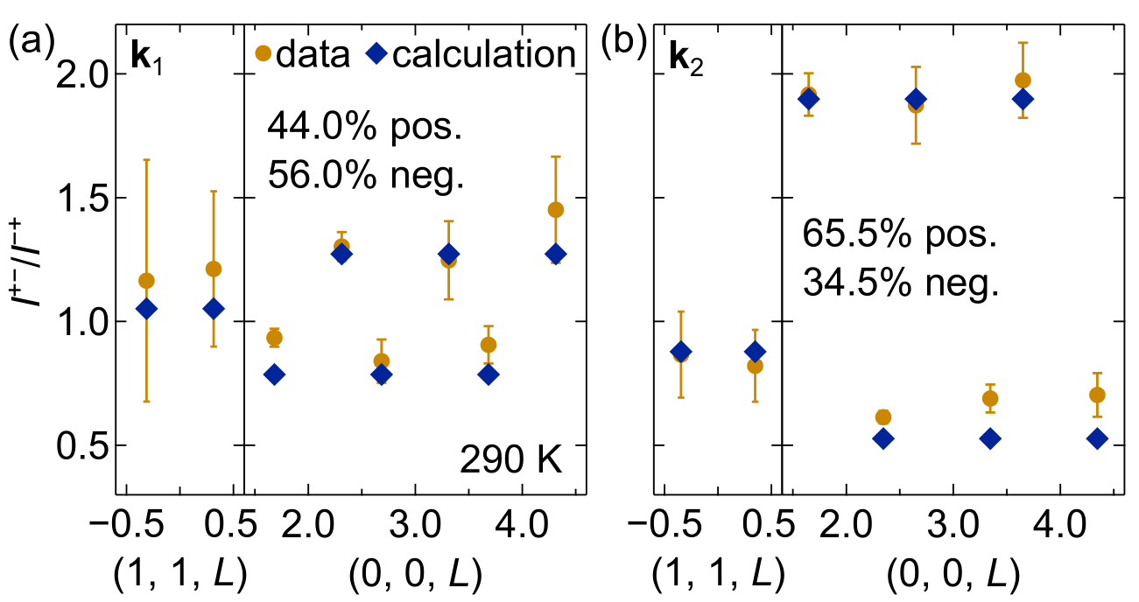
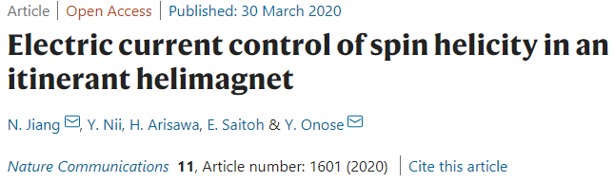
$$F_{M}^{±}$$
Helimagnetism in centrosymmetric YMn₆Sn₆ due to frustrated interlayer exchange, should not see chiral imbalance
Possible control of spin helicity?
MnP
NATIONAL INSTITUTE of STANDARDS and TECHNOLOGY ● NIST CENTER for NEUTRON RESEARCH

Slide 26
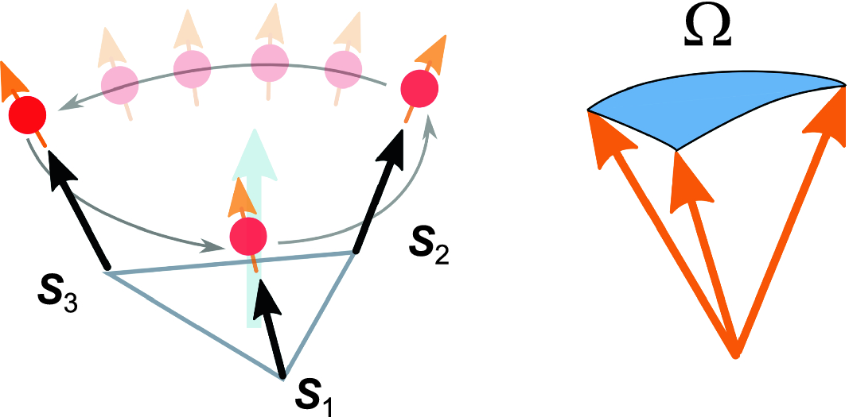
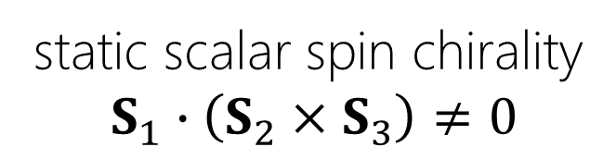
topological Hall effect arises from charges moving through a spatially varying magnetic field: chiral and non-coplanar spin configuration required.
static scalar spin chirality
$$S_{1}∙\left(S_{2}×S_{3}\right)≠0$$
Observation of topological Hall effect indicates an underlying topologically protected spin structure
→robust phase
Yokouchi T. Springer Theses (2019). https://doi.org/10.1007/978-981-32-9385-4_1
NATIONAL INSTITUTE of STANDARDS and TECHNOLOGY ● NIST CENTER for NEUTRON RESEARCH

Slide 27
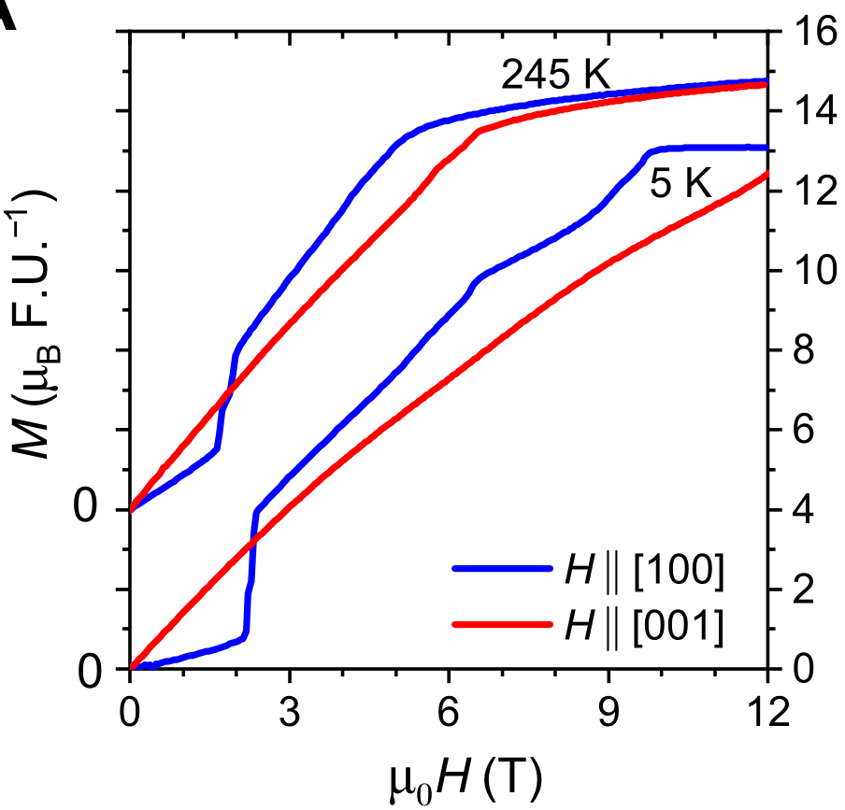
When a magnetic field is applied in-plane, there are many new magnetic phases. The topological Hall effect was observed in one of these phases at elevated temperatures.
NATIONAL INSTITUTE of STANDARDS and TECHNOLOGY ● NIST CENTER for NEUTRON RESEARCH

Slide 28
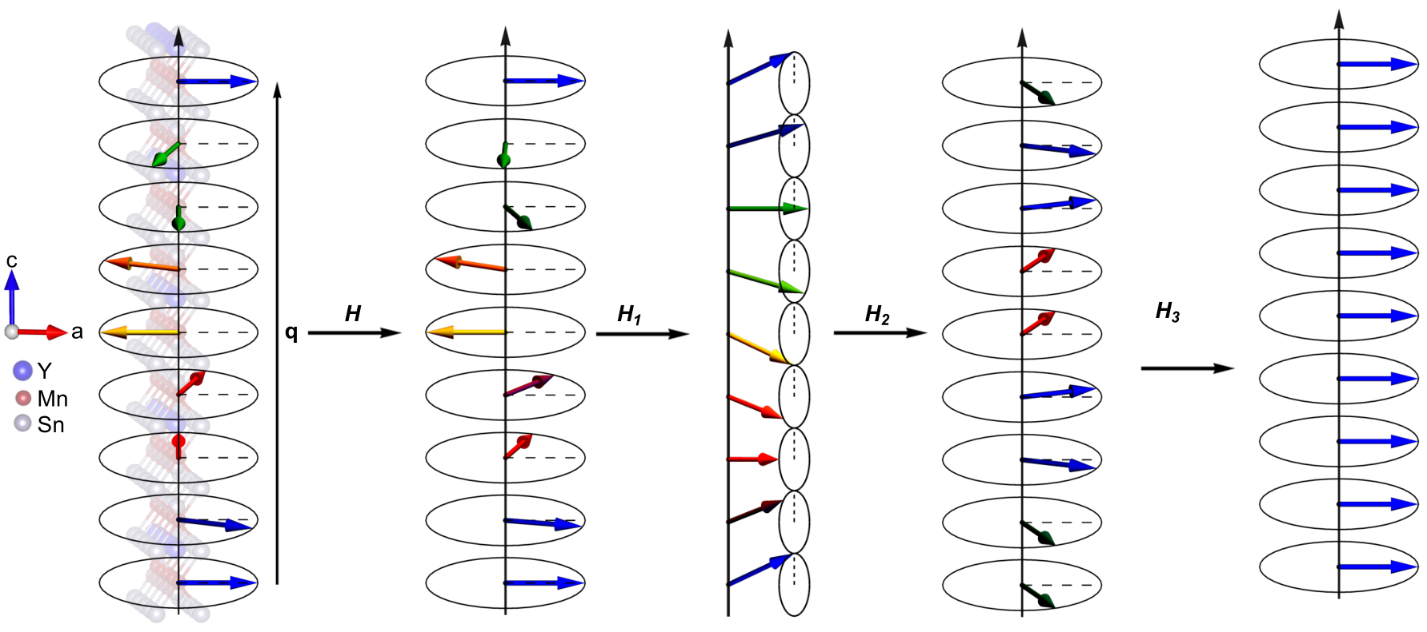
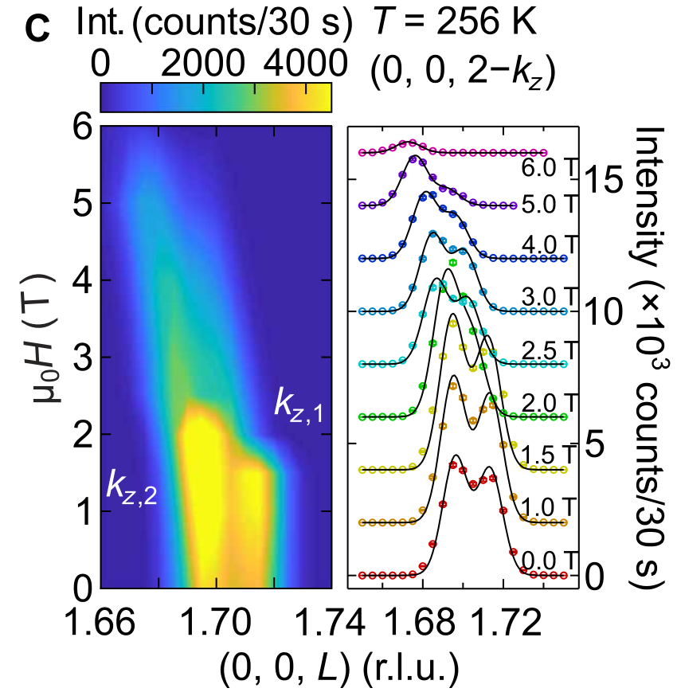
Neutron diffraction work at NCNR showed the topological Hall effect coincided with a transverse conical spiral (TCS) magnetic structure
~50% reduction in neutron intensity
H
double spiral to transverse conical spiral
NATIONAL INSTITUTE of STANDARDS and TECHNOLOGY ● NIST CENTER for NEUTRON RESEARCH

Slide 29
All the other structures in the magnetic phase diagram were identified via neutron diffraction
DS
(distorted spiral)
TCS
(transverse conical spiral)
FL
(fan-like)
FF
(forced ferromagnet)
double spiral
NATIONAL INSTITUTE of STANDARDS and TECHNOLOGY ● NIST CENTER for NEUTRON RESEARCH

Slide 30
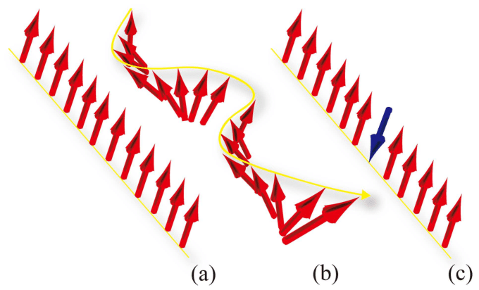
The elevated temperatures of the topological Hall effect along with the null scalar spin chirality indicated thermal fluctuations of the magnons are playing a part
Nakata et al. J. Phys. D: Appl. Phys. 50 114004 (2017).
NATIONAL INSTITUTE of STANDARDS and TECHNOLOGY ● NIST CENTER for NEUTRON RESEARCH

Slide 31
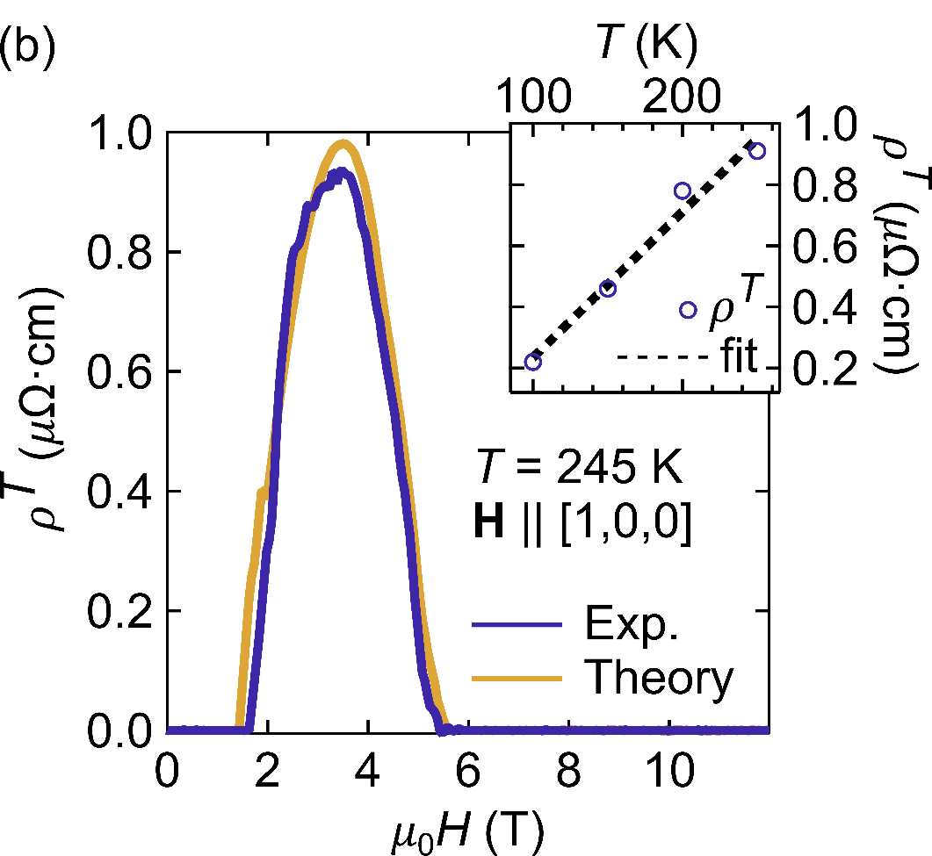


The elevated temperatures of the topological Hall effect along with the null scalar spin chirality indicated thermal fluctuations of the magnons are playing a part
$$I⟂[100]$$
$$Hǁ[100]$$
NATIONAL INSTITUTE of STANDARDS and TECHNOLOGY ● NIST CENTER for NEUTRON RESEARCH

Slide 32
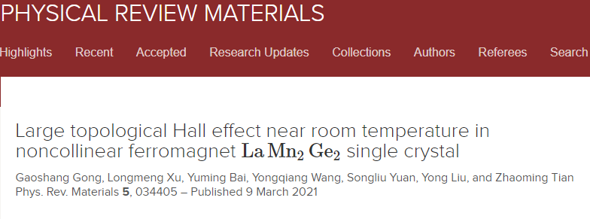
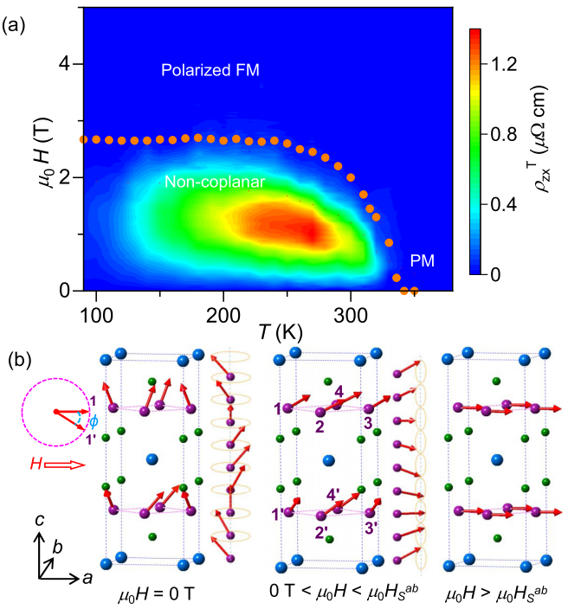
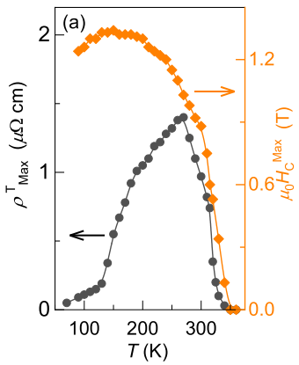
NATIONAL INSTITUTE of STANDARDS and TECHNOLOGY ● NIST CENTER for NEUTRON RESEARCH

Slide 33
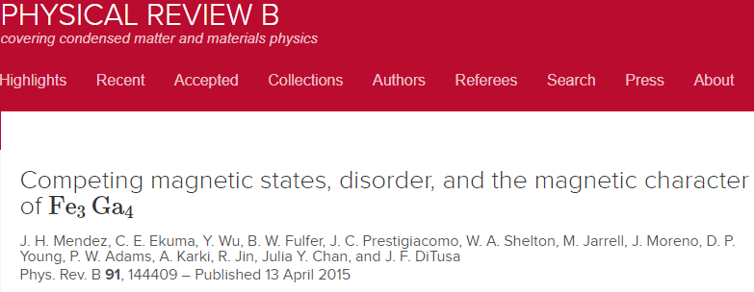
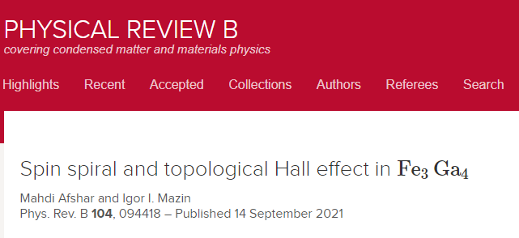
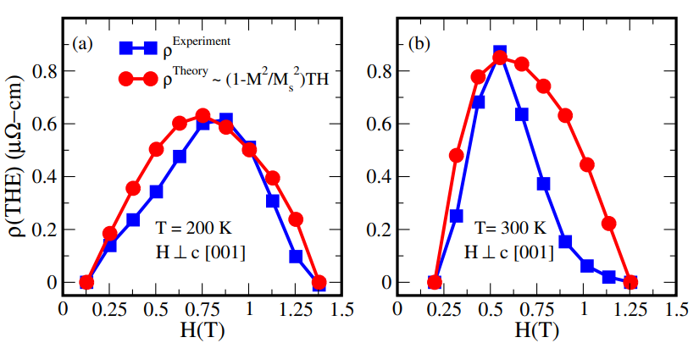
NATIONAL INSTITUTE of STANDARDS and TECHNOLOGY ● NIST CENTER for NEUTRON RESEARCH

Slide 34

$$F_{M}^{±}$$
The interlayer magnetic interactions coupled with an applied magnetic field in the ab-plane lead to a complex and multi-magnetic structure B-T phase diagram
NATIONAL INSTITUTE of STANDARDS and TECHNOLOGY ● NIST CENTER for NEUTRON RESEARCH

Slide 35
$$F_{M}^{±}$$
Polarized neutron scattering revealed an imbalance between the positive and negative chiral domain population
NATIONAL INSTITUTE of STANDARDS and TECHNOLOGY ● NIST CENTER for NEUTRON RESEARCH

Slide 36
$$F_{M}^{±}$$
The elevated temperatures of the topological Hall effect along with the null scalar spin chirality indicate thermal fluctuations of the magnons are playing a part
NATIONAL INSTITUTE of STANDARDS and TECHNOLOGY ● NIST CENTER for NEUTRON RESEARCH

Slide 37
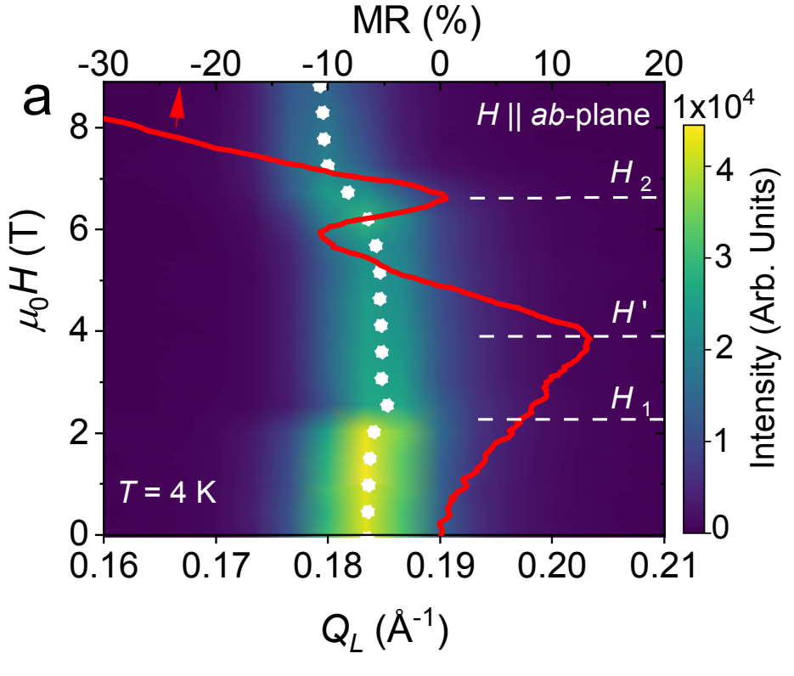
Recent developments for our YMn₆Sn₆ research: magnetotransport reveals two types of Lifshitz transitions
P. E. Siegfried et al, Comm. Phys. 5, 58 (2022)
Driven by a continuously changing magnetization (rare) (H`)
Electron-spin coupling driven, without large SOC (H₂)
NATIONAL INSTITUTE of STANDARDS and TECHNOLOGY ● NIST CENTER for NEUTRON RESEARCH

Slide 38
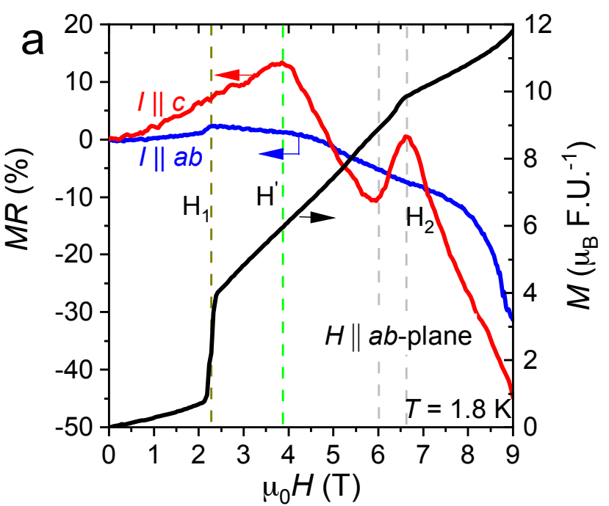
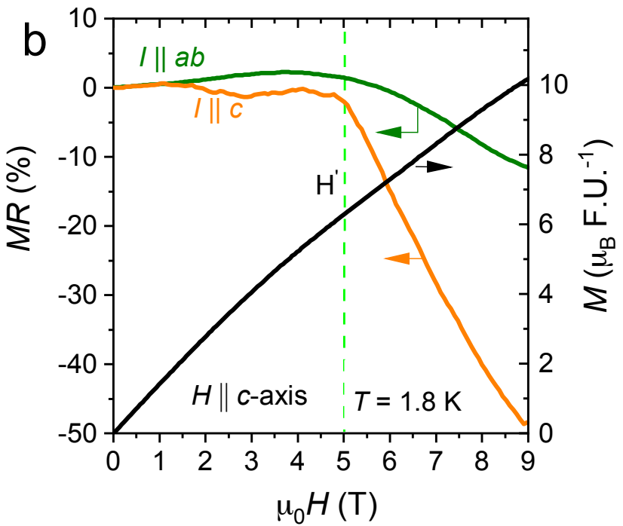
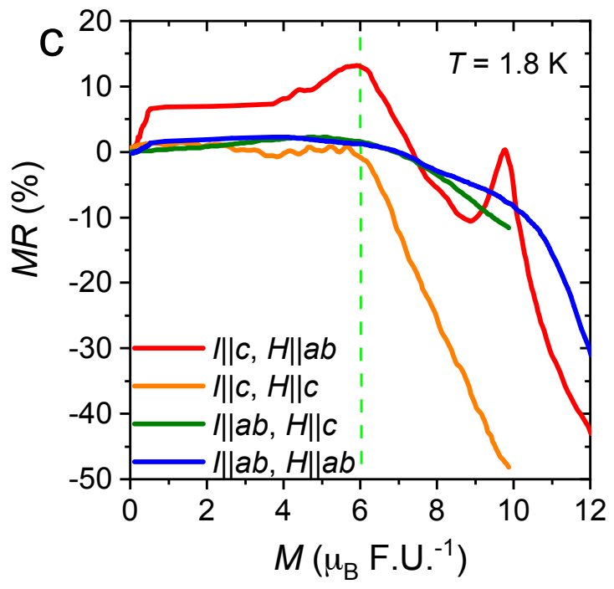
Recent developments for our YMn₆Sn₆ research: magnetotransport reveals two types of Lifshitz transitions
Driven by a continuously changing magnetization (rare) (H`)
Electron-spin coupling driven, without large SOC (H₂)
NATIONAL INSTITUTE of STANDARDS and TECHNOLOGY ● NIST CENTER for NEUTRON RESEARCH

Slide 39
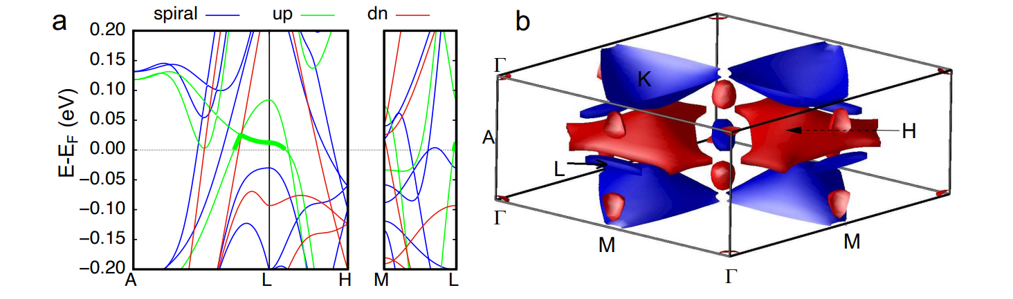
Recent developments for our YMn₆Sn₆ research: magnetotransport reveals two types of Lifshitz transitions
Driven by a continuously changing magnetization (rare) (H`)
Electron-spin coupling driven, without large SOC (H₂)
NATIONAL INSTITUTE of STANDARDS and TECHNOLOGY ● NIST CENTER for NEUTRON RESEARCH

Slide 40
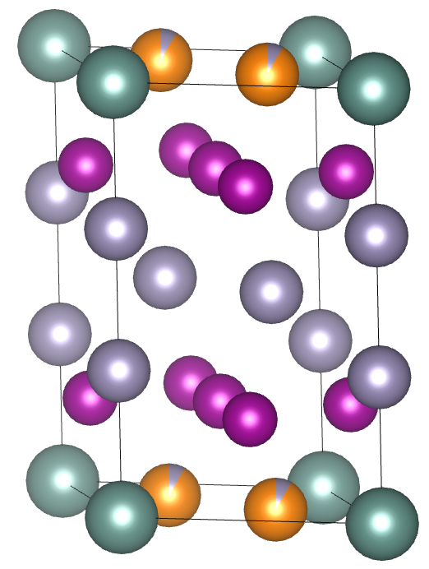
Recent developments for our YMn₆Sn₆ research: Ge-doped neutron diffraction
YMn₆Sn_{6-x}Ge_{x} (x ≈ 1.8)
Ge preferentially goes into Y layer
Magnetization measurements show similar µ₀H-T phase diagram to parent but points to absence of TCS phase
YMn₆Ge₆ is a commensurate c-axis antiferromagnet at RT and undergoes a commensurate-incommensurate transition below 80 K to a c-axis cone antiferromagnetic structure (easy-axis)
G. Venturini et al. J. Alloy Compd. 200(1–2),51-57 (1993).
NATIONAL INSTITUTE of STANDARDS and TECHNOLOGY ● NIST CENTER for NEUTRON RESEARCH

Slide 41


Recent developments for our YMn₆Sn₆ research: Ge-doped neutron diffraction
No high temperature commensurate phase found
Two wavevectors still present with k_{i} = (0, 0, k_{z,i}) (i = 1,2)
T_{N} = 348 K
NATIONAL INSTITUTE of STANDARDS and TECHNOLOGY ● NIST CENTER for NEUTRON RESEARCH

Slide 42

Recent developments for our YMn₆Sn₆ research: Ge-doped neutron diffraction
 | YMn₆Sn₆ | YMn₆Sn_{6-x}Ge_{x} (x ≈ 1.84)
Mn-Mn in-plane | 2.767 Å (FM) | 2.700 Å
Mn-Mn d₁ | 4.552 Å (FM) | 4.644 Å
Mn-Mn d₂ | 4.458 Å (AFM) | 4.036 Å
Mn-Mn d₂
Mn-Mn d₁
NATIONAL INSTITUTE of STANDARDS and TECHNOLOGY ● NIST CENTER for NEUTRON RESEARCH

Slide 43


Recent developments for our YMn₆Sn₆ research: Ge-doped neutron diffraction
NATIONAL INSTITUTE of STANDARDS and TECHNOLOGY ● NIST CENTER for NEUTRON RESEARCH

Slide 44


Recent developments for our YMn₆Sn₆ research: Ge-doped neutron diffraction
NATIONAL INSTITUTE of STANDARDS and TECHNOLOGY ● NIST CENTER for NEUTRON RESEARCH

Slide 45



k = (0, 0, k_{z})
k_{z} ~ 0.23 (0 T) – 0.24 (6 T)
k = (0, 0, k_{z})
k_{z} ~ 0.18
NATIONAL INSTITUTE of STANDARDS and TECHNOLOGY ● NIST CENTER for NEUTRON RESEARCH

Slide 46
$$F_{M}^{±}$$
Thank you for your attention!
Ghimire et al. Science Advances, 6, 51, eabe2680 (2020). DOI: 10.1126/sciadv.abe2680
Dally et al. Physical Review B, 103, 094413 (2021). DOI: 10.1103/PhysRevB.103.094413
P. E. Siegfried et al, Comm. Phys. 5, 58 (2022). https://doi.org/10.1038/s42005-022-00833-2
NATIONAL INSTITUTE of STANDARDS and TECHNOLOGY ● NIST CENTER for NEUTRON RESEARCH

