Slide 1


Priority Action Report
Wildlife Forensics
Biology/DNA SAC
M. Katherine Moore, Chair
Mary K. Burnham-Curtis, Vice Chair
February 22, 2016

Slide 2
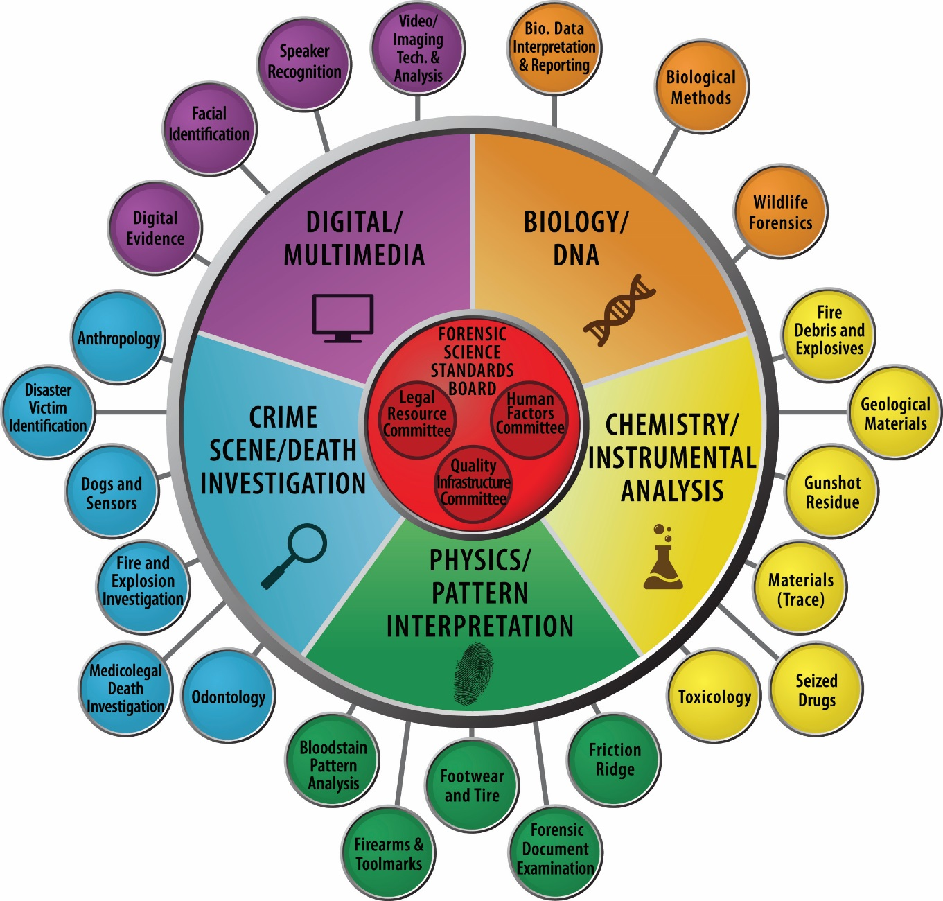

Slide 3
Subcommittee Leadership
Position | Name | Organization | Term | Email
Chair | Kathy Moore, M.S. | NOAA Northwest Fisheries Science Center Forensic Laboratory | 2 | Kathy.Moore@noaa.gov
Vice Chair | Mary Burnham Curtis, Ph.D. | USFWS National Fish and Wildlife Forensics Laboratory | 2 | Mary_Curtis@fws.gov
Executive Secretary | Kim Frazier, M.S. | Wyoming Game and Fish, Wildlife Forensic and Fish Health Laboratory | 4 | Kim.Frazier@wyo.gov

Slide 4
Subcommittee Members
# | Name | Organization | Term | Email
1 | Tasha Bauman, M.S. (HFC Liaison) | Wyoming Game and Fish, Wildlife Forensic and Fish Health Laboratory | 4 | Tasha.Bauman@wyo.gov
2 | Jason Byrd, Ph.D. (LRC Liaison) | University of Florida | 2 | Jhbyrd@ufl.edu
3 | Christina Lindquist, M.S. (QIC Liaison) | U. California-Davis, Veterinary Genetics Laboratory Forensic Unit | 2 | Cdlindquist@ucdavis.edu
4 | Trey Knott, M.S. (Kavi Liaison) | NOAA Northwest Fisheries Science Center Forensic Laboratory | 3 | Trey.Knott@noaa.gov
5 | Christopher O’Brien, Ph.D. | University of New Haven | 4 | Rcobrien@newhaven.edu
6 | David Foran, Ph.D. | Michigan State University | 3 | Foran@msu.edu
7 | Jenny Giles, Ph.D. | Consultant | 4 | jennylgiles@gmail.com
8 | Pepper Trail, Ph.D. | USFWS National Fish and Wildlife Forensics Laboratory | 2 | Pepper_Trail@fws.gov
9 | Brandt Cassidy, Ph.D. | DNA Solutions, Inc. | 3 | Bgcassidy@cox.net
10 | John Planz, Ph.D. | University of North Texas Health Sciences University | 3 | john.planz@unthsc.edu

Slide 5
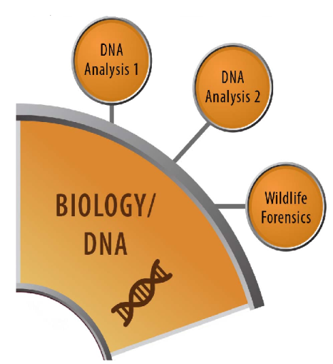
Discipline Description
The Wildlife Forensics Subcommittee will focus on standards and guidelines related to taxonomic identification, individualization, and geographic origin of non-human biological evidence based on morphological and genetic analyses.

Slide 6
Summary of Standards/Guidelines Priority Actions
Priority | Working Title of Document
1 | General Standards for Wildlife Forensic Practice
2 | Report Writing Standards
3 | Terminology
4 | DNA Standards
5 | Morphology Standards
6 | Validation - holding pattern

Slide 7
Standards/Guidelines Development Priority 1
Document Title: General Standards for Wildlife Forensic Practice
Scope: This document provides minimum standards and recommendations for practicing wildlife forensic analysts. This document covers good laboratory practices, evidence handling, and training as well as considerations of phylogeny, taxonomy, and reference collections that are specific to wildlife forensic science.
These minimum standards and recommendations are not intended to replace standards in ISO 17025 or other forensic laboratory standards, but are designed to provide guidance for small laboratories and part-time practitioners who are outside of traditional forensic laboratories.
Objective/rationale: Standardize laboratory best practices for wildlife forensic practitioners.
Issues/Concerns: Acceptance in the SDO process
Task Group Name: Standards and Guidelines TG
Task Group Chair Name: Chris O’Brien
Task Group Chair Contact Information: rcobrien@newhaven.edu
Date of Last Task Group Meeting: 28/Jan/2016

Slide 8
Standards/Guidelines Development Priority 1 Document - General Standards
Key Components of Standard:
Training and Personnel
Evidence Handling
Equipment and Methods
Reference Materials and Collections
Case Documentation

Slide 9
Standards/Guidelines for Reference
Topic 1:General Standards for WF Practice
Title | Organization
SWGWILD Standards and Guidelines, v. 2.0 | SWGWILD
Quality Assurance Standards | FBI
ISFG Recommendations | IFSG
ISO 17025:2005 | ISO
Guide 19: Modules in a Forensic Science Process | ILAC
Supplemental Requirements for the Accreditation of Forensic Testing Laboratories | ASCLD/LAB
Forensic Requirements for Accreditation (FRA-1:2008/1) | FQS/ANAB
Primary literature publications | n/a

Slide 10
Standards/Guidelines Development Priority 2
Document Title: Wildlife Forensic Report Writing Standard
Scope: This document describes the information to be provided in reports of wildlife forensic examinations. Requirements for both genetic and morphological examination reports are covered. Forensic reports serve a variety of audiences, and must provide a clear and concise summary of methods, results, and conclusions for the use of the investigator, the court, and the litigants.
Objective/rationale: Standardize components included in wildlife forensic reporting documents
Issues/Concerns: Acceptance in the SDO process
Task Group Name: Report Writing TG
Task Group Chair Name: Pepper Trail
Task Group Chair Contact Information: pepper_trail@fws.gov
Date of Last Task Group Meeting: 28/Jan/2016

Slide 11
Standards/Guidelines Development Priority 2 Document - Report Writing
Key Components of Standard:
Chain of custody information
Examination Requested
Examination Conducted
Examination Results
Examination Conclusions

Slide 12
Standards/Guidelines for Reference
Topic 2: Report Writing
Title | Organization
SWGWILD Report Writing Guidelines (DRAFT) | SWGWILD
SWGWILD Standards and Guidelines, v. 2.0 | SWGWILD
Quality Assurance Standards | FBI
ISFG Recommendations | IFSG
Primary literature publications | n/a
20 documents from the Catalog under the topic ‘reporting’ | various

Slide 13
Priority 3: Terminology
Priority Level: High
Suggested Path: SDO
Terminology and definitions as used in Wildlife Forensics
Genetics (cross-discipline)
Morphology
SAC-level Task Group established
Task Group Name: Terminology
Task Group Chair Name: Mary Burnham Curtis
Task Group Chair Contact Information: Mary_Curtis@fws.gov

Slide 14
Standards/Guidelines for reference
Terminology
Title | Organization
Terminology section of: SWGWILD Standards and Guidelines, v. 2.0 | SWGWILD
Terminology section of: SWGWILD Report Writing Guidelines (DRAFT) | SWGWILD
ASTM standards (several) for forensic terminology | ASTM
SWGDAM terminology | SWGDAM

Slide 15
Standards/Guidelines Reviewed For Technical Merit
Title | Developing Organization | Status* | OSAC Process Stage (e.g., RA 100)
Wildlife Forensics General Standards | Wildlife Sub | Submitted for Review | SDO-300
Wildlife Forensics Report Writing Standards | Wildlife Sub | Ready for Submission to SAC | SDO-300

Slide 16
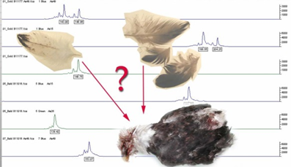
Research Gaps Identified
Develop STR Panels
Validate Existing STR Panels
Geographic Assignment

Slide 17
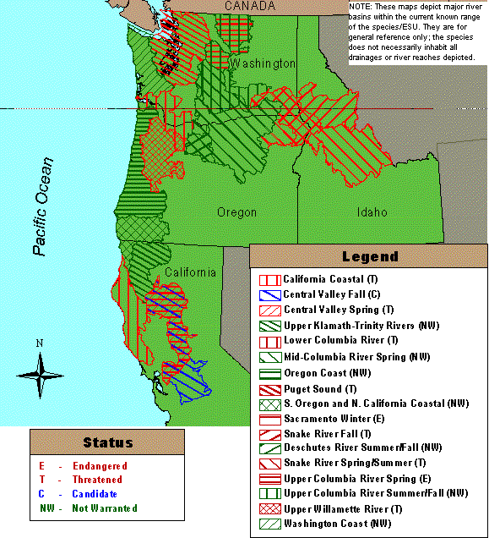
Upper Columbia River Chinook
The Upper Columbia River has two sympatric populations of Chinook salmon (Oncorhynchus tshawytscha)
Spring-run (endangered ESA)
Summer-run (not listed)
U
C
R
s
p
U
U
U
C
C
C
R
R
R
s
s
s
p
p
U
C
R
s
p
U
C
R
s
p
p
U
C
R
s
u
/
f
a
U
U
U
U
C
C
C
C
R
R
R
R
s
s
s
s
u
u
u
u
/
/
/
/
f
f
f
f
a
a
a
U
C
R
s
u
/
f
a
a
S
R
f
a
S
S
S
R
R
R
f
f
f
a
a
S
R
f
a
S
R
f
a
L
C
R
a
L
L
L
L
C
C
C
C
R
R
R
L
C
R
R
M
C
R
s
p
M
M
M
C
C
C
R
R
R
s
s
s
p
p
M
C
R
s
p
M
C
R
s
p
p
S
R
s
p
/
s
u
S
S
S
R
R
R
s
s
s
p
p
p
/
/
/
s
s
s
u
u
S
R
s
p
/
s
u
S
R
s
p
/
s
u
U
W
R
u
U
U
U
W
W
W
R
R
U
W
R
U
W
R
R
D
R
s
u
/
f
a
D
D
D
R
R
R
s
s
s
u
u
u
/
/
/
f
f
f
a
a
D
R
s
u
/
f
a
D
R
s
u
/
f
a
a
Notes:
There are two sympatric populations of chinook salmon in the Methow River.
The summer-run chinook is not listed and the spring-run is listed as endangered under the ESA.
The upper Columbia has both natural and hatchery stocks for summer-run chinook.
There are natural spring-run Chinook. Plus, Winthrop-Carson hatchery operates a spring-run chinook program.

Slide 18
Summary
Rank | Topic Area
1 | General Standards for WF Practice
2 | Report Writing Standards
3 | Terminology
4 | DNA Standards
5 | Morphology Standards
6 | Standardized STR panels
7 | Validation
Liaise with cross-discipline groups
Meet regularly and review documents
Draft new standards for SDO approval
Initiate SDO process for General and Reporting Standards

