Slide 1

What is chromatography
all about?
Lane C. Sander, Ph.D.
Chemical Sciences Division
Material Measurement Laboratory
National Institute of Standards and Technology¹
¹Contribution of the National Institute of Standards and Technology. Not subject to copyright. Certain commercial equipment, instruments, or materials are identified to specify adequately the experimental procedure. Such identification does not imply recommendation or endorsement by the National Institute of Standards and Technology, nor does it imply that the materials or equipment identified are the best available for the purpose.
Notes:
This presentation will provide a brief overview of the basic principles of liquid chromatography, with demonstrations using food dyes. The first few slides provide background material that should help to provide a basis for understanding the chromatographic separation videos.

Slide 2
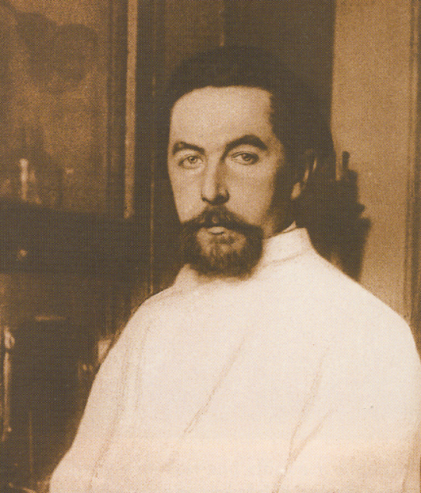
Chromatography
“…a process by which a mixture is separated into at least two fractions having different compositions”
1903 – Russian botanist Mikhail Tswett reports a process for the separation of different chlorophylls from plant extracts by passage through various powdered adsorbents
  Coined term “Chromatography” (color writing)
  Considered the “Father of Chromatography”
Why are separations desired?
  To identify what is present (qualitative analysis)
  To determine how much is present
  (quantitative analysis)
  To purify compounds
Separations are achieved based on differences in chemical properties
Notes:
Chromatography is an example of a process by which a mixture is separated into at least two fractions with different compositions. Other separation methods exist, such as distillation, recrystallization, and extraction.
Chromatography was first described over 100 years ago by a Russian botanist named Mikail Tswett. His research focused on the separation and purification of chlorophyll pigments from plant extracts. Plant extracts were applied at the top of a tube containing a powdered chalky adsorbent, and a solvent was allowed to flow though the tube. Bands appeared over time along the column that were created by the different plant pigments. For the development of this technique, Tswett is widely regarded as the father of chromatography.
Separations serve three purposes: identification of the components in a mixture, measurement of how much of each component is present, and purification.
Although the original research was carried out with colored pigments, and the demonstration that will be shown in this presentation utilizes food dyes, the chromatographic process does not depend on color, but instead is based on chemical properties of the components and how they interact with the adsorbent.

Slide 3
Separations…
mixture
How do we “un-mix” the mixture?
chromatography
Notes:
It is easy to visualize the chromatographic process in a cartoon. Red and blue pigments can be combined to form a mixture. The question can be asked:
How can the mixture be separated into the individual pigments?

Slide 4
How does chromatography work?
A mixture is introduced onto a “column” that contains an adsorbent
A solvent flows through the column and components move at different rates
The components flow out of the column and can be collected individually or measured
Chromatography is used to:
  Identify components
  Determine how much
  Purify substances
Notes:
This figure shows a few basic aspects of chromatography.
A chromatographic column consists of a tube that contains an adsorbent.
Solvent flows though the tube either by gravity, or with the action of a pump. The mixture is applied to the top of the column, and the components move through the column at different rates.
When a component flows out of the bottom of the column, it can be detected, measured, and collected.
Thus, chromatography is used to analyze mixtures by identifying the components, determining the amount of each present, and in some cases, purifying the separate parts.

Slide 5
How does chromatography work?
Solvent
(mobile phase)
A mixture is introduced onto a “column” that contains an adsorbent
Plant pigments
Packing material
(Stationary phase)
Notes:
This figure shows a few basic aspects of chromatography.
A chromatographic column consists of a tube that contains an adsorbent.
1) A mixture is introduced onto the “column” to begin the separation.

Slide 6
How does chromatography work?
Solvent
(mobile phase)
A mixture is introduced onto a “column” that contains an adsorbent
Solvent flows through the column and components move at different rates, resulting in separations
Plant pigments
Packing material
(Stationary phase)
Notes:
Solvent flows though the tube either by gravity, or with the action of a pump, and the components move through the column at different rates, resulting in separations.

Slide 7
How does chromatography work?
Solvent
(mobile phase)
A mixture is introduced onto a “column” that contains an adsorbent
Solvent flows through the column and components move at different rates, resulting in separations
The components flow out of the column and can be collected individually or measured
Chromatography is used to:
  Identify components
  Determine how much
  Purify substances
Plant pigments
Packing material
(Stationary phase)
Notes:
When a component flows out of the bottom of the column, it can be detected, measured, and collected.
Thus, chromatography is used to analyze mixtures by identifying the components, determining the amount of each present, and in some cases, purifying the separate parts.

Slide 8
The basics…
The components are detected instrumentally as they elute from the column, and are represented graphically as a “chromatogram”
Individual components are represented as “peaks” (curves)
Distance along the x-axis represents time
Elution time is characteristic of component identity
The amount of each component is proportional to the peak size
time
A
B
Amount →
C
Time →
Notes:
In the examples to follow, the components can be viewed directly since they are strongly colored. In analytical chemistry, an instrumental detector is used to permit accurate measurement of the compounds.
Individual components are represented graphically as peaks in a figure called a chromatogram.
The distance along the x-axis represents time since the start of the process. The amount of time needed for a compound to pass through the column depends on how strong the interactions are with the adsorbent. This elution time can help to identify the components that are present.
The height of each peak is related to the amount of each component present. The more concentrated the mixture, the bigger the peaks.

Slide 9
Instrumentation
Notes:
This drawing shows the parts of a liquid chromatograph. Solvents are pumped through tubing into a column containing the adsorbent. A valve called an injector permits introduction of the sample. Tubing at the bottom of the column carries the solvent into a detector, which produces a signal processed by a computer. The resulting chromatograms provide quantitative and qualitative information about the sample.

Slide 10
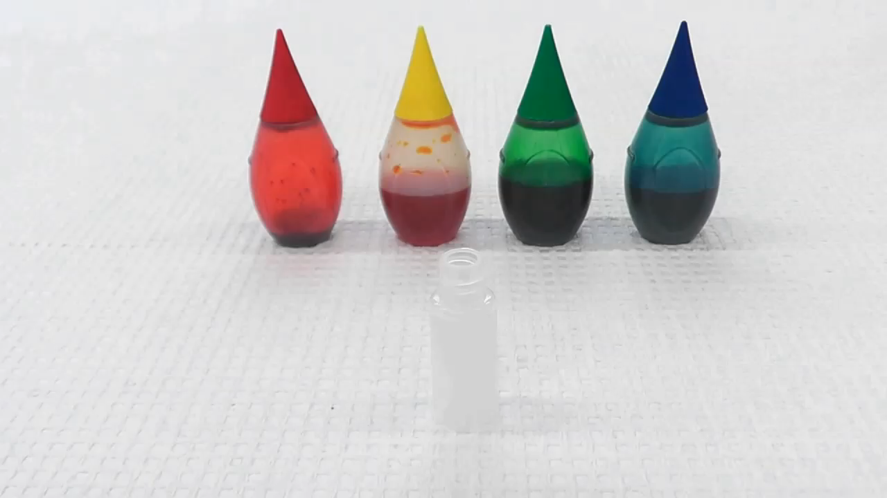
Notes:
In the first example, red, yellow and blue food color dyes are combined in a small vial. This vial will be placed in a liquid chromatographic instrument, and injected onto the top of a glass column. The process is visible because the demonstration column is made of glass. In analytical chemistry, columns are typically made of metal for practical reasons. In this demonstration column, the top of the adsorbent is lowered a couple of centimeters to permit visualization of the separation process. The response of a detector will be displayed at the same time as the separation, to illustrate how chromatograms are generated.
The sample is introduced onto the column using an autosampler. This device samples a portion of the liquid through a septum in the cap of the vial using a needle. The sample is transferred to an injector, which switches the sample into the flowing solvent called the mobile phase. At the left, the glass column is shown, and to the right, the detector response.
This is the approximate beginning of the separation, when the sample containing the mixture of the three dyes is introduced onto the column. Concentration occurs at the top of the adsorbent, and separation of the dyes begins almost immediately. As the yellow dye exits the column, tubing carries the flowing solvent with the dye into a detector. The resulting signal is indicated by a peak. When the yellow dye is completely eluted from the column, the signal returns to a low level, called the baseline. As the red dye elutes, the signal increases and then decreases. This peak indicates the red dye. Finally, as the blue dye elutes from the column into the detector, a third peak is generated.
In the next video, on the left, a close up is shown of the top of the column. In the inset image on the right, the bottom of the column is shown. Instead of connecting a detector, the solvent is allowed to flow out of the column, and the individual dyes are collected in separate vials. These samples can be compared with the original containers to show that the mixture has been separated into the component parts.
In the next demonstration, the green dye will be processed separately. Ask yourself the question: Will the chromatographic separation show that the dye is made of a single green component, or a mixture of dyes? In theory, either case is possible. Almost immediately, it is evident that the green food coloring dye consists of a mixture of yellow and blue dyes.
In the last example, a grape flavored soft drink is analyzed. Because the color of the soft drink is not as concentrated as the food dyes, a larger sample is injected using a manual injection valve. Also shown in this figure is a chromatographic pump that provides the solvent flow through the column. When the injection valve is switched, the sample flows into the column and is concentrated at the top of the adsorbent. Again, it is immediately apparent that the purple grape color is the product of two dyes, namely, red and blue. As before, these dyes can be collected into separate vials as they elute from the column. If the dyes are mixed, the purple color is again restored.

Slide 11
Chromatography Today…
Modern chromatographic methods utilize high efficiency columns and sensitive, selective detectors to produce accurate measurements
Applications include
  Clinical analyses
  Environmental analyses
  Forensic investigations
  Food and nutrition
Analysis of Green Tea
450
400
SRM 3254
EGCG
)
350
V
m
300
EGC
(
e
250
s
n
C
o
200
p
Caf
ECG
s
e
150
R
GA
TB
EC
GCG
100
GC
IS
50
0
0
5
10
15
20
25
30
Time (min)
Anal Bioanal Chem (2012) 402:473–487
Notes:
Different types of chromatograph are used in a broad spectrum of chemical applications. A few examples include clinical analyses, environmental analyses, forensic investigation, and studies of food and nutrition. Such complex samples may contain thousands of components, and their analysis is made possible by chromatography.

Slide 12


www.nist.gov
Notes:
To learn more about the National Institute of Standards and Technology, visit www.nist.gov

