Slide 1
A State Perspective of Standards that would be useful in the Characterization of SARS-COV-2 through Wastewater
Funded by CDC ELC, NIH, and Environmental Public Health Tracking.

Slide 3
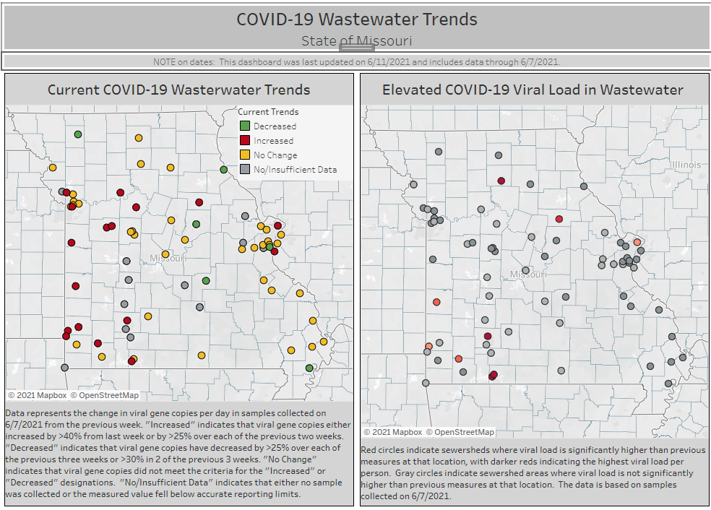

Slide 4
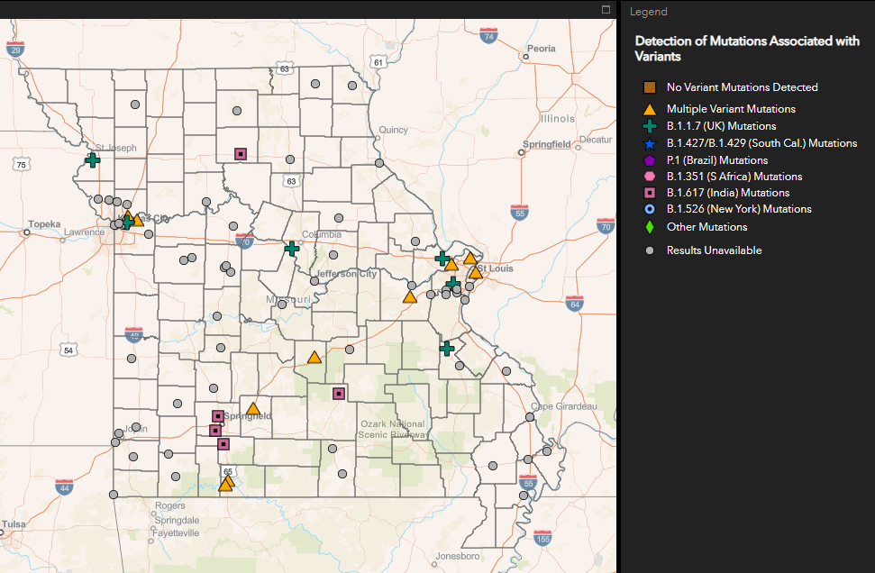
Statewide Variant Detection

