Slide 1
Disaster Resilience
Federal Funding Opportunity
August 25, 2016

Slide 2
Webinar Agenda
Welcome
Overview of Relevant NIST Research Programs
Logistical Overview
Question and Answer Session

Slide 3
NIST Research Programs
The Disaster Resilience (DR) Research Grants Program seeks applications from eligible applicants to conduct research aimed at advancing the principles of resilience in building design and building codes and standards.
Research proposals must support the overall effort of developing science-based building codes by evaluating potential technologies and architectural design criteria to improve disaster resilience in the built environment. Research projects must be aligned with NIST work in:
Wildland Urban Interface Fires
Windstorm Impact Reduction
Earthquake Hazard Reduction
Disaster and Failure Studies

Slide 4
Wildland Urban Interface Fires
This program develops, advances, and deploys measurement science to quantify the generation of vegetative and structural firebrands, investigate the ignition of fuels by firebrands within communities, and better characterize the exposure of structures to firebrand flux in order to reduce the risk of fire spread in wildland-urban interface (WUI) communities.
Further Information: http://www.nist.gov/el/fire_research/wildland/

Slide 5
Windstorm Impact Reduction & Structural Performance under Multi-Hazard Program
These two programs support research to improve the understanding of windstorms (hurricanes, tornadoes, thunderstorms, and others) and coastal flooding events (storm surge and tsunamis), their impacts, and impact mitigation, including: (1) the quantification of these hazards and associated loads, including by computational fluid dynamics techniques; (2) the quantification of the impacts of windstorms, including identification of causes and trends in loss of life from windstorms; and (3) the design, construction, and retrofit of buildings, structures, and lifelines to resist these hazards.
Further Information: http://www.nist.gov/el/nwirp/windstorm-rd.cfm and http://www.nist.gov/el/building_materials/program_structures.cfm

Slide 6
Earthquake Hazard Reduction
The program conducts research in the areas of earthquake impact reduction (including engineering for existing buildings and physical infrastructure/lifelines). Specific areas of research include:
  developing improved analytical models and simulation capabilities to evaluate existing building vulnerabilities and collapse risk under strong earthquake shaking through analytical and/or experimental studies, including study of older non-ductile masonry, structural steel or reinforced concrete buildings or building elements;
  developing potential cost effective solutions to mitigate earthquake vulnerabilities in existing buildings through the use of new materials, innovative practices or other means;
  (3) developing improved techniques, tools, and guidelines to assess civil lifelines (e.g., underground water pipes) at both the individual component and system scales to improve resilience; and
  (4) developing improved techniques, tools, and guidelines for modeling and evaluating soil liquefaction effects on buildings and civil lifeline systems to mitigate their impact.
Further Information: http://www.nist.gov/el/nehrp/program_earthquake.cfm

Slide 7
Disaster and Failure Studies
This program’s research is in the areas of disaster and failure studies, and includes the development of innovative measurement methods and technologies to collect or to characterize the measurement uncertainty of data from field studies.
Further Information: http://www.nist.gov/el/disasterstudies/index.cfm

Slide 8
Friendly Reminder: Ongoing Website Update
NIST is in the process of converting the sitewide web content management platform.
Information available on the NIST website is subject to revision, removal, or location change within the NIST domain at any time and may or may not be readily available.
Proponents are urged not to assume the future availability of any website information used in the preparation of a proposal.

Slide 9
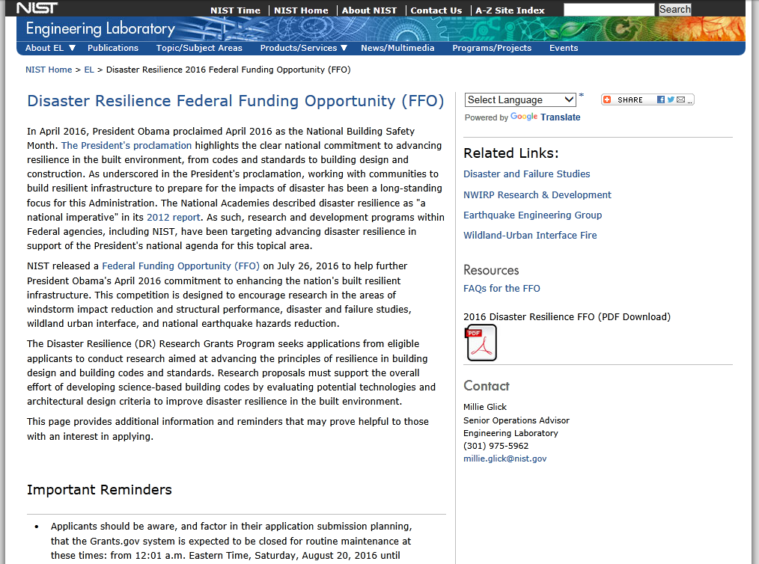
Frequently Asked Questions
http://www.nist.gov/el/dr_ffo_qanda.cfm
Check back frequently. Updated on a regular basis with questions received. Answers are shared with everyone in order to ensure fairness.
The FAQ site contains a subscription feature. Simply enter an email address in the dialogue box on the FAQ page.
*** Note: To ensure that the information is up to date interested parties may need to refresh the web page. ***

Slide 10
Disaster Resilience FFO –
Funding: Up to $3 million
  NIST anticipates funding five to fifteen awards in the range of $300,000 to $1,000,000 each with project performance periods of up to three years, consistent with the multi-year funding policy
Application Process: Single application. No pre-application is required.
Cost Share: Cost sharing is not required.

Slide 11
Eligibility
Eligibility for all programs listed in this FFO is open to all non-Federal entities. Eligible applicants include institutions of higher education, non-profit organizations, for-profit organizations, state and local governments, Indian tribes, hospitals, foreign public entities, and foreign governments. NIST is not able to accept an application from an individual unaffiliated with a sponsoring applicant organization.
  ***FFRDC, energy lab contractors, or other special situations should consult their GC to determine eligibility.

Slide 12
Award Announcement
Anticipated Announcement and Award Dates.
  Review and selection is expected to be completed in late 2016.
  The earliest anticipated start date for the award is expected to be February 2017.

Slide 13
What We Expect to See in a Successful Proposal
Identify the specific disaster resiliency problem that the applicant proposes to solve that aligns with, or is complementary to, one of the existing EL Disaster Resilience Programs, explain the problem’s difficulties, and describe the benefits that would accrue if the problem were solved.
Propose a technical approach that directly addresses the identified problem.

Slide 14
What We Expect to See in a Successful Proposal
Provide a schedule of milestones for the overall project that includes metrics for measuring the success of the proposed efforts, and include plans for publication in professional literature and for technology transfer.
Describe the qualifications, proposed roles, and level of planned effort of the project participants, including the proposed role of the project lead.

Slide 15
Evaluation Criteria
Problems, Solutions and Technical Approach. (0-35 points)
Statement of Work and Potential Impact of the Results. (0-35 pts)
Qualifications and Experience of Key Personnel and Resources Availability. (0-15 points)
Budget Narrative. (0-15 points)

Slide 16
Problems, Solutions and Technical Approach
(0 – 35 pts)
  Note: each sub-criterion will be given approximately equal weight
  Reviewers will evaluate:
  how well the applicant demonstrates a clear understanding of the problems and solutions;
  the fitness, alignment and complementary nature of the proposed technical approach within the context of existing Engineering Lab DR Research Grants Program projects; and
  the degree to which the technical approach is comprehensive, innovative, feasible, and likely to solve the identified problems, produce the anticipated impacts, and meet the objectives of the DR Research Grants Program.

Slide 17
Statement of Work and Potential Impact of the Results
(0 to 35 pts)
  Reviewers will evaluate the appropriateness, quality, reasonableness and completeness of the applicant’s statement of work, including the plans to manage the project tasks, timeline, and work of all project staff, to ensure realization of project goals and objectives.
  The potential impact of the project results, including plans for publication in professional literature and technology transfer, will also be evaluated.

Slide 18
Qualifications and Experience of Key Personnel and Resources
(0 to 15 pts)
  Reviewers will evaluate the appropriateness, quality and degree of the qualifications and experience of the project leader and proposed staff, as well as the adequacy and quality of the applicant’s access to equipment and facilities, to assess the likelihood of achieving the objectives of the project.
  If access to necessary equipment is limited or not available and the applicant plans to purchase equipment, proposed equipment purchases will be evaluated according to the Budget Narrative evaluation criteria.

Slide 19
Budget Narrative
(0 to 15 pts)
  Reviewers will assess the budgeted costs against the proposed activities to determine the practicality of the proposed budget with respect to developing and implementing the proposed project.

Slide 20
Review and Selection Process
Evaluation Panel will prepare and provide a final adjectival ranking taking into consideration the following:
  all application materials;
  results of the reviewers’ evaluations; and
  any clarifying information obtained through written questions or teleconferences with the applicants.
Adjectival Rankings
  Fundable, Outstanding
  Fundable, Very Good
  Fundable
  Unfundable

Slide 21
Review and Selection Process
Selection Official
The Selecting Official shall generally select and recommend applications for award based upon the adjectival rankings of the applications.
The Selecting Official may select and recommend an application for award out of rank order (i.e., from a lower adjectival category) based on one or more of the following selection factors:
  results of the reviewers’ evaluations, including the technical reviews and the Evaluation Panel review;
  the availability of Federal funds;
  whether the project duplicates other projects funded by NIST, DoC, or by other Federal agencies;
  alignment with EL priorities; and
  balance across EL Disaster Resilience programs.

Slide 22
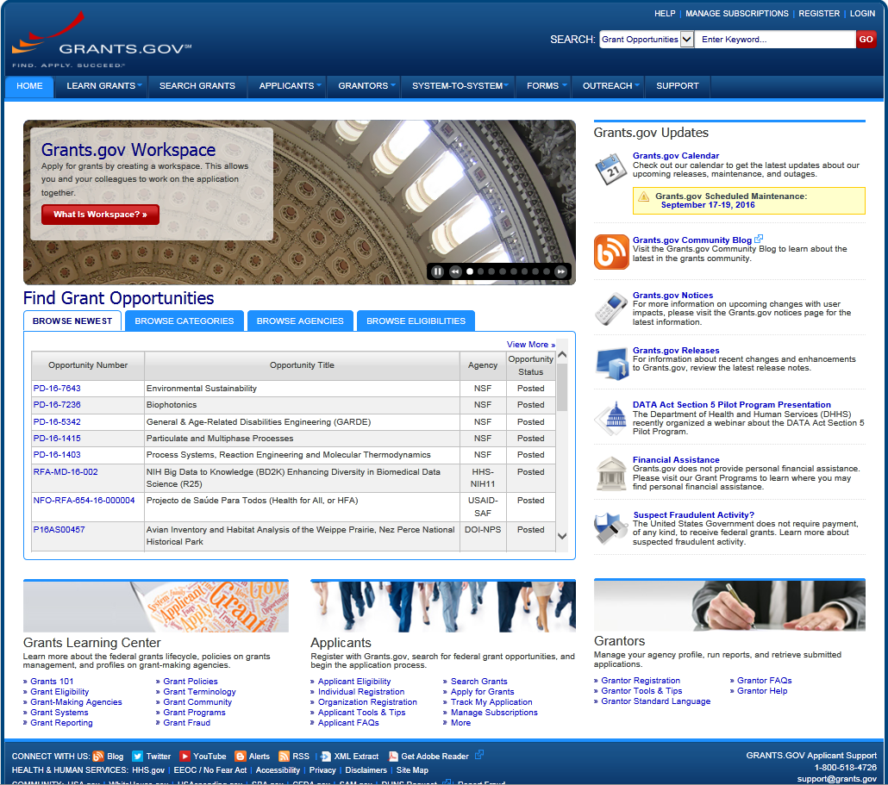
How Does One Apply?
Logistical Overview
Information for successful application submission on the Grants.gov
system is detailed in the “Applicants” section or the “Grants Learning
Center” found at the bottom of the www.grants.gov home page.
Grants Learning
Center at grants.gov
Applicants
Information
at
grants.gov

Slide 23
Required Application Documents
Applicants are strongly urged to read Section IV.2.b., Attachment of Required Application Documents, found on pages 11 and 12 of the FFO.
Applicants should carefully follow the instructions and recommendations regarding attachments and using Grants.gov’s Download Submitted Applications feature to check that all required attachments were contained in their submission.
Applications submitted without the required documents will not pass the Initial Administrative Review.
For a complete list of Required Forms and Document please refer to Section IV.2.a on pages 6 through 11 of the FFO.

Slide 24
Timing
When developing your submission timeline, please keep in mind that:
all applicants are required to have a current registration in the electronic System for Award Management (SAM.gov); the free annual registration process in the SAM.gov (see Section V.3. and Section IV.7.a.(1).b. of this FFO) often takes between three and five business days and may take as long as two weeks;
applicants must have a current registration in Grants.gov; and
applicants using Grants.gov will receive email notifications over a period of up to two business days as the application moves through intermediate systems before the applicant learns via a validation or rejection notification whether NIST has received the application.

Slide 25
Timing (cont’d)
Application is due no later than 11:59 p.m. Eastern Time, Friday, September 23, 2016 via the Grants.gov website.
  Note: Grants.gov system is expected to be closed for routine maintenance at these times: from 12:01 a.m. Eastern Time, Saturday, September 17, 2016 until Monday, September 19, 2016 at 6:00 a.m. Eastern Time. Applications cannot be submitted when Grants.gov is closed.
To avoid any potential processing backlogs due to last minute Grants.gov registrations, applicants are highly encouraged to begin their Grants.gov registration process early.

Slide 26
Clarifying Guidance:
Data Management Plan (DMP)
Authorization:
Office of Science and Technology Policy Memorandum for the Heads of Executive Departments and Agencies, February 22, 2013, Increasing Access to the Results of Federally Funded Scientific Research
NIST Policy 5700.00, Managing Public Access to Results of Federally Funded Research
NIST Order 5701.00, Managing Public Access to Results of Federally Funded Research
Overview
The DMP is a supplementary document of not more than two pages that must include, at a minimum:
a summary of proposed activities that are expected to generate data,
a summary of the types of data expected to be generated by the identified activities,
a plan for storage and maintenance of the data expected to be generated by the identified activities, and
a plan describing whether and how data generated by the identified activities will be reviewed and made available to the public.
Notes:
As long as the DMP meets these NIST requirements, it may take the form specified by the applicant's institution or some other entity (e.g., the National Science Foundation or the National Institutes of Health).
All applications for activities that will generate scientific data using NIST funding are required to adhere to a DMP or explain why data sharing and preservation are not within the scope of the project.
Reasonable costs for data preservation and access may be included in the application.
The sufficiency of the DMP will be considered as part of the administrative review; however, the DMP will not be evaluated against any evaluation criteria.
The DMP is a supplementary document of not more than two pages.

Slide 27
Clarifying Guidance:
Budget Narrative Format
Separate Budget by project year so that work and the associated costs are clearly definable/associated with the available funding for that year.
Costs should be placed under the applicable budget categories of Personnel, Fringe Benefits, Travel, Equipment, Supplies, Contractual, Other, or Indirect Charges.
The total dollar amounts listed under each budget category in the Budget Narrative must match the dollar amounts listed on the SF424A.
Cost computations and written justification must be provided for all costs in the Budget Narrative.
The Budget Narrative and SF424A should only include the Federal share of costs. Cost share is not required.
Best estimates are acceptable.
The Budget and scope are subject to negotiation and amendment, if selected for funding.

Slide 28
Clarifying Guidance:
Multi-Year Funding Policy
When an application for a multi-year award is approved, funding will usually be provided for only the first year of the project.
If a project is selected for funding, NIST has no obligation to provide any additional funding in connection with that award. Continuation of an award to increase funding or extend the period of performance is at the sole discretion of NIST.
Continued funding will be contingent upon satisfactory performance, continued relevance to the mission and priorities of the individual DR Research Grants Programs, and the availability of funds.

Slide 29
Points of Contact
Programmatic and technical questions | Millie Glick Phone: 301-975-5962 E-mail: millie.glick@nist.gov
Application submission | Christopher Hunton Phone: 301-975-5718 Fax: 301-975-8884 E-mail: grants@nist.gov Or Grants.gov Phone: 800-518-4726 E-mail: support@grants.gov
Grant rules and regulations | Dean Iwasaki Phone: 301-975-8449 Fax: 301-975-8884 E-mail: dean.iwasaki@nist.gov

Slide 30
Useful Web Links
NIST Disaster Resilience Federal Funding Opportunity (FFO): http://www.nist.gov/el/disaster_ffo.cfm
FAQ’s for the Disaster Resilience FFO:
http://www.nist.gov/el/dr_ffo_qanda.cfm
NIST Disaster Resilient Buildings, Infrastructure, and Communities Goal: http://www.nist.gov/el/disresgoal.cfm
US Government Grant Site: http://www.grants.gov/
NIST FFO Synopsis on US Government Grant Site: http://www.grants.gov/web/grants/view-opportunity.html?oppId=286558

Slide 31
Questions
Thank you for your interest in the
NIST Disaster Resilience Federal Funding Opportunity
We will now take questions from the webinar attendees.

Slide 32
Back up Slides

Slide 33
Collaborations with NIST Staff
All applications should include a description of any work proposed to be performed by an entity other than the applicant, and the cost of such work should ordinarily be included in the budget.
If an applicant proposes collaboration with NIST, the statement of work should include a statement of this intention, a description of the collaboration, and prominently identify the NIST employee(s) involved, if known.
Any collaboration by a NIST employee must be approved by appropriate NIST management and is at the sole discretion of NIST.
Prior to beginning the merit review process, NIST will verify the approval of the proposed collaboration. Any unapproved collaboration will be stricken from the application prior to the merit review. Any collaboration with an identified NIST employee that is approved by appropriate NIST management will not make an application more or less favorable in the competitive process.

