Slide 1
VVSG 2.0 draft requirements:
Improving the accessibility and usability of voting systems
Part 2: Updates to best practices and new technologies for voting systems
The National Institute of Standards and Technology and the Center for Civic Design, hosted by the Center for Technology and Civic Life
September 25, 2019

Slide 2

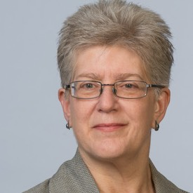

Hello, there!
Sharon Laskowski
NIST
sharon.laskowski@nist.gov
Whitney Quesenbery
Center for Civic Design
whitney@civicdesign.org
Kurt Sampsel
Center for Technology and Civic Life
kurt@techandciviclife.org

Slide 3

The 2002 Help America Vote Act has given NIST a key role in helping to realize nationwide improvements in voting systems, including assisting the Election Assistance Commission with the development of voluntary voting system guidelines.
vote.nist.gov

Slide 4

The Center for Technology and Civic Life
Using technology to improve how local government and communities interact
@helloCTCL
www.techandciviclife.org
Notes:
I’ll say a bit about the Center for Technology and Civic Life, or CTCL. We are a civic tech nonprofit organization, and we’re on a mission to make it as easy as possible for people to find official election information. Our Government Services team, which I’m a part of, approaches this mission by supporting election officials with resources like training and tech tools so that they can run inclusive and secure elections.

Slide 5
The Center for Civic Design
Democracy is a design problem! We work to ensure voter intent through design.
@CivicDesign
www.civicdesign.org
civicdesign.org/projects/roadmap/
Notes:
The Center for Civic Design is a nonprofit organization and our work focuses on the voter experience. We bring civic design skills in research, usability, design, accessibility, and plain language to improve the voting experience, make elections easier to administer, and encourage participation in elections. We have worked on ballot design since 2001, including the honor of being a member of the first advisory committee for voting system standards, and working on research to support those requirements.

Slide 6
Housekeeping
Use chat to communicate
Update your screen name
Mute your audio if you aren’t speaking

Slide 7
What we will cover in these webinars
An introduction to the VVSG 2.0 draft requirements to improve the accessibility and usability of voting systems.
Part 1: Introducing the human factors requirements
and the process used to create them
Part 2: Updates to best practices and new technologies for voting systems with examples of why and how the requirements were updated

Slide 8
About the Voluntary Voting System Guidelines (VVSG)
The Help America Vote Act directs the Election Assistance Commission to create voting system guidelines and defines the process.

Slide 9
HAVA includes basic requirements for accessibility
  HAVA includes requirements that voting systems:
  Are accessible for individuals with disabilities with same opportunity for participation (including privacy and independence) as other voters.
  Provide voters an opportunity to verify their choices, and change the ballot or correct any error before the ballot is cast and counted, in a private and independent manner.
  Provide alternative language accessibility pursuant to Section 203 of the Voting Rights Act.
    Section 301 (3) and (4)
Notes:
HAVA also included requirements for what voting systems had to do, and directed that the standards include requirements to make it so.
The key ones relevant to this webinar are listed on this slide.

Slide 10
VVSG 2.0 Principles for accessibility and usability
1: High quality design
2: High quality implementation
3: Transparent
4: Interoperable
5: Equivalent and consistent voter access
6: Voter privacy
7: Marked, verified, and cast as intended
8: Robust, safe, usable, and accessible
9: Auditable
10: Ballot secrecy
11: Access control
12: Physical security
13: Data protection
14: System integrity
15: Detection and monitoring

Slide 11
Goals for the accessibility and usability updates
  Address issues that voters still encounter with accessible voting systems
  Catch up to current best practices in election systems
  Catch up to best practices in user interface design and usability
  Cover new technologies now in common use
  Match updated laws and standards
  Write clear, testable requirements

Slide 12
What we will cover in the this webinar
Part 2: Examples of updates to best practices and new technologies for voting systems
Addressing Federal accessibility regulations
Text size and contrast
Plain language requirements
Gestures and scrolling
Ballot selections review
Voter control of ballot selection

Slide 13
Examples of updated requirements
Notes:
In this webinar, we will take a deep dive into examples of updates requirements, looking at the problem we were trying to solve, how it fit into our overall goals and how it can improve the accessibility and usability of voting systems

Slide 14
1.
Addressing federal accessibility regulations
Goals for the update
Match updated laws and standards
Cover new technologies now in common use

Slide 15
Why the requirements needed updating
Federal accessibility guidelines in “Section 508” have changed since VVSG 1.1
New rules accommodate larger motorized wheelchairs
Rules for web and other documents incorporate the international Web Content Accessibility Guidelines (WCAG 2.1)
Voting systems often include functions beyond a polling place marking device
Web pages to check if a ballot was counted
Remote accessible voting systems
Pre-marking systems

Slide 16
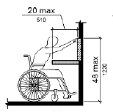
Updating guidelines for voters using wheelchairs
Federal regulations cover:
Floor space needed for physical access
Room for a personal attendant
Distance a voter can reach to touch a control on the voting system
Updated requirements:
Reference the federal standards
Link to U. S. Access Board guidance
Add guidance notes on use in voting systems
Sample “reach and touch” diagram
Notes:
New motorized wheelchairs have different space requirements, so the Access Board updated the reach and touch requirements

Slide 17
Updating the VVSG to include federal accessibility laws
Federal regulations cover:
Any information or computer technology (ICT)
Section 508 was “refreshed” in 2008
Updated requirements:
Added tags to identify requirements based on a source in Section 508/WCAG
Added specific references where needed
Added a requirement to explicitly include the full Section 508 for the entire voting system
Notes:
Image source: dcma.mil

Slide 18
2.
Text size and contrast
Goals for the update
Address issues reported by voters and research evidence
Make ballots and other materials easier for voters to read

Slide 19
Why the requirements needed updating
There was strong evidence that the text sizes available in current voting systems were not large enough in either the default or large size ranges.
Evidence included:
Anecdotal evidence from voter feedback
Research at the University of Baltimore with voters with low literacy
Research from an EAC Accessible Voting Technology Initiative grant showing that voting systems were not including the largest text sizes in the VVSG 1.1 ranges
Usability testing from other voting system research
Notes:
Make it easier for more voters to read the ballot without special assistive technology, including older voters and voters with low literacy
Provide minimal requirements to ensure that the ballot layout is not distorted by changes in text size for a more consistent layout at different text sizes.
Address the need for vertical scrolling among contests with a large number of candidates or when the text is large enough that the contest does not fit on a single screen.

Slide 20
Making the text presentation more helpful to all voters
Updated requirements for text size:
Increase the default text size to 4.8mm
Added for discrete text sizes
Allowed continuous text scaling as an option
Allowed horizontal scrolling or panning at text sizes over 200% (7.1mm)
Updated requirements for text color and contrast:
Specified the options more precisely
Added colors for those who need low contrast

Slide 21
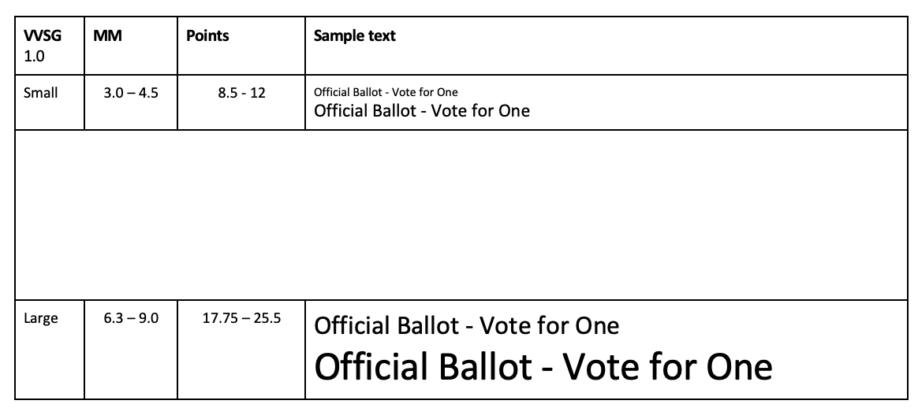
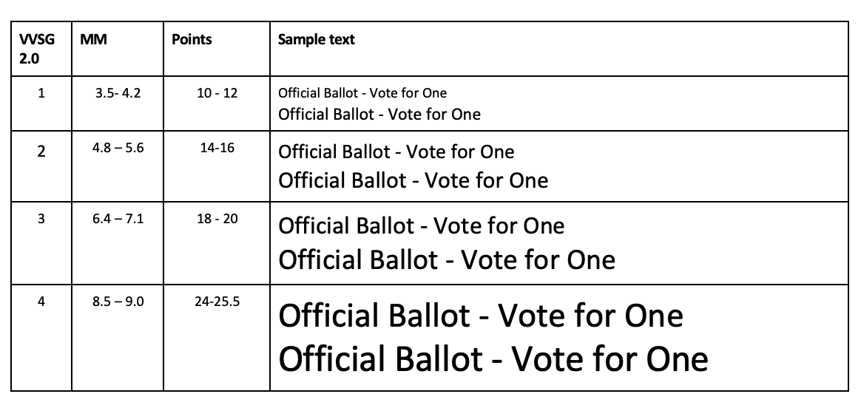
Comparing the text sizes in 1.1 and 2.0
The two sizes in 1.1 left a gap in the middle that included the most useful text sizes for many voters
1.0 and 1.1 have 2 text size ranges:
3.0-4.5 mm - default
6.3-9.0mm
2.0 has 4 text size ranges:
3.5-4.2 mm
4.5-5.6 mm – default
6.4-7.1 mm
8.5-9.0 mm
Notes:
Arrows show the default size

Slide 22
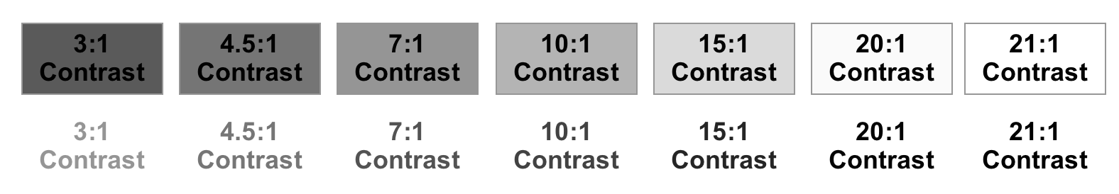
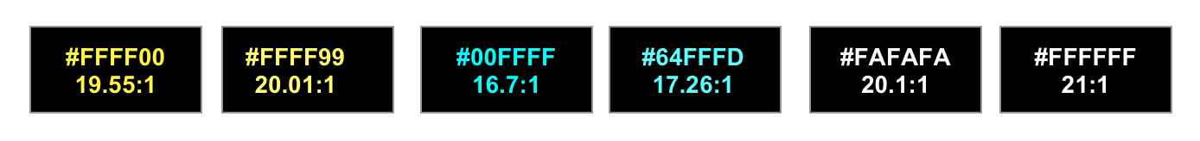

Sample color contrast settings
Contrast samples included in guidance notes to show combinations that meet the requirements
Grey scale samples at 3:1 to 21:1
High contrast examples at 16.1:1 to 21:1
Low contrast examples at 4.8:1 to 7.86:1

Slide 23
3.
Plain language requirements
Goal for the update
Write clear, testable requirements

Slide 24
Why the requirements needed updating
The core requirement remains the same, but we changed the approach to how it was written to:
Make it more testable, even with requirements that are hard to measure
Give manufacturers and testers better tools to meet the requirement
Make it easier to apply to all requirements for instructions, notices, messages and general usability for voters
Would even one use of passive voice fail a system?

Slide 25
What we learned in the gap analysis
There is better appreciation of plain language as important for voting systems.
NIST research still useful for voting systems.
There are tools that can help guide writing.
It’s important for cognitive disabilities and low literacy or English proficiency
Updated requirements:
Single broad requirement
Specifically includes administrative interfaces
Specific elements listed in discussion notes
7.3-P
Information and instructions for voters and election workers must be written clearly, following the best practices for plain language.

Slide 26
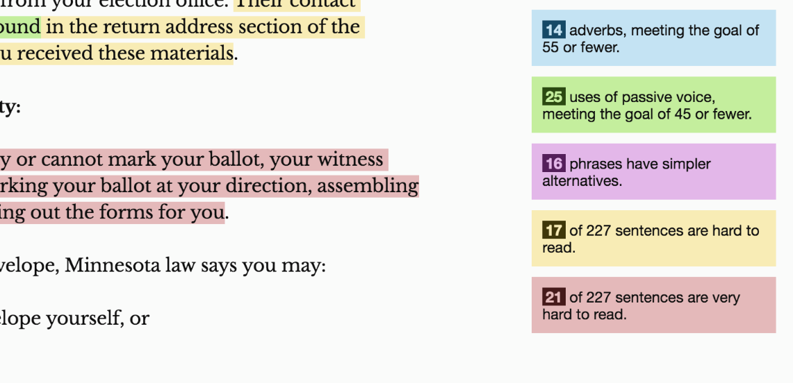
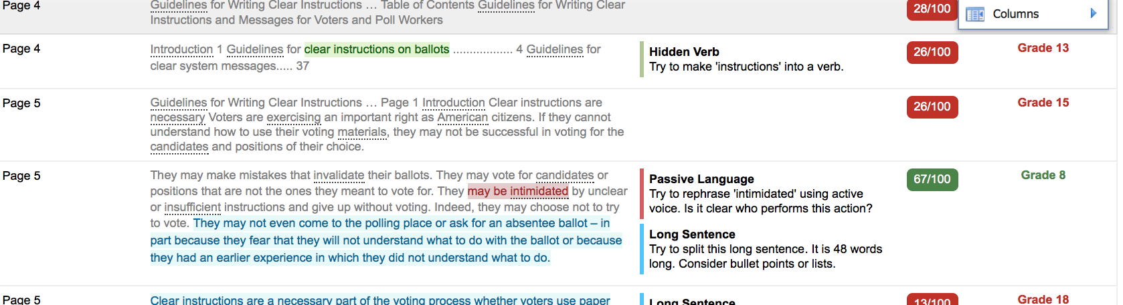
We reviewed plain language evaluation tools
We reviewed tools that can evaluate short texts against plain language practices such as:
Sentence and word length
Passive verbs and hidden verbs
Words easily misused
Complex phrases or jargon
Duplicate or unnecessary words
We found several free or low-cost programs that are useful for both writing and evaluation
Sample review results from 3 tools

Slide 27
Plain language of the requirements
One of our long-time goals has been plain language of the requirements. Practicing what we preach, we also worked on making the requirements themselves clear.
The new requirements (for all principles) include
“Must” (not “shall”) following guidance in Federal Register
Active voice that establishes what aspects of a voting system are responsible

Slide 28
4
Gestures and scrolling
Goal for the update
Cover new technologies in common use

Slide 29
Why the requirements needed updating
VVSG 1.1 did not allow scrolling within a contest because of concerns about the digital divide and accessibility of conventional scroll bars.
A contest may not fit on a single screen because:
  The list of candidates or ballot question text is long
  The voting system or marking device has a small screen
  The voter has increased the text size
Using separate pages adds navigational complexity and reliance on voters understanding the boundaries of the contest.
Voting system logic had problems handling the interaction accurately.
Notes:
Problems with scroll bars
Current versions of the two major platforms -- Windows and MacOS -- use different logic for the scrolling interaction, so that there is no common convention to draw on, and even an experienced computer user might be confused.
Touch screen mobile devices and tablets use tapping and other gestures that are more common and expected, even by people who may not use a touch device regularly.
Users may be more familiar with a mouse “scroll wheel” instead of on-screen controls.
Platform conventions are not consistent
Complex interaction; control at the edge of screen

Slide 30
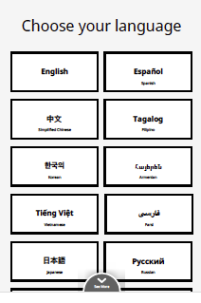
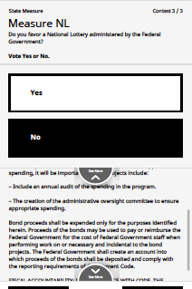
There are alternatives to scroll bars
Scroll bars are just one way to move within a list, so other designs can be allowed as an alternative.
Updated requirements:
Allow pagination or scrolling with
  Fixed header/footer for orientation
  Cues that there are more items
  Option to sync audio and visual
Works in all interaction modes
Single-touch buttons can be used to move within a long list or text.

Slide 31
Allowing simple gesture meets voter expectations
Voters often expect to be able to swipe to scroll
Updated requirements allow common gestures as an optional alternative that:
Does not allow navigation off the current contest
Does not create accidental activation
Work consistently across the entire voting session
Do not require sequential, timed, or simultaneous actions
What’s a simple, common gesture?
Tap
Pinch or spread fingers to zoom
Swipe to scroll
Press and hold to drag
- analysis of style guides for commercial platforms
Notes:
List of common gestures is based on review of commercial platform guidelines
Not allowed: double-tapping, multiple finger swiping, touch and hold
The goal is not a complete screen-access interface --- there are too many differences in even the most well-known platforms – but to include simple gestures as an option.

Slide 32
5.
Ballot selections review
Goals for the update
Catch up to best practices in election systems
Address issues that voters still encounter with accessible voting systems
Cover new technologies now in common use

Slide 33
Why the requirements needed updating
HAVA requires an opportunity to:
Review selections before printing or casting
Be notified of overvotes
Make changes
All current voting systems include a review screen
Bring current practice and common features into the VVSG as a baseline
Leave room for innovation and design
Notes:
We discussed design details, but decided not to be too specific about the design, but include important features

Slide 34
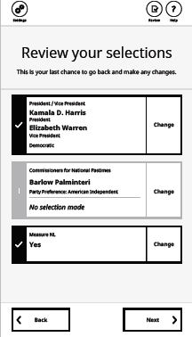
There are a lot of small variations in design
We don’t have a lot of evidence about what works better
The interactions between design elements is complex
Collection of review screen images
Notes:
Issues:
- How to indicate undervotes
- How to indicate change possibilities
- Navigation to and from screens

Slide 35
6.
Voter control of ballot selections
Goals for the update
Catch up to best practices in election systems
Address issues that voters still encounter with accessible voting systems

Slide 36
Why the requirements needed updating
The voting system should not take control of selections away from voters.
When a contest does not fit on one screen, system actions may not be visible on the screen.
Clear feedback helps voters understand the rules for each contest
Voter control is especially important for accessibility.
Feedback in the audio format helps voters understand the current status, and what will happen as a result of their answer
Large text modes are more likely to have some candidates out of sight

Slide 37
The draft requirement puts the voter in control
An electronic ballot interface must give voters direct control over making or changing vote selections within a contest.
It allows
Vote-for-one: An immediate change from one choice to another
Vote-for-multiple: No automatic deselections, notification to voter of their options if they attempt to select more than allowed
Re-ordering candidates in preferential voting only when requested
Clear feedback for group selections, such as straight-party voting
Notes:
The complexity was in the detail and being sure that we didn’t make the requirement too narrow

Slide 38
Updating to modern technology conventions
Technology has changed a lot since 2004-2009, when the current voting system standards were written.
Guidance papers with the research evidence and rationale for the changes will help everyone understand how to design and implement voting systems using the new requirements.

Slide 39
The goal
Voting systems that meet the principles in the VVSG and are designed, implemented, and evaluated using best practices for user-centered design, usability, and accessibility.

Slide 40
Group discussion questions
What resonated with you today?
What did we cover that you have questions about?
Is there some thing we didn’t discuss today that you’re curious about?

Slide 41
Resources
Human Factors Public Working Group
https://collaborate.nist.gov/voting/bin/view/Voting/HumanFactors
VVSG 2.0 Draft Requirements
https://collaborate.nist.gov/voting/bin/view/Voting/VVSG20DraftRequirements
NIST and the Help America Vote Act
https://vote.nist.gov
A Roadmap for Usability and Accessibility of Elections
https://civicdesign.org/projects/roadmap/

Slide 42
Find these webinars online?
VVSG 2.0 draft requirements:
Improving the accessibility and usability of voting systems
Part 1: Introducing the human factors requirements
Part 2: Updates to best practices and new technologies for voting systems
We will post the webinars when they are captioned and approved by NIST

