Slide 1
VVSG 2.0 draft requirements:
Improving the accessibility and usability of voting systems
Part 1: Introducing the human factors requirements
The National Institute of Standards and Technology and the Center for Civic Design, hosted by the Center for Technology and Civic Life
September 25, 2019

Slide 2
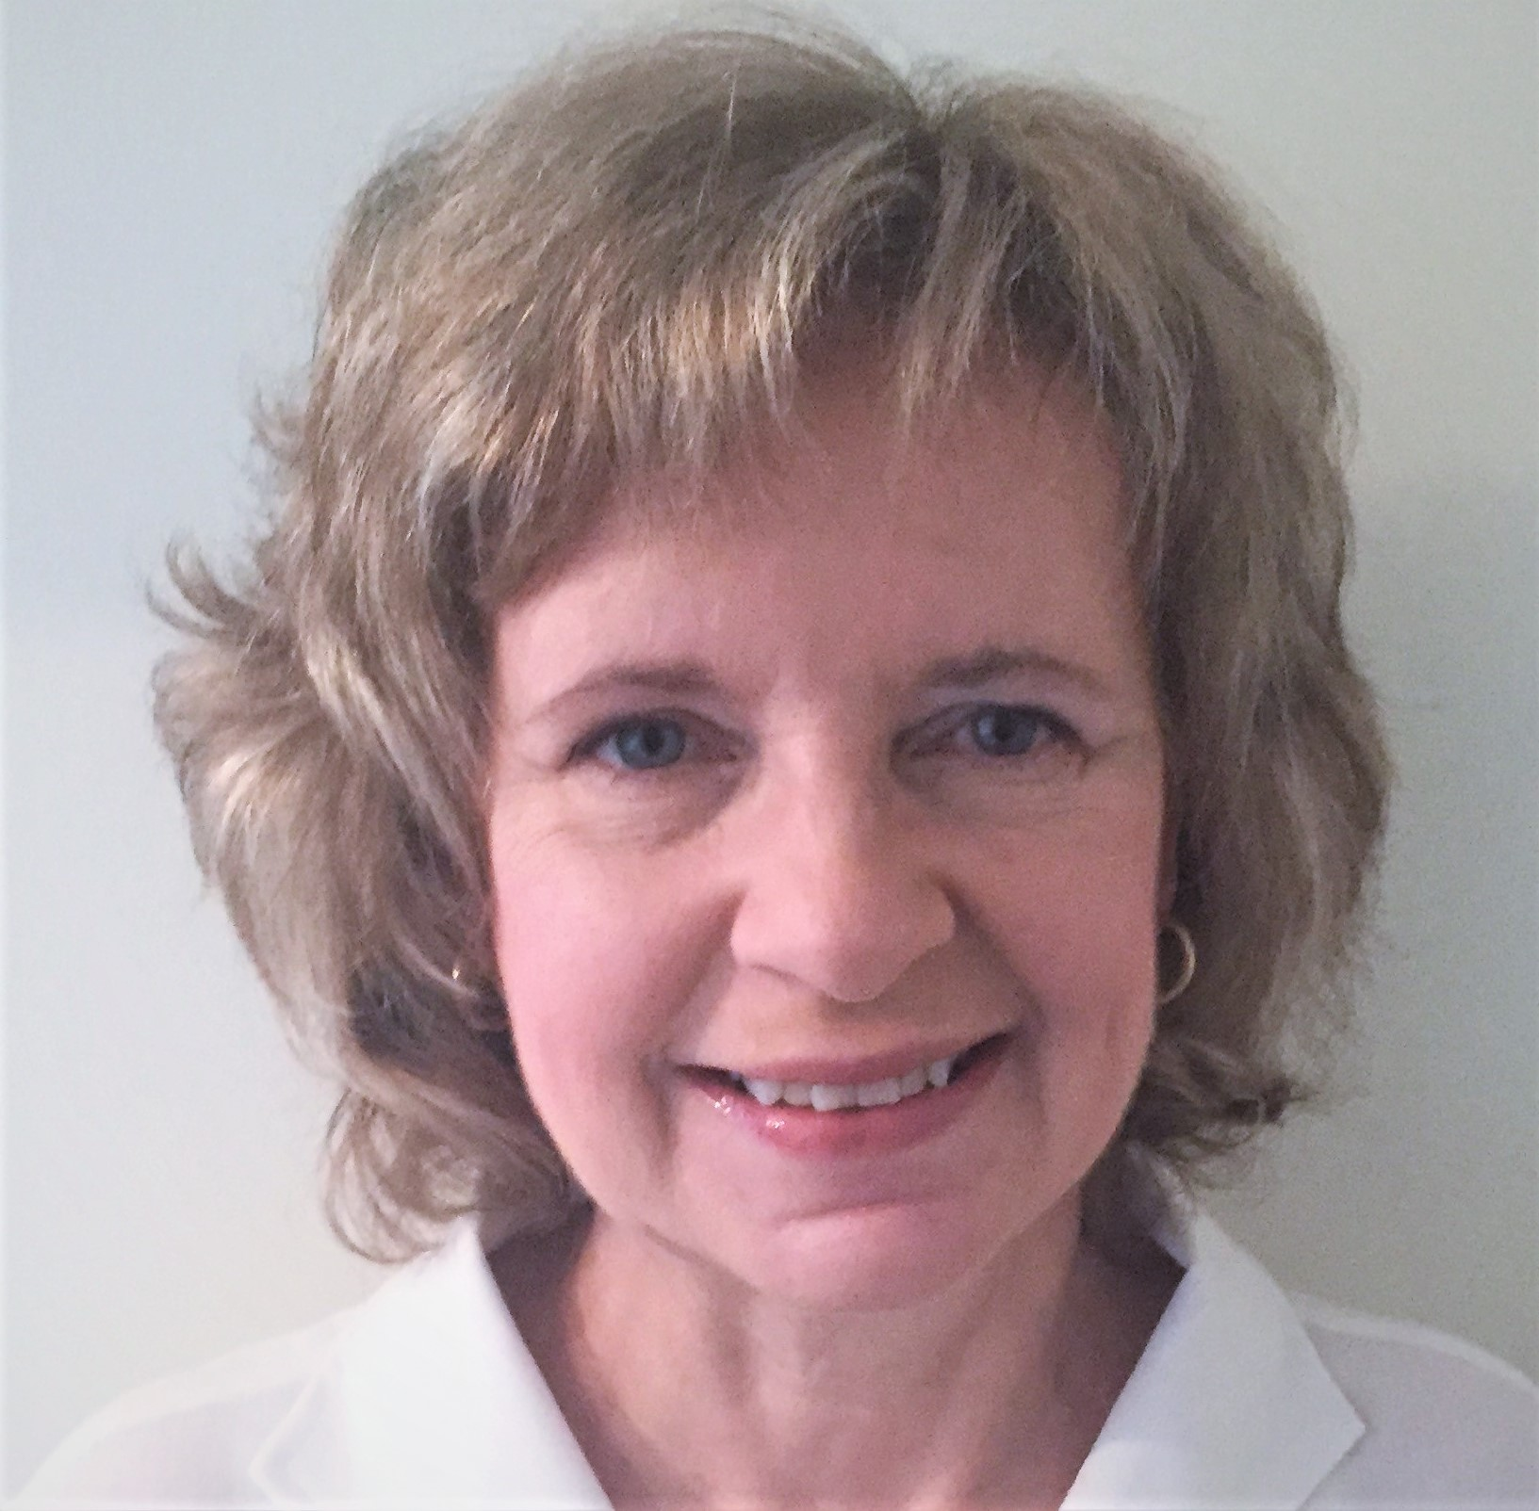
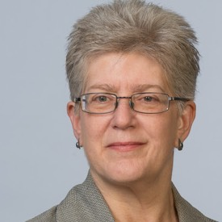

Hello, there!
Sharon Laskowski
NIST
sharon.laskowski@nist.gov
Whitney Quesenbery
Center for Civic Design
whitney@civicdesign.org
Kurt Sampsel
Center for Technology and Civic Life
kurt@techandciviclife.org

Slide 3

The 2002 Help America Vote Act has given NIST a key role in helping to realize nationwide improvements in voting systems, including assisting the Election Assistance Commission with the development of voluntary voting system guidelines.
vote.nist.gov
Notes:
NIST is part of the DOC. We work with industry and academia to advance innovation and improve quality of life through standards, metrics and evaluation.
Our work in voting systems Include technical support for the EAC’s TGDC.

Slide 4

The Center for Technology and Civic Life
Using technology to improve how local government and communities interact
@helloCTCL
www.techandciviclife.org
Notes:
I’ll say a bit about the Center for Technology and Civic Life, or CTCL. We are a civic tech nonprofit organization, and we’re on a mission to make it as easy as possible for people to find official election information. Our Government Services team, which I’m a part of, approaches this mission by supporting election officials with resources like training and tech tools so that they can run inclusive and secure elections.

Slide 5
The Center for Civic Design
Democracy is a design problem! We work to ensure voter intent through design.
@CivicDesign
www.civicdesign.org
civicdesign.org/projects/roadmap/
Notes:
The Center for Civic Design is a nonprofit organization and our work focuses on the voter experience. We bring civic design skills in research, usability, design, accessibility, and plain language to improve the voting experience, make elections easier to administer, and encourage participation in elections. We have worked on ballot design since 2001, including the honor of being a member of the first advisory committee for voting system standards, and working on research to support those requirements.

Slide 6
Housekeeping
Use chat to communicate
Update your screen name
Mute your audio if you aren’t speaking

Slide 7
About the Voluntary Voting System Guidelines (VVSG)
The Help America Vote Act (HAVA) directs the Election Assistance Commission to create voting system guidelines and defines the process.
Notes:
In 2002, the Help America Vote Act established the Election Assistance Commission (EAC) The EAC was given a number of roles, including creating voting system standards, to be known as the Voluntary Voting System Guidelines (VVSG). HAVA also defined the process, including setting up advisory committees to help develop the requirements of the standard.
*voluntary for states to adopt.

Slide 8
How the draft requirements are developed
  Recommendations drafted by the NIST Voting Project team as directed and approved by the Technical Guidelines Development Committee (TGDC).
  The Election Assistance Commission (EAC) reviews the draft, consults with its boards, and collects public comments, and can update before approving.
  For VVSG 2.0, NIST Public Working Groups added input from government, election officials, product developers, vendors, academic researchers, and advocates.
  The Human Factors Public Working Group focused on guidance for accessibility and usability, and consideration of these across all requirements.
Notes:
Here come the acronyms!
The Help America Vote Act (HAVA).
Directs the Election Assistance Commission (EAC) to create voluntary voting system guidelines
Creates the Technical Guidelines Development Committee (TGDC) to make recommendations for those guidelines
NIST chairs the TGDC and provides support for developing the requirements
For VVSG 2.0, a new approach:
NIST Public Working Groups allow input from government, commercial, and academic sectors in developing the requirements

Slide 9
Timeline of the VVSG development
2002
HAVA creates EAC
2005
VVSG 1.0
approved
2009
VVSG 1.1
released for public comment
2015
VVSG 1.1
approved
2017
VVSG 2.0
TGDC recommends new high-level Principles & Guidelines
2019
VVSG 2.0
draft requirements to TGDC on Sept 19-20
Notes:
The big gap in the middle occurred when there was no quorum of commissioners to approve the VVSG 1.1

Slide 10
HAVA includes basic requirements for accessibility
  HAVA includes requirements that voting systems:
  Are accessible for individuals with disabilities with same opportunity for participation (including privacy and independence) as other voters.
  Provide voters an opportunity to verify their choices, and change the ballot or correct any error before the ballot is cast and counted, in a private and independent manner.
  Provide alternative language accessibility pursuant to Section 203 of the Voting Rights Act.
    Section 301 (3) and (4)
Notes:
The key ones relevant to this webinar are listed on this slide.
HAVA also included requirements for what voting systems had to do, and directed that the standards include requirements to make it so.
Calls out the role of human factors and usability in the design and application of voting systems, including assistive technologies for individuals with disabilities (including blindness) and varying levels of literacy;

Slide 11
What we will cover in this webinar
Part 1: Introducing the human factors requirements to improve the accessibility and usability of voting systems.
How VVSG 2.0 and the requirements are organized
How the requirements were developed using an evidence-based process
Overview of the human factors principles and the key concepts in the requirements

Slide 12
What we will cover in the next webinar
Part 2: Updates to best practices and new technologies for voting systems
Examples of new or updated requirements
How the new requirements will improve the accessibility and usability of voting systems

Slide 13
VVSG 2.0 is a fresh start
Organizes the technical requirements into
15 principles for good elections
Notes:
The whole VVSG is now organized around principles for election administration, so it’s easier to see how each requirement contributes to good election administration and a good voting experience

Slide 14
VVSG 2.0 - Principles
1: High quality design
2: High quality implementation
3: Transparent
4: Interoperable
5: Equivalent and consistent voter access
6: Voter privacy
7: Marked, verified, and cast as intended
8: Robust, safe, usable, and accessible
9: Auditable
10: Ballot secrecy
11: Access control
12: Physical security
13: Data protection
14: System integrity
15: Detection and monitoring
Notes:
With guidelines for each to help clarity and organize the requirements.
Just overview: hf, security, interop, and high quality hw/sw

Slide 15
VVSG 2.0 Principles for accessibility and usability
1: High quality design
2: High quality implementation
3: Transparent
4: Interoperable
5: Equivalent and consistent voter access
6: Voter privacy
7: Marked, verified, and cast as intended
8: Robust, safe, usable, and accessible
9: Auditable
10: Ballot secrecy
11: Access control
12: Physical security
13: Data protection
14: System integrity
15: Detection and monitoring

Slide 16
How the principles and requirements work together
The principles (and guidelines) are high level goals for a voting system.
The detailed technical requirements are specific, testable ways to meet the goals of the principles.

Slide 17
Goals for the accessibility and usability updates
  Address issues that voters still encounter with accessible voting systems
  Catch up to current best practices in election systems
  Catch up to best practices in user interface design and usability
  Cover new technologies now in common use
  Match updated laws and standards
  Write clear, testable requirements
Notes:
17 years since HAVA: new technology and research both for voting and in UI design.

Slide 18
A universal design approach
Designing a product or service so that it can be accessed, understood and used to the greatest extent possible by all people regardless of their age, size, ability or disability
Principles of Universal Design
Center for Universal Design at North Carolina State University
Notes:
Address issues that voters still encounter with accessible voting systems.
Our approach: design for widest range of capabilities.
Work better for more people.

Slide 19
Clear relationship to other laws and standards
  Election laws
  Help America Vote Act, Voting Rights Act
  Disability laws
  ADA, Access Board ICT Standards “Section 508” and W3C Web Content
  Accessibility Guidelines (WCAG 2.1), Assistive Technology Act
  Technical standards and guidance
  FCC Hearing Aid Standard, ISO Software Quality Requirements and
  Evaluation standards, FDA process requirements, NIST research reports
Notes:
Elections and voting systems don’t stand alone –
In addition to the laws that directly affect voting systems, there are other federal and state laws including disability laws – and applicable standards

Slide 20
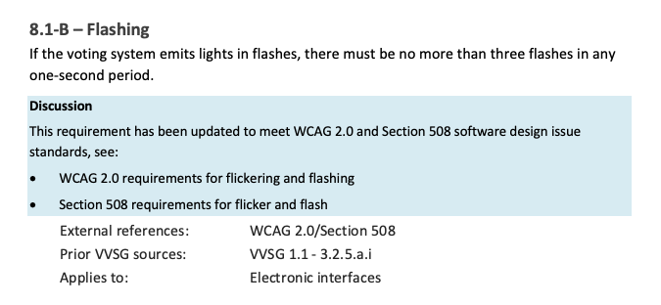
Requirements written in plain language
Number and title
Normative text
Discussion
Metadata
References
VVSG source
Scope
Notes:
We also redesigned the standard so that it’s easier to read
Drafted in plain language
(active voice, use “must” and “may”)
Scope clearly stated
Notes preserve the rich discussion on the public working group with rationale, examples and references. Not normative, but helpful for implementation and evaluation.
Metadata shows connections
Cross-references show important relationships between requirements
Source tracks connection to VVSG 1.1

Slide 21
An evidence-based process
The NIST Public Working Groups let us gather input from researchers, advocates, vendors and election officials

Slide 22
Getting from VVSG 1.1 to the draft VVSG 2.0
  Reorganize the requirements into principles
  A bottom-up look at how the requirements fit into the new structure
  Gap analysis
  Bi-weekly Human Factors Public Working Group discussions looked for gaps where voter needs were not met
  Research guidance
  Looked at new research literature and current practices
  Draft and review
  Continued public discussions to review and refine the requirements
Notes:
We started the public working group meetings in the summer of 2016 and continued, with some vacations over that time.
Went through the draft twice plus deep dives into issues raised.

Slide 23
Research guidance took a deep dive into key topics
Interaction details
  Text size and contrast
  Plain language
  Scrolling on a ballot
  Navigation from the review screen
  Navigation issues for long contests
  Remote accessible ballot marking
  Ballot verification
Landscape analysis
  Emerging assistive technologies that might be used in a polling place
  Reports and recommendations from the Accessible Voting Technology projects
  Election accessibility issue reports
Notes:
[ Next webinar will have examples of how this work was used to update the requirements]

Slide 24
Overview of the human factors principles
Most requirements for usability and accessibility are in Principles 5 - 8

Slide 25
Principle 5
Equivalent and Consistent Voter Access
All voters can access and use the voting system regardless of their abilities, without discrimination.
  Voters have a consistent experience throughout the voting process within any method of voting.
  Voters receive equivalent information and options in all modes of voting.

Slide 26
Modes of voting
Principle 5 defines the presentation and interaction modes needed for accessibility
Presentation modes
  Visual
  Enhanced visual
  (text size and contrast)
  Audio
Interaction modes
  Touch
  Tactile controls
  Non-manual access

Slide 27
Principle 6
Voter Privacy
Voters can mark, verify, and cast their ballot privately and independently.
  The voting process preserves the privacy of the voter's interaction with the ballot, modes of voting, and vote selections.
  Voters can mark, verify and cast their ballot or other associated cast vote record, without assistance from others.

Slide 28
Voter privacy vs ballot secrecy
Principle 6 meets HAVA requirements for independent and private voting.
Voter privacy is separated from ballot secrecy (covered in Principle 10)
Voter privacy
Privacy during voting including a voter’s interaction with the ballot, modes of voting, and selections
Includes the ability to mark, verify, and cast a ballot without assistance
Ballot secrecy
Preventing links between a voter and a ballot after the ballot has been cast to prevent identifying how someone voted

Slide 29
Principle 7
MARKED, VERIFIED, AND CAST AS INTENDED
Ballots and vote selections are presented in a perceivable, operable, and understandable way and can be marked, verified, and cast by all voters.
  The default voting system settings present a ballot usable for the widest range of voters, and voters can adjust settings and preferences to meet their needs.
  Voters and election workers can use all controls accurately, and voters have direct control of all ballot changes and selections.
  Voters can understand all information as it is presented, including instructions, messages from the system, and error messages.

Slide 30
POUR Principles
Principle 7 is organized to match the principles of the Web Content Accessibility Guidelines (WCAG)
Perceivable
Operable
Understandable
Robust (covered in Principle 8)
Notes:
P7, Requirements that are central to the voter interaction 50 requirements.

Slide 31
Principle 8
ROBUST, SAFE, USABLE, AND ACCESSIBLE
The voting system and voting processes provide a robust, safe, usable, and accessible experience.
  The voting system’s hardware, software, and accessories are robust and do not expose users to harmful conditions.
  The voting system meets currently accepted federal standards for accessibility.
  The voting system is evaluated with a wide range of representative voters, including those with and without disabilities, for effectiveness, efficiency, and satisfaction.
  The voting system is evaluated for usability for election workers.
Notes:
Robust: standard audio jacks, no flashing, no interference with hearing aides, etc.
Will talk about the usability testing/evaluation in a moment.

Slide 32
Principle 2
HIGH QUALITY IMPLEMENTATION
The voting system is implemented using high quality best practices.
  2.2 - The voting system is implemented using best practice user-centered design methods that consider a wide range of representative voters, including those with and without disabilities, and election workers.

Slide 33
Usability testing and user-centered design
Principle 8 and Principle 2.2 require a process and specific approaches to usability testing voting systems including:
  What aspects of the system must be tested
  Who is included in the testing
  When testing takes place
  How the results of any usability test are reported
  How the overall user-centered design process is reported
Notes:
Usability testing and reporting by manufacturers has been required in 1.0 and 1.1. The updates in 2.0 are aimed at making it easier to run the required tests, so the work has more impact on a+u

Slide 34
Usability
The effectiveness, efficiency and satisfaction with which specified users achieve specified goals in particular environments.
Definition from an international standard
ISO 9241
Notes:
Although usability may sound like a simple term, it has a formal definition in an ISO standard that is well established from the late 90’s.
Another definition from the same series defines the relationship between usability and accessibility.

Slide 35
Accessibility
The extent to which products, systems, service, environments and facilities can be used by people from a population with the widest range of characteristics and capabilities to achieve a specified goal in a specified context of use.
Definition from an international standard
ISO 9241

Slide 36
Usability testing with voters and election workers
The usability tests required in Principle 8.3 and 8.4 are final checks to be sure that the voting system can be used to complete typical tasks
  For voters
  Completing an entire voting session including activation, marking, review and verification, and casting the ballot
  Includes accessible voting for people with disabilities
For election workers
  Opening the polls
  Conducting polling including all accessibility features
  Closing the polls
Notes:
Usability testing is also a term of art, referring to a method for working with people who might use a product or service. The general method can be adapted to quick informal tests, but what we are talking about in Principle 8 are more formal tests that evaluate a product when it is ready for release
In this case.. voters and election workers.

Slide 37
Voting systems must be tested with a wide audience
The VVSG specifies that voting systems need to be usable by the following groups:
  Voters in the general population, using the visual interface
  Voters who speak a system-supported language as their primary language
  Voters who are blind, using the audio-tactile interface
  Voters with low vision, using the enhanced visual features with or without audio
  Voters with low dexterity, using the visual-tactile or non-manual interface

Slide 38
Usability testing is done by the system vendor
Vendors arrange for usability testing and include the report in their materials for certification testing.
  Guidance on how to conduct and report on this usability testing includes
  An outline of the process of running a test
  Guidance on working with voters with disabilities
  Sample forms and other materials
  A standard template for reporting, the CIF for Voting Systems, a modified version of the Common Industry Format in ISO/IEC 25602

Slide 39
User-centered design (UCD)
A way of building systems focused on meeting users’ own goals. UCD includes activities and methods for discovering what users need, and what meets those needs.
Definition from an international standard
ISO 9241

Slide 40
User-centered design is a process
A good user-centered design process includes different methods, conducted at each phase of a voting system’s development.
Early in the design/ development
Conducting research to understand what voters need, including preferences and constraints for accessible voting
As the system is developed
Evaluating the design by trying out early versions and making changes to better support voters and election workers
Final evaluation to confirm final design
Usability testing the complete system to be sure all the parts work together before certification testing

Slide 41
UCD includes a variety of methods for different goals
Goal | Related methods
Develop requirements and understand user needs | Observation of current or potential people using existing voting systems | Interviews with election administrators or voters | Surveys of existing customers about how they use their current systems
Validate initial feature ideas and prototypes | Usability testing of rough prototypes with a small group | Exploring new ideas after testing
Identify usability problems in features under development | Usability testing of in-development software, focusing on particular features | Inspection of near-completed features by experts for common usability issues
Establish evidence of finished system usability | Usability testing with a diverse set of potential users | Surveys of people using the new system to identify usability issues discovered in the wild

Slide 42
UCD is documented with a report of the process
The report includes:
  Timeline of activities and methods used.
  Participants included in the activities, including their role and any voters with disabilities included.
  Detail on the activity and VVSG Principles covered.
  Summary of the results of the activity: what was learned that was incorporated into the voting system implementation.

Slide 43
The goal
Voting systems that meet the human factors principles in the VVSG and are designed, implemented, and evaluated using best practices for user-centered design, usability, and accessibility.

Slide 44
The next webinar looks at what’s new
Part 2: Updates to best practices and new technologies for voting systems
Example of new or updated requirements
How the new requirements will improve the accessibility and usability of voting systems

Slide 45
Group discussion questions
What resonated with you today?
What did we cover that you have questions about?
Is there some thing we didn’t discuss today that you’re curious about?

Slide 46
Resources
Human Factors Public Working Group
https://collaborate.nist.gov/voting/bin/view/Voting/HumanFactors
VVSG 2.0 Draft Requirements
https://collaborate.nist.gov/voting/bin/view/Voting/VVSG20DraftRequirements
NIST and the Help America Vote Act
https://vote.nist.gov
A Roadmap for Usability and Accessibility of Elections
https://civicdesign.org/projects/roadmap/

Slide 47
Find these webinars online?
VVSG 2.0 draft requirements:
Improving the accessibility and usability of voting systems
Part 1: Introducing the human factors requirements
Part 2: Updates to best practices and new technologies for voting systems
We will post the webinars when they are captioned and approved by NIST

