Slide 1

Volumetric Transfer of Liquids
Lane C. Sander, Ph.D.
Chemical Sciences Division
Material Measurement Laboratory
National Institute of Standards and Technology¹
¹Contribution of the National Institute of Standards and Technology. Not subject to copyright. Certain commercial equipment, instruments, or materials are identified to specify adequately the experimental procedure. Such identification does not imply recommendation or endorsement by the National Institute of Standards and Technology, nor does it imply that the materials or equipment identified are the best available for the purpose.
Notes:
Although volumetric measurements are usually less accurate than gravimetric based measurements, volumetric measurements are still in common use due to the convenience, and often higher throughput, that may be afforded by liquid pipettes. Analysts should be aware of the performance limitations that can be expected for methods that rely on volumetric measurements, and precautions that must be observed to achieve the best results. When practical, it is recommended that gravimetric based measurements be used in place of volumetric based measurements.

Slide 2
Volumetric Transfer – General Considerations
Advantages
  Ease of use
  High throughput
Limitations
  Viscosity
  Temperature
  Wettability
  Volatility
Other Considerations
  Calibration
  Skill of analyst
  Proper function of instrumentation
  Traceability
Notes:
Automatic pipettes have wide appeal due to their ease of use, and high throughput. The best performance typically results for aqueous samples, including biological fluids.
Reduced precision and accuracy is common for pipetting organic liquids. Differences in handling result from changes in wettability and viscosity of organic liquids, compared with aqueous samples. Accuracy is also degraded by evaporation of organic solvents. Density is of course influenced by temperature, and better precision is achieved when the laboratory environment is controlled.
Volumetric-based measurements rely on calibration of the equipment used, whether it is simple volumetric glassware or automatic pipettes. Proper use and function of the equipment, and the skill of the analyst are factors that contribute to the accuracy of the measurements. Traceability of volumetric measurements to mass units of the SI require a conversion through density; this in principle adds additional uncertainty to the measurement, and the possibility of a broken traceability linkage. These limitations may outweigh the advantages that are sometimes perceived for volumetric based sample handling.

Slide 3
Volumetric vs Gravimetric Metrology
Gravimetric Basis
  Balances provide 5 to 6 significant figures
  Gravimetric error is often insignificant compared to other error sources
  Error: < 0.01%
Volumetric Basis
  Typically 3 significant figures
  Volumetric measurement error may represent the primary error source
  Error: 1% to 3% for each aliquot
  Errors can be potentially very large for multiple additions
    Example: multiple aliquots are combined in the preparation of a calibration solution,
    each contributing 1% to 3%. The resulting errors could exceed 5%
Notes:
It may be useful to consider the performance of gravimetric and volumetric based metrology.
Modern electronic balances commonly provide 5 or 6 significant figures, with repeatable performance. Because both the precision and accuracy of gravimetric measurements is high, overall contributions of weighing errors are often insignificant compared to other aspects of sample processing. Errors associated with weighing are typically < 0.01%.
Volumetric manipulations can provide 3 or 4 significant figures, depending on the skill of the analyst. As a consequence, the volumetric component may represent the primary error source for sample processing. For example, consider a process that requires the addition of multiple aliquots of a liquid. If the accuracy of each volumetric addition is 1 or 2%, significant error could result as each contribution is compounded.

Slide 4
Quantitative Transfer of Liquids
Approaches
  Glass pipettes & volumetric glassware
  Gas tight syringes
  Pipetters
    Positive displacement
    Air displacement
    Manual (mechanical)
    Electronic
Precision/accuracy
  Volumetric measurements typically limited
  to 4 significant figures (best case)
  Pipetters
    Accuracy: 1% to 3% (CV; coefficient of variation)
    Precision: 0.25% to 1.5 % (CV)
Notes:
The classical approach to volumetric based measurements utilizes calibrated glass pipettes and other volumetric glassware. Gas tight syringes are frequently used with liquids for both volumetric and gravimetric based measurements; however, the accuracy of syringe calibration is less reliable than for containers with a fixed-volume. Different types of automatic pipettes are available for different applications. These differences will be examined in more detail in the following slides. In brief, automatic pipettes can be divided into positive displacement and air displacement types. The pipetting action can be either manual or electrically powered.
The precision of volumetric measurements is usually limited to 4 significant figures. The accuracy of automatic pipettes is variable, but depends on the quantity of liquid that is transferred and the range of the pipetter. As a rule of thumb, better performance results for measurements in the range of 20% to 100% of the capacity of the pipette. For example, avoid the use of a 1 mL pipette to deliver 10 μL.
The precision of automatic pipettes is usually better than the accuracy, by a factor of 2 to 4 times.

Slide 5

Precision As a Function of Liquid Composition
Air displacement pipettes work best with aqueous samples
Expect reduced accuracy and precision with organic liquids
Notes:
Most pipette tips are designed for use with aqueous samples. The tips are intended to contain and deliver liquids such that no liquid residue is present after the delivery. With organic liquids, residual liquid is apparent after delivery. This adversely affects both accuracy and precision of pipette function, since the recovery is neither quantitative and nor reproducible. In the example shown using a 100 uL pipette, for aliquots of water, the CV of the corresponding masses was 0.4%, whereas using the same pipet with ethanol aliquots, the CV of the corresponding masses was 2.2%. In extreme cases, the liquid may drip out of the pipet tip prior to dispensing.

Slide 6
Positive Displacement vs Air Displacement Pipettes
Positive Displacement
  Best for viscous liquids
Air Displacement
  Best for aqueous liquids
Notes:
Automatic pipettes can be divided into two groups: positive displacement pipettes, and air displacement pipettes. Positive displacement pipettes utilize a disposable tip that includes an integral disposable piston. The tip and piston work much like a syringe. In operation, liquid to be transferred is in contact with both the tip and the piston. As the piston is raised, the fluid is drawn into the tip, and when the piston is lowered, the liquid is expelled. The primary advantage of this type of pipette is that is can be used with more viscous fluids than air displacement pipettes. To avoid cross contamination, tip and piston sets must be changed when a solution with different composition is processed.
Air displacement pipettes utilize a piston that is a permanent part of the device, that is enclosed in the body of the pipette. Displacement of the piston changes the differential air pressure, and controls flow of liquid into and out off the tip. Disposable tips contact the solution, but the solution is contained within the tip and does not contact the internal piston.

Slide 7
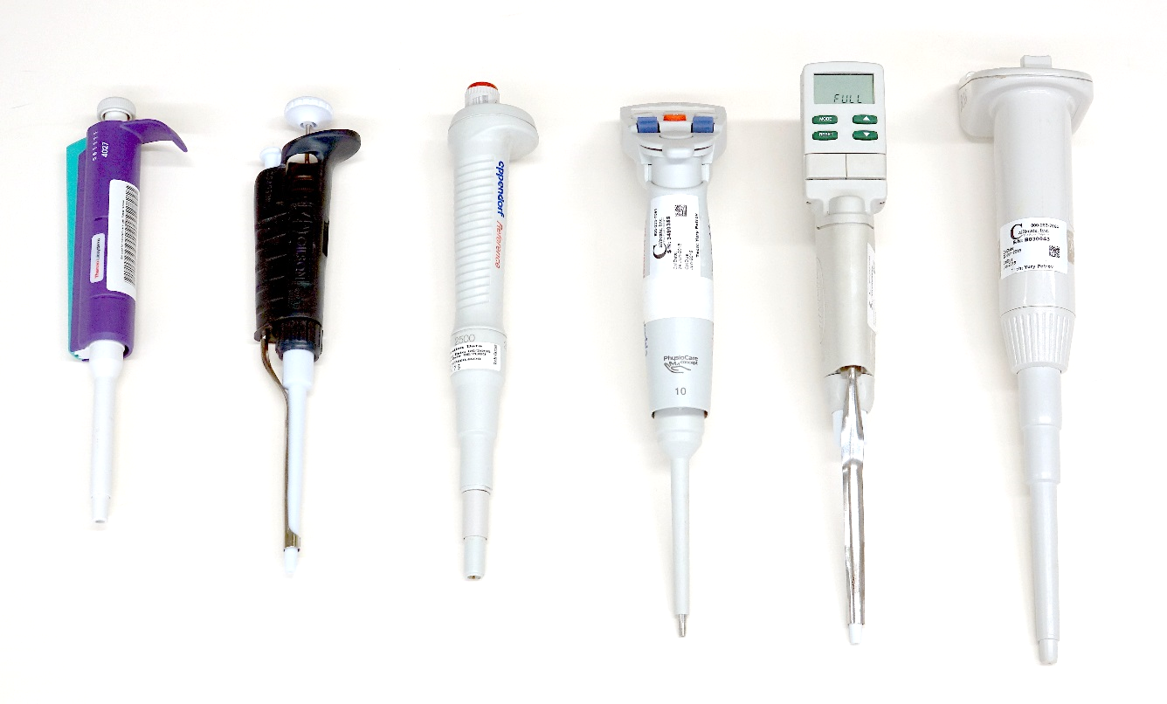
Manual and Electronic Pipettes
Manual pipettes provide fixed or adjustable pickup volumes
Electronic pipettes provide a broad range of features
  adjustable pickup
  multiple aliquots from a single pickup
  control of pickup rate
Manual pipettes
Electronic pipettes
Notes:
Manual pipettes are available with a fixed pickup volume, or with adjustable pickup. Fixed pickup volumes are available from uL quantities to mL quantities, and are significantly less expensive than pipettes with adjustable pickup volumes.
Electronic pipettes offer adjustable pickup volumes, and can be programmed to control the rate of sample pickup and delivery. This feature may be important if samples are viscous, in which case controlled pickup can help to prevent degassing and bubble formation. Electronic pipettes can also be programmed to deliver multiple small aliquots from a single larger pickup.

Slide 8
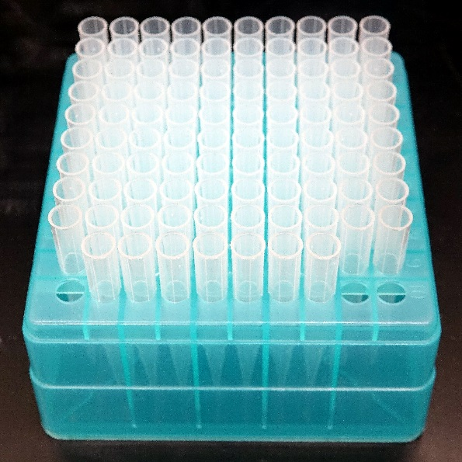
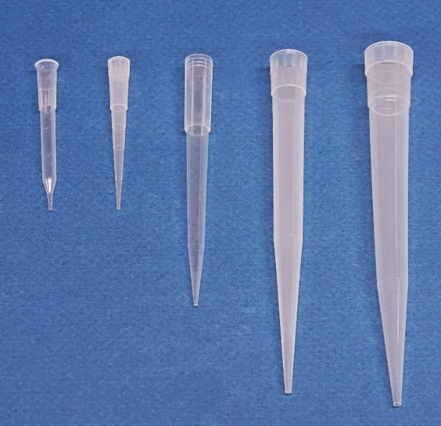
Pipette Tips
Pipette tips are available in different configurations
  Common sizes: 10 μL, 100 μL, 1 mL, 2.5 mL, 5 mL
  Pipette tips differ in
    Wall thickness
    End configuration
    Composition
    Surface coating
    e.g., PTFE (polytetrafluroethylene), siliconized tips
  Tips may include integral filters
    Reduce cross contamination
    Protect the pipette mechanism
Tips are designed “to contain”
  Liquid is expelled completely during delivery
  Best function is with aqueous solutions
  Organic liquids may not be fully expelled (poor accuracy)
tip rack
pipette tips
Notes:
A variety of tips configurations are available
Pipette tips are matched to the capacity of the pipette, and common sizes range from 10 uL to 5 mL.
The physical configuration of pipette tips varies among manufacturers and applications. Differences include differences in the wall thickness, the tip end configuration, tip composition, and surface coating. Most pipette tips are molded from polypropylene; however, specialty tips are manufactured from Teflon and other polymers. In the case of Teflon, due to cost, the tips are intended for reuse. For aqueous samples, the best tip performance results for tips that exhibit hydrophobic surface properties. The high contact angle that results facilitates recovery of the liquid from the tip. Polypropylene is reasonably hydrophobic, but surface coatings are sometimes added to reduce sample retention and enhance recovery. Siliconized tips, and tips coated with PTFE are examples. Proprietary coatings are also available, and these tips are referred to as low retention tips.
Pipette tips may also include integral filters. The filters prevent aspirated liquids from contacting the pipette mechanism and they also provide a barrier to protect the sample from residual aerosols that might be formed from previously pipetted samples.
Pipette tips are designed to contain the measured liquid quantity, and this quantity is completely expelled during delivery.
The pipette tips work best with aqueous solutions since these solutions do not wet the pipette tip. Because the tips are wetted by organic liquids, poor accuracy can be expected.

Slide 9
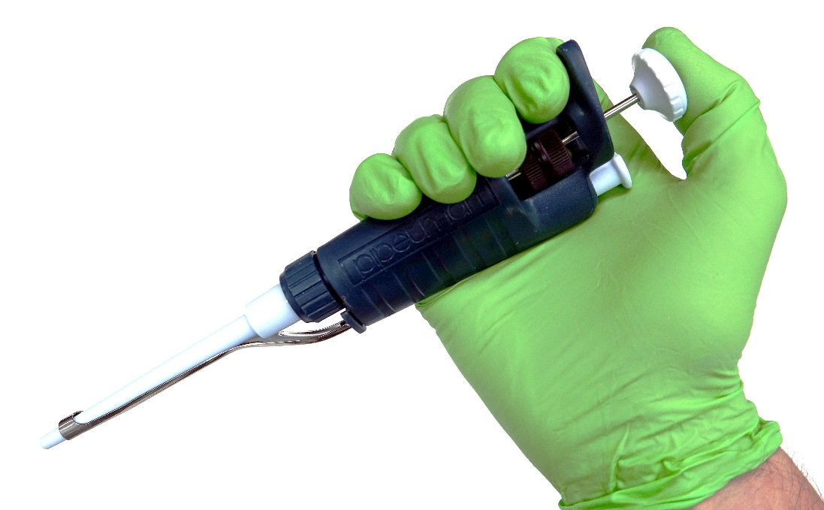
Manual Pipettes
Suction and dispensing actions are thumb actuated
Pipets are available in fixed-volume and adjustable-volume configurations
initial position
pickup/dispense (1st stop)
purge (2nd stop)
tip ejector
Notes:
With manual pipettes, suction and dispensing actions are thumb actuated. Manual pipettes are available in fixed-volume and adjustable-volume configurations.
The action of the piston has three positions: the initial or rest position, the dispensing position, and the purge position. Accurate pickup and delivery of the liquids results for depression of the plunger to the first stop position. Liquid residues, if any, can be purged from the tip at the second stop position. Additional plunger resistance is present for depression between the first and second stop positions.
A tip ejector button facilitates tip changes without having to touch the used tip.

Slide 10
Recommended Operation
For adjustable pipettes, the best performance results for the range 35% to 100% of the volume indicated
Tip immersion depth
  Volumes up to 10 μL: 1 mm to 2 mm
  Volumes up to 1 mL: 3 mm to 6 mm
  Larger volumes: 1 cm
  Lower tip end as needed during aspiration.
Tip angle
  Aspiration: ≈ vertical
  Dispensing: < 20 °; in contact with wall of vessel
Aspirate and dispense liquids at a controlled rate, particularly for larger volumes.
  Liquid may enter pipette mechanism if large volumes are rapidly aspirated
  Aerosols are easily generated with rapid delivery of liquids
Notes:
For adjustable pipettes, the best performance results for the range 35% to 100% of the volume indicated. Avoid small volumes less than 10% of the maximum pipettes capacity. Never adjust pipettes outside of the operating range (e.g., 105% of volume)
To achieve consistent results, the pipette tip must be positioned properly. Tip immersion depth should be just sufficient to achieve complete aspiration. Inaccurate results occur when the immersion depth is excessive. If necessary, lower the tip as the liquid is withdrawn.
It is also useful to maintain a vertical position during sample pickup, and to touch the tip to the wall of the vessel during dispensing.
With manual pipettes, try to aspirate and dispense liquids at a controlled rate, particularly for larger volumes. Problems can occur if liquid pickup is uncontrolled – the liquid may spray into the pipette mechanism, particularly with large volumes. When dispensing liquids, try to use a slower, controlled rate to minimize aerosol formation.

Slide 11
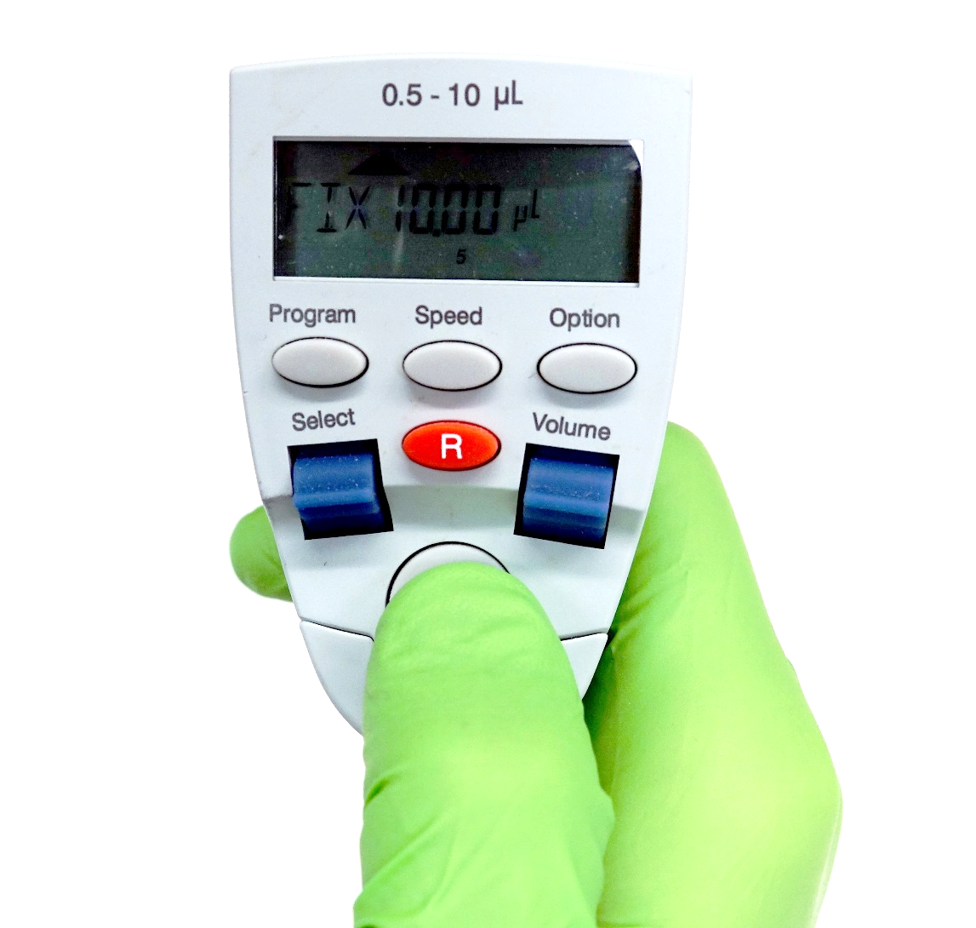
Electronic Pipettes
Suction and dispensing actions are push- button actuated
Pipets are available in adjustable-volume configurations, with advanced features
  Single pickup and delivery
  Multiple pickup and delivery
  Mixing
  Variable aspiration and dispensing rates
Follow recommendations for mechanical pipettes
Notes:
With electronic pipettes, pickup and dispensing operations are achieved with a motorized plunger. Control of the volume, rate of pickup and dispensing, and mode of operation are specified by the analyst. Operation is similar to manual pipettes, and precautions about tip orientation also apply to electronic pipettes.
Many electronic pipettes offer a feature that permits multiple aliquots to be dispensed from a single larger sample pickup. This is a very convenient way of aliquotting small volumes of a single sample. Precautions against using a pipette to dispense volumes less than about 10% of the maximum capacity also apply to multiple aliquots.

Slide 12
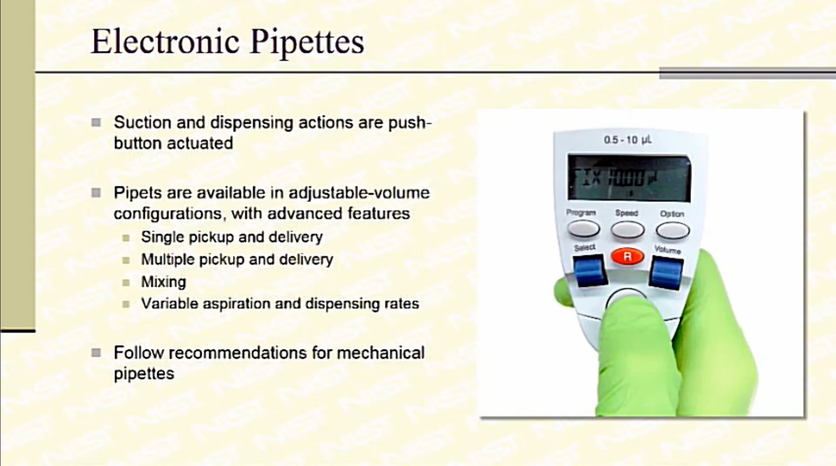
Notes:
The following video segments illustrate the use of manual and electronic pipettes.
With adjustable manual pipettes, an odometer style display indicates the volume to be delivered. The example shown includes a release button the prevents unintentional changes in the volume. When setting the volume, never attempt to adjust the volume outside of the device specifications, as this may affect the calibration or damage the mechanism.
Manual pipettes have three positions: the rest position, the first stop position for pickup and delivery, and the second stop position for expelling residual liquid.
The style and function of electronic pipettes differs among manufacturers; however, once set, the operation is similar to manual pipettes. Pickup and delivery are usually actuated with a pushbutton using the thumb or forefinger, depending on design. Pickup and delivery functions are cycled with each actuation.
Pipette tips are often provided in racks to permit ease of use. The racks also serve to prevent tip contamination through handling. Avoid the use of excessive force with tip insertion, as this may make subsequent tip removal more difficult.
When pipetting liquids, try to orient the pipette near vertical, with the tip only slightly below the surface of the liquid. Place the tip against the wall of the receiving container to prevent aerosol formation. In the example shown, this precaution was not taken, and splashes can be observed to result.
Most pipette tips are designed to work best with aqueous samples. After pipetting a liquid, no residue should remain in the pipet tip. As is shown in the video for water, after use, no traces of water are apparent in the tip.
With organic liquids, including alcohols, residues are not fully expelled during the delivery step since the liquid acts to wet the tip surface. This affects both the accuracy and precision of the transfer, and unfortunately, this is a limitation of the devices. The analyst should be aware that reduced analytical performance is likely when pipetting organic liquids.

Slide 13

www.nist.gov
Notes:
To learn more about the National Institute of Standards and Technology, visit www.nist.gov

