Slide 1

Welcome
NIST Safety Update
Richard Kayser
Chief Safety Officer, NIST
Visiting Committee on Advanced Technology
February 3, 2016

Slide 2



AGENDA
Report regularly to the VCAT on NIST’s safety improvement efforts.
2014 SAFETY
CLIMATE SURVEY
SAFETY
COMMUNICATIONS
DISCUSSION
2

Slide 3
2014 NIST Safety Climate Survey Planned Actions
01
EMPLOYEE RIGHTS
AND RESPONSIBILITIES
Improve communication to employees
of their safety rights and responsibilities.
04
SAFETY TRAINING
Improve the quality of
safety training.
02
05
MANAGEMENT OBSERVATIONS
Incorporate discussions of safety culture issues into management observations.
UNSAFE CONDITIONS
AND PRACTICES
Provide guidance on addressing
unsafe conditions and practices.
03
INCIDENT REPORTING &
LESSONS LEARNED
Implement improved incident reporting processes and mechanisms for sharing lessons learned.
06
PERFORMANCE APPRAISALS
Re-emphasize the importance of employees receiving safety performance feedback during performance appraisals.
Notes:
Reprise of what we focused on last time (SLT and Item 1)
What we will focus on this time (Items 2 and 4)
What we’re likely to cover next time

Slide 4

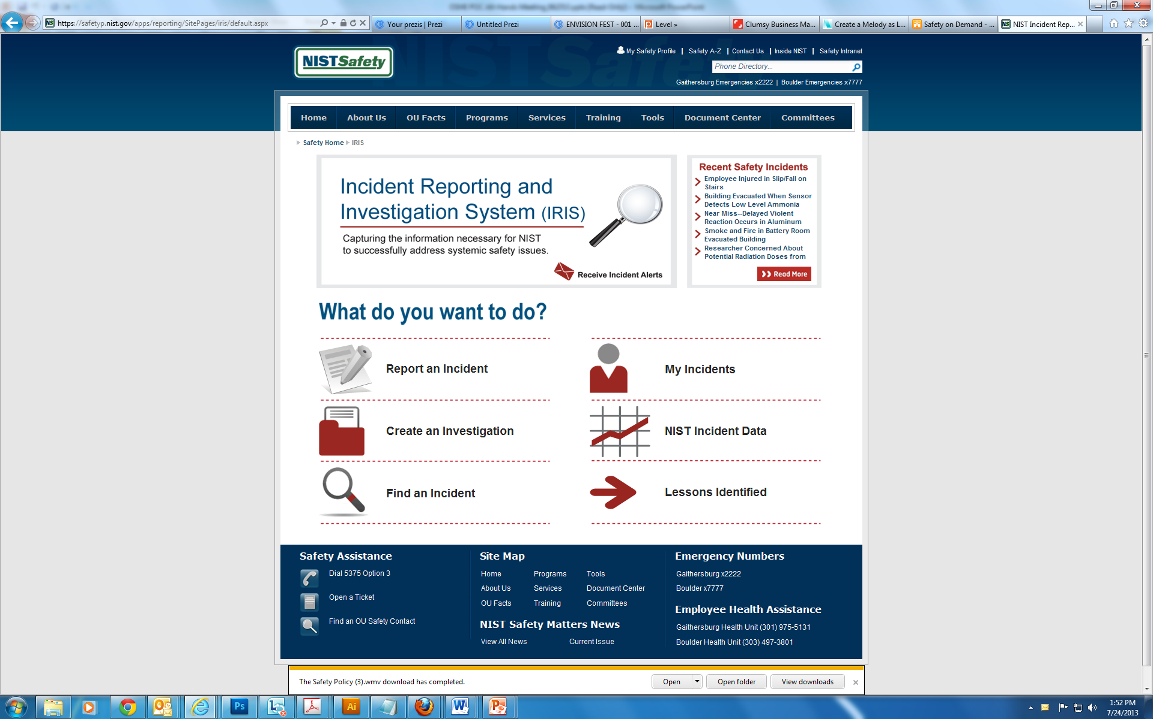
2014 NIST Safety Climate Survey
1.
A large majority of respondents agreed that reporting incidents helps improve safety at NIST.
2.
Less than half of respondents use incident reports for lessons learned.
3.
Apparent disconnect between perceived value and practical application.

Slide 5



Opportunities for Improvement
Improve
What’s Reported
Improve Sharing Lessons Learned
01
03
Improve Incident
Investigations
02

Slide 6
Improve What’s Reported
Eliminate Reporting
of Minor Incidents
Improve Information Consistency
Refine what should and shouldn’t be reported
Filter unnecessary reports in the OUs and Safety Office
Provide in-person and 0n-line refresher training for those who do reporting
Consider having fewer employees do reporting

Slide 7
Improve Incident Investigations
Training
Tools
Procedures
Support
Provide in-person and on-line refresher training on incident investigations
Provide guidance and other resources
Consider having fewer employees conduct incident investigations
Provide expert safety assistance as needed

Slide 8
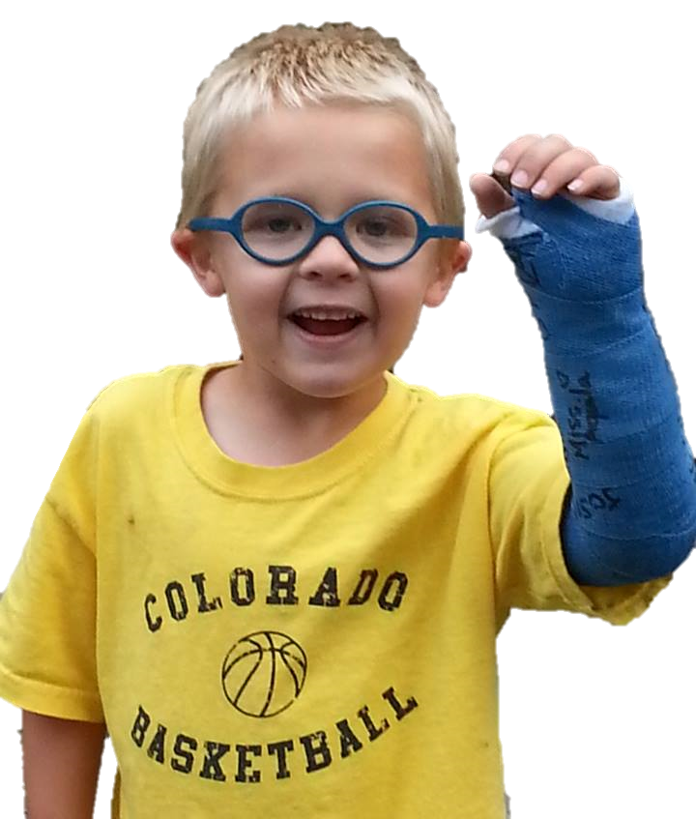
Improve Sharing Lessons Learned
Reach more staff with better information.
Grow IRIS email alert subscriptions
Increase communication vehicles
Communicate incident trends
Keep communications positive

Slide 9
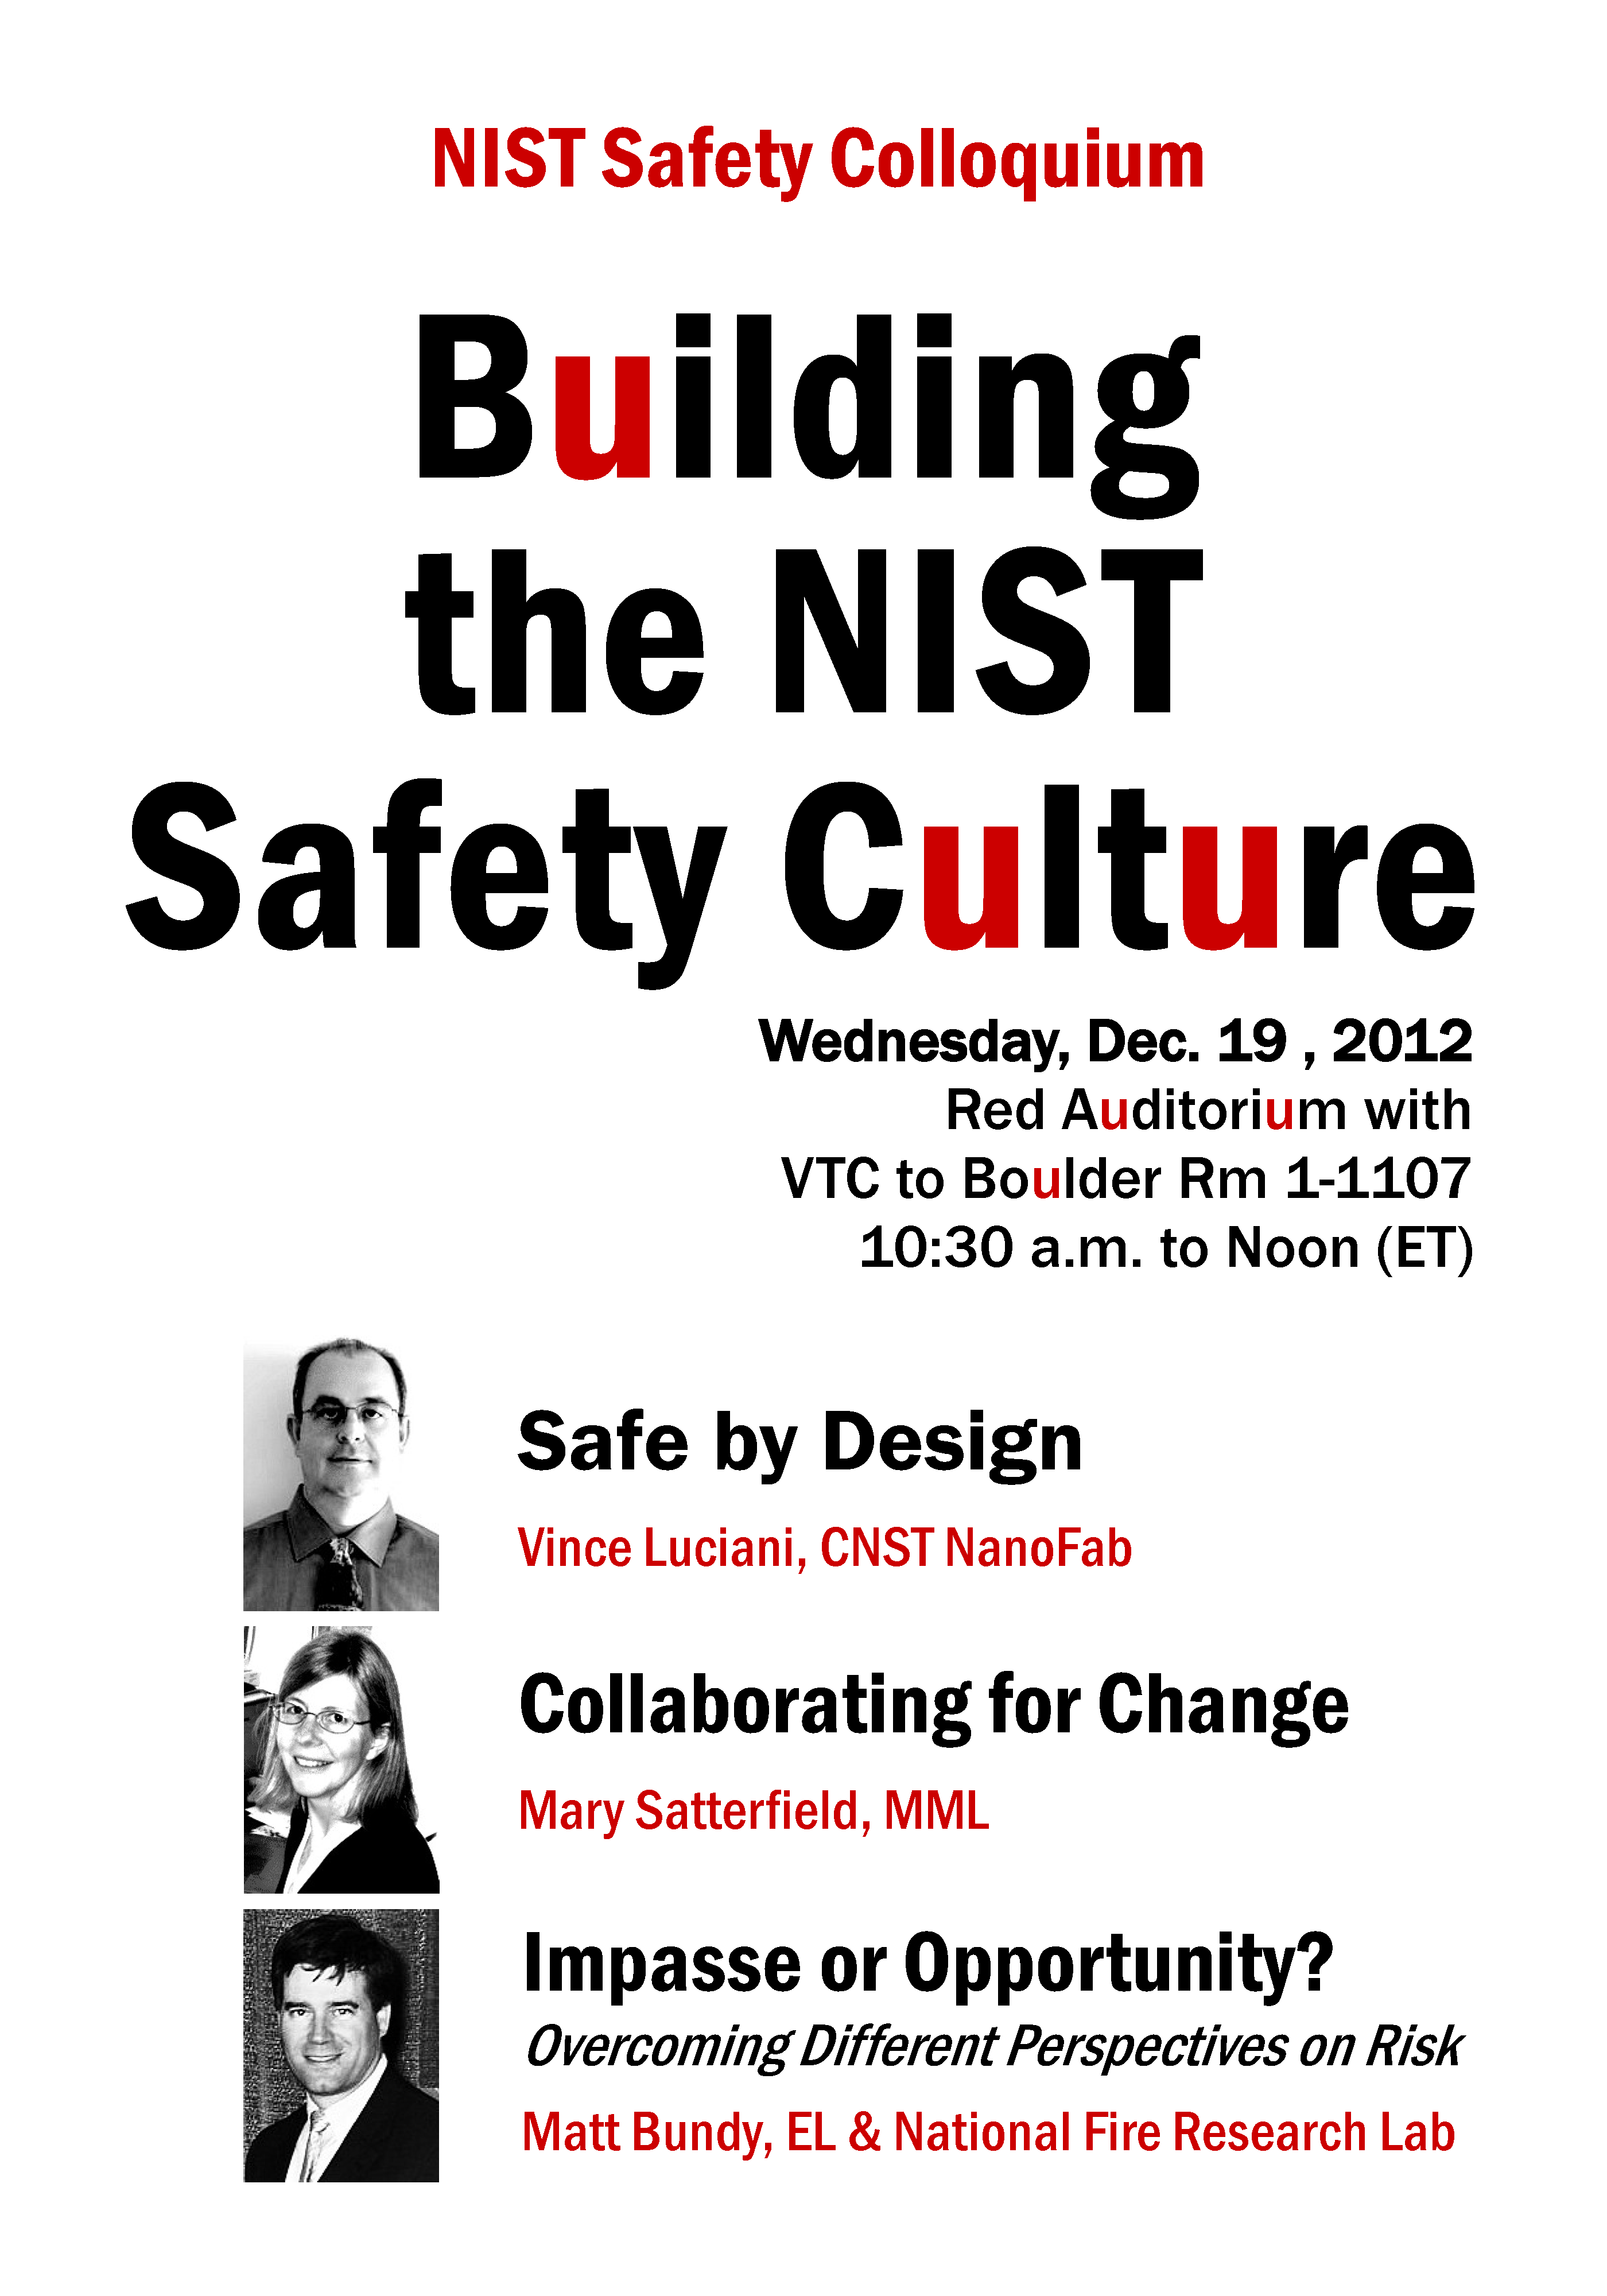
Safety Communications
“It’s not about us,
it’s about you.”

Slide 10
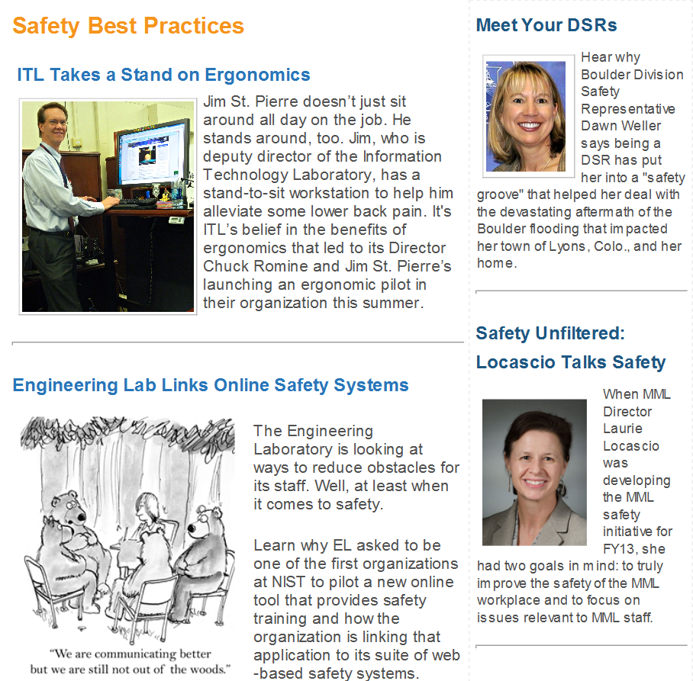
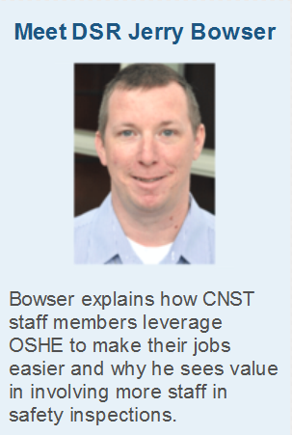
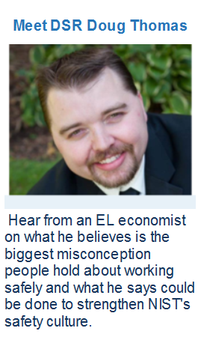

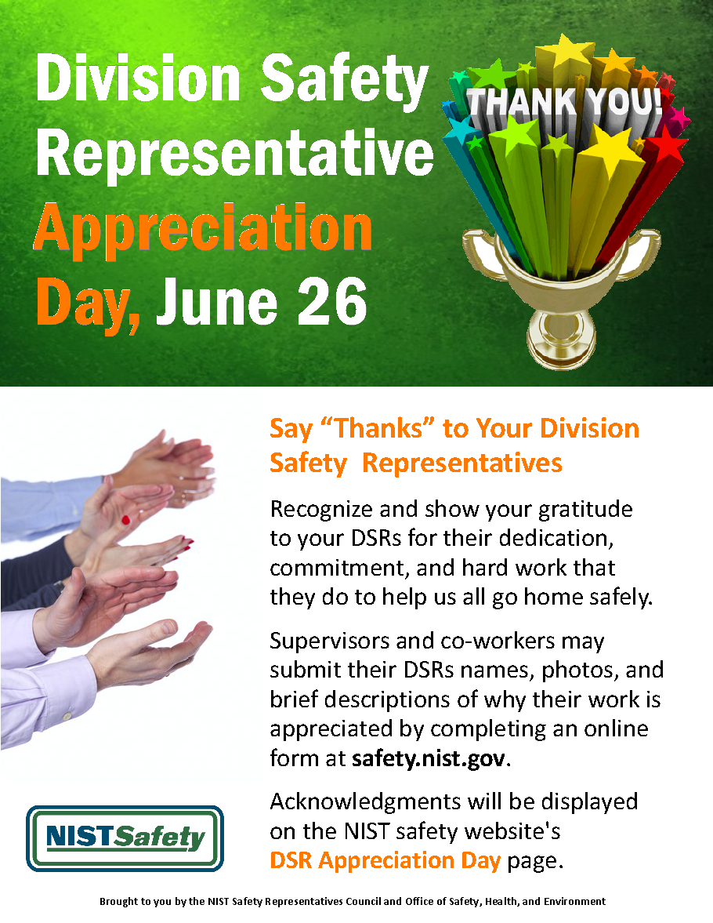
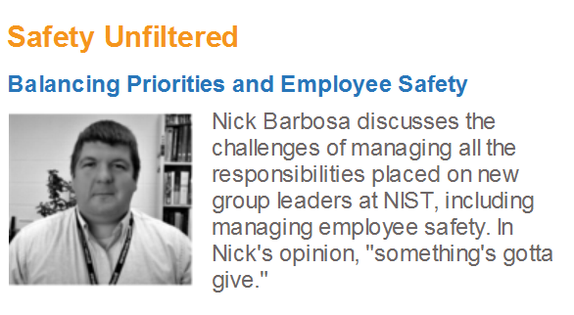

Our Communications Approach
Personal
Peer-to-Peer
Emotional
Fun

Slide 11

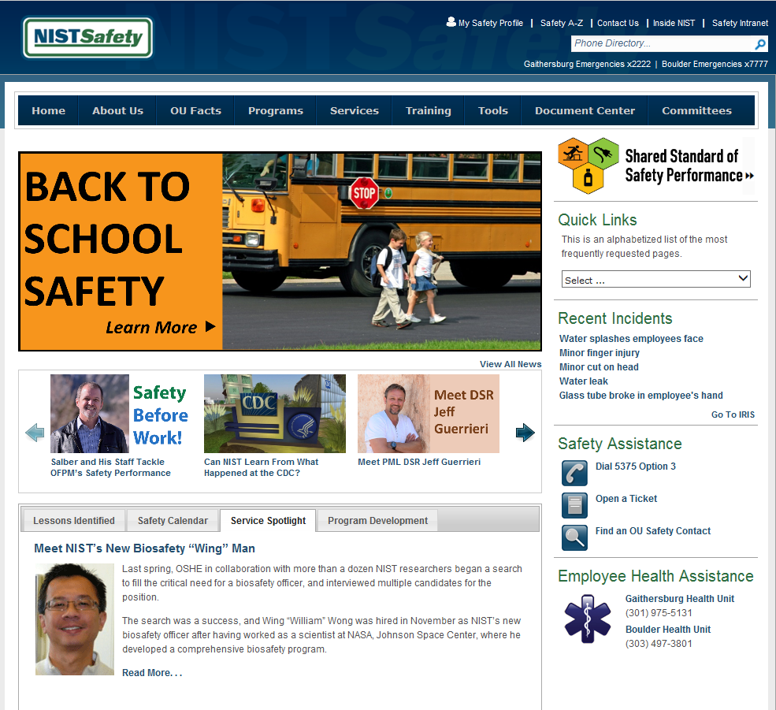



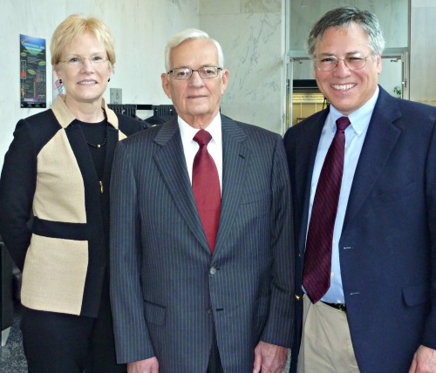

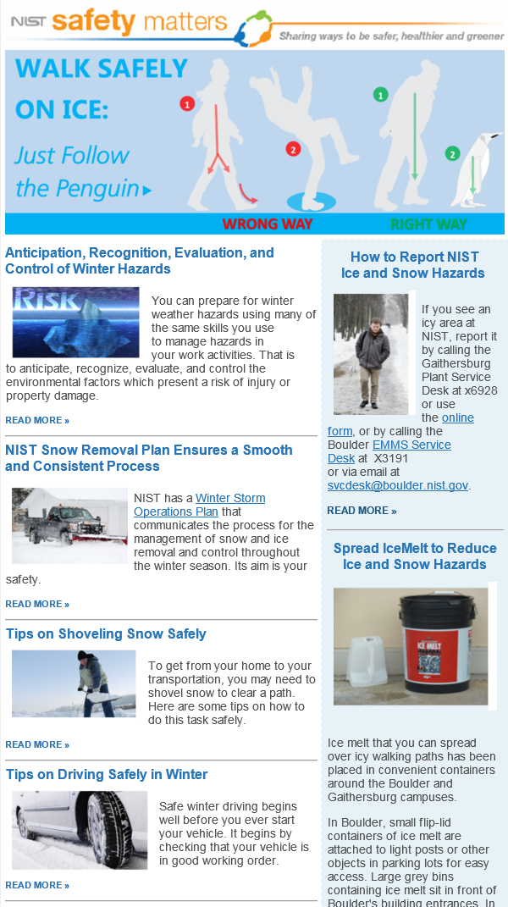
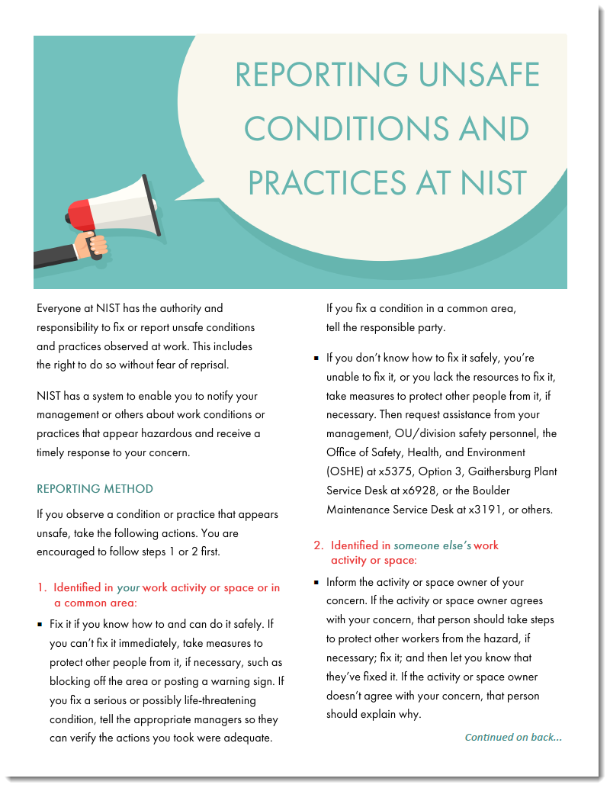
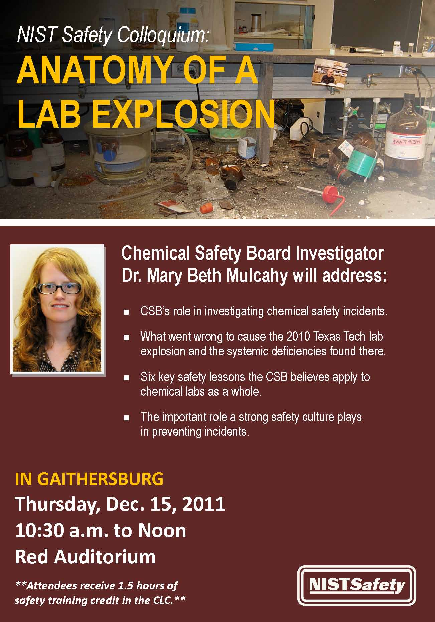



Communication Channels
Website
Email Newsletter
Safety Colloquia
NISTube Videos
Plain Language Guidance

Slide 12
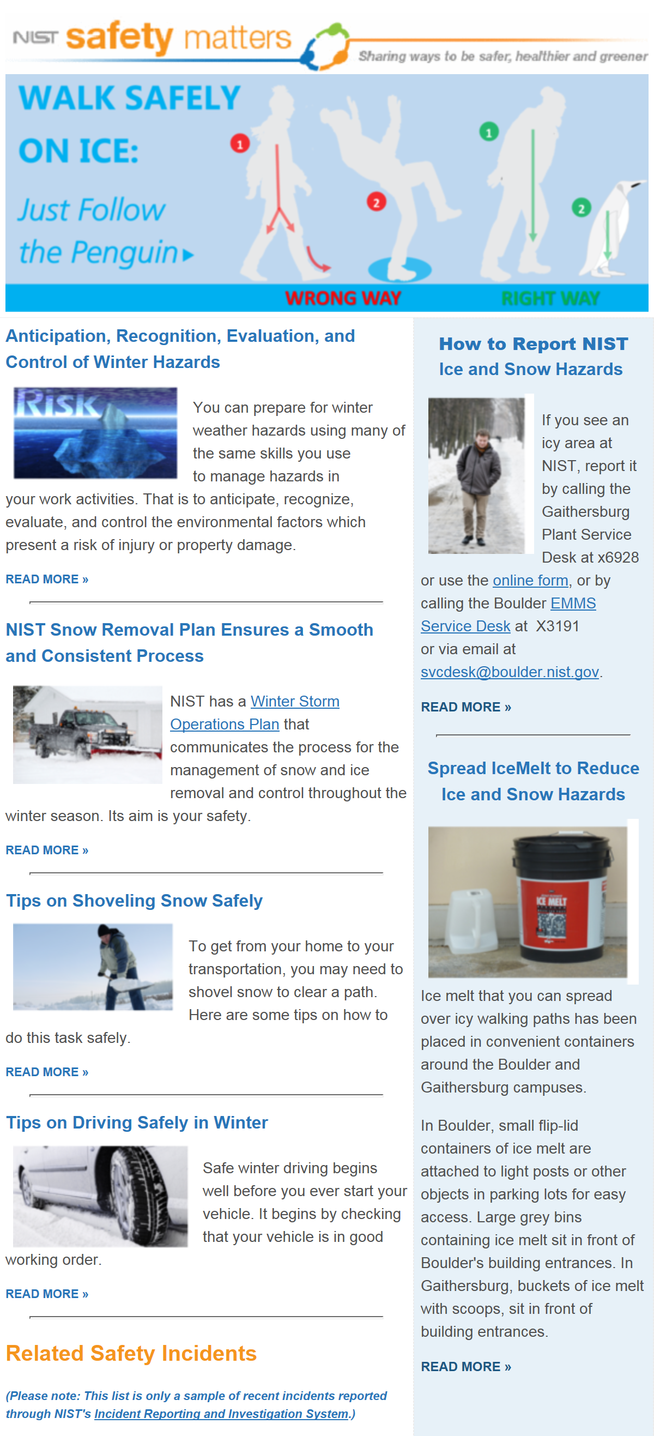
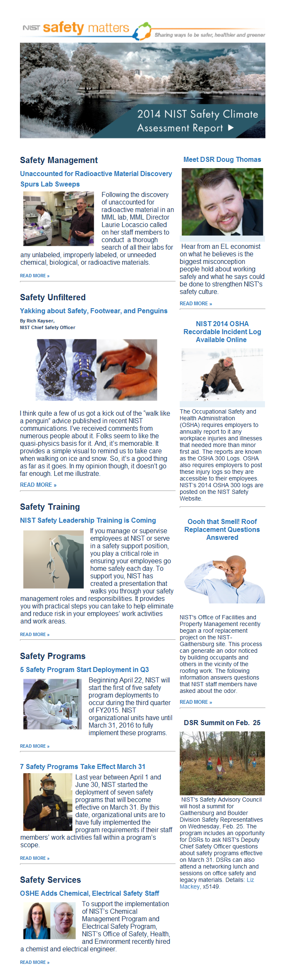
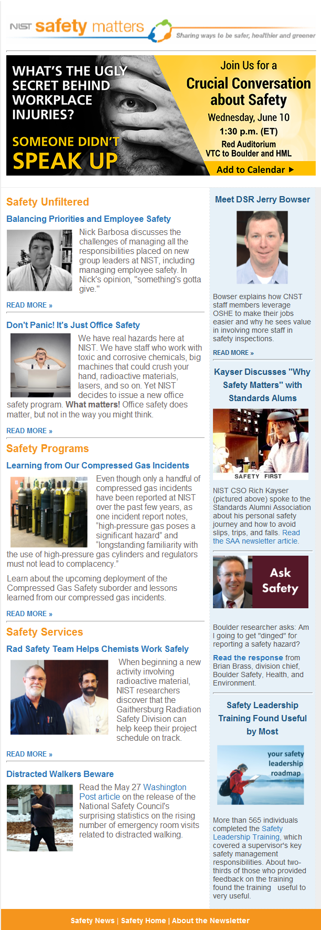
NIST Safety Matters
40% of emails opened
Popular articles include
opinion pieces, staff interviews, and incident reports
Emphasis on peer-to-peer conversations, practical information, and emotional and personal accounts

Slide 13
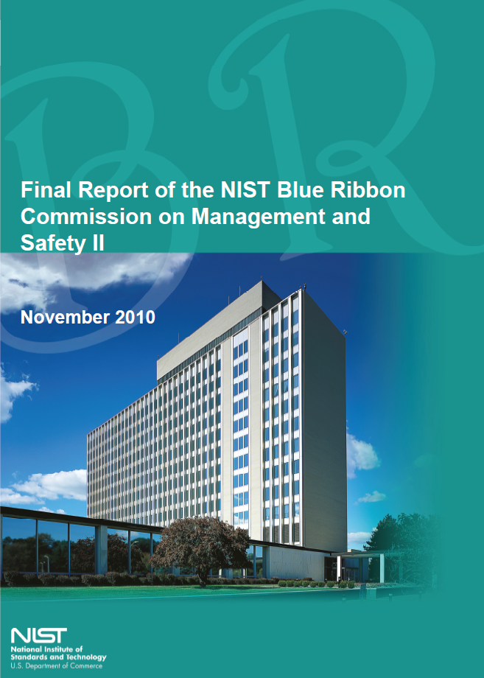
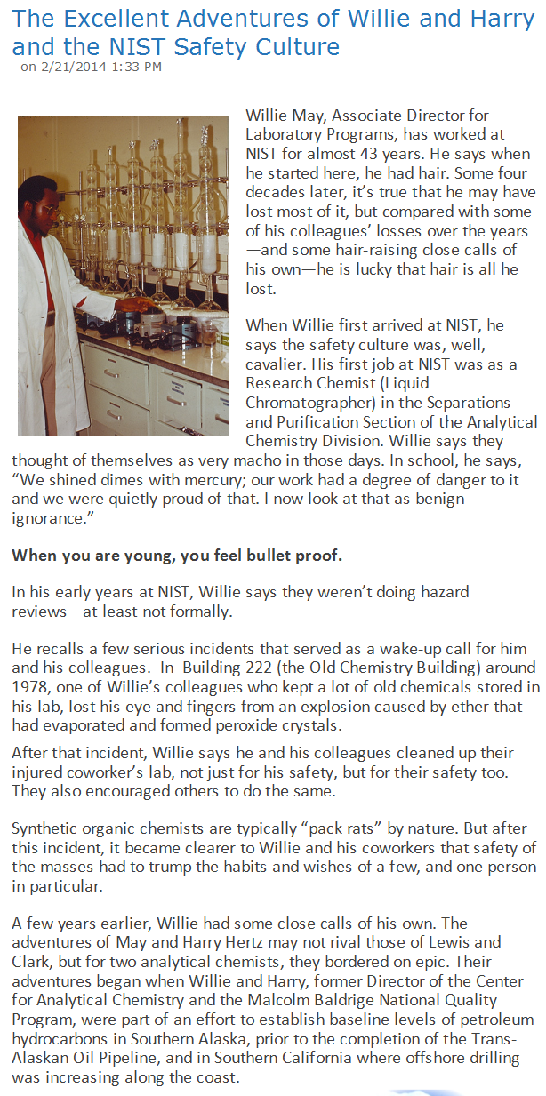
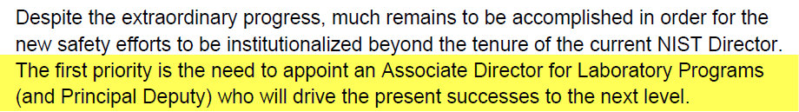
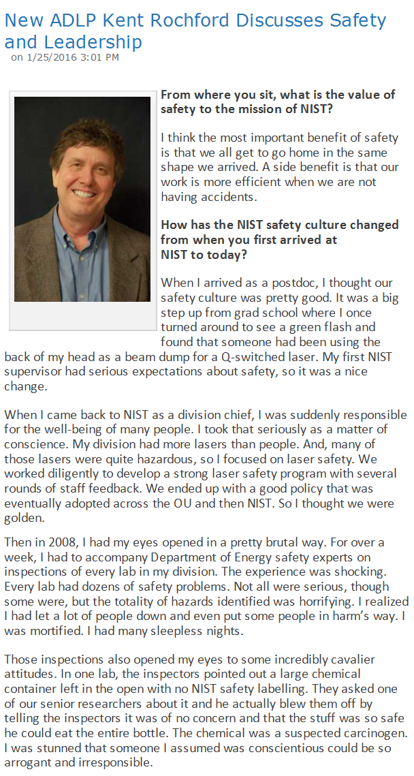
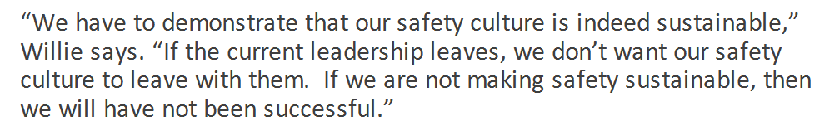
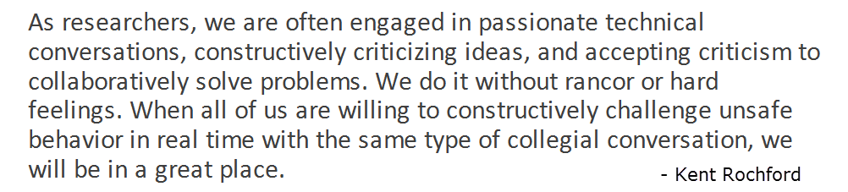
Leadership Communications
- Willie May
- Kent Rochford

Slide 14

Discussion

