Slide 1
Department of Veterans Affairs
VA Health Systems Interoperability Training Program
Standards Based Interoperability
Session 2 Part 2: Interoperability Basics
Robert Snelick
Computer Scientist
Testing Infrastructure Project Manager
National Institute of Standards and Technology (NIST)
August 2024

Slide 2
Speaker
Robert Snelick
Project Manager and System Architect - National Institute of Standards and Technology (NIST)
Co-chair – HL7 Conformance Working Group
HL7 v2 Management Board
Architect and lead of the NIST Testing Infrastructure for conformance test tools including those for the CDC, AIRA, IHE, and ONC MU EHR Certification
Co-author – Healthcare Interoperability Standards Compliance Handbook, Springer 2016

Slide 3
Outline
Motivation and Background
Foundation of Interoperability
Fundamental Concepts and Terms
Conformance and Profiling
Introduction to Testing

Slide 4
Interoperability Basics
How does Interoperability come to be?
Standards
Requirement Specification
Conformance
Compliance
Compatibility
Information Models
Terminology
Semantic Understanding
Use Cases
Profiling
Implementation
Success Metrics
Computable Standard Formats
Specification Tools
Conformance Testing
Real Life Scenarios
Directed Test Cases
Test Data Sets
Conformance Test Tools
Testing Frameworks
Data Quality
Functional Requirements
Interoperability Testing
Life Cycle

Slide 5
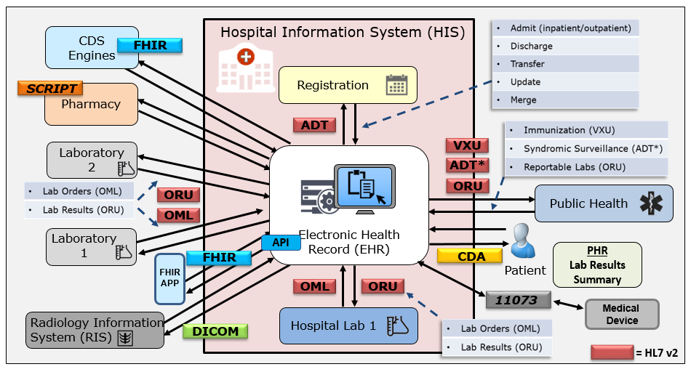
Healthcare Landscape and Standards
Variety and volume of data exchange is daunting
100s of million of exchanges performed in a single organization per year
Provide a common language and set of expectations that enable interoperability
Fundamental building blocks for developing and deploying technology products
Establish consistent protocols that can be universally understood and adopted
Allow for systems to be verified—thus offering credibility
Give customers a choice, thus enabling competition

Slide 6
Why do we need Standards?
Combinatorial explosion of the number of interfaces needed
The more interconnected systems, the greater the benefit of using standards
Multiple point-to-point non-standard solution
Single standard solution
But can we really get a “one-size” fits all standard?
In most cases, NO, but we can significantly reduce the number of translations needed and site-specific details
If standards are underspecified or not specific, there can be multiple interpretations of the standard—which pushes us back to where we started
Conformance, profiling, and precise documentation puts us back on track

Slide 7
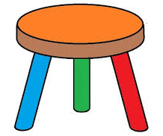
Foundations of Interoperability
Well-defined Standards
Testing
Implementation
Development Lifecycle
Standards
Testing
Implementation
HIT Interoperability
Implementation
Well-defined Standards
Conformance Testing

Slide 8
Success Depends On
Well-defined Standards – precise and complete requirement specification
Conformance constructs – some standards have sophisticated constructs, others do not
Profiling (Management and Use)
Testing standards and trial implementations
Conformance Test tools
Initial test implementations
Reference
Pilot
Standards Development Lifecycle
Feedback to authors, tool developers, and implementers
Interoperability Testing

Slide 9
Failure Happens When:
One or more components are omitted or are not sufficient
Standards
Testing
Implementation
HIT
ability
Inter
oper
Implementation
Well-defined Standards
X
Conformance Testing

Slide 10
Fundamental Concepts

Slide 11
Key Concepts and Terms
Conformance
Interoperability
Compliance
Compatibility
Alert: Not everyone will agree on these definitions
Alert: Some use these terms interchangeably
Alert: Terms are overloaded in use
11

Slide 12
Conformance
Defined as the fulfillment of a product, process, or service of specified requirements [1,2].
The concept of conformance is essential to any standard for providing an objective measure of how closely implementations satisfy the requirements defined in the standard [1,2].
Specification
Does the system implement the requirements as stated in the specification?
Conformance
Implementation
[1] ISO Reference - ISO/IEC 17000 Conformity assessment - Vocabulary and general principles, first edition 2004-11-02.
[2] Glossary of Conformance Terminology, Interoperability and Conformance Technical Committee, OASIS. http://www.oasis-open.org/committees/ioc/glossary.htm

Slide 13
Interoperability
“is the ability of two or more systems or components to exchange information and to use the information that has been exchanged.” [1]
Two Key Parts:
1) information must be exchanged, which refers to the technical/functional/syntactical characteristic;
2) but the more important part is the correct semantic interpretation allowing for use of the exchanged information [2].
Implementation
Implementation
Interoperability
Can two interconnected systems exchange data and use that data to perform a business function as both intended?
[1] [IEEE-1990] Institute of Electrical and Electronics Engineers. IEEE Standard Computer Dictionary: A Compilation of IEEE Standard Computer Glossaries. New York, NY: 1990.
[2] Benson T. Principles of Health Interoperability HL7 and SNOMED. Health Informatics Series, Springer-Verlag, London Limited 2010.

Slide 14
Compliance
Is the degree to which a derived specification adheres to the requirements defined in the foundational specification (standard)
In other words, are the rules for adding constraints or extending the specification faithfully followed
Specification
Does a derived specification apply constraints to a base specification in accordance with the constraint model?
Compliance
Derived Specification

Slide 15
Compatibility
Declares whether two specifications define sets of requirements that are harmonized with each other, allowing systems that implement them to work together, i.e., interoperate
Compatibility is a prerequisite for interoperability
Specification
Compatibility
Specification
Do the specifications define a set of harmonized requirements?

Slide 16
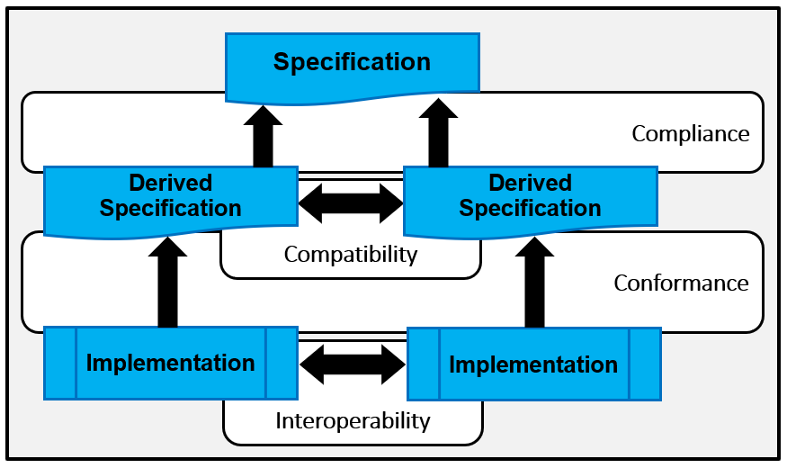
Relationships

Slide 17
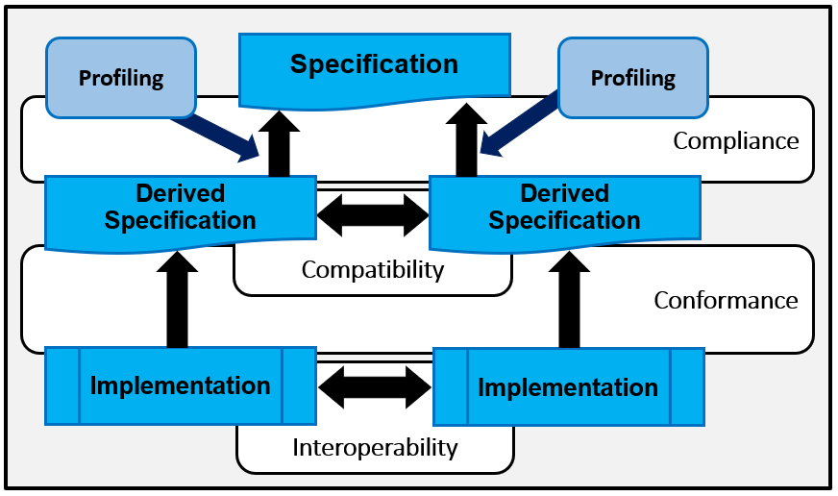
Profiling: Use Case Specific Requirements
We must profile in a consistent manner using “rich” conformance constructs.

Slide 18
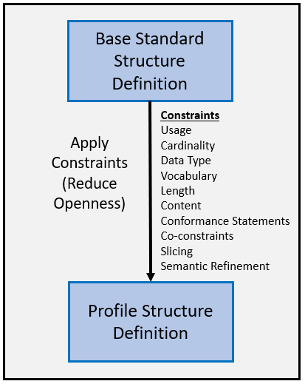
Profiling Overview
The base standard is a framework that contains many templates (starting point) that is intended to be constrained for a specific use and context.
Allows implementers to document an agreed-upon subset of the standard, and thus arrive at a common interpretation
Conformance Constructs provides the mechanisms to apply constraints in a consistent manner

Slide 19
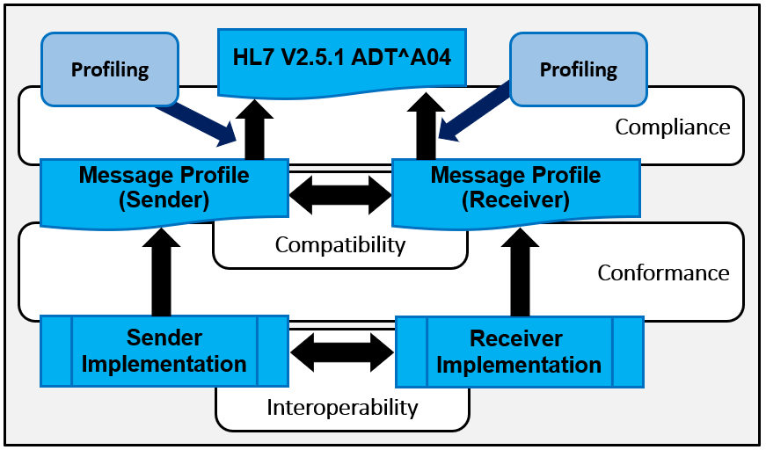
In the Context of HL7 v2

Slide 20
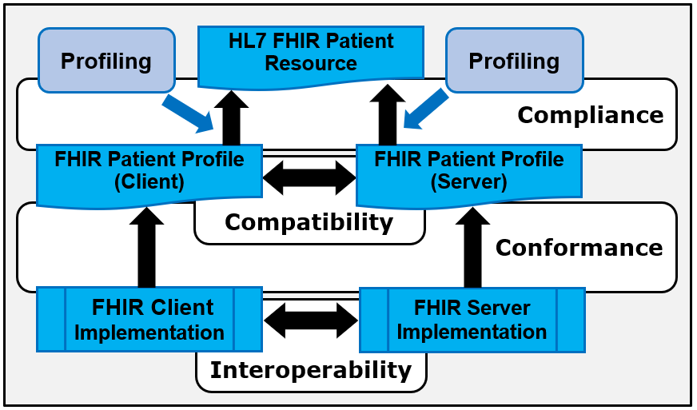
In the Context of HL7 FHIR

Slide 21
Layers of Interoperability
Organizational Interoperability
Standardized process (workflow) elements using business process modeling tools
Can we accomplish the clinical task? What we want!
Semantic Interoperability
Standardized meaning (model elements) and terms/vocabulary for data interpretation, e.g., LOINC, ICD-10CM
Common information model—an understanding
Syntactic Interoperability
Standardized data exchange formats, e.g., HL7 v2, CDA, XML
Domain independent data exchange—processing of the data at these level is agnostic to the meaning of the data
Structural Interoperability
Simple EDI, envelopes
Technical Interoperability
Signals using standard protocols for technically secure data transfer, e.g., TCP/IP
Standards
Standards provide the foundation for each layer
What’s important about the data exchange is how it is used in the clinical setting to affect care, change and automate processing workflow.
Interoperability Levels: Blobel B. Introduction into Advanced eHealth – The Personal Health Challenge (Adapted).

Slide 22
Conformance Methodology and Profiling

Slide 23
Conformance Methodology
Is the Foundation for Requirements and Testing
Provides the means for specifying requirements
Unambiguous
Precise (detailed)
High-level (pre-coordinated) Constructs provide a formal (“structured”) mechanism for specifying requirements
Consistent
Levels of specificity (specification level appropriate)
Provides a shorthand notation for expressing explicit statements of requirements
E.g., “R” = “Element X SHALL BE implemented and SHALL …”
Computable
Enables discrete and deterministic outcomes/testing

Slide 24
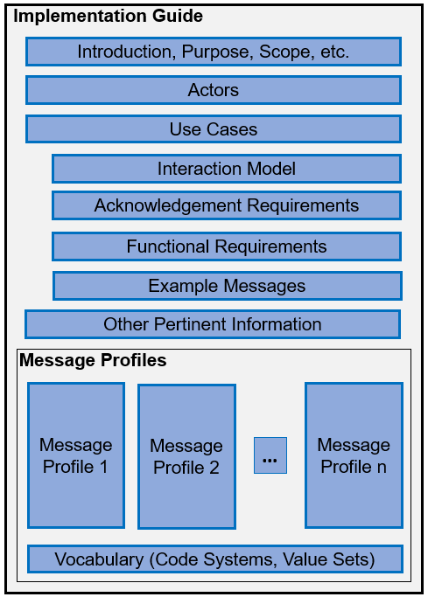
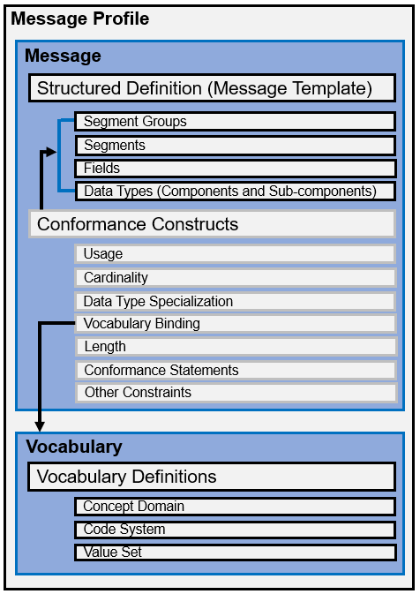
Implementation Guides (Specifications)

Slide 25
Conformance Constructs Examples
Mandatory (M):
data element SHALL BE supported
data element SHALL BE valued
data element SHALL NOT contain a data-absent-reason
Require, but may be Empty (RE):
data element SHALL BE supported
data element SHALL BE valued if known
data element MAY contain a data-absent-reason

Slide 26
Conformance Constructs Examples
Restrict the content of a data element:
Address Type {H, M, O}
Vaccine Codes {85, 88, 101, 102, 111, … }
Set the minimum and maximum numbers of times a data element may or must appear:
[1..1], [0..*] , [1..5]
Restrict the structure and type of data and element can contain:
{
element 1 : String;
element 2 : Numeric;
element 3 : Coded
}

Slide 27
Lack of Universal Terms and Concepts
Constructs for Support and Present
Must Support and Must be valued
Allowance for data-absent reason (e.g. UNKNOWN) depends on the standard
Similar concepts ←→ Different Terms
No Direct Mapping
HL7 v2
HL7 V3 and CDA
HL7 FHIR
NCPDP SCRIPT
ebXML
Support and Presence Usage
Required (R)
Mandatory (M)
Minimum Card. >= 1 & Must Support = true
Mandatory (M)
Required (R)
Element must be valued, but coded elements may include a null-flavor if the element is bound to a value set with null-flavors
Element must be valued; null-flavors are not-allowed OR Required (R), Minimum Cardinality = 1, and null-flavors allowed
Support and presence for an element is controlled by Cardinality (>= 1) and mustSupport = true
Element must be valued; no mention of null-flavors
Element must be valued; no mention of null-flavors

Slide 28
Vocabulary Concepts
Term | Definition | Examples
Code | A unique and discrete “identifier” that represents a concept; typically, is (and should be) agnostic to the concept it is representing | “M” “2093-3”
Concept | A notion that conveys semantic meaning | “male” “Cholesterol”
Code System | Managed collection of codes that represent concepts used in a particular business or technical area | LOINC CVX
Concept Domain | An abstract notion that refers to a set of related ideas and is essentially a named Semantic Category that serves to help define the meaning of a particular data element | Postal Code Immunizations Gender
Value Set | A collection of codes targeted for a specific use | US Zip Codes
(2093-3, Cholesterol, LN)
Notes:
(1) LN = LOINC, LN is the code for LOINC that represents the code system
(2) 2093-3 Full Concept is: Cholesterol [Mass/volume] in Serum or Plasma
Code
Concept
Code System

Slide 29
Vocabulary Relationships
Concept Domain
Code System
Value Set
Vocabulary
Postal Codes
US ZIP Codes
State of Alaska ZIP Codes
A specific set of codes is given for generally a broader use case. All US ZIP codes. Code → 15846 Concept → ZIP code for Kersey, PA
No specific codes given; the semantics of the concept is given. General postal code concept—the specifics are not given—could be for US, Germany, Canada, etc.
A specific set of codes is given for generally a specific use case. All Alaska ZIP codes. Code → 99829 Concept → ZIP code for Hoonah, AK
Levels of specificity and use—tied to specificity of the specification
Any levels can be bound to a data element
Profiling adds constraints which further defines the semantics of the bound data element

Slide 30
Profiling Examples
Optional (O) → Mandatory (M)
Required (R) → Mandatory (M)
[0..*] → [1…1]
{M, F, A, O, U} → {M, F, U}
{Set of CVX codes} → {207, 208, 210, 212}
COVID-19 Administered Vaccines

Slide 31
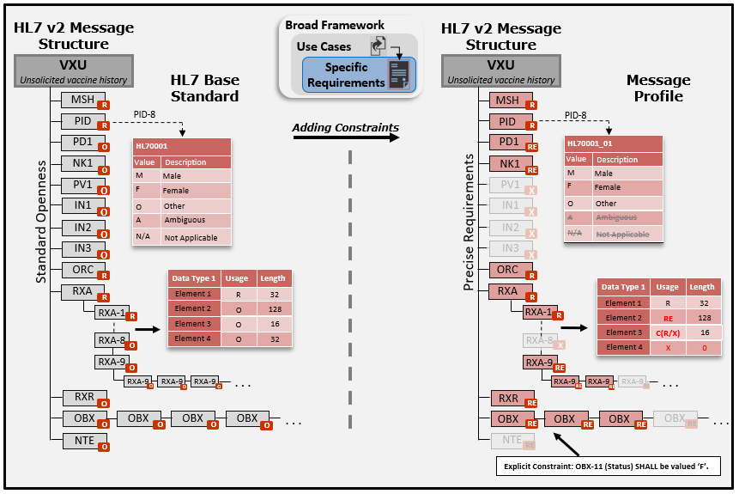
Profiling Example – HL7 v2

Slide 32
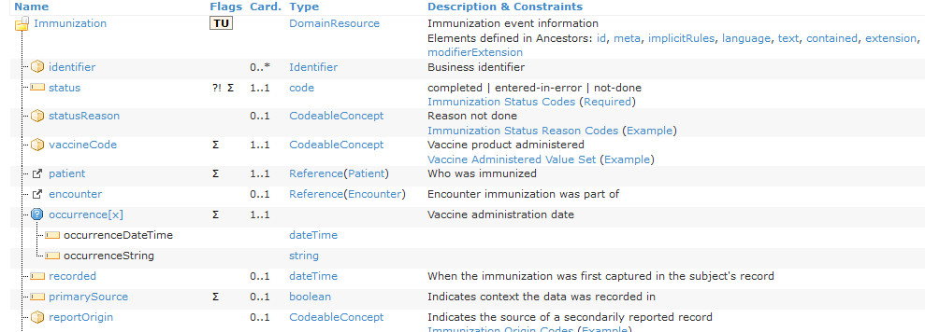
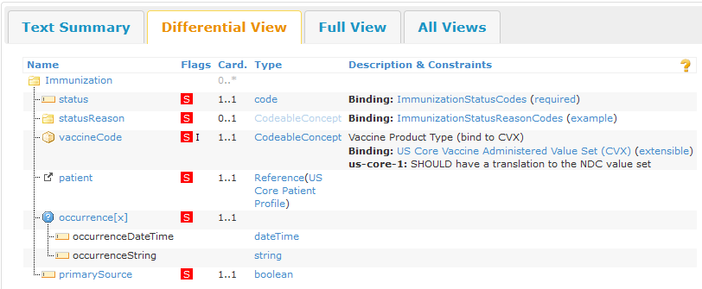
HL7 FHIR Profiling Overview
An explicit binding to a code system was made (CVX) with a binding strength of “extensible”.
Cardinality changed from 0..1 to 1..1

Slide 33
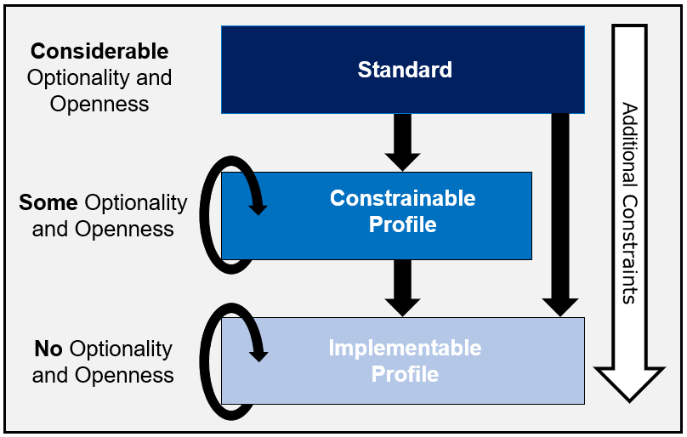
Profiling Hierarchy

Slide 34
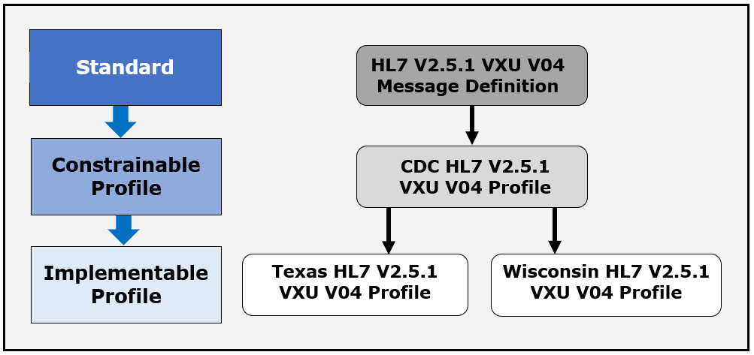
Profiling Hierarchy in Context

Slide 35
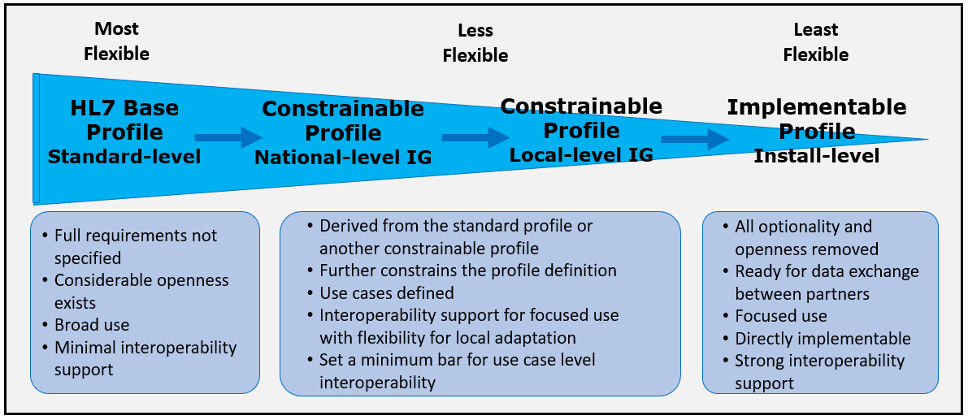
Profiling Spectrum

Slide 36
Testing

Slide 37
Testing Overview
Conformance Testing
Degree of confidence
Can’t be proven
Interoperability Testing
Two “conformant” systems doesn’t guarantee interoperability
Very large test space
Specification
Conformance
Implementation
Implementation
Implementation
Interoperability

Slide 38
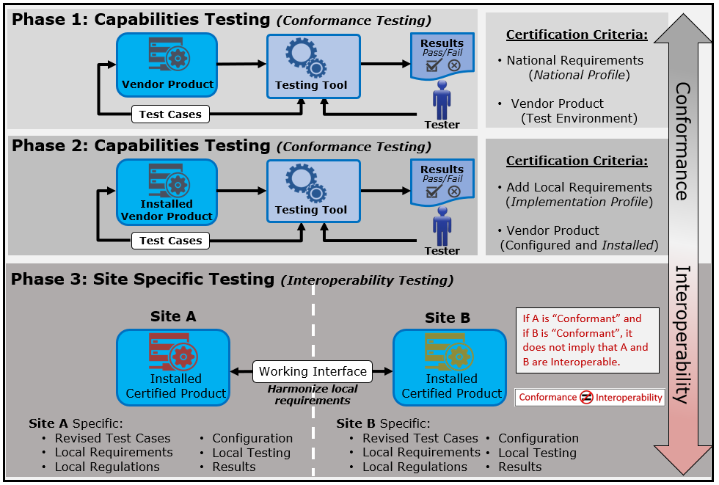
Levels of Testing

Slide 39
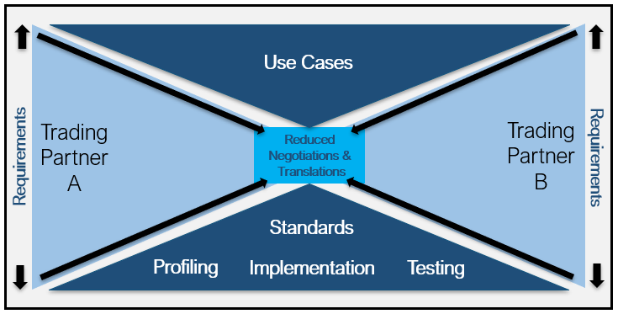
Towards Interoperability
The quality of a standard is dependent on how well (precise and complete) the requirements are conveyed
Conformance is the “language” that allows for a precise specification and interpretation of requirements
Allows for meaningful assertions of implementations through conformance testing
Standards and Conformance to those standards provide a path to interoperability

Slide 40
Thank You
Contact: Rob Snelick
Email: robert.snelick@nist.gov

