Slide 1
Utilizing FCS Express to Standardize Cytometry Analysis Protocols and Consolidation of Reporting Results
Sean Burke
De Novo Software
November 18, 2021
Notes:
Introduce yourself
Thank the organizers and attendees
Say why you are here

Slide 2
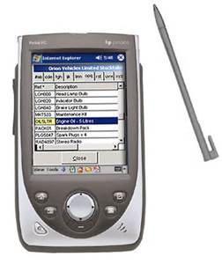


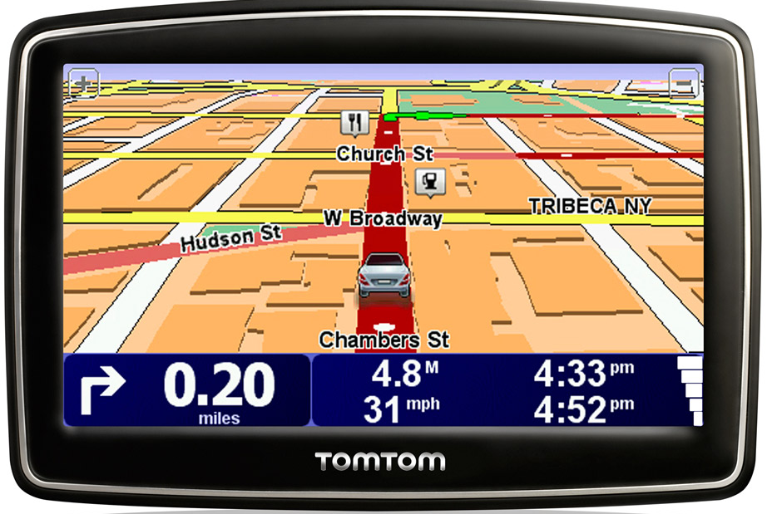
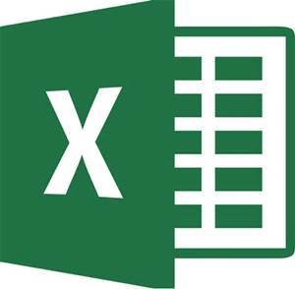






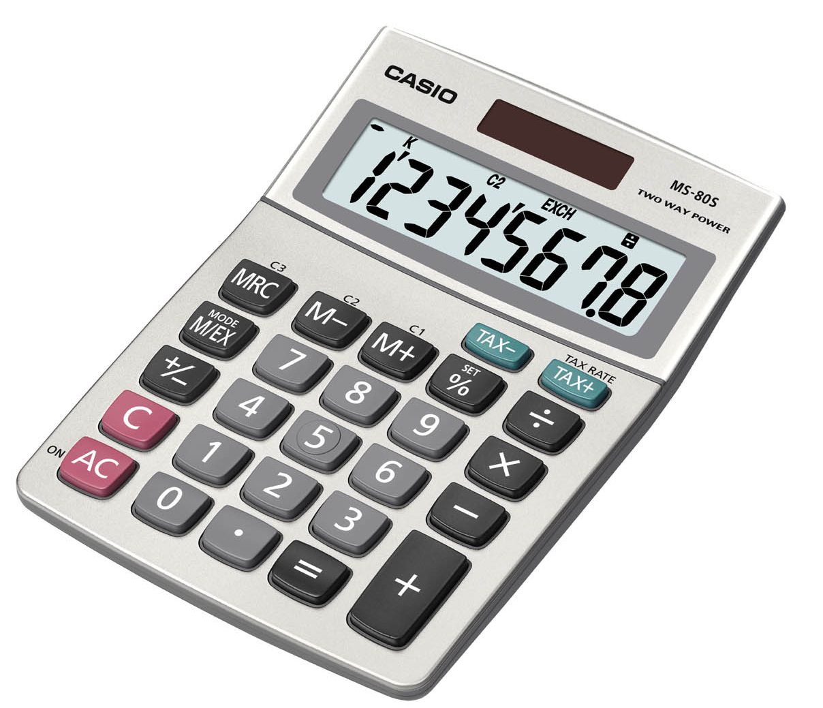
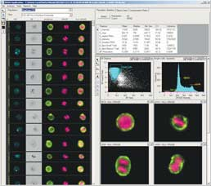

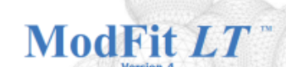
Why Use FCS Express
Technology Convergence
The need for convergence
Other Cytometry
Analysis Software
®
Amnis

Slide 3
Why is consolidation and convergence helpful when it comes to standardization and validation?
Ease of use
  Overly burdensome workflows require extra time, effort, training, and support
Reduce opportunity for errors
  Complex workflows involving many software components may allow human error to creep into results
Validation
  A single software solution is easier for standardization and validation than performing across multiple platforms
Uptake
  A consolidated workflow with one set of standardized tools is easier for researchers to learn and implement than many tools that may work very differently

Slide 4
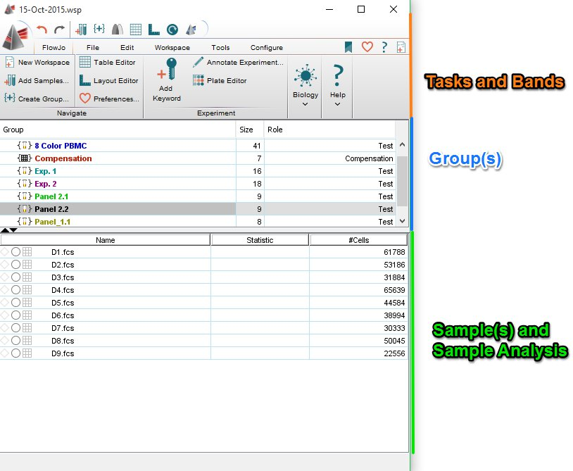
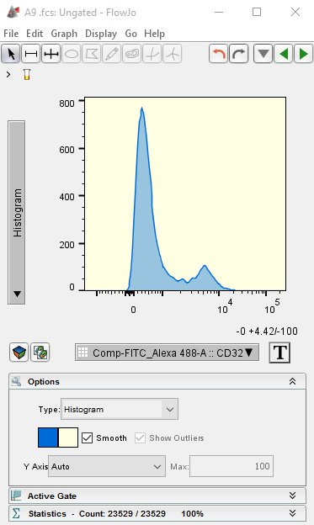
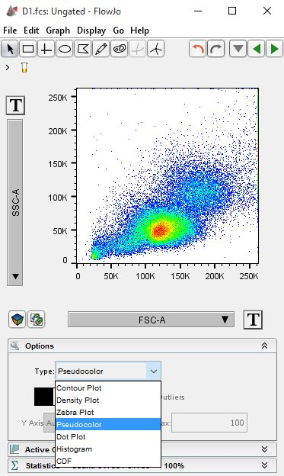


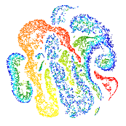
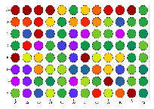
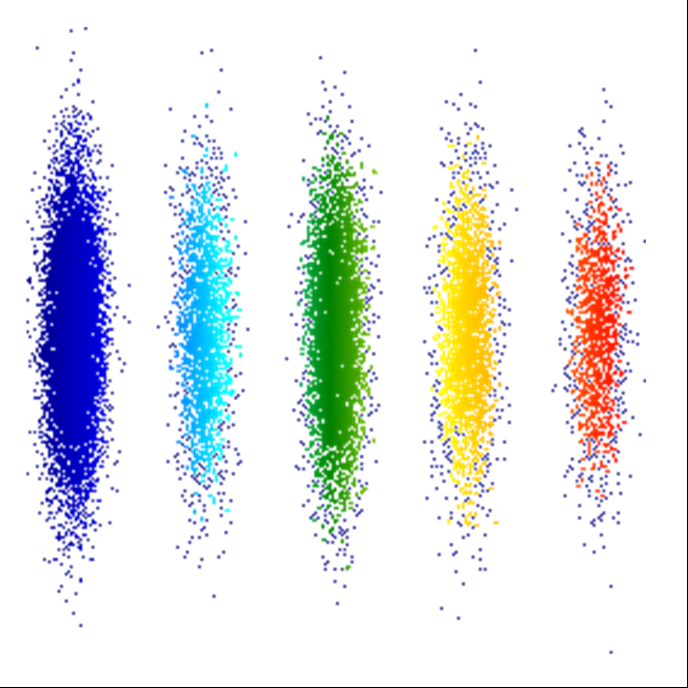
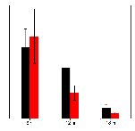




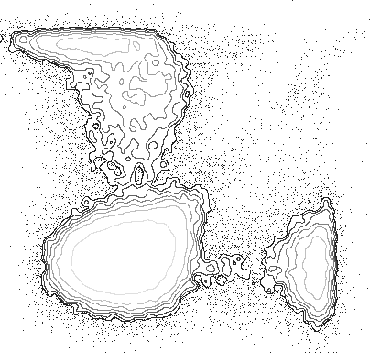
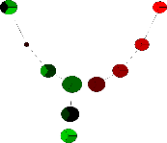

What is the FCS Express difference?
Other flow software programs generally produce plots and basic stats
FCS Express is a fully integrated analysis, statistics, graphing, calibration and reporting tool for producing RESULTS
Final Results
Final Results

Slide 5
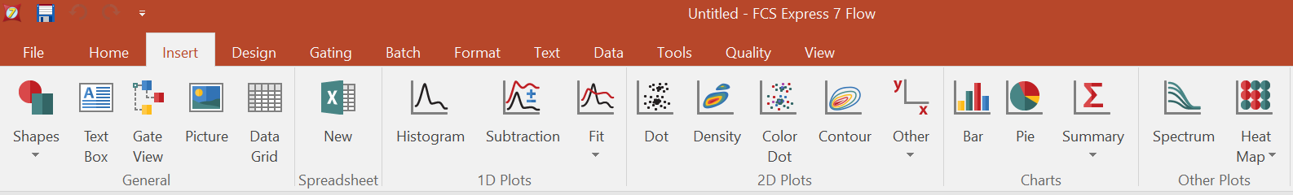
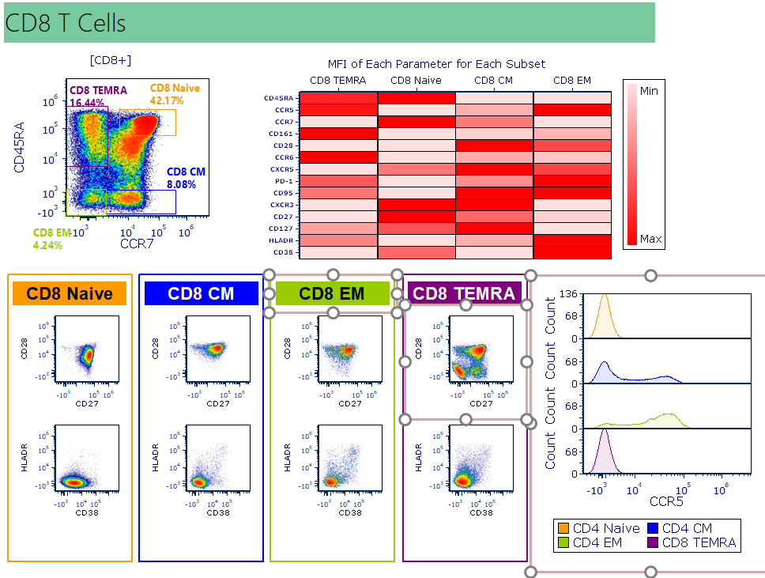
Ease of Use / Uptake
FCS Express looks, feels, and operates similar to Microsoft Office products
Researchers already know how to use the familiar tools in FCS Express
Minimal training involved
Uptake of standardized protocols is easy to achieve

Slide 6

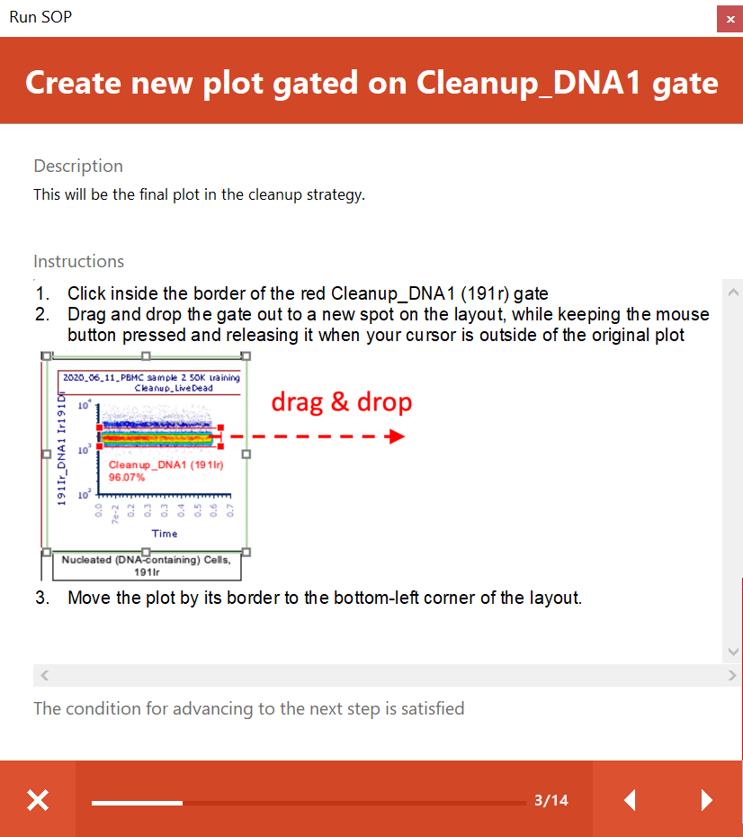
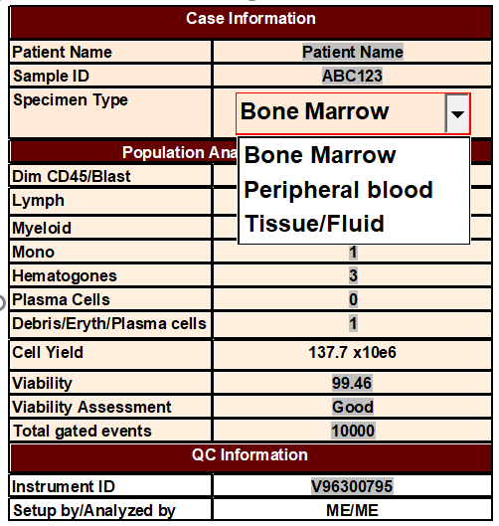
Reduce opportunity for errors
Statistics and meta data are linked dynamically to data and final analysis
Standard Operating Procedures are built-in to FCS Express
Copy and pasting of results to external software packages and LIS/LIMS is not necessary with FCS Express.
  Results are directly integrated or exportable with one click
QC on results within FCS Express
Analysis check points and alerts integrated

Slide 7
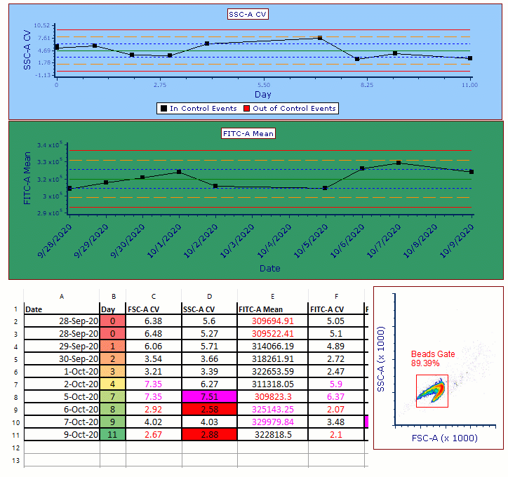
Consolidation of software programs needed to achieve a final result
Integrated spreadsheets with dynamic linking to gates, data, and integrated charts

Slide 8
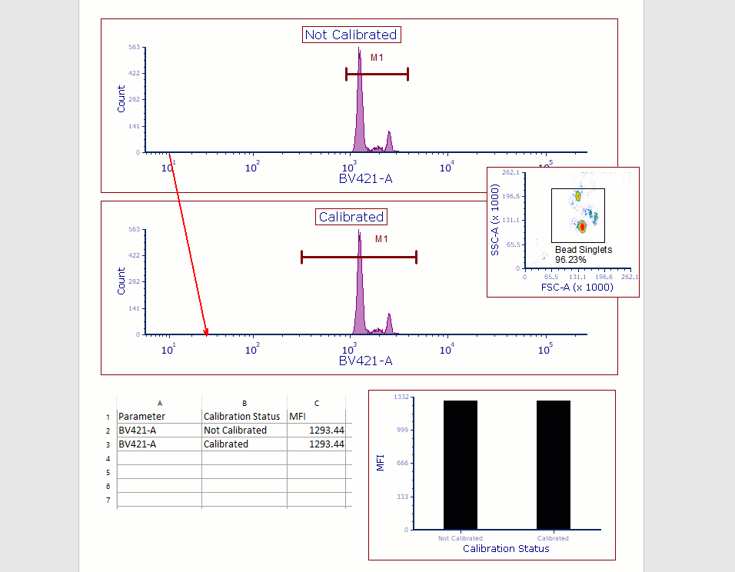
Consolidation of software programs needed to achieve a final result
Channel calibration for MESF provided within FCS Express
No need to move between flow software, Excel, and other tools to arrive at calibrated results.
Results in FCS Express are dynamically linked so all final results provided are fully calibrated if desired.

Slide 9
Validation and Standardization
  A single software solution is easier for standardization and validation than performing across multiple platforms
  FCS Express incorporates all of the tools needed across various software platforms within one package
  FCS Express licensed as RUO or IVD with or without features helping to enable CFR Part 11 Compliance
  Mix and match approach allows labs and networks of labs to easily scale to their validation and compliance needs.
Final Results

Slide 10
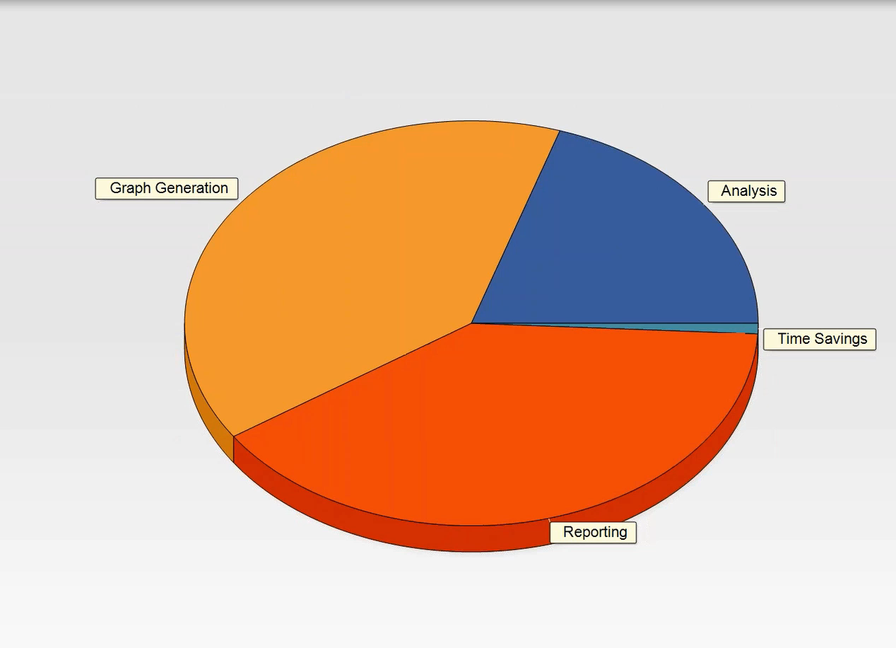
Analysis of raw results can be a minor part of achieving final standardized results

Slide 11
Future Collaborations - Cytapex
Rapid (60 sec/file), standardized, robust, 100% reproducible gating
Mimics your current gating hierarchy
Peer-reviewed superiority to manual and automated approaches
Thresholds automatically adjusted for each sample
Perfect FMO gating
FCS Express & OMIQ compatible output
Entirely customized outputs: reports, figures, spreadsheets
Gating results can be leveraged for discovery
Used in prospective clinical trials & 6/top 10 pharma
  Sole source provider
  Vendor of choice after in head to head competition

Slide 12
Thank You
Utilizing FCS Express to Standardize Cytometry Analysis Protocols and Consolidation of Reporting Results
Sean Burke
De Novo Software
November 18, 2021

