Slide 1
Summary: The following slides may be leveraged to present NIST’s process for updating the Cybersecurity Framework.
Audience: These slides are intended for an audience who is seeking to gain insight into, or emulate, NIST’s collaborative and repeatable process for maintaining and updating the Framework.
Learning Objectives:
Recognize the need for continuous improvement of the Framework
Recognize how NIST engages with the community to gather feedback for future updates
Comprehend the differences between major, minor, and administrative updates
Understand the update cycle, timeline, and activities

Slide 2
Framework Update Process
July 2018
cyberframework@nist.gov

Slide 3
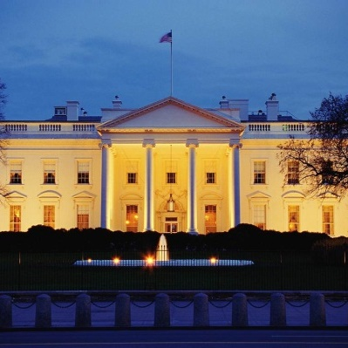
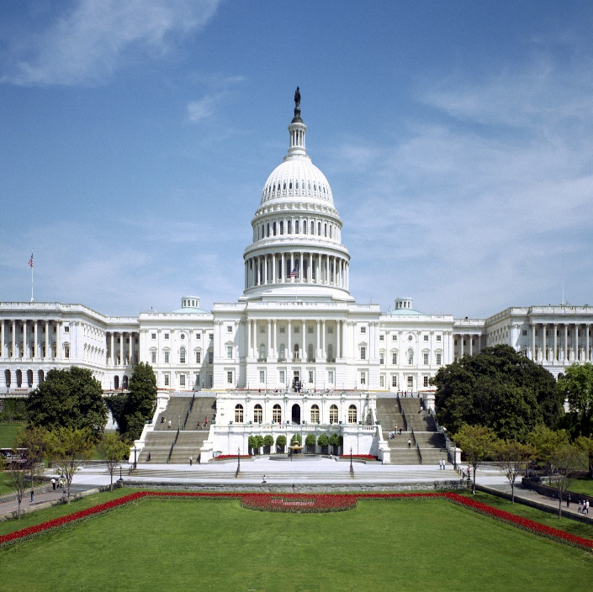
Continued Improvement of Critical Infrastructure Cybersecurity
February 12, 2013
“It is the policy of the United States to enhance the security and resilience of the Nation’s critical infrastructure and to maintain a cyber environment that encourages efficiency, innovation, and economic prosperity while promoting safety, security, business confidentiality, privacy, and civil liberties”
Executive Order 13636
December 18, 2014
Amends the National Institute of Standards and Technology Act (15 U.S.C. 272(c)) to say:
“…on an ongoing basis, facilitate and support the development of a voluntary, consensus-based, industry-led set of standards, guidelines, best practices, methodologies, procedures, and processes to cost-effectively reduce cyber risks to critical infrastructure”
Cybersecurity Enhancement Act of 2014 (P.L. 113-274)
Notes:
The Framework for Improving Critical Infrastructure Cybersecurity will continue to be updated as necessary in accordance with EO 13636 and the Cybersecurity Enhancement Act of 2014.

Slide 4
Coordinating & Consulting Adherence with Cybersecurity Enhancement Act of 2014
(1) In general.—In carrying out the activities under subsection (c)(15), the Director--
``(i) <<NOTE: Coordination.>> coordinate closely and regularly with relevant private sector personnel and entities, critical infrastructure owners and operators, and other relevant industry organizations, including Sector Coordinating Councils and Information Sharing and Analysis Centers, and incorporate industry expertise;
``(ii) <<NOTE: Consultation.>> consult with the heads of agencies with national security responsibilities, sector-specific agencies and
other appropriate agencies, State and local governments, the governments of other nations, and international organizations;
…
``(vii) prevent duplication of regulatory processes and prevent conflict with or superseding of regulatory requirements, mandatory standards, and related processes;
4
Notes:
There are two types of contributors identified in the Cybersecurity Enhancement Act of 2014 defining how individuals can participate in the update of the Framework for Improving Critical Infrastructure Cybersecurity based on their role.

Slide 5
Continued Improvement of Critical Infrastructure Cybersecurity
Update Activities | Engagement
Request for Information – Views on the Framework for Improving Critical Infrastructure Cybersecurity – Dec 2015 | 105 Responses
7th Workshop – Apr 2016 | 653 Physical Attendees, 140 Online Attendees
Draft 1 – Framework Version 1.1 – Released Jan 2017 | -
Request for Comment – Proposed update to the Framework for Improving Critical Infrastructure Cybersecurity – Jan 2017 | 129 Responses
8th Workshop – May 2017 | 517 Physical Attendees, 1528 Online Attendees
Request for Comment – Cybersecurity Framework Version 1.1 – Draft 2 – Dec 2017 | 89 Responses
Framework Version 1.1 – Released April 2018 | -
Notes:
NIST routinely engages industry through three primary activities described below. Activities performed during the update process for v1.1 are described on this slide.
First, NIST continually and regularly engages in community outreach activities by attending and participating in meetings, events, and roundtable dialogs.
Second, NIST solicits direct feedback from industry through requests for information (RFI), requests for comments (RFC), and through the NIST Framework team’s email (cyberframework@nist.gov).
Finally, NIST observes and monitors relevant resources and references - including descriptions of Framework use - published by government, academia, and industry.

Slide 6
Features List Concept Living Document Process
Features List
Sorted by effect on backwards compatibility
Prioritized based on stakeholder importance
Major
Minor
Administrative
Meetings
Events
Roundtable Dialogs
Requests for Information
Requests for Comments
Observations from Resources
Observations from References
Subject Matter Expertise
cyberframework@nist.gov
6
Notes:
NIST catalogs all comments and feature enhancements received on the Framework in a Features List. NIST then categorizes all comments and feature enhancement suggestions on the Features Lists as either Major, Minor, or Administrative comments based on the degree to which implementing the change would impact compatibility with prior versions of the Framework. The features are also prioritized based on their perceived importance to stakeholders.
The Framework is a living document and is intended to be updated based on industry feedback and recommendations as well as NIST’s continued goal to inform the community. The Features List aides NIST in properly tracking, adjudicating, and incorporate comments into updates as appropriate.

Slide 7
Milestones Three Year Minimum Update Cycle
New Version?
3 years from last Final Update
Features List
(Version A)
Major
Minor
Administrative
Features List
(Version B)
Major
Minor
Administrative
Features List
(Version C)
Major
Minor
Administrative
Draft Framework Update
Publish Framework Update
X
Annual Conference
Annual Conference
Annual Conference
Annual Conference
7
Notes:
The Framework update process integrates the NIST Cybersecurity Risk Management Conference into a public-private dialog that asks stakeholders every three years:
Is it an appropriate time for an update, and if so
What would you like to see in that update?
Stakeholder input helps NIST determine whether an update is warranted and what type of update is needed (major, minor, administrative).
If NIST learns that industry is not prepared for a new update, or sufficient features have not been identified to warrant an update, NIST continues to collect comments and suggestions for feature enhancement, bringing those topics to the annual Cybersecurity Risk Management Conference for discussion, until such a time that an update is warranted.
If the Framework stakeholders believe an update is needed, NIST discerns the type of update required and creates a Draft Framework Update. The Draft Framework Update is published before the annual Cybersecurity Risk Management conference. During the conference, NIST establishes tracks to allow conference participants an opportunity comment on the proposed draft.
With stakeholder disposition understood from the most recent conference, NIST then publishes a final version of the Framework. This process repeats over time to refine, clarify, and enhance the Framework.

Slide 8
Framework Versioning Process Living Document Process
What? | Who? | Administrative | Minor | Major
Nominate Features for Consideration | All* | Happens through dialog and cyberframework@nist.gov | Happens through dialog and cyberframework@nist.gov | Formal Request for Information through Federal Register, 60 day comment period, and Published Comment Analysis
Review Nominated Features | NIST** | Unless otherwise requested by stakeholders, this process initiates three years from the publication date of the last final version
(Request for) Comment on Proposed Features | Stakeholders | Not Required | Informal comments, 30 day comment period | Formal Request for Comment through Federal Register, 60 day comment period, and Published Comment Analysis
Host Workshop [NIST] to Discuss Proposed Features | All | Not Required | Required
Publish Workshop Summary of Next Steps | NIST | Not Required | Required
Draft Down-Selected Features into Proposed Update | NIST | Required | Required
(Request for) Comment on Proposed Update | Stakeholders | Informal comments, 30 day comment period
Host Workshop [NIST] to Discuss Proposed Update | All | Not required for Administrative Version | Required
Publish Workshop Summary of Next Steps | NIST | N/A | Required
Publish Final Update | NIST | Three month minimum versioning timeline | One year & six month minimum versioning timeline | One year & six month minimum versioning timeline
* Includes NIST and Framework stakeholders ** An opportunity to confer with collaborators, as defined in CEA of 2014
8
Notes:
This table describes the steps NIST takes to update the Framework in additional detail and demonstrates the difference in process between administrative, minor, and major updates.

Slide 9
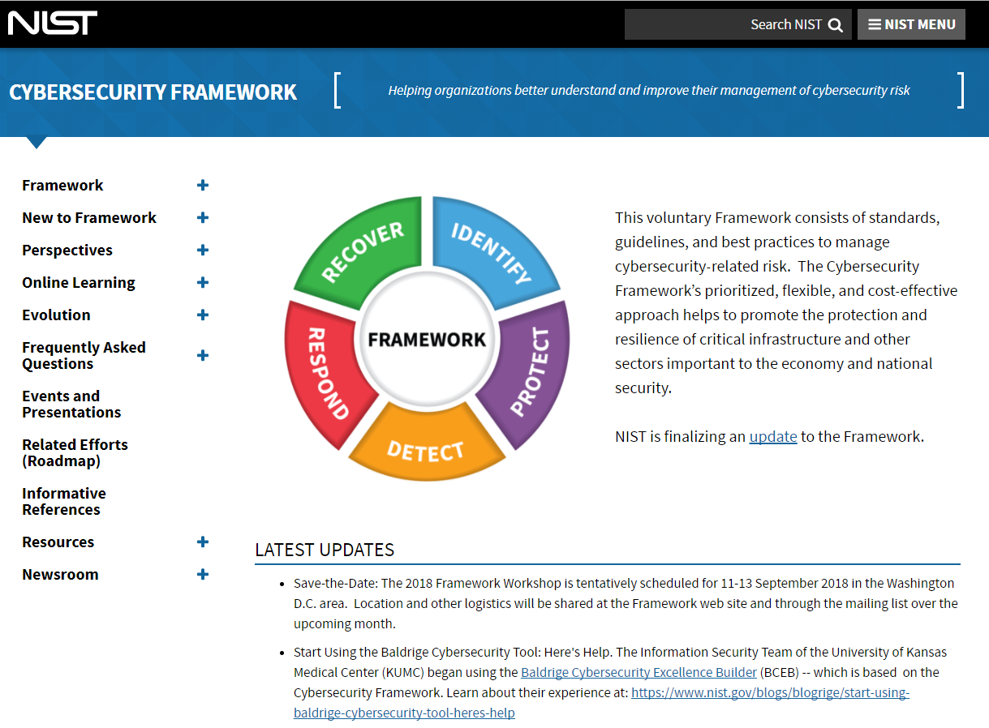
Resources
Framework for Improving Critical Infrastructure Cybersecurity and related news and information:
www.nist.gov/cyberframework
Additional cybersecurity resources:
http://csrc.nist.gov/
Questions, comments, ideas:
cyberframework@nist.gov
9

