Slide 1

Lessons Learned in Using the Baldrige Cybersecurity Excellence Builder with the Cybersecurity Framework
The Cybersecurity Framework “Next Up!” Webcast Series
July 2018
cyberframework@nist.gov

Slide 2
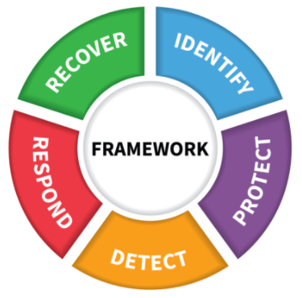
Objective and Agenda
The Cybersecurity Framework “Next Up!” Webcast Series
Objective: Learn how the University of Kansas Medical Center applied the Baldrige Cybersecurity Excellence Builder and the Cybersecurity Framework
Cybersecurity Framework Basics
  www.nist.gov/cyberframework
Baldrige Cybersecurity Excellence Builder Overview
  https://www.nist.gov/baldrige/products-services/baldrige-cybersecurity-initiative
University of Kansas Medical Center Implementation
  http://www.kumc.edu/
Discussion and Question-Answer Time

Slide 3
Our Guests
The Cybersecurity Framework “Next Up!” Webcast Series
Ellen Garshick
Program Analyst
Baldrige Performance Excellence Program
Steffani Webb
Vice Chancellor of Administration
University of Kansas Medical Center

Slide 4
Notes to Viewers
The Cybersecurity Framework “Next Up!” Webcast Series
Questions can be send throughout the session to cyberframework@nist.gov or Twitter #CyberFramework
Pre-registration is appreciated, but not necessary. Additional viewers are welcome at https://www.nist.gov/news-events/events/2018/07/cybersecurity-framework-webcast-next
The presentation will be recorded for future playback. Those videos will be available with closed captioning in late July or early August 2018.

Slide 5
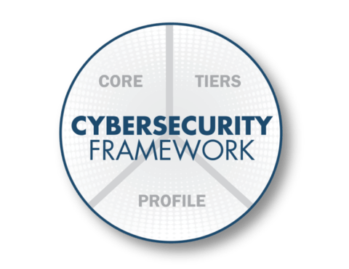
Cybersecurity Framework Components
Three Basic Ways to Support Your Cybersecurity Risk Management
    Cybersecurity outcomes and informative references
    Enables
    communication
    of cyber risk across
    an organization
    Describes how cybersecurity risk is managed by an organization and
    degree the risk management
    practices
    exhibit key characteristics
    Aligns industry standards and best practices to the Framework Core in an implementation scenario
    Supports prioritization and measurement while factoring in business needs

Slide 6

Implementation Tiers
Evaluating Cybersecurity Risk Management Practices
 | 1 | 2 | 3 | 3 |  | 4
 | Partial | Risk Informed | Repeatable | Repeatable |  | Adaptive
Risk Management Process | The functionality and repeatability of cybersecurity risk management
Integrated Risk Management Program | The extent to which cybersecurity is considered in broader risk management decisions
External Participation | The degree to which the organization: monitors and manages supply chain risk benefits my sharing or receiving information from outside parties

Slide 7
Core
A Catalog of Cybersecurity Outcomes
 | Function | Understandable by everyone Applies to any type of risk management Spans both prevention and reaction Defines the entire breadth of cybersecurity Decomposes to pair with detailed treatments of cybersecurity
What processes and assets need protection? | Identify
What safeguards are available? | Protect
What techniques can identify incidents? | Detect
What techniques can contain impacts of incidents? | Respond
What techniques can restore capabilities? | Recover

Slide 8
Profile
Customizing Cybersecurity Framework
Ways to think about a Profile:
A customization of the Core for a given sector, subsector, or organization
A fusion of business/mission logic and cybersecurity outcomes
Identify
Protect
Detect
Respond
Recover
An alignment of cybersecurity requirements with operational methodologies
A basis for assessment and expressing target state
A decision support tool for cybersecurity risk management

Slide 9
Baldrige Cybersecurity Excellence Builder
What is it?

Slide 10
Systems Perspective
All parts of your organization working in harmony
Understand business factors & organizational priorities underlying your cybersecurity program.
Hire & retain the cybersecurity workforce you need. Engage & empower your workforce to achieve objectives.
Set clear strategic priorities/objectives related to cybersecurity.
Understand how leaders’ actions guide & sustain cyber risk management.
Track results and use them to evaluate & improve policies & operations.
Understand and meet customers’ requirements & expectations for cybersecurity.
Measure & analyze cybersecurity outcomes that matter.
Design and manage effective and efficient cybersecurity operations.

Slide 11
Example – Category 5: Workforce

Slide 12
The Builder and the Framework Core
Organized by the parts of the system
    Cybersecurity activities and informative references, organized around particular outcomes
    Enables communication of cyber risk across an organization

Slide 13
The Builder, Tiers, and Profiles
How well are you achieving the chosen tier and profile? What should you improve?
    Describes how cybersecurity risk is managed by an organization and
    degree the risk management
    practices
    exhibit key characteristics
How effective and efficient are your cybersecurity-related processes? How good are your results?
    Aligns industry standards and best practices to the Framework Core in an implementation scenario
    Supports prioritization and measurement while factoring in business needs
How well are you achieving this scenario? Where do you need to improve?

Slide 14
Context, Processes, and Results
Business factors; strategic situation
Processes you use
Results you achieve
Rubric: How are you doing?

Slide 15
Example - Detection of Cyber Events
C.1a(4): What are your organization’s major physical and virtual assets, including its data, knowledge, devices, systems, facilities, and equipment? What are your priorities for protecting these assets, based on their criticality and business value?
6.1(c): Detection of Cybersecurity Events
(1) How do you detect anomalies in a timely manner and assess the impact of cybersecurity events?
(2) How do you monitor information systems and assets at discrete intervals to identify cybersecurity events and verify the effectiveness of protective measures?
(3) How do you maintain and test detection processes and procedures to ensure timely and adequate awareness of anomalies?
7.1, Q2: What are your results for the detection of cybersecurity events?
Organizational Context
Processes you use
Results you achieve

Slide 16
Assessing Processes: “ADLI”
Approach
Deployment
Learning
Integration
Do you have a process for accomplishing this?
How consistently are your key processes used where they should be used?
Do you improve the process regularly, and share the improvements?
How well do your processes reflect your organization’s needs and goals?
Is the process well-ordered and repeatable?

Slide 17
Assessing Results: “LeTCI”
Levels
Trends
Comparisons
Integration
What is your current performance?
Are the results improving, staying the same, or getting worse?
How does your performance compare with that of others?
Are you tracking important results?
Are you using the results to make decisions?

Slide 18
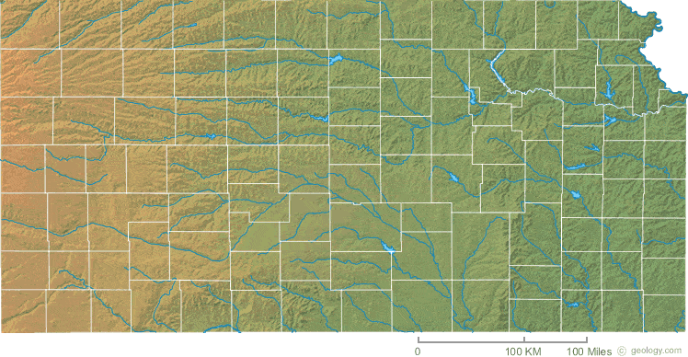
The University of Kansas Medical Center
Our mission is to improve lives and communities in Kansas and beyond through innovation in education, research and healthcare.
Our vision is to lead the nation in caring, healing, teaching and discovering.
Schools of Medicine, Nursing, and Health Professions
This shall be
a place where
the people of
Kansas and
areas surrounding
may enjoy the best
medical care
available anywhere.
- Simeon Bell, M.D. - 1905
Salina
Kansas City
Wichita

Slide 19
How InfoSec supports the organization
Don’t limit
yourself,
discover
new areas of
expertise.
- Sunday Adelaja
Use your passion
and expertise to
provide long term
value and innovative solutions for your [company].
- Benjamin Kofi Quansah
We support the mission and vision by enabling the use of technology in a manner that ensures availability, confidentiality, integrity, reliability, and security of KUMC’s information resources.
We strive to secure the organization in a manner that does not impede or compromise business operations.
We focus on adding value to the education, research, and health care operations.

Slide 20

Why we used the BCEB
To help with program development for our new Office of Information Security
To help us address a wide variety of specific (and serious) challenges
To contribute to the InfoSec community
To help the technically focused InfoSec team understand “the business” that they are serving and supporting
To foster a strong customer focus in the InfoSec team
A rising tide
raises all boats.
- John F. Kennedy

Slide 21
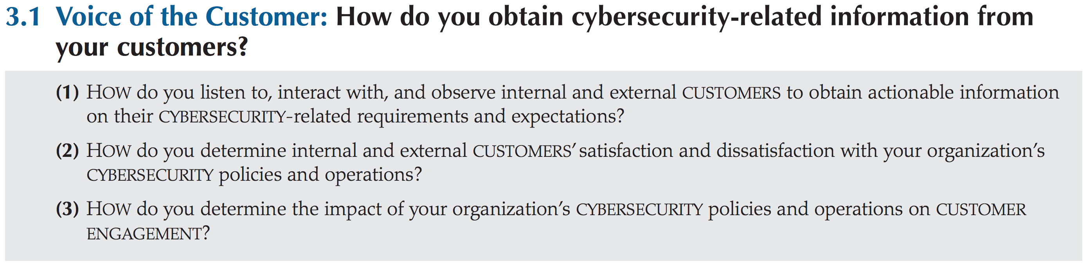
21

Slide 22
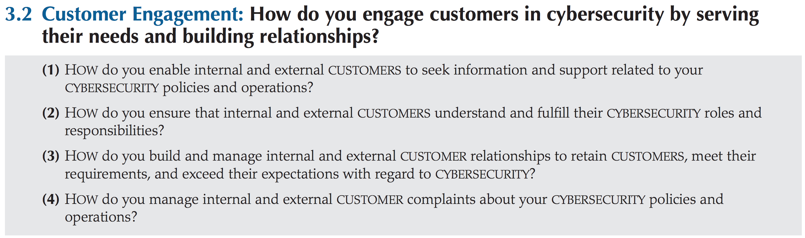
22

Slide 23
How we began
Our Executive Vice Chancellor and I held a kickoff meeting to set the stage and emphasize the importance of InfoSec to our organization.
We emphasized that this wasn’t a test or a “gotcha” exercise and that this would be enjoyable and worth the time and effort.
The InfoSec team met for two hours weekly over six months to answer the organizational context questions and work through the questions in the process categories and results categories.
Associate Vice Chancellor for Organizational Improvement led us through these questions and then developed a comprehensive self-assessment report based on this effort.
Few people
know how to
take a walk. The
qualifications are
endurance, plain
clothes, old shoes,
an eye for nature,
good humor, vast
curiosity, good speech,
good silence and
nothing too much.
- Ralph Waldo Emerson

Slide 24
Was it worth the time and effort?
Yes!!! A lot of cross-sharing and learning has resulted from the process and continues the more we use it.
This has moved us beyond the technical and controls-focused elements of the CSF and addressed the process and delivery side of the house, bridging what had been a major gap.
The gaps we identified have resulted in action plans, funding opportunities, and deep alignment to the business.
Excerpts of our work have been useful in InfoSec strategic planning, budget requests, and communicating to our key customers and key partners what we need from them and how our program works.
The creation
of a thousand
forests is in
one acorn.
- Ralph Waldo Emerson

Slide 25
What else we got from this effort
An honest assessment of where we are and where we want to be; a baseline to measure against in the future.
A paradigm shift – a major change in how we think about and approach our work – that continues to evolve.
A self-assessment document that will be revisited and updated as the program matures.
A new, business-oriented language to use in communicating and working with partners and customers.
A boost in clarity, empowerment, and morale for the team.
A path forward!
Do not go
where the path
may lead;
go instead where
there is no path
and leave a trail.
- Ralph Waldo Emerson

Slide 26
ROI
Short-term ROI is more qualitative; long-term value will be more quantitative.
We are now better equipped to support our organization’s missions.

Slide 27
What’s next
We will make a second pass through the BCEB questions and our self-assessment document, this time including key customers and stakeholders to validate our thoughts and improve our understanding of their needs.
We will update the organizational context and self-assessment document and use them as a foundation to develop a strategic plan and action plans for our program.

Slide 28
A few closing thoughts
Many InfoSec staff are deeply analytical and can get stuck in the analysis paralysis problem. The BCEB is helpful in facilitating the analysis and inspiring decisions and action.
Greatness doesn’t happen overnight -- it is a process. BCEB is all about process and process improvement.
You can get started with no prior experience.
This is really kind of fun!
Do not wait until the conditions are perfect to begin. Beginning makes the conditions perfect. – Alan Cohen
You don’t
have to be
great to get
started, but you
do have to get
started to be great.
-James Clear

Slide 29
QUESTIONS
&
DISCUSSION
The reward of a thing well done
is having done it.
- Ralph Waldo Emerson
29

Slide 30
Resources
The Cybersecurity Framework “Next Up!” Webcast Series
Framework for Improving Critical Infrastructure Cybersecurity
  www.nist.gov/cyberframework
The Baldrige Cybersecurity Initiative
  https://www.nist.gov/baldrige/products-services/baldrige-cybersecurity-initiative
University of Kansas Medical Center
  http://www.kumc.edu/
Questions and Thoughts
  cyberframework@nist.gov

Slide 31
Upcoming
The Cybersecurity Framework “Next Up!” Webcast Series
NIST Cybersecurity Risk Management conference
November 7-9, 2018
Renaissance Baltimore Harborplace
Registration now open
https://www.nist.gov/news-events/events/2018/11/nist-cybersecurity-risk-management-conference
31st Baldrige Quest for Excellence conference
April 7-10, 2019
National Harbor, Maryland, Gaylord National Harbor
https://www.nist.gov/baldrige/conferences

Slide 32
Ways to Share Framework Best Practices
The Cybersecurity Framework “Next Up!” Webcast Series
Share your Resources with others in coordination with NIST
Publish Success Stories of your Framework implementation in coordination with NIST
Submit an idea for the NIST Call for Speakers
cyberframework@nist.gov for all NIST
coordination and communication

