Slide 1
PCEA
Standards & Testing
Recommendations
Technical guidelines development committee
February 9th, 2016

Slide 2
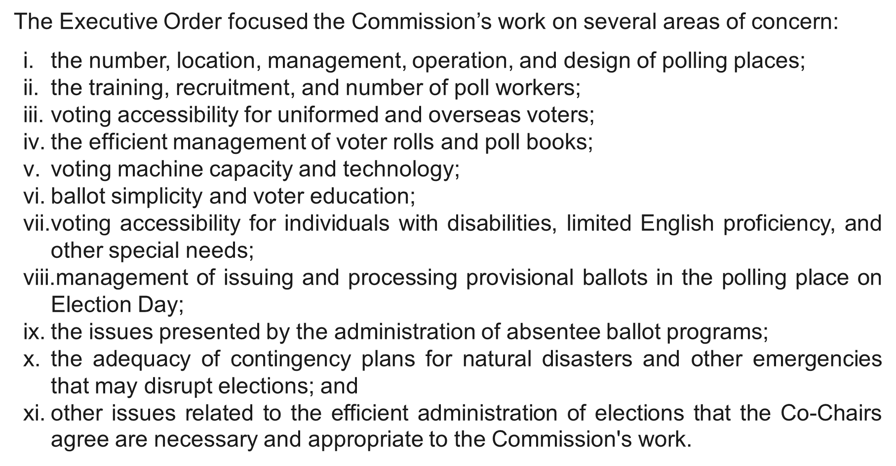

Slide 3
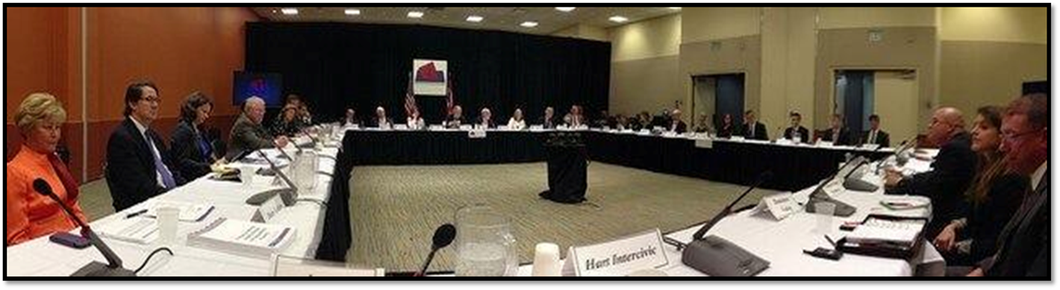
PCEA
Standards: What we heard
  Stifle innovation
  Too prescriptive
  Too voluminous
  Difficult to understand
  Out dated
  Lack of EAC Commissioners hinder advances

Slide 4
PCEA
Testing: What we heard
  Too costly
  Takes too long
  Issues with “nimbleness” of modifications
  Desire for clarity in testing

Slide 5
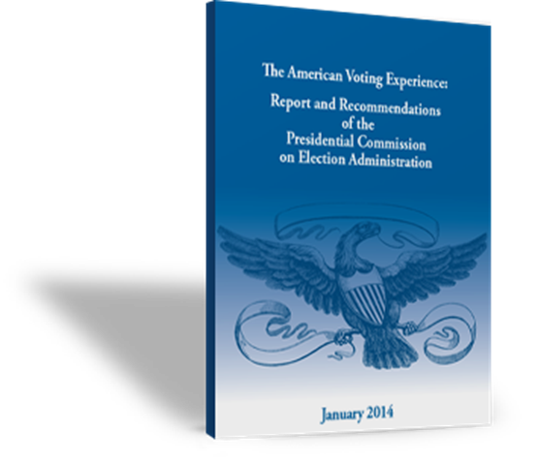
PCEA
Standard Related Recommendations
  Reform of the standard-setting and certification of voting equipment.
  Minimum, quorum of EAC Commissioners not necessary for standard setting.
  Let the Boards continue their work.

Slide 6
PCEA
Certification Related Recommendations
  Should have ability to allow for innovation and testing of new methods and ideas rather than merely perpetuating status quo.
  Certification should be done so that changes & modifications can be done quickly.

Slide 7
“Reform of the standard-setting and certification of voting equipment”

Slide 8
New path for the VVSG:
  Re-evaluation of scope
  Re-envisioning creation process
  Re-inventing format & application

Slide 9
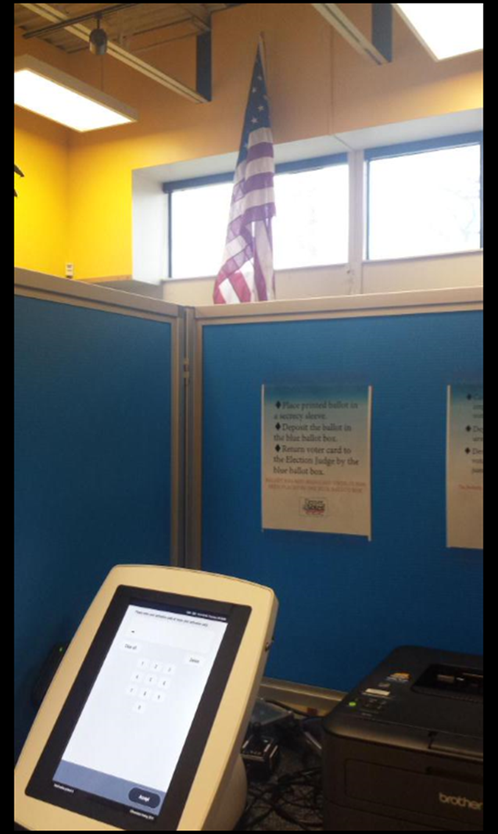
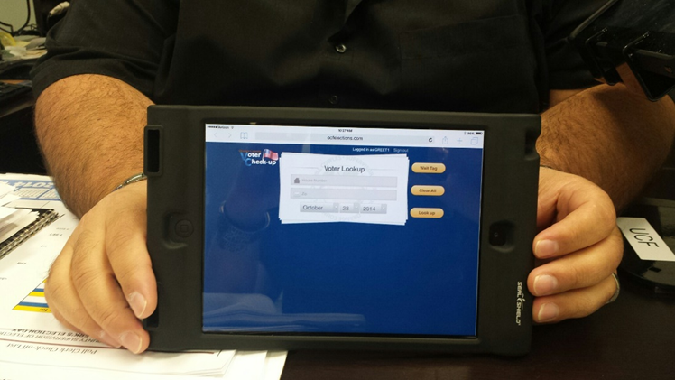
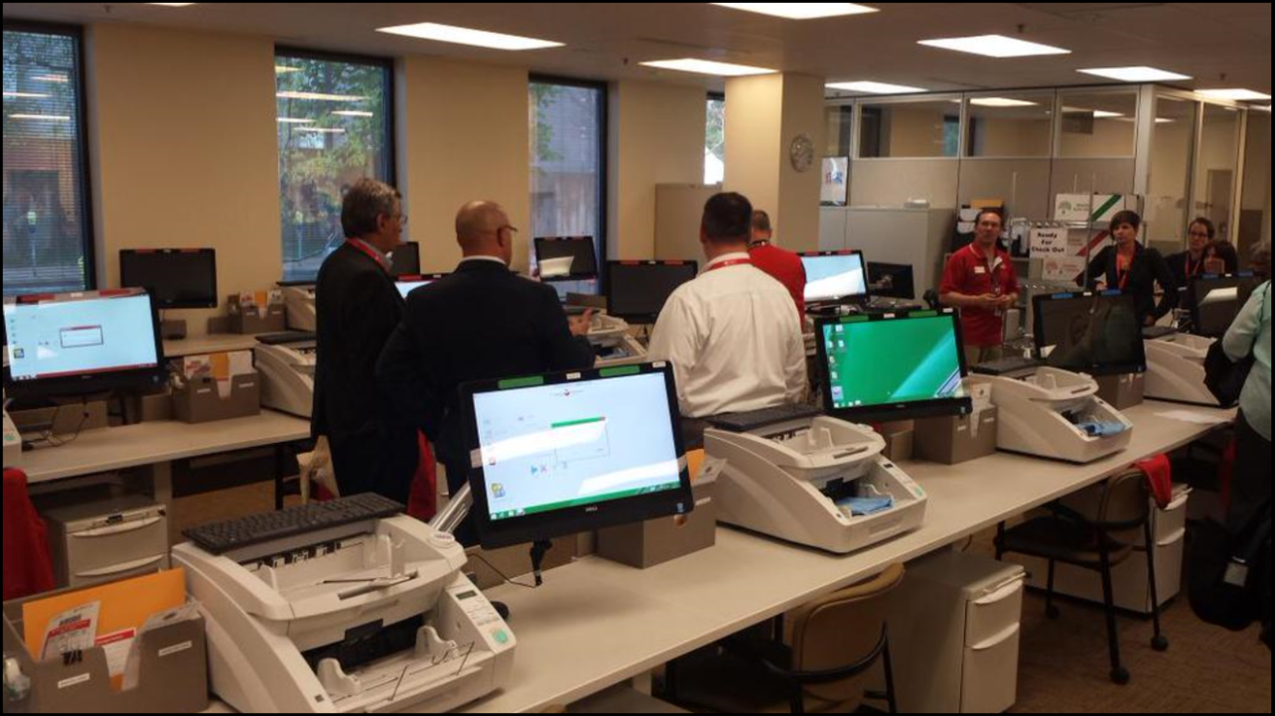
Re-evaluation
New working group format lends itself to the re-evaluation of what the current voting environment is.
We now have
  electronic ballot delivery
  growing EPB & BOD usage
  smart technology & COTS being used in the field

Slide 10
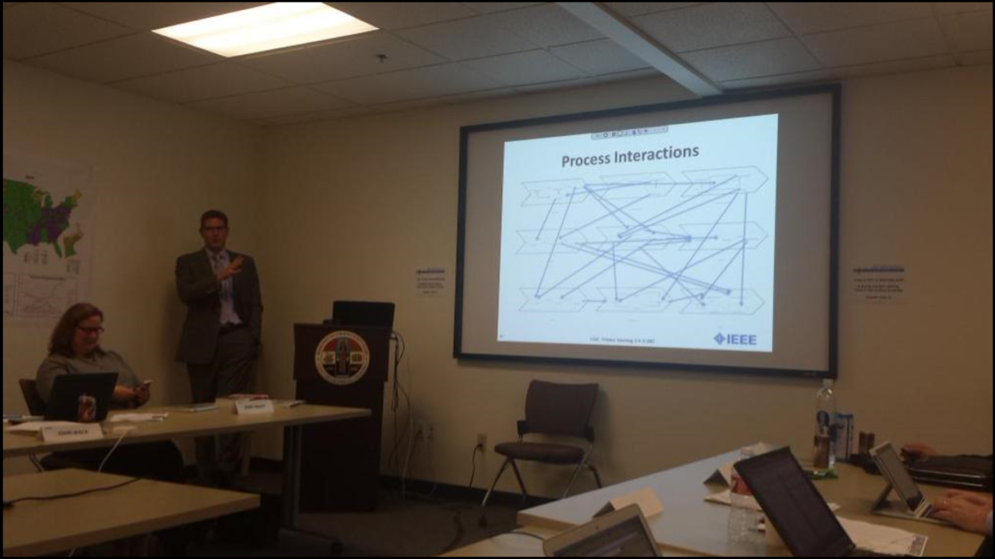
Re-Evaluation: Elections are complex, and continue to get more complicated with each passing legislative session or court case.

Slide 11
Getting an accurate pulse of where we are at is important, although it can seem like we are continually rehashing some of the same issues.

Slide 12
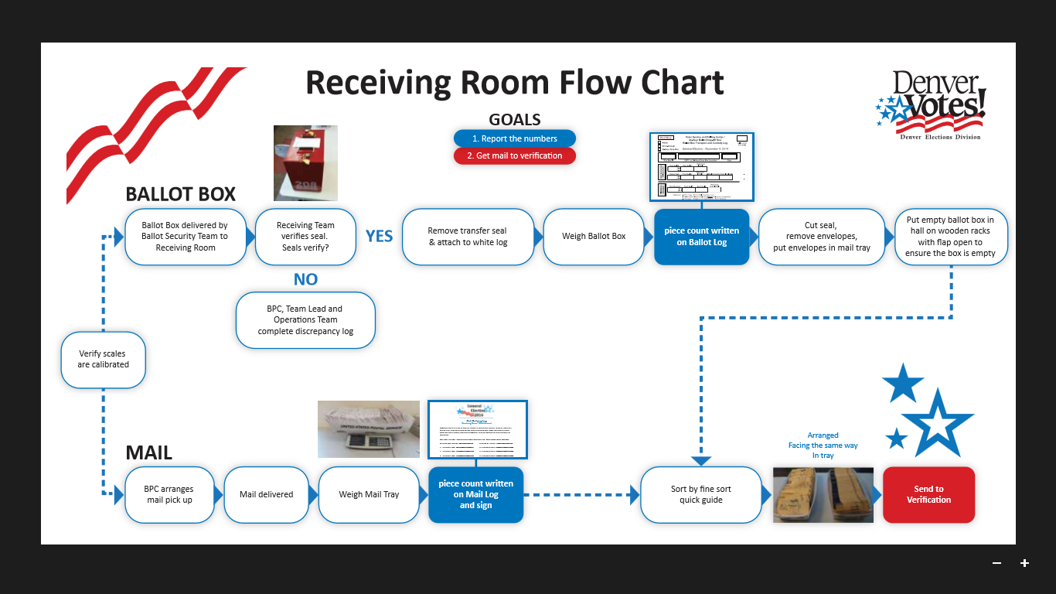
BPC gathered people together to discuss some of these same questions in Nashville back in December.

Slide 13
Re-Envisioning the Process
The working-group approach to the standard creation is an attempt to shift the lengthy delays at the end of the process with the burst of interest that seems to “enjoy”, to the beginning of the work and channel those energies productively with the hope of truncating the time needed.
This relies heavily upon participation.

Slide 14
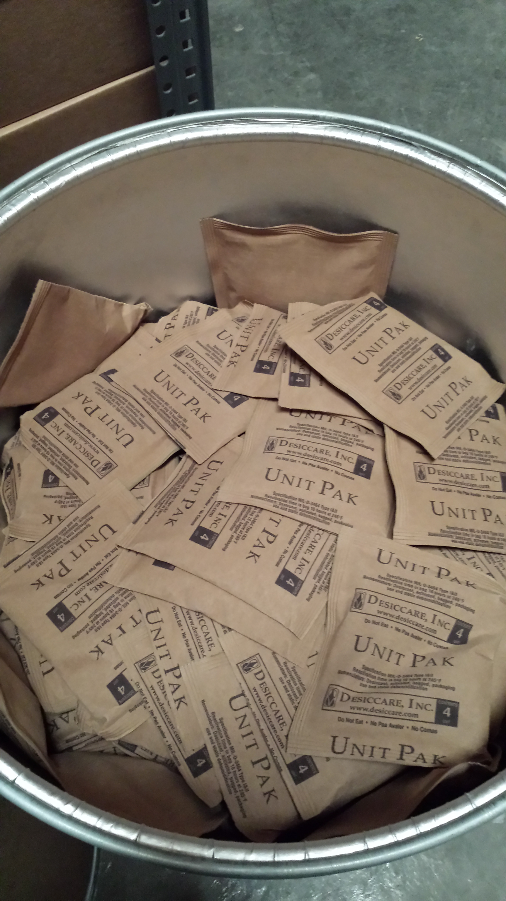
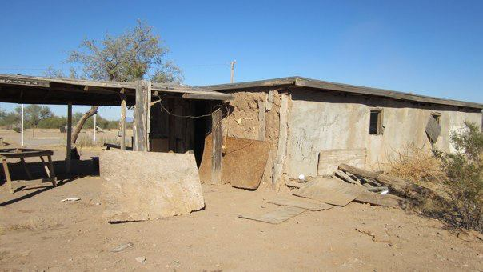
Processes are varied across the country, some deal with humidity and others static, but all are counting ballots.
Orange Co, FL
Maricopa Co, AZ

Slide 15
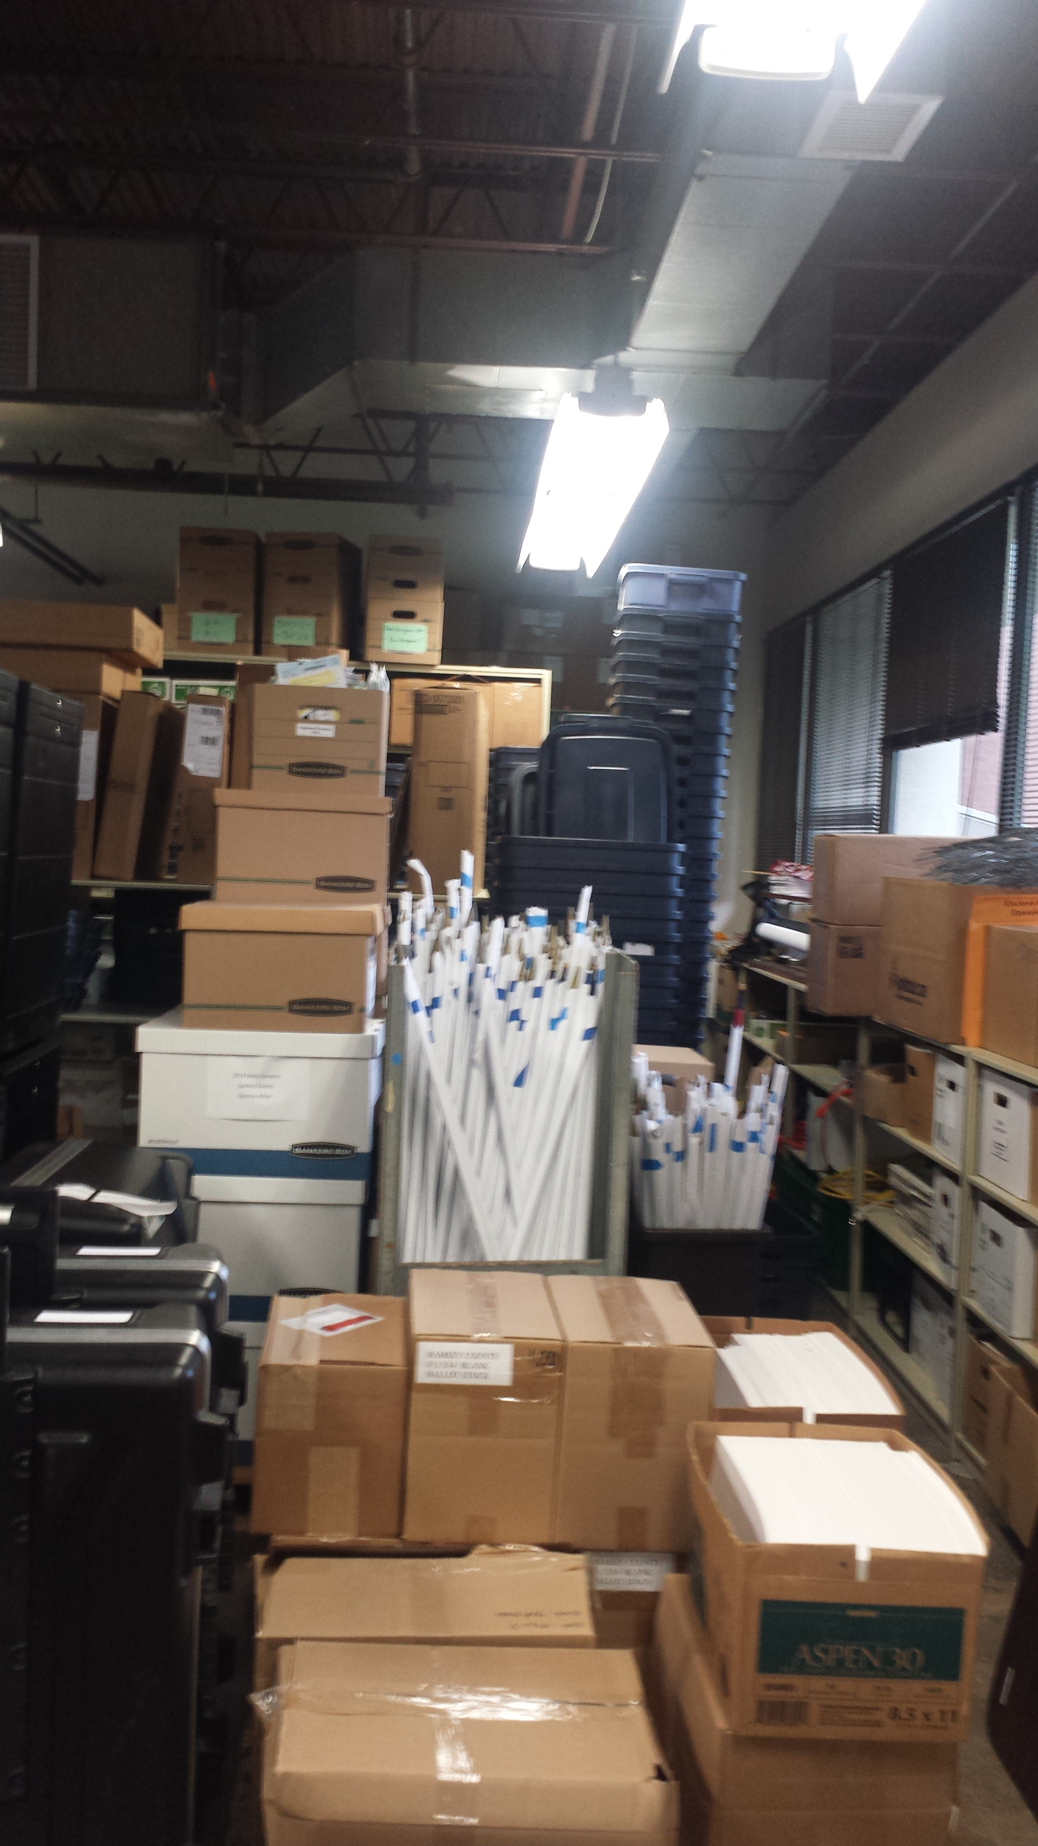
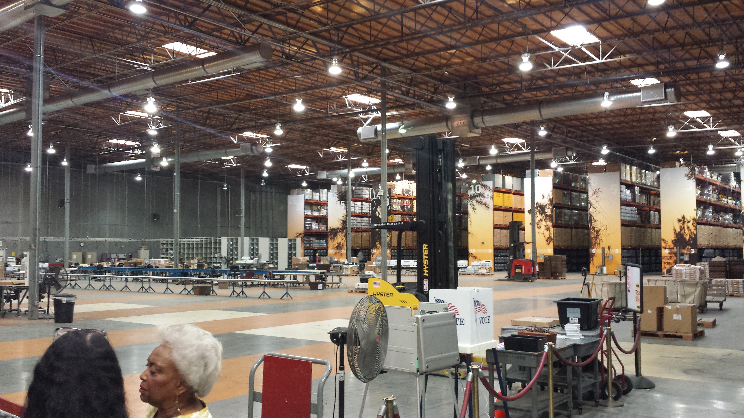
Some storage is minimal, others are vast.
Ramsey Co, MN
Los Angeles Co, CA

Slide 16
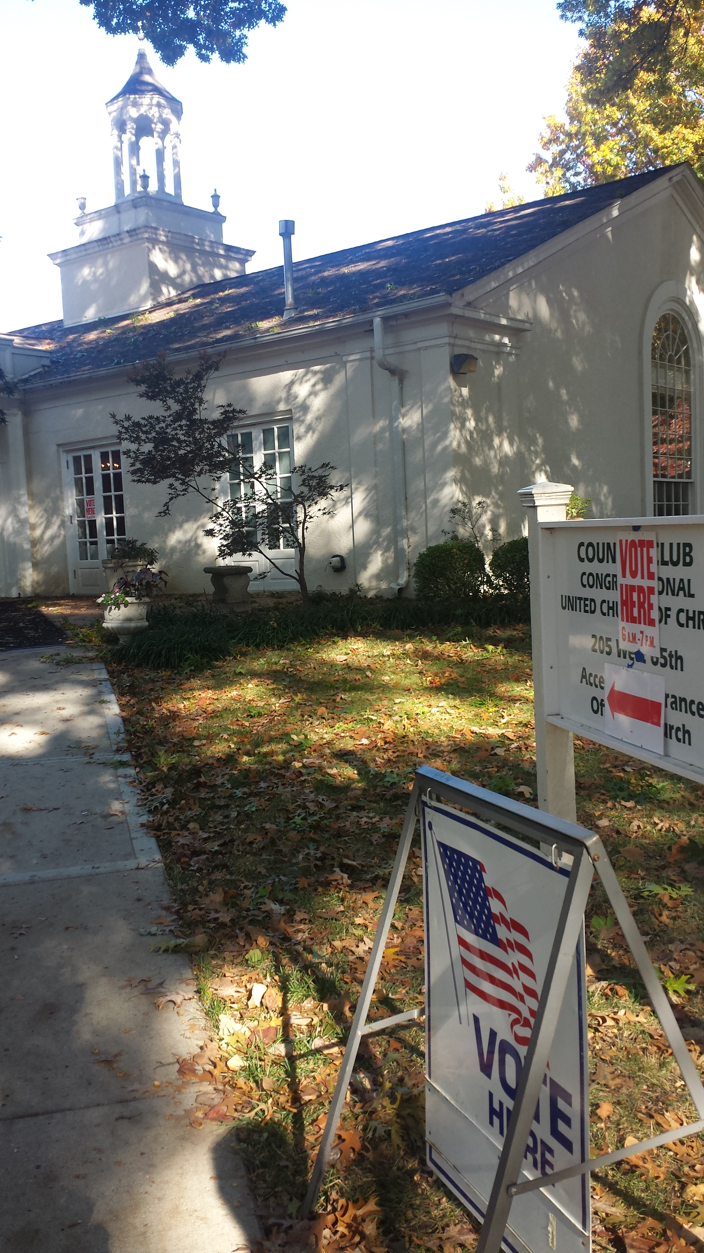
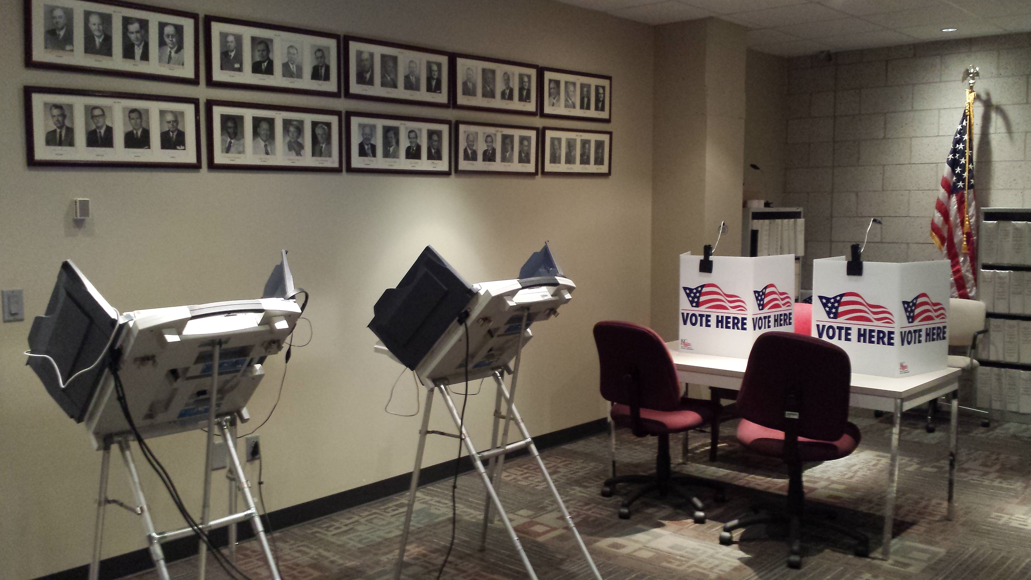
Some ballots are cast on Election Day, some before.
Kansas City, MO

Slide 17
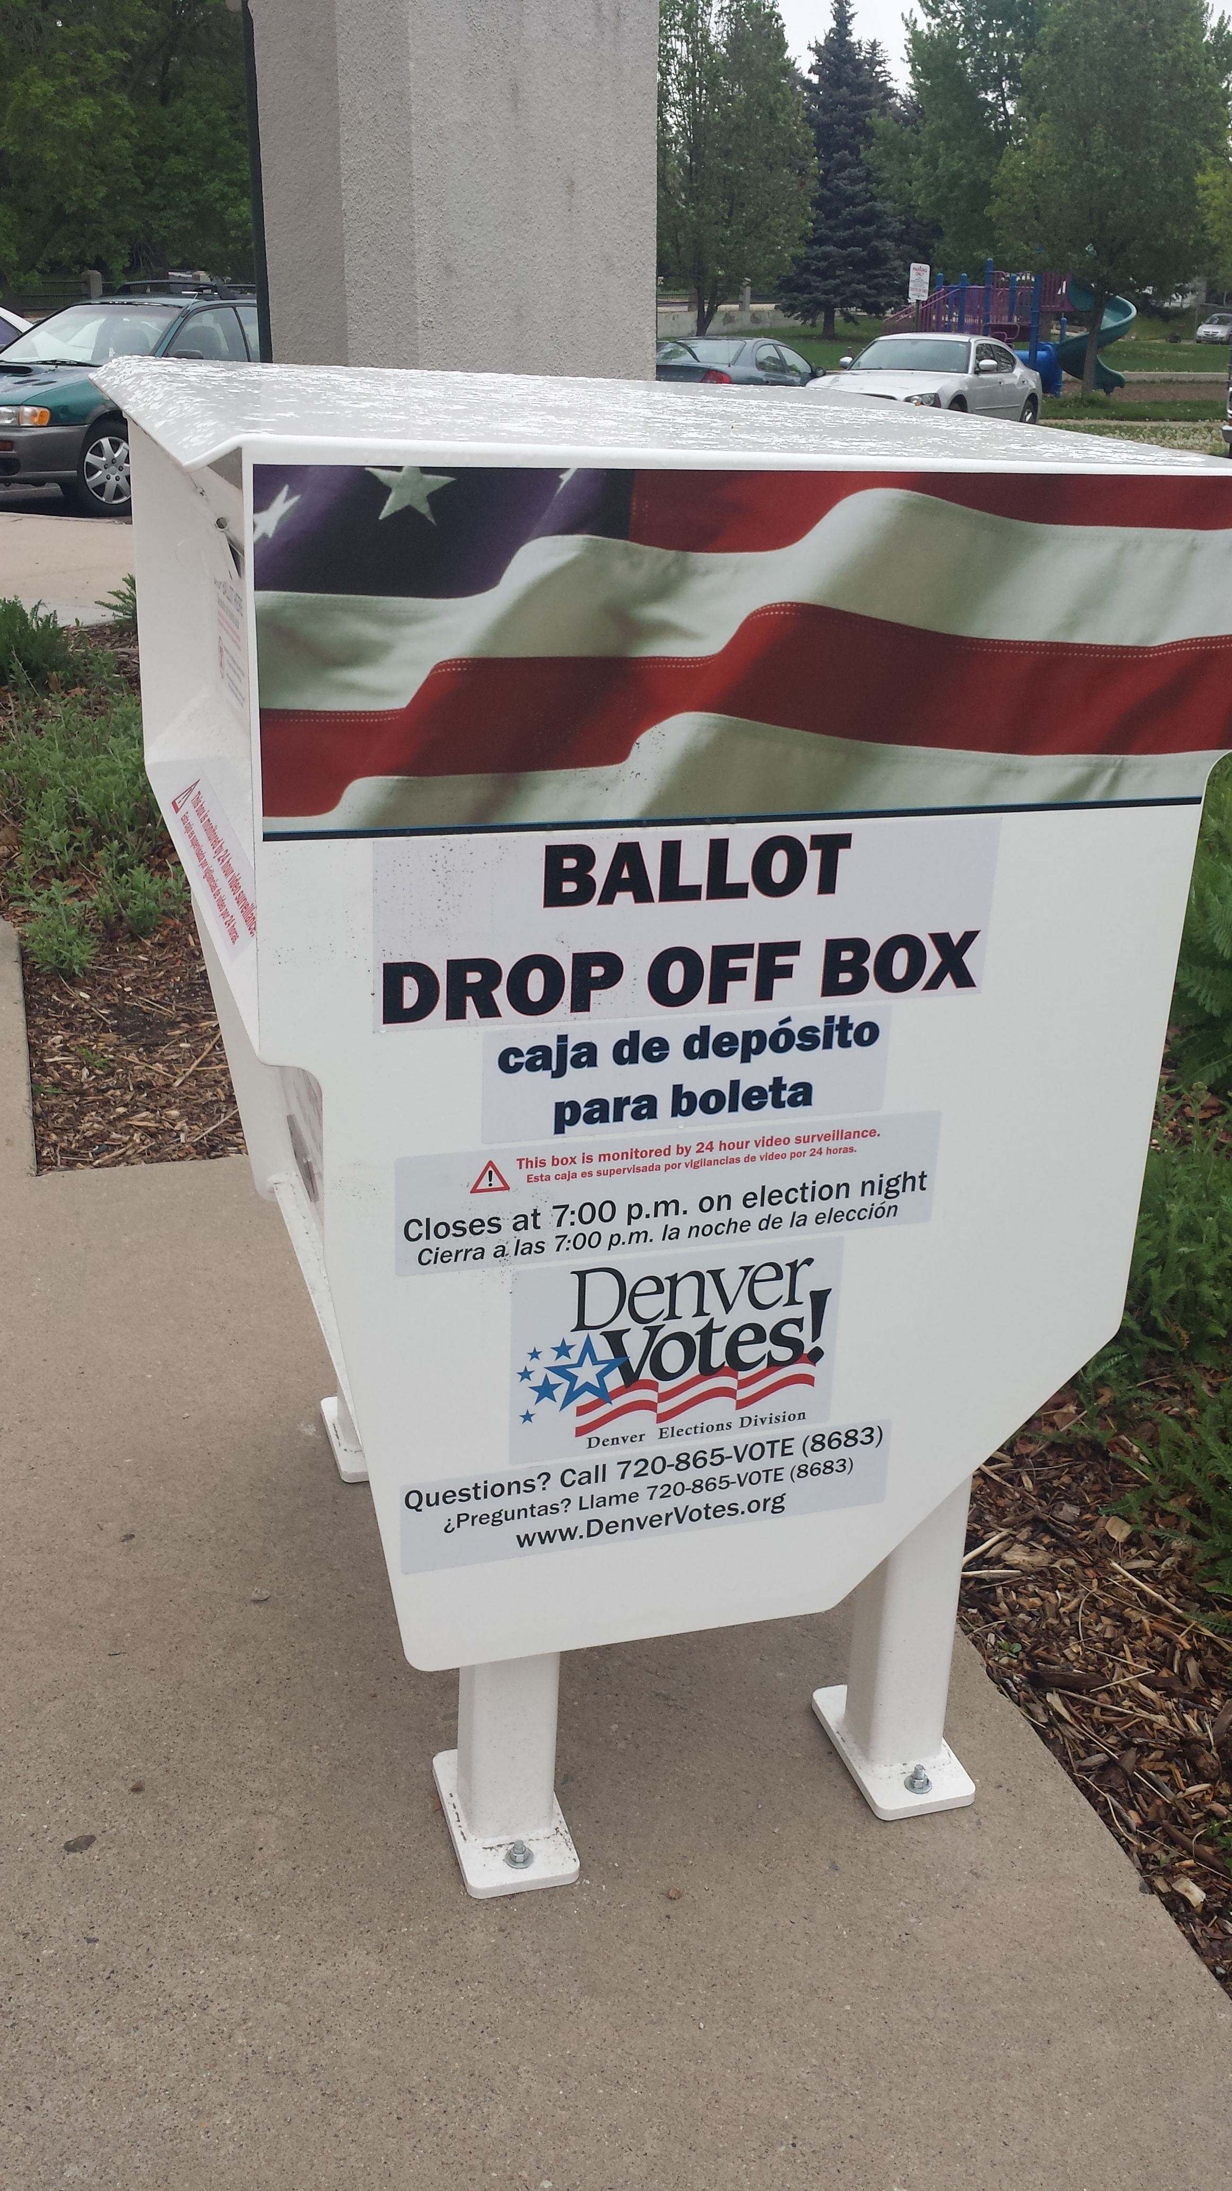
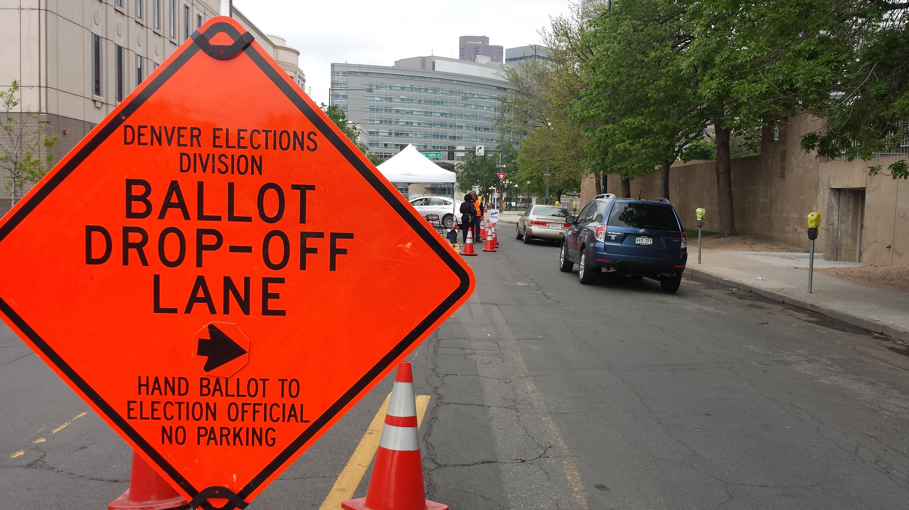
Some delivered by USPS, but returned in person.
Denver, CO

Slide 18
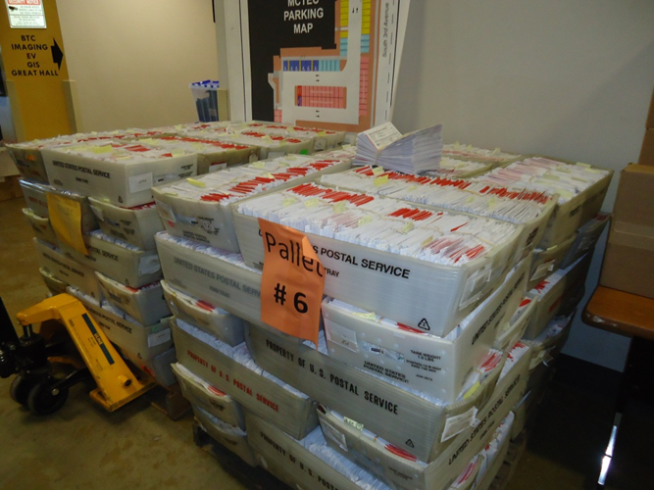
Some are returned by USPS.
Maricopa Co, AZ

Slide 19
Re-Envisioning the Process
The NASED Technology Group looked at how other standards are created and the idea of leveraging other standard work to inform the VVSG.
Considerations:
There are THOUSANDS of standards & standard setting bodies.
If other work is utilized, how/who maintains it to ensure validity and iterative currency?

Slide 20
2/8: David’s spoke about the fast pace of changes in technology--how do we ensure that the standards stay current if it takes years to revise?
What are the implications on the VVSG if it is tied to other standards? Does HAVA allow for updates to the VVSG via updates to those other standards without the TGDC?

Slide 21
2/8: Diane mentioned that there are lots of existing access standards and how do we leverage that? Particularly with the election concentration on paper?
& Where is the distinction made clear regarding what are LEGAL requirements and what are “voluntary” standards?

Slide 22
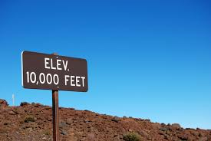
Re-Invention VVSG
High-Level Requirements
By establishing that the VVSG contains only that which is necessary to maintain the philosophical principles established, AND NOTHING MORE, we have the potential to reach our goal of an understandable VVSG.

Slide 23
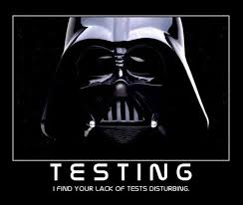
Re-Invention VVSG
Test Assertions
Detailed Test Assertions that support the Requirements provide a clear path for rigorous testing while also increasing the uniformity of testing performance amongst the VSTLs.

Slide 24
Re-Invention VVSG
Levels/Layers/Scaling
2/8 there were numerous mentions of looking at the VVSG as a multi-layered document. At the HAVA core you have the defined scope.
2/8 McDermott suggested the Technical/Functional/Geographic approach with testing scalable—not a pass/fail

Slide 25
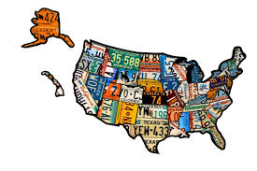
Re-Invention VVSG
Geographic/State Mapping
A review of what the individual state requirements are, and where there is overlap or gaps with the VVSG, should inform the conversation.

Slide 26
Re-Invention VVSG
State Mapping
In this context is it important to look at the state certification requirements as well as state processes?
Consider, what if a handful of states do something—is that to drive the conversation and a standard creation?
Straight-ticket, ranked-choice, top-two, etc.

Slide 27
Re-Invention VVSG
State Mapping
IF SO:
2/8 Katy mentioned that there are currently 26 states allowing for return either via an online portal (6) or email (21). YET this is a traditional nonstarter…

Slide 28
Re-Invention VVSG
Levels/Layers/Scaling
Consider this when thinking about the inclusion of voter registration and common data formats:
Many states implemented statewide systems 10 years ago in response to HAVA, and they did so quickly.
Many states are now rebuilding & modernizing—the opportunity to make great gains is upon us.

Slide 29
Re-Invention VVSG
Levels/Layers/Scaling
Considering the increase in online voter registration, having some resource of how to do it well, so that it is accessible to voters but also so that data is best leverage to increase the efficacy of election administration, would be helpful.
2/8: Jeremy E. mentioned the candidate who had a party change that they were unaware of.
Tech issue? Or procedural call--modification of address and party blank means no change to party or to remove party?

Slide 30

Certification Reform?
Any opportunity to leverage the testing manufacturers/ vendors are already doing?
2/8: Merle discussed the possibility of vendor attestations
What elements of the testing and certification process take the most time? How can that be economized without sacrificing overall integrity of the process?

Slide 31
We’ve heard about making the VVSG consumable for election officials, voting equipment usable for voters with varying abilities and needs, but lets not forget that they also have to be operational for poll workers…our volunteer army.
Do the standards take them into consideration?

Slide 32
I’d like to leave you with some examples of what they can do with the advanced technology of an adhesive/beaded seal…

Slide 33
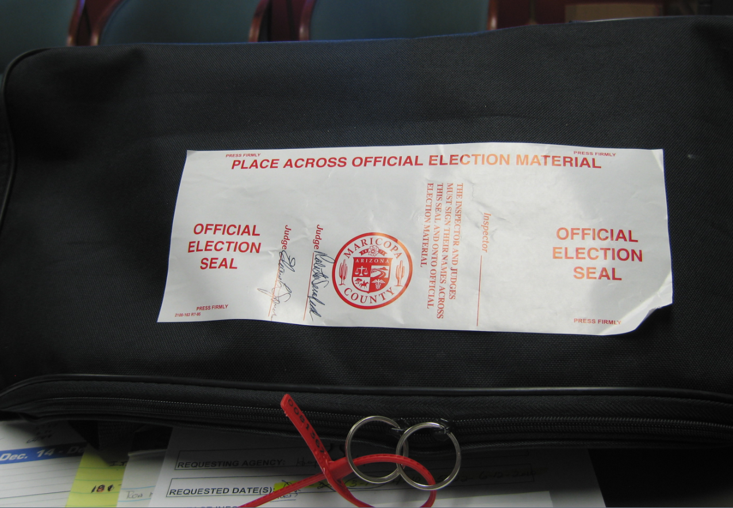
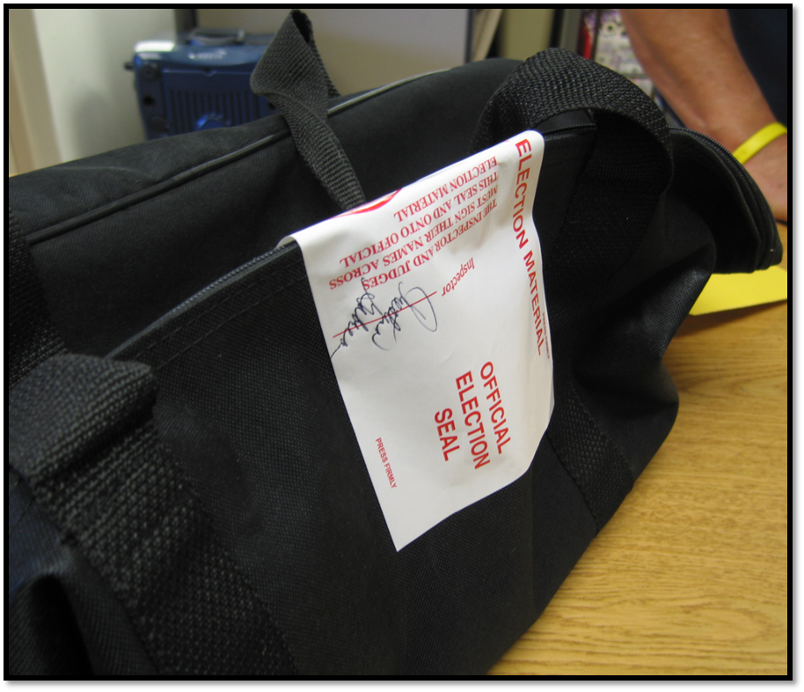
Election Realities:
Human Element
Maricopa Co, AZ

Slide 34
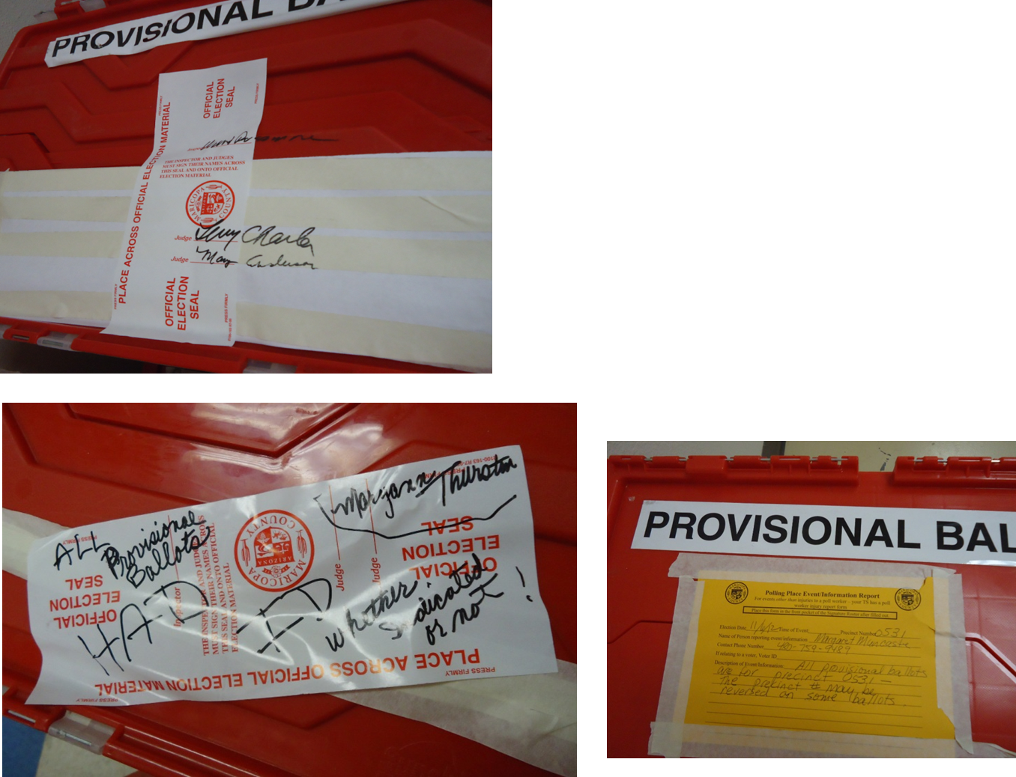
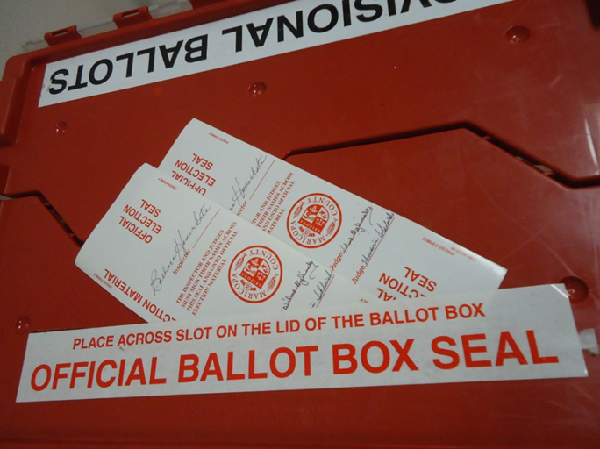
Election Office Realities:
Human Element…
Maricopa Co, AZ

Slide 35
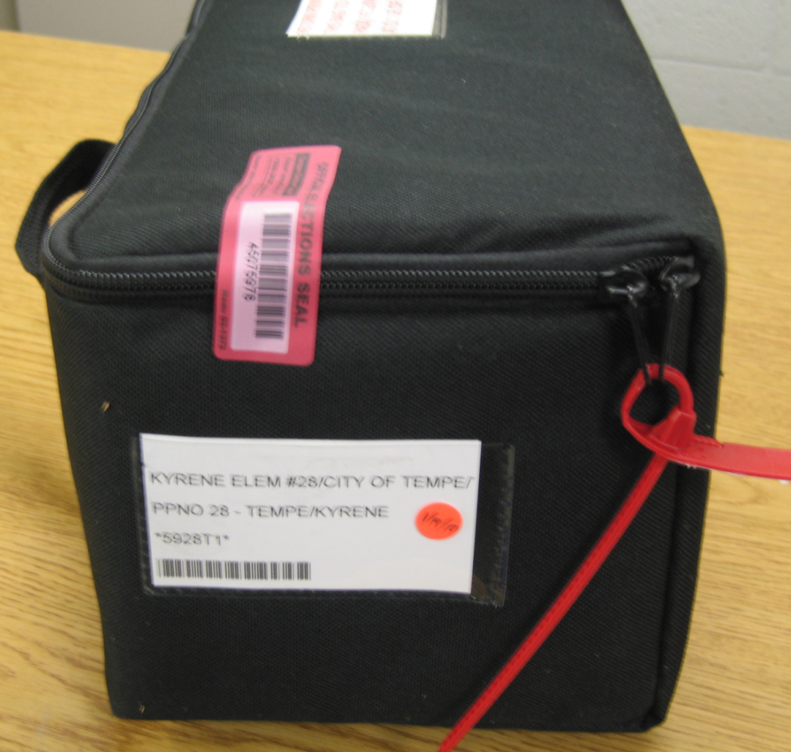
Election Realities:
Human Element
Maricopa Co, AZ

Slide 36
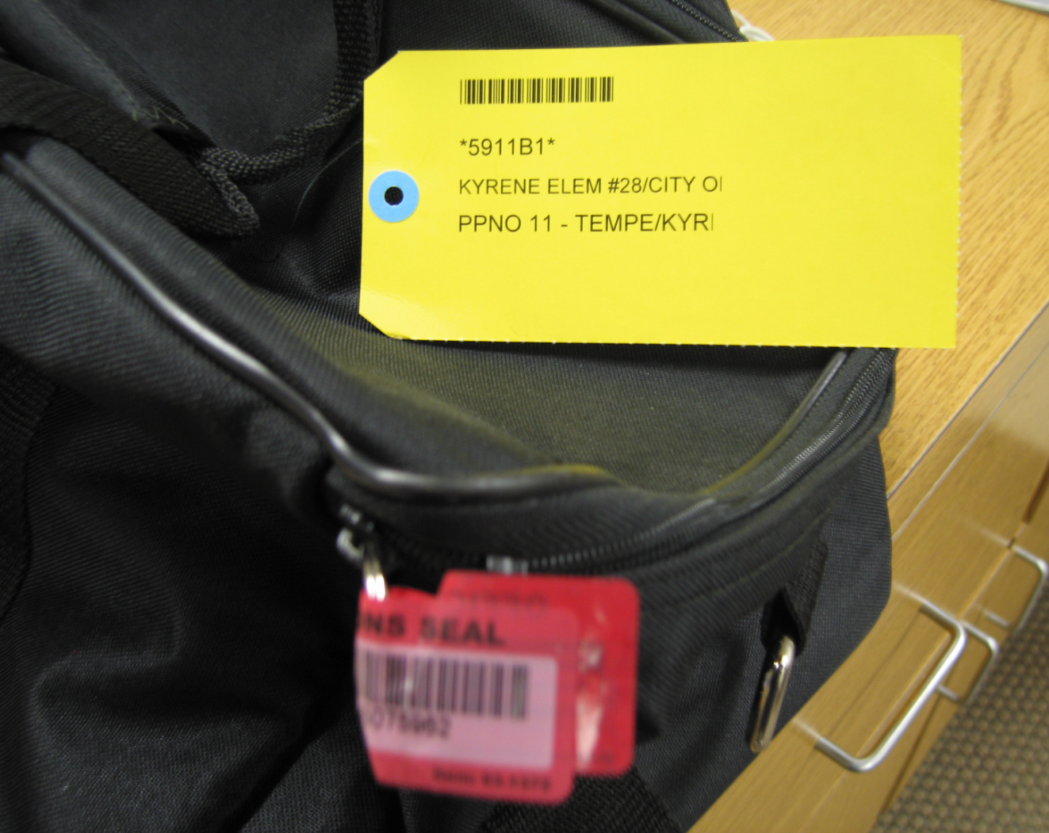
Election Realities:
Human Element
Maricopa Co, AZ

Slide 37
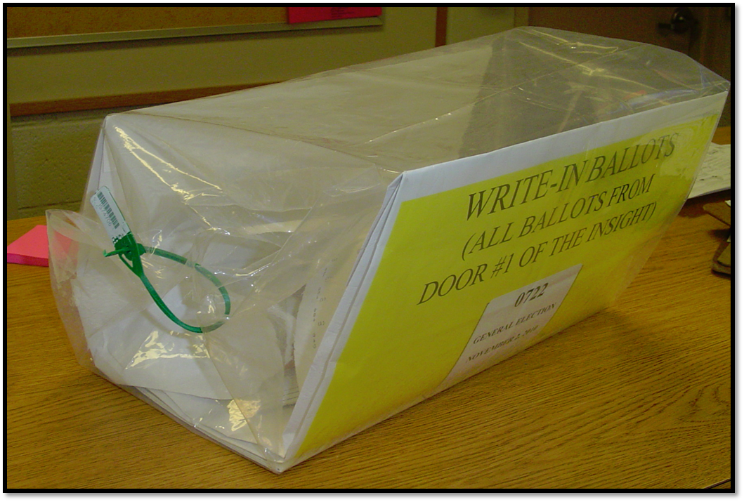
Election Realities:
Human Element
Maricopa Co, AZ

Slide 38
2/8: So as Diane mentioned yesterday, and what the PCEA heard repeatedly, pollworkers don’t always set up/turn on the accessible device. WHY?
It may be useable for the voter, but not for the worker & ten years of training hasn’t changed that.

Slide 39
So.
Should the standards inform the ability to actually USE the equipment—not to register your selections and to vote, but to SIMPLY TURN IT ON & PREP IT FOR THE VOTER?

Slide 40
2/8: “Everything has changed except our way of thinking”
(Merle channels Einstein—again)

Slide 41
2/8: As Jeremy (G) mentioned, time is of the essence and there is monumental work to be done.

Slide 42
Do we continue in the current paradigm, continue the status quo?

Slide 43

“You’re gooder than that”

Slide 44

Or do we pick up the mantle to forge this new path through uncharted waters?
“What will be your Space Jam?”

Slide 45
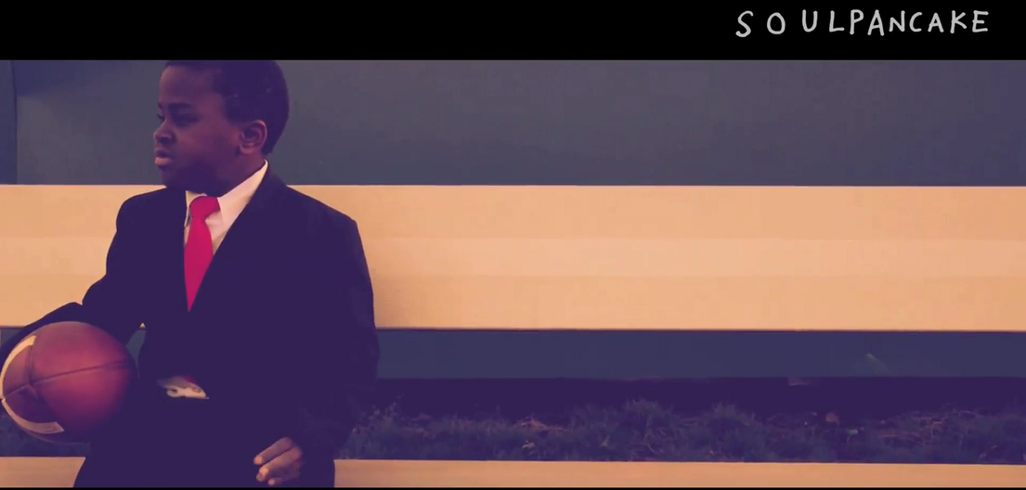
“What will you create that will make the world awesome?”

Slide 46
Tammy Patrick tpatrick@bipartisanpolicy.org

