Slide 1
Certification Strategies
Technical Guidelines Development Committee Meeting
Gordon Gillerman
National Institute Of
Standards and Technology
February 9, 2016

Slide 2
NIST - Standards Coordination Office
National Voluntary Laboratory Accreditation Program
  Voting System Testing – Handbook 150-22
Federal Standards Policy Coordination
Standards and Conformity Assessment Services for Agencies
Standards Information Services for Industry

Slide 3
Federal Standards Policy
The National Technology Transfer and Advancement Act
  “to coordinate Federal, State, and local technical standards activities and conformity assessment activities, with private sector technical standards activities and conformity assessment activities, with the goal of eliminating unnecessary duplication and complexity in the development and promulgation of conformity assessment requirements and measures”
OMB A-119, Federal Participation in the Development and Use of Voluntary Consensus Standards and in Conformity Assessment Activities
NIST Guidance on Federal Conformity Assessment – 15 CFR 287

Slide 4
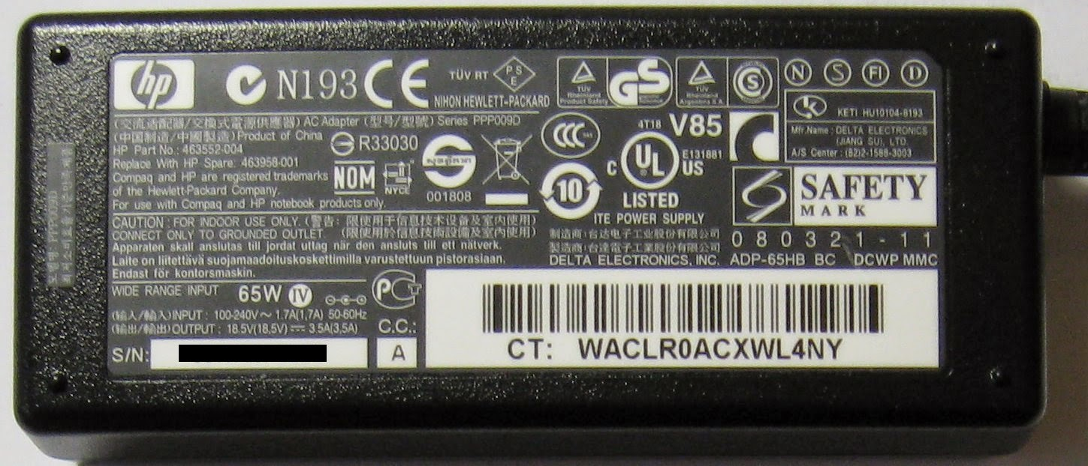
Certification Strategies

Slide 5
International Approach in Electrical Safety

Slide 6
Gordon Gillerman
Director
Standards Coordination Office
National Institute of
Standards and Technology
(301) 975-8406
gordon.gillerman@nist.gov

