Slide 1
TGDC Meeting Scope of Standards and Testing Washington, DC February 8-9, 2016
Notes:
TGDC Meeting in DC, February 2016.

Slide 2
Scope
1 : space or opportunity for unhampered motion, activity, or thought
2 : extent of treatment, activity, or influence
3 : range of operation

Slide 3
Scope
Future VVSG Development Goals
EAC Future VVSG Working Group
July 15, 2015
The purpose and scope of the VVSG must be defined and confirmed
Why is this the highest priority recommendation from the Working Group?

Slide 4
Purpose of Standards and Testing
Standards and Testing have multiple purposes:
Statute/Rule checklist item
Indemnification
Assurance of functionality/quality
Illumination of behaviors, attributes, and interoperability of the system. Informs correct use and best-practice implementation
Ultimately the purpose is to reduce uncertainty and mitigate risk of adoption and use. This means context is important.

Slide 5
In the beginning…
Voting Machine

Slide 6
In the beginning…
Voting Machine
A machine is…
an apparatus using or applying mechanical power and having several
parts, each with a definite function and together performing a
particular task.
Stand-alone
Mechanical (electro-mechanical)
Durable
Finite in purpose
Precinct-based
Proprietary

Slide 7
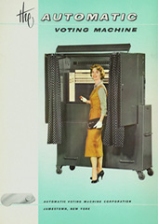
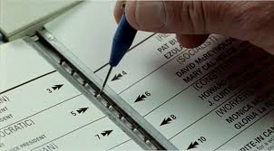
Pre-HAVA
Voting Machine
Ballot design anomalies manifest in voting machine outcomes
Auditability concerns manifest in voting machine design and limitations
Age and design concerns are illuminated by research and audits
HAVA passed, creating a path forward for replacing voting machines with systems that better addressed a constrained set of issues

Slide 8
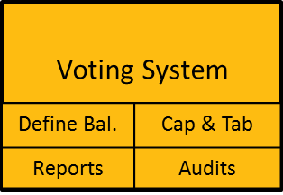
HAVA definition
… the total combination of mechanical, electromechanical, or electronic equipment (including the software, firmware, and documentation required to program, control, and support the equipment) that is used—
(A) to define ballots;
(B) to cast and count votes;
(C) to report or display election results; and
(D) to maintain and produce any audit trail information

Slide 9
What has changed since 2000?
Everything.
Statutes & Rules
HAVA
MOVE Act
Myriad of state statutes/rules on virtually every aspect of election administration, most of which impact voting system technology, directly or indirectly

Slide 10
What has changed since 2000?
Operations
Advanced/Early voting
Voter ID
UOCAVA ballot delivery
Online Voter Registration
Vote Centers
Vote-by-Mail
Cost structure
Accessibility requirements
Security requirements

Slide 11
What has changed since 2000?
Technology
Client-Server Architecture
Apps and ubiquitous computing
ePollbooks
Ballot-on-Demand
Precinct Management Systems
Online VR
Absentee Ballot Management Systems
Super VR systems with integrated functions
Multi-modal systems
Multi-vendor systems
COTS

Slide 12
What has changed since 2000?
Voter Expectations
Transparency
Cost
Convenience
Speed

Slide 13
We created a construct – an abstraction - for viewing the voting system in a partial vacuum of operational complexity.
Voting System
Define Bal. | Cap & Tab
Reports | Audits
This abstraction has purpose – it helped us isolate what we thought was important and simplify the scope of problems addressed by the systems and in turn, simplified the design and administration of standards and tests.
This abstraction and simplification has created a gap between the model and reality that has become increasingly difficult to manage.

Slide 14
Interaction of Voting and Election Systems
DMV
Online VR System
GIS
(re)Districting
Systems
Candidate Qualifying System
VR System
Auto VR System
Auditing
Systems
Voter Information
System
E-pollbooks
Pollworker/
Staff
Training Sys.
Voting System
Ballot Tracking System
Define Bal. | Cap & Tab
Reports | Audits
Barcode
Scanner
Statewide
Election Night Reporting
UOCAVA /
Ballot Delivery/Return
Ballot Marking System
Ballot on Demand
Administrative Reports
+-
Voter Authentication System
Ballot Printing
Precinct Mgt Systems
Absentee Application
© 2016

Slide 15
Election Systems
Those systems that collect, process and store data related to elections and election administration.
The core election system has traditionally been the voting system.
In the future, these systems will not be separable. The extent of integration could make the boundary designation of a “voting” system, both impossible and irrelevant.

Slide 16
Interaction of Voting and Election Systems
DMV
Online VR System
GIS
(re)Districting
Systems
Candidate Qualifying System
VR System
Auto VR System
Auditing
Systems
Voter Information
System
E-pollbooks
Pollworker/
Staff
Training Sys.
Voting System
Ballot Tracking System
Define Bal. | Cap & Tab
Reports | Audits
Barcode
Scanner
Statewide
Election Night Reporting
UOCAVA /
Ballot Delivery/Return
Ballot Marking System
Ballot on Demand
Administrative Reports
+-
Voter Authentication System
Ballot Printing
Precinct Mgt Systems
Absentee Application
© 2016
Notes:
Efforts of the EAC to expand the envelope of voting system to include technologies that abutt the VS

Slide 17
Scope
VS functionality as defined by HAVA

Slide 18
Scope
Hybridized standards and tests,
new tools, new methods
Other Election Systems
Interoperability
Configurations
VS functionality as defined by threats
VS functionality as defined by market

Slide 19
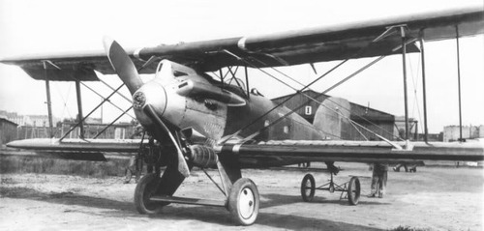
FAA Guidelines – an analogy
1926 – Safety of pilots, passengers, civilians, property. Advancement of the science and practice of commercial aviation.

Slide 20
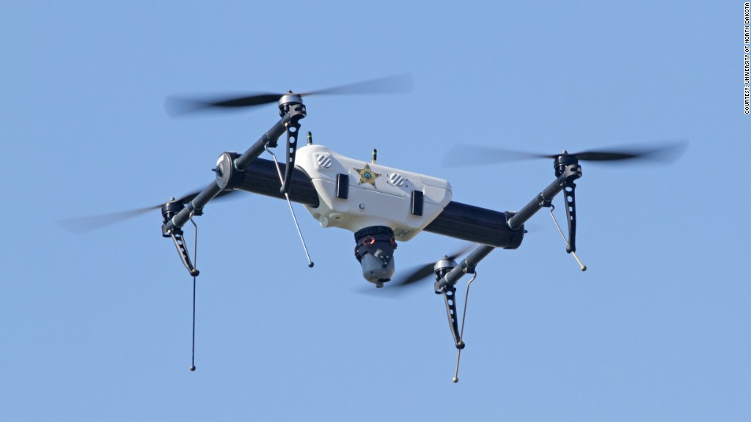
FAA Guidelines
2016 – Pilots, aircraft, air traffic control, airports, training, maintenance, manufacturing and drones…

Slide 21
Challenge
For the VVSG to accomplish its highest level goals and remain relevant to the design, testing and certification of voting(election) systems, it must adapt.
That adaptation will include new tools, new organizational structure, and new perspectives – but it must also include a broadening of scope.

Slide 22
Challenge
Adapting the VVSG, and the processes used to create it, manage it, and apply it, is essential to its continued relevance. The scope of testing and validating systems must reflect the here-and-now as well as the future of election technologies.
“ All failures are failures to adapt. All successes are successful adaptations.” – Max Mckeown

Slide 23
Thank You!
Merle S. King
mking@kennesaw.edu

