Slide 1


Broadening Our Thinking:
going beyond voting systems &
including our UOCAVA voters
Federal Voting Assistance Program
Technical Guidance Development Committee (TGDC)
8 February 2016

Slide 2

UPDATE ME
Federal Voting Assistance Program
Update Me
8 February 2016

Slide 3
UPDATE ME
Federal Voting Assistance Program
Update Me
8 February 2016

Slide 4

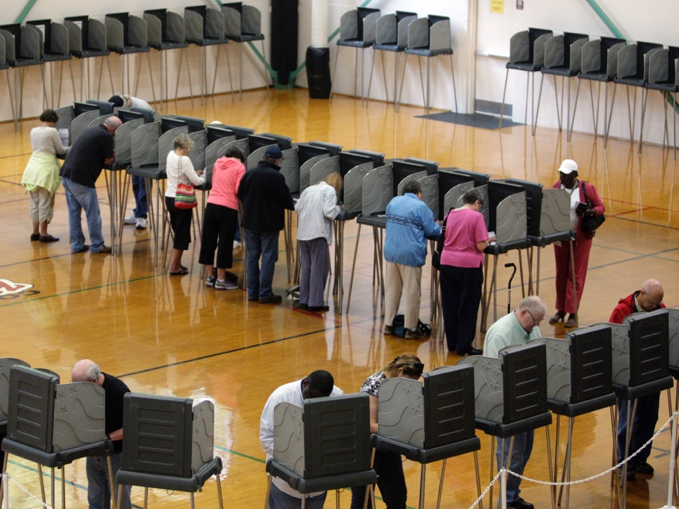

Slide 6
FVAP’s renewed focus

Slide 7
FVAP’s renewed focus
The electronic voting demonstration project was repealed.
FVAP returned to its focused on providing customer service for UOCAVA voters.
UOCAVA blank ballot delivery systems remain a means to an end for compliance.
While we see progress, we see challenges as well in serving the unique characteristics of the UOCAVA population.

Slide 8
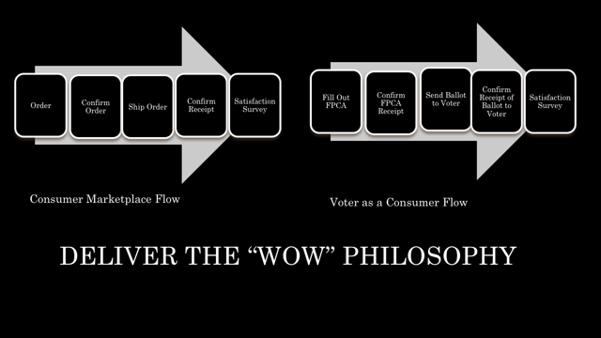

Challenges
  Mobility
  Complexity
  Disconnected from Voting Community
  Communication
Notes:
Storytelling, in the form of personas, is one of the most effective ways to translate research data
into information that resonates with decision makers and priority audiences.
The personas presented here are based on data analyses using the Federal Voting Assistance
Program’s (FVAP) 2012 Post-Election Survey of Active Duty Military, the 2012 Post-Election Survey
of Spouses of Active Duty Military, and the survey of overseas citizens.
We have analyzed the Active Duty Military (ADM), spouse, and overseas
citizen populations in several ways, including an analysis of their propensity to vote and exploratory
cluster analysis. After thoroughly examining data across available sources to identify patterns and
trends, we employed reasoned segmentation to make sure that personas were representative of
potential Uniformed and Overseas Citizens Absentee Voting Act (UOCAVA) voters. To assess media
usage by various segments, we analyzed Google Analytics data for the FVAP.gov website and used
results from the 2013 Status of Forces Survey of Active Duty Members (SOFS-A).

Slide 9

Challenges
  Mobility
  Complexity
  Disconnected from Voting Community
  Communication
Notes:
Storytelling, in the form of personas, is one of the most effective ways to translate research data
into information that resonates with decision makers and priority audiences.
The personas presented here are based on data analyses using the Federal Voting Assistance
Program’s (FVAP) 2012 Post-Election Survey of Active Duty Military, the 2012 Post-Election Survey
of Spouses of Active Duty Military, and the survey of overseas citizens.
We have analyzed the Active Duty Military (ADM), spouse, and overseas
citizen populations in several ways, including an analysis of their propensity to vote and exploratory
cluster analysis. After thoroughly examining data across available sources to identify patterns and
trends, we employed reasoned segmentation to make sure that personas were representative of
potential Uniformed and Overseas Citizens Absentee Voting Act (UOCAVA) voters. To assess media
usage by various segments, we analyzed Google Analytics data for the FVAP.gov website and used
results from the 2013 Status of Forces Survey of Active Duty Members (SOFS-A).

Slide 10

FVAP facing challenges in a new way
  Look to the Data
  New Outreach Efforts
  Cooperative Solutions:
    Council of State Governments
      PCEA Report
      Technology
      EAC/FVAP Survey
    EAC/FVAP/MPSA/USPS Mail Emphasis
Notes:
Storytelling, in the form of personas, is one of the most effective ways to translate research data
into information that resonates with decision makers and priority audiences.
The personas presented here are based on data analyses using the Federal Voting Assistance
Program’s (FVAP) 2012 Post-Election Survey of Active Duty Military, the 2012 Post-Election Survey
of Spouses of Active Duty Military, and the survey of overseas citizens.
We have analyzed the Active Duty Military (ADM), spouse, and overseas
citizen populations in several ways, including an analysis of their propensity to vote and exploratory
cluster analysis. After thoroughly examining data across available sources to identify patterns and
trends, we employed reasoned segmentation to make sure that personas were representative of
potential Uniformed and Overseas Citizens Absentee Voting Act (UOCAVA) voters. To assess media
usage by various segments, we analyzed Google Analytics data for the FVAP.gov website and used
results from the 2013 Status of Forces Survey of Active Duty Members (SOFS-A).

Slide 11
Personas
  Effective way to translate research data
  Based on data analyses using:
    2012 Post-Election Survey of Active Duty Military (ADM)
    2012 Post-Election Survey of Spouses of ADM
    Survey of Overseas Citizens
    Google Analytics for FVAP.gov
    2014 Status of Forces Survey of ADM (SOFS-A)
Notes:
Storytelling, in the form of personas, is one of the most effective ways to translate research data
into information that resonates with decision makers and priority audiences.
The personas presented here are based on data analyses using the Federal Voting Assistance
Program’s (FVAP) 2012 Post-Election Survey of Active Duty Military, the 2012 Post-Election Survey
of Spouses of Active Duty Military, and the survey of overseas citizens.
We have analyzed the Active Duty Military (ADM), spouse, and overseas
citizen populations in several ways, including an analysis of their propensity to vote and exploratory
cluster analysis. After thoroughly examining data across available sources to identify patterns and
trends, we employed reasoned segmentation to make sure that personas were representative of
potential Uniformed and Overseas Citizens Absentee Voting Act (UOCAVA) voters. To assess media
usage by various segments, we analyzed Google Analytics data for the FVAP.gov website and used
results from the 2013 Status of Forces Survey of Active Duty Members (SOFS-A).

Slide 12

Persona 1: George, Older Overseas Citizen Voter
  Media Use and Behavior:
    Uses email, does some online shopping, not generally tech-savvy, uses personal computer
  FVAP User Behavior:
    Likely to visit website directly based on voting experience
  Voting Experience:
    Registration Likelihood: HIGH
    Ballot Return Likelihood: HIGH
    Feels voting is an opportunity to express American pride and maintain connection to U.S.
    Main sources of voting info: State and LEOs, other ex-pats
  Challenges:
    Assumes FVAP is for military voters and is unaware of services available for overseas civilians
    Sends and receives voting materials in paper form and is not aware of online registration and ballot delivery options
  Needs:
    A convenient, centralized one-stop shop for current voting information, deadlines, forms
    Timely reminders of registration, ballot request and ballot return deadlines
    Feedback from LEO about the status of his registration, ballot request and returned ballot

Slide 13

Persona 2: Andrea, Unaware Overseas Citizen Voter
  Media Use and Behavior:
    Tech-savvy and heavy social media user; accesses Internet on her cell phone and personal laptop
  FVAP User Behavior:
    Likely to be referred from another source (Dept of State); likely to use online assistant to complete FPCA
  Voting Experience:
    Registration Likelihood: LOW
    Ballot Return Likelihood: LOW
    Voted in U.S. no experience with absentee; perceives voting as a way to stay connected
    Main sources of voting info: family and friends, other ex-pats
  Challenges:
    Unaware of right to vote from overseas; unfamiliar with process; unlikely to seek out information independently
    Confusion about what State she should vote in; might decide not to participate if she feels process is hard or overwhelming
  Needs:
    Detailed info about right to vote and process
    Information about voting assistance resources
    Help identifying her State and its requirements
    Timely reminders of registration, ballot request and ballot return deadlines

Slide 14

Persona 3: Johnny, Young ADM Voter
  Media Use and Behavior:
    Tech-savvy and heavy social media user; accesses Internet on his cell phone
  FVAP User Behavior:
    Likely to directly visit FVAP.gov based on word of mouth and VAO outreach
  Voting Experience:
    Registration Likelihood: MODERATE
    Ballot Return Likelihood: LOW
    First-time voter with no experience or knowledge of absentee process; views voting as important right but ambivalent about participating
    Main sources of voting info: DoD resources, family and friends, VAO
  Challenges:
    Voting is not a priority, has little motivation to seek out info independently; might decide not to participate if she feels process is hard or overwhelming
    Likely to register but might fail to return ballot without follow-up prompting
    Unstable mailing address due to frequent moves
  Needs:
    Step-by-step info of the process; assistance filling out FPCA
    Proactive engagement by VAO; support from Commander
    Electronic registration options

Slide 15

Persona 4: Davis, Senior Enlisted ADM
  Media Use and Behavior:
    Internet access mostly limited to time in ship/computer lab; uses Internet and social media regularly to communicate with family while deployed
  FVAP User Behavior:
    Likely to directly visit FVAP.gov, though referrals are helpful; likely to use paper forms
  Voting Experience:
    Registration Likelihood: HIGH
    Ballot Return Likelihood: MODERATE
    Has voted in the past and generally understands absentee process; believes if he doesn’t vote, can’t complain
    Main sources of voting info: DoD resources, spouse, VAO
  Challenges:
    Has experienced difficulties voting in the past, skeptical his vote will count
    Likely to register but may fail to return ballot without reminders/encouragement
    Speed and quality of mail system, limited time and Internet access; unfamiliar with FWAB
  Needs:
    Accurate info about voting rights and reassurance vote will be counted; support from Commander
    Timely reminders of registration, ballot request and ballot return deadlines
    Feedback from LEO about the status of his registration, ballot request and returned ballot

Slide 16
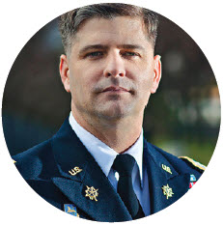
Persona 5: Arlo, Military Officer
  Media Use and Behavior:
    Internet access primarily through personal computer; uses email and Facebook to communicate with family/friends
  FVAP User Behavior:
    Likely to directly visit FVAP.gov without referrals
  Voting Experience:
    Registration Likelihood: HIGH
    Ballot Return Likelihood: HIGH
    Extensive experience voting absentee; views voting as civic duty and takes it very seriously
    Main sources of voting info: DoD resources, spouse, VAO
  Challenges:
    Has experienced difficulties voting in the past, including not getting ballot on time; sometimes unsure whether ballot was counted
    Feels unprepared to assist Service members who look to him for guidance about voting; struggles to discuss voting without discussing politics
  Needs:
    Reliable, up-to-date information about the voting assistance resources available that he can share with subordinates
    Timely reminders of registration, ballot request and ballot return deadlines
    Feedback from LEO about the status of his registration, ballot request and returned ballot

Slide 17

Persona 6: Hanna, Military Spouse
  Media Use and Behavior:
    Uses Internet and social media to communicate with family/friends; use cell phone and personal computer
  FVAP User Behavior:
    Likely to be referred to FVAP.gov by online sources or through independent search
  Voting Experience:
    Registration Likelihood: MODERATE
    Ballot Return Likelihood: MODERATE
    Sometimes voted in home jurisdiction but unfamiliar with absentee process; recognizes voting as an important right
    Main sources of voting info: DoD voting assistance resources, spouse and other military families, VAO
  Challenges:
    Would like to vote but has little knowledge of process; limited time/energy to figure out process
    Often receives inaccurate information through social network of military families and is unsure who can be trusted as a source of reliable information
  Needs:
    Step-by-step info of the process and available resources
    Timely reminders of registration, ballot request and ballot return deadlines
    Assistance communicating important info to spouse

Slide 18

The complex election framework
Since 2010, FVAP witnessed a growing complexity to the election landscape
  States vary in the accepted methods of receipt for applications and ballots (mail, online and fax)
  States vary in the corresponding deadlines based on mode of transmissions
  Procedures remain focused on comparing wet signatures
    Ballot application to ballot
    Voter registration application to ballot
  UOCAVA tailored systems vary significantly with each jurisdiction
    “Push” versus “pull” systems of emails versus downloads

Slide 19

What contributes to complexities?
Cost for UOCAVA specific systems
  Smaller jurisdictions will seek lowest cost options
Interplay between State laws and translation into technical processes
  State laws have to be reapplied and interpreted for new technologies
Lack of understanding with technical complexities for electronic transmission
  State and local election officials are not experts in cyber policy
The existing Information Assurance security posture for federal agencies, DoD and the Internet
  The underlying security policies for agencies has an impact on the success of the military to receive messages
One size does not fit all
  Trying to force technical solutions may lead to unintended consequences

Slide 20
What can the TGDC do?
Set aside the security of electronic ballot return as a separate issue
Embrace the fact that electronic ballot delivery systems are here
Offer best practices and recommendations that fit the various types of systems and embrace principles of usability for the current technology
Reconcile Information Assurance policies and issue best practices for structuring communication based on the current environment
Change the mindset from one of certification to one of usability and “how to”
SERVICE ALL VOTERS
VOTER EXPERIENCE BECOMES PRIORITY

Slide 21


Let’s all do this together
Capture the existing, look to the future
AND….......

Slide 22

UPDATE ME
Federal Voting Assistance Program
Update Me
8 February 2016

