Slide 1
NIST Voting program
MARY BRADY, Program manager
TGDC Meeting: February 2016

Slide 2
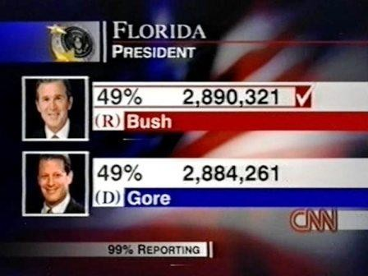
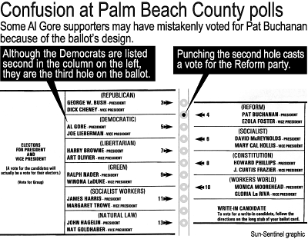
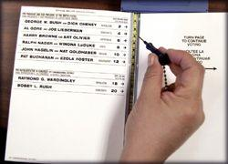
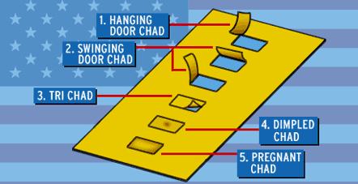
Motivation: 2000 Presidential Election

Slide 3
Congressional Mandates
HAVA 2002 (Public Law 107-252) : The Help America Vote Act (HAVA) requires NIST/SSD to provide technical support for the development of Voluntary Voting Standard Guidelines (VVSG). Such technical work includes computer security, methods to detect and prevent fraud, protection of voter privacy, the role of human factors, including assistive technology for voters with disabilities, and remote access voting, including voting through the internet.
MOVE 2009: The Military and Overseas Voters Empowerment Act of 2009 (MOVE) directs NIST and EAC to provide ”best practices or standards in accordance with electronic absentee voting guidelines established”… to support the pilot program or programs developed by DOD as directed by the Uniformed and Overseas Citizens Absentee Voting Act (UOCAVA) of 1986 as amended.

Slide 4
VVSG Development
EAC
Standards Board
Advisory Board
TGDC
NIST Director
NIST
  Voting Guidelines
VVSG 1.0 -- 2005
VVSG 2.0 -- 2007
VVSG 1.1 -- 2015

Slide 5
VVSG: In use in 47/50 States
WA
ME
MT
ND
OR
MN
NY
ID
SD
WI
WY
MI
IA
PA
NV
NE
IN
OH
VT
IL
WV
NH
UT
CO
VA
CA
KS
MO
KY
MA
NC
RI
TN
CT
AZ
NM
OK
AR
SC
GA
NJ
MS
AL
DE
TX
LA
MD
FL
DC
AK
Standards
Certification
VSTL
HI

Slide 6
Interaction of Voting and Election Systems
(re)Districting
Candidate Qualifying
VR System
Voter Information/
Education
Pollworker/
Staff
Training
Audits
E-pollbooks
Voting System
Capture
Tabulation
UOCAVA /
Ballot Delivery
Election Night Reporting
Ballot Marking System
Ballot on Demand
Administrative Reports
Voter
Voter Authentication Systems
Ballot Printers

Slide 7
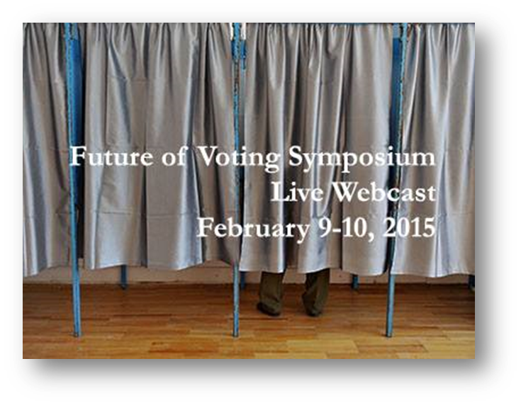
Future of Voting – Feb 2013, 2015
NIST/EAC Symposiums
Explore Emerging Trends in Voting

Slide 8
Standards
Standards Efforts
NIST Roadmap
NASED Subcommittee
CSG Technology Group
IEEE VSSC
EAC Future VVSG

Slide 9
VVSG Development
EAC
Standards Board
Advisory Board
TGDC
NIST Director
NIST
PWG’s
  Voting Guidelines
Input on front-end
Shorter public comment period

Slide 10
BoA
TGDC
SB
VVSG PWG
Standards
IEEE
ANSI
ACCESS Board
Executive Committee
EOs
EOs
EOs
WGs
Election Processes
Election Functions
Technology Solutions
Pre-Election
Election
Post-Election
Experts
Constituencies
Technical Approach
Implementation Details
Testing Processes
Experts
U & A
Cybersecurity
Experts
Interoperability
Experts
Testing
Build, Test
Notes:
The proposed new working groups have been organized with these principles in mind.
They allow a high level of access for all important stake holders to every step of the process
and to every supporting aspects drawn from technology or expert, discipline-specific insights.
This makes the standard and the technologies they specify build in all of these important elements
into every step of the process while enabling the standard to achieve full coverage across the entire election process itself.

Slide 11
Public Working Groups
Public working groups gather inputs from election officials and locales to inform the standards work
  Established e-mail lists, Twiki for collaboration
  Twiki: ~8,000 views, ~500 file uploads
  Initial election models generated
Top down/bottom up approach to identifying priorities for both public working groups and constituency groups
  TGDC-Feb2016: Review models, discuss priorities
  Constituency Groups: Meeting & discussing priorities
Identify Priority Action Plans (PAPs)
Public working groups and constituency groups work to fill needs highlighted by priority areas

Slide 12
Public Working Groups: Doing the Work
Sign up for Group Email Lists
Receive and Activate TWiki Account
Learn / Use Twiki
Participate in group meetings
Define Processes on TWiki
Develop and Carry Out Action Plans

Slide 13
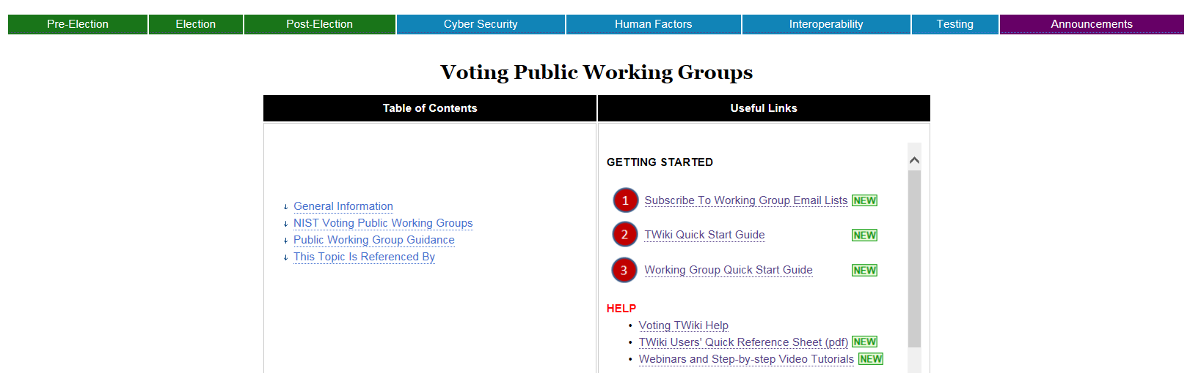
Learn / Use the TWiki
Process WG Pages
Subscribe / Activate
Get Started
Group Guidance
Step-by-step Help
Quick Ref. Guide
Webinars / Step-by-step Video Tutorials

Slide 14
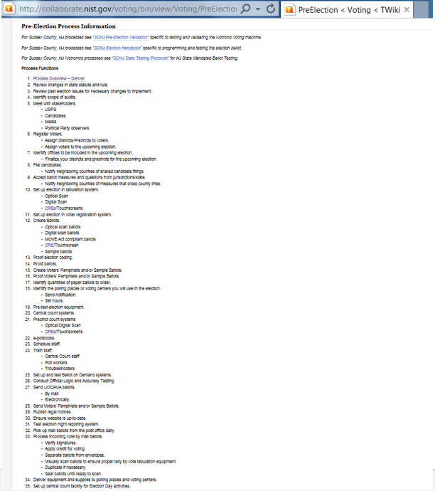
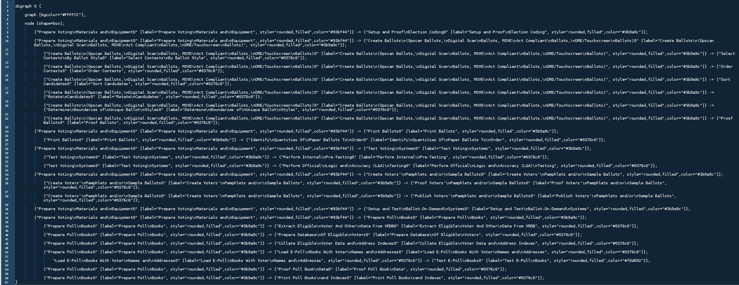
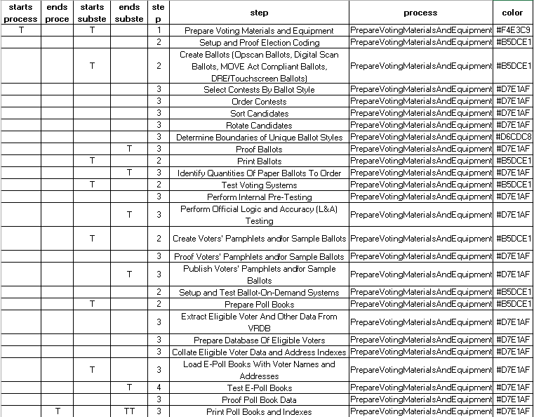
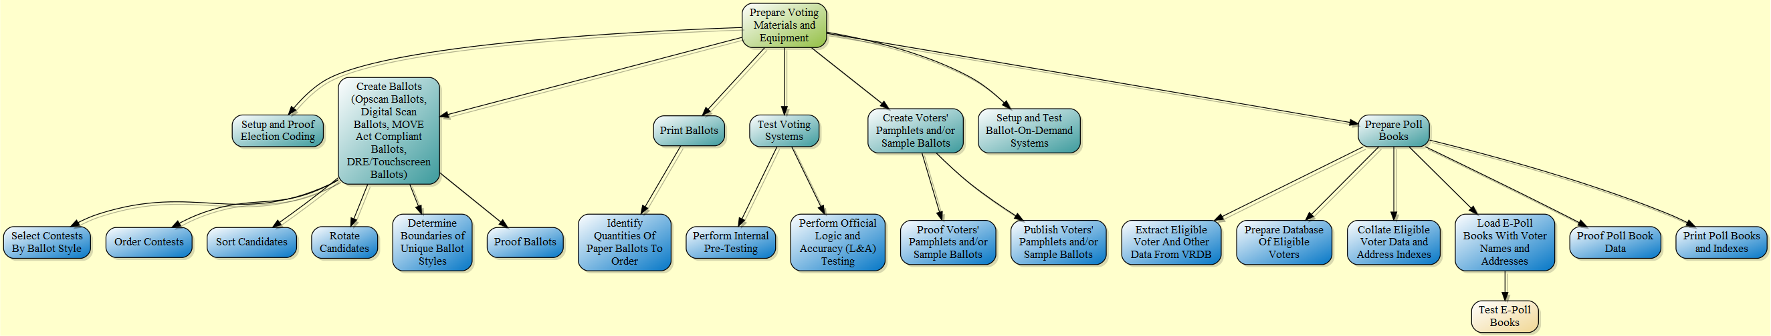
Process Model Creation
Voting TWiki Page
Process Model
Process Spreadsheet
TWiki Processes
PlantUML Code Generator
Election Process Model
Pre-Election Process Model Output:
Prepare Voting Materials and Equipment

Slide 15

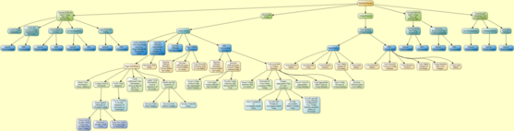
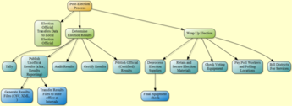
Progress…Election Models

Slide 16
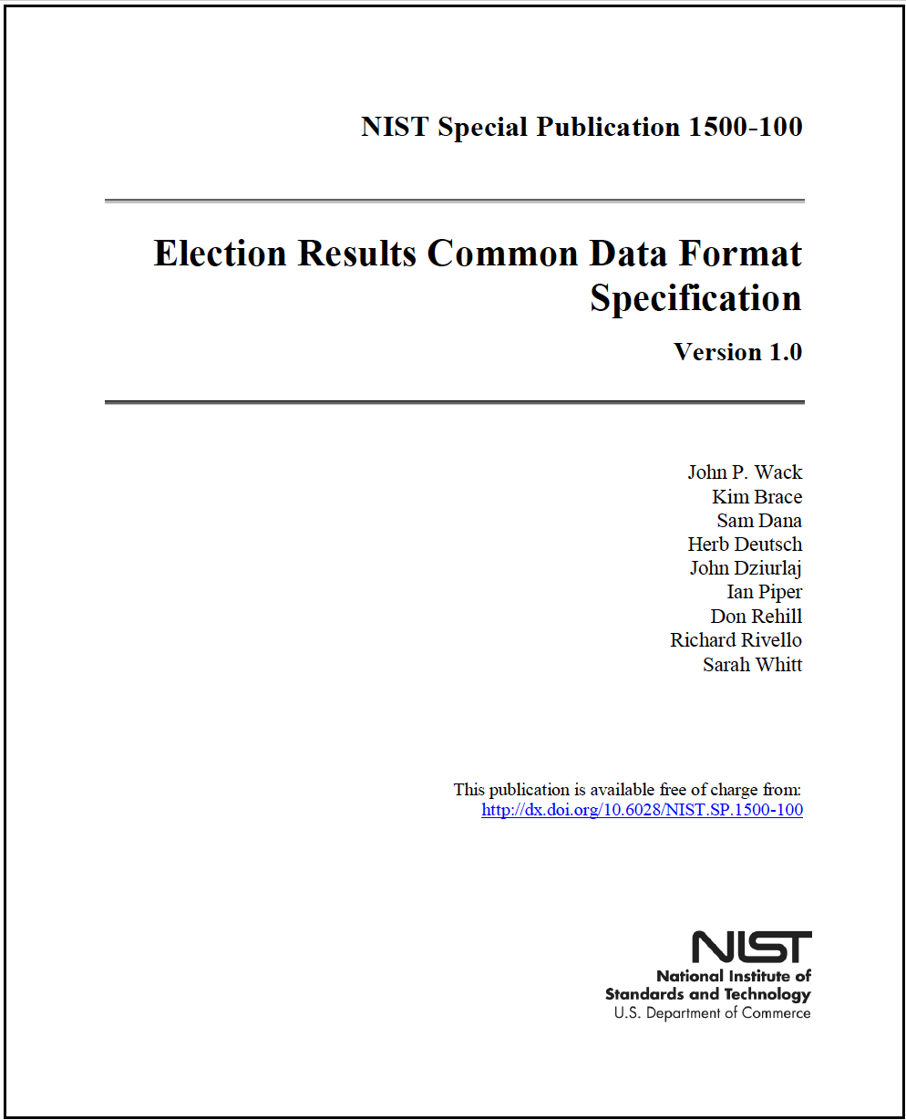
Election Results CDF Specification
For pre- and post-election data, reporting aggregated and detailed election results
Earlier version already in use in OH, used in PEW/Google’s VIP 5.0
1500 series publications for public working group outputs

Slide 17
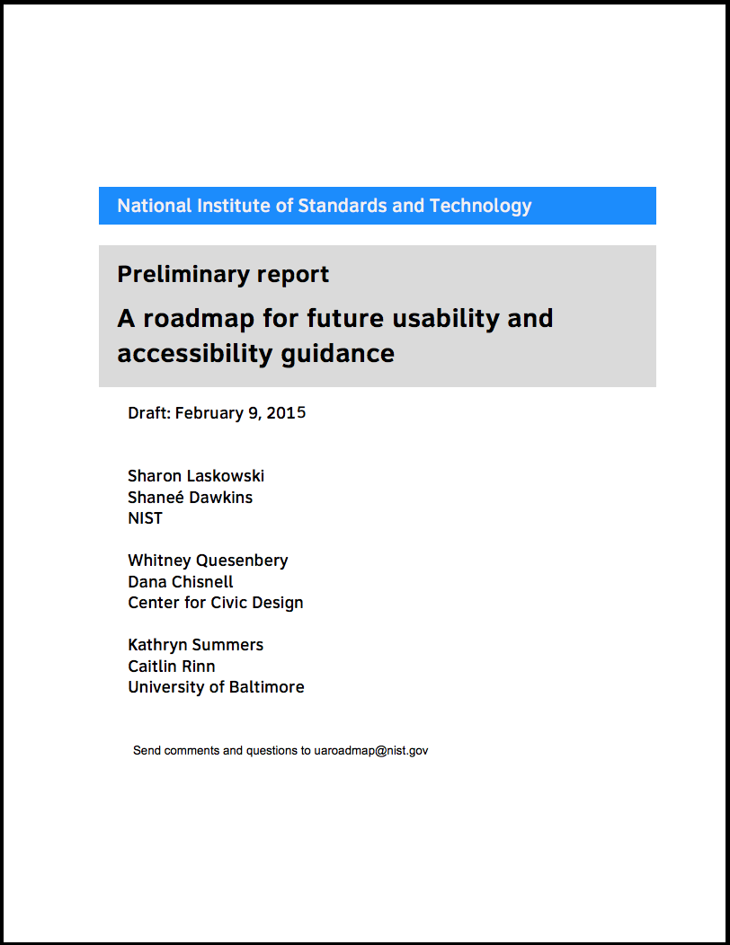
Usability & Accessibility Roadmap
Partnered with Center for Civic Design, convened 2 Workshops
Identified Six Priority Areas:
  Support the design process
  Engage voters effectively
  Address the entire voter journey
  Support evolving technology
  Provide useful guidance and standards
  Improve testing in design and certification

Slide 18
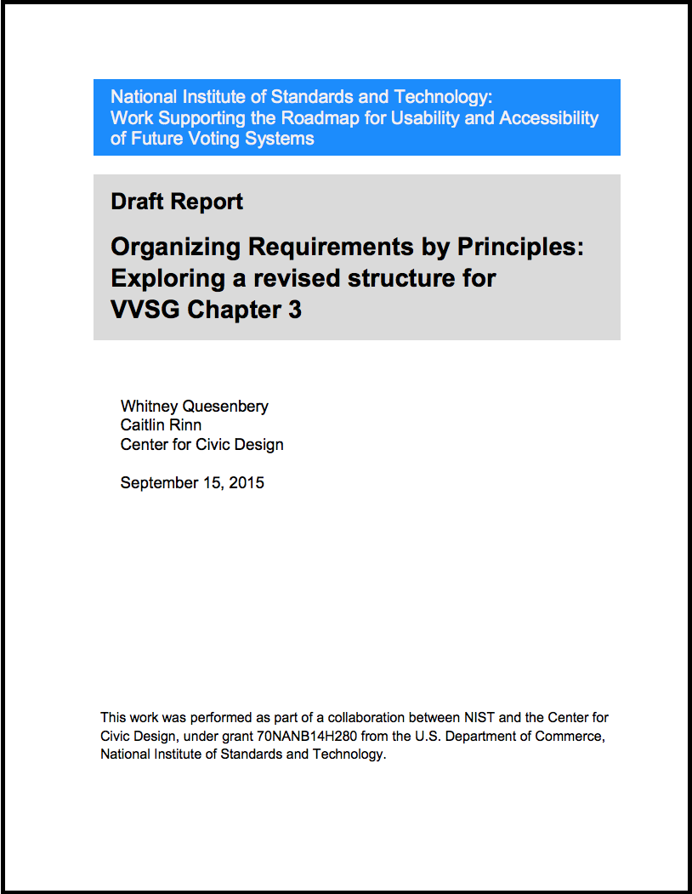
VVSG U&A Requirements
Follow-on from U&A Roadmap and NASED Principles/Test Assertion effort
Support universal design that will make all voting systems accessible.
Clearly identify requirements necessary to meet legal accessibility requirements in HAVA and the ADA.
Make the VVSG more usable by organizing the requirements around clear principles.
Show how detailed requirements and other guidance can be organized to meet these principles.

Slide 19
TGDC February 2016
Identify key election processes
Discuss use cases that touch different layers (technology, security, human factors, interoperability) and occur in different contexts (pre-election, election, post-election)
Create a plan to fill in the details of that map (processes, principles, concepts)
Use that high-level map and plan to prioritize and drive activities in all groups toward formal description of that process
  Develop Template for overall process (PAP Template)
  Develop Template for each case of that process (PAP Case Templates)

Slide 20
PAP Map: Ballot Marking
Ballot Marking
Absentee
Votomatic
Electronic Ballot Marking
Online
Ballot Marking
Mark @ home +
QR Codes
Pen /
Paper
Punch
Card
Traditional
Tablet
Client / svr
cloud
Constrained
Env.
COTS
Env.
You own data
Don’t
Know where data is

Slide 21
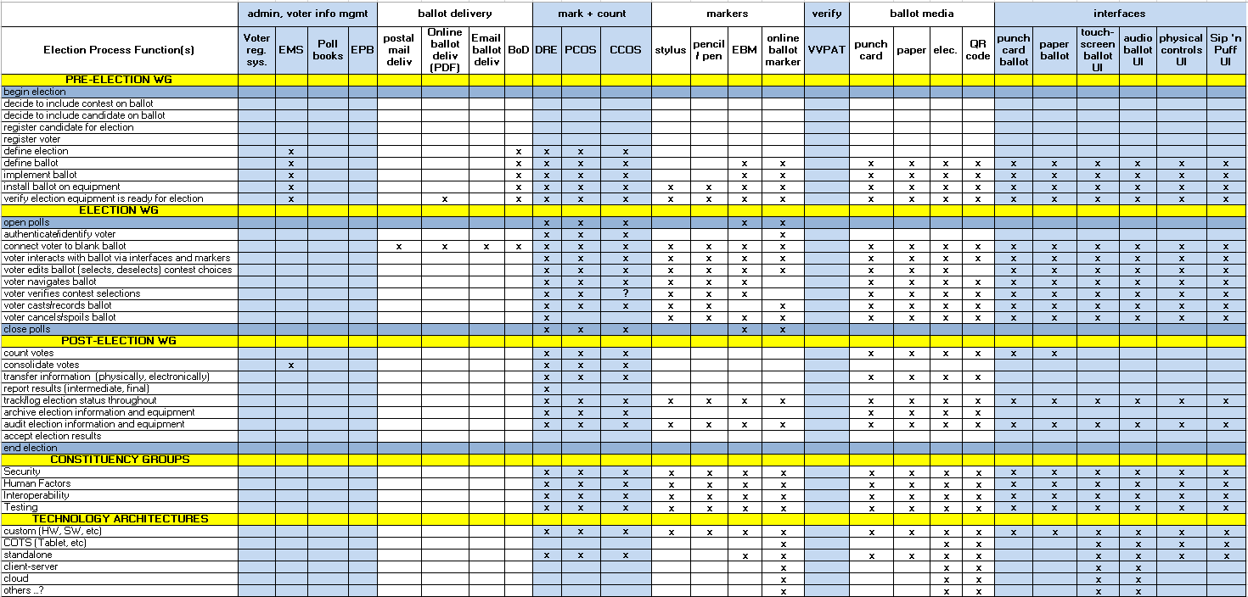
PAP Matrix (Ballot Marking): A Single PAP Touches all Groups

Slide 22
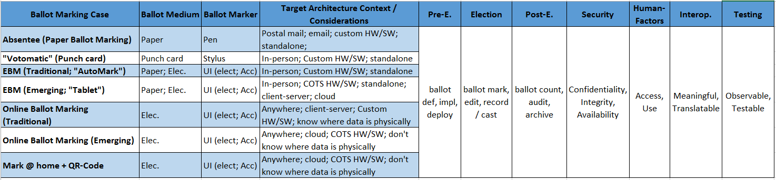
Ballot Marking Summary View

Slide 23
Summary
Elections are complex and the elections community is very diverse
Wider engagement of state and local election officials, manufacturers, test laboratories, academics, and a number of advocacy groups
Working with the broader elections community on laying the foundation for the next version of the VVSG
Let’s get to work!

