Slide 1
Pre-Election Process Models
Lori Augino
TGDC, February 8-9, 2016

Slide 2
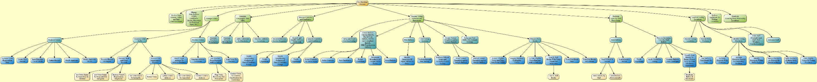
Pre-Election Process Model

Slide 3
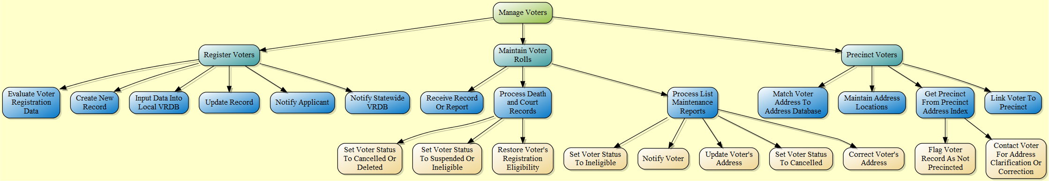
Manage Voters

Slide 4
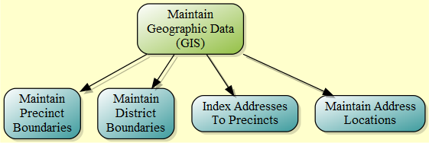
Maintain Geographic Data (GIS)

Slide 5
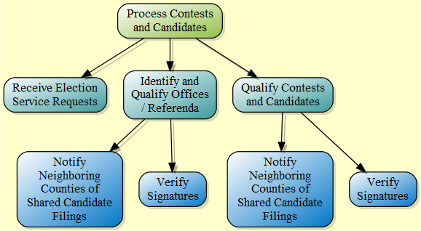
Process Contests and Candidates

Slide 6
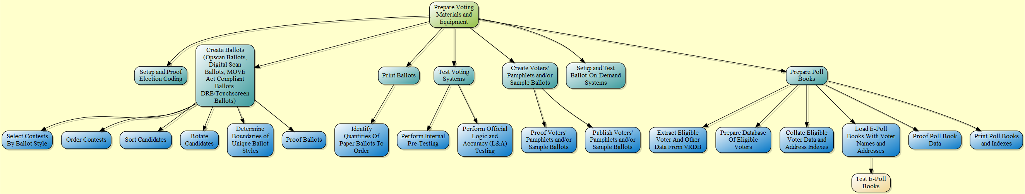
Prepare Voting Materials and Equipment

Slide 7
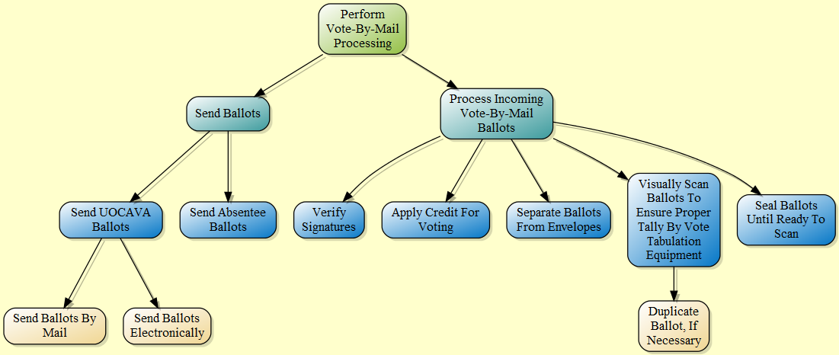
Perform Vote-By-Mail Processing

Slide 8
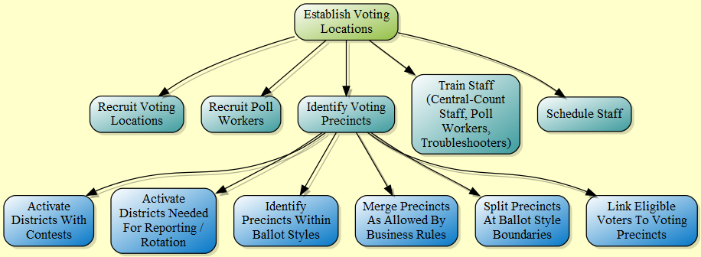
Establish Voting Locations

