Slide 1
Post-Election Process Model
Linda Lamone
TGDC, February 8-9, 2016

Slide 2
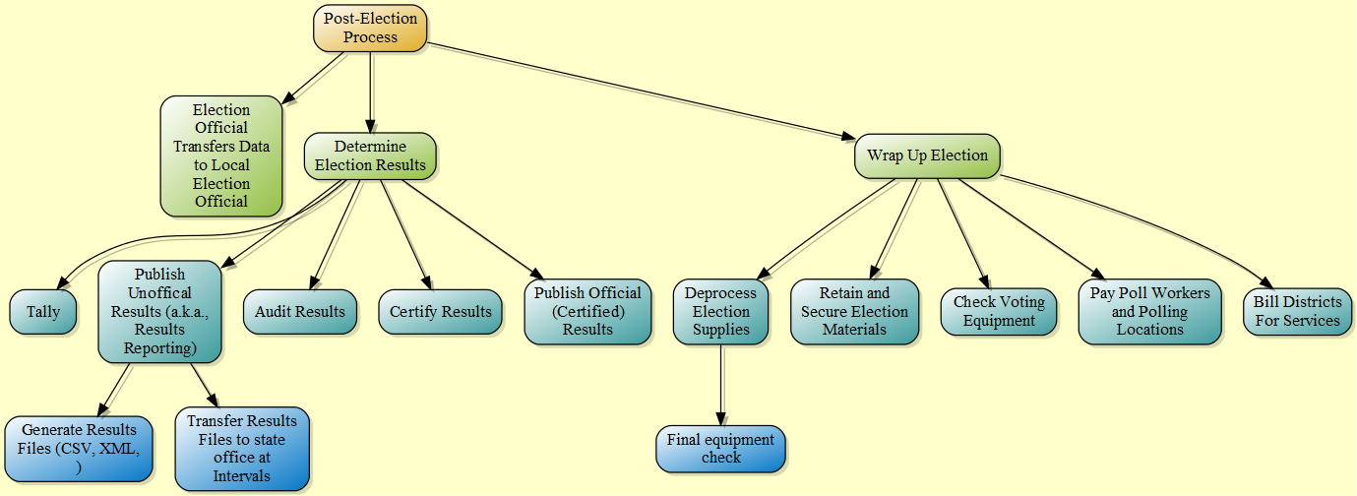
Post-Election Process Model

