Slide 1
Voting Technology and State Policy 2016
By Katy Owens Hubler
Democracy Research, LLC
Consultant for the National Conference of State Legislatures (NCSL)

Slide 2
What Does NCSL Do?
Serves 7,383 legislators and 25,000 legislative staff
Provides non-partisan research & analysis
Links legislators with each other and with experts
Speaks on behalf of state legislatures in D.C.

Slide 3
What I'll Discuss
Recent legislative trends in voting technology
Purchasing and funding options being considered by states
Notes:
What I’ll talk about…

Slide 4
Recent Legislative Trends
Notes:
-Three legislative trends (perennial “hot” topics”) from the last 15 years – pre-ED voting started higher, increasing a bit but not dramatically. Voter ID saw a dramatic increase but is now leveling out. Online voter registration has seen a huge uptick.

Slide 5
Online Voter Registration
(the biggest issue in 2015)
Notes:
-NM and IA’s systems went live in January and Alabama just last week, so in 2016 we’re up to 30 states with online registration. Another 2 (OK and FL) have enacted it and are still working on implementing their systems.

Slide 6
Other states considering online registration this year
New Hampshire
New York
Ohio
Rhode Island
Tennessee
Wisconsin
Automatic registration
Notes:
-also saw the first automatic registration bills enacted in the last couple of years – OR and CA. Almost half of the states have seen legislation introduced that would establish automatic voter registration.

Slide 7
List Maintenance: Within a State
Virginia
  Dept. of Health (death records)
  State Police (felon records)
  U.S. Attorney’s Office (felon records)
  Central Criminal Records Exchange (felon records)
  State Circuit Courts (mental incompetency)
  Dept. of Motor Vehicles (SSN; non-citizen records)
  Bureau of Vital Statistics (death records)
  USPS (street address records)
  SAVE Program (citizenship verification)
  Interstate crosschecks
Notes:
-Virginia is just one example – every state has a web of agencies that it works with to conduct checks of the voter list, with various levels of automation and frequency.
-And in addition, like a growing number of states Virginia also participates in ERIC and the Interstate Crosscheck

Slide 8
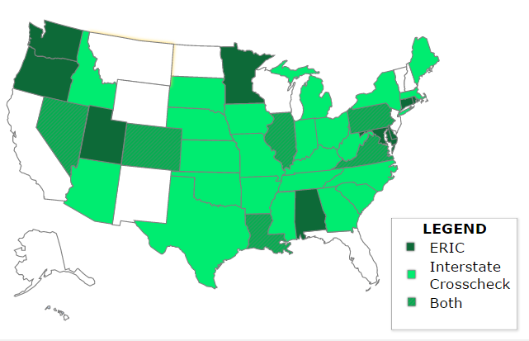
Interstate Data Matching
Notes:
-Interstate Crosscheck and the Electronic Registration Information Center, aka ERIC
-Have seen more legislation on this in the last couple of years.
-Alabama, Texas, and Virginia authorized interstate data-sharing of voter registration lists in 2015. Legislation pending in HI, NJ, WI.
-Appeals to both sides of the aisle: clean rolls help everybody
-While this isn’t so much a “you have it or you don’t have it” like OVR, it is the coming thing

Slide 9
*
Notes:
-32 states have jurisdictions that use EPBs
-authorization not always required
-2 states – Georgia and Maryland – use them statewide.
-States are now looking at process for testing and certifying EPBs – 7 states now do this. The latest are ID and CA in 2015.
-Ohio appropriated $12.7 million to roll out e-poll books across the state
-Wisconsin has looked at it in the past and may again in the future, Rhode Island, New Jersey and Vermont all considering their use

Slide 10
Ballot-on-Demand
California: must be certified by state
Tennessee: must have approval from state to use
Ohio: setting some requirements
Colorado: requires use of ballot-on-demand ballots during pre-election testing

Slide 11
Ballot Marking Devices
California: must be certified by the state
States that set requirements in statute:
  Colorado, New York, West Virginia
Arkansas: incorporates ballot marking device into its definition of a voting machine

Slide 12
Electronic Ballot Transmission
Web Portal: Alabama Alaska Arizona
(5) Missouri North Dakota
Email or Fax: Colorado Delaware District of Columbia
(21+DC) Idaho Indiana Iowa
Kansas Maine Massachusetts
Mississippi Montana Nebraska
Nevada New Jersey New Mexico
North Carolina Oklahoma Oregon
South Carolina Utah Washington
West Virginia
Fax: California Florida Hawaii
(6) Louisiana Rhode Island Texas
None (Mail): Arkansas Connecticut Georgia
(18) Illinois Kentucky Maryland
Michigan Minnesota New Hampshire
New York Ohio Pennsylvania
South Dakota Tennessee Vermont
Virginia Wisconsin Wyoming
Notes:
-the issue that’s being talked about around the edges: voting with assistance from the Internet.
-the iteration of this that is already happening is electronic ballot transmission, which allows some voters (often restricted to UOCAVA voters) to return a voted ballot over email, fax or web-based upload (note that fax is often also considered “internet assisted” since many overseas voters use web-based fax systems). 32 states have this in some form.
-Alabama only has a web-based upload system (fax/email not available). Missouri limits the use of EBT to military voters serving a “hostile zone”

Slide 13
Electronic Ballot Transmission Legislation
Calling for studies or pilots
  Introduced in several states, enacted in Texas
Expanding it to voters other than military/overseas
  Voters with disabilities: Utah (enacted), Montana (failed)
  Out-of-state college students: Kansas (pending), Mississippi (failed)
  Emergency first responders: New Mexico, Missouri (failed)
  Any registered voter: Hawaii (pending)
Notes:
-note that Mississippi allow electronic ballot delivery for emergency first responders

Slide 14
Post-Election Audits
More than half of states have statutorily required post-election audits
  Introduced this year in Kansas
Automated audits
  Authorized by Connecticut and New York in 2015
Risk-limiting audits
  Colorado moving that way by 2017
  California pilots
  Bill failed in Rhode Island in 2015
Notes:
-CT and NY authorized automated audit options in 2015.
-KS legislation pending
-CO moving to risk-limiting audit by 2017
-RI risk-limiting legislation failed

Slide 15
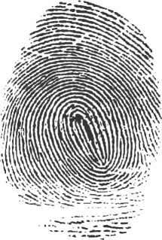
Other Recent Bills of Interest
Election Technology Commissions
Biometric ID
  2015: NM (failed)
  2016: OK “computerized finger image” for voter registration (introduced)

Slide 16
Voting Systems
Most states use some aspect of the EAC’s testing and certification program:
  12 states require full federal certification
  9 and D.C. require testing to federal standards
  16 states require testing by a federally accredited laboratory
  4 states refer to federal agencies or standards, but do not fall into the categories above
  9 states have no statutes or regulations that mention a federal agency, certification program, laboratory, or standard, but most of these still rely on the federal program for guidance
Notes:
-Legislation around this isn’t a huge trend by any means – we’re talking 1% of the election legislation bills enacted.
-But there have been some bills updating references to technology: for example removing recommendations to Votomatic punch card machines, defining “electronic media device”
-legislation removing references to NASED or the FEC in regards to standards, testing and certification
-mention CA from 2014?

Slide 17
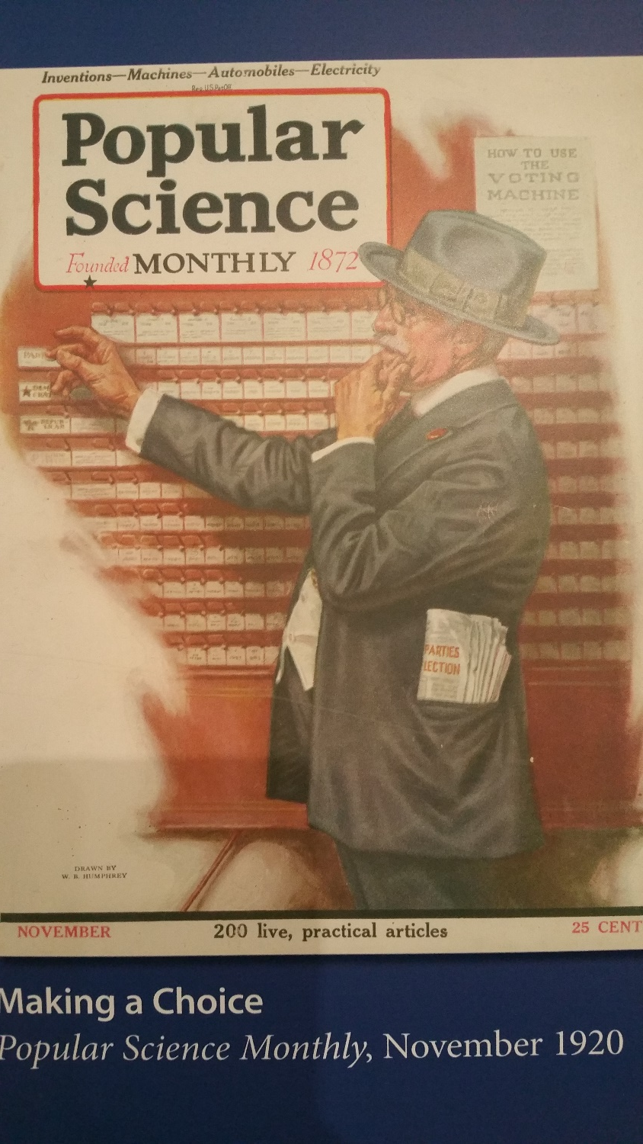
Aging Voting Equipment
The majority of jurisdictions across the country bought equipment between 2002 and 2008.
Now many of these systems are aging – whose responsibility is it to purchase new ones?
HAVA state plans concentrated much of the power/responsibility of purchasing on the states.
Notes:
-the question for states: do they want to keep the power/responsibility of purchasing equipment? Some argue it should go back to the local level. Others are surprised this is even a conversation.

Slide 18
Potential Funding Streams:
Ways States are Helping
Direct appropriation for statewide bulk purchase
Funding split 50/50 between state and counties
State negotiating contract
Dedicated revenue through fees
Grant programs to counties
Notes:
-direct appropriation: New Mexico: Prior to HAVA each county chose and bought its own equipment, and the state had a voting system revolving fund. Now, there’s a statewide system – state negotiated contract with vendor. Funds provided by legislature in two appropriation “chunks.” The state maintains the machines and oversees storage requirements and upgrades.
-Funding split 50/50: Maryland
-State negotiating contract: Colorado. UVS study group over the last two years, pilots of different systems in various counties, state chose a system. SOS office can’t obligate counties to use the Dominion system, but it will be the only system that they provide support for and will be the only certified system in the state (statute requires counties to only use certified systems). State providing inducement in the form of leftover HAVA funds. $850,000 is being made available for paying up to 50 percent of county costs in training, testing, installing and managing the use of new Dominion voting machines. not all counties will buy right away.
-dedicated revenue through fees: business side of SOS, LA just enacted legislation allowing SOS to charge for maps that it produces and put that money into the Voting Technology Fund
-MO grant programs to counties with leftover HAVA funds

Slide 19
Potential Funding Streams:
Local Jurisdictions
Capital requests
Budgeting over time
Using county funds to buy in bulk
Notes:
-often more possible for the larger counties
-smaller counties may have to budget over time – anecdotally, many don’t know where the funds are coming from
-4 big counties in KS, 12 small counties in FL getting together – with the help of the state (or not)

Slide 20
Other Things Being Considered to Manage Costs
Leasing
COTS
Open source software
Notes:
-leasing – Maryland chose this option and smaller jurisdictions are considering it as well.
-COTS – this is being talked about in a lot of places. I don’t have a good estimate of how many jurisdictions may be using or planning to use COTS hardware in some way, but it is certainly something being discussed.
-Travis County, L.A., SF

Slide 21
Questions?
Katy Owens Hubler
435-647-6051
katyowenshubler@democracyresearch.com

