Slide 1
Election Day Process Models
Bob Giles
TGDC, February 8-9, 2016

Slide 2
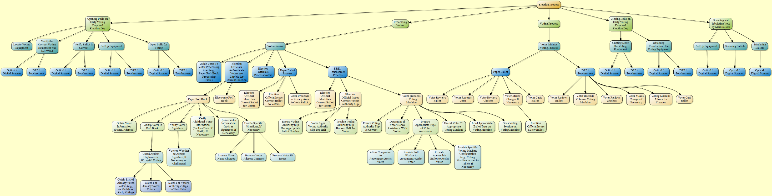
Election-Day Process Model

Slide 3
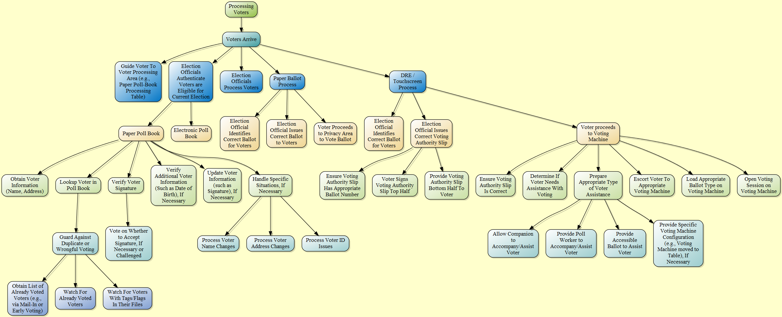
Processing Voters

