Slide 1

Metrology and Entanglement Distribution in Metropolitan Quantum Networks
Thomas Gerrits
Jaden He
Paulina Kuo
Ya-Shian Li-Baboud
Jabir MV
Anouar Rahmouni
Yicheng Shi
Abdella Battou
Riley Dawkins
Jing Su
Boris Korzh
Oliver Slattery
Josh Bienfang
Alan Migdall
Ivan Burenkov
Sergey Polyakov
Pranish Shrestha
Mheni Merzouki
Abderrahim Amlou
*Any mention of commercial products is for information only; it does not imply recommendation or endorsement by NIST.

Slide 2
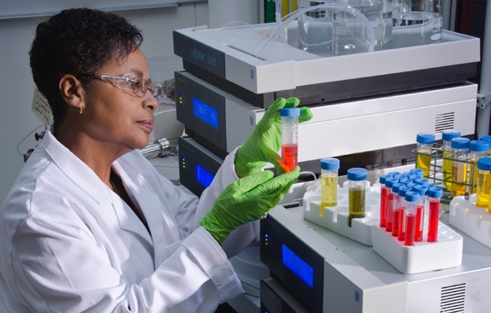
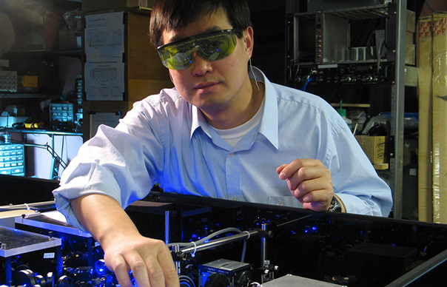
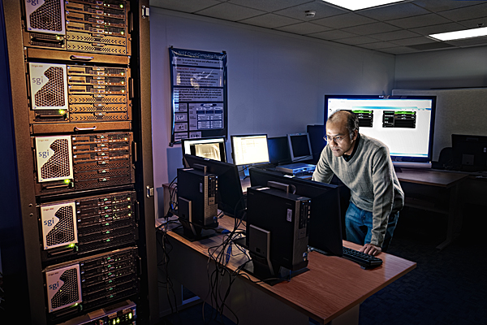
NIST Mission
To promote U.S. innovation and industrial competitiveness by advancing measurement science, standards, and technology in ways that enhance economic security and improve our quality of life
a
©Robert Rathe
Credit: J.Burrus/NIST
©Nicholas McIntosh Photography

Slide 3



Quantum Networking
To promote U.S. innovation and industrial competitiveness by advancing measurement science, standards, and technology in ways that enhance economic security and improve our quality of life
Testbeds
When do things break?
Metrology
How do things break?
Standards
Inform future standards
©Robert Rathe
©Nicholas McIntosh Photography

Slide 4
It’s All About Transporting Photons
Sources
Detectors
Switches
Fibers
Converters
Memories
Repeaters
Qubits
etc.
components
components
C
C
components
quantum link, e.g. fiber
classical link
Node
It’s a challenge! Deployed Fibers
Retain information imprinted on photons
Heterogenous operation

Slide 5
Quantum Networking Challenges
Must operate in practical, deployed environment
Compared to Classical Networking, Quantum Networking needs:
  Noise to be 9 orders of magnitude lower
  Timing to be 5 orders of magnitude better
Understand and reduce sources of noise/errors due to more stringent requirements
Measurements will destroy the qubits – a need for non-invasive telemetry

Slide 6
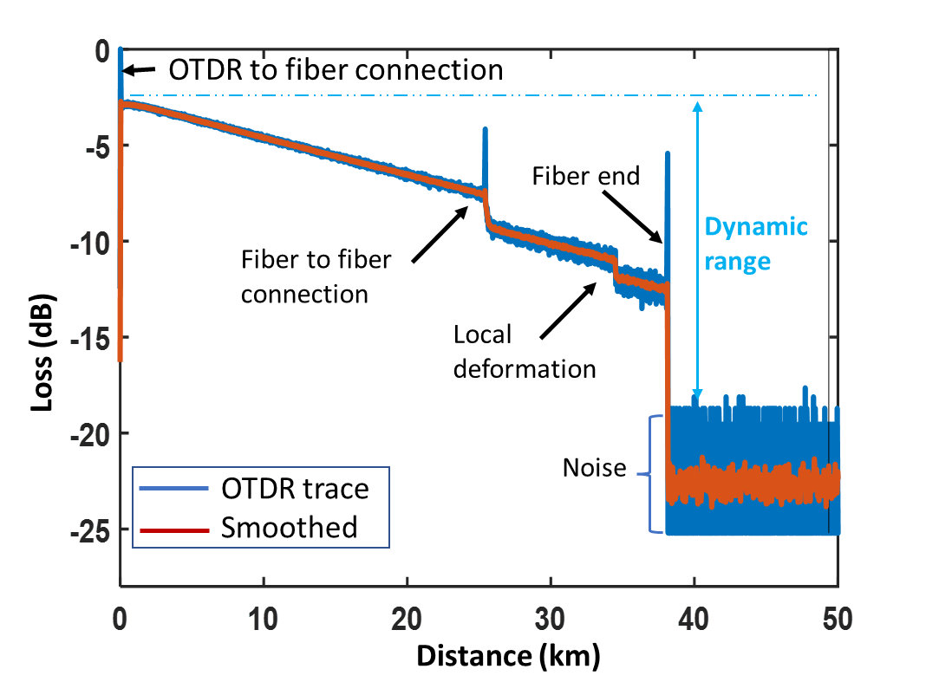
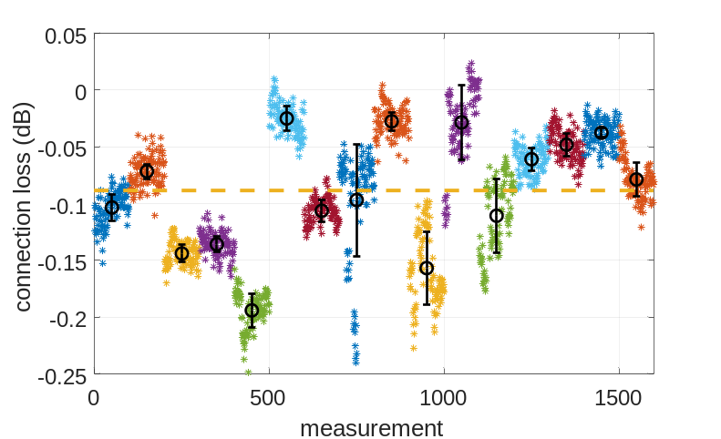
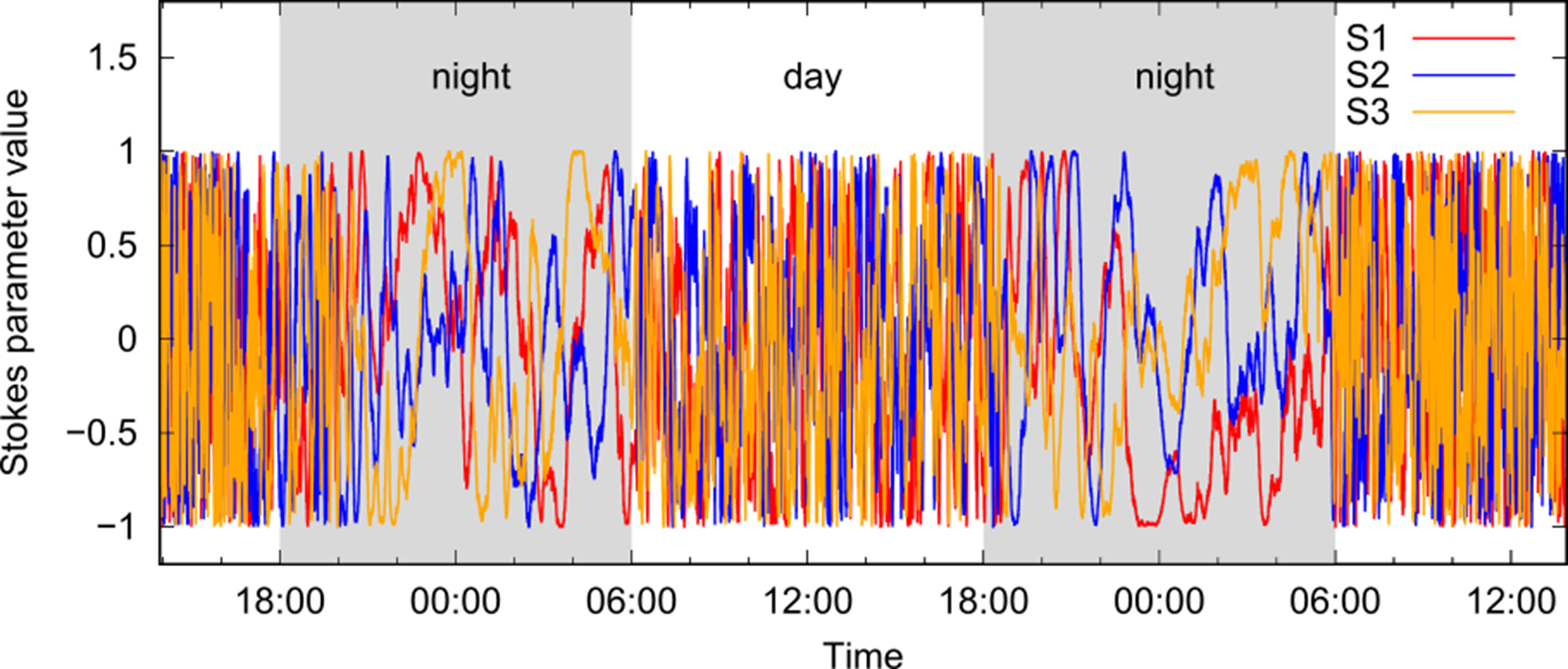
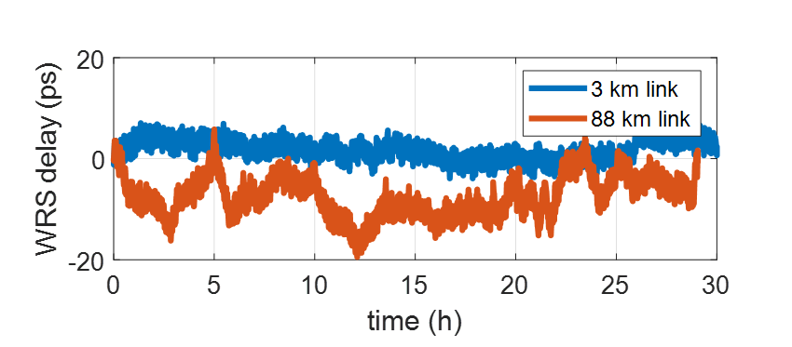
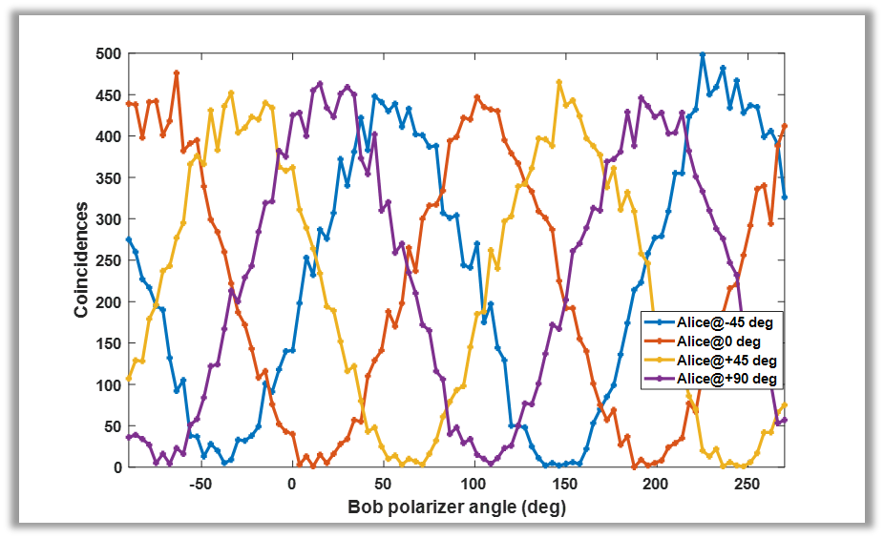
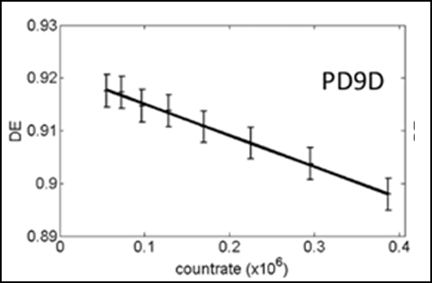
Quantum Network Metrology Tasks
Fiber loss characterization
Fiber connector loss characterization
Fiber polarization stability
Detector characterization
Node synchronization
Quantum/Classical Coexistence
Notes:
Metrology for Quantum
Quantum for Metrology

Slide 7
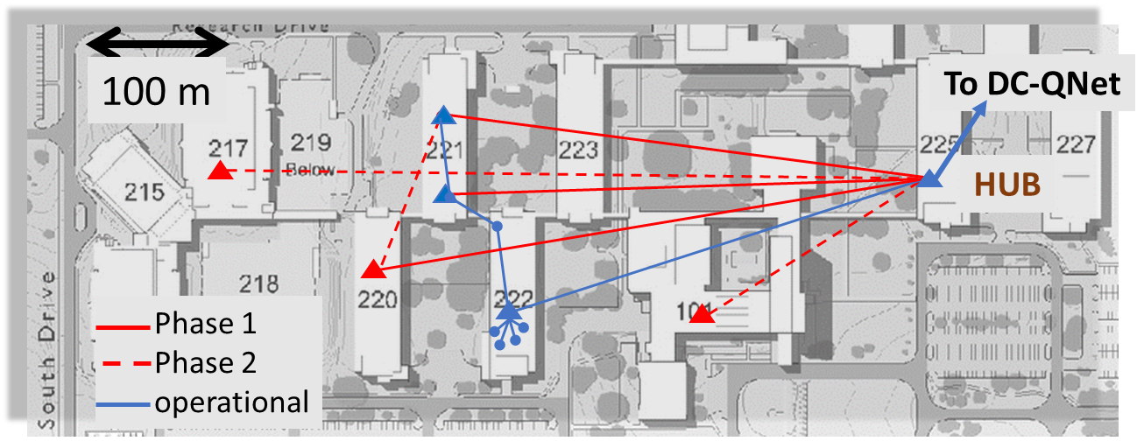
Testbeds
to UMD
100 m

Slide 8
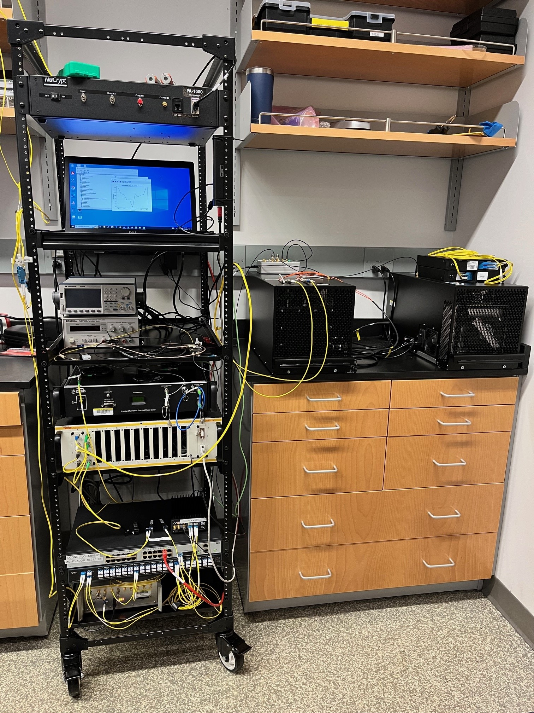
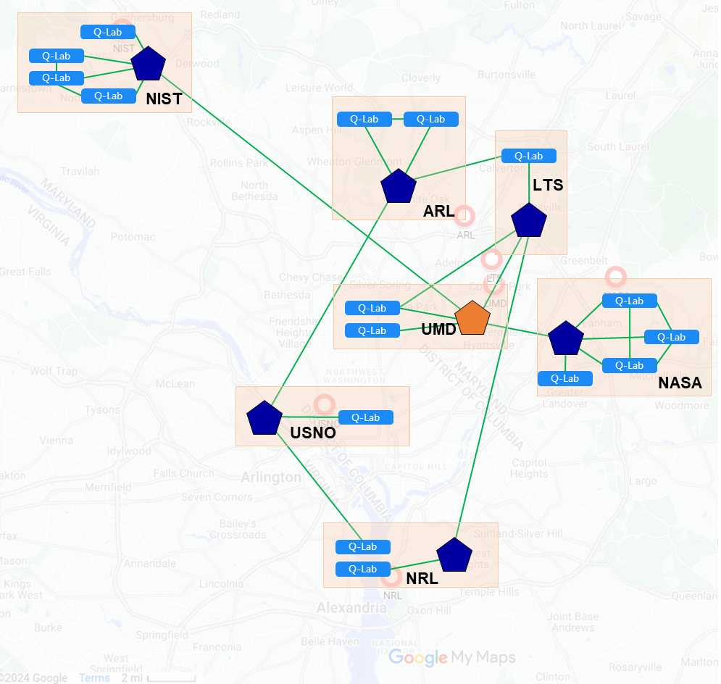
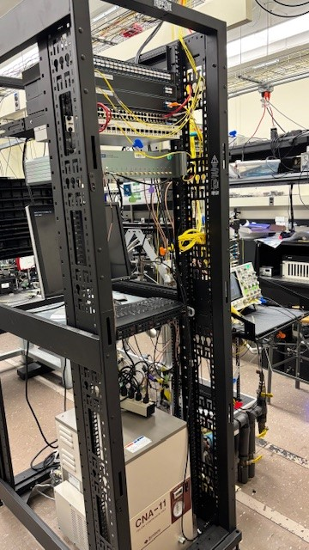
NIST – UMD(JQI) Quantum Network Nodes
60 km aerial fiber
14 km
Quantum network nodes
Entangled Source
Detectors
Time taggers
Synchronization
Polarization stabilization

Slide 9
Benchmarking Synchronization Systems
Polarization Entanglement Distribution Over Aerial Fibers
Optical Fiber Connector Loss

Slide 10
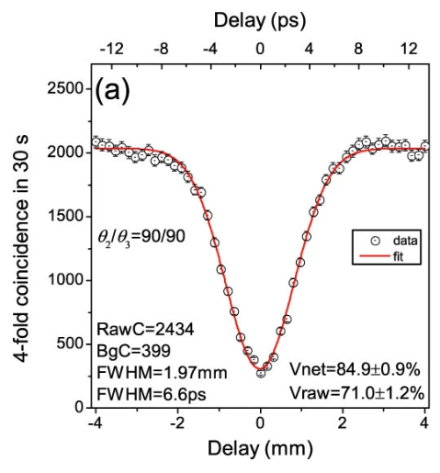
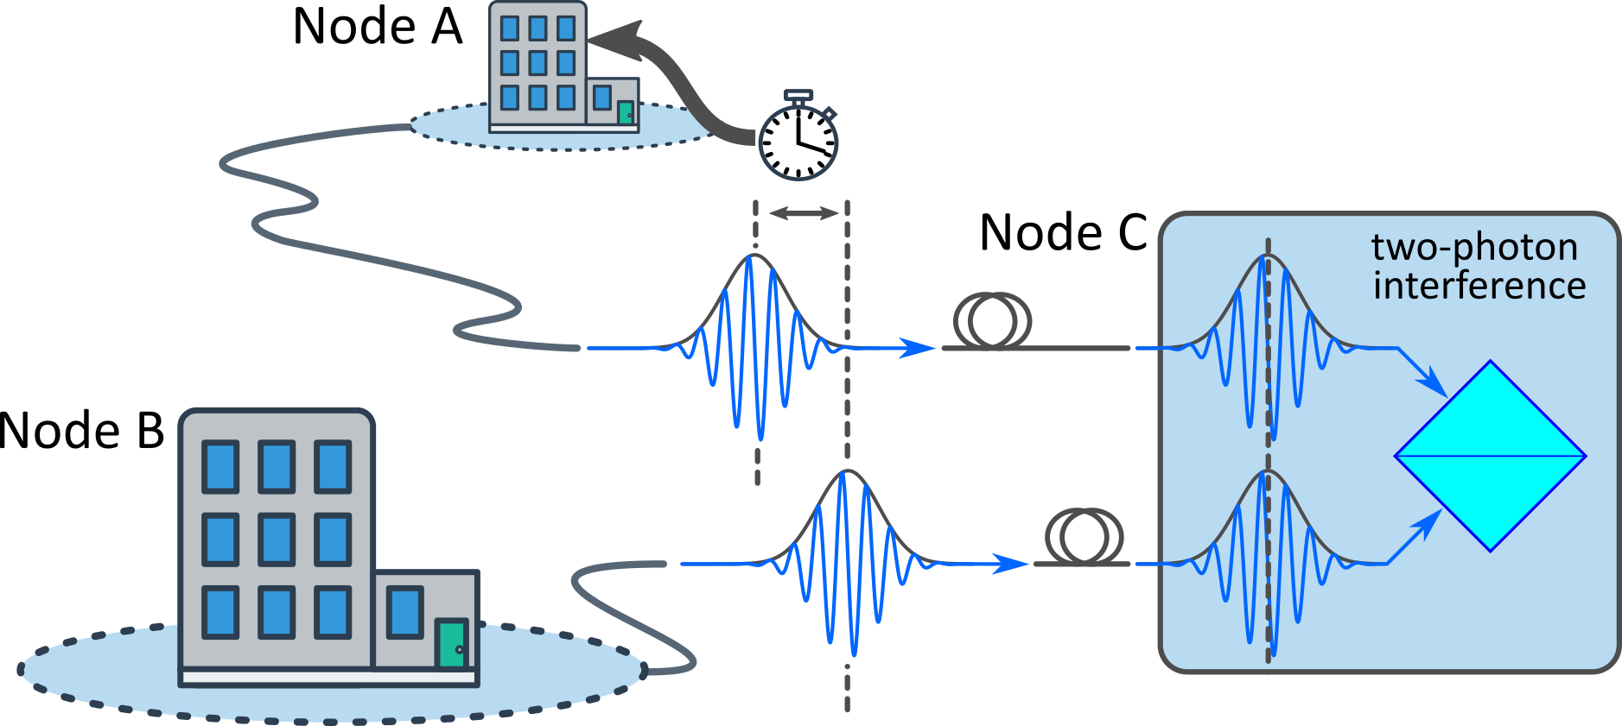
Node synchronization: Entanglement Swapping
Excellent synchronization is required
Polarization must be stabilized
Photon noise must be mitigated
Jin et al, Sci Rep 5, 9333 (2015)
10’s km
*
*10 ps ≡ 2 mm in fiber
Notes:
Why do we need stabilization systems? On the right you see a representative graph for a foundational operation on a QN. Entanglement swapping. Entanglement swapping is needed to cover long distances for QNs to mitigate loss that occurs within the optical fiber. Entanglement swapping entails the simultaneous arrival of two photons from distant nodes at the location where the swapping occurs. These photons travel at the speed of light and were very short, about 10 ps to be more precise, and their temporal shape is indicated by this Gaussian envelope. 10 ps at the speed of light corresponds to 2 mm path length in optical fibers. So, we are now trying to solve the challenge of having two photons, at the speed of light, arrive within less than 2 mm from one another after having travelled through ten’s of km of fibers. Also, some very efficient swapping protocols require optical phase stabilization – here we are talking about attosecond stabilization – another 3 orders of magnitude. I guess you can see how difficult this is in a deployed environment. Furthermore, swapping requires both photons to have the same polarization, and therefore polarization must also to stabilized. All of this stabilization has to happen without imposing noise on the delicate quantum photons.

Slide 11
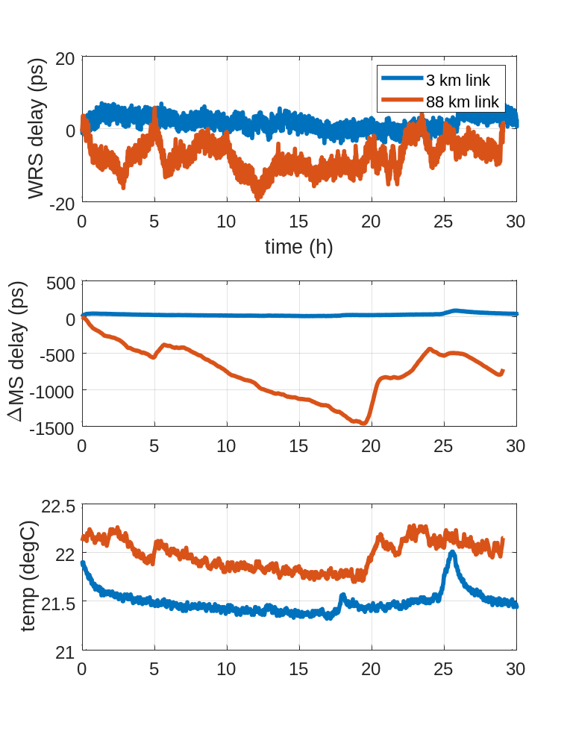
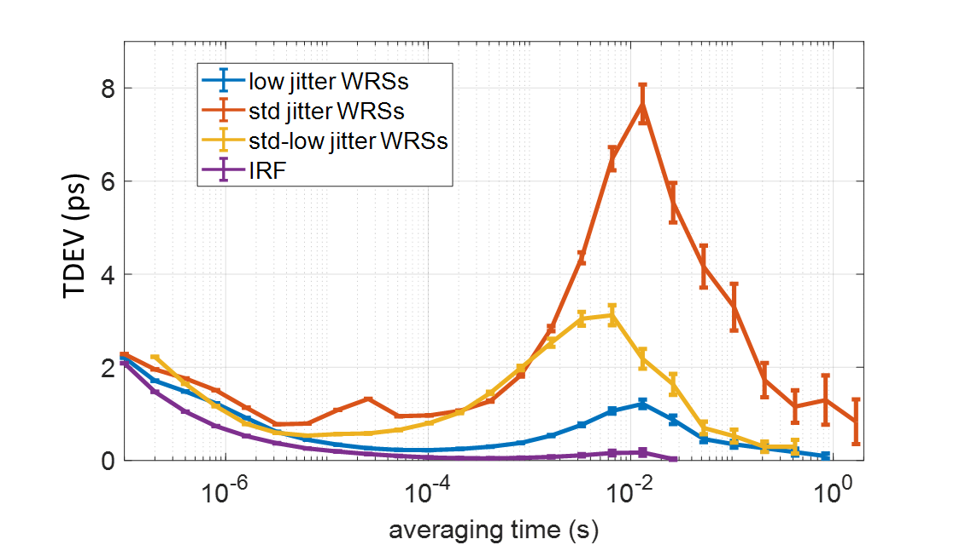
High-Accuracy PTP Performance
Long term stability
Short term stability
Short term stability: ~ 1 ps
Long term stability: < 5 ps p-p @3 km
< 30 ps p-p @88 km (in lab)
T. Gerrits, et al., CLEO 2022, paper FM1C.2.

Slide 12
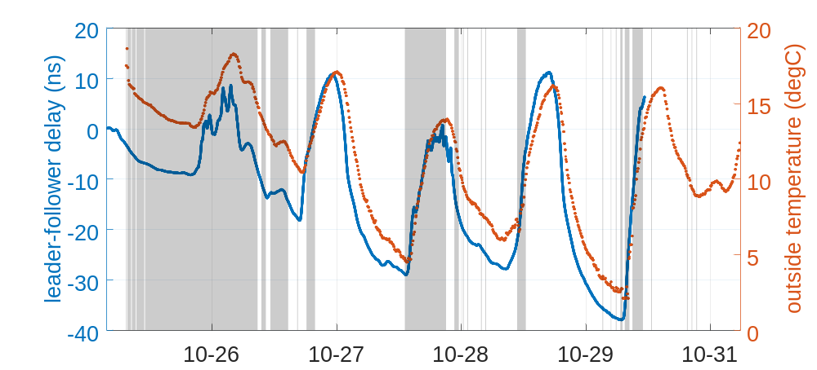
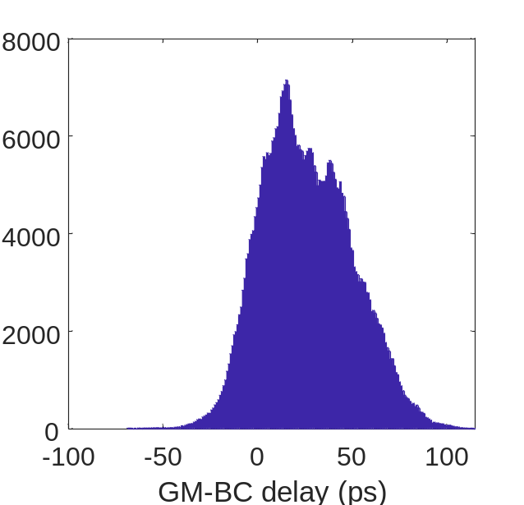
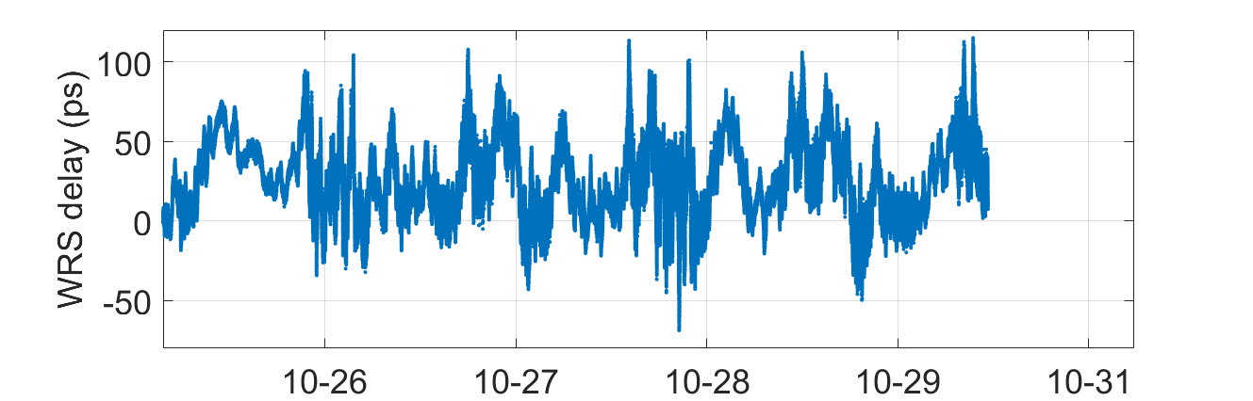
Metropolitan Scale Node Synchronization
60 km aerial fiber link
Δt_{p-p} = 184 ps
Δt_{FWHM} = 60 ps
GM – BC delay (ps)
W. McKenzie, et al., CLEO 2023, paper FF3A.3.

Slide 13
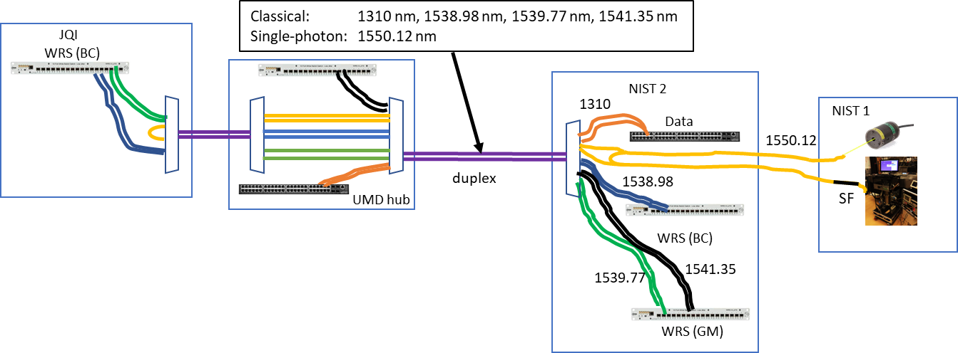
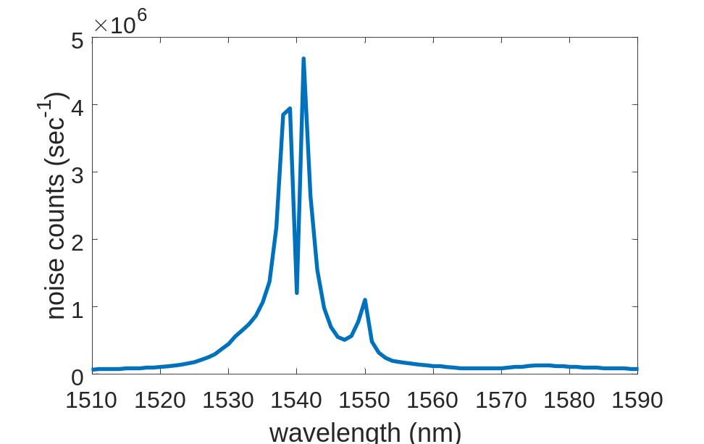
Benchmarking Synchronization Systems
pulsed laser
(pilot)
SNSPD
1538.98
1541.35
1539.77
1550.12
Single-photon
spectrum
Dongxing He, et al., J. Opt. Commun. Netw. 17, 1128-1135 (2025)

Slide 14
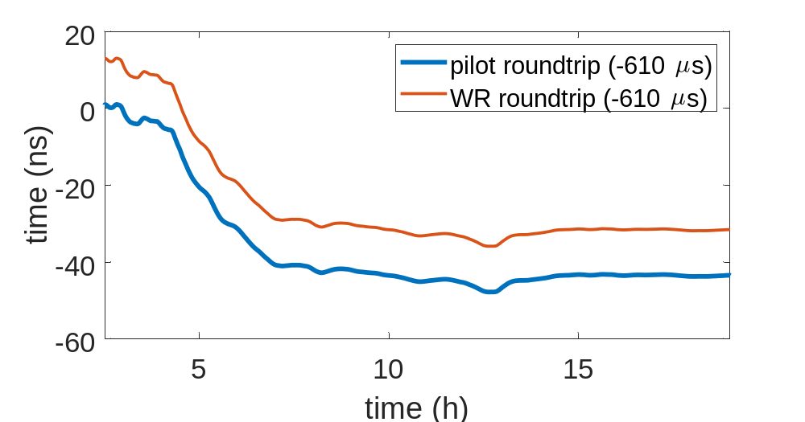
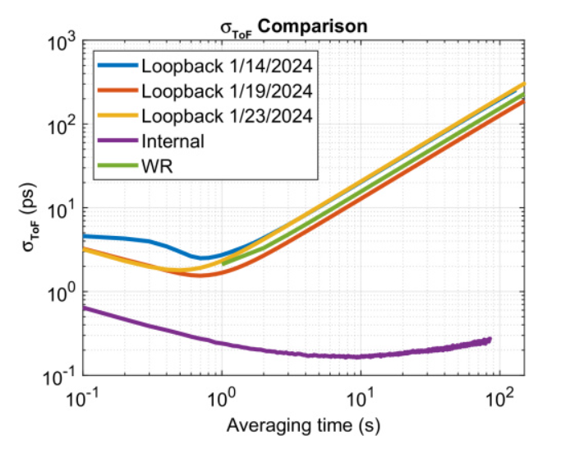
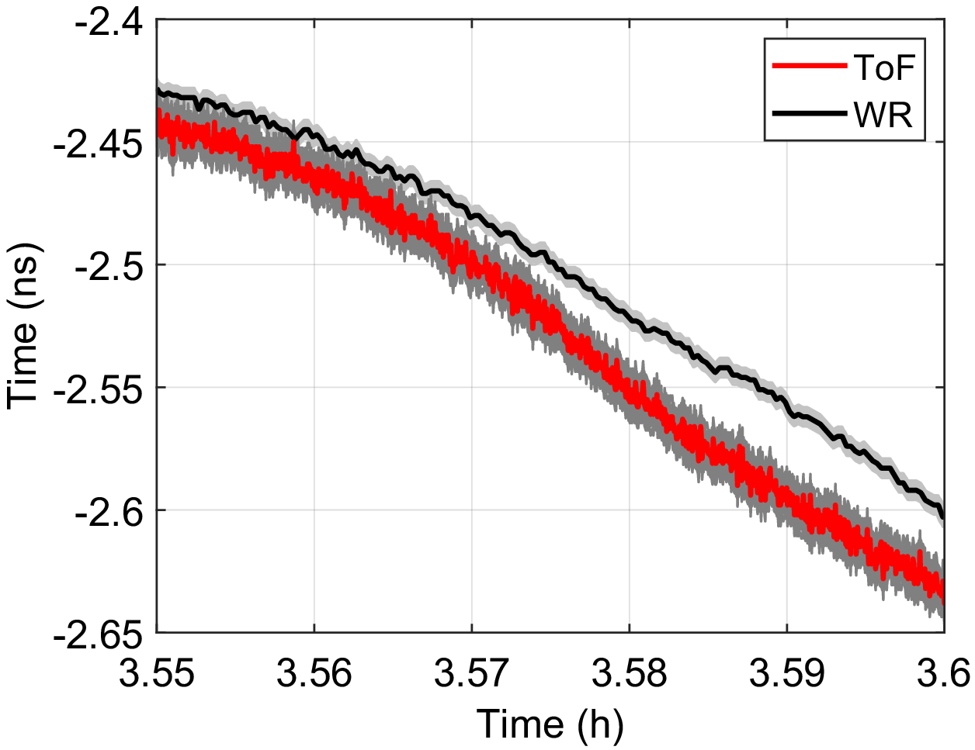
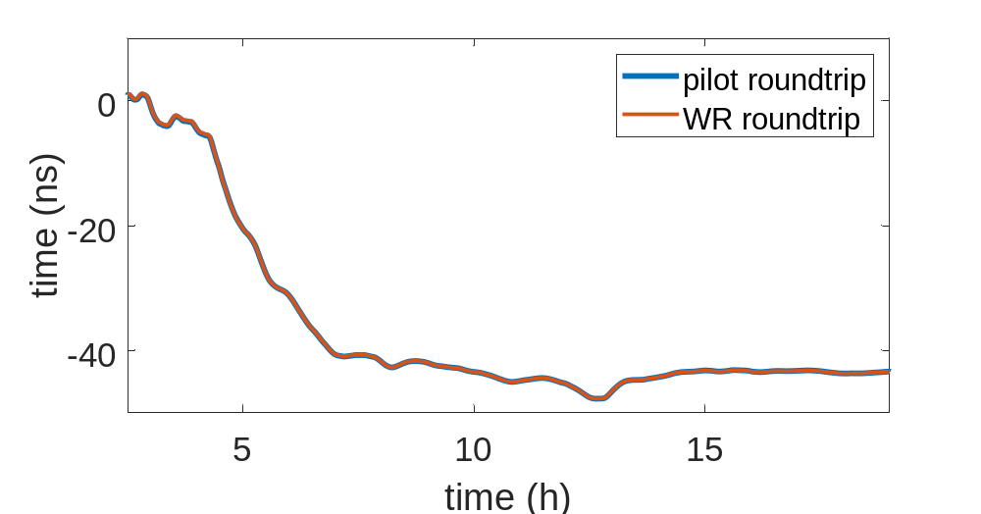
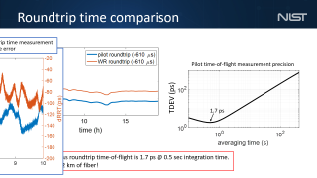
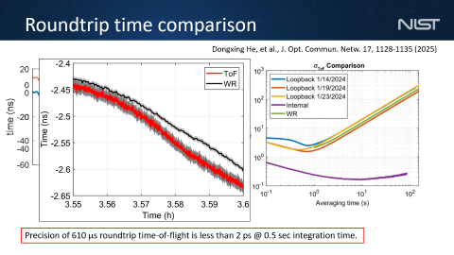
Roundtrip time comparison
Dongxing He, et al., J. Opt. Commun. Netw. 17, 1128-1135 (2025)
Precision of 610 μs roundtrip time-of-flight is less than 2 ps @ 0.5 sec integration time.

Slide 15
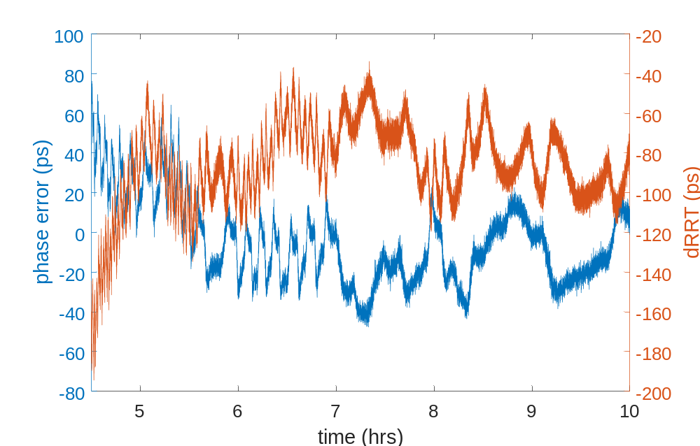
Roundtrip time comparison
WR roundtrip time measurement
& WR phase error
Dongxing He, et al., J. Opt. Commun. Netw. 17, 1128-1135 (2025)
Phase error (10’s of ps) matches in amplitude the difference between WR-RTT estimate and time-of-flight.

Slide 16
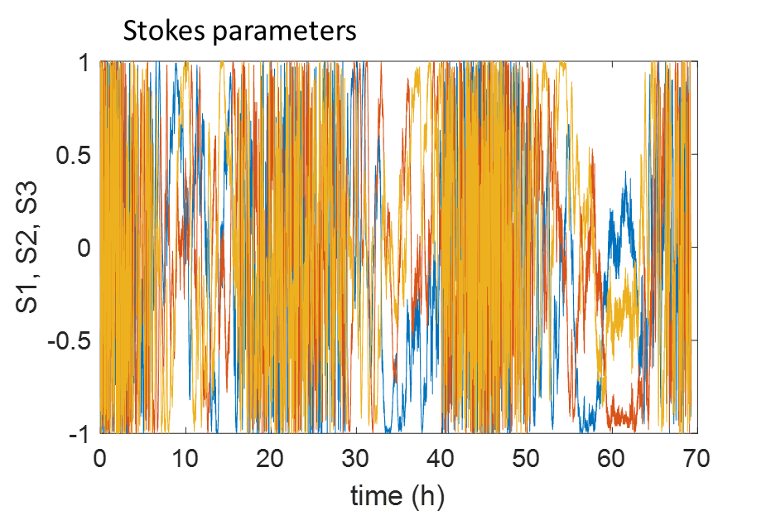
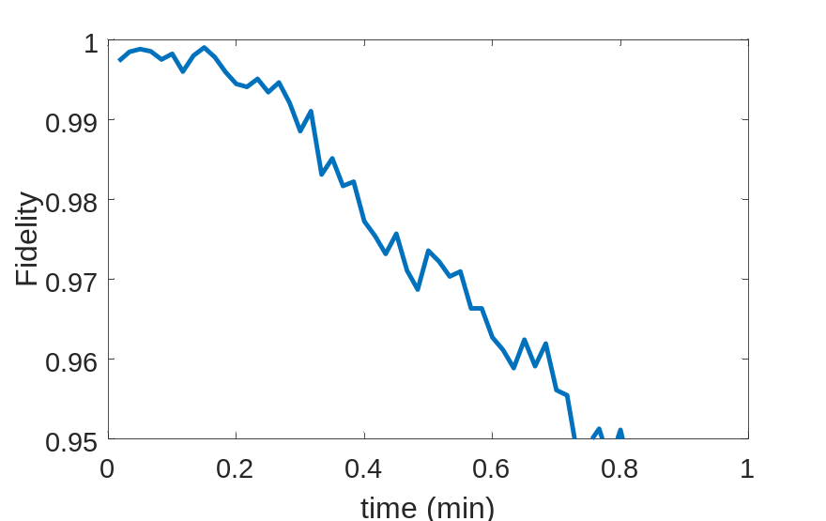
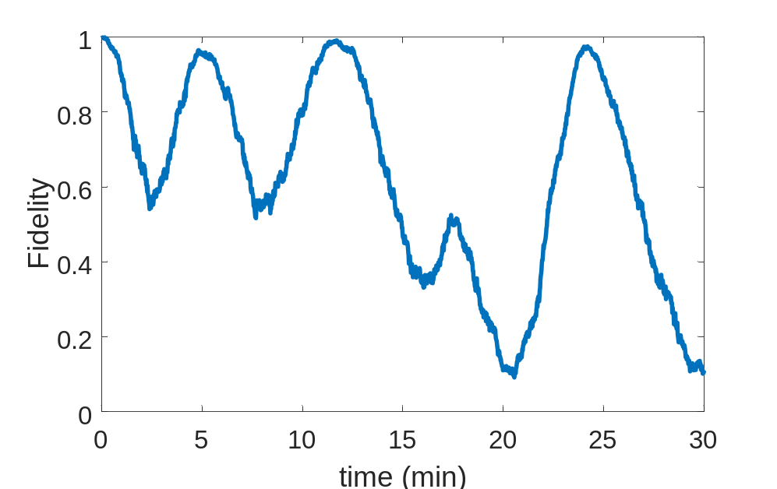
Aerial Polarization State Fidelity Drift
Active stabilization is required
Fidelity vs. time
Fidelity vs. time

Slide 17
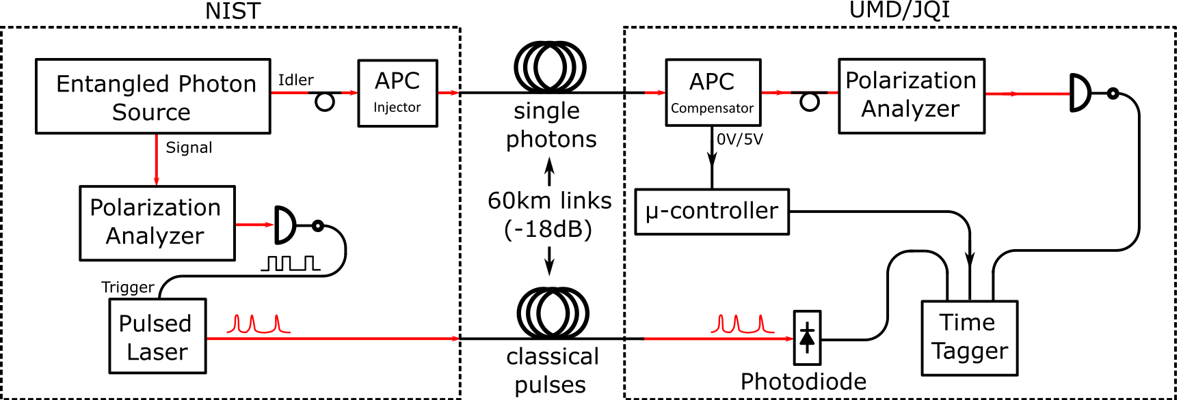
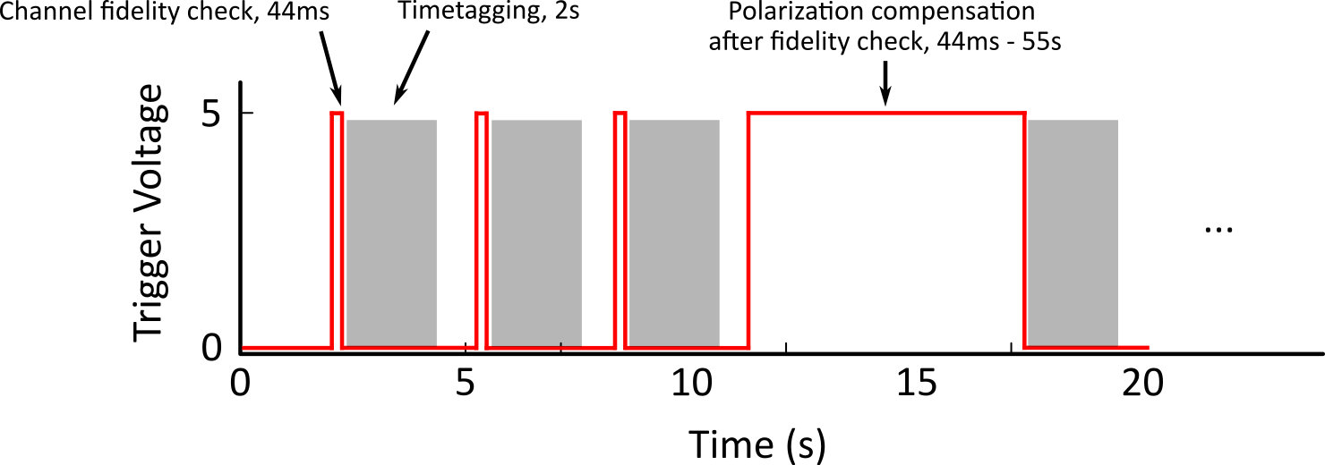
Incorporating Polarization Stabilization in Entanglement Distribution
APC performs compensation if fidelity check result < 98%;
Time-tagging sessions scheduled right after compensation
Y. Shi, et.al. J. Opt. Commun. Netw. 18, 813-819 (2026)

Slide 18
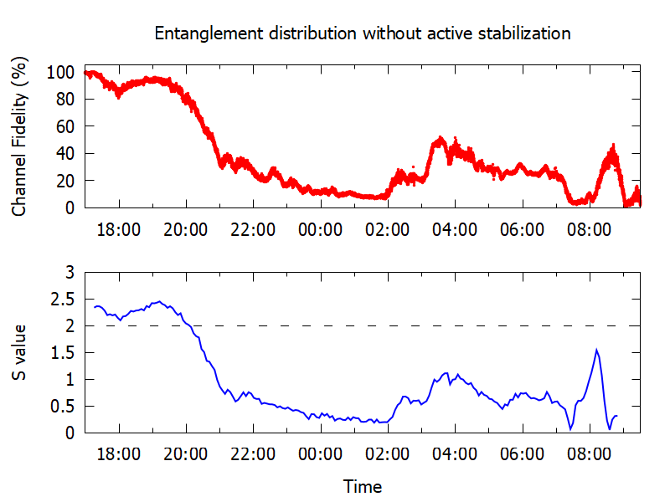
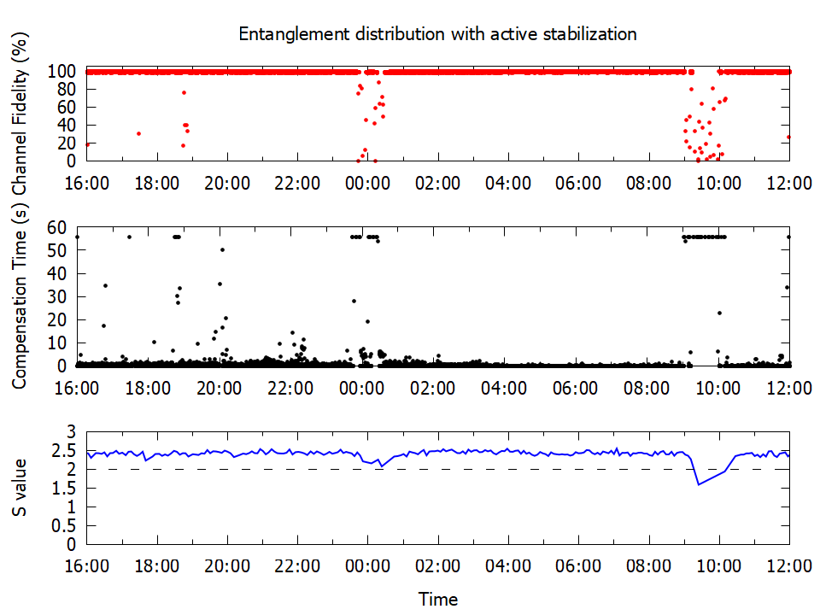
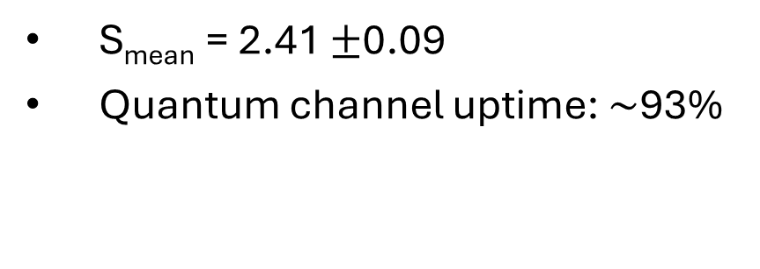
Entanglement Distribution over Polarization-stabilized fiber: Result
S_{mean} = 2.41 $±$0.09
Quantum channel uptime: $\sim$93%
Y. Shi, et.al. J. Opt. Commun. Netw. 18, 813-819 (2026)

Slide 19
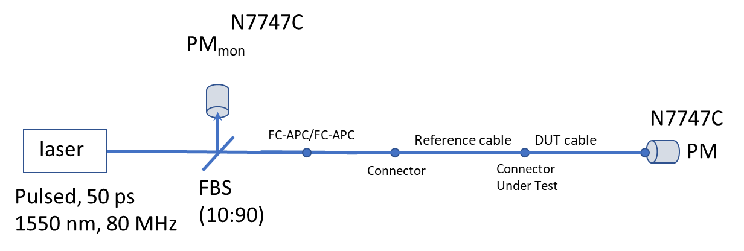
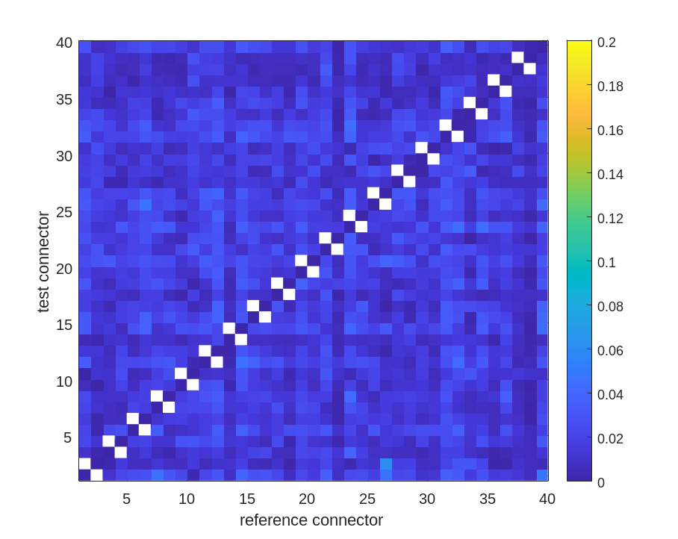
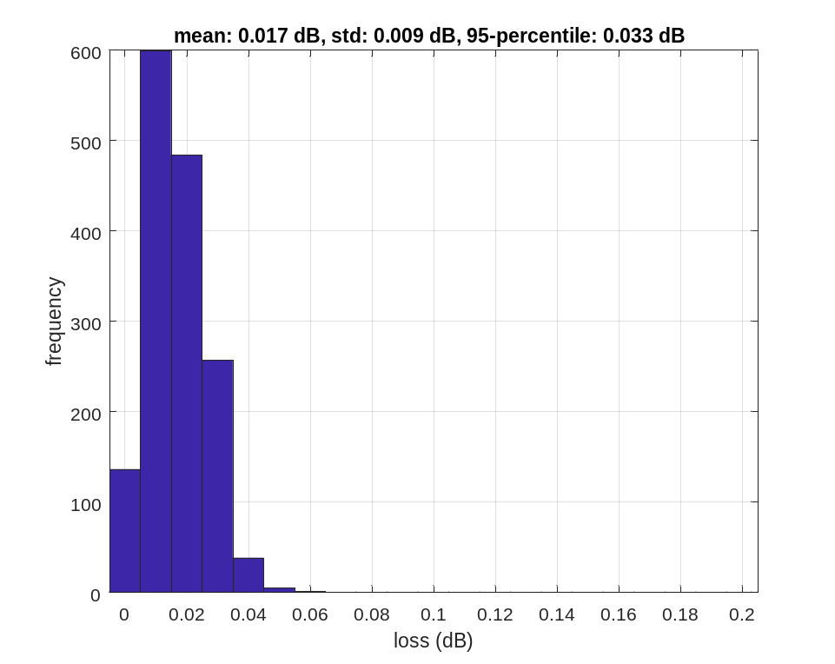
Low-loss, high repeatability fiber connectors
Evaluate 40x40 random fiber connector matings on a batch of 20 patchcords following IEC 61300-3-34 standard
Loss: 0.39 ± 0.21 %
95-percentile: 0.76 %
J. Su et al., CLEO 2026, paper JTU.176.

Slide 20
Conclusions & Outlook
Metrology will play an important role for the success of Quantum Networks
We are studying the behavior of deployed fibers to mitigate sources of noise
Metrology will be integrated into the quantum network control plane
Synchronization benchmarking can identify errors in node synchronization
Successful distribution of entanglement over a 60 km aerial noisy fiber link
Thank you!
We are hiring!!! Now accepting applications for Postdoc and Graduate Student positions in experimental quantum optics for quantum networking.
gerrits@nist.gov

Slide 21

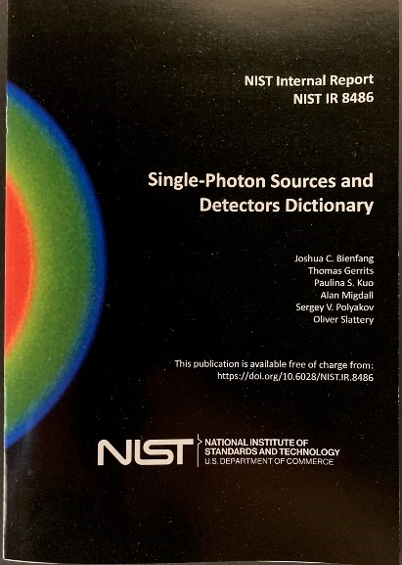



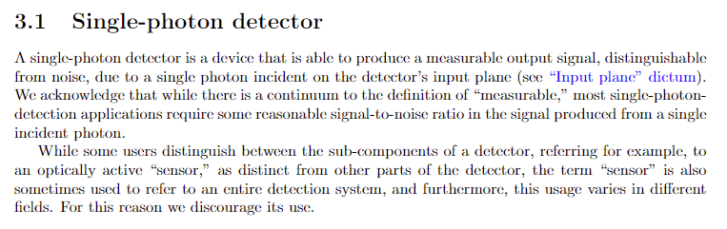
Device Metrics - Dictionary
A common language to promote clarity in communication
Provides clarity on datasheets
Serves as basis for standard development

