Slide 1
Measurement Process Flow Chart
(EXAMPLE: Nanotoxicity Assay)
Seed Cells
Add Nanoparticles
Incubate 24 h
Remove Supernatant
Treat with MTS Reagents
Measure Abs₄₉₀

Slide 2
Measurement Process Flow Chart (TEMPLATE)

Slide 3
Measurement Controls (TEMPLATE)
Variables/Factors | Why an Issue? | Control Experiment /Approach | Reference Material?
EXAMPLE: Nanotoxicity assay: Variable: Cell toxicity response | Cell response varies due to many factors (passage, incorrect seeding, variability in medium, contamination, etc.) | Add cadmium sulfate to cells to establish a reproducible “toxic” response in the assay | Cadmium sulfate

Slide 4
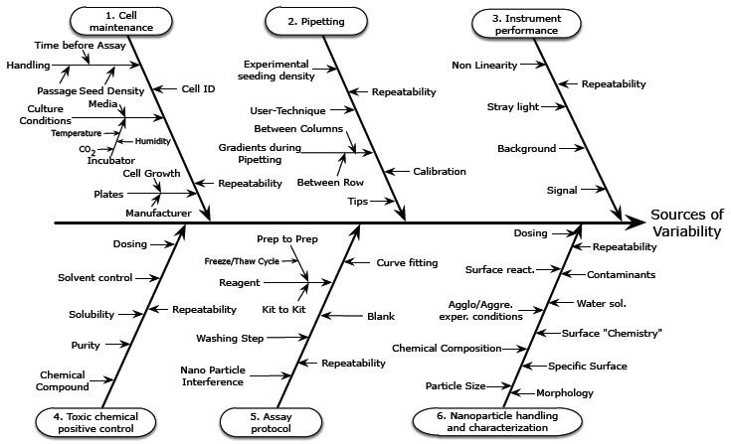
Ishikawa Diagram (EXAMPLE: Nanotoxicity Assay)
Rösslein M, Elliott JT, Salit M, Petersen EJ, Hirsch C, Krug HF, Wick P. Use of Cause-and-Effect Analysis to Design a High-Quality Nanocytotoxicology Assay. Chem Res Toxicol. 2015, in press.

Slide 5
Ishikawa Diagram (TEMPLATE)
Cause
Effect
Problem

Slide 6
Reference Materials (TEMPLATE)
1
What reference materials do you employ in your assay. How & why do you use them?
2
What needs do you see for new or better reference materials. How would you use them? Why?
What properties must be specified for the proposed new reference materials?

Slide 7
Inter-Laboratory Studies (TEMPLATE)
1
What is the goal of the inter-laboratory study? Tech. transfer? Establishing a standard test method?
4
What process controls should there be?
1. | 4.
2. | 5.
3. | 6.
Others?
2
Participating Labs
1. | 4.
2. | 5.
3. | 6.
Others?
3
How will the SOP be established? | How will operators be trained? | Parameters that must be tested for sensitivity? | Materials to distribute to all participating labs? | Materials provided by the participating labs? | What level of agreement is adequate? When are we done?

