Slide 1
Technical Overview of NIST-Developed Tool to Assess IIS Data Quality
Hossam Tamri, NIST
AIRA National Meeting
May 2-4, 2023

Slide 2
Table of contents
qDAR Workflow Overview
Message Quality Evaluator (MQE)
qDAR Command Line Interface
  Data Extract
  Analysis Configuration
  qDAR CLI Overview
  Aggregate Detections File (ADF)
  HTML Summary
  Reporting Group Hashes Mapping
qDAR Web Application
  Web Application Overview
  ADF Analysis
  Analysis Report

Slide 3
qDAR Workflow Overview
patients.tsv
P
Configuration.json
IIS
qDAR CLI
C
vaccinations.tsv
V
HTML Summary
Aggregate Detections File
Reporting Group Hash Mapping
S
ADF
RH
IIS Side
AIRA Side
Create Configurations
Create Report Templates
Run Queries
Create Reports
Manage ADFs
qDAR Web App
Analysis
Reports

Slide 4
Message Quality Evaluator (MQE)
MQE Detections
MQE0141 – Patient name first is missing
MQE0309 – Vaccination CVX code is unrecognized
MQE0263 – Vaccination admin date is on first day of month
[…]
HL7 Message
MQE
M
Used in the qDAR CLI project
Detection engine developed and maintained by the MQE community
Allows detection of data quality issues and other notable characteristics
Each detection is identified by a unique MQE code (E.g. MQE0141)

Slide 5
qDAR CLI

Slide 6
Data Extract
patients.tsv
Cohort subject to data quality analysis is defined by AIRA
Tab separated files
Each column contains either data or metadata
  AIRA Data Extract specification provides guidance on fields extraction
Patient demographic information
  Patient name, DOB, address…etc.
Vaccination information
  Vaccination date, CVX, MVX,…etc.
  Reporting Group Field
    Used to group immunization records for reporting purposes
    Entity that is viewed as the owner of this vaccination event
P
IIS
vaccinations.tsv
V
Metadata Values
Excluded | [[EX]]
Not Collected | [[NC]]
Not Extracted | [[NE]]
Value Present | [[VP]]
Value Not Present | [[NP]]
Value Length | [[LEN {n}]]

Slide 7
Data Extract
patients.tsv
Patient ID | Name First | Name Middle | Name Last | Mother Maiden | Mother Last | DOB | Gender | Street Address | …
ABC123 | [[VP]] | [[NP]] | [[VP]] | [[VP]] | [[NP]] | 01012021 | M | 10 Main Str | …
DEF456 | … | … | … | … | … | … | … | … | …
vaccinations.tsv
Patient ID | Event ID | Reporting Grp | Sending Org | Responsible Org | Location | Provider | CVX | NDC | Date | …
ABC123 | X | Group 1 | [[VP]] | [[VP]] | [[NE]] | [[NE]] | 08 | [[NP]] | 02012021 | …
ABC123 | Y | Group 1 | [[NP]] | [[NP]] | [[NE]] | [[NE]] | 108 | [[NP]] | 03102021 | …
ABC123 | Z | Group 2 | [[VP]] | [[NP]] | [[NE]] | [[NE]] | 102 | [[NP]] | 04052021 | …
XYZ123 | A | … | … | … | … | … | … | … | … | …

Slide 8
Analysis Configuration
patients.tsv
P
Configuration.json
IIS
qDAR CLI
C
vaccinations.tsv
V
The configuration file is distributed by AIRA with the CLI
Contains parameters for the analysis
  Age group brackets to use for aggregation
    E.g., Birth -> 1 month, 1 month -> 2 months, 2 months -> 3 months …
  MQE detections to check for
  Fixed date of evaluation (as-of date)
    Ensures consistent age grouping regardless of when the analysis is performed

Slide 9
qDAR Command Line Interface Overview
patients.tsv
P
IIS
Configuration.json
qDAR CLI
C
vaccinations.tsv
V

Slide 10
qDAR Command Line Interface Overview
Self contained JAR file – No access to internet or databases required
Leverages MQE project to detect data quality issues
How it works
  Iterates through patient records and fetches their vaccinations
  Consolidates into a “Patient Vaccination Record”
  Runs the record through MQE
    Aggregates detections counts
  Collects coded values used in the record
    Aggregates vocabulary code counts
  Aggregates vaccination events CVX code counts
    Based on Age group, Vaccination Year, Event Source, Gender
  Writes results to an aggregate detections file (ADF)
  Encrypts ADF – Using qDAR’s public key

Slide 11
Aggregate Detections File
patients.tsv
P
IIS
Configuration.json
qDAR CLI
C
vaccinations.tsv
V
HTML Summary
Aggregate Detections File
Reporting Group Hash Mapping
S
ADF
RH

Slide 12
Aggregate Detections File
Metadata Fields
Field | Content
Total Analysis Time | The total time the CLI took to finish the analysis
Analysis Date | The date the analysis was run
Configuration | A copy of the configuration that was used for the analysis
Summary | Counts of processed records, patients by age group, and counts of populated data fields
Version | Version of the CLI used to perform the analysis
Build | Build date of the CLI used to perform the analysis
MQE Version | Version of MQE embedded in the CLI
Inactive Detections | List of detections that could not be checked because MQE doesn’t support them
Historical | Number of historical vaccination records found
Administered | Number of administered vaccination records found

Slide 13
Aggregate Detections File
Patient Related Detections
Age Group | Detection Code | Counts (negative, positive)
1 month -> 2 months | MQE0141 | (1, 10)
 | MQE0650 | (3, 5)
2 months -> 3 months | MQE0141 | (1, 2)
 | MQE0650 | (4, 9)
Patient Related Vocabulary
Age Group | Table | Codes | Counts
1 month -> 2 months | GENDER_0001 | M | 10
 |  | F | 5
 | LANG_0296 | ENG | 15
 |  | FRE | 1

Slide 14
Aggregate Detections File
Vaccination Event Related Detections
Reporting Group Hash | Age Group | Detection Code | Counts (negative, positive)
REPORTING_GROUP_ONE | 1 month -> 2 months | MQE0141 | (1, 10)
 |  | MQE0650 | (3, 5)
 | 2 months -> 3 month | MQE0141
 |  | MQE0650
REPORTING_GROUP_TWO | …. | …. | ….
Vaccination Event Related Vocabulary
Reporting Group Hash | Age Group | Table | Codes | Counts
REPORTING_GROUP_ONE | 1 month -> 2 months | CVX | 08 | 10
 |  |  | 110 | 5
REPORTING_GROUP_TWO | …. | …. | …. | ….

Slide 15
Aggregate Detections File
Vaccination Event
Reporting Group Hash | Vaccination Year | Gender | Event Source | Code | Count
REPORTING_GROUP_ONE | 2020 | M | 00 | 110 | 10
 |  |  |  | 08 | 5
 |  |  | 01 | 03 | 2
 |  |  |  | … | …
 |  | F | 01 | 110 | 20
 |  |  |  | … | …
 | 2021 | F | 00 | …. | …
 |  |  |  | … | …
REPORTING_GROUP_TWO | 2020 | M | 00 | 08 | 6
… | … | … | … | … | …

Slide 16
Aggregate Detections File
Patient Related Detections & Patient Related Vocabulary - by Reporting Group
  Reporting Group field is tied to a Vaccination Event
  A patient record can have vaccination events coming from different reporting groups
  A patient related detection or vocabulary code counts towards all reporting groups for the patient
  Example: Patient Record with Detection “First name missing”
    Vaccination Record
      Vaccination 1 -> Reporting Group A
      Vaccination 2 -> Reporting Group B
      Vaccination 3 -> Reporting Group C
  The detection “First name is missing” is going to count for all three reporting groups A, B and C.

Slide 17
HTML Summary
patients.tsv
P
IIS
Configuration.json
qDAR CLI
C
vaccinations.tsv
V
HTML Summary
Aggregate Detections File
Reporting Group Hash Mapping
S
ADF
RH

Slide 18
HTML Summary
Contains list of Issues encountered by CLI during the processing
  Limited to the first 50 issues found
Counts of patient records, vaccination records and other metrics
Counts of patients per age group
Counts of times every field in the extract was populated with a value or a metadata value
The HTML Summary serves as a basis for checking that the expected content of the extracted data files matches what qDAR has processed

Slide 19
Reporting Group Hashes Mapping
patients.tsv
P
IIS
Configuration.json
qDAR CLI
C
vaccinations.tsv
V
HTML Summary
Aggregate Detections File
Reporting Group Hash Mapping
S
ADF
RH

Slide 20
Reporting Group Hashes Mapping
Reporting Groups are used to aggregate data in the ADF
The values of Reporting Groups are obfuscated using a one way hashing function (MD5)
The ADF file uploaded in the web application does not contain Reporting Group values but their hash values
The CLI will output a CSV file that contains the mapping between Reporting Group values and their matching hash values
The CSV mappings file can be used to decode Reporting Group hash values back to their original value
  Manually by looking up the mappings file
  Automatically using the Analysis Report UI utility
    Reporting Groups will be revealed in the report
    All processing is done locally – the CSV file is not sent to the server

Slide 21
qDAR Web Application

Slide 22
qDAR Web Application Overview
Analysis Configuration
Configuration.json
Create Analysis Configuration
C
C
to CLI
Report Template
Analysis
Reports
Create Report Template
T
ADF
ADF
From CLI
A
Upload ADF
Query
Query
Data Table
Run Query
Q

Slide 23
qDAR ADF Analysis
The ADF file can be further analyzed to produce an analysis report
The analysis report contains data tables
Each row in a data table contains a combination of fields and the percentage of occurrences for that combination
Percentages can be based on a group of field values
  E.g., percentage of occurrences of an MQE detection per age group
A threshold can be set as a target for a row in a data table
  Value shall be higher than Target
  Value shall be lower than Target

Slide 24
qDAR Analysis Report

Slide 25
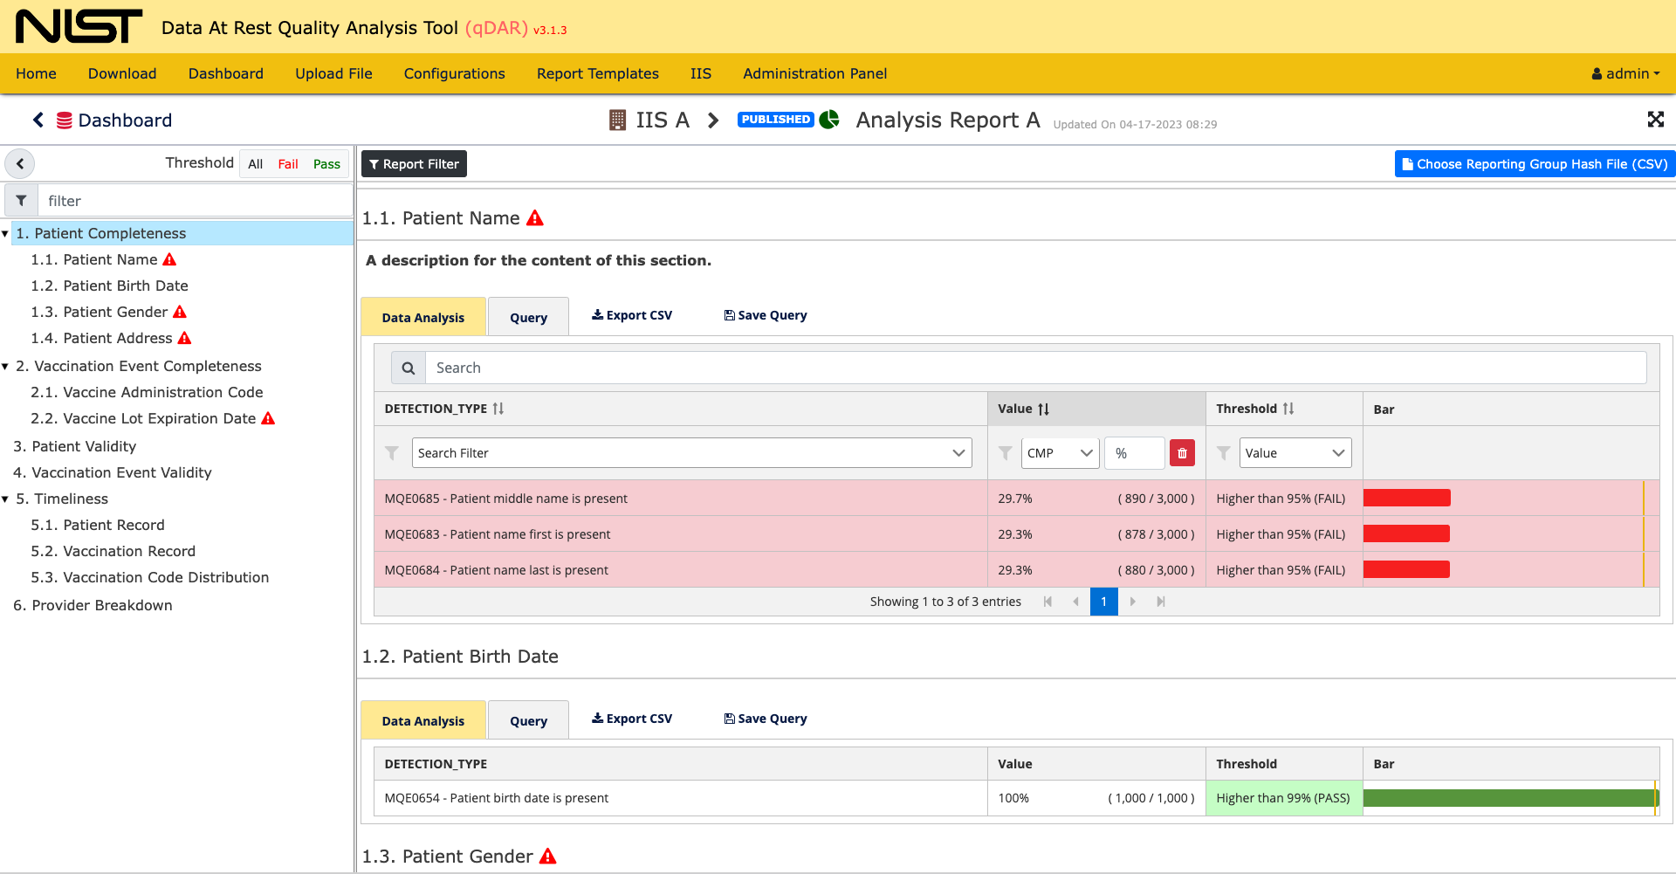
Threshold Filter
Report Filter
Section Title
Reporting Group Hash File Selection
Threshold Fail
Section Description
Section Data Table
Table Of Contents

Slide 26
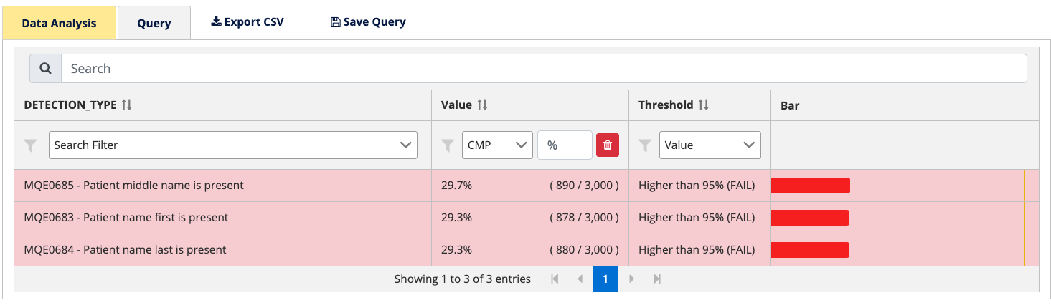
Analysis Report Data Table
Rows Filter
Threshold Visual Representation
Analysis Query Fields
Result Value (Percentage)
Threshold & FAIL / PASS Indicator
Percentage Visual Representation

Slide 27
qDAR Overview
patients.tsv
P
Configuration.json
IIS
qDAR CLI
C
vaccinations.tsv
V
HTML Summary
Aggregate Detections File
Reporting Group Hash Mapping
S
ADF
RH
IIS Side
AIRA Side
Create Configurations
Create Report Templates
Run Queries
Create Reports
Manage ADFs
qDAR Web App
Analysis
Reports

