Slide 1

ITU-T Standardization on quantum communications: from Quantum Key Distribution Network to Quantum Network
QCE2026 Workshop
Quantum Networking: Experiments, Simulation, and Standards for Scalable Infrastructure
2026. 9. 14.
Taesang Choi
Korea University

Slide 2
Topics
Standardization on QKDN in ITU-T
Standardization on Quantum Communications in ISO/IEC JTC3
Standardization on QKD in ETSI ISG QKD & TC GT
Standardization on QN in ITU-T

Slide 3
Topics
Standardization on QKDN in ITU-T
Standardization on Quantum Communications in ISO/IEC JTC3
Standardization on QKD in ETSI ISG QKD & TC QT
Standardization on QN in ITU-T

Slide 4
One of ITU-T's densest Recommendation families
55
39
10
6
Recommendations
in force
Y.3800-series
(SG13)
X-series
(SG17)
Q.416x series
(SG11)
Across SG13, SG17 and SG11
Y.3800 - Y.3838: architecture, QoS,
interworking, resilience
X.1702 and X.1710 - X.1718:
security framework and measures
Protocols for QKDN reference-point
interfaces
What the numbers say
First Recommendation Y.3800 (10/2019); latest Y.3836, Y.3837 and Y.3838 prepublished 08/2026 - an unbroken eight-year cadence.
SG13 owns roughly 70% of the corpus; SG17 supplies the security layer; SG11 supplies the wire-level protocols.
The centre of gravity has moved from "what is a QKDN" (2019-2021) to interworking, federation, autonomic QoS and resilience (2023-2026).
Notes:
55 = 39 (Y.3800-Y.3838) + 10 (X.1702, X.1710-X.1718) + 6 (Q.4160-Q.4165).

Slide 5
Five ITU-T bodies shape the QKDN programme
13
Study Group 13 - Future networks
Q16/13, retitled for 2025-2028 as "Future networks: Trustworthy and quantum enhanced networking". Owns the Y.3800-series: overview, requirements, functional architecture, key management, control and management, QoS, interworking, resilience.
17
Study Group 17 - Security
Q15/17 "Quantum-based security". Owns X.1710-X.1718 (QKDN security framework, key management, node protection, authentication, interworking security) plus X.1702 on quantum noise RNG architecture.
11
Study Group 11 - Protocols and testing
Owns Q.4160-Q.4165: the protocol framework and the concrete protocols for the Ak, Kq-1, Kx and Ck reference-point interfaces, plus QKDN interworking protocols.
JCA
JCA-QKDN - coordination
Established December 2022, reports to TSAG. Coordinates QKDN standardization across ITU-T and liaises with external SDOs. Chair: Junsen Lai (CAICT); Vice-Chairs: Hao Qin (NUS) and Kaoru Kenyoshi (NICT). Fifth meeting: Geneva, 12 December 2025.
FG
FG-QIT4N - closed pre-standardization
Focus Group on Quantum Information Technology for Networks, September 2019 to November 2021. Delivered nine technical reports (D1.1-D1.4 general network aspects; D2.1-D2.5 QKDN) that seeded the SG13 and SG17 work.
Notes:
TSAG = Telecommunication Standardization Advisory Group. JCA-QKDN is the cross-SG coordination point and the external liaison channel.

Slide 6
Y.3800 - Y.3805 define the four-layer model
User network / service layer
The five founding Recommendations
Cryptographic applications consuming keys
Y.3800
10/2019
Overview on networks supporting QKD
QKDN management and control layer
Y.3801
04/2020
Y.3804 control and management · Y.3805 SDN control
Functional requirements for QKDN
Y.3802
12/2020
Functional architecture (Amd.1 11/2023)
Key management layer
Y.3803
12/2020
Y.3803 key management: relay, storage, supply
Key management (Amd.1 11/2023)
Y.3804
09/2020
Quantum layer
Control and management (rev. 04/2025)
QKD modules and links generating raw key material
Y.3805
12/2021
SDN control (Amd.1 11/2023)
Notes:
Y.3802 is the anchor architecture Recommendation; the layered model it defines is reused by every later Y.38xx and by SG17's X.171x security work.

Slide 7
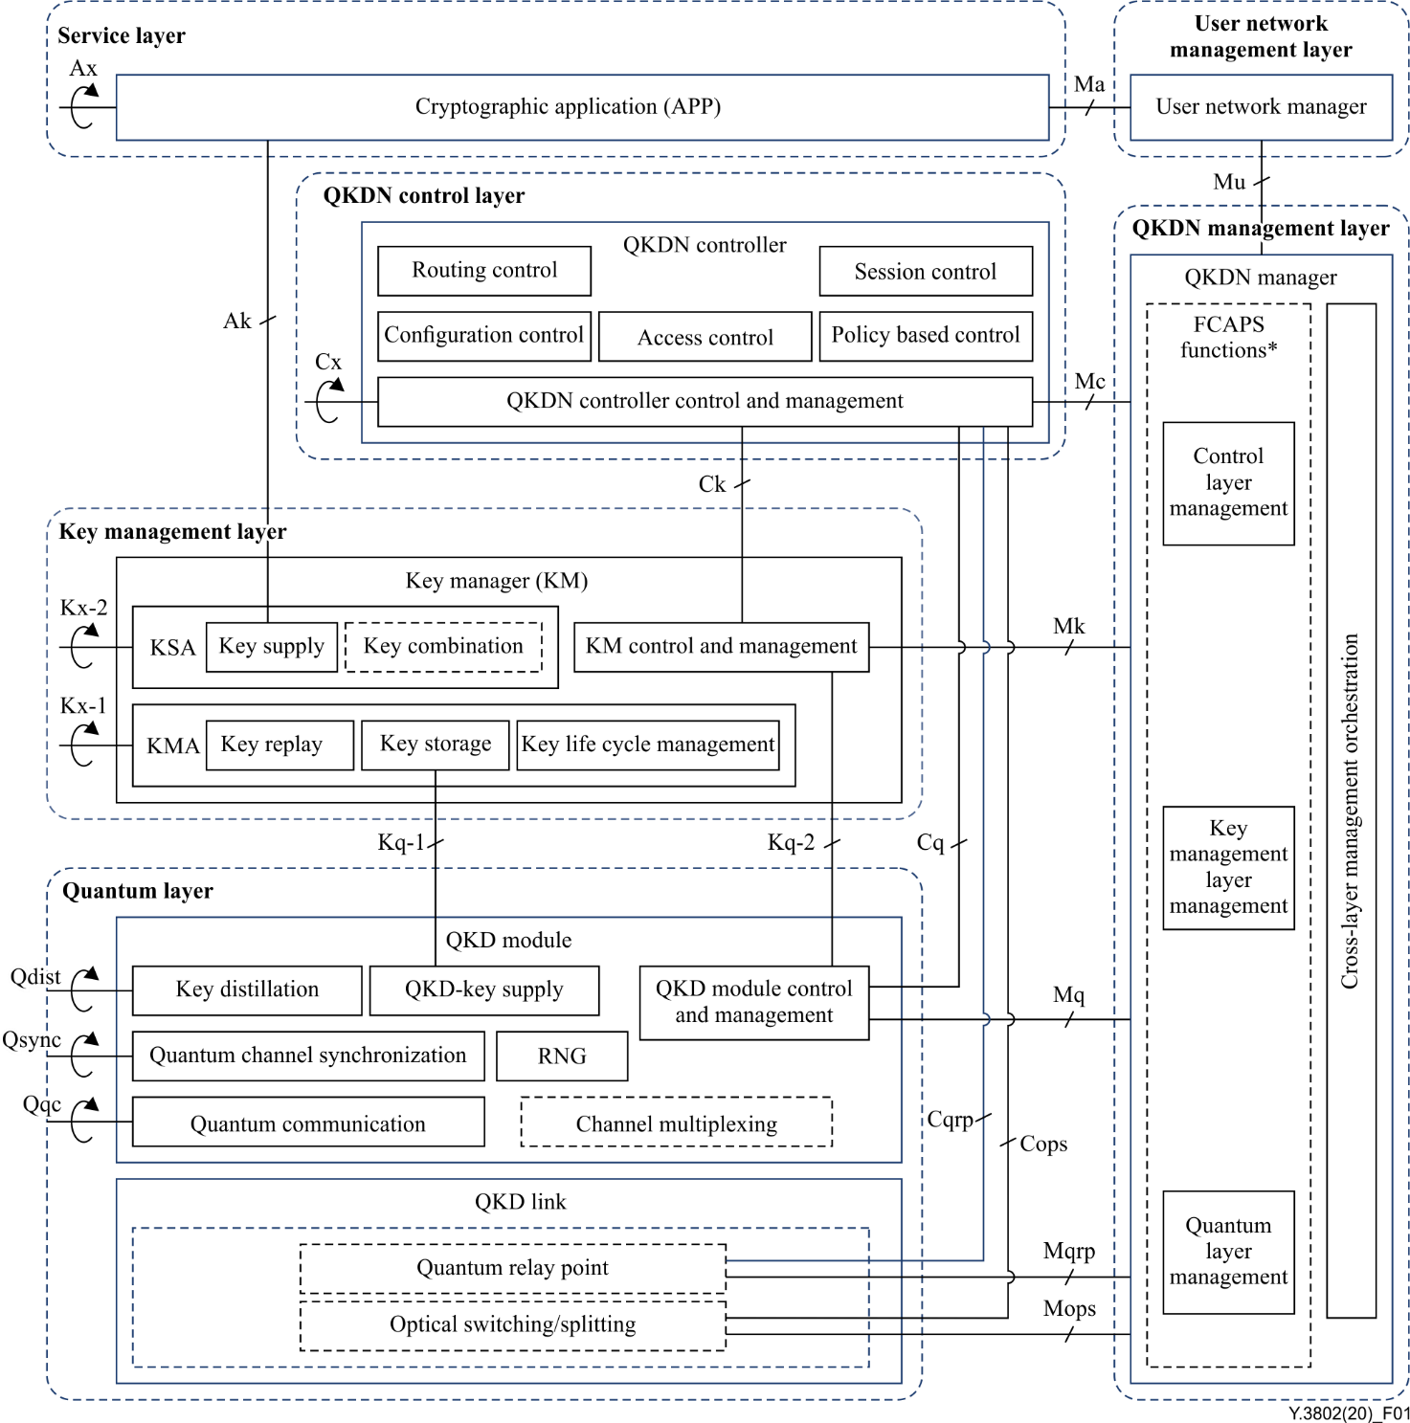
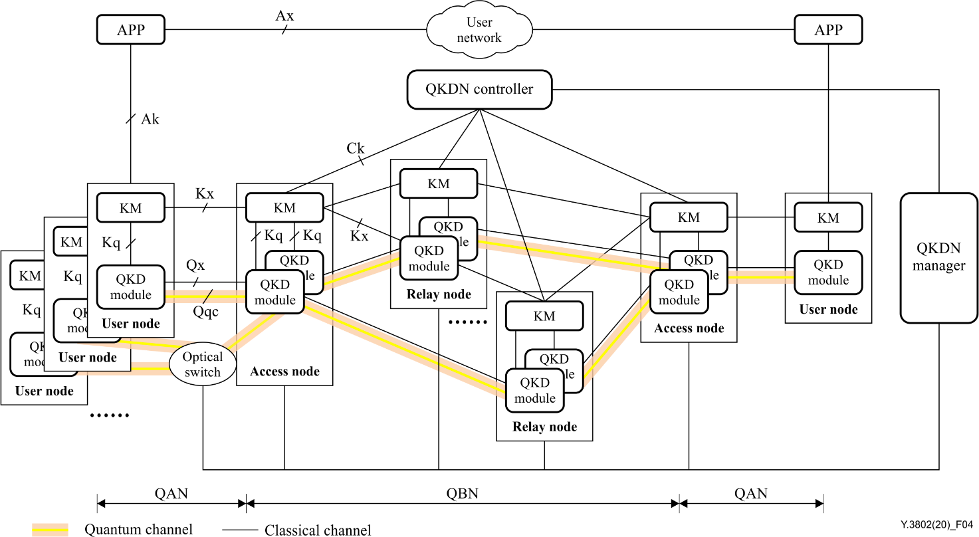
Y.3802: QKDN Functional architecture
Notes:
TSAG = Telecommunication Standardization Advisory Group. JCA-QKDN is the cross-SG coordination point and the external liaison channel.

Slide 8
Six work streams beyond the foundation set
Interworking
QoS assurance
Machine learning
and autonomic operation
Y.3810, Y.3813, Y.3817,
Y.3818, Y.3820, Y.3829
Y.3806, Y.3807, Y.3811,
Y.3823, Y.3827, Y.3836
Y.3812, Y.3814, Y.3816,
Y.3819, Y.3822, Y.3834
Framework, functional requirements, architecture, SDN control and QoS across QKDN domains
Requirements, parameters, architecture, end-to-end allocation and measurement methodology
ML-based QoS assurance, ML enablement architecture, autonomic management and control
Resilience and
dependability
Integration with
other networks
Deployment, federation
and orchestration
Y.3815, Y.3821, Y.3830,
Y.3833, Y.3837
Y.3808, Y.3825, Y.3826,
Y.3828, Y.3831, Y.3835
Y.3809, Y.3824,
Y.3832, Y.3838
Overview and requirements for resilience, key supply protection and recovery, dependability assessment
Secure storage networks, time-sensitive networks, and user networks running end-to-end modern cryptography
Role-based deployment model, federation reference models, orchestration framework, service awareness

Slide 9
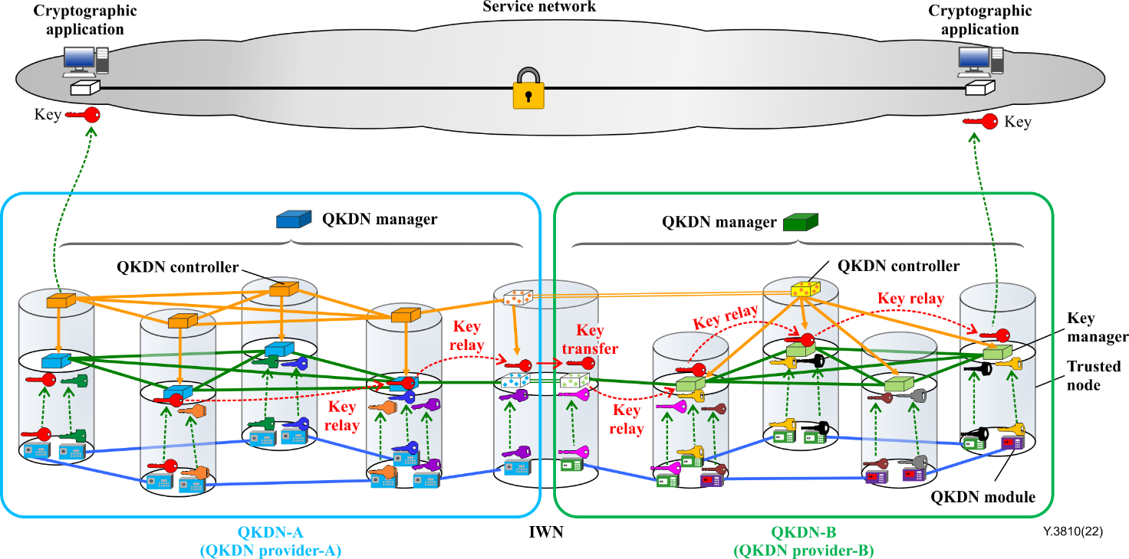
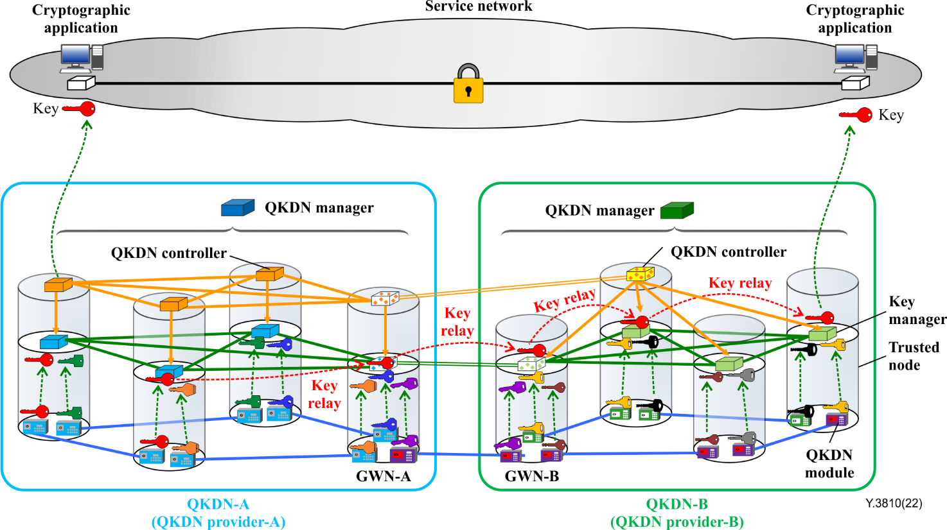
Y.3817: QKDN Interworking Functional architecture
QKDNi with IWFs
QKDNi with GWIs
Notes:
TSAG = Telecommunication Standardization Advisory Group. JCA-QKDN is the cross-SG coordination point and the external liaison channel.

Slide 10
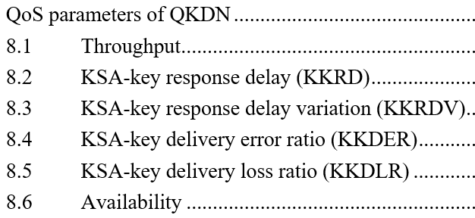


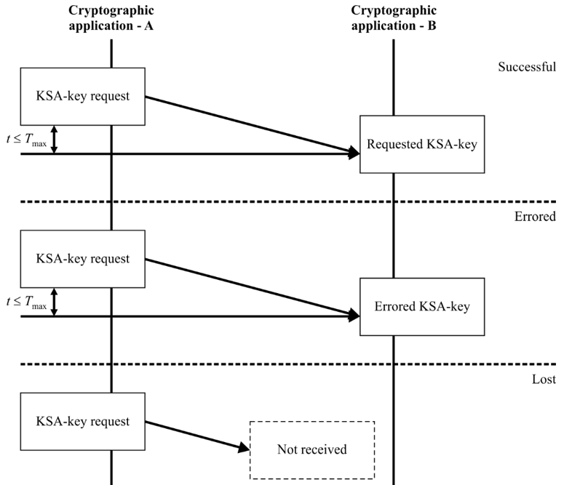
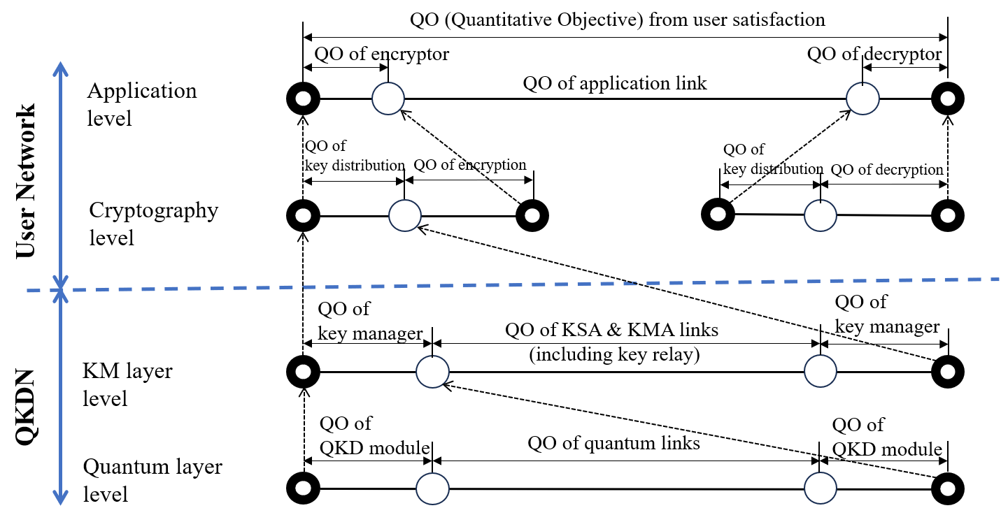
QKDN QoS Parameters and Measurement
QoS Parameters
QoS Measurement
Notes:
TSAG = Telecommunication Standardization Advisory Group. JCA-QKDN is the cross-SG coordination point and the external liaison channel.

Slide 11
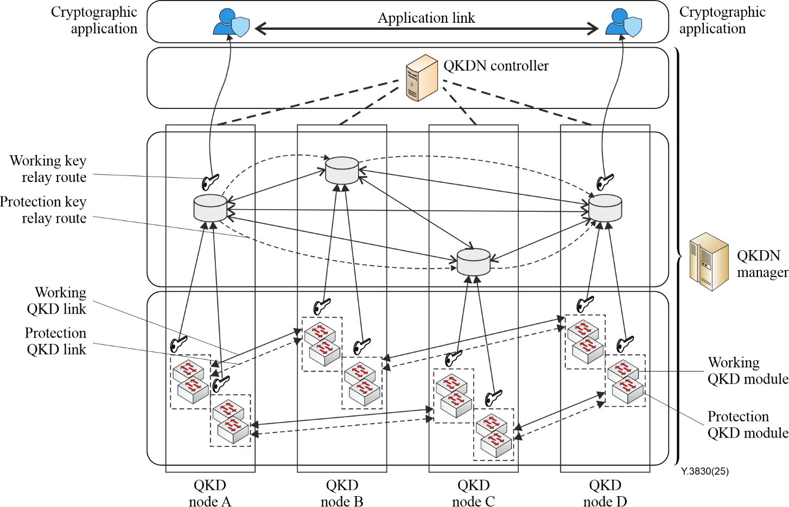
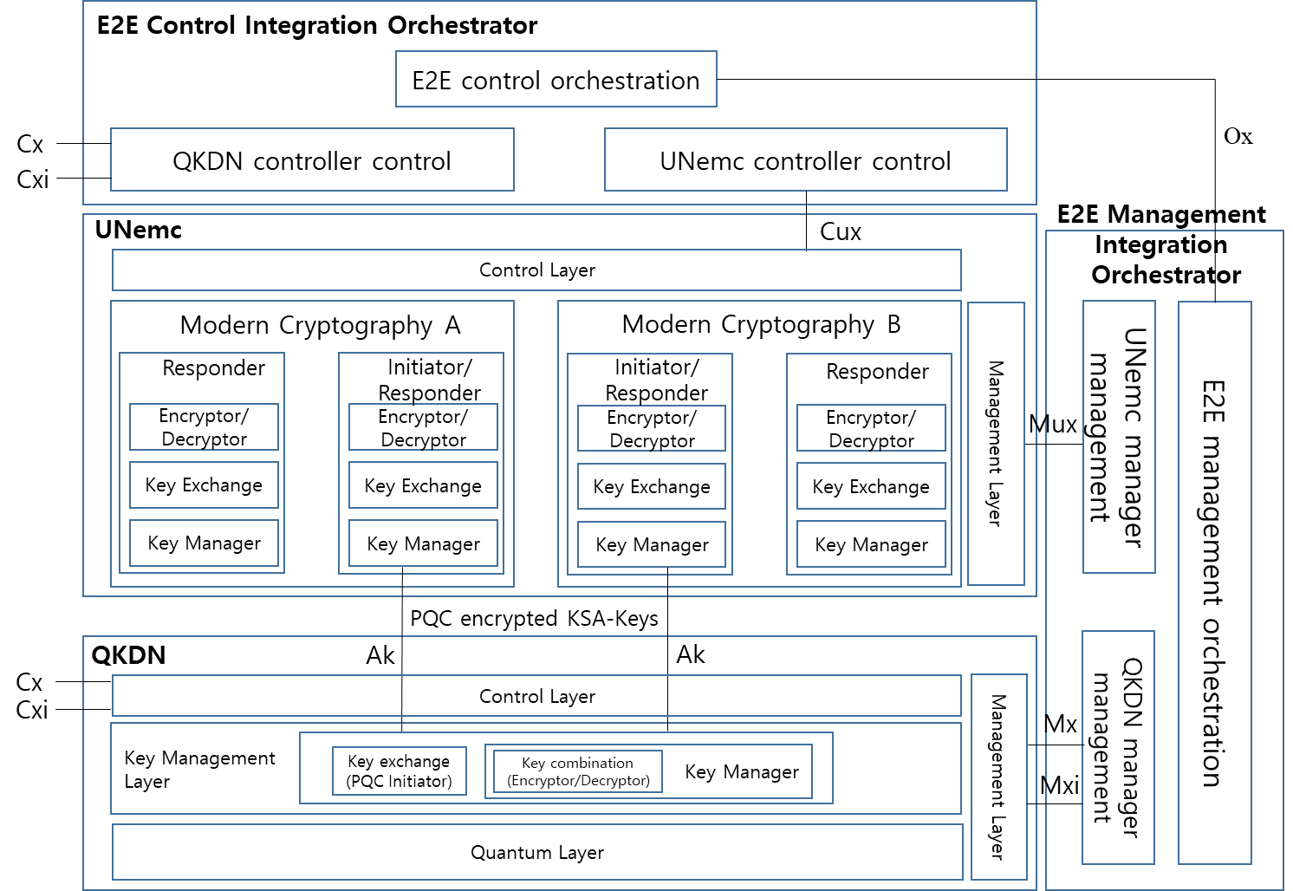
QKDN Resilience and Integration with User Network
QKDN key supply protection and recovery for resilience
QKDN and User Network supporting end-to-end cryptography services
Notes:
TSAG = Telecommunication Standardization Advisory Group. JCA-QKDN is the cross-SG coordination point and the external liaison channel.

Slide 12
The security layer: ten X-series Recommendations
X.1702
Quantum noise random number generator architecture
X.1714
Key combination and confidential key supply for QKDN
11/2019
10/2020
X.1710
Security framework for QKDN
X.1715
Security for integration of QKDN and secure storage network
10/2020
07/2022
X.1711
Framework of QKD protocols in QKD networks
X.1716
Authentication and authorization in QKDN
03/2026
10/2024
X.1712
Security requirements and measures for QKDN - key management
X.1717
Security requirements and measures for QKDN control and management
10/2021
10/2024
X.1713
Security requirements for the protection of QKD nodes
X.1718
Security requirements and measures for QKDN interworking
04/2024
03/2026
Notes:
Note the 2026 additions: X.1711 closes the protocol-security gap and X.1718 mirrors SG13's interworking architecture on the security side.

Slide 13
The architecture turned into wire protocols
Q.4160
12/2023
Q.4161
12/2023
Q.4162
12/2023
QKDN - Protocol framework
Protocols for Ak interfaces
Protocols for Kq-1 interfaces
Q.4163
12/2023
Q.4164
04/2025
Q.4165
01/2026
Protocols for Kx interfaces
Protocols for Ck interfaces
QKDN interworking - Protocol framework
Why this track matters
SG13 defines reference points; SG11 specifies what actually crosses them - Ak (application to key manager), Kq-1 (key manager to QKD module), Kx (key manager to key manager), Ck (controller to key manager).
Without Q.416x, multi-vendor QKDN deployments stay pilot-scale; this is the layer that decides whether procurement can be competitive.
Q.4165 (01/2026) extends the framework across administrative domains, pairing with SG13's Y.3810/Y.3813/Y.3818 and SG17's X.1718.

Slide 14
From QKDN to quantum-enhanced networking
01
Q16/13 retitled
For 2025-2028 the SG13 Question reads "Future networks: Trustworthy and quantum enhanced networking" - explicitly broader than the QKDN-only framing of 2022-2024.
02
Q15/17 continues as "Quantum-based security"
SG17 keeps a dedicated quantum Question and delivered X.1711 and X.1718 in March 2026.
03
Quantum-safe converges with quantum-enhanced
XSTR.qs-IMT2030 under Q1/17 - "Benefits and challenges of technical approaches for quantum-safe IMT-2030 networks", targeted for 2028-Q2, liaising with SG13.
04
JCA-QKDN still the coordination hub
Fifth meeting held in Geneva on 12 December 2025; maintains the Quantum Information Technology standards database and the external SDO liaison channel.
05
Ecosystem activity beyond Recommendations
ITU Global Quantum Drill 2026, Dubai, 17-18 September 2026 - operational readiness exercises alongside the written standards.
Notes:
The Q16/13 retitling is the single clearest signal that ITU-T intends to go beyond key distribution in this study period.

Slide 15
Topics
Standardization on QKDN in ITU-T
Standardization on Quantum Communications in ISO/IEC JTC3
Standardization on QKD in ETSI ISG QKD & TC QT
Standardization on QN in ITU-T

Slide 16
One committee, one publication, one communication item
1
14
1
0
Published standard
Work programme items
Quantum communication
project
Published quantum
comms standards
ISO/IEC 4879:2024
Quantum computing - Vocabulary
Four still at preliminary
(PWI) stage
IEC/ISO TR 63760, in WG 16,
CD stage due 12/2026
None from JTC 3 - the QKD
security standards sit in SC 27
Note that
JTC 3 is two and a half years old: announced by IEC and ISO in January 2024, it is still building its work programme rather than shipping standards.
Quantum communications is explicitly inside JTC 3's scope, but only one project addresses it directly - and it is a Technical Report, not an International Standard.
ISO/IEC does already publish on quantum communications - ISO/IEC 23837-1 and -2 on QKD security evaluation - but through JTC 1/SC 27, not JTC 3.
Work programme counts as published on the IEC JTC 3 dashboard, 14 September 2026.

Slide 17
A young committee with a very broad scope
Scope
Established
Announced by IEC and ISO,
11 January 2024
Standardization in the field of quantum technologies - including quantum information technologies (quantum computing and quantum simulation), quantum metrology, quantum sources, quantum detectors, quantum communications, and fundamental quantum technologies. JTC 3 coordinates results with committees whose scopes cover sector-specific applications.
Secretariat
United Kingdom (BSI);
IEC provides administration
Excluded
Chair
Sector-specific applications, and the fields of information technology (JTC 1 and its SCs), nanotechnology (IEC TC 113, ISO TC 229), fibre optics (IEC TC 86), cryogenic vessels (ISO TC 220) and semiconductors (IEC TC 47).
Mr Haeseong Lee
Term of office to 2030-02
Membership
The fibre-optics carve-out matters for quantum communications: the physical layer of quantum links - connectors, interconnect, transmission media hardware - belongs to IEC TC 86, not to JTC 3.
34 participating countries,
10 observer countries
Plenaries
Last: Jinan, China, 27-28 May 2026
Next: Hamburg, 18 Nov 2026

Slide 18
One joint SC, five WGs, three advisory groups
JSC 3A
Quantum computing
WG 9
Terminology and quantities
Joint subcommittee, secretariat France. Its scope explicitly EXCLUDES quantum communications.
IEC/ISO 63607 general quantities and 63655 general vocabulary, both forecast 2029-03.
WG 10
Quantum sensors
WG 13
Quantum random number generators
Five items - gravimeters, magnetometers, detector tomography, sensor overview.
TR 63742 entropy source randomness quality and TR 63744 QRNG overview.
WG 14
Quantum enabling technology
WG 16
Quantum Communication
Photonic source and single-photon detector characterization - the metrology quantum links rest on.
The only group whose remit is quantum communications. One deliverable in progress.
PT 63622
Quantum Photonics Vocabulary
AG 1 / AG 8 / AG 17
Strategic planning, Chair's advisory, Investigation and new technology studies
Project team, forecast publication 2028-01.
Where new topics are scoped before they become work items.

Slide 19
IEC/ISO TR 63760, and nothing else yet
IEC/ISO TR 63760
Quantum technologies - Quantum communication - Influence of transmission media on the implementation of quantum communication
Technical Report · Working Group 16 · Project leader: Mr Weiyang Zhang (China) · Entered ACD stage 2026-07 · Next stage due 2026-12 · No forecast publication date registered
A Technical Report, not a standard
Early in the pipeline
A TR records the state of the art and informs future work. It carries no normative requirements, so nothing in it can be specified against or certified to.
It reached approved-committee-draft stage in July 2026 with the next stage due December 2026. On typical JTC 3 timelines, publication lands 2028 at the earliest.
Deliberately physical-layer
A near-twin exists in SC 27
Transmission media - fibre type, loss, dispersion, free space - is exactly the boundary where JTC 3's fibre-optics exclusion meets IEC TC 86's quantum interconnect work.
ISO/IEC DTR 25544 covers the effect of specific transmission media on the security evaluation of QKD, and is already at approval stage 50.00 - well ahead of TR 63760.

Slide 20
Quantum sensing has five items; comms has one
Sensing leads
Five of fourteen items are quantum sensors and metrology - gravimeters, magnetometers, detector tomography, an overview TR.
Mostly reports
Seven items are Technical Reports and one is a Technical Specification. Only four are headed for International Standard status.
Nothing before 2028
The earliest forecast publication in the whole programme is 2028-01 (Quantum Photonics Vocabulary); most land 2029.

Slide 21
All fourteen items, September 2026
IEC/ISO 63607
Terminology and quantities - General quantities
IEC/ISO TR 63744
Overview of quantum random number generator
WG 9 · 2029-03
WG 13 · 2029-11
IEC/ISO 63655
Terminology and quantities - General vocabulary
IEC/ISO TR 63760
Quantum communication - influence of transmission media
WG 9 · 2029-03
WG 16 · CD 12/2026
IEC/ISO 63622
Quantum Photonics Vocabulary
IEC/ISO TR 63770-1
Quantum sensors - Part 1: Overview, examples and applications
PT 63622 · 2028-01
WG 10 · stage 2026-12
IEC/ISO 63692
Absolute quantum gravimeters based on free-falling cold atoms
PWI TR JTC3-1
Characterization of NV-diamonds for magnetometers
WG 10 · 2028-09
WG 10 · PWI 2026-03
IEC/ISO TS 63687
Hanbury-Brown-Twiss interferometry for photonic quantum sources
PWI JTC3-3
Quantum spectroscopy with undetected photons (QSUP)
WG 14 · 2028-10
WG 10 · PWI 2026-04
IEC/ISO TR 63742
Randomness quality and testing for quantum entropy sources
PWI JTC3-4
Verifying a quantum measurement - detector tomography
WG 13 · 2029-11
WG 10 · PWI 2026-04
IEC/ISO TR 63743
Metrics for single-photon detector characterization
PWI TR JTC3-5
Quantum computing - control and measurement system testing
WG 14 · 2029-11
WG 14 · PWI 2026-06

Slide 22
JTC 3 and ITU-T are a decade apart
ITU-T
IEC/ISO JTC 3
Started
Focus Group in 2019; first Recommendation Y.3800 in 10/2019
Committee announced 01/2024; first publication 05/2024
Output to date
55 Recommendations in force across SG13, SG17 and SG11
1 publication: ISO/IEC 4879:2024, quantum computing vocabulary
On quantum communications
39 Y.3800-series plus 10 X-series and 6 Q.416x - architecture, key management, QoS, interworking, security, protocols
1 Technical Report in progress (TR 63760); QKD security sits in JTC 1/SC 27
Character of the work
Network architecture, operations and interfaces for deployed QKD networks
Terminology, device characterization, measurement methods and security evaluation
Next visible milestone
Continued interworking and federation output through the 2025-2028 study period
TR 63760 committee draft due 12/2026; first JTC 3 standards land 2028-2029

Slide 23
Topics
Standardization on QKDN in ITU-T
Standardization on Quantum Communications in ISO/IEC JTC3
Standardization on QKD in ETSI ISG QKD & TC QT
Standardization on QN in ITU-T

Slide 24
A mature interface corpus, a young architecture
13
32
12
0
Deliverables in force
Work items on the books
Currently in drafting
Published network
architecture
GS QKD 002 to 020 plus
GR QKD 003 and 007
Including every edition,
2 stopped and 1 withdrawn
Eight new numbers plus four
revisions of existing ones
GR QKD 017 is a stable draft;
GS QKD 022 is an early draft
What the numbers say
ETSI has been at this since 2008 — longer than anyone — but its output has concentrated on device characterisation, implementation security and, above all, interfaces.
The newest deliverable, GS QKD 020 (06/2026), is an interoperable key-management API: the centre of gravity has moved to multi-vendor operation.
Network architecture is the conspicuous gap. Two work items now address it, and neither has been published — roughly six years after ITU-T Y.3802 specified one.

Slide 25
An Industry Specification Group, not a TC
What an ISG is, and why it matters here
Optical characterisation
An ETSI Industry Specification Group publishes Group Specifications (GS) and Group Reports (GR). They are approved by the group's own members rather than by an ETSI-wide national vote, so they appear faster than European Standards — and they carry no regulatory status. For QKD this has been the right trade: the field needed running code and interoperable APIs long before it needed a normative European Standard.
Optical components, complete QKD modules, penetration testing.
GS QKD 011, 013
Security
Implementation security, evaluation activities, protocol security proofs, authentication.
GS QKD 005, 008, 010, 016, 024; GR QKD 019
The stated remit, in ETSI's own words
“Specification of interfaces, implementation security requirements and optical characterisation of QKD systems and their components, enabling robust deployable solutions to protect next-generation telecommunications.”
Vocabulary
Improving and aligning use of terminology across the field.
GR QKD 007
Read that literally: interfaces, implementation security, optical characterisation. Network architecture is not in the sentence — which is exactly why it is the newest addition to the work programme.
Interoperability
Application and key delivery interfaces, interoperable KMS interfaces, network architectures, QKD in software defined networks.
GS QKD 004, 014, 015, 018, 020, 021, 022, 023; GR QKD 017
Work-area headings are ETSI's own; the deliverable mapping is this deck's, based on each work item's registered title.

Slide 26
The thirteen published deliverables
Versions shown are the current edition in force. GS QKD 001 (security assurance requirements) was stopped in 2011 and GS QKD 006 (integration into optical networks) in 2013.
Deliverable
Version
Title
Note
GS QKD 002
06/2010
Use Cases
The founding document
GR QKD 003
03/2018
Components and Internal Interfaces
Edition 2; GS QKD 003 withdrawn 11/2018
GS QKD 004
08/2020
Application Interface
Edition 3 in drafting
GS QKD 005
12/2010
Security Proofs
Edition 2 in drafting, retitled
GR QKD 007
01/2026
Vocabulary
Edition 2, refreshed after 8 years
GS QKD 008
12/2010
QKD Module Security Specification
Unrevised since 2010
GS QKD 011
05/2016
Component characterization: optical components
Optical characterisation stream
GS QKD 012
02/2019
Device and Communication Channel Parameters
Deployment parameters
GS QKD 014
02/2019
REST-based key delivery API
The widely implemented one; ed.2 in drafting
GS QKD 015
04/2022
Control Interface for Software Defined Networks
Edition 2; edition 3 in drafting
GS QKD 016
01/2024
Common Criteria Protection Profile — P&M modules
Edition 2; the certification anchor
GS QKD 018
04/2022
Orchestration Interface for Software Defined Networks
Pairs with GS QKD 015
GS QKD 020
06/2026
REST-based Interoperable Key Management System API
Newest; horizontal KMS-to-KMS keys

Slide 27
The interface stack, layer by layer
Six of the thirteen in-force deliverables are interfaces. This stack — not an architecture document — has been ETSI's QKDN contribution to date.
Orchestration
SDN orchestrator to SDN controller. GS QKD 021 extends it to multi-domain networks with cooperating key management systems.
GS QKD 018 (published) · GS QKD 021 (draft)
Control
SDN controller to QKD nodes. Edition 3 adds abstraction models and workflows for horizontal cooperation between key management systems.
GS QKD 015 ed.2 (published) · ed.3 (draft)
Key management
KMS to KMS, horizontally, inside a common trusted node — so a QKD network can serve applications even when the two key managers come from different vendors.
GS QKD 020 (published 06/2026)
Key delivery
Key manager to application, over a REST API. The most widely implemented ETSI QKD specification, and the de facto integration point for products.
GS QKD 014 (published) · ed.2 (draft)
Application
The application-facing interface: how an encryptor or a key consumer asks for key material.
GS QKD 004 ed.2 (published) · ed.3 (draft)
Monitoring
Monitoring interface and data model — the operational telemetry layer that the published stack currently lacks.
GS QKD 023 (draft)

Slide 28
Twelve work items, nine due 2 December 2026
Work item
Title
Current status
Next milestone
GS QKD 004 ed.3
Application Interface
Stable draft 05/2026
TB approval 02/12/2026
GS QKD 005 ed.2
Protocol structures and security proofs
Stable draft 06/2026
TB approval 02/12/2026
GS QKD 010
Implementation security: Trojan horse attacks
Stable draft 06/2026
TB approval 02/12/2026
GS QKD 013
Characterisation of QKD transmitter optical output
Stable draft 12/2025
TB approval 02/12/2026
GS QKD 014 ed.2
REST-based key delivery API
Stable draft 06/2025
TB approval 02/12/2026
GS QKD 015 ed.3
SDN control for interoperable KMS
Stable draft 05/2026
TB approval 02/12/2026
GR QKD 017
Analysis of QKD network architectures
Stable draft 05/2026
TB approval 02/12/2026
GR QKD 019
Design of QKD interfaces with authentication
Stable draft 06/2025
TB approval 02/12/2026
GS QKD 021
SDN orchestration for interoperable KMS
Stable draft 12/2025
TB approval
GS QKD 023
Monitoring Interface and Data Model
Stable draft 06/2026
TB approval 02/12/2026
GS QKD 022
Network Architecture
Early draft 07/2026
Stable draft 02/12/2026
GS QKD 024
CC Protection Profile — Key Processing Module
Proposed to TB 03/2025
Early draft
Status and milestone dates as registered in the ETSI Work Programme on 16 September 2026. TB approval = approval by the ISG itself.

Slide 29
GR QKD 017 surveys it; GS QKD 022 specifies it
GR QKD 017
GS QKD 022
Analysis of QKD Network architectures
Network Architecture
Stable draft, 05/2026 · TB approval due 02/12/2026
Early draft, 07/2026 · stable draft due 02/12/2026
“Review the variety of architectures that have been proposed for QKD networking. Reveal the basic functionalities that the mentioned architectures implement as well as the commonalities between them. A specific objective will be to identify architectural components, their purpose and their conceptual interfaces, and assess the interoperability potential for networks based on distinct architectural designs.”
“Specify a QKD network architecture building on analysis in GR QKD 017. It will identify network functionalities and interfaces aligned with modern communication networking paradigms suitable for both stand-alone critical infrastructures and integration with general telecommunications networks.”
A survey before a specification
Aligned with ordinary networking
But it is an early draft
ETSI is deliberately mapping the existing architecture proposals — including ITU-T's — before committing to one. GR QKD 017's explicit objective is to assess interoperability between networks built on different architectural designs.
GS QKD 022's scope commits to functionalities and interfaces “aligned with modern communication networking paradigms”, and to serving both isolated critical infrastructure and integration with public telecom networks.
GS QKD 022 reached early-draft status only in July 2026, with a stable draft targeted for December. Publication is realistically 2027 at the earliest.

Slide 30
Topics
Standardization on QKDN in ITU-T
Standardization on Quantum Communications in ISO/IEC JTC3
Standardization on QKD in ETSI ISG QKD & TC QT
Standardization on QN in ITU-T

Slide 31
A mandate in place, a work programme of one
0
1
~9
5
Published deliverables
Work item registered
Months of operation
Officers elected
ETSI's own committee page:
“There are no standards to
show here.”
DTR/QT-001 → TR 104 323,
version 0.0.3, early draft
Created 29/09/2025;
kick-off meeting 04/12/2025
Chair plus four Vice-Chairs,
from five organisations
Read this carefully before drawing conclusions
Zero published output is not a judgement on the committee — it is what a nine-month-old TC looks like. ETSI's own QKD group took two years from formation to its first deliverable.
The significance of TC QT is institutional rather than technical: unlike an ISG, a Technical Committee can produce European Standards and answer Standardisation Requests.
For anyone asking what ETSI specifies today on QKD networks, the answer is still ISG QKD's thirteen Group Specifications and Reports — not TC QT.

Slide 32
Created to consolidate, and to serve policy
The stated objective
29 Sep 2025
ETSI Board approves creation
“The primary objective of the technical committee is to develop specifications that address quantum communications and quantum networks across multiple sectors, deploying quantum-based solutions to lay the foundations for secure global communications networks.”
Announced as a move to consolidate current standards and address future market needs. Mark Pecen of EigenQ named to convene the kick-off.
15 Oct 2025
First work item proposed
Note what that sentence puts first: quantum communications and quantum networks. The question you are asking is TC QT's declared centre, not a side interest.
DTR/QT-001, the ecosystem vision and roadmap, is registered before the committee has even met.
The policy drivers named by ETSI
04 Dec 2025
Kick-off meeting, Sophia Antipolis
European Quantum Act — TC QT is positioned to contribute
Officers elected, work item adopted, and agreement to co-locate future meetings with ETSI's other quantum groups.
European Chips Act
EuroQCI, the European Quantum Communication Infrastructure
Feb–Sep 2026
Three drafts of the roadmap
Horizon Europe research outcomes, fed into standardisation
v0.0.1 in February, v0.0.2 in March, v0.0.3 in September 2026. Stable draft targeted for 2 December 2026.

Slide 33
Six declared areas; two are your question
Quantum communications
Quantum networking
Satellite quantum communications
Secure data transmission using superposition and entanglement.
Connecting quantum systems for distributed computing and cryptography.
Beacon signals, interfaces and security for space-based quantum systems.
Directly relevant
Directly relevant
Relevant — and new to ETSI
Quantum sensing
Quantum random number generators
Quantum security
Ultra-precise measurement: timing, synchronisation, physical quantities.
True randomness from photon detection or electron spin.
Methodologies for assessing hardware vulnerabilities and side-channel risk.
Adjacent
Adjacent
Adjacent
Satellite quantum communications is the one genuinely new claim. Neither ISG QKD nor ITU-T's Y.3800-series treats space-based QKD as a first-class subject, and EuroQCI has a space segment — so this is where TC QT could add something rather than consolidate something.

Slide 34
One Technical Report, at early draft
DTR/QT-001
ETSI TR 104 323 — Quantum Technologies (QT); Vision and roadmap for QT ecosystem
“A periodically updated report serving as a gateway to the work of QT and to the vision of QT as the technology evolves. It will identify the eco-system thus identifying who the players are and where they will contribute to the QT standards effort. It will identify essential goals across the stakeholder community and paths to enable their fulfilment.”
Rapporteur: Scott Cadzow (Cadzow Communications) · Technical Officer: Gabriele Perrone · Supported by IBM Europe, Cadzow Communications, NCSC and EigenQ · Registered keywords include NETWORK, SECURITY, privacy and Quantum Key Distribution
Version
Date
What happened
Proposed
15 Oct 2025
Work item proposed to TB QT in contribution QT(25)1007, before the committee's first meeting
Adopted
04 Dec 2025
Adopted at the kick-off meeting via QT(25)1007r1
v0.0.1
15 Feb 2026
First early draft, contributed for discussion; noted by the committee on 23 February
v0.0.2
18 Mar 2026
Second early draft, the output of the committee's drafting session
v0.0.3
09 Sep 2026
Current draft — described as trimming Q&A from the drafting-day document, leaving actionable notes
Next
02 Dec 2026
Target status: stable draft

Slide 35
TC QT and ISG QKD, side by side
ETSI TC QT
ETSI ISG QKD
Type
Technical Committee — can produce European Standards and harmonised standards
Industry Specification Group — Group Specifications and Reports only, no regulatory status
Created
29 September 2025; first meeting 4 December 2025
2008 — ETSI's, and the world's, first QKD standards group
Output to date
None published; one work item at early draft
13 deliverables in force, 12 more in drafting
Scope
Quantum communications, networking, satellite, sensing, QRNG, quantum security
QKD interfaces, implementation security, optical characterisation, protection profiles
On quantum networks
Declared primary objective — nothing written yet
GR QKD 017 and GS QKD 022, both unpublished
Relationship
Meetings co-located with ISG QKD and Quantum Safe Cryptography to ensure convergence
Continues its own work programme; two ISG QKD figures sit on the TC QT officer slate
ISG QKD figures from the companion review in this series, accessed 16 September 2026.

Slide 36
Four ETSI bodies touch quantum
TC QT
Quantum Technologies
Communications, networking, satellite, sensing, QRNG, security. One roadmap TR in progress.
0 published
ISG QKD
Quantum Key Distribution
Interfaces, key management, SDN control, optical characterisation, Common Criteria profiles.
13 in force
TC CYBER
Cyber Security
Post-quantum cryptography, quantum-safe hybrid key exchange (2025), and QRNG implementation guidelines — TR 104 171, published 03/2026.
Published
ETSI/IQC
Quantum Safe Cryptography Conference
The annual cross-cutting venue. The June 2026 edition drew more than 250 participants; the 2026 conference was held in Ottawa.
Annual event
The committee agreed at its kick-off to hold its meetings alongside ISG QKD and the Quantum Safe Cryptography group “to ensure convergence and maximize participation from quantum experts”. Watch that arrangement: it is how a merger would begin if one is coming.

Slide 37
Three bodies, three different jobs
ETSI ISG QKD
ITU-T (SG13/17/11)
IEC/ISO JTC 3
Started
2008 — the oldest QKD standards group
Focus Group 2019; Y.3800 in 10/2019
Committee announced 01/2024
Output in force
13 Group Specifications and Reports
55 Recommendations
1 publication (quantum computing vocabulary)
Centre of gravity
Interfaces, APIs, optical characterisation, Common Criteria protection profiles
Network architecture, key management, QoS, interworking, security framework
Terminology, device metrology, security evaluation
Network architecture
GR QKD 017 and GS QKD 022 — both unpublished
Y.3802 published 12/2020, now with 39 Y.38xx Recommendations
None
Regulatory weight
None — GS/GR are not European Standards
ITU-T Recommendations, referenced by operators and regulators
International Standards once published
What to use it for
Building and integrating products; multi-vendor interoperability
Designing and operating a network; procurement language
Evaluating and certifying devices

Slide 38
Topics
Standardization on QKDN in ITU-T
Standardization on Quantum Communications in ISO/IEC JTC3
Standardization on QKD in ETSI ISG QKD
Standardization on QN in ITU-T

Slide 39
Quantum networking is still pre-standardization
Covered today
Not yet in Recommendations
Trusted-node QKD networks: architecture, key management, control and management
Interworking and federation between QKDN operators
QoS assurance, including ML-based and autonomic variants
Resilience, dependability and key supply recovery
Integration with secure storage networks, time-sensitive networks and user networks using classical or post-quantum cryptography
Security framework, node protection, authentication and authorization
Interface protocols for Ak, Kq-1, Kx and Ck
Entanglement distribution and entanglement swapping as network services
Quantum repeaters and quantum memory - no ITU-T Recommendation addresses either
Quantum internet control plane, routing and resource scheduling for entangled pairs
Distributed quantum computing over networks and blind quantum computing
Device-independent and measurement-device-independent QKD in a network setting
Satellite and free-space QKD segments as first-class network elements
FG-QIT4N's D1.1-D1.4 reports (2021) mapped this terrain in terminology, use cases and standardization outlook, but the material has not yet converted into Recommendations. The recharted Q16/13 is the vehicle if it does.
Every one of these lines rests on the trusted-node model: keys are relayed hop by hop through nodes that must be physically and procedurally secured. That assumption is the boundary of today's ITU-T Recommenations.

Slide 40
Quantum networking is still pre-standardization
Y.Supp 75
12/2023
Y.Supp 98
12/2023
Y.Supp.QN-arch
12/2023
ITU-T Y.3000 series – Quantum key distribution networks – Quantum-enabled future networks
ITU-T Y.3000 series – Technical considerations toward quantum networks
ITU-T Y.3000 series – Technical considerations of quantum network architecture
Three pre-standardization documents
Y.Supp 75 - ocuses on the activity status of studies and research from academia, research institutes and standards development organizations (SDOs).
Y.Supp 98 introduces more technical aspects which might be required towards quantum networks.
Y.Supp.QN-arch introduces different approaches of the layered models and other architectures of QN, functional elements involved, addressing, forwarding and routing mechanisms, QN routing taxonomy, and control and management mechanisms.

Slide 41
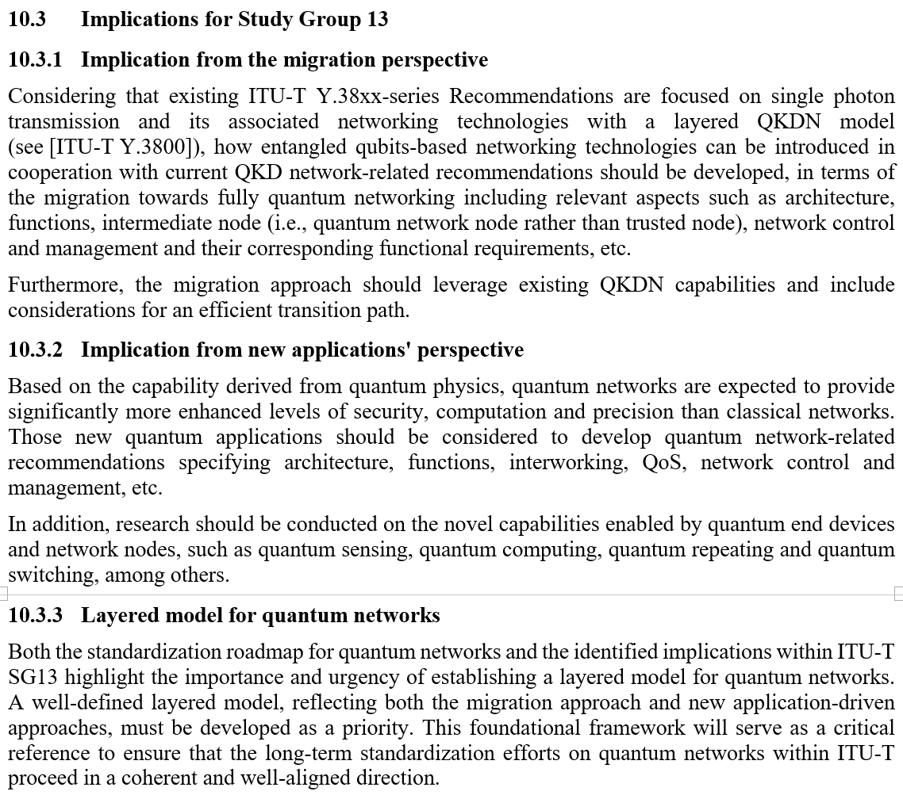
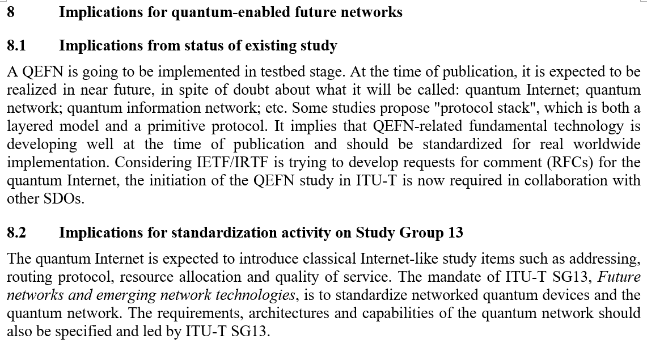
Quantum networking is still pre-standardization
Y.Supp 75 Standardization Implications
Y.Supp 98 Standardization Implications
Notes:
TSAG = Telecommunication Standardization Advisory Group. JCA-QKDN is the cross-SG coordination point and the external liaison channel.

Slide 42
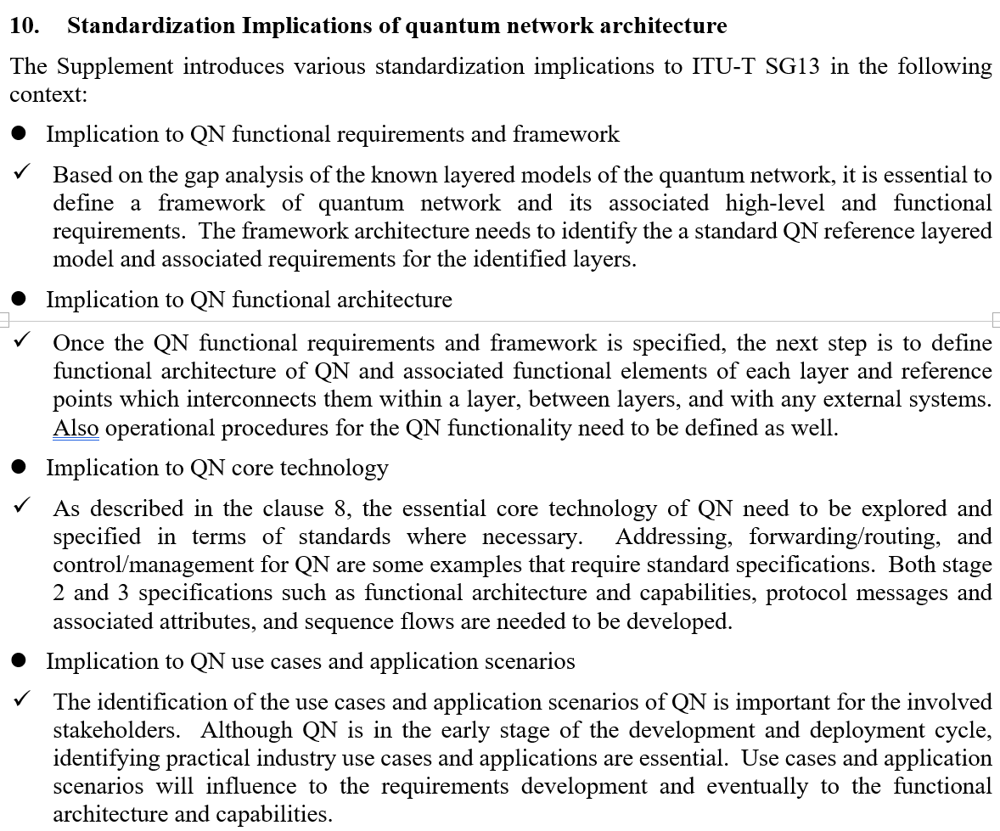
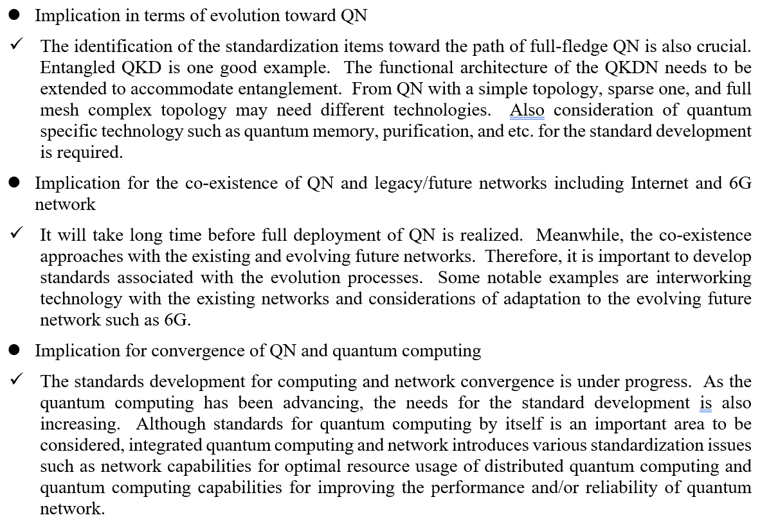
Quantum networking is still pre-standardization
Y.Supp.QN-Arch Standardization Implications
Notes:
TSAG = Telecommunication Standardization Advisory Group. JCA-QKDN is the cross-SG coordination point and the external liaison channel.

Slide 43
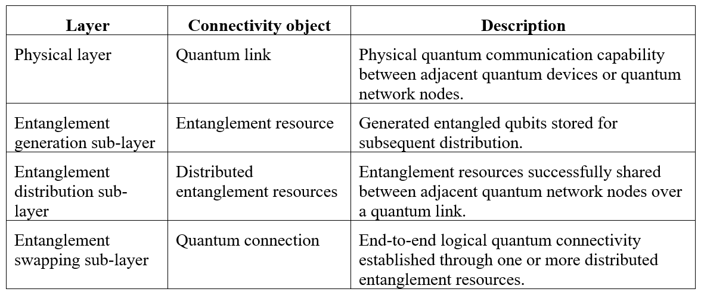
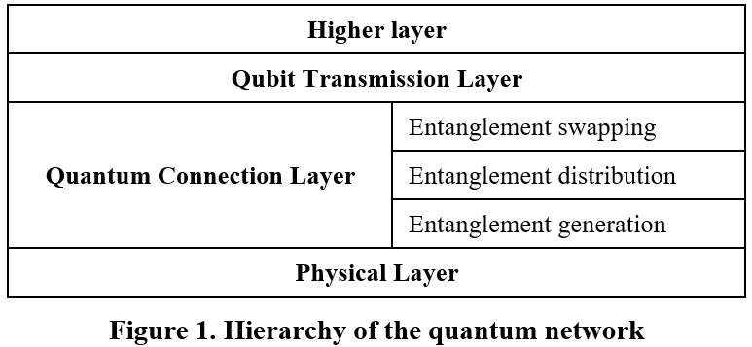
First Quantum Network Normative draft Recommendation
Y.QN-LM: Quantum Network: Layered Model
initial proposal (08/2026)
Table 1. Connectivity hierarchy across the layered model
Notes:
TSAG = Telecommunication Standardization Advisory Group. JCA-QKDN is the cross-SG coordination point and the external liaison channel.

Slide 44
Initial but crucial issues for agreement across SDOs
1
Terminology
2
Scope
Quantum Network vs Quantum Communications vs Quantum Internet
Telecommunications (including Mobile communications) vs Internet vs anything NEW! (QN standalone?)
3
Architecture
4
Interoperability & Backward compatibility with Classical Nets
Layered vs Layer agnostic
XSTR.qs-IMT2030 links SG17's quantum-safe work to SG13's future-network agenda. Expect IMT-2030 security architecture to reference both PQC and QKDN.

Slide 45
Thank You
choits@kora.ac.kr

