Slide 1
Quantum Networking Applications Roadmap (WKS::QNET::QSIMU::537.3)
Session 3 of the Workshop on Quantum Networking: Experiments, Simulations and Standards for Scalable Infrastructure
2026-09-17
Timothy C. Burt | Scientist, Quantum Solutions

Slide 2

Quantum Networking Applications Roadmap (QNAR)
Quantum Networking Applications Roadmap (QNAR)
  Initiated by the Center for Quantum Networks (CQN) as part of its Industry Partnership Program
    Completed QNAR Version 1.0 in 2023
  The Quantum Economic Development Consortium (QED-C) continued the work in collaboration with CQN
    Held workshop with academia, industry, and government
    Conducted survey
    Released QNAR Version 2.0 in 2026 (publicly available)
This is a high-level summary of QNAR 2.0

Slide 3
Shaping the Study
Application
Network metrics
Enabling technologies
Quantum network metrics
  Fidelity
  Synchronization
  Transmission rate
  Transmission distance
  Number of nodes
  Size
  Connectivity
Quantum enabling technologies
  Quantum memory
  Quantum light source
  Light-matter interface
  Transduction/frequency converters
  Single photon detectors
  Quantum repeaters
  Quantum satellite infrastructure
  Quantum optical network switches
Levels
  Quantitative measures of capability
Applications
  Quantum key distribution (QKD)
  Blind quantum computing (BQC)
  Quantum-secure direct communications (QSDC)
  Quantum position verification (QPV)
  Quantum secret sharing (QSS)
  Clustered quantum computing (CQC)
  Distributed quantum computing (DQC)
  Quantum-enhanced time synchronization (QETS)
  Distributed quantum sensing (DQS)
Analysis
  Time to commercialization
  Network metric gap
  Technology gap
QSDC
# nodes
Quantum memory
1.5
4.7
1.0

Slide 4
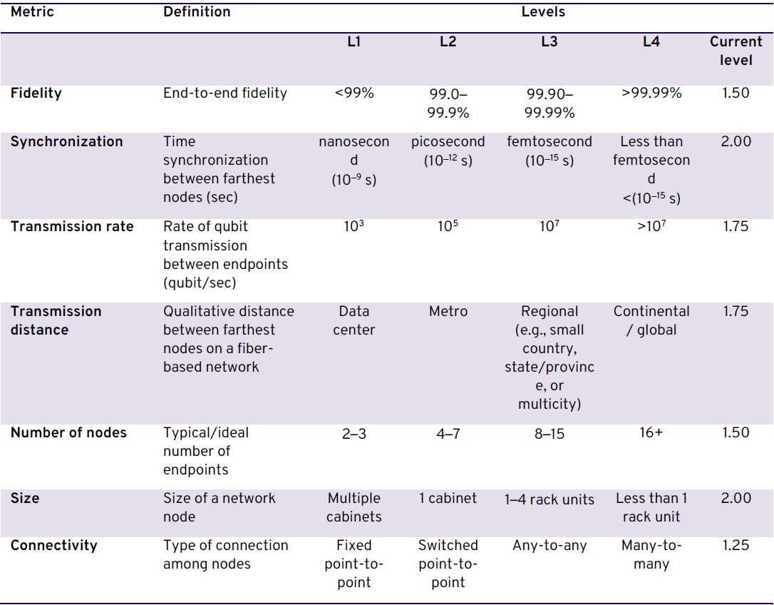
Quantum Network Metrics
Measures to describe quantum network capabilities

Slide 5
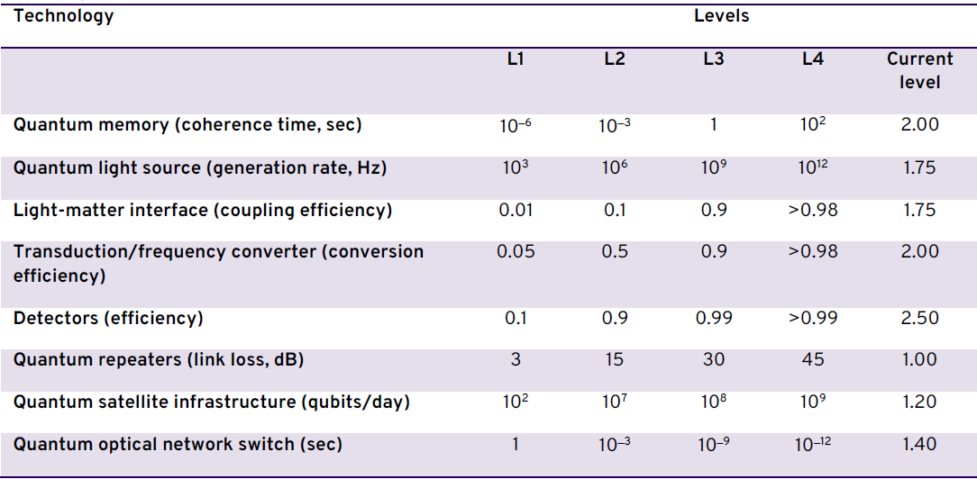
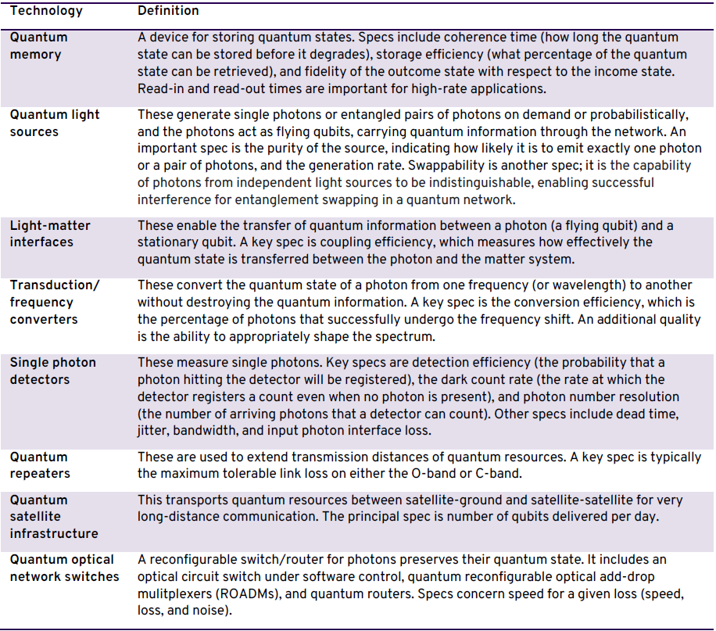
Quantum Enabling Technologies
Measures to describe quantum specific enablers
Definitions
Classical enabling technologies were identified and described, but not quantified

Slide 6
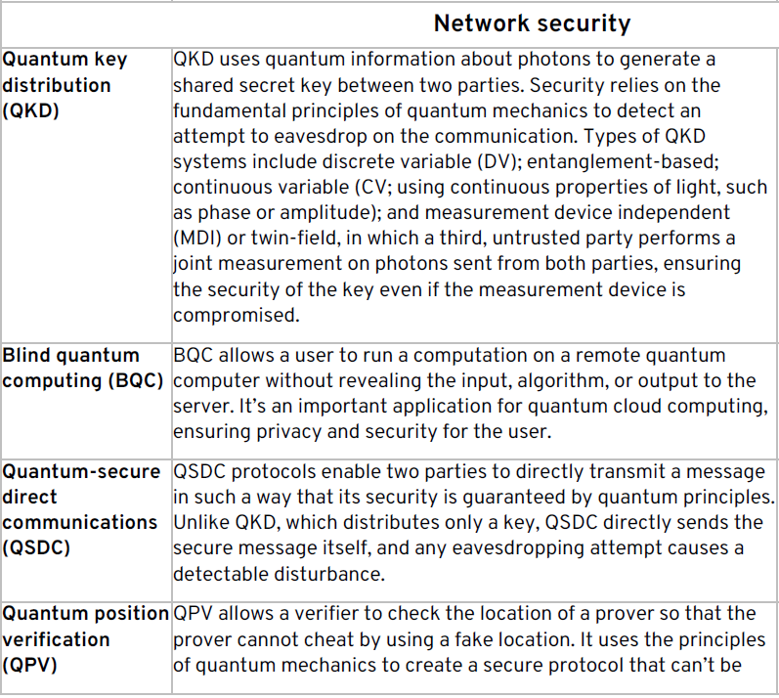
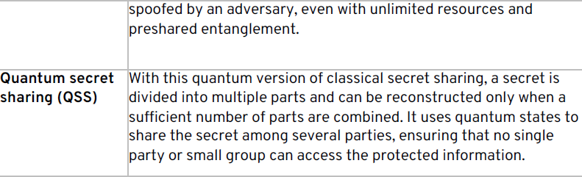
Applications: Network Security

Slide 7
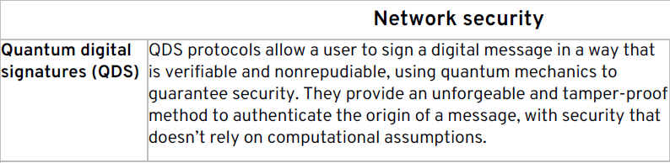
Applications: Network Security

Slide 8
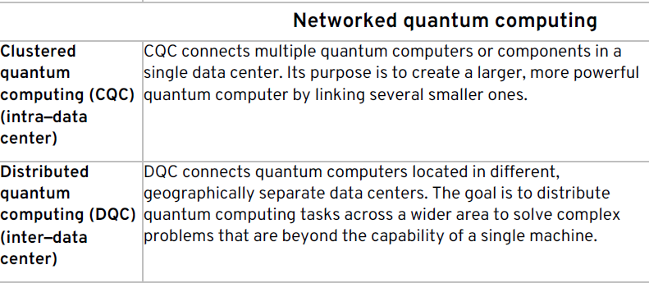
Applications: Networked Quantum Computing

Slide 9
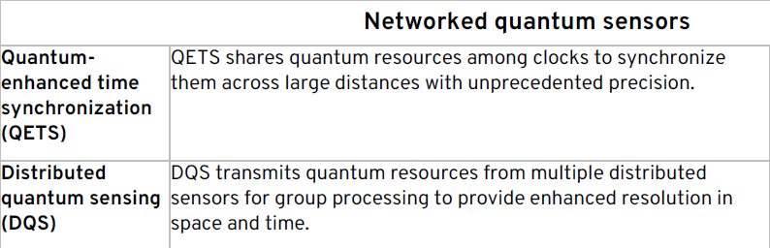
Applications: Networked Quantum Sensors

Slide 10
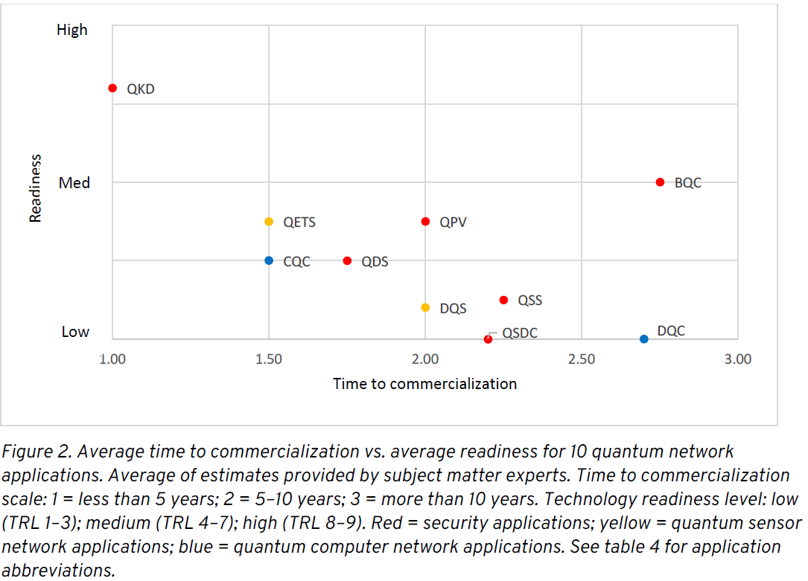
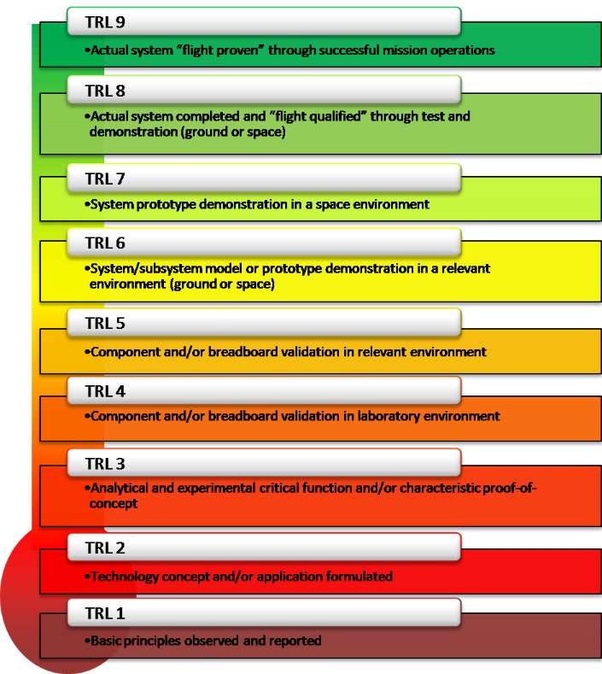
Readiness and Time to Commercialization
Readiness: related to technology readiness level (TRL)
Time: corresponds to time ranges

Slide 11
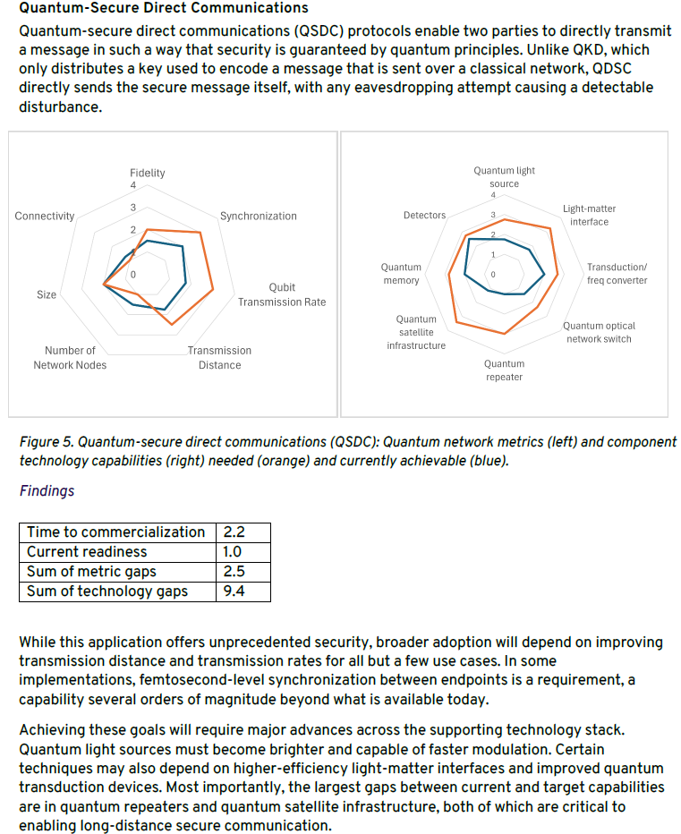
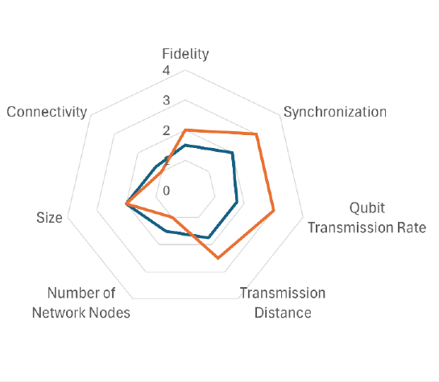
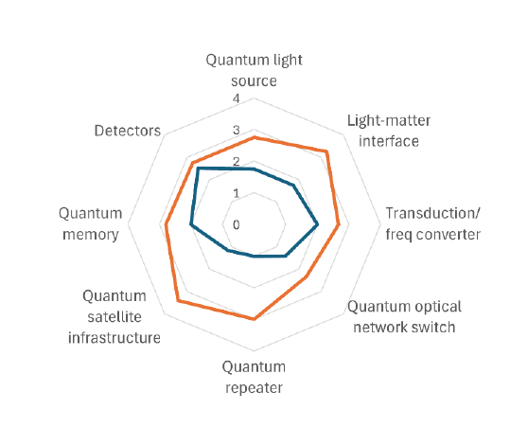

Representative Portions of Application Narrative and Analysis
Introduction
Network metrics
Measures
current
needed
$$gap = ∑{needed}_{i} − {current}_{i}$$
Scores
Enabling technologies
Findings

Slide 12
Observations and Conclusions
Observations
Conclusions
The gap for an application’s network metrics and enabling technologies “is an indicator of the magnitude of the challenges that must be overcome”
Applications with the smallest combined metric and technology gaps
  Quantum digital signatures (5.0)
  Quantum key distribution (6.2)
  Quantum secret sharing (6.3)
  Distributed quantum sensing (6.7)
Applications with the largest combined metric and technology gaps
  Distributed quantum computing (inter–data center) (25.1)
  Blind quantum computing (20.25)
  Quantum position verification (9.3)
  Clustered quantum computing (intra–data center) (15)
Applications with the shortest estimated time to commercialization:
  Quantum digital signatures
  Quantum key distribution
  Clustered quantum computing (intra–data center)
  Quantum-enhanced time synchronization
“this study provides a systems perspective on the gaps that need to be addressed […and] can inform funding agencies and private investors when deciding where to allocate resources.”
“one application can leverage advances in other areas and thus create a virtuous cycle”
“This analysis highlights the key performance and technology barriers to making various quantum networks available for researchers and innovators to create the quantum-enabled future.”
“The ability to network quantum devices and to distribute quantum information is integral to achieving the full benefits and value of quantum capabilities in computing, sensing, communication, and cryptography.”

