Slide 1
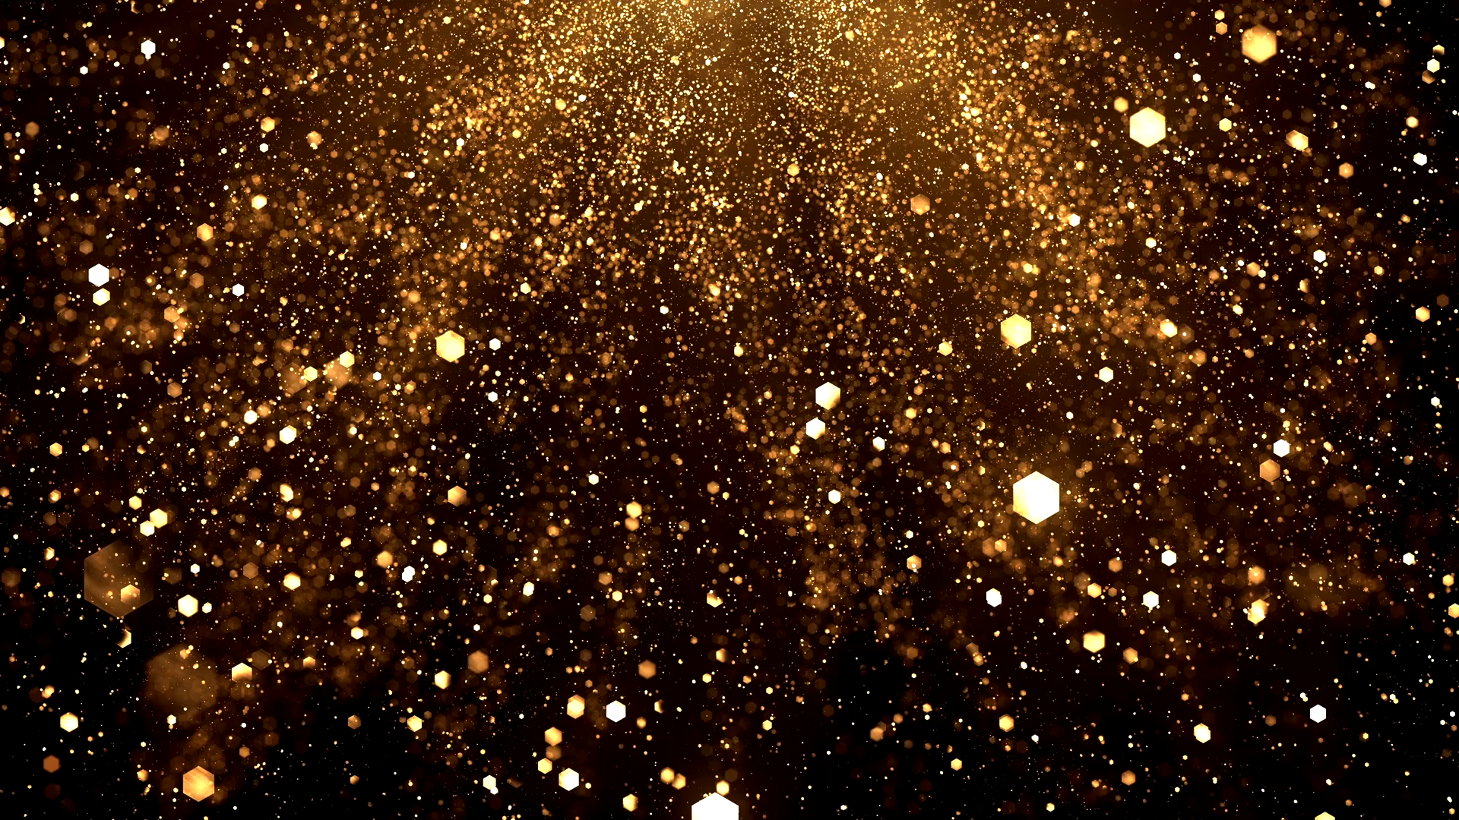

Looking at everything while looking at nothing
An introduction to Small-Angle Neutron Scattering
NIST Center for Neutron Research
Ryan P. Murphy

Slide 2
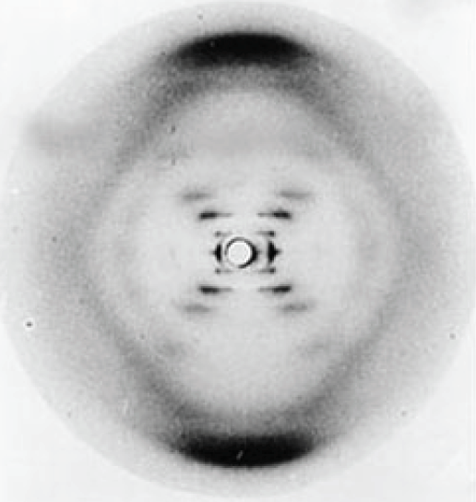
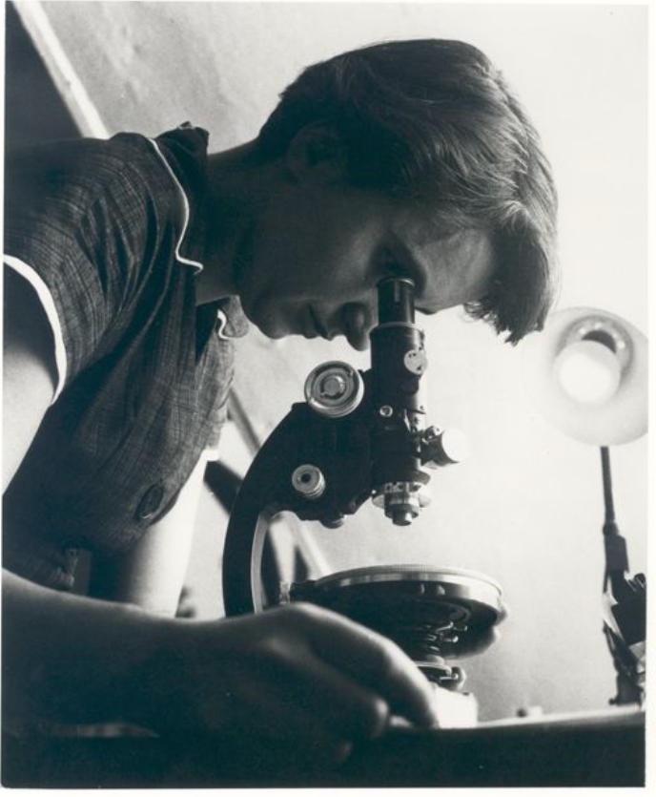
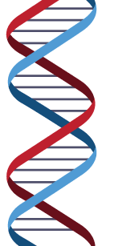
Exposure 51
DNA
0.34 nm
3.4 nm
φ
φ
Rosalind Franklin
Credits: Photo of Rosalind Franklin courtesy of Vittorio Luzzati. Photo of x-ray crystallography
(Exposure 51) courtesy of King's College Archives. King's College London.

Slide 3
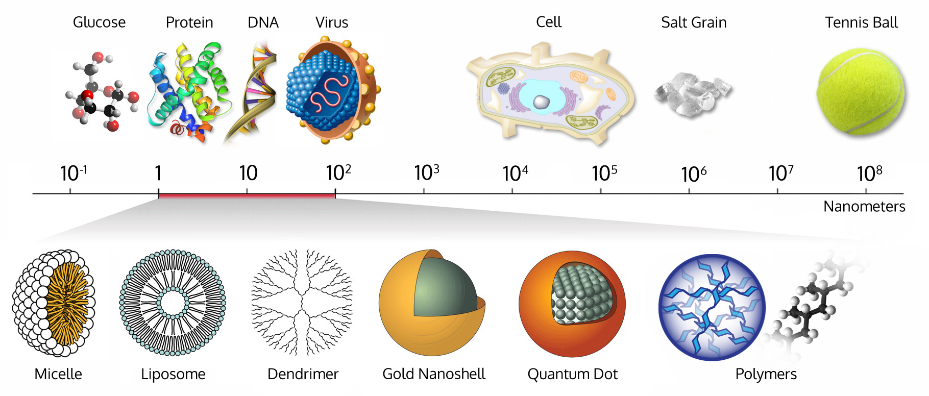
“Seeing” collections of atoms
www.wichlab.com/research

Slide 4
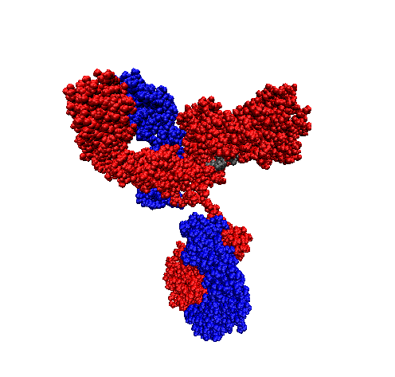
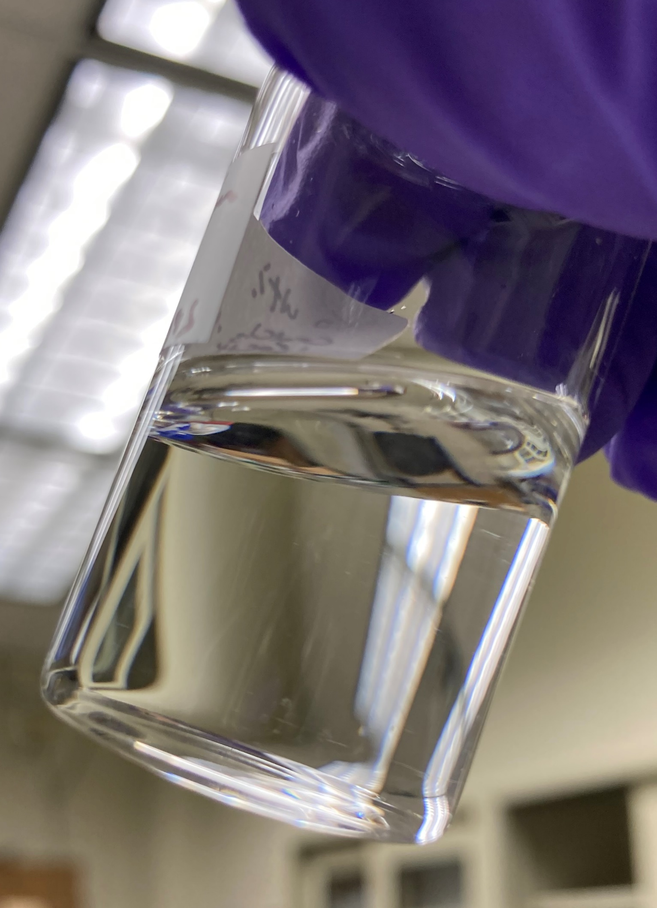
How many particles are there?
10,000,000,000,000,000
10¹⁶
NIST mAb
≈ 10 nm
≈ 150 kg/mol
≈ 10 mg/mL
https://www.nist.gov/programs-projects/nist-monoclonal-antibody-reference-material-8671

Slide 5
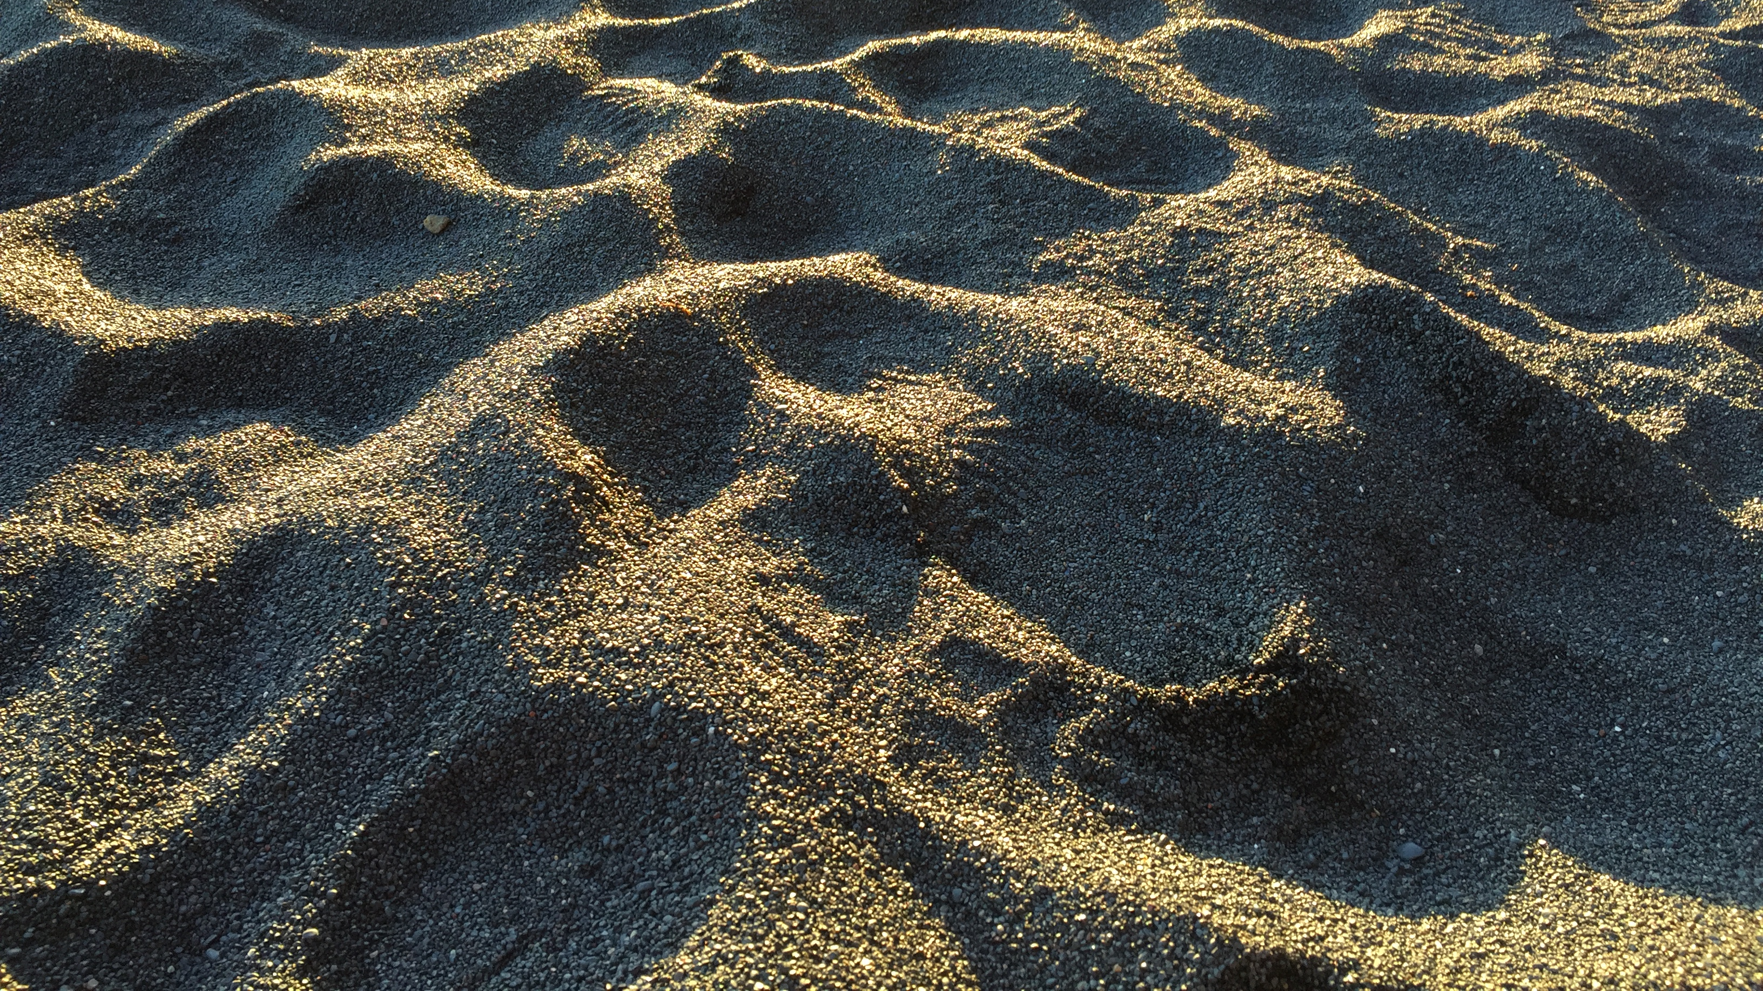
10⁶

Slide 6
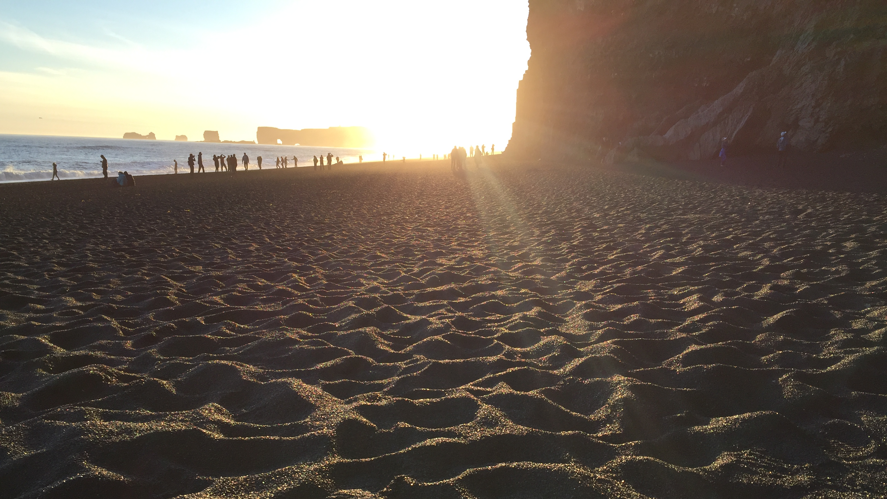
10¹⁰

Slide 7
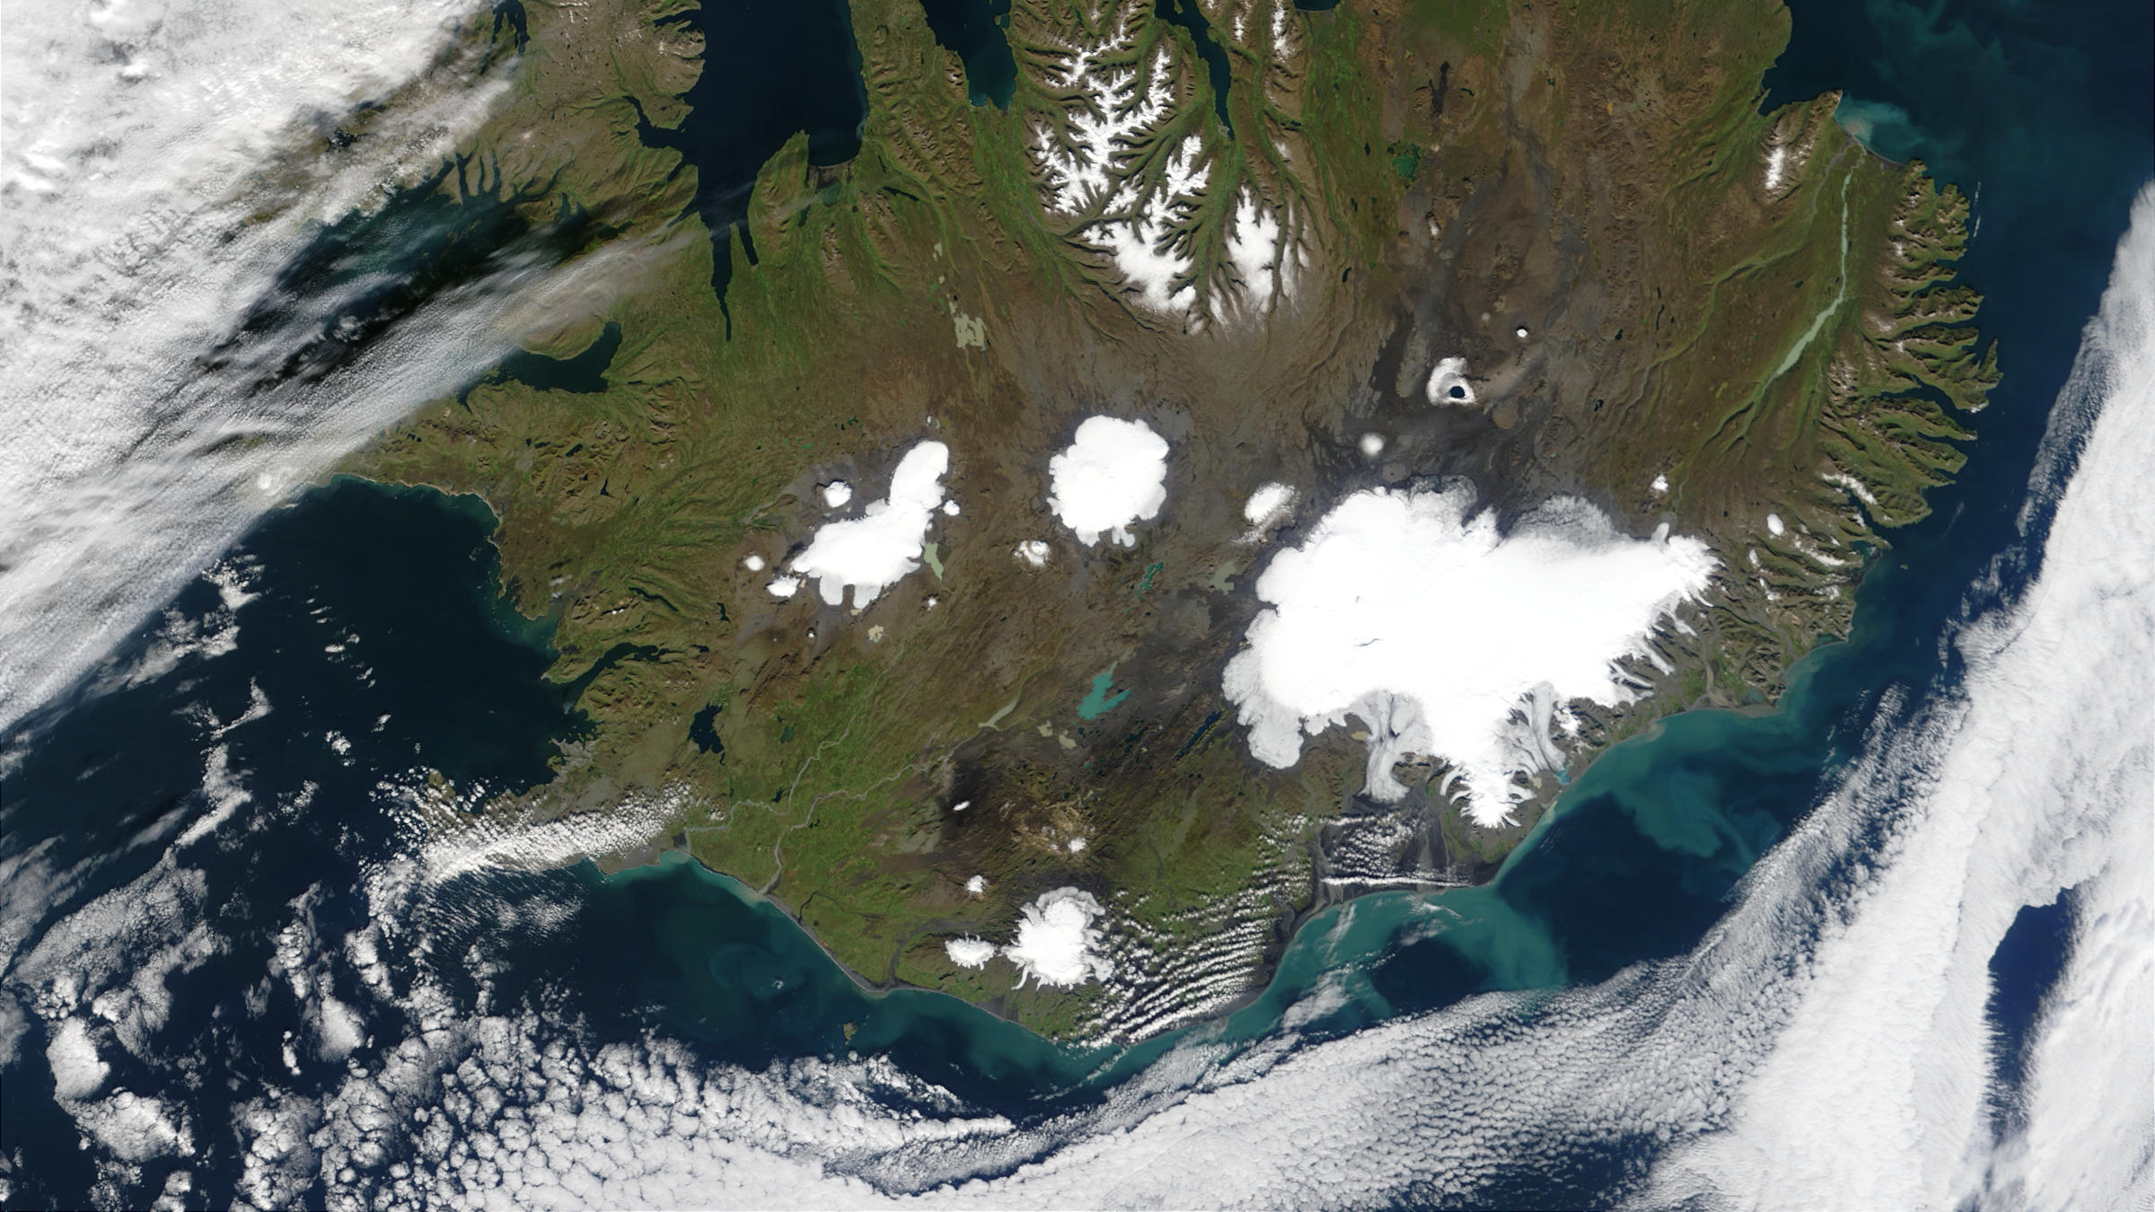
10¹³
Iceland
Reynisfjara

Slide 8
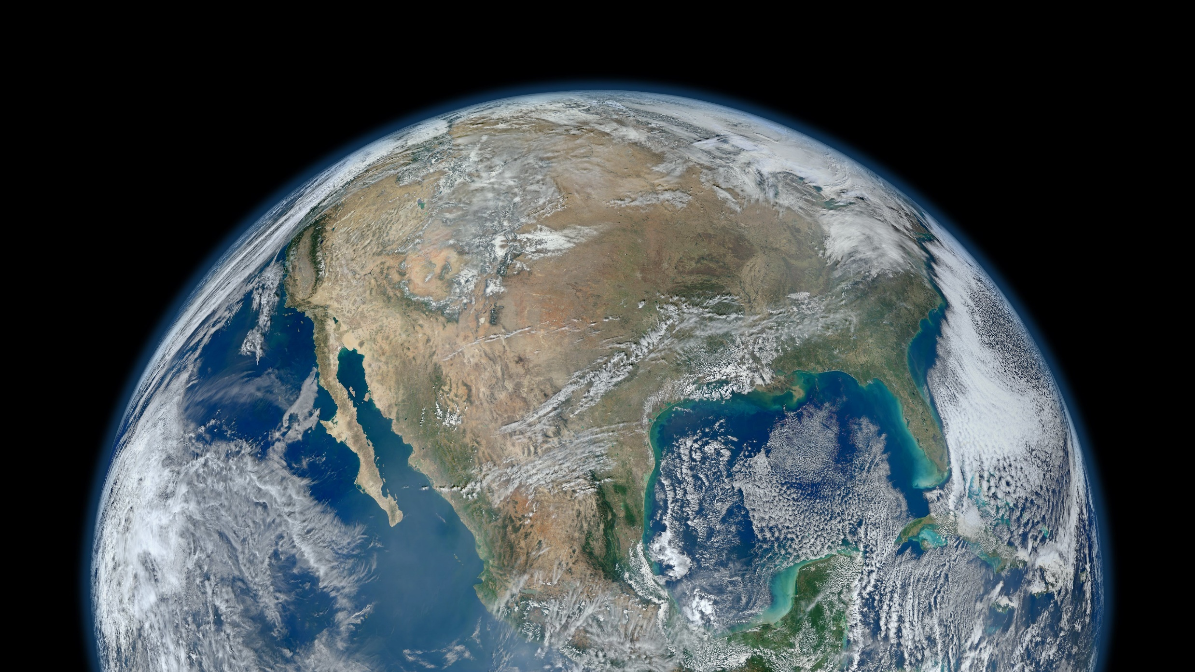
Iceland
Sand grains along coastlines on Earth
10¹⁶
https://www.flickr.com/photos/gsfc/

Slide 9
How can we measure the structure of this many objects?

Slide 10
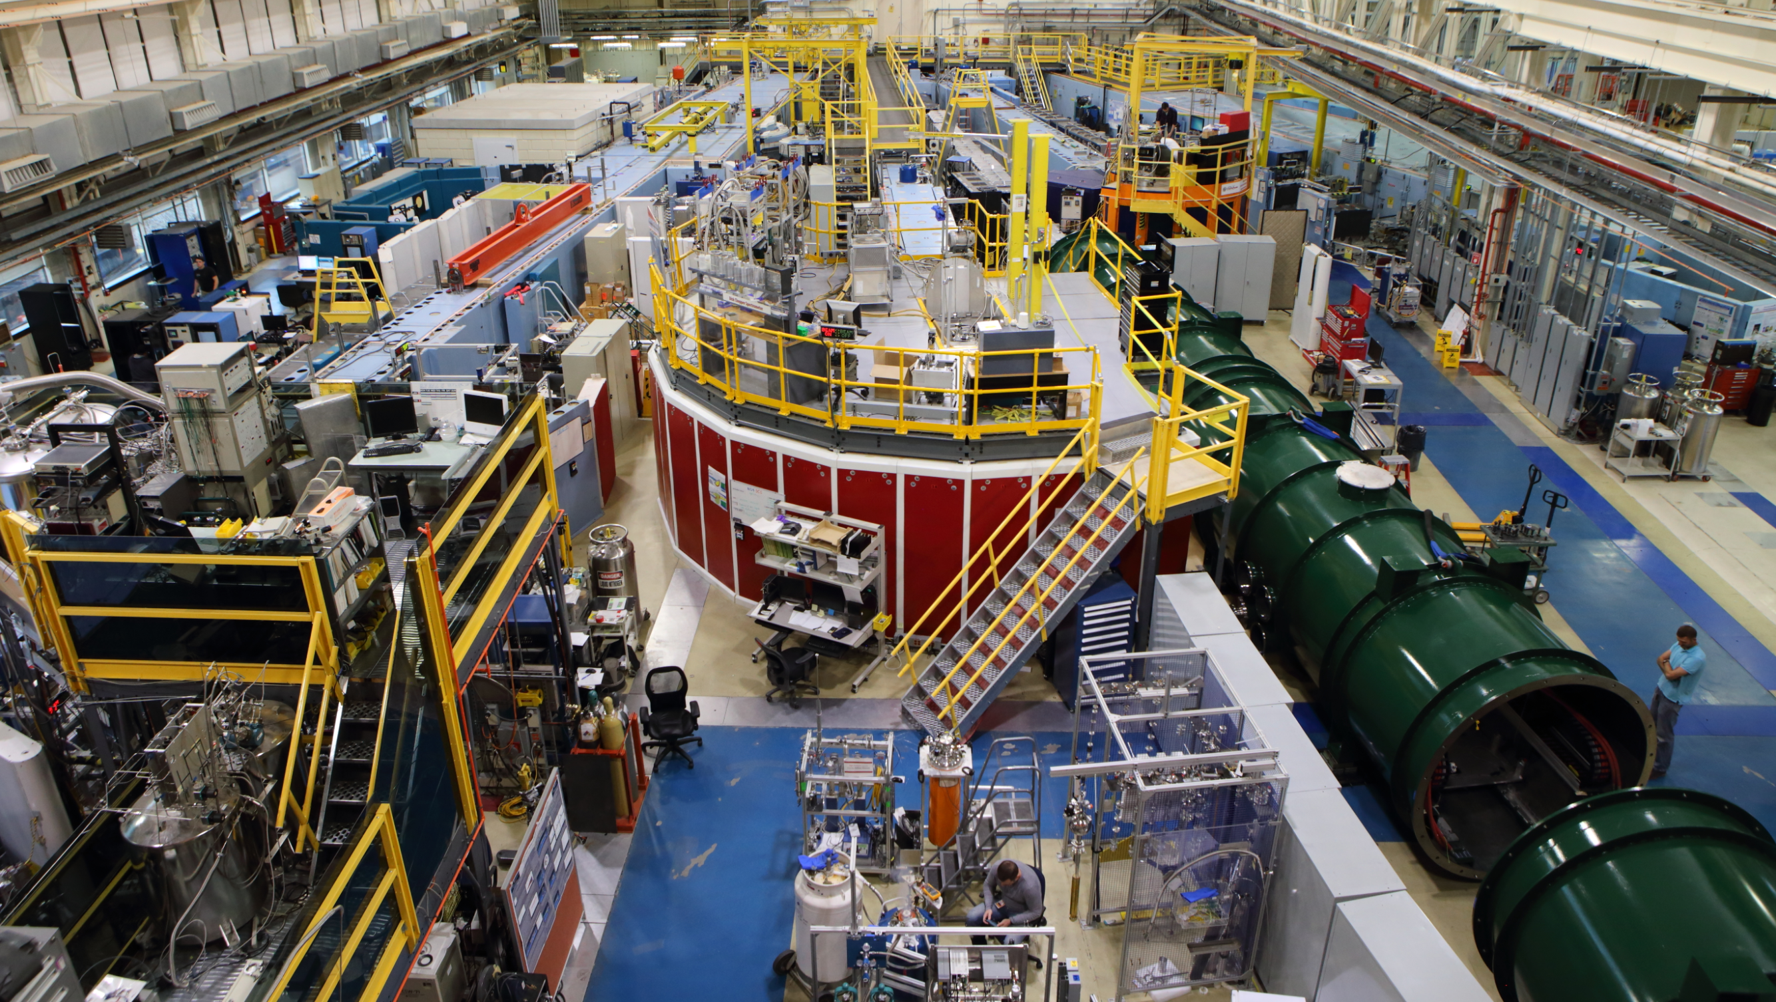

BT5 USANS
Small-Angle
Neutron
Scattering
(SANS)
NGB-10m SANS
NGB-30m SANS
NG3
VSANS
NG7 SANS

Slide 11
What is scattering?
Why at small-angle?
Why use neutrons?

Slide 12
What is scattering?
Why at small-angle?
Why use neutrons?

Slide 13
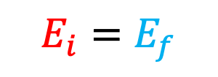


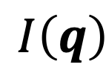

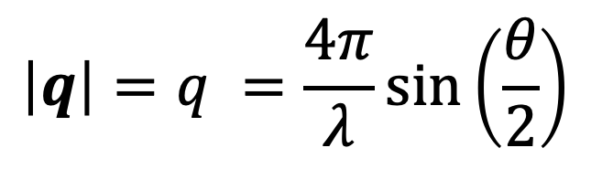
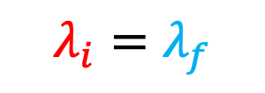
Scattering
$$I\left(q\right)$$
$$λ$$
Scattered
k_{s}
k_{i}
$$q$$
$$θ$$
Absorbed
Transmitted
$$\left|q\right|=q =\frac{4π}{λ}sin\left(\frac{θ}{2}\right)$$
_{Source}
_{Sample}
_{Detector}
$$E_{i}=E_{f}$$
$$λ_{i}=λ_{f}$$
Elastic scattering:

Slide 14

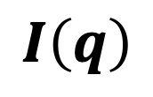





$$q_{z}$$
Scattering in 3D
$$q_{y}$$
$$q_{x}$$
$$q$$
$$θ$$
k_{s}
Scattered
$$I\left(q\right)$$
Absorbed
Transmitted
_{Detector}
k_{i}
$$λ$$
_{Sample}
_{Source}

Slide 15
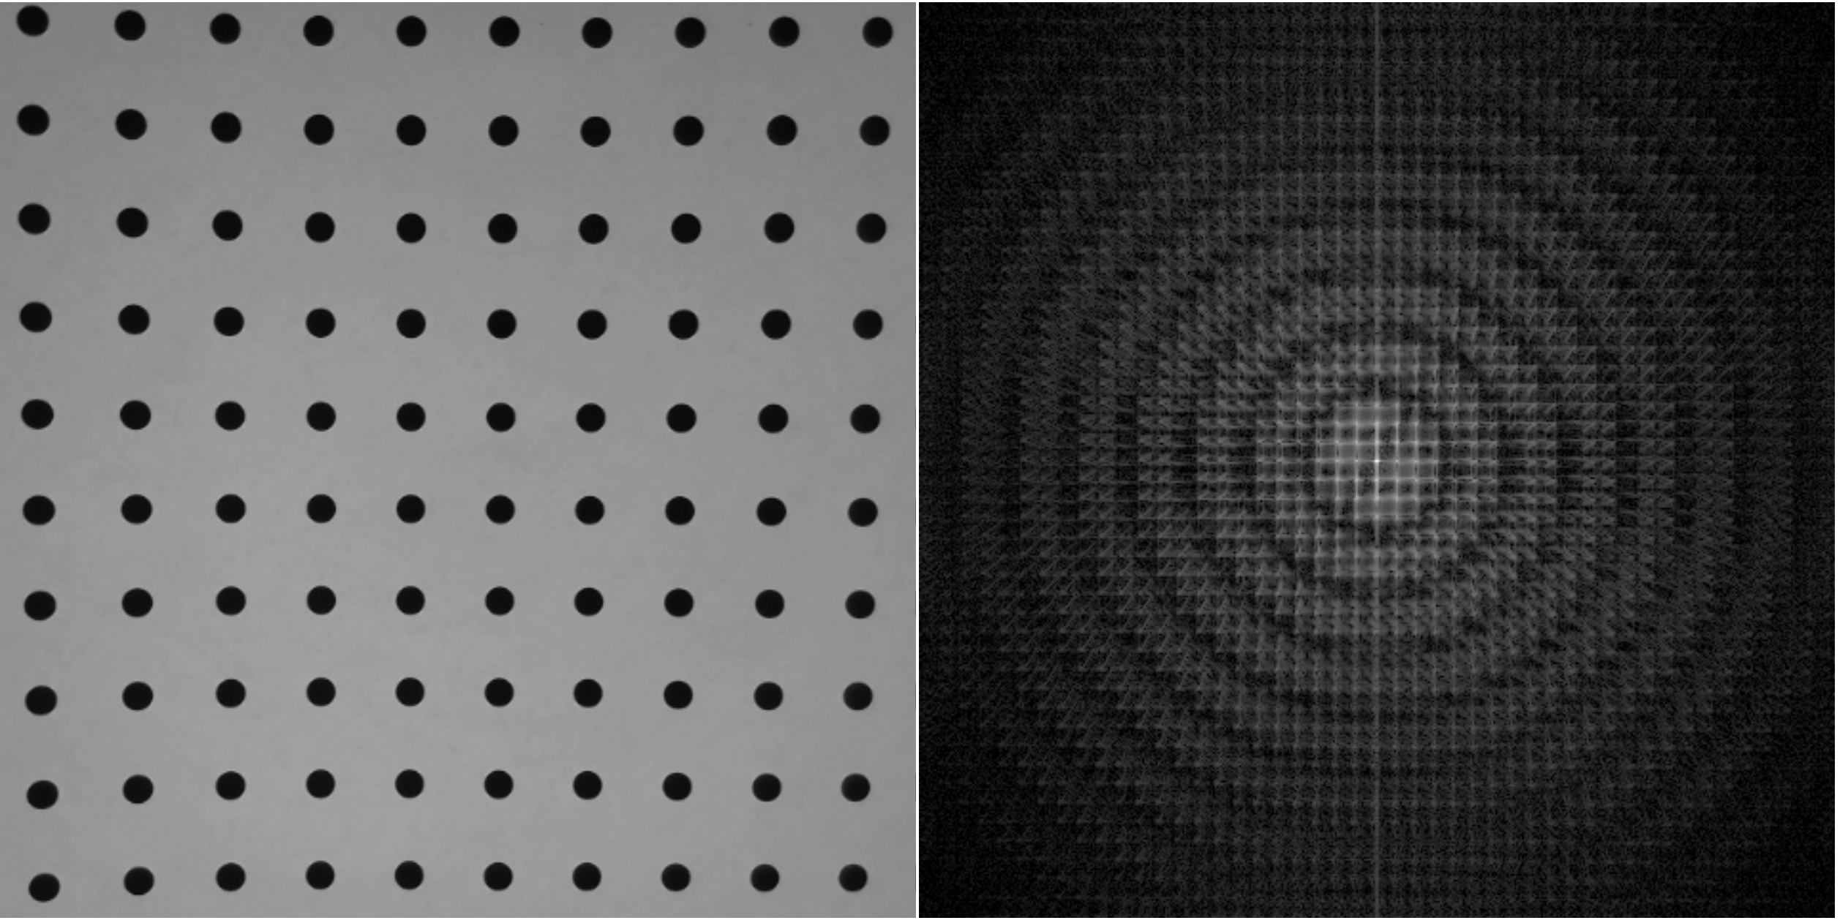


Sample
Detector
1 m
$$q$$
$$r$$
Transmitted neutrons
blocked by beamstop
L
This is what you can interact with
(You being a neutron)
This is your transverse coherence length

Slide 16
You are detected here
at time t+dt
You interact and change momentum (direction) here
at time t

Slide 20
10⁵ – 10⁶ counts later…

Slide 22
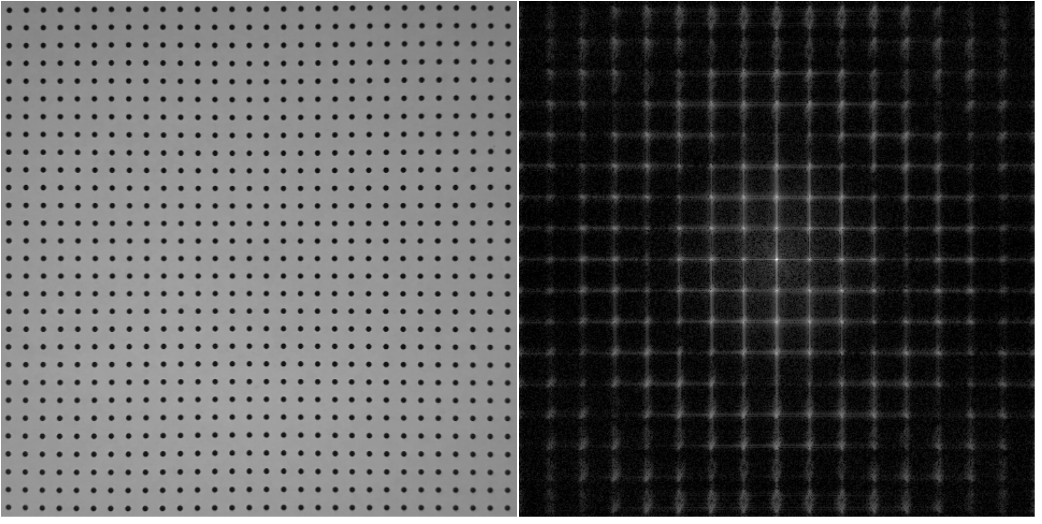

Slide 23
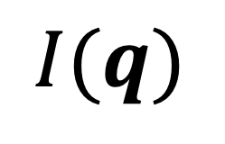
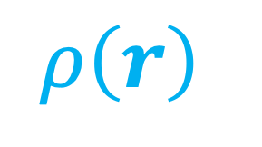
r (x,y,z)
space
[nm]
q (q_{x},q_{y},q_{z})
space
[nm⁻¹]
$$ρ\left(r\right)$$
$$I(q)$$

Slide 24
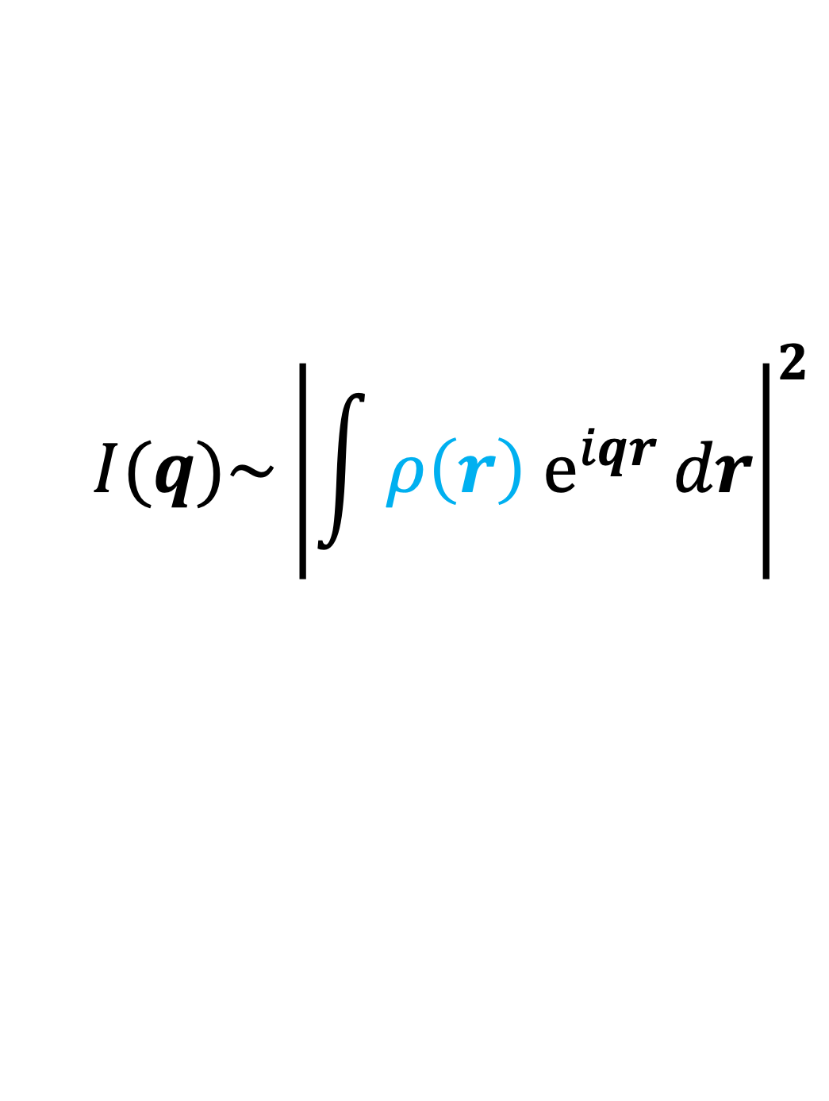
Fourier transform
$$I(q)\sim {\left|\int{ρ\left(r\right) e^{iqr}}dr\right|}^{2}$$
Scattering intensity is related to the differences in scattering length density distribution, ρ(r)
Intensity at q ~ |Fourier transform of ρ(r)|²

Slide 25
Demonstration
Contrast
Size
Shape
Distribution
Interaction
Orientation
Complex shapes
Phase loss
FFT Software:
Brian Maranville: https://pages.nist.gov/reflectometry-calculators/fourier_webcam/
Brian Pauw: https://lookingatnothing.com/

Slide 26
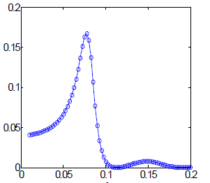

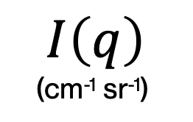


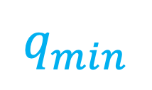
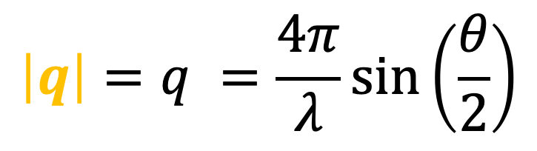
$$\left|q\right|=q =\frac{4π}{λ}sin\left(\frac{θ}{2}\right)$$
$$I\left(q\right)$$
(cm⁻¹ sr⁻¹)
$$q_{min}$$
$$q_{min}$$
$$q_{max}$$
$$q_{max}$$
q (Å⁻¹)

Slide 27
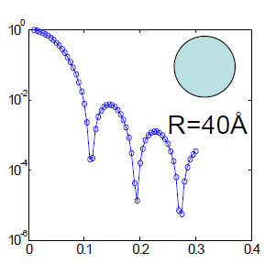
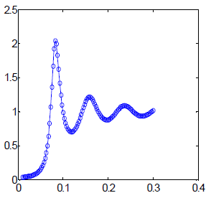
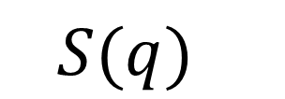

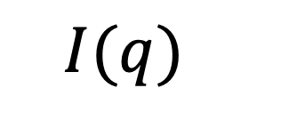
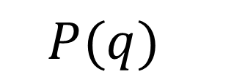

Some math for isotropic monodisperse spheres
Real space, r (Å)
Positions
Contrast
Shape
=
( - )²
x
x
‘neutron color’
‘intraparticle’
‘inside’
‘interparticle’
Scattering space, q (Å⁻¹)
‘between’
${Δρ}^{2}$
$$P(q)$$
$$S(q)$$
$$I(q)$$
~
x
x
$$3×{10}^{−6}$$
q (Å⁻¹)
q (Å⁻¹)
adapted from Y. Liu
‘Colloidal interactions in solution’

Slide 28
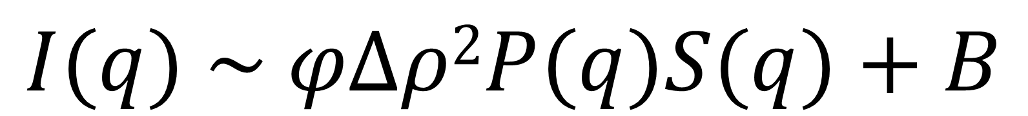
Some math for isotropic monodisperse spheres
incoherent
scattering
coherent scattering
scattering intensity
$$I(q) \sim φΔρ2P(q)S(q)+B$$
particle volume fraction
scattering length density difference
form
factor
structure
factor
background

Slide 29
What is scattering?
Why at small-angle?
Why use neutrons?

Slide 30
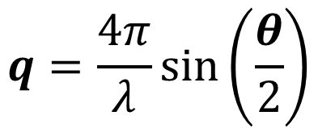

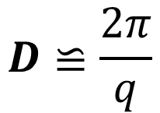

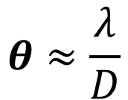
“Small” angles
I(q)
Bragg condition
$$2D\sin\left(\frac{θ}{2}\right)=nλ$$
k_{s}
scattered
$$θ$$
q
$$D$$
k_{i}
transmitted
$$D≌\frac{2π}{q}$$
$$q=\frac{4π}{λ}\sin\left(\frac{θ}{2}\right)$$
$$θ≈\frac{λ}{D}$$
1 nm to 10 µm
1 Å⁻¹ to 0.00003 Å⁻¹
30° to 0.0006°

Slide 31
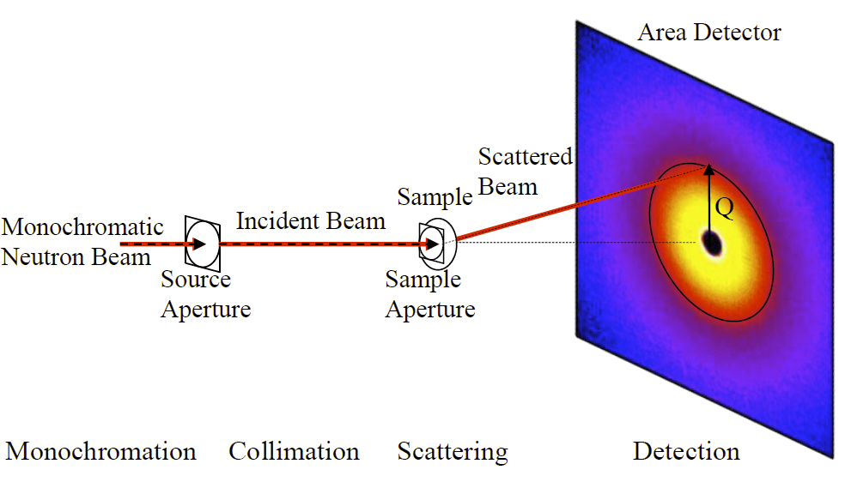





What q-range do you need?
Wavelength
$$q=\frac{4π}{λ}sin\left(\frac{θ}{2}\right)$$
$$λ$$
$$θ$$
$$q_{y}$$
sample
Sample-detector distance
$$q_{x}$$
Hammouda, B. (2016). The SANS Toolbox. Gaithersburg, MD, NIST Center for Neutron Research.
https://www.nist.gov/system/files/documents/2023/04/14/the_sans_toolbox.pdf

Slide 32
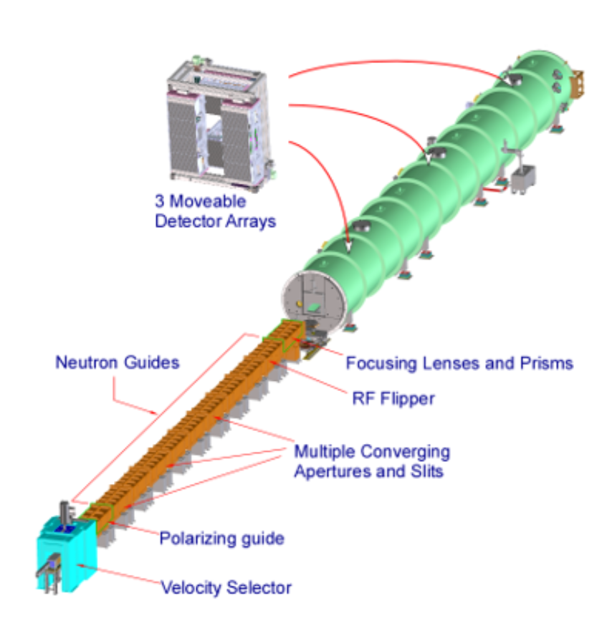
What q-range do you need?
Mid-q
High-q
Low-q
VSANS
Fractal dimensions
Cluster lengths
Second virial coefficients
Radius of gyration
Pore radius
Surface area
Particle radius
Radius distribution

Slide 33
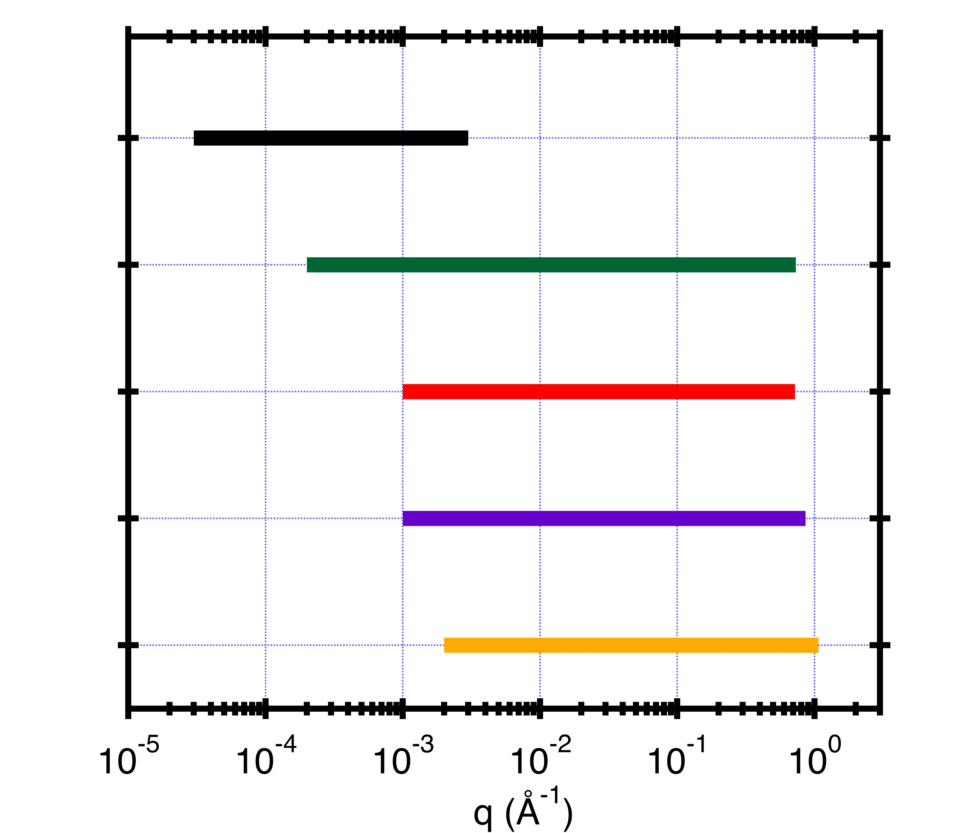
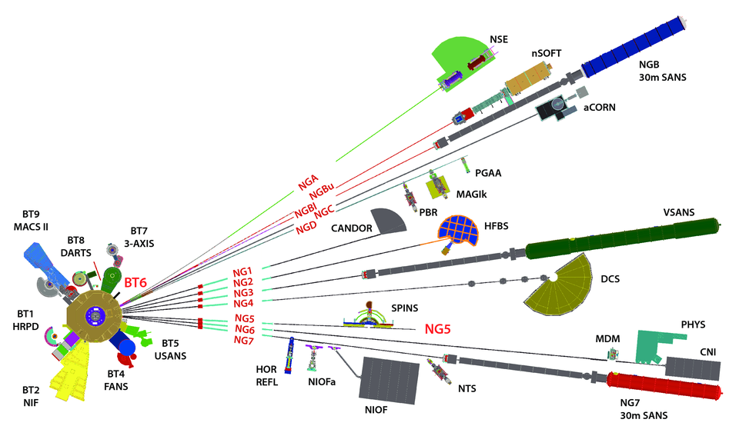
The q-range we can offer
D = 2π/q
6 µm 0.6 µm 600 Å 60 Å 6 Å
USANS λ = 2.4 Å, Δλ/λ = 6%, 0.0006 ° < θ < 0.06 °
vSANS-48m 4.5 < λ < 20 Å, Δλ/λ=1% & 12.5%, 0.017 ° < θ < 30 °
NG7-30m 4.5 < λ < 20 Å, 11% < Δλ/λ < 25%, 0.056 ° < θ < 30 °
NGB-30m 3.0 < λ < 20 Å, 11% < Δλ/λ < 25%, 0.065 ° < θ < 24 °
nSOFT-10m 3.0 < λ < 20 Å, 11% < Δλ/λ < 25%, 0.17 ° < θ < 30 °
80 m

Slide 34
BT5 USANS
NGB-10m SANS
NGB-30m SANS
NG7 SANS
NG3
VSANS

Slide 35
What is scattering?
Why at small-angle?
Why use neutrons?

Slide 36
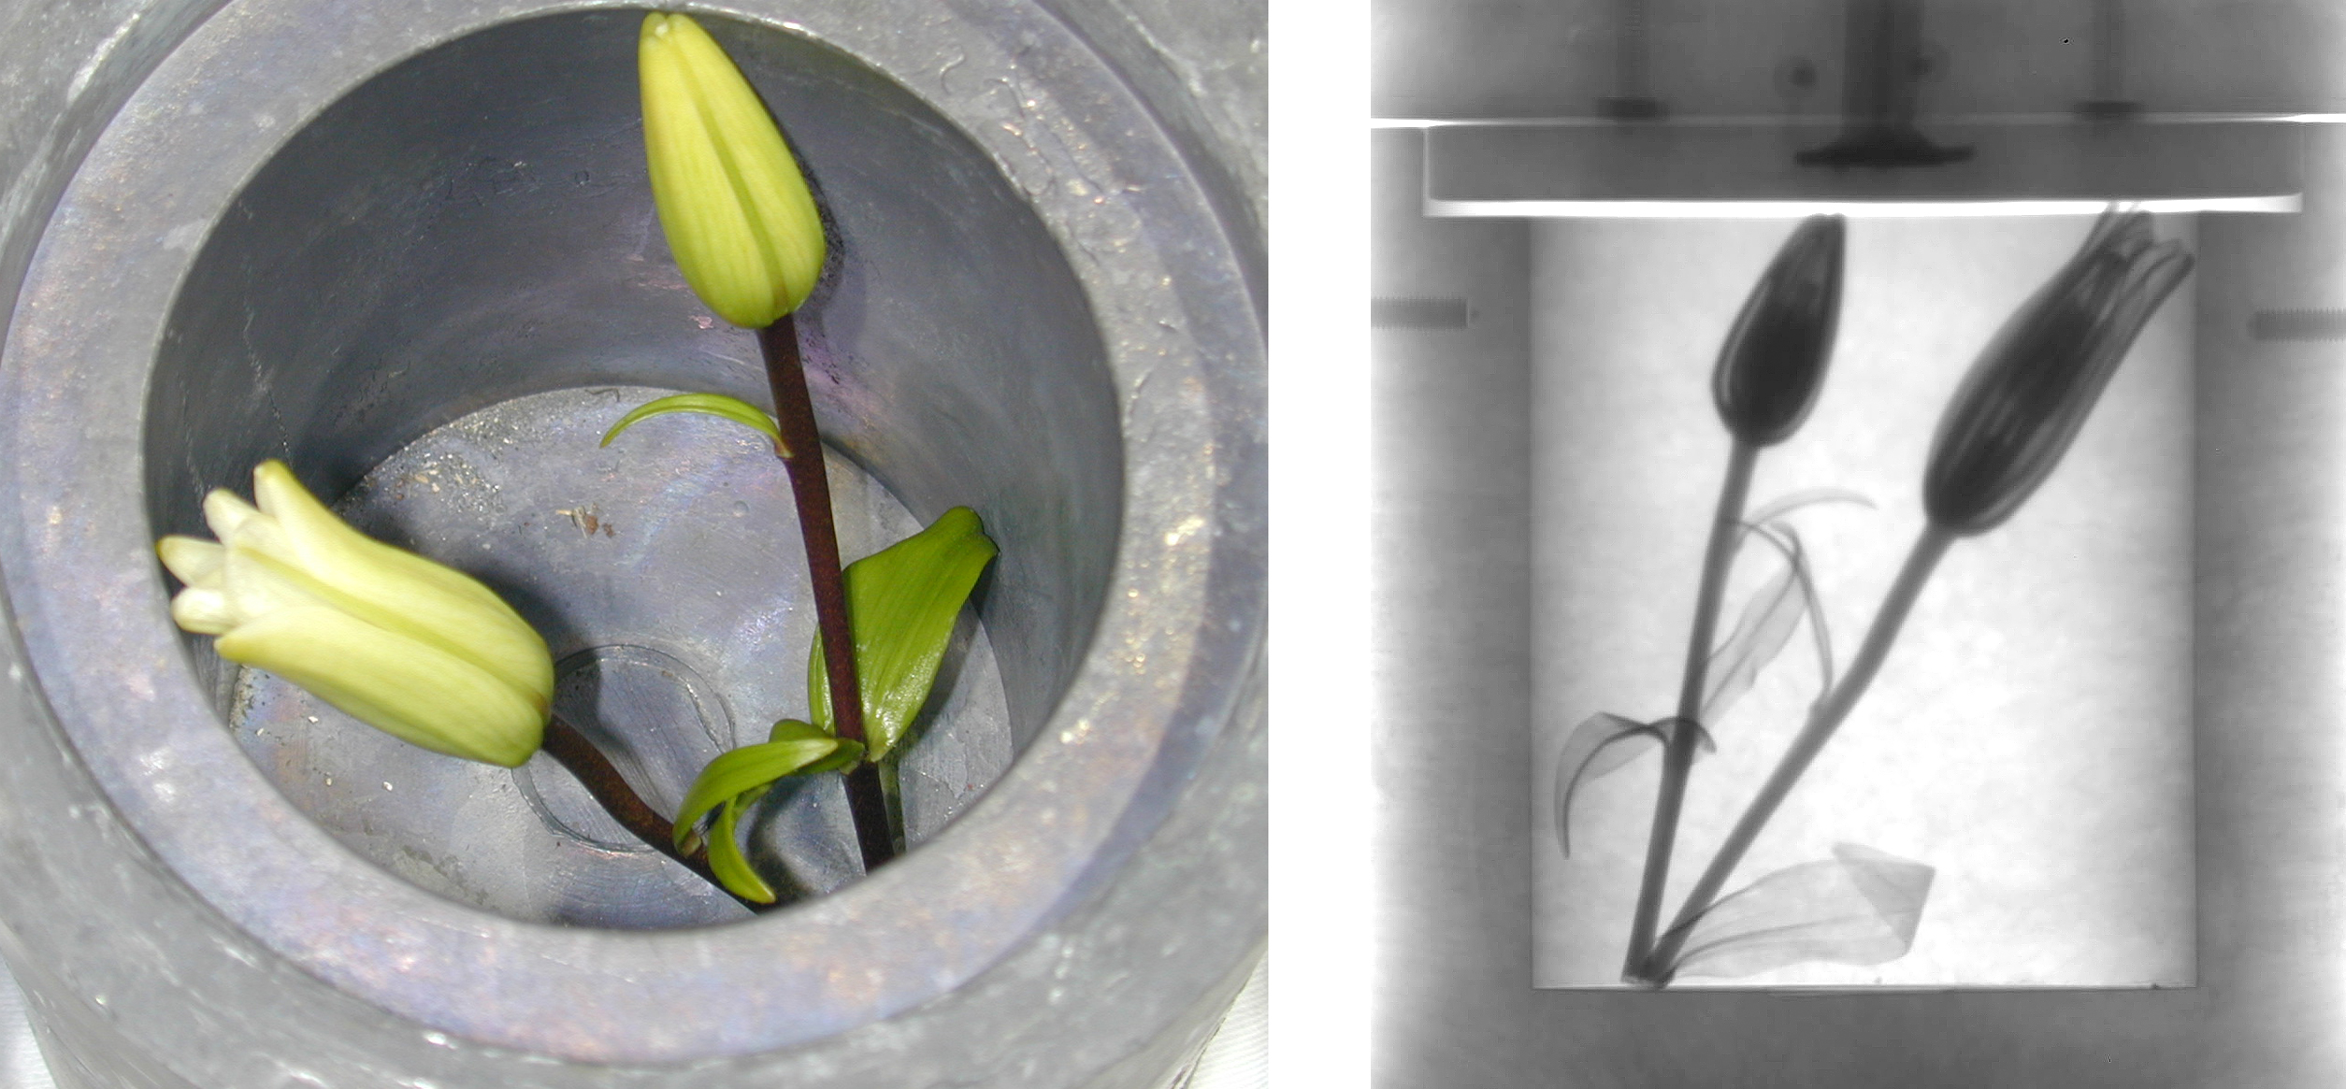

scattering length*
Contrast
neutron
X-ray
H
$$ρ=\frac{\sum{b_{i}}}{V}$$
D
C
O
b_{i} = scattering length
V = molecular volume
Al
Si
scattering length density calculator
https://www.ncnr.nist.gov/resources/activation/
Fe
Neutron image: Daniel Hussey/NIST
*X-ray scale reduced by ~ 1.5X to compare with neutron scale
adapted from presentation by J. D. Copley

Slide 37



Contrast variation
$$Core+Shell$$
$$Shell$$
$$Core$$
ρ_{solvent} ≠ ρ_{core} ≠ ρ_{shell}
core and shell are visible
ρ_{solvent} = ρ_{core}
shell is visible
ρ_{solvent} = ρ_{shell}
core is visible

Slide 38
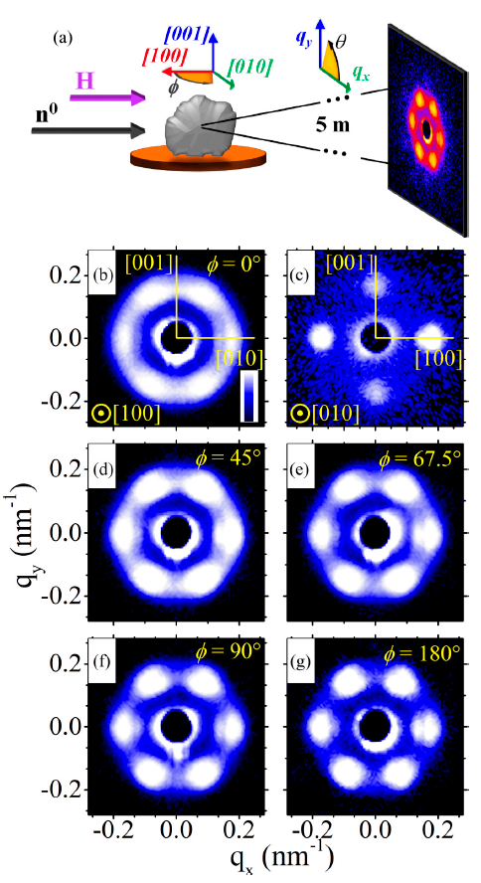
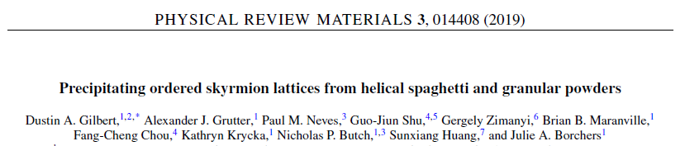
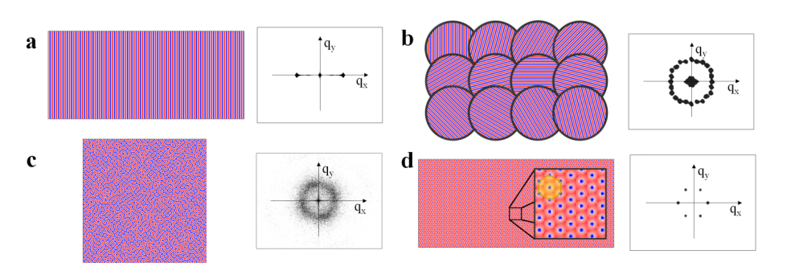
Magnetic structures
Gilbert, D. A., et al. (2019). Physical Review Materials 3(1).

Slide 39
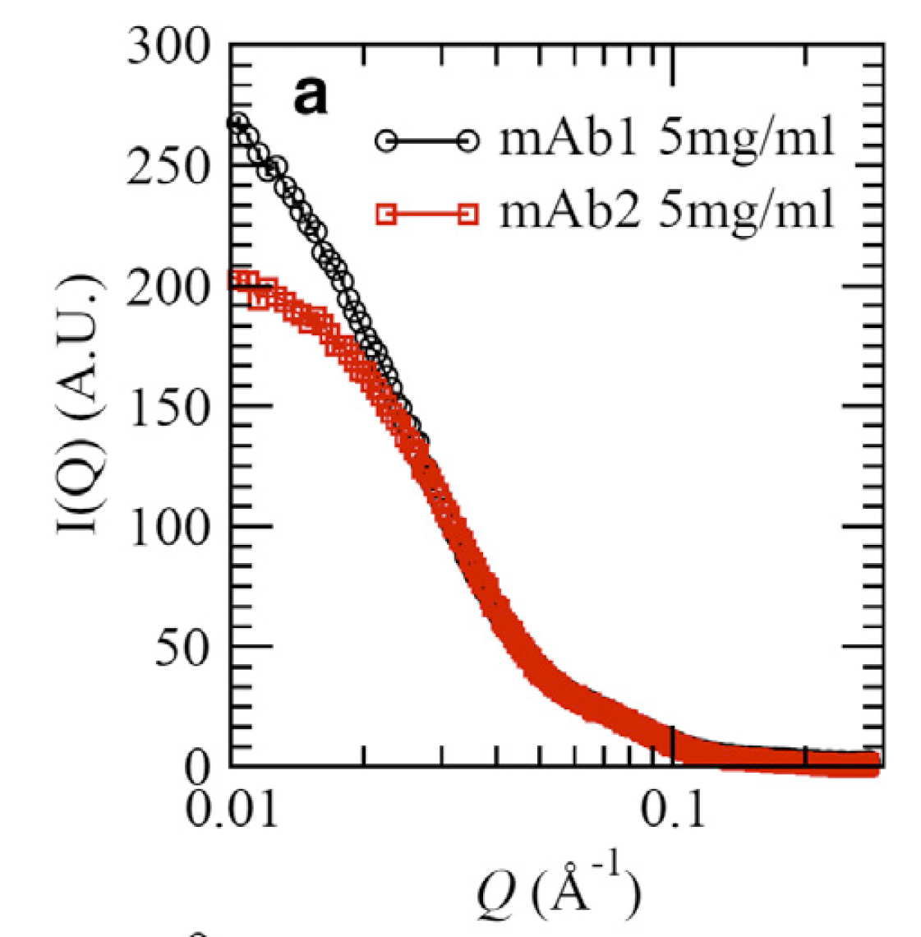
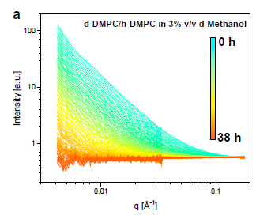
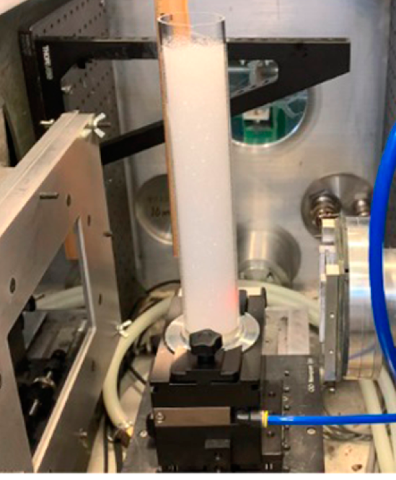


Non-destructive
foams
biologicals
kinetics
Perticaroli, S., et al. (2020). Langmuir 36(48): 14763-14771.
Yearley, E. J., et al. (2014). Biophys J 106(8): 1763-1770.
Nguyen, M. H. L., et al. (2019). Biophys J 116(5): 755-759.

Slide 40



Extreme environments
Shear rates ~ 10⁻³ to 10⁷ s⁻¹
Pressures ~ vacuum to 4400 bar
Temperatures ~ 1.5 K to 800 K
Teixeira, S. C. M., et al. (2018).
Journal of Neutron Research 20(1-2): 13-23.
https://www.nist.gov/ncnr/sample-environment

Slide 41
Neutrons
Photons
Interact with nuclei
Isotope contrast (H/D)
Magnetic structure
Non-destructive
Extreme environments
Sample activation
Lower flux
Fewer sources
Interact with electrons
Higher flux
Finer q-resolution
Smaller samples sizes
Many sources
Ionizing damage (X-rays)
Poor contrast at low Z

Slide 42

Summary
What is scattering?
Why at small-angle?
Why use neutrons?
A change in neutron momentum due to the sample, collectively producing an intensity interference pattern that is related to the
scattering length density distribution
I(q) ~ |FT{ρ(r)}|²
Scattering angles needed to resolve length scales:
$D≈{2π}/q≈$ 1 nm to 10 um
$q=\frac{4π}{λ}\sin\left(\frac{θ}{2}\right)$ $≈$ 1 Å⁻¹ to 0.00003 Å⁻¹
$θ≈$ 30° to 0.0006°
Unique element contrast, isotope variation, magnetic structure, non-destructive, extreme sample environments

Slide 43
Looking at everything
(in the beam path)
Sand grains along coastlines on Earth
10¹⁶
https://www.flickr.com/photos/gsfc/

Slide 44
Looking at nothing something?
DNA
0.34 nm
3.4 nm
φ
φ
Rosalind Franklin
Credits: Photo of Rosalind Franklin courtesy of Vittorio Luzzati. Photo of x-ray crystallography
(Exposure 51) courtesy of King's College Archives. King's College London.

Slide 45


Rosalind Franklin Institute
Rutherford Appleton Laboratory
Didcot, Oxfordshire, UK

Slide 46
Looking at everything while looking at something
An introduction to Small-Angle Neutron Scattering
NIST Center for Neutron Research
Ryan P. Murphy

