Slide 1
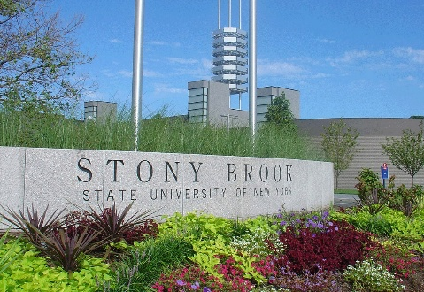
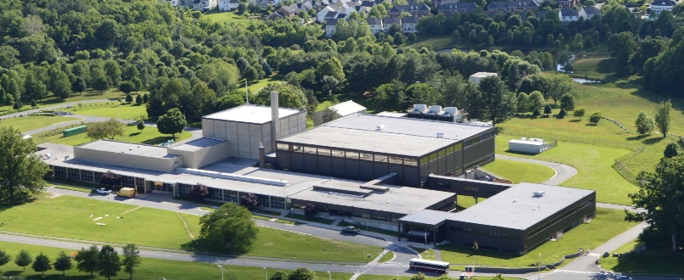



Industrial Research Applications of Neutron Scattering
A STORY IN THREE PARTS
Job hunting/Grant request? Try these industries
Accessing resources for that work
A few examples
Stony Brook
NCNR/U Del.
NCNR/CHRNS Summer School
July 27-31, 2026
Hubert E. King Jr
Bell Labs
ExxonMobil (retired)
IBM T.J. Watson Research
Notes:
You heard yesterday how neutron can give unique information about materials
Today I’m going to give you information about that information can be valuable in industry. For those interested in numbers. Our analysis shows a value of 29 billion dollars for just four well-documented case studies. Obviously this is a lower bound of the total impact
For me:PhD Stony Brook, student research at Bell, then to IBM for a postdoc, then ExxonMobil for a long career. Finally retired a few years back and came to NCNR and I also hold a visiting appointment with U. Del
Today I’ll tell you about my experiences and some of those from NCNR staff

Slide 2
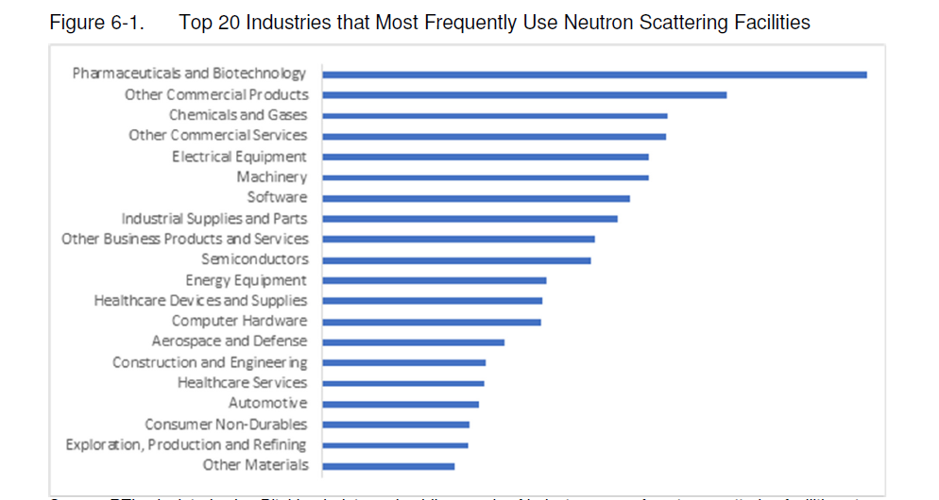
Industrial Impact from 2024 RTI Report
Commercial Products/Services= Isotope Production & Transmutation (P in Si)
Walsh, A. C., Nienow, S., Merker, J. M. S., Decker, E. C., Strack, C. N., Salem, M. E., Martin, G., & Shaw, B. (2024). Assessment of the retrospective and prospective economic impacts of investments in U.S. neutron research sources and facilities from 1960 to 2030: Final report. RTI International
Notes:
Companies using neutron scattering for include ExxonMobil, Dow Chemical and PPG Industries in the chemicals and gases industry, Coherent Corp. and Raychem in the electrical equipment industry, and Intel and Texas Instruments in the semiconductor industry.

Slide 3
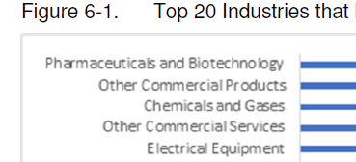
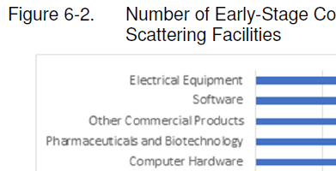
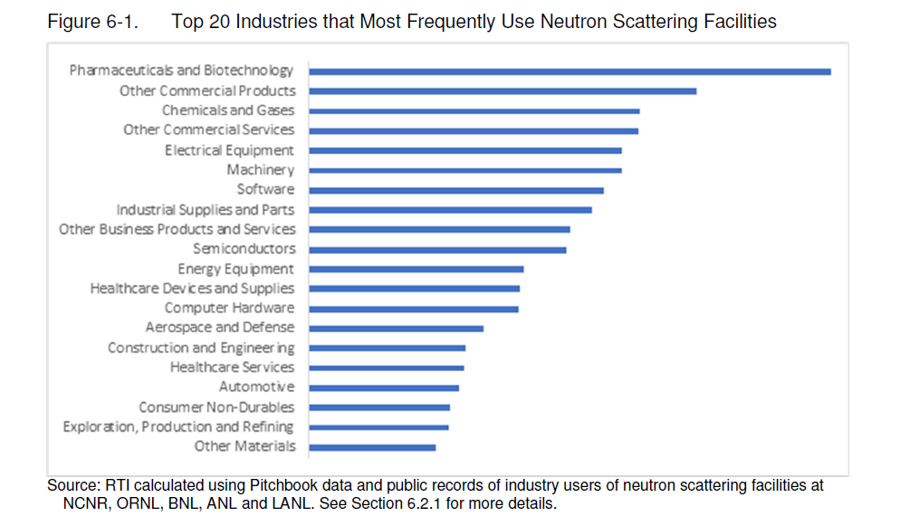
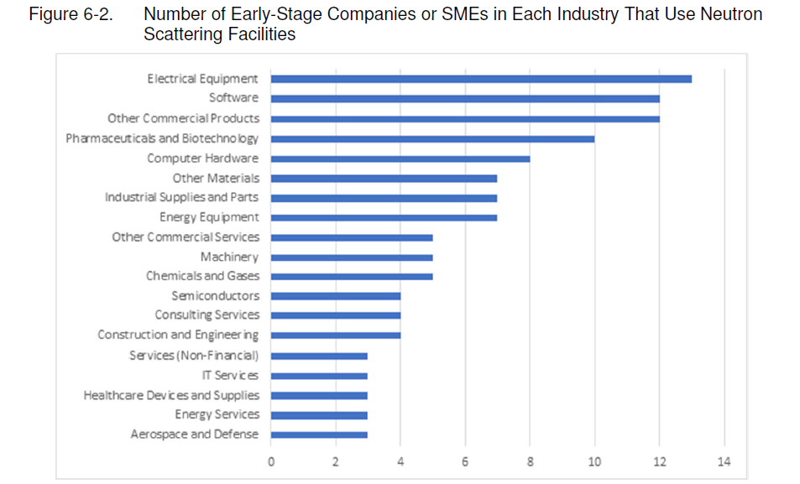
Industrial Impact
NOW
EMERGING
Top 5
Commercial Products/Services= Isotope Production & Transmutation (P in Si)

Slide 4
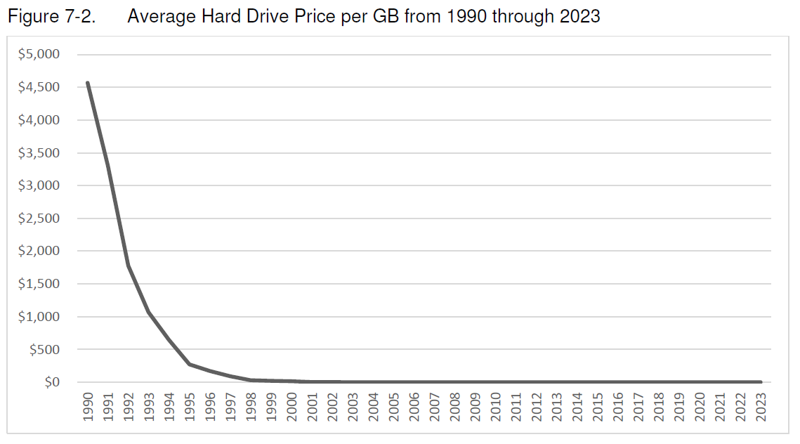
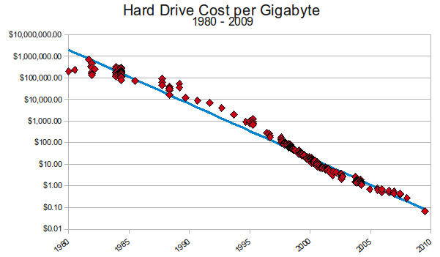
Neutron Research Has Yielded Substantial Impacts in Multi-Industries
Four Case Studies from RTI
Computer Performance
Aerospace Safety
BioPharma
Electric Vehicles
Neutron scattering research facilities have generated a Net Present Value of $29.4 billion
Polarized Neutron Reflectometry Studies Of Giant Magnetoresistance Materials
Average Hard Drive Price per GB
$5000
$2500
$0
1990
2000
2010
2020
Walsh, et al . RTI International
https://mkomo.com/
Notes:
Polarized neutron reflectometry helped establish how magnetization is distributed through the nanometer-scale layers used in giant magnetoresistance (GMR) devices. GMR structures contain alternating magnetic and nonmagnetic conducting layers; their electrical resistance changes strongly when the magnetizations of neighboring magnetic layers switch between parallel and antiparallel alignment.
The key technical contribution of polarized neutrons was their ability to measure, nondestructively and with depth resolution: the thickness and magnetic moment of each buried layer,
whether adjacent magnetic layers were parallel or antiparallel,
the strength of magnetic coupling across the nonmagnetic spacer,
interfacial roughness, intermixing, and magnetically “dead” regions.
This information allowed researchers to optimize layer thicknesses and interfaces so that very small magnetic fields from densely packed recorded bits produced a large, reliable resistance change in the read head. The resulting GMR sensors could read much smaller bits, sharply increasing areal storage density and lowering the cost per gigabyte. The report therefore describes polarized neutron reflectometry as the technique of choice for understanding the individual nanolayers required for high-density GMR recording.

Slide 5
Why Industry Needs Neutrons
Small-angle scattering answers product questions that are hard to reach with lab characterization alone.
RTI 2024 impact signal: 372 U.S. companies • 1,565 patents • 22,808 publications • $29.4B estimated NPV
Measure the
real product state
See what other
probes miss
Connect structure
to decisions
1
2
3
Concentrated • opaque
multiphase • frozen • flowing
Hydrogen-rich materials
buried interfaces • isotope contrast
Formulation • stability
processing • performance
Neutrons penetrate sample environments and allow measurements under processing, storage, and use conditions.
H₂O/D₂O contrast variation separates components and highlights soft matter, polymers, proteins, and formulation additives.
Scattering converts nanoscale/microscale structure into choices industry cares about: candidate, recipe, shelf life, and reliability.
Pharma is a prime target: modern drug modalities span ~1 nm to >1 μm, matching the wide length-scale reach of SANS/USANS.
Sources: RTI International economic-impact report (2024); CHRNS 2024 industrial examples; Amgen biotechnology small-angle scattering slides.
Notes:
Think about the properties of neurons you heard yesterday and you can begin to see why they are useful in industry

Slide 6

Key Skill For Industrial Scientist- Listening
WHAT THEY SAY
WHAT YOU THINK
Solution is cloudy
Particle sizes ~ 250 nm. Aggregates? USANS
Solution has blue tint
Particle sizes ~ 50 nm. Molecular? SANS
Polymer solution. MW? Dilute, semi-dilute, shear thinning? RheoSANS
Solution viscosity a problem
Polymer melt- Chain alignment? RheoSANS
Entanglement length? Deuterated chain SANS study
Polymer film not puncture resistant
Cracks around weld
Residual stress? Neutron diffraction
Nanoporous rock- potential for gas/oil
Wikipedia
Pore size ranges nm-μm ideal for USANS/SANS
Notes:
These simple examples can help you develop a skill which is key- hearing other’s problems and perhaps their language and creating a plan to solve those problems.
You might need to learn a entirely new technical language outside your science background

Slide 7





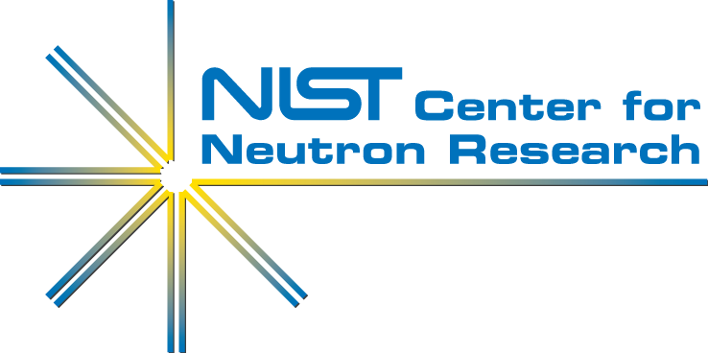
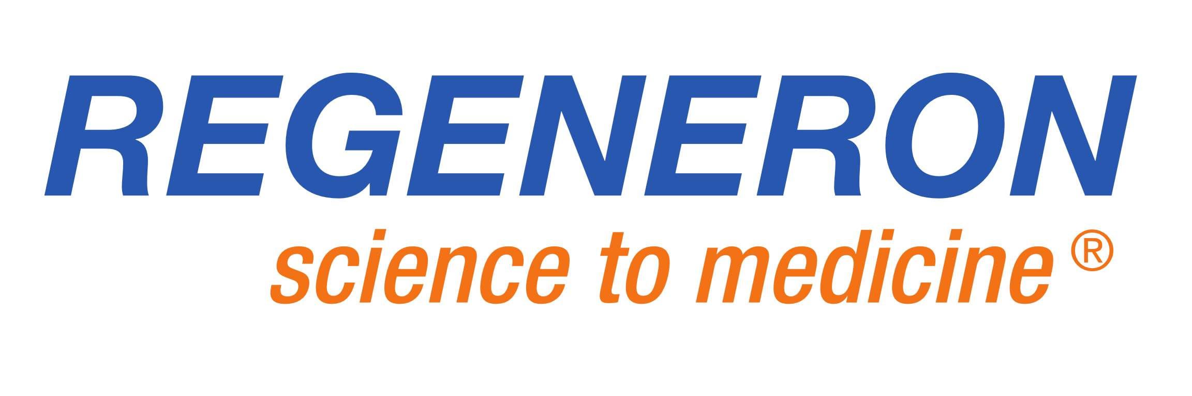
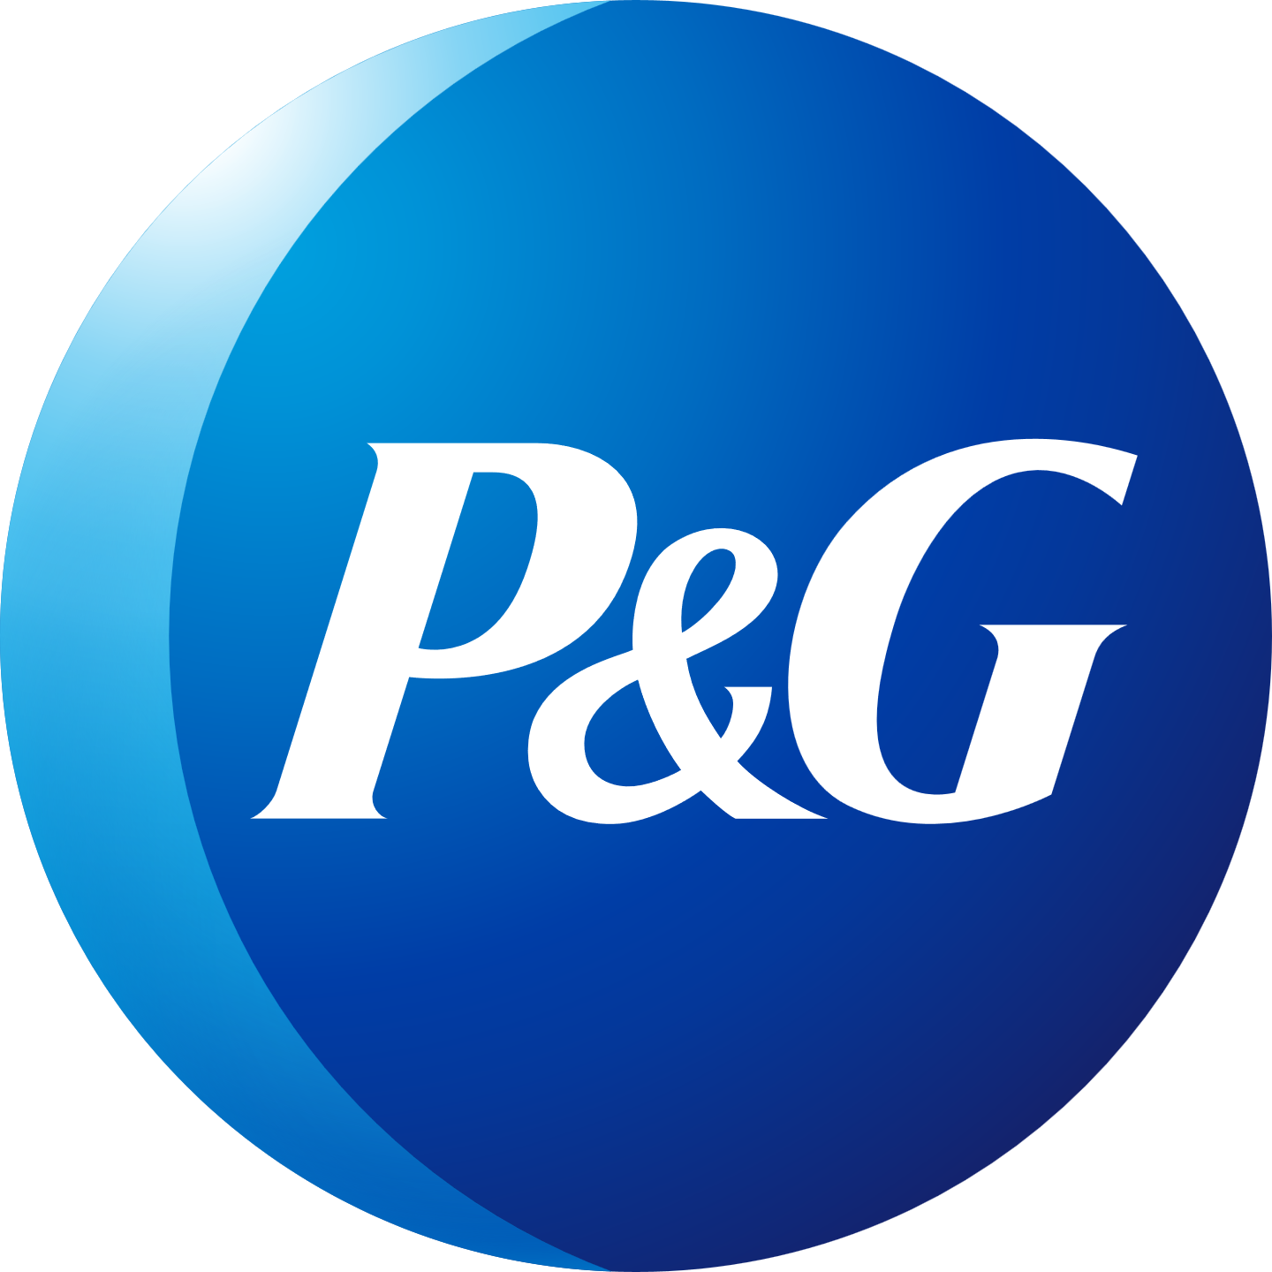


How To Access Neutrons: Going Beyond Beamtime Proposals
nSoft nMat
THEN: nSoft Provides a non-proprietary environment where soft materials manufacturers gain expertise and drive innovation in neutron measurements.
Materials Science
Measurement Needs
nSoft
Solutions to challenges
Neutron-based Measurements
NOW: nMat Over 20 industry affiliates and now growing with expansion beyond soft-materials to new comprehensive materials consortia
Jonathan Seppala, director
Notes:
You may have had experience obtaining beamtime thru proposals.
Industry needs can be too immediate to go thru the uncertainty and delay of obtaining beam time
A few years back we invented a mechanism to facility industrial use- nSoft- aimed at solft-matter problems
Now, we are broadening the science areas and adding new partners thru nMat.
When you find yourselves in an industrial position. Give the Director Jonathan a call to see how that project you have in mind can be accommodated
Now lets turn to some examples.

Slide 8


Slide 9
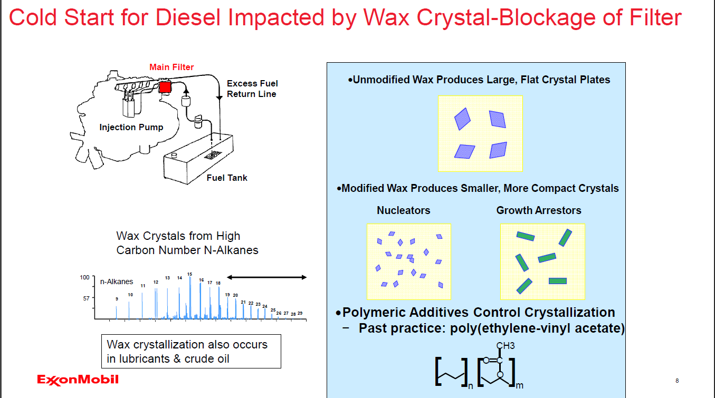

Notes:
Suppose on a cold day you start your diesel truck, car, bus etc. It might operate briefly then shut down. Classic behavior for wax crystal separates blocking the fuel filter an a cold overnight.
It’s hard to fight thermodynamics, so we learned to control the kinetics of crystal grown- working great until higher wax fuels came on market. Then the reliable technology of Ethylene vinyl acetate did not work.
We listened to the polymer chemists and fuel formulators to hear about their experience with this random co-polymer . Longer ethylene runs are better- up to point . Branching is good unless too high ETC
Comb polymers had shown some promise, especially if side chains were similar to carbon number of alkanes
Any commercial package would be less than 400 ppm

Slide 10
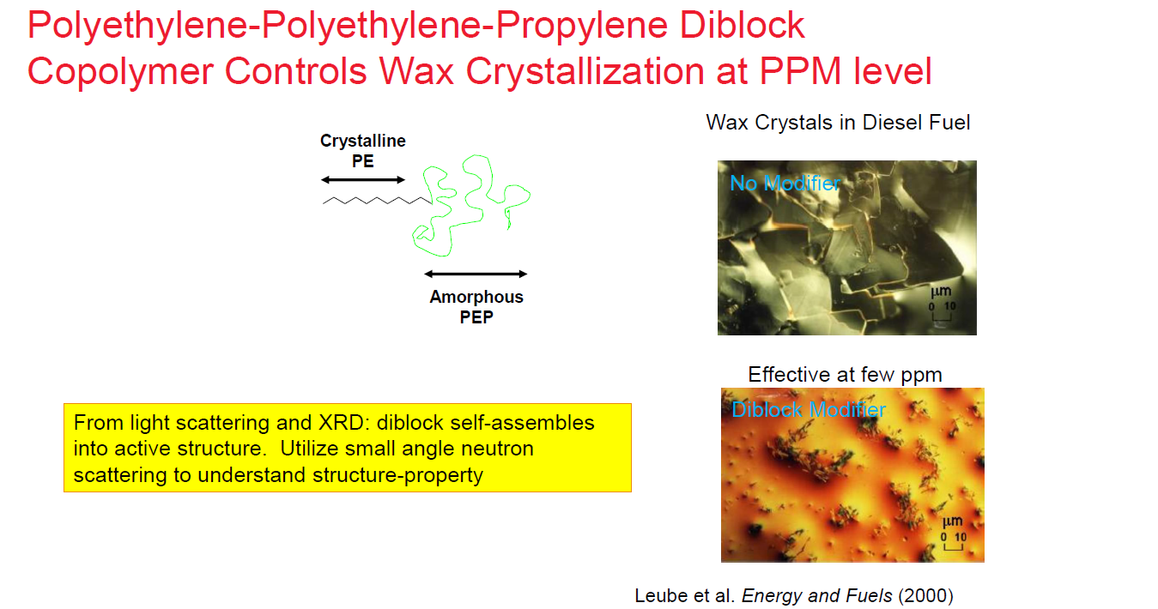
Notes:
We reasoned that a crystalline and amorphous part was needed, but guessed that a diblock would give use much better control. These were sold to the business as a means to test polymer geometry. I emntion this since adding such a tailored polymer was guessed to be too expense
Well, we had not anticipated their effectiveness a few ppm was more than enough
The story got better thanks to further neutron experiments. The power of changing contrast

Slide 11
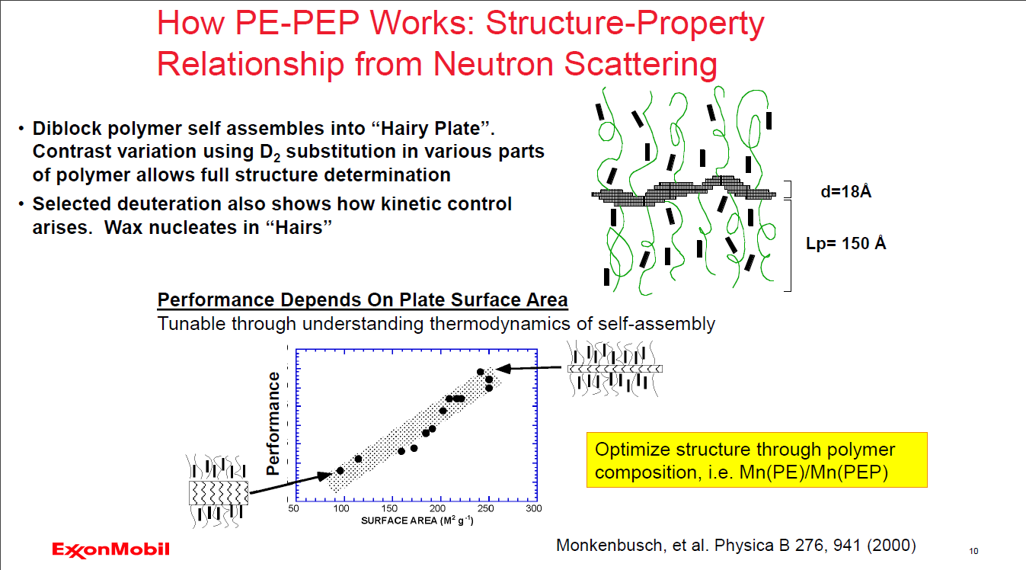
Notes:
Varying the contrast of the two parts of the deblock and combining that with exploring how the wax interacted with these hairy plates allowed us to optimize the structure.
WE learned- make the crystalline cores small and give adequate amorphous to mop up the alkanes, thus interfering with crystal nucleation and growth
Because these were so effective, only a few ppm is needed and such dibloks are included in winter diesel

Slide 12
Pharma is a prime target for SANS
Molecular entities span the natural length-scale range of small-angle scattering

Slide 13
Amgen Has Built An Array Of Drug Modalities
Small Molecules
Therapeutic Proteins
Monoclonal Antibodies
Small Molecules
Small Molecules
Peptides
Fusion Proteins
BiTE®
Bispecific Antibodies
Small Molecules
Small Molecules
Oncolytic Immunotherapy
Viruses
Antibody Drug Conjugates
Car-T Cells
THANKS TO:
Nick Clark AMGEN
Susan Kruger, NCNR
Yun Liu, NCNR
Peptibodies
~1 nm
Length Scales
~1200 nm
Notes:
Our next example comes from a collaboration between Amgen scientist Nick Clark (former NCNR PostDoc) and NCNR staff Susan Kruger. We will also describe several projects by Yun Li here at NCNR with a variety of companies. I encourage you to chat with them if you want to know more
This picture shows a range of moieties and gives some length scales- you can see the overlap in sizes with those probed by neutrons

Slide 14

Roadmap For Antibody Drug Development
  Stages of Monoclonal Antibody (mAb) Development
    Candidate selection
    Bioactivity and Safety
    Formulation and Stability
    Drug Substance Process Optimization
    Drug Product Process Optimization
SANS
IND
Filing
DP
DS
First in Patients (FIH)
Phase 1 Trials
Drug Product Optimization
Drug Substance
Formulation and Stability Optimization
Biological Activity Optimization
Antibody-Selectivity Optimization
Discovery
~3-5 years
Notes:
Like my wax additive example. The path from a effective molecule and a formulation that can be distributed and given to patients is a long one. Because SANS can tell us unique information about these high-MW additives. They can help along this path

Slide 15
Advanced And Proven Characterization Techniques Are What Make Drug Development Possible At The Current Pace The Industry Demands
Structural
Circular Dichroism (CD)
Fourier Transform Infrared Spectroscopy (FTIR)
Fluorescence Spectroscopy
NMR Spectroscopy
Crystallography
Biophysical
  Dynamic Light Scattering (DLS)
  Static Light Scattering (SLS)
  Analytical Ultracentrifugation (AUC)
  SEC-SAXS
  SANS
Chemical
  Mass Spectrometry
    (HDX, MS/MS, Intact mass)
  Chromatographic techniques (IEX, RP)
Constraints could be combined to further improve SAS characterizations
Small Angle Scattering techniques are emerging as powerful tools for Biomanufacturing
Notes:
Obviously Pharma employes many analytic techniques to examine the products along the path of formulation
Here is where your ability to listen can help. When you hear about other results, it is your job to understand what these data tell you about the SANS experiment. You might need to learn a new language- study other analytic methods- ask colleagues for help.
Combining techniques is a base case in todays world

Slide 16
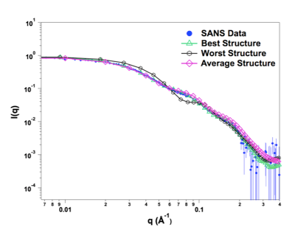
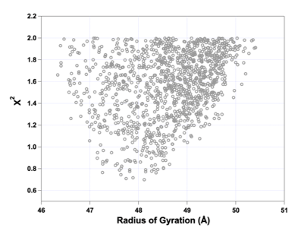
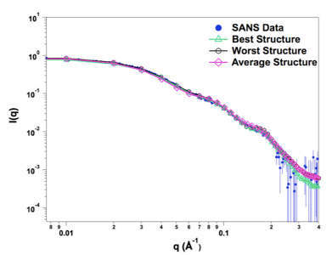
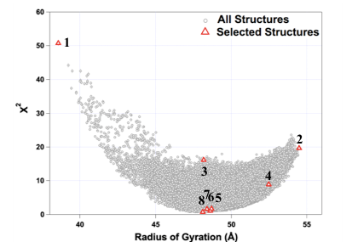
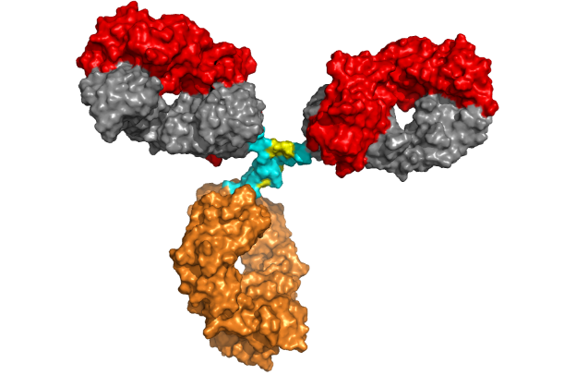
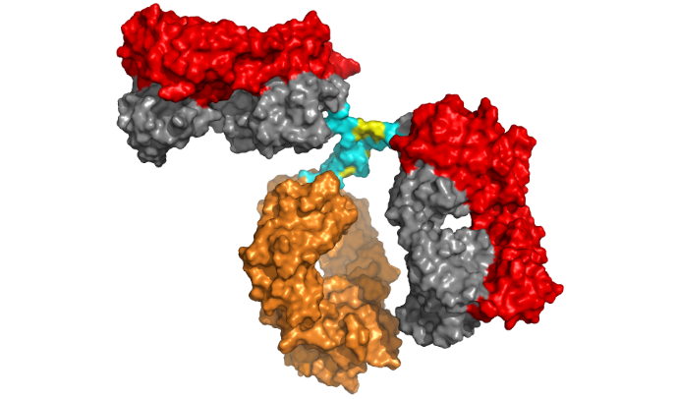
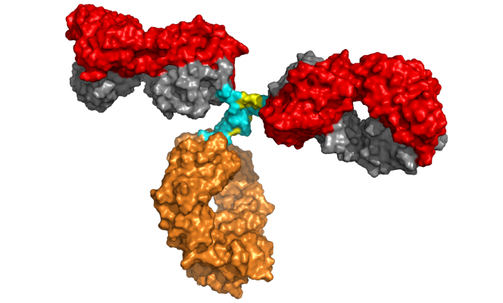
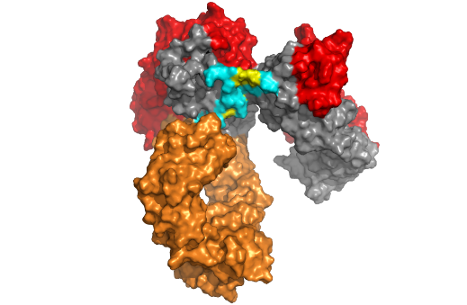
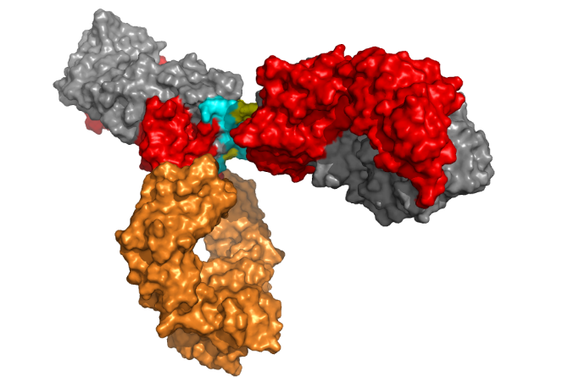
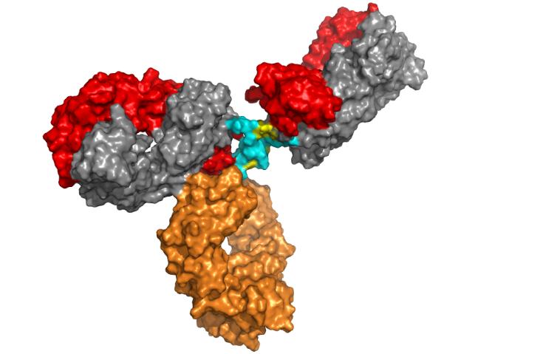
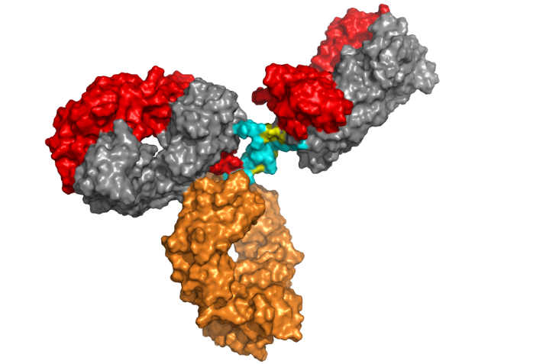
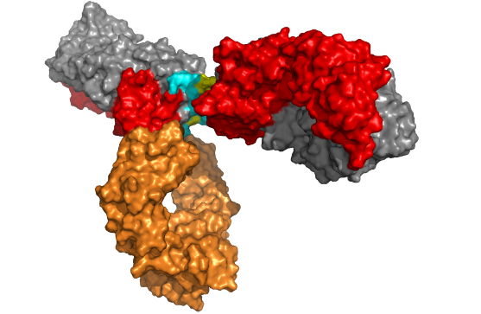
Monte Carlo Ensemble Fit To mAbs Data
Best-Fit Structures
3
1
4
2
We now have our scattering curve under dilute conditions: $≤$ 5 mg/mL
1
2
3
4
1
2
3
4
Notes:
Here’s an example of combing energetics from Mote-Carlo simulations of monoclonal antibodies with SANS
WE start with 8 candidate structures. Energetics then reduce that by half- to 4

Slide 17
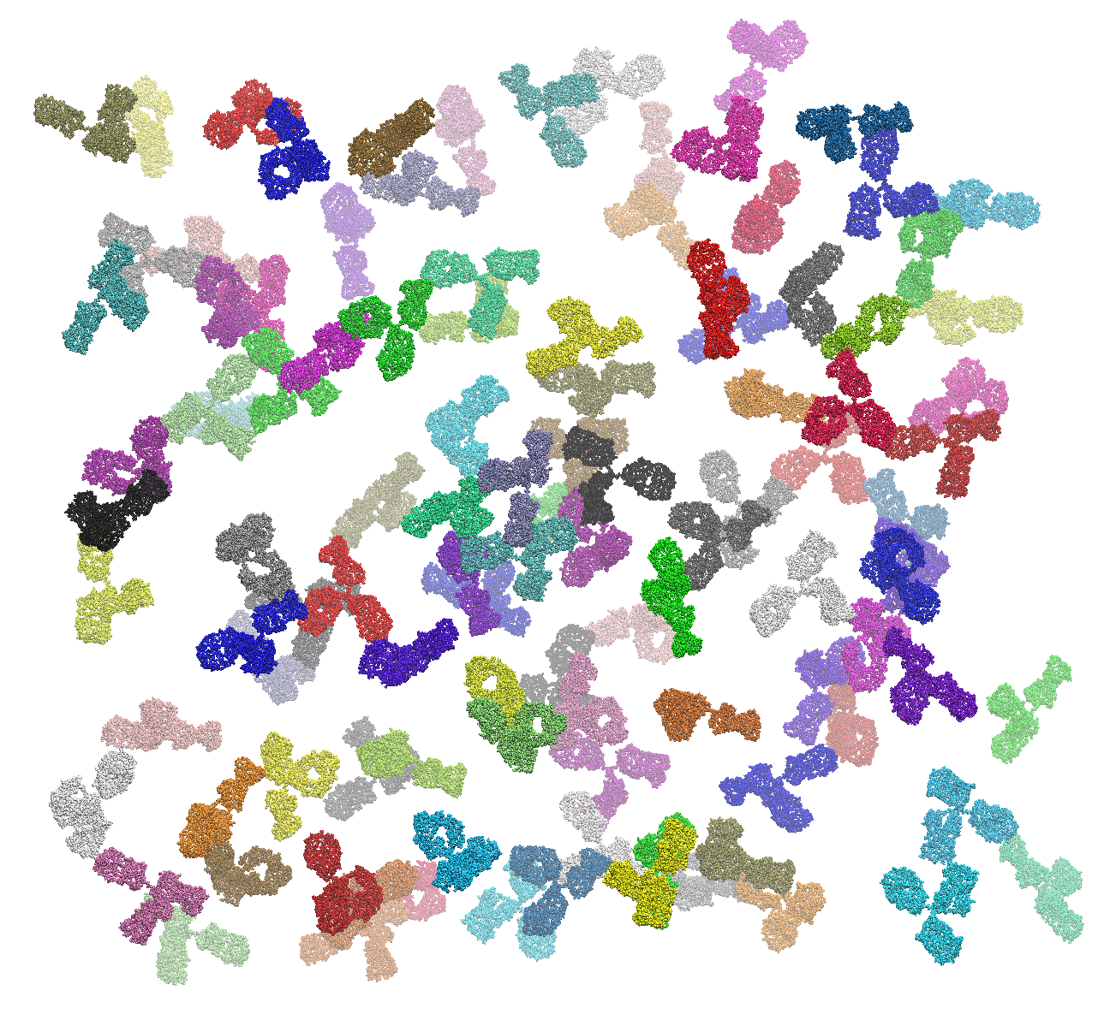
What Happens When You Measure Monoclonal Antibodies At Therapeutically Relevant Concentrations?
ASA-IgG2 mAb at ~50mg/ml

Slide 18
Small-angle Scattering Profiles Reveal Intermolecular Interactions
Intermolecular Spacing (d)
d ≈ 241 Å
d ≈ 207 Å
d ≈ 190 Å
q
q
q
q
q
q
q
q
q
q
q
q
q
q
q
q
q
q
q
q
q
q
q
q
q
q
q
q
q
q
q
q
q
q
q
q
q
q
q
q
q
q
q
q
q
q
q
q
q
q
q
q
q
q
q
q
q
q
q
q
q
q
q
q
q
q
q
q
q
q
q
q
q
q
q
q
q
q
q
q
q
q
q
q
q
q
q
q
q
q
Increasing mAb concentration
50 mg/mL
150 mg/mL
Notes:
Remember Ryan’s structure factor that descrbes inter-particle scattering- here it is as we increase mAbs concentration
WE are using neutrons to help determine the solution structure as we increase dug concentration towards actual concentrations for formulation

Slide 19
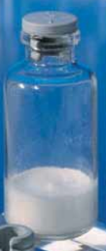
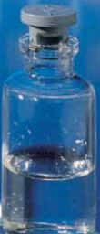
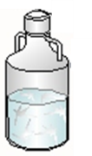
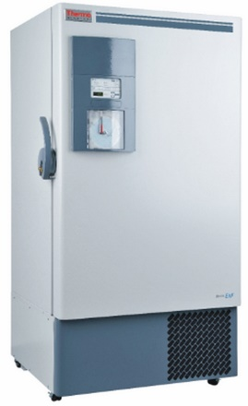
Freeze-thaw Studies
Protein and nanoparticle-based therapies
Store Frozen
Process to DP
Final Drug Substance (DS)
Final Lyophilized or Liquid Drug Product (DP)
DS storage can last years
Processed into drug product as needed
Can cost significantly more to store if it proves unstable at -20 to -40 ⁰C
  Storage will have to be -70 to -80 ⁰C
$
$$$
vs
Courtesy of Nick Clark, Amgen, Inc.
Notes:
Storage conditions are of interest for protein based therapies but also for vaccines as we recall for the Covid-19 vaccines. Drug formulations are often stored in concentrated form and even final DP can be at high concentration.

Slide 20
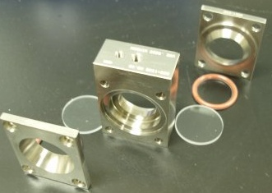
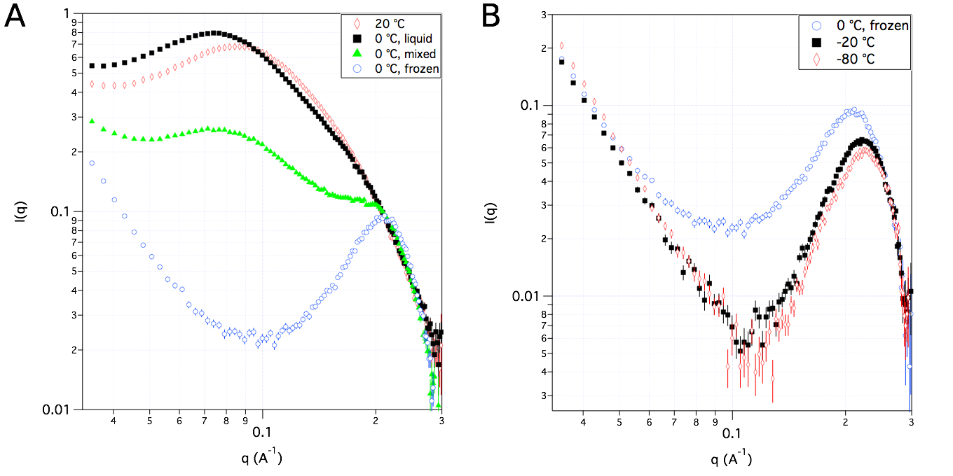
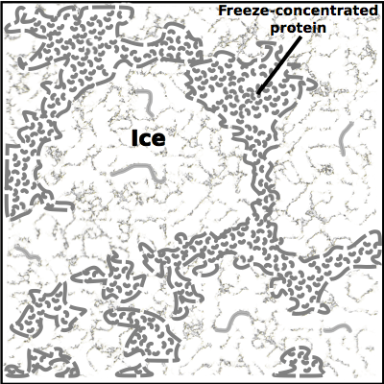
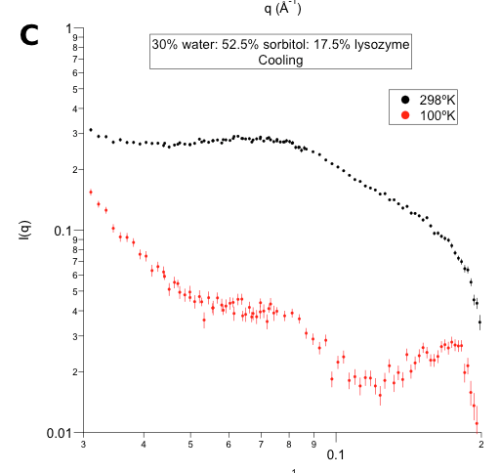
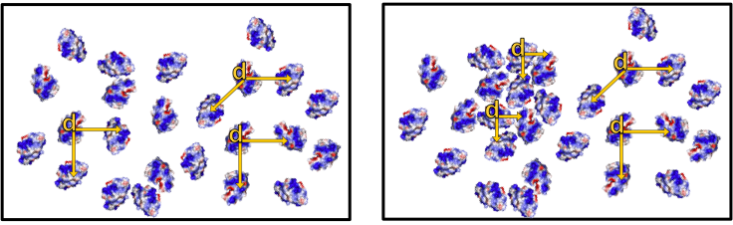
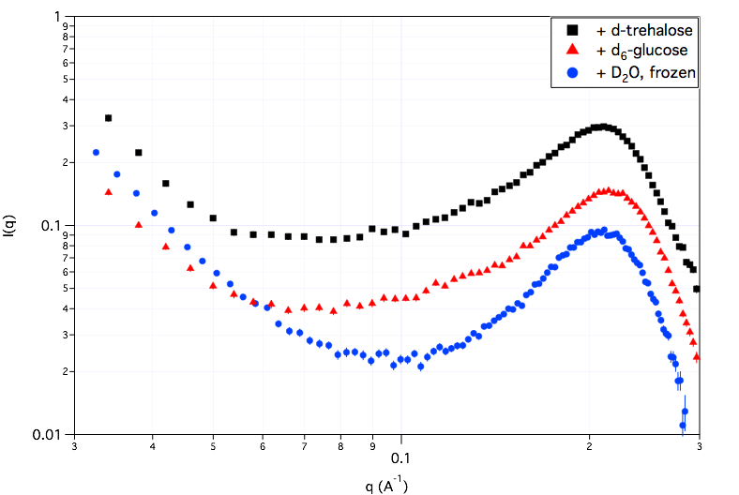
SANS From Proteins In Ice
freezing lysozyme in water
w/ Ti windows
J. Phys. Chem. B 116, 9653 (2012)
Faraday Disc. 158, 285 (2012)
freezing proteins in sorbitol-water
J. Phys. Chem. B, 2012, 116, 4439
&
Soft Matter, 2014,10, 4056-4060
distance ~ 29 Å
Notes:
These formulations are primary water based. When ice forms it pushes the polymer solution into an even more concentrated liquid.
Use neutron methods we can look at the concentrated solution polymer chain configuration. These have been used to test the stability of proteins after addition of stabilizing agents
Both in situ and time depend effects can be measured by using neutron scattering

Slide 21
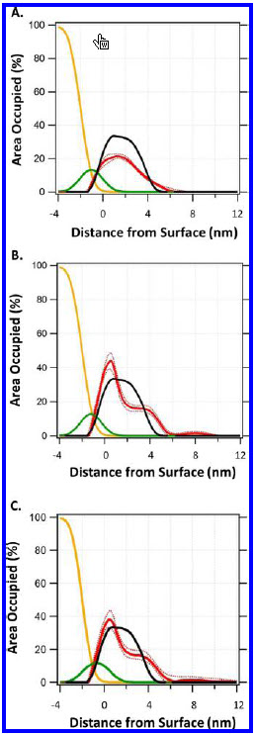
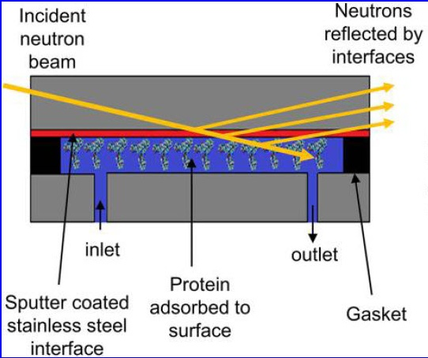
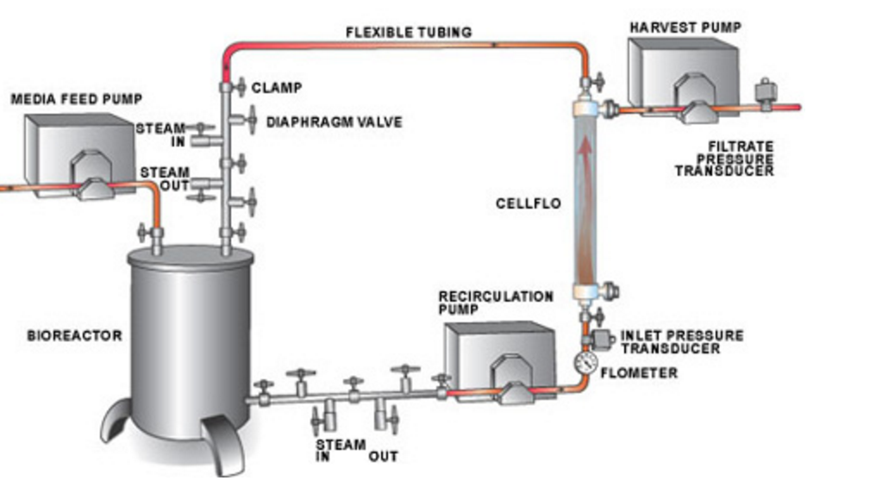
mAbs At Surfaces. NIST Studies Help Evaluate Adsorption Propensity
Generic Production Equipment Diagram
Bioprocess Technology Consultants
bptc.com
Kalonia et al., Mol. Pharmaceuticals 15, 3, 1319-1331
Also see work done by U. Del and nSoft:
Perevozchikova et al., J Pharm Sci 104:1946–1959
Notes:
Synthesis and processing involves a reactor whose surface can interact
This interaction can be measured with reflectivity and various additive formulations test to examine how to minimize the effects

Slide 22
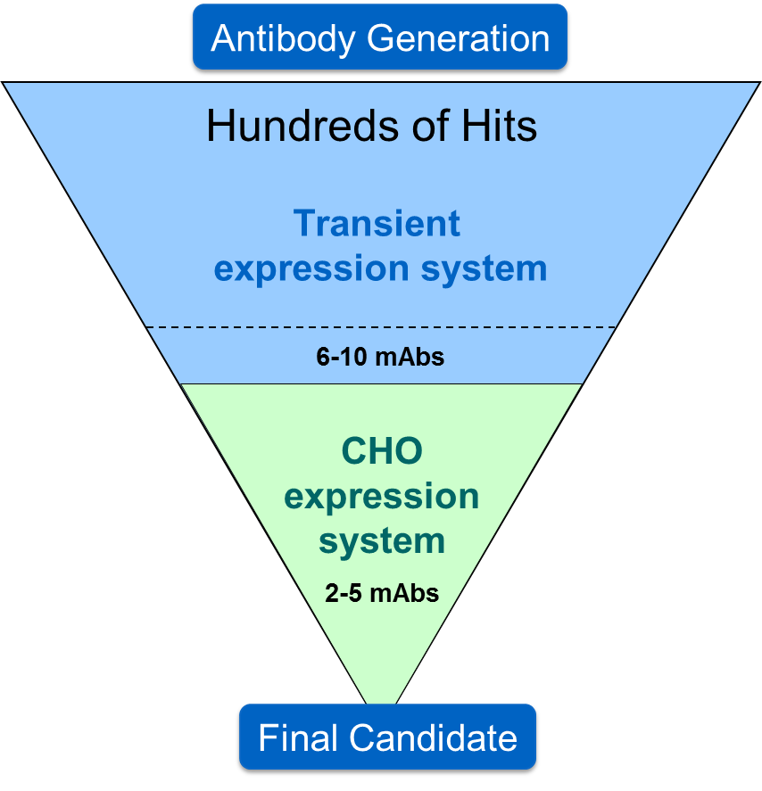
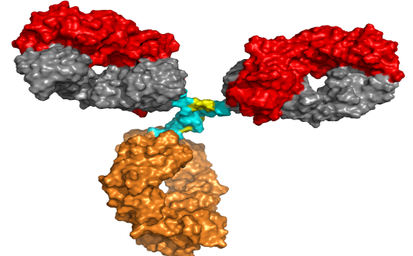
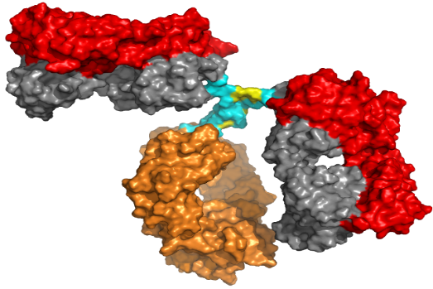
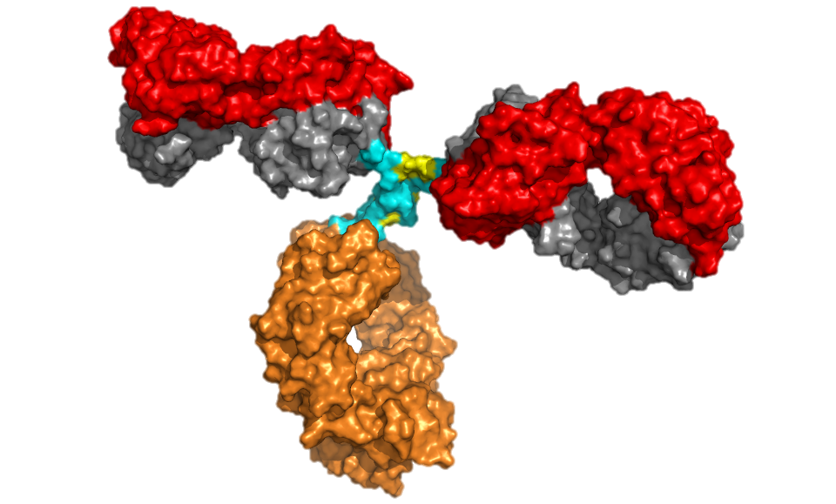
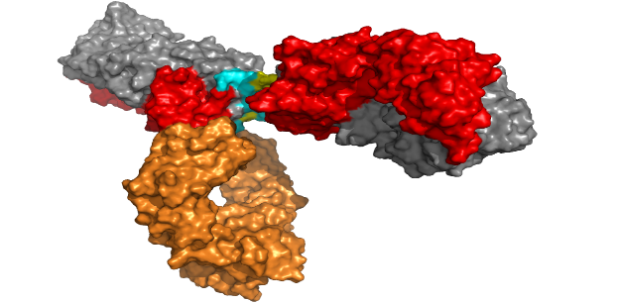

Molecule Assessment Example From A Recent mAbs Campaign For A New Disease Target (Amgen)
Four IgG2 candidate mAbs
  mAb1, mAb2, mAb3 and mAb4
Assessments
  Sequence Analysis
  Expression
  Purification
  Bioactivity
  Biophysical Properties
  Formulation Analysis
Neutrons can help!
There can be only one!
mAb1
mAb2
mAb3
mAb4
Winner = ??

Slide 23


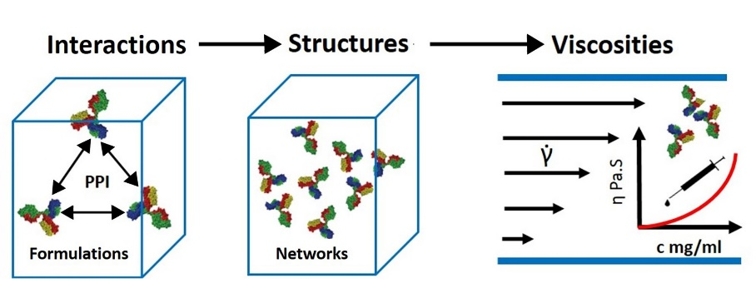
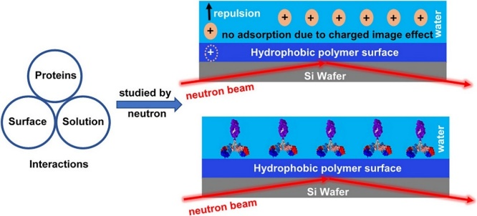
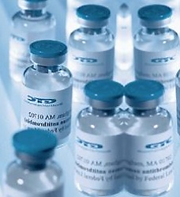
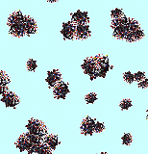
Neutron Scattering And Pharmaceutical Materials
Viscosity
NSE and SANS are used to study the physical origins of the high viscosity of concentrated proteins solutions.
Genentech
Eli Lilly
Merck
AstraZeneca
Zhenhuan Zhang, Yun Liu, “Recent progresses of understanding the viscosity of concentrated protein solutions”, Current Opinion in Chemical Engineering, 16, 48-55(2017)
Yearley et al. Biophys. J (2013), Yearley et al. Biophys. J (2014), Godfrin et al. JPCB (2016)
Surface Adsorption
NR and SANS is used to study the interaction between excipient molecules and proteins in bulk and at interfaces.
Zhang et al. Colloids and Surface B (2018). Zhang et al. J. of Colloid Interface Science, 584, 429 (2019).
Stability of excipient molecules
SANS is used to study the degradation and stability of protein formulations
Nayem et al., J. Pharm. Sci. 109, 1498-1508(2020).
Gilbert et al., J. Pharm. Sci. 110, 2396-2404(2021).
Gilbert et al., Molecular Pharmaceutics, 19, 862-875(2022)
Ford et al., J. Pharm. Sci. 112, 731-739(2023).

Slide 24




Summary
The unique properties of neutron as a probe can impact industrial research
Measure the operando state
  T/P Environmental cells
  High-field magnets
  Shear cells
See what other probes miss
  Hydrogen/Deuterium
  Magnetic moment
Connect structure to decisions
  Length scales overlap those in many important technologies: rocks, proteins, lipids, thin films
Your role is to connect the problem to a solution by careful listening and insightful experiment design. Uncover the key structure/property relationships

Slide 25
EXTRA

Slide 26


Slide 27


Slide 28


Slide 29


Slide 30
Some NCNR Examples of Collaborations on Industrial Problems

Slide 31


nSoft Example: Direct Observation of Clusters In
Concentrated Monoclonal Antibody (mAb) Solutions
Over the past 30-plus years the biotechnology industry has mastered protein engineering, cloning and cell culture techniques that make designing and producing therapeutic antibodies with a singular, monoclonal, specificity an exciting reality. Therapeutic monoclonal antibodies (mAb) have been found to be highly effective agents in the treatment of immunological and allergic disorders as well as malignant growths with a high level of success due to their structure specificity and low toxicity in contrast to many traditional small molecule drug options. Over 80 mAbs have been approved by the Food and Drug Administration for clinical use and several hundred are currently in development with global market value over 100 billion dollars. Because of their success and effectiveness, mAbs are one of the fastest growing therapeutic agents on the market.
The importance of mAb-based drugs motivates fundamental research into problems related to their manufacture and ease of clinical uses. In particular, the pharmaceutical industry is proposing to use subcutaneous injection (SC) delivery methods for some mAbs for convenience and reduced number/frequency of administrations.
Biotechnology companies are striving to produce highly concentrated ( > 100 mg/mL) patient-injectable antibody solutions. Due to the increased concentration, the solution viscosity for some antibody formulations becomes too high to be able to be injected using the SC route. It has been believed that the unusually high viscosity of these antibody solutions are due to the formation of reversible aggregates (dynamic clusters) at high concentrations.
However, to date, it has been difficult to directly observe these mAb dynamic clusters and quantitatively characterize their microstructure in crowded environments. Here, we combine the methods of small-angle neutron/x-ray scattering (SANS/ SAXS), neutron spin echo (NSE) to conclusively identify the formation of dynamic clusters in highly concentrated and viscous mAb solutions. In particular, NSE allows the estimation of the hydrodynamic radius and characterization of the dynamic properties in concentrated solutions.
Neutron Spin Echo
Dynamic range: a few ps to 100 ns
.
Self-Diffusion Ratio
I. E. Zarraga (Genentech Inc.), E. J. Yearly (UD/NCNR), J. Curtis (NCNR) , N. J. Wagner (UD), and Y. Liu (NCNR/UD)

Slide 32
Rheo-USANS For Paint Formulation: Controlled TiO₂ Dispersion
A commercial paint exhibits a desired viscosity profile over shear rates from ≈10⁻⁵ s⁻¹ for settling to > 10⁴ s⁻¹ for brushing, rolling, and spray applications. In general, the composition and chemistry govern the formulation microstructure. Due to formulation complexity, a full understanding of the fundamentals of paint rheology is still somewhat elusive but has been attributed to changes in the flow-induced hierarchical structure existing in the paint. In this work, we have utilized ultra small-angle neutron scattering under shear (rheo-USANS) to study structural evolution of paints. Employing the structural parameters obtained from the scattering data, we developed an elementary viscosity expression that demonstrated good agreement between measured and calculated flow curves.
In typical paint formulations, the volume fraction of solids ranges from about 15 % to 45 %, with about 5 % to 35 % of the volume being polymeric latex binders. The rest of the solids are primarily inorganic pigment particles (TiO₂ and extender). To achieve the desired viscosity profile over a wide shear rate range, rheology modifiers (RMs) such as hydrophobically modified ethylene oxide urethane (HEUR) polymer are widely used in the coatings industry. HEUR polymers are nonionic, associative thickeners consisting of a hydrophilic poly(ethylene oxide) (PEO) backbone and hydrophobes.
Structural studies of commercially relevant paints in the wet state have been difficult to accomplish due to the opacity of the suspensions, relatively high volume fraction of solids, presence of different types of particles (e.g. latex and TiO₂) and relatively large and polydisperse particle sizes (100 nm to 10 μm).
Dow Scientists awarded the 2012 American Coatings Award, from The American Coatings Association
A. K. Van Dyk, T. Chatterjee, V. V. Ginzburg, A. I. Nakatani (The Dow Chemical Company)

Slide 33



Advanced Cancer Therapies
New cancer therapies that use active viruses cannot always be studied using standard drug development practices. The NIST Center for Neutron Research user facility provides the biopharmaceutical industry with neutron scattering methods and modeling techniques to help them understand the properties of their viral drug formulations.
These capabilities were recently used to shed light on properties of a new class of biomolecules, oncolytic viruses, which preferentially infect and kill cancer cells. Amgen partnered with NIST to perform studies on the first oncolytic virus (TVEC) therapy approved by the FDA.
There was concern about possible structural changes occurring within the central core of TVEC. As TVEC is a live virus particle, it was unclear how to formulate and characterize such a complicated system. With SANS and contrast variation deduce some of the structural changes of concern.
With guidance on “activity” or “functionality” of the formulation by biological function assays (i.e. plaque assays … growing the virus and counting active particles), an experiment was designed to look for changes during processing, where the product undergoes several freeze-thaw steps which could potentially damage TVEC.
Major structural changes of TVEC samples were observed in a protein-free formulation upon multiple freeze-thaw steps. These changes were not seen in a protein-containing formulation
Contrast studies of TVEC indicate that internal structures of lipid, protein, and nucleic acid are amiable to study with SANS. Preliminary studies indicate that it is the internal structure of TVEC that changes upon freezing and thawing.
Oncolytic virus particle
Credit: image courtesy of Amgen
Core-Shell Model
J. E. Curtis and S. Krueger (NIST), A. McAuley (Amgen)
Amgen acknowledges the valuable impact of small-angle neutron scattering (SANS) measurements on one of our newer virus based drugs…” Arnold McAuley, Amgen Senior Scientist

Slide 34

How Can Neutron User Facilities Increase Usage By Biotechnology Companies?
Bring forward more modeling techniques and software
Strive for increased accessibility for biotechnology
    Increased support for proprietary mode?
    Biotech training opportunities
Coarse-grain models (where appropriate)
Hybrid approaches: neutrons plus other probes
Lower barriers to initiate modeling
Generic models to protect intellectual property
Stand alone software for internal company use
Mail-in SAS mode (for service fee)
Rapid processing, “batch mode” to address high-throughput screening
Auto Formulation Lab:
AI meets Experiment Design

