Slide 1
How to obtain beamtime
Yamali Hernandez
Summer School 2026

Slide 2
What questions to ask yourself before you start your neutron journey
Is neutron scattering the right tool to study the problem I’m investigating
Which is the right instrument?
What type of sample preparation resources will I need?
What sample environment should I use?
Yes
Where do I apply for beamtime?

Slide 3
At the NCNR
New Proposal: this is a proposal for instrument time submitted when a call is announced. The proposals will be reviewed by scientific and technical reviewers and the Beam Time Allocation Committee (BTAC)
Beamtime request: It is NIST internal time for NIST research programs. Under certain conditions (like feasibility time), external users can coordinate time with an instrument scientist
Quick Access Proposal: a proposal submitted asking for access to the instruments in the near future for measurements that cannot be delayed. It will be reviewed by the BTAC and held to a much higher standard than regular proposals
Proprietary research agreement: this is not a proposal; talk to Ron Jones

Slide 4

How the system works: new proposals
3 to 5 Scientific Reviews
Technical and Safety Reviews
Proposal is submitted
2
BTAC
Members
Letters are sent with results
BTAC: Beam Time Allocation Committee

Slide 5
Before writing, be aware!!!!!!!
The PDF of your proposal must not be longer than 3 letter-size pages in length, including references, nor more than 1500 kb in file size.
This is a proposal for ONE EXPERIMENT; it is not a 25- page multifaceted proposal to a funding body.
You can use high-resolution images- recommended!

Slide 6
Start writing: Motivation (2-3 paragraphs maximum!)
What is the general problem and why it is important (We will solve the world's energy crisis ...)
State your hypothesis and what is the particular aspect of the problem being investigated by the team and how does it relate to the larger issue OR How is your project different from what has been done before? (Revealing new insights into the cooperative mechanism of proton conduction in …. )
How this neutron scattering experiment will help answer the problem you are investigating? (The contrast factor will allow us to focus on just the proton ...)
What are the expected outcomes? (Oh, a Nature paper you say! How may we help? ) (We expect to be able to determine if the hypothesized coupling between H⁺ and …. )

Slide 7
Start writing: Experimental description
Describe samples and the conditions for your experiment (shear, pressure, magnetic field, temperature) that relates to the problem you are studying. This should clearly relate to your hypothesis.
Would the sample be available for the experiment immediately? Do you need deuteration? Have you done characterization? Are there sample availability restrictions (Expense? Lifetime? Collaborator makes them?) Any troublesome isotopes?
Safety: Let us know if samples
or experimental conditions may pose a risk or hazard
Include data from other techniques if appropriate (mw, SAXS, density, susceptibility, film thickness, transition temperature…)
Use equations and model calculations when possible for contrast/isotopic content/magnetic moment etc
Explain data analysis if non-standard
Modeling/data from preliminary results or if previously awarded beamtime

Slide 8

Start writing: Justification
It costs over $10,000 per day to run an experiment at the NCNR
Can the goals of this experiment be achieved at my home lab?
The NCNR, like other facilities, will be oversubscribed!
Can the goals of this experiment be achieved better at another facility? Could /should we get beamtime there?
Make sure you provide additional justification for :
the number of samples
the number of experimental conditions, or instrument settings
time to collect data under each condition, and total time
why neutrons? (if not done so already)
why this instrument? (if not done so already)

Slide 9
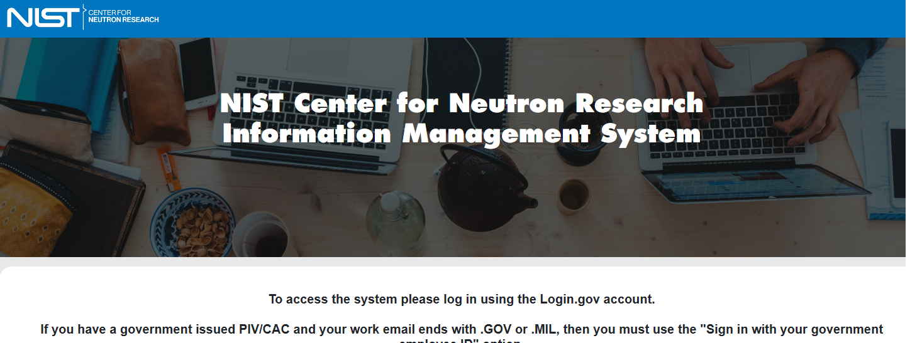
Where do I apply?
Go to: https://www.nist.gov/ncnr
Click: Logon to your IMS account
https://ncnrims.nist.gov/

Slide 10
Next Proposal Call
What is the NCNR plan:
Opens: Thursday, July 30, 2026
Closes: September 15, 2026 @ Midnight
Results: December 2026
Resources:
Literature search
Web searches
Instrument scientists
Training:
Oak Ridge National Laboratory: “Proposal Writing Workshop and
Staff Question & Answer Breakout Sessions”- August 6, 2026, at 2:00 pm
Please remember that we are subject to reactor schedules and the federal government shutdown.

