Slide 1
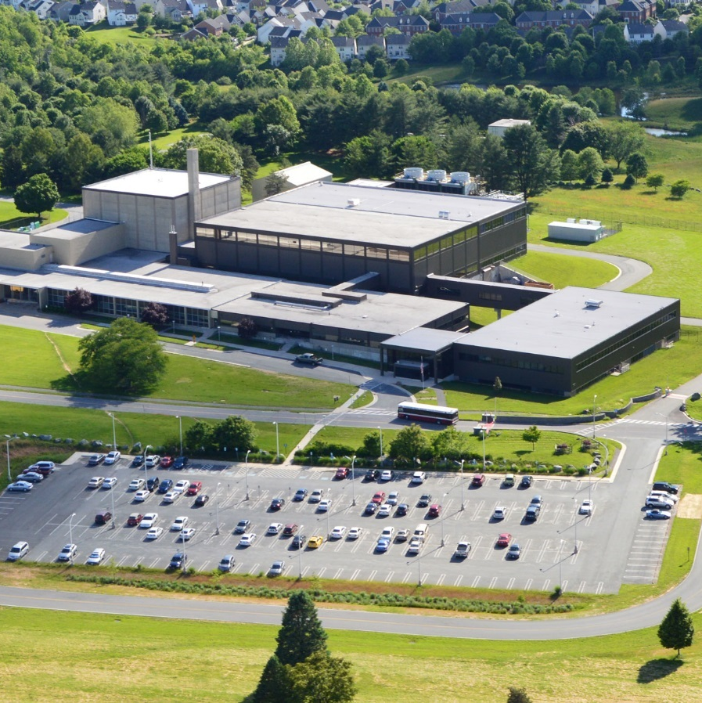
Science at the NCNR
Ronald Jones, Group Leader
Neutron Condensed Matter Science
2025 CHRNS Summer School

Slide 2
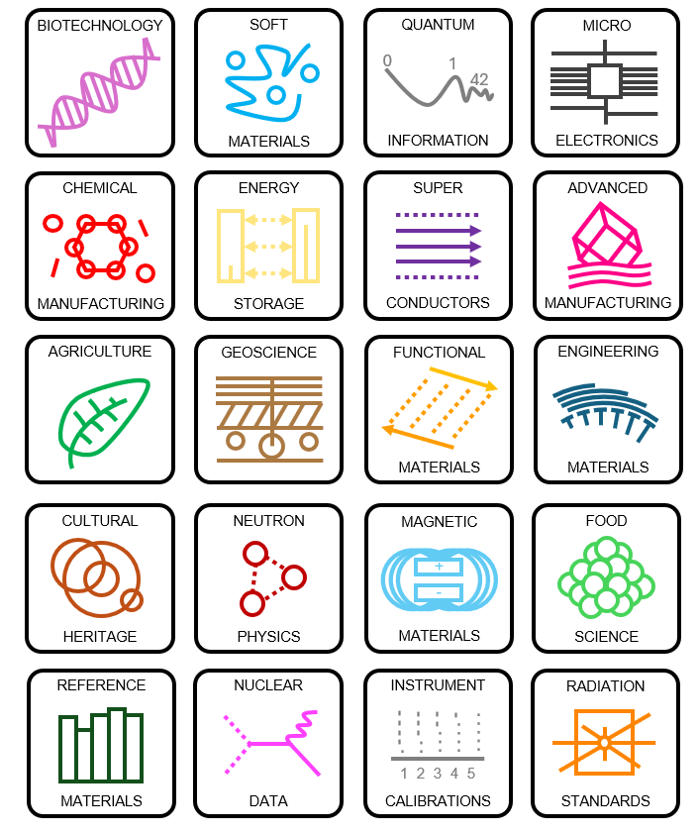
What does the NCNR do?
NIST Mission
To promote U.S. innovation and industrial competitiveness by advancing measurement science, standards, and technology in ways that enhance economic security and improve our quality of life.
NCNR Mission
To advance economic and technical excellence in the U.S. by providing world-class neutron measurement capabilities to meet the needs of researchers from industry, academia, and government.

Slide 3
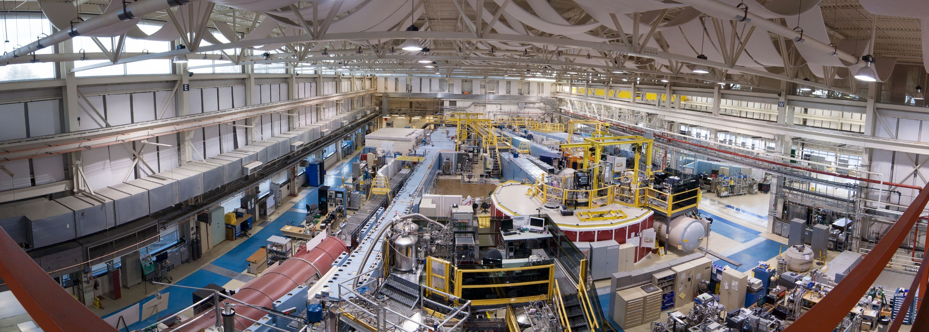
Neutron Instruments at NCNR

Slide 4
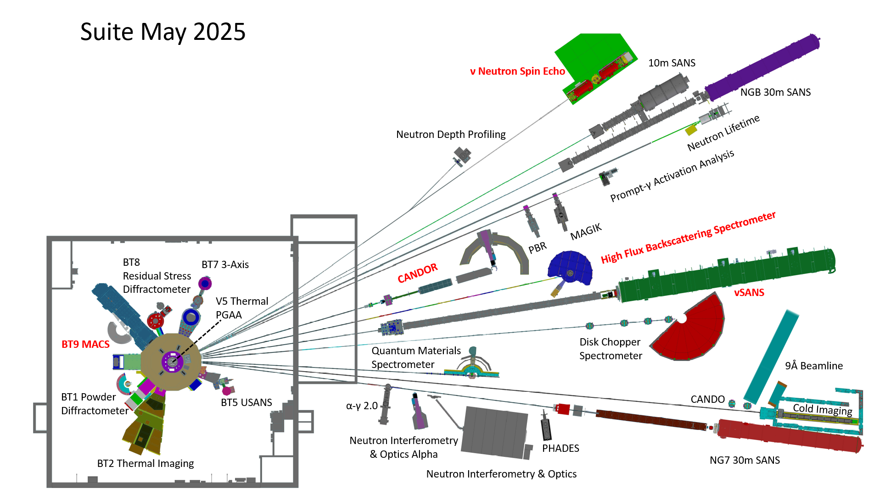
Neutron Instruments at NCNR
29 Beam Instruments
NCNR: 17 Scattering + test station
Physical Measurement Lab: 8
Material Measurement L: 3 + rabbits
BT4 3-Axis / FANS

Slide 5
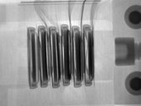
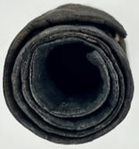
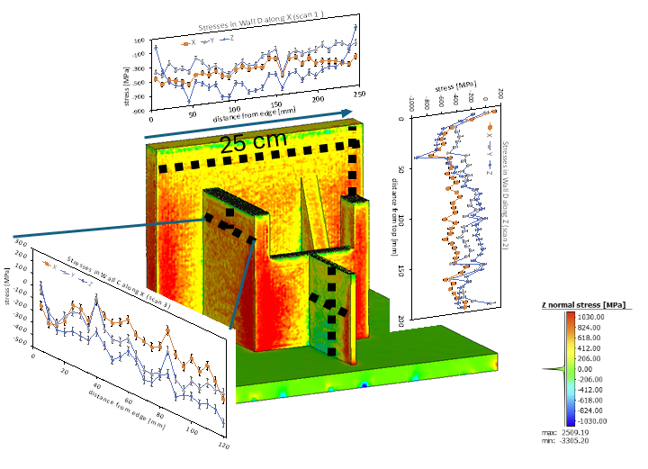
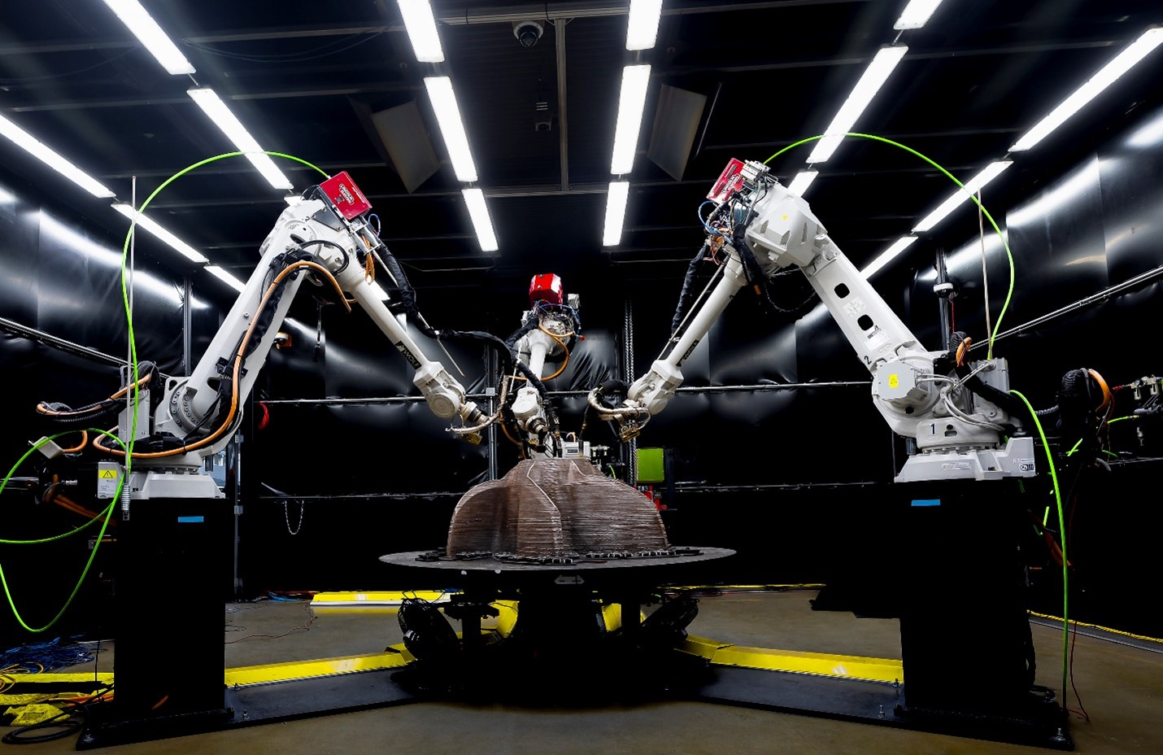
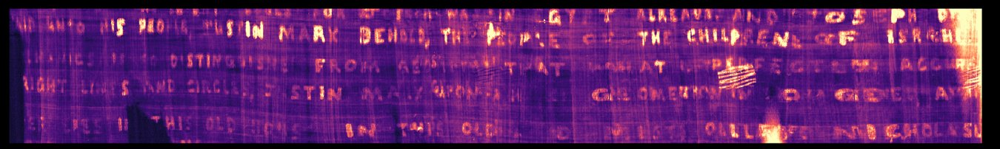
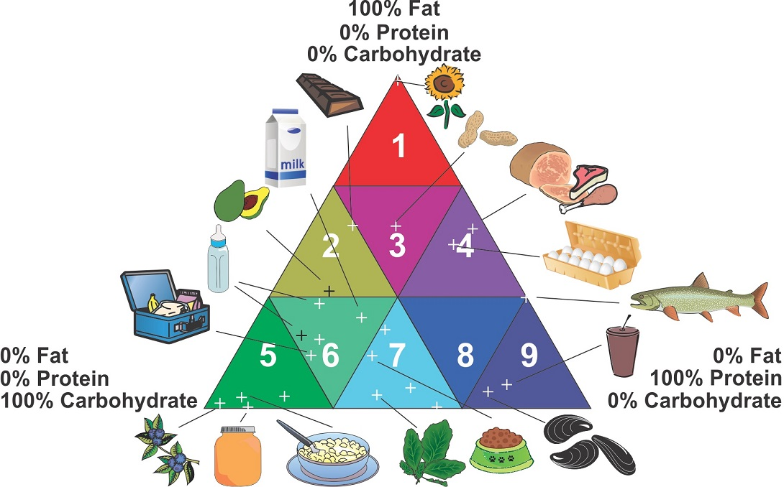
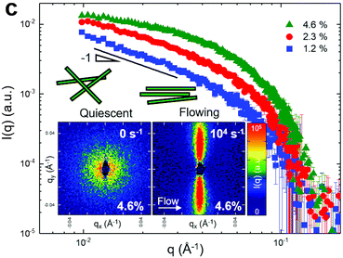
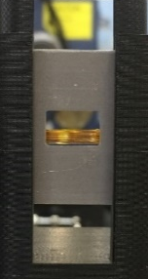
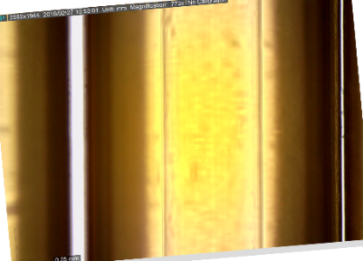
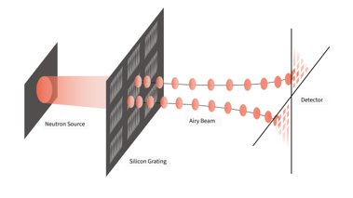
Broad Science Program
Engineering
T. Gnäupel-Herold et. al., Inconel 718 superalloy artifact
Neutron Imaging
D. Hussey, J. LaManna, D. Jacobsen, others
Standard Reference Materials
N. Sharp, H. Chen-Mayer, M. Vega-Martinez, J. Weaver, C. Zangmeister
Archaeology
R. Bishop et. al., Mayan trade routes
Rheo-SANS
R. Murphy, K. Weigandt, J. Krzywon, P. Butler, more…
Neutron Physics
D. Sarenac et. al., Neutron Airy Beam
D
50 μm

Slide 6
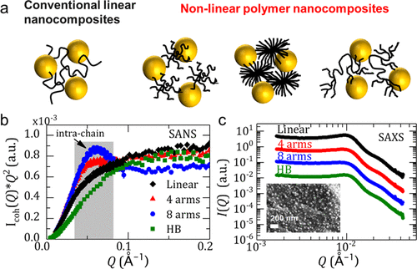
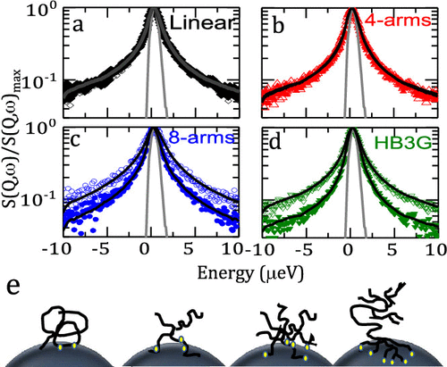
Polymer Nanocomposites
Darvishi, Nazeer, Tyagi, Zhang, Narayanan, Kizilel, Senses
Macromolecules 54, 10118 (2021)
SANS
HFBS
Notes:
For HFBS data, open circles are the neat material, and filled are PNCs with 30 vol % loading. HB = hyperbranched PEO.

Slide 7
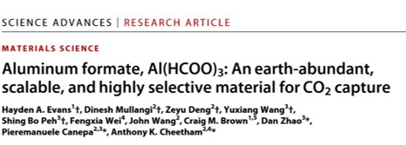
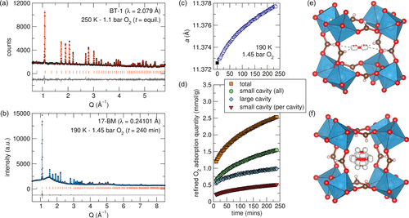
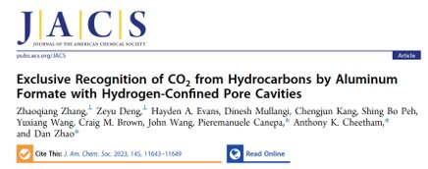
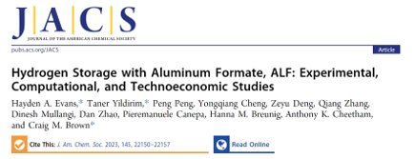
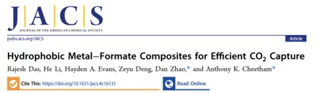
Aluminum Formate (ALF)
BT-1 Powder Diffractometer
Hayden Evans, Craig Brown, Taner Yildirim; Cheetham Group, others

Slide 8
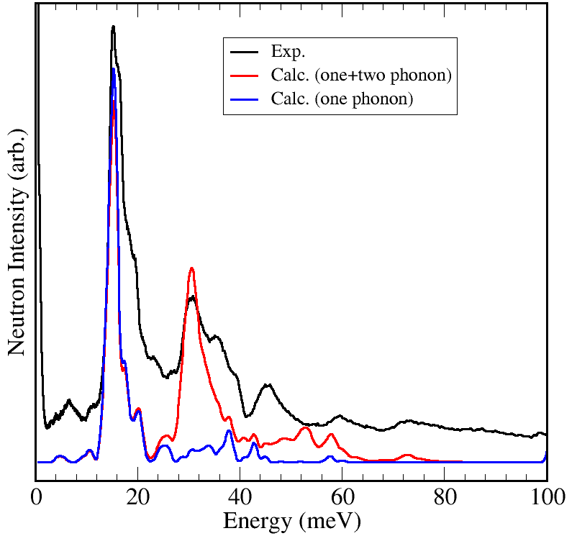
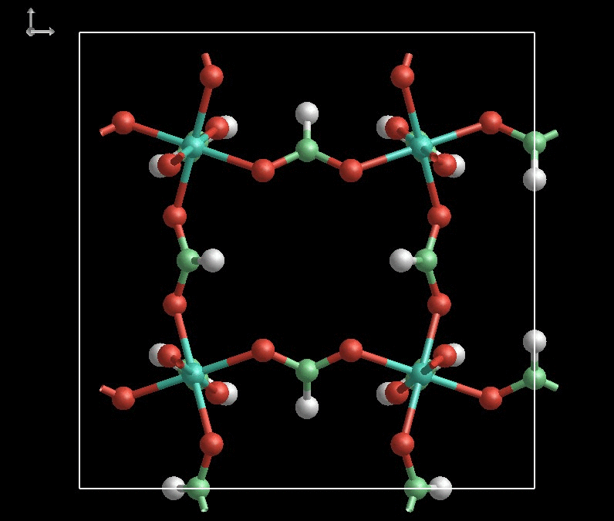
Aluminum Formate (ALF)
Hayden Evans, Craig Brown, Taner Yildirim; Cheetham Group, others
Gate opening mode: This gate opening mode controls the gas adsorption and desorption kinetics in ALF.
Quantum sieving up to 90 K (D₂&H₂ separation)
He confinement up to 80 K

Slide 9
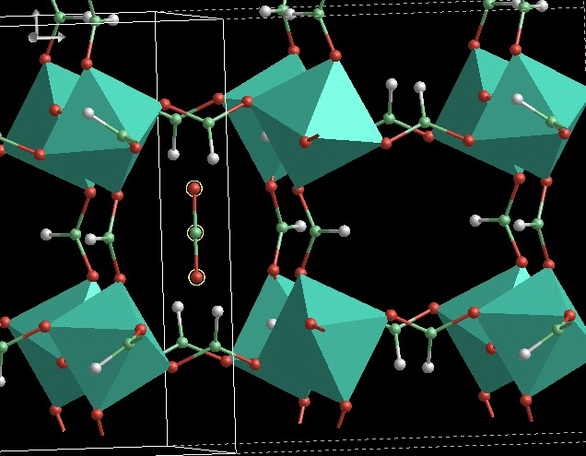
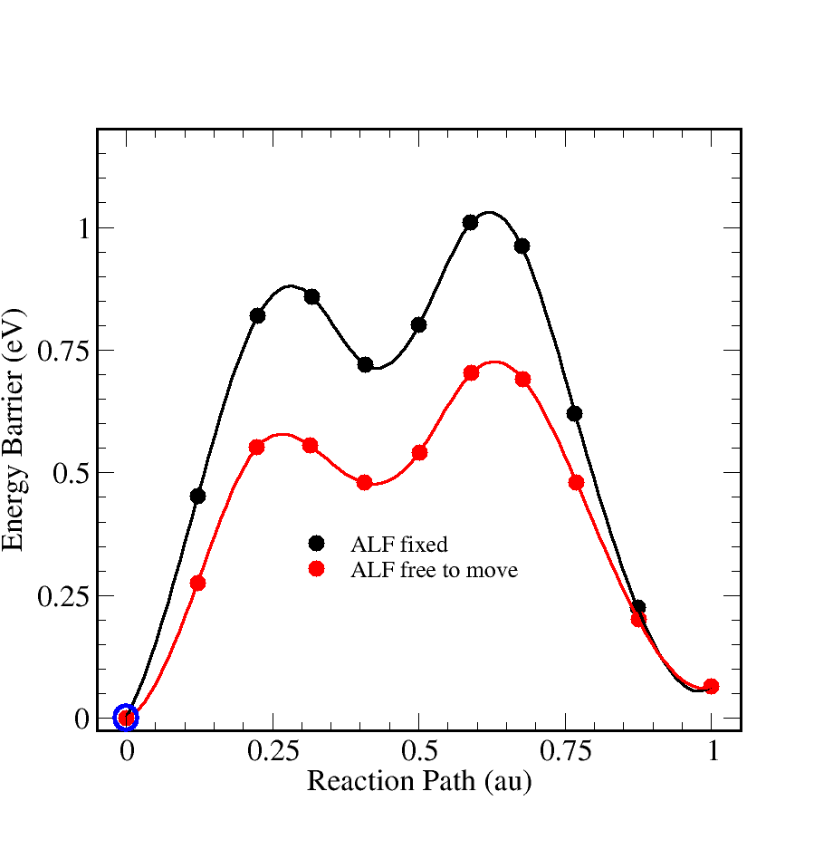
Aluminum Formate (ALF)
Hayden Evans, Craig Brown, Taner Yildirim; Cheetham Group, others

Slide 10
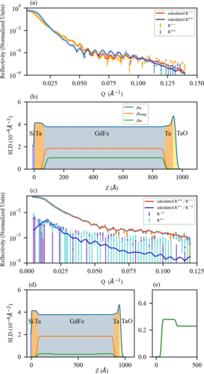
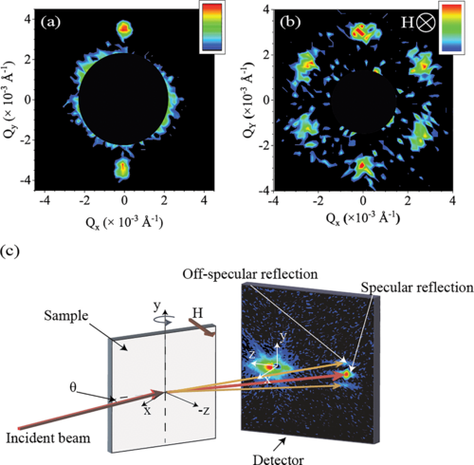
Hybrid Skyrmions
Liyanage, Tang, Quigley, Borchers, Grutter, Maranville, Sinha, Reyren, Montoya, Fullerton, DeBeer-Schmitt, Gilbert - Phys. Rev. B 107, 184412
VSANS / CANDOR (PNR)
Notes:
Fe (0.36 nm)/Gd (0.4 nm / Si

Slide 11
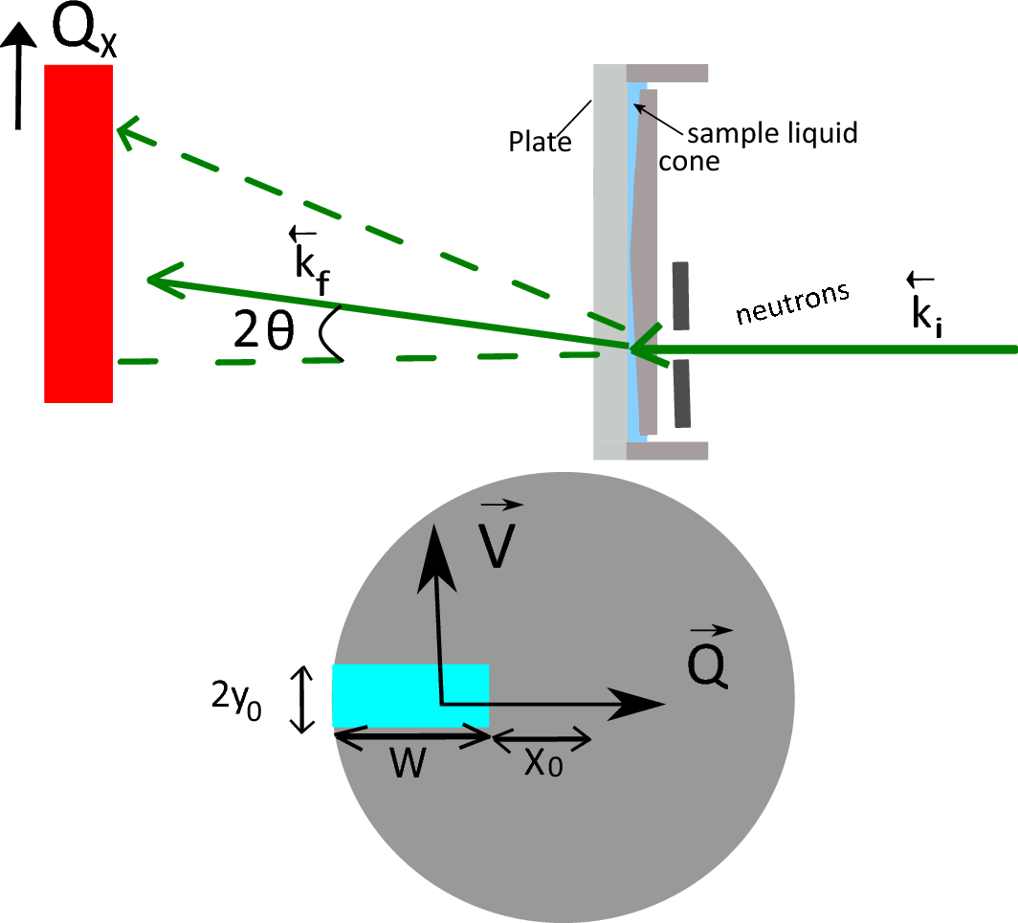
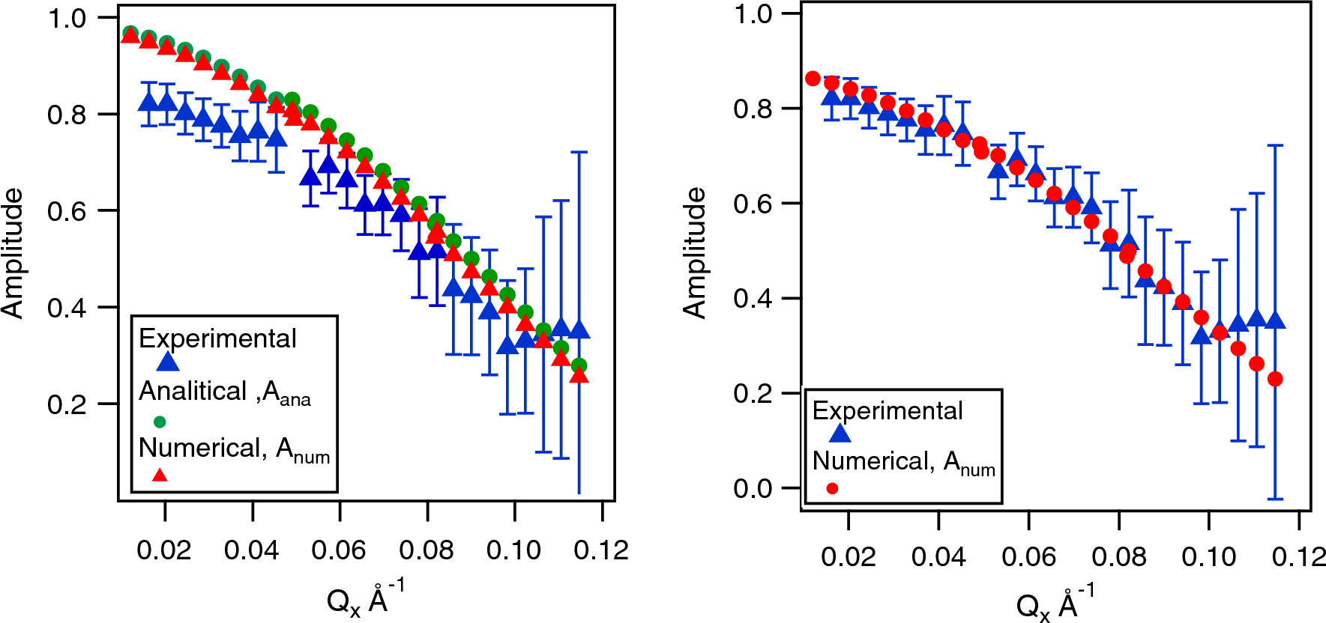
Rheo - Spin Echo Neutron Spectroscopy
Gvaramia, Gutfreund, Falus, Faraone, Nagao, Wolff; Sci. Rep. 13, 13051 (2023)
Neutron Spin Echo / SANS
Notes:
We compare the measured phase shift and depolarisation due to Doppler scattering from a rotating graphite disk to numerical and analytical calculations and find excellent agreement. This allows to take into account Doppler scattering during the data processing and makes longer Fourier times as well as higher shear rates and Q ranges possible with neutron spin echo spectroscopy, enabling for example the study of polymers under high shear.

Slide 12
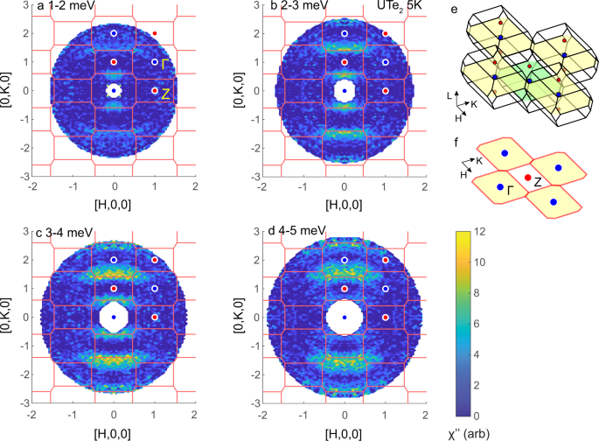
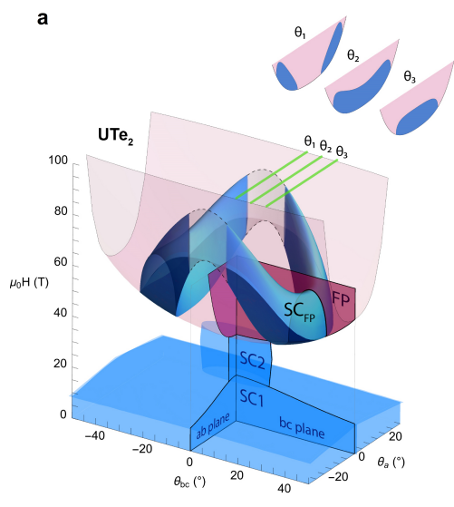
Uranium DiTelluride (UTe2)
Nick Butch, Sheng Ran, Silvia Lewin, Peter Czajka, Corey Frank, Tom Halloran, Gicela Saucedo Salas, UMD, MAGLAB, many others
MACS
Butch et al, npj Quantum Materials 7, 39 (2022)
Notes:
INS: The temperature dependence of the low-energy magnetic excitations in the spin-triplet superconductor UTe₂ was measured via inelastic neutron scattering in the normal and superconducting states. These excitations have a peak instensity at 4 meV, follow the Brillouin zone edges near the crystallographic b-axis, obey the paramagnetic structural symmetry, and track the temperature evolution of the heavy fermion bulk magnetic susceptibility. Thus, the imaginary part of the dynamic susceptibility follows the behavior of interband correlations in a hybridized Kondo lattice with an appropriate characteristic energy. These excitations are a lower-dimensional analog of phenomena observed in other Kondo lattice materials, such that their presence is not necessarily due to dominance of ferromagnetic or antiferromagnetic correlations. The onset of superconductivity alters the magnetic excitations noticeably on the same energy scales, suggesting that these changes originate from additional electronic structure modification.

Slide 13
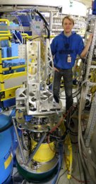
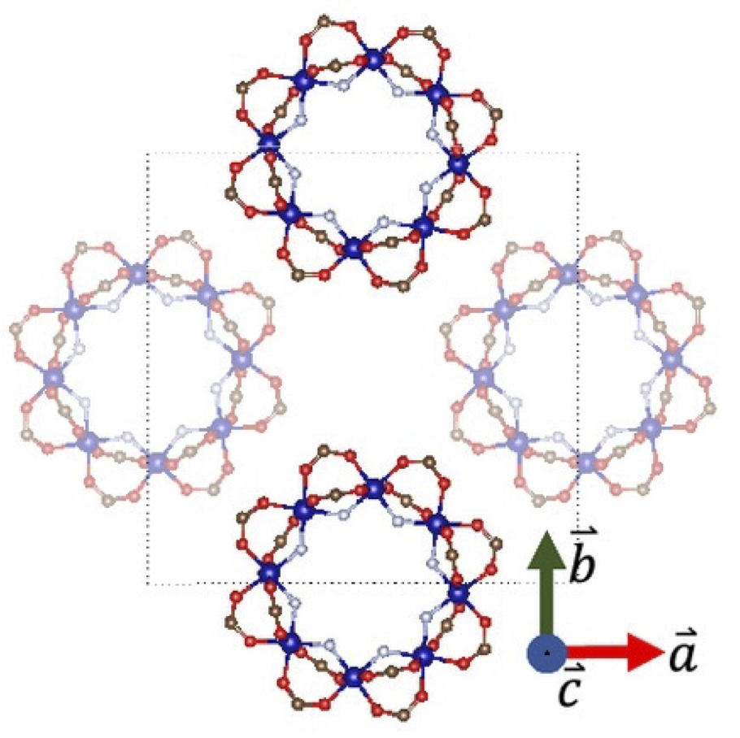
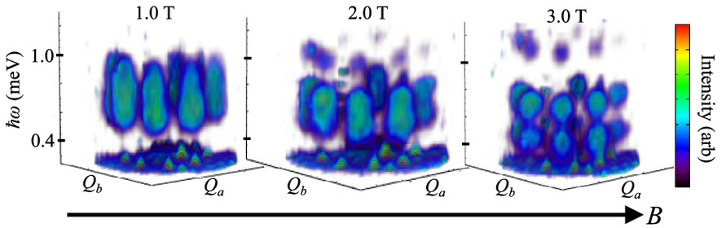
Time evolution of a pumped magnet
T. Reeder et al. PNAS,
https://doi.org/10.1073/pnas.2415300121
The tetragonal cell hosts two Cr₈F₈Piv₁₆ molecules creating a staggered stacking of molecular square lattice planes
Continuous sample rotation
Magnetic field
Cryostat (temperature)
Square microwave pump
Event mode neutron detection
Map four-dimensional space
MACS
Reveals different time scales in the dynamics of the Cr₈ molecules when subjected to microwave pulses → resonant pumping produces a steady state that cannot be described by a conventional thermal equilibrium state
Notes:
In postprocessing, the event mode data were binned into neutron counts versus scattering angle, sample rotation, energy transfer, and time relative to microwaves turning on. Such data were subsequently transformed into an event count map in a four-dimensional space d(Qx,Qy,hw,t) and the corresponding coverage map reporting the fission monitor count ħ associated with each pixel.

Slide 14
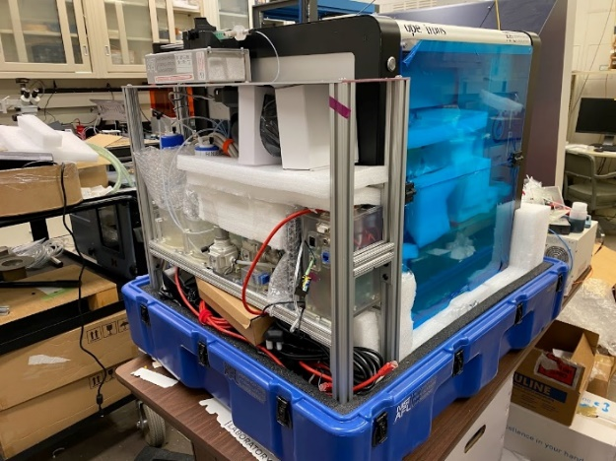
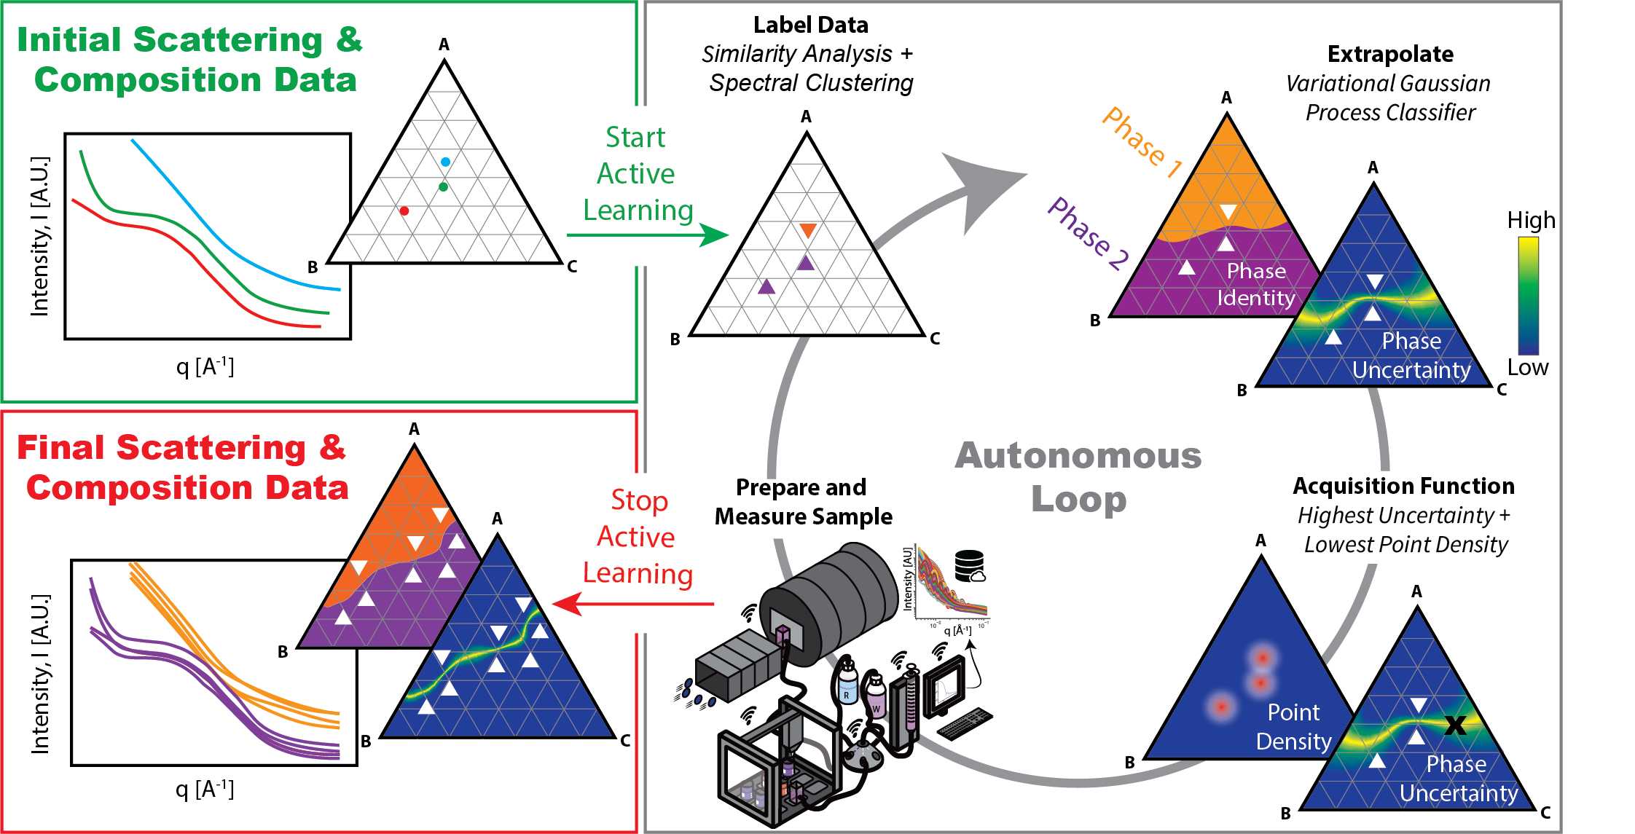
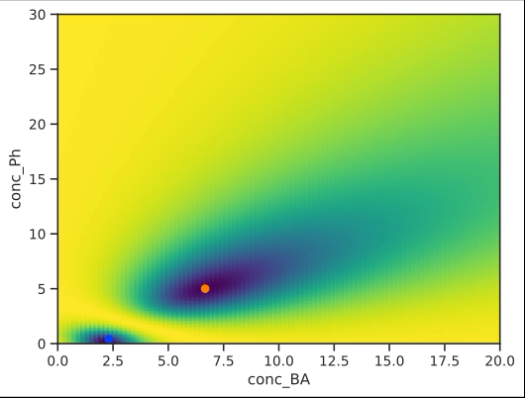
Autonomous Formulation Lab (AFL)
Peter Beaucage, Donald Sutherland, Tyler Martin 10.1021/acs.macromol.4c01410
github.com/usnistgov/AFL-agent
github.com/usnistgov/AFL-hardware
github.com/usnistgov/AFL-automation

Slide 15
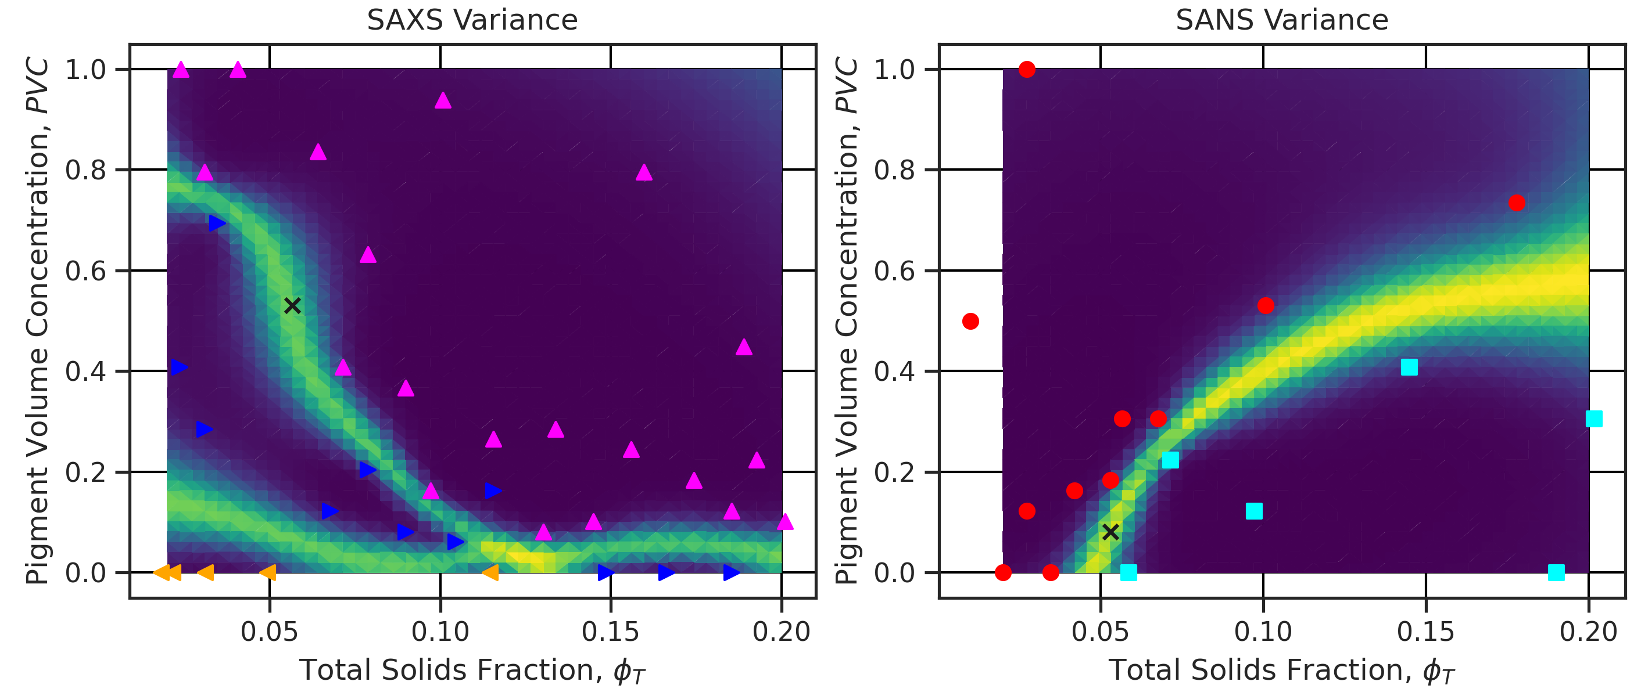
Autonomous Formulation Lab (AFL)
Peter Beaucage, Jeff Krzywon, Tyler Martin, Donald Sutherland, Brad Sutliff, McGlynn; Dow Chemical, Diamond, ISIS

Slide 16
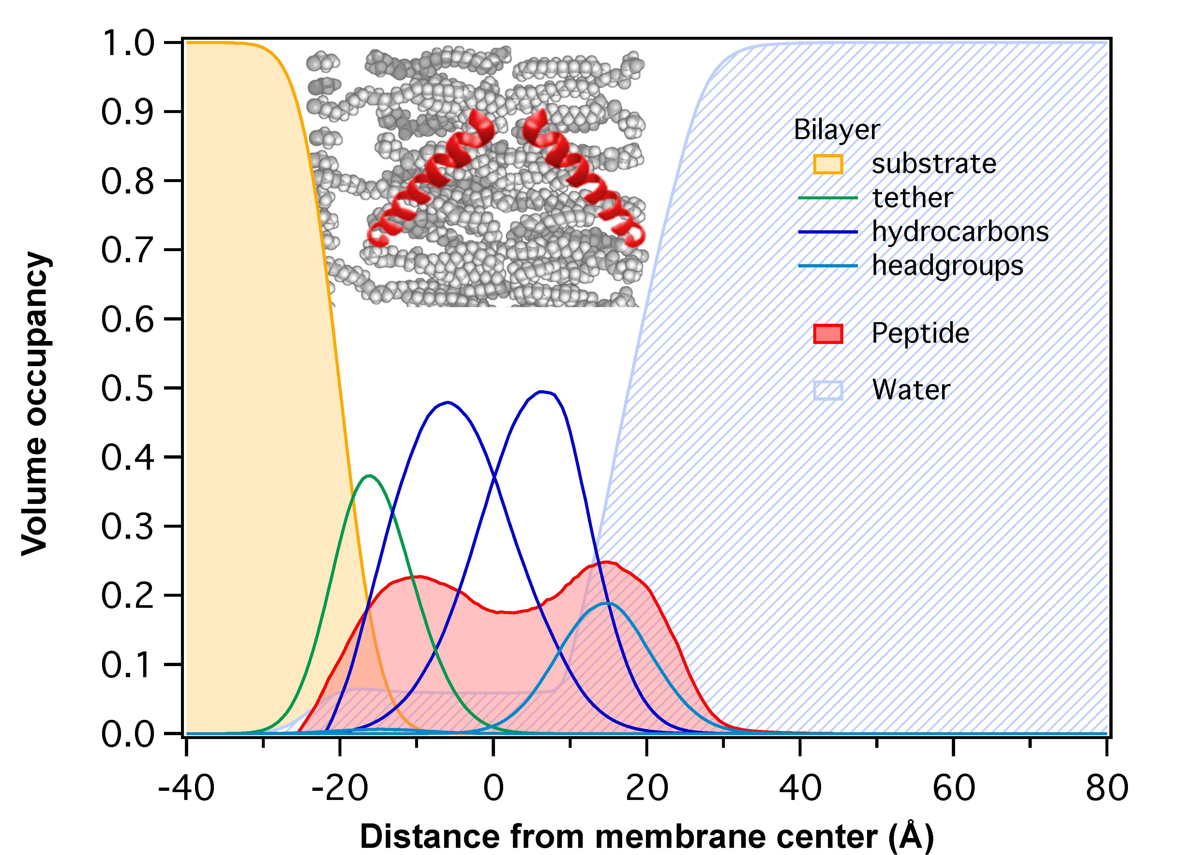
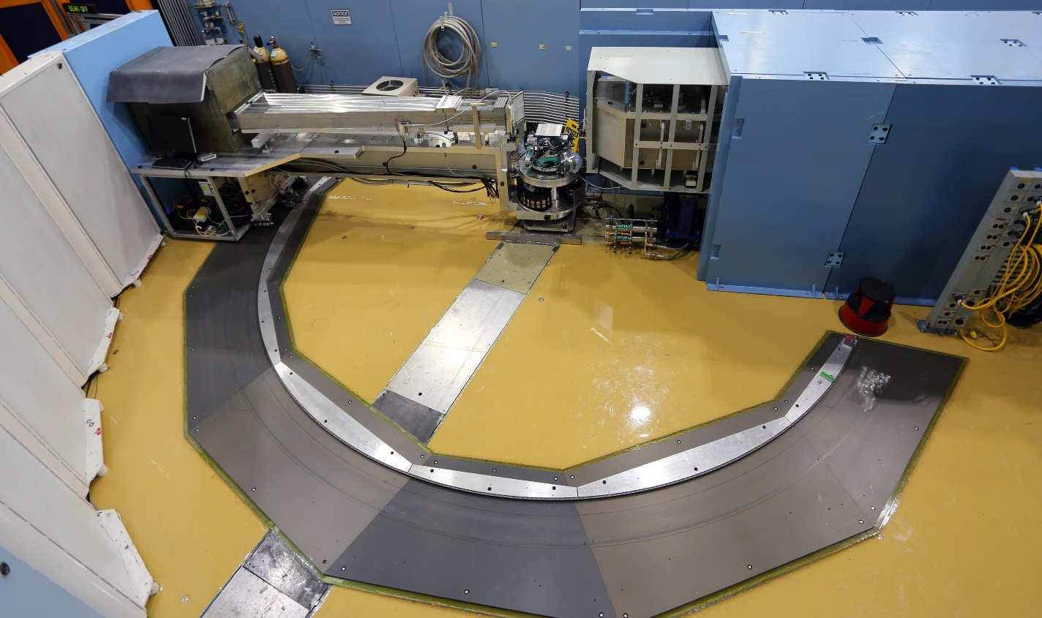
ROADMAP
David Hoogerheide, Megan Mitchell, Frank Heinrich, Brian Maranville, Charles Majkrzak; others
Neutron reflectometry (NR)
Therapeutically relevant µM peptide concentrations
Membrane thickness
Surface peptide
Embedded peptide
CANDOR
Membrane integrity (water content)
Translocated peptide

Slide 17
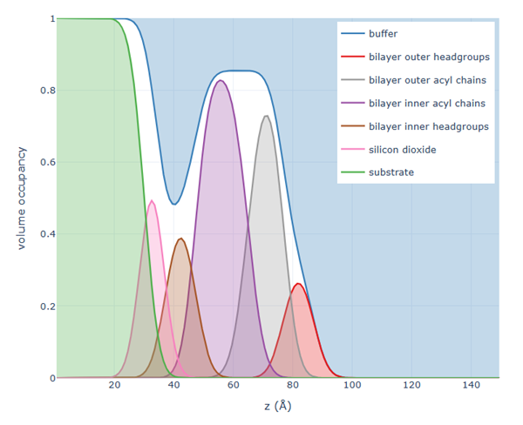
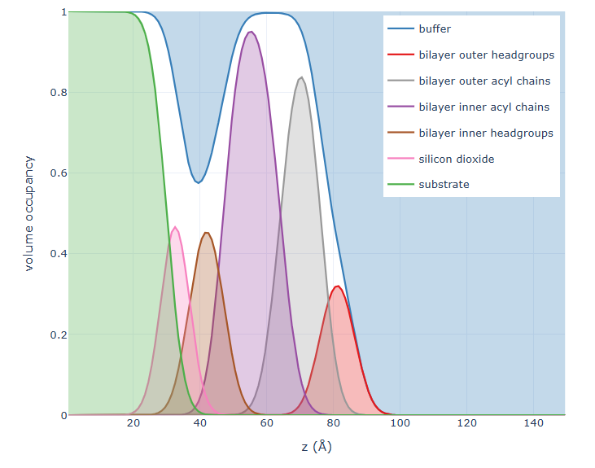
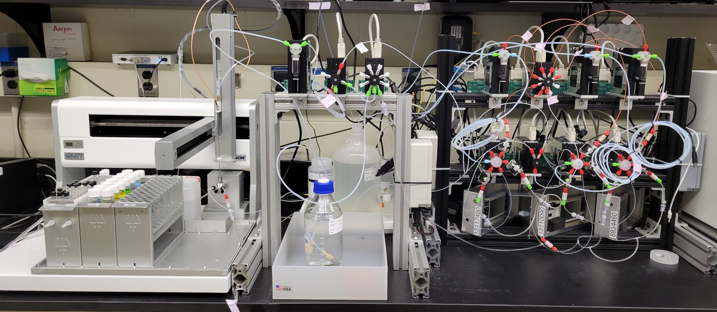
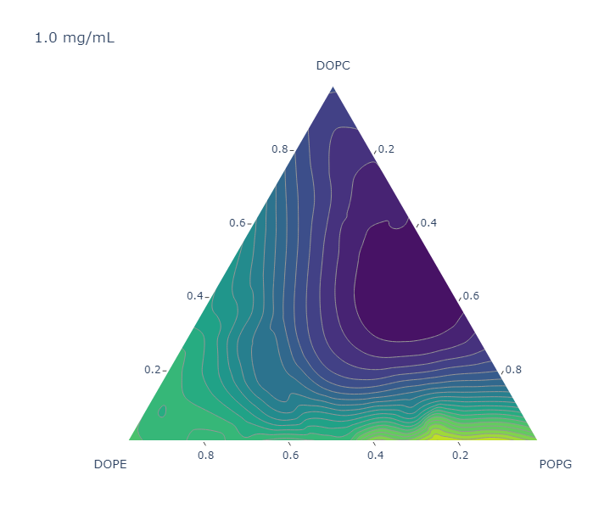
ROADMAP
David Hoogerheide, Megan Mitchell, Frank Heinrich, Brian Maranville, Charles Majkrzak; others
Bilayer
completeness

Slide 18
What does the NCNR do?
NIST Mission
To promote U.S. innovation and industrial competitiveness by advancing measurement science, standards, and technology in ways that enhance economic security and improve our quality of life.
NCNR Mission
To advance economic and technical excellence in the U.S. by providing world-class neutron measurement capabilities to meet the needs of researchers from industry, academia, and government.

