Slide 1
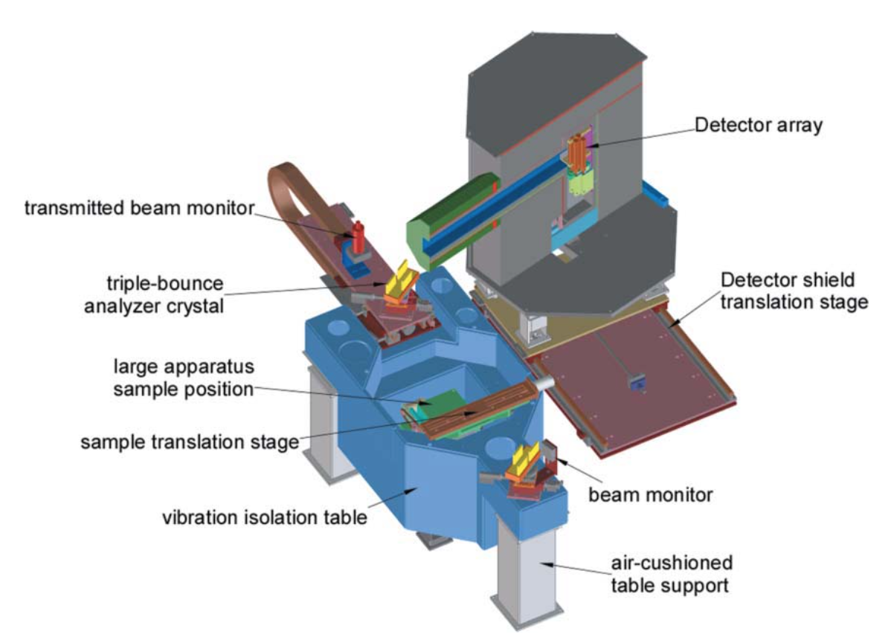
Scattering Theory: Transmission & Multiple Scattering
By: John Barker
Date: 7/22/2024

Slide 2
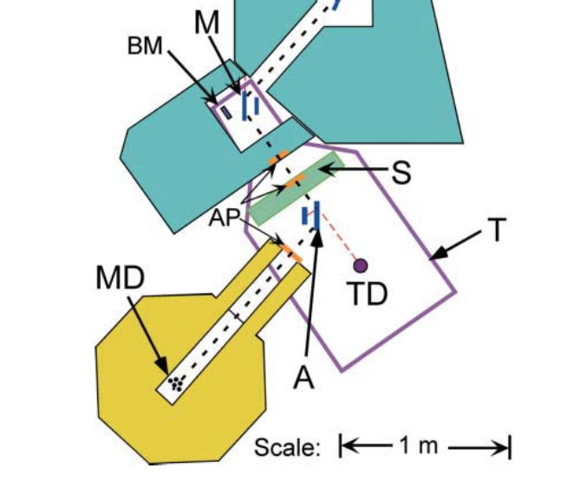
Sample Transmission Measurement:
Transmission Detector collects over large solid angle, +/- 10˚ in both directions
Main Detector collects scattering from analyzer crystal rotated to obtain rocking curve with few arc-sec resolution in one direction
Transmission:
$$T=\frac{I_{sample}}{I_{empty}}$$

Slide 3
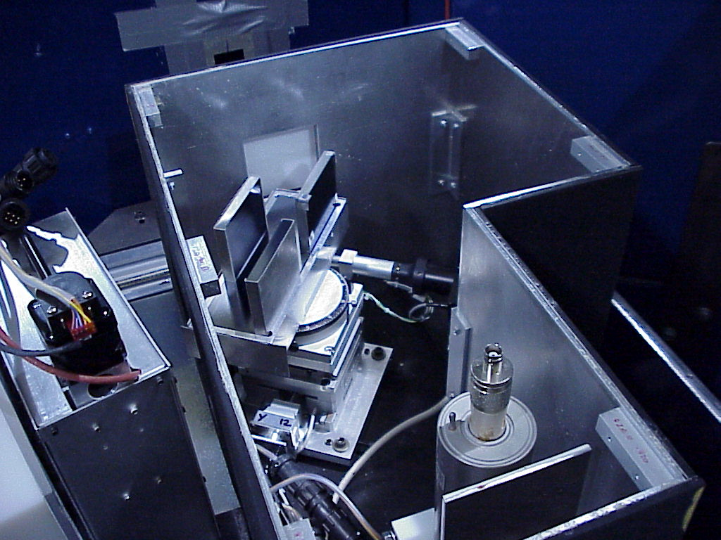
3-Bounce
Channel-Cut
Silicon (220)
Analyzer
Goniometer
Transmission
Detector

Slide 4
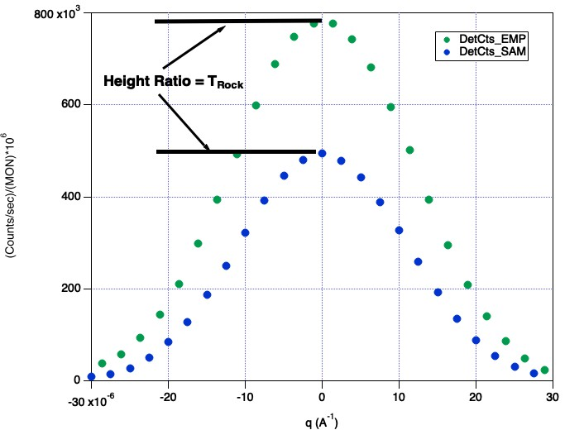
Sample transmissions are needed for three calculations:
1) Subtracting Instrument background:
$I_{cor}\left(q\right)=I_{sam}$(q)-$T_{rock}I_{emp}\left(q\right)−(1−T_{rock})I_{bgd}(q)$
2) Placing scattering on absolute scale
$$I_{abs}\left(q\right)∝\frac{I_{cor}}{{tT}_{wide}}$$
3) Fraction of Small angle scattering
events: T_{SAS}
$T_{SAS}$=$\frac{T_{rock}}{T_{wide}}$

Slide 5
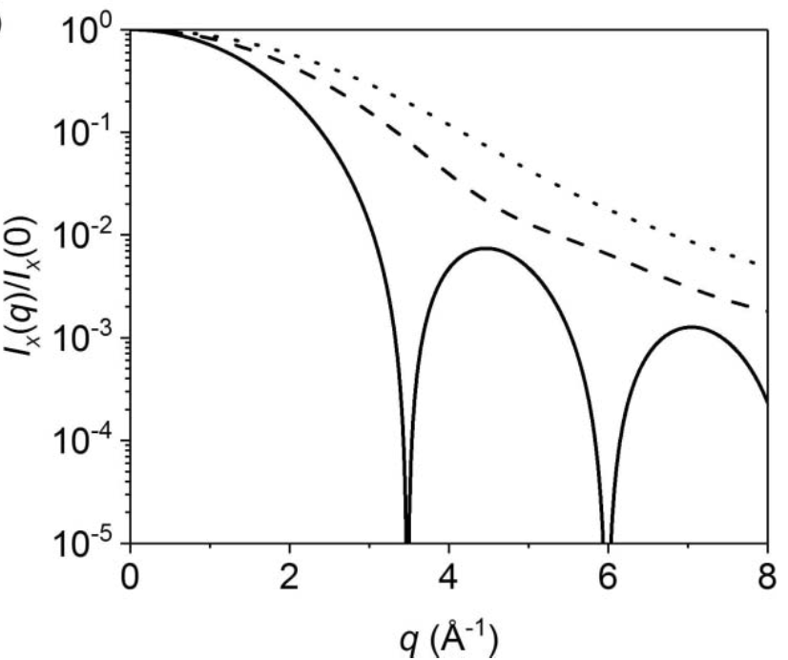
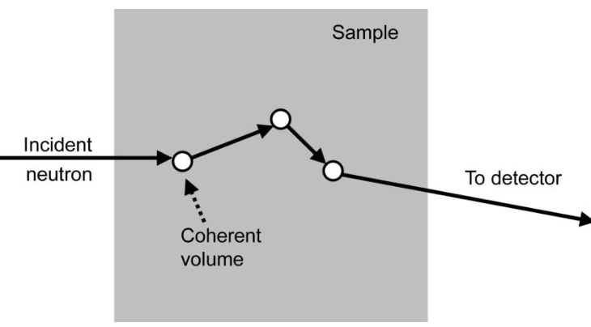
Multiple Scattering
Higher order scattering is ‘background’
To mitigate:
Choose shorter wavelength λ
Thinner sample t_{S}
Reduce contrast Δρ²
Bgd ~ d_{S} Δρ²λ²
Scattering from Spheres
Triple
Double
Single
Jensen (2018) J. Appl. Cryst. 51, 1455

