Slide 1
Looking at everything while looking at nothing an Introduction to Small-Angle Neutron Scattering
NIST Center for Neutron Research
Ryan P. Murphy

Slide 2
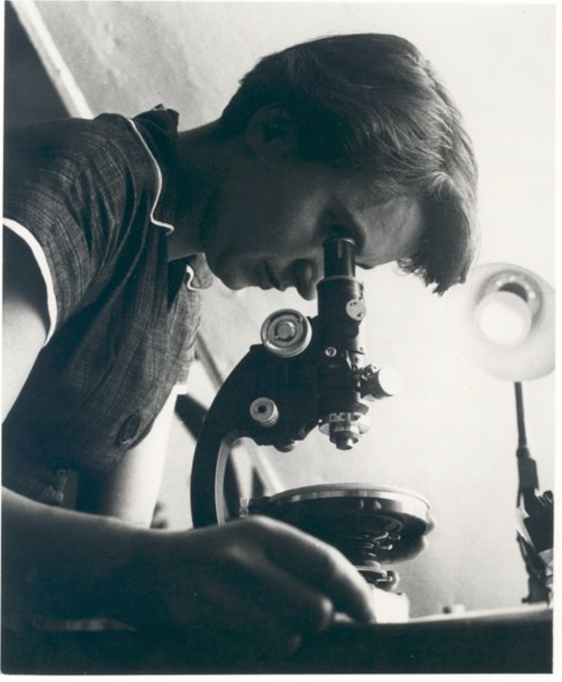
Exposure 51
DNA
0.34 nm
3.4 nm
φ
φ
Rosalind Franklin
Credits: Photo of Rosalind Franklin courtesy of Vittorio Luzzati. Photo of x-ray crystallography
(Exposure 51) courtesy of King's College Archives. King's College London.

Slide 3
“Seeing” collections of atoms
www.wichlab.com/research

Slide 4
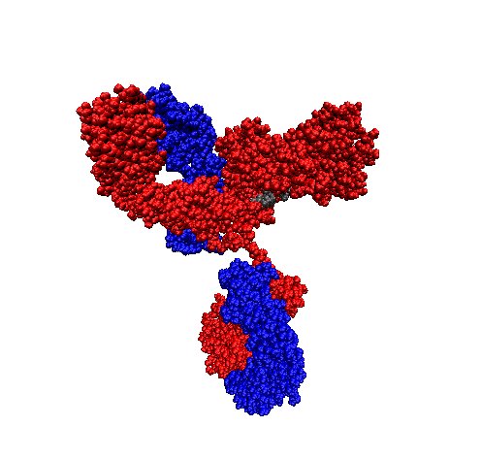
How many particles are there?
10,000,000,000,000,000
10¹⁶
NIST mAb
≈ 10 nm
≈ 150 kg/mol
≈ 10 mg/mL
https://www.nist.gov/programs-projects/nist-monoclonal-antibody-reference-material-8671

Slide 5
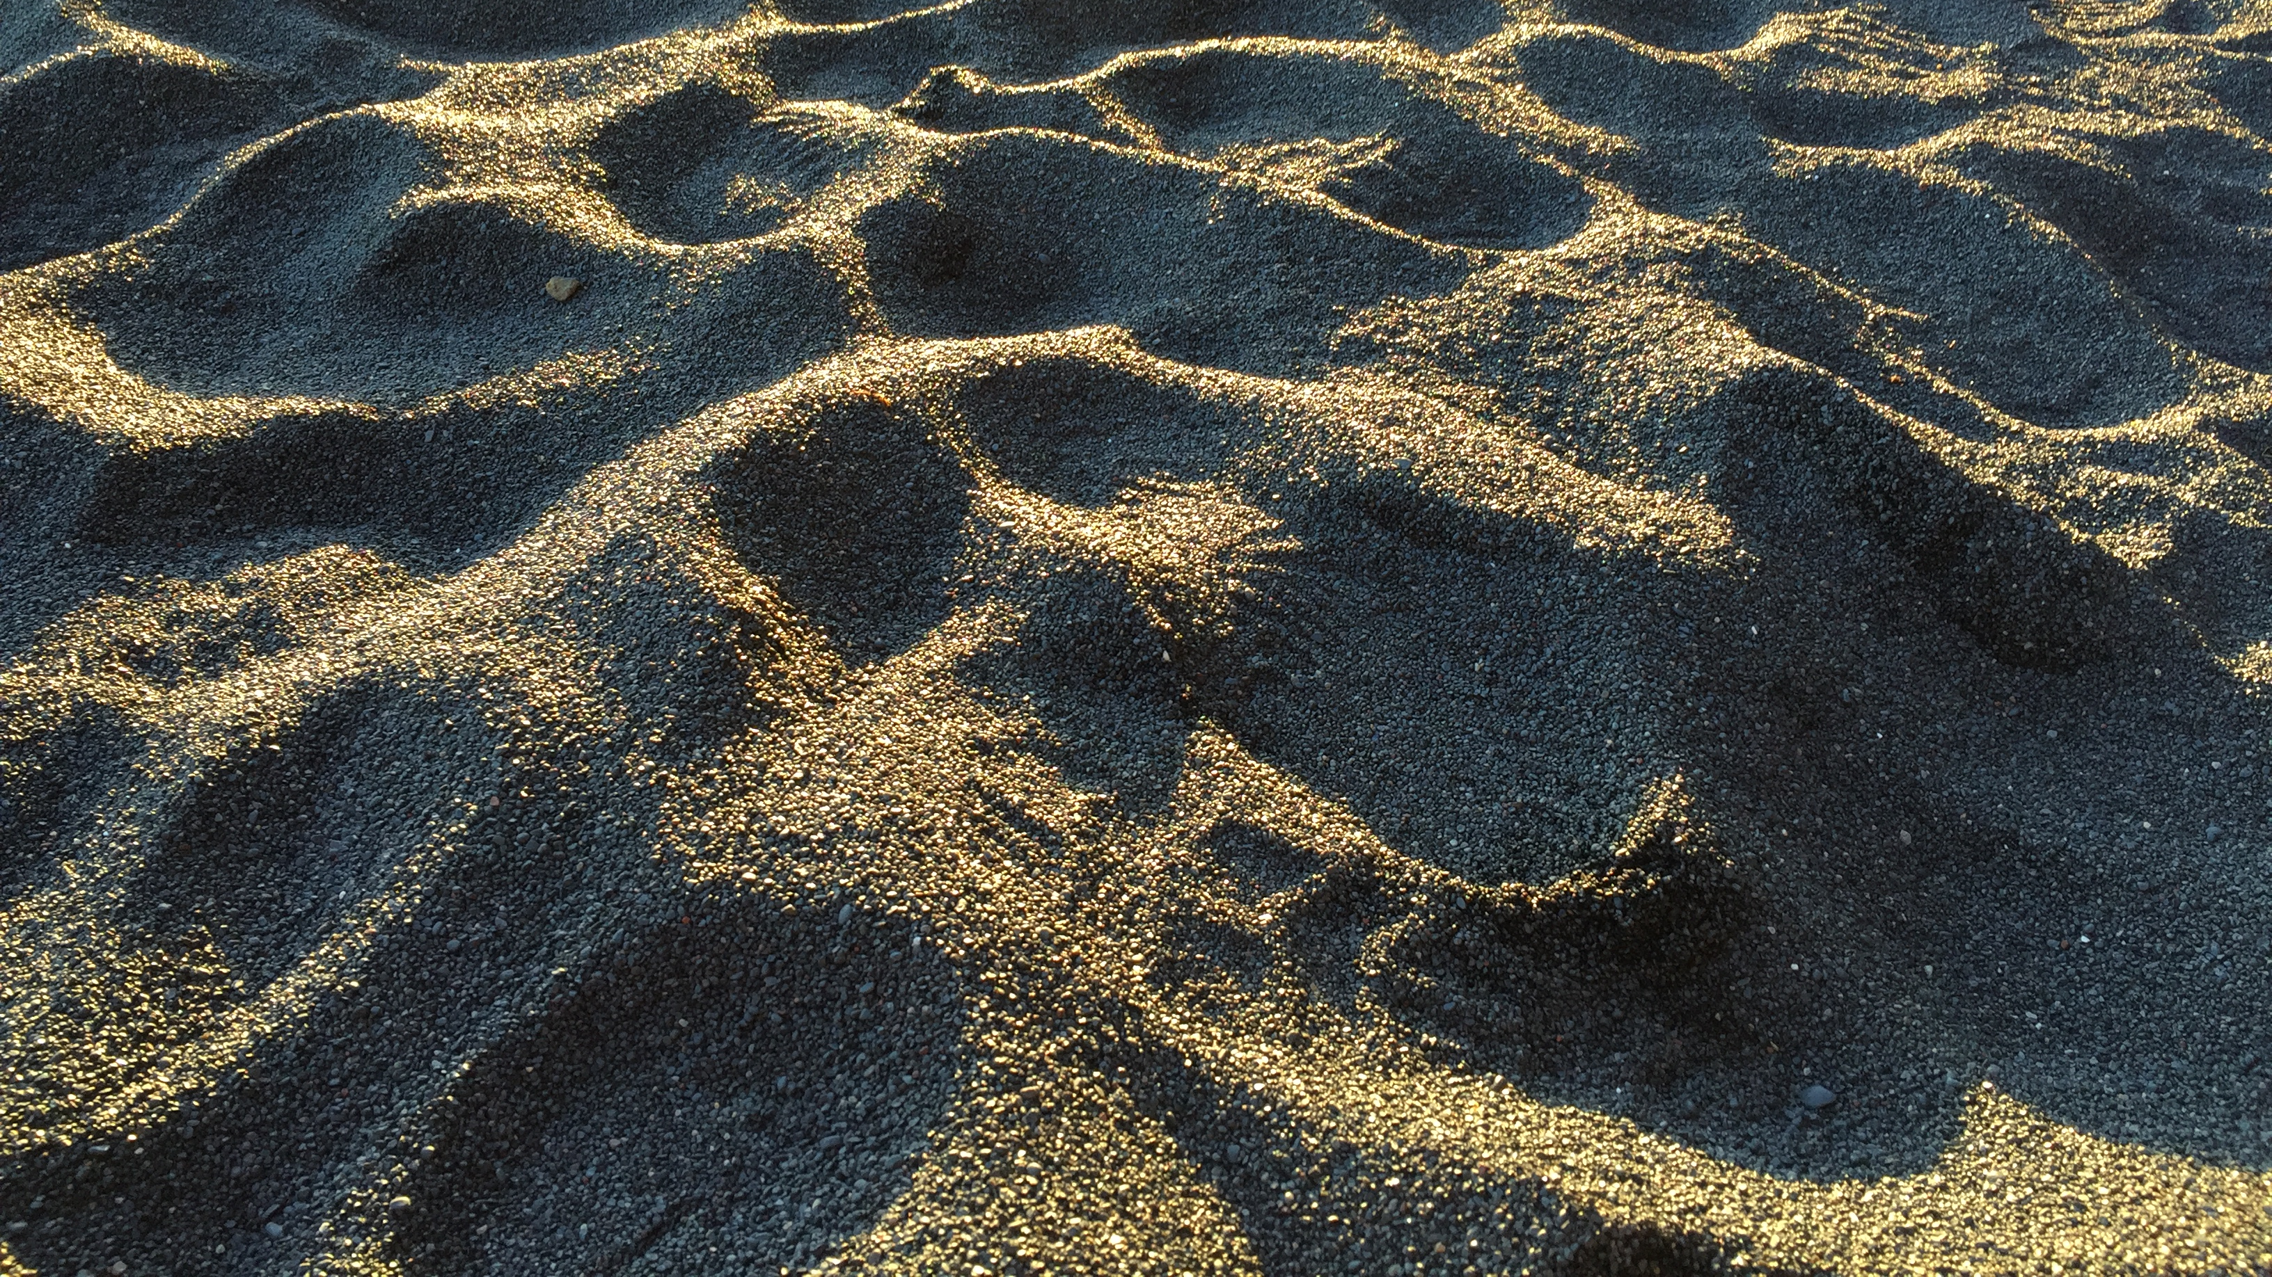
10⁶

Slide 6
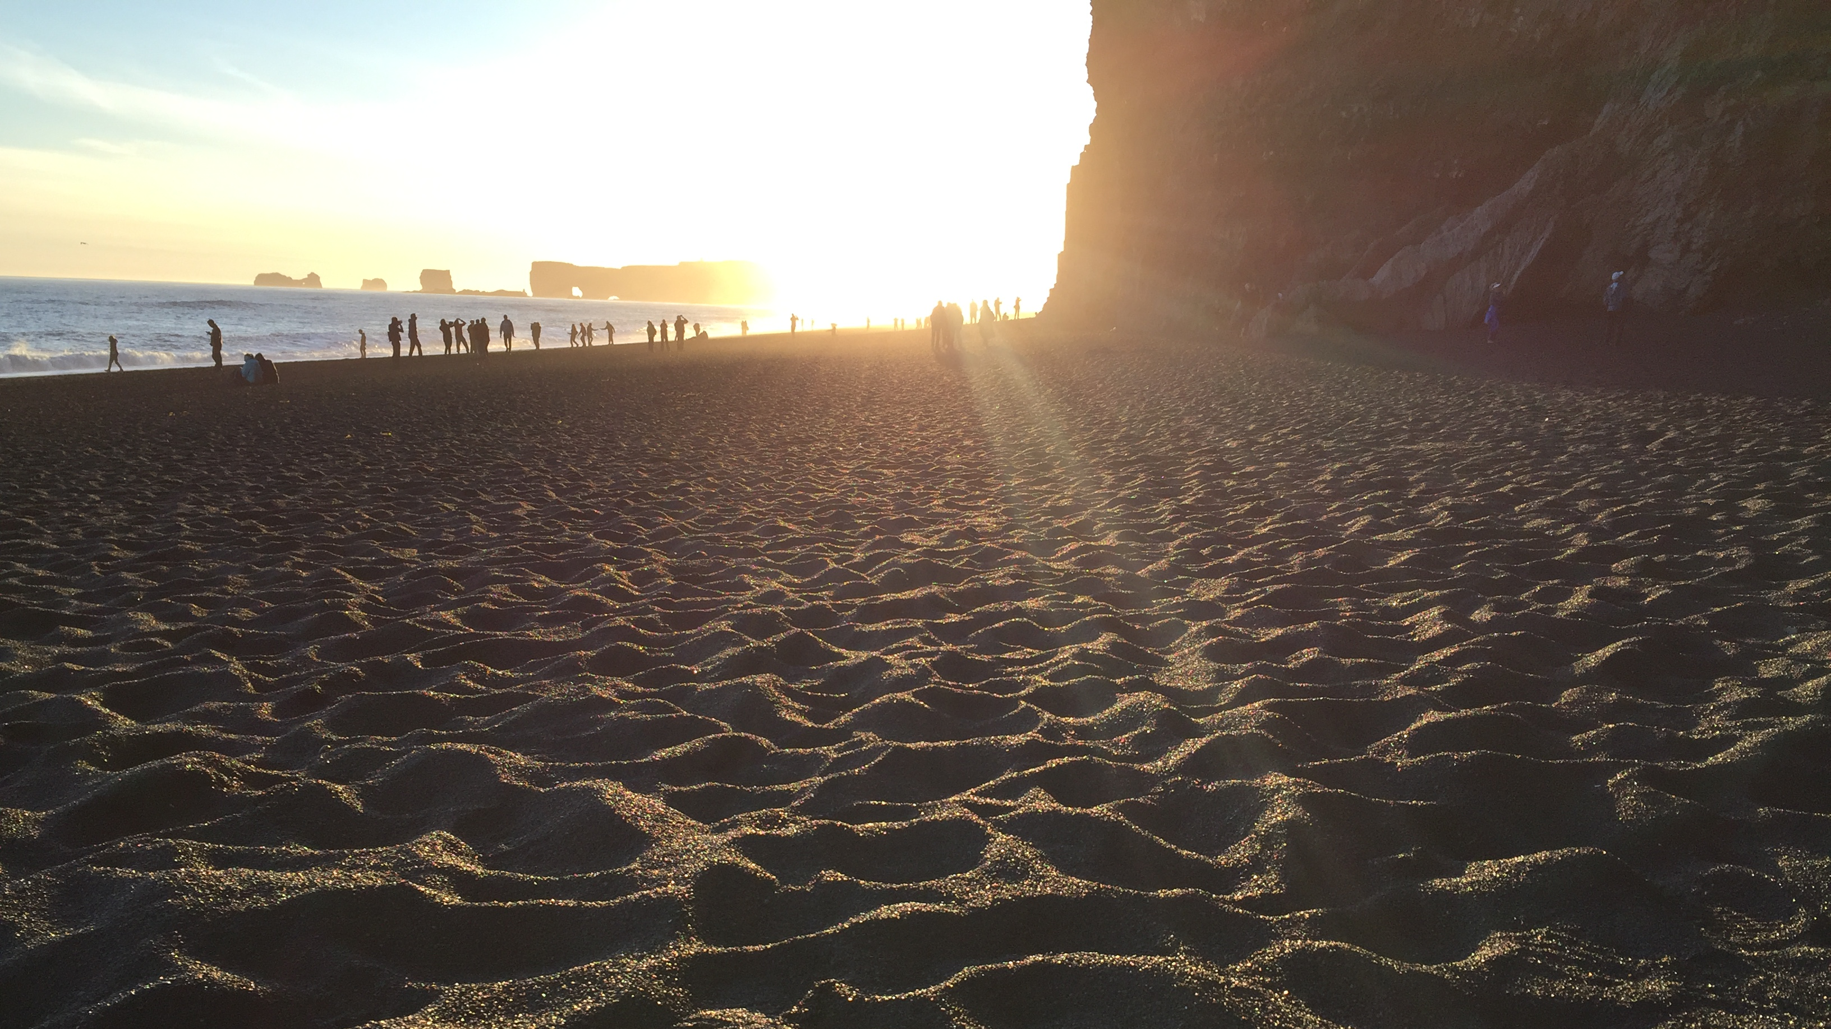
10¹⁰

Slide 7
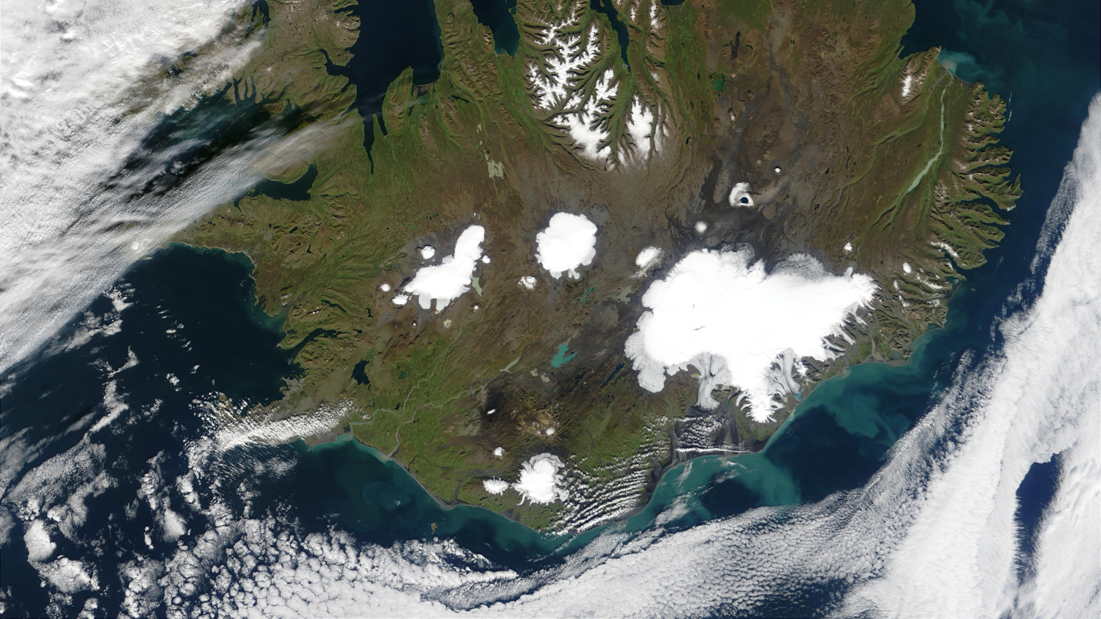
10¹³
Iceland
Reynisfjara

Slide 8
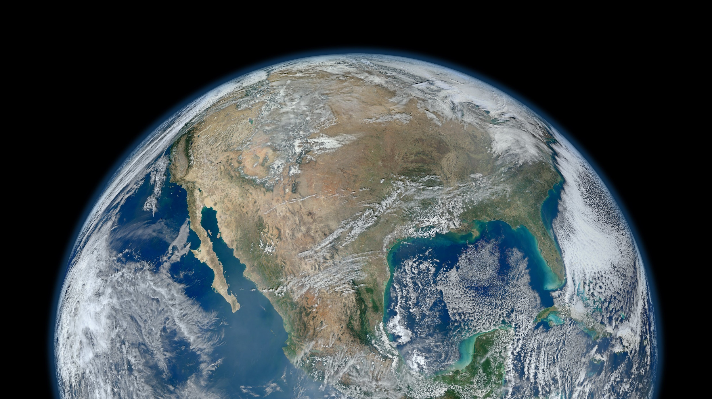
Iceland
10¹³
Sand grains along coastlines on Earth
10¹⁶
https://www.flickr.com/photos/gsfc/

Slide 9
How is it possible to measure the structure of so many things all at once?

Slide 10
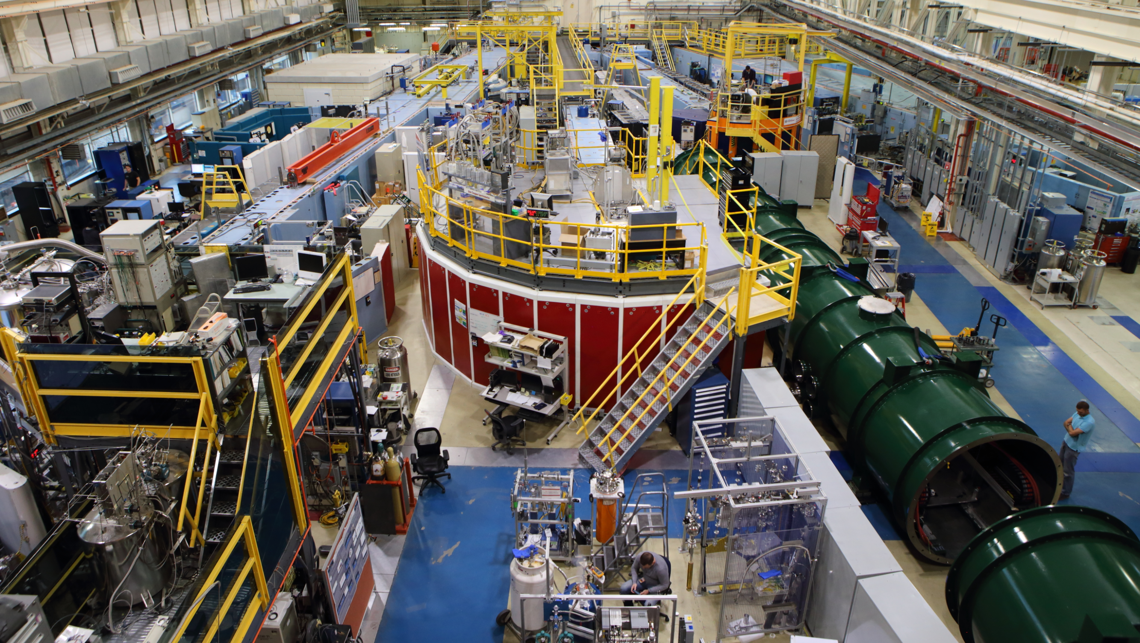
BT5 USANS
Small-Angle
Neutron
Scattering
(SANS)
NGB-10m SANS
NGB-30m SANS
NG3
VSANS
NG7 SANS

Slide 11
What is scattering?
Why at small-angle?
Why use neutrons?

Slide 12
What is scattering?
Why at small-angle?
Why use neutrons?

Slide 13
Scattering
$$I\left(q\right)$$
scattered
k_{s}
k_{i}
$$q$$
$$θ$$
absorbed
transmitted
$$q =\frac{4π}{λ}sin\left(\frac{θ}{2}\right)$$
_{source}
_{sample}
_{detector}

Slide 16
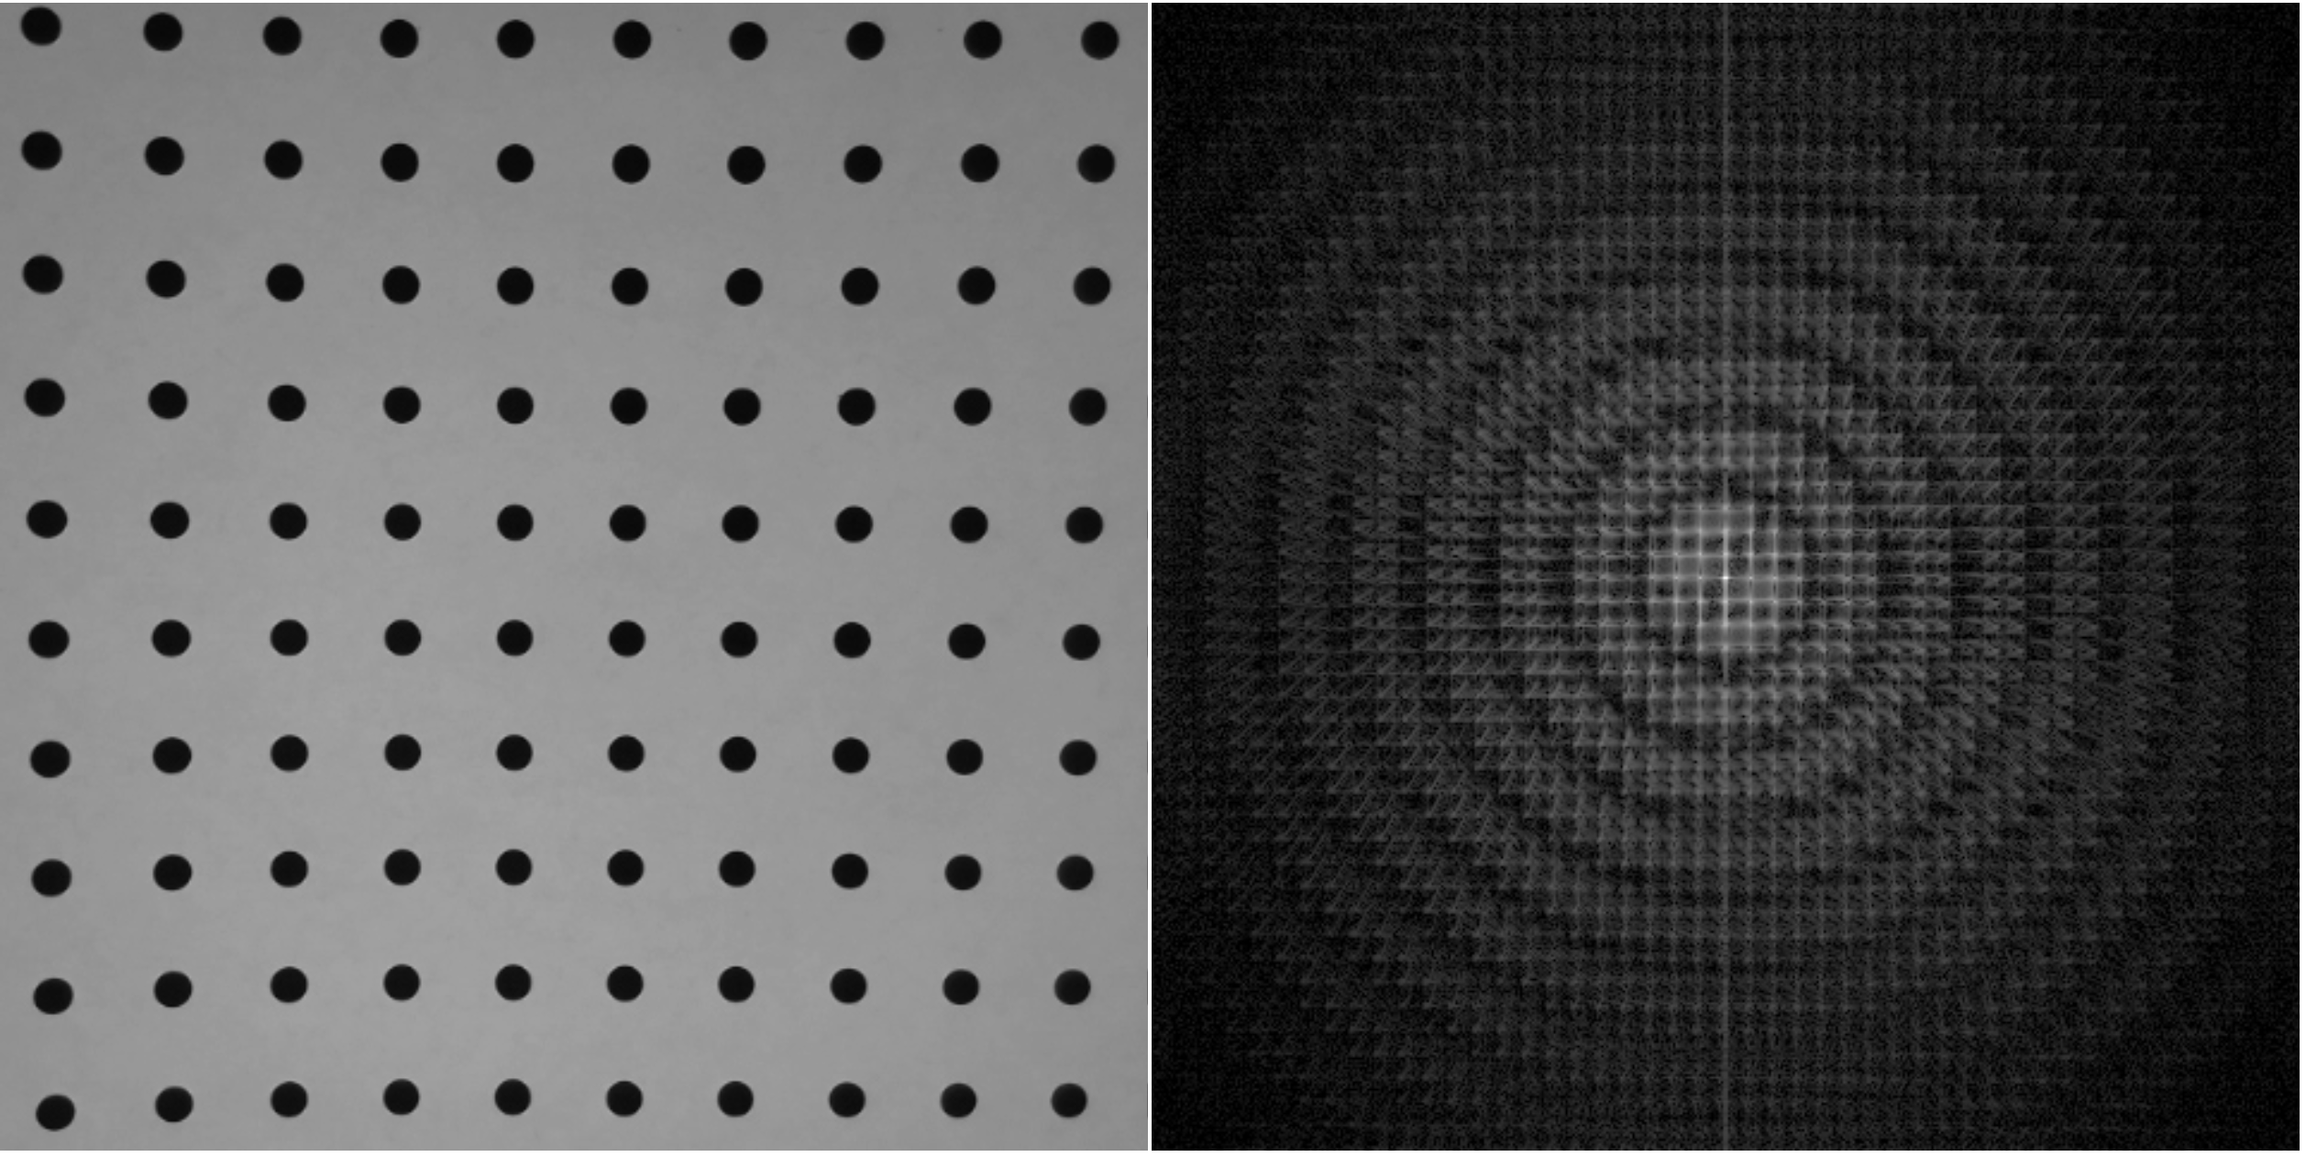
Scattering

Slide 17
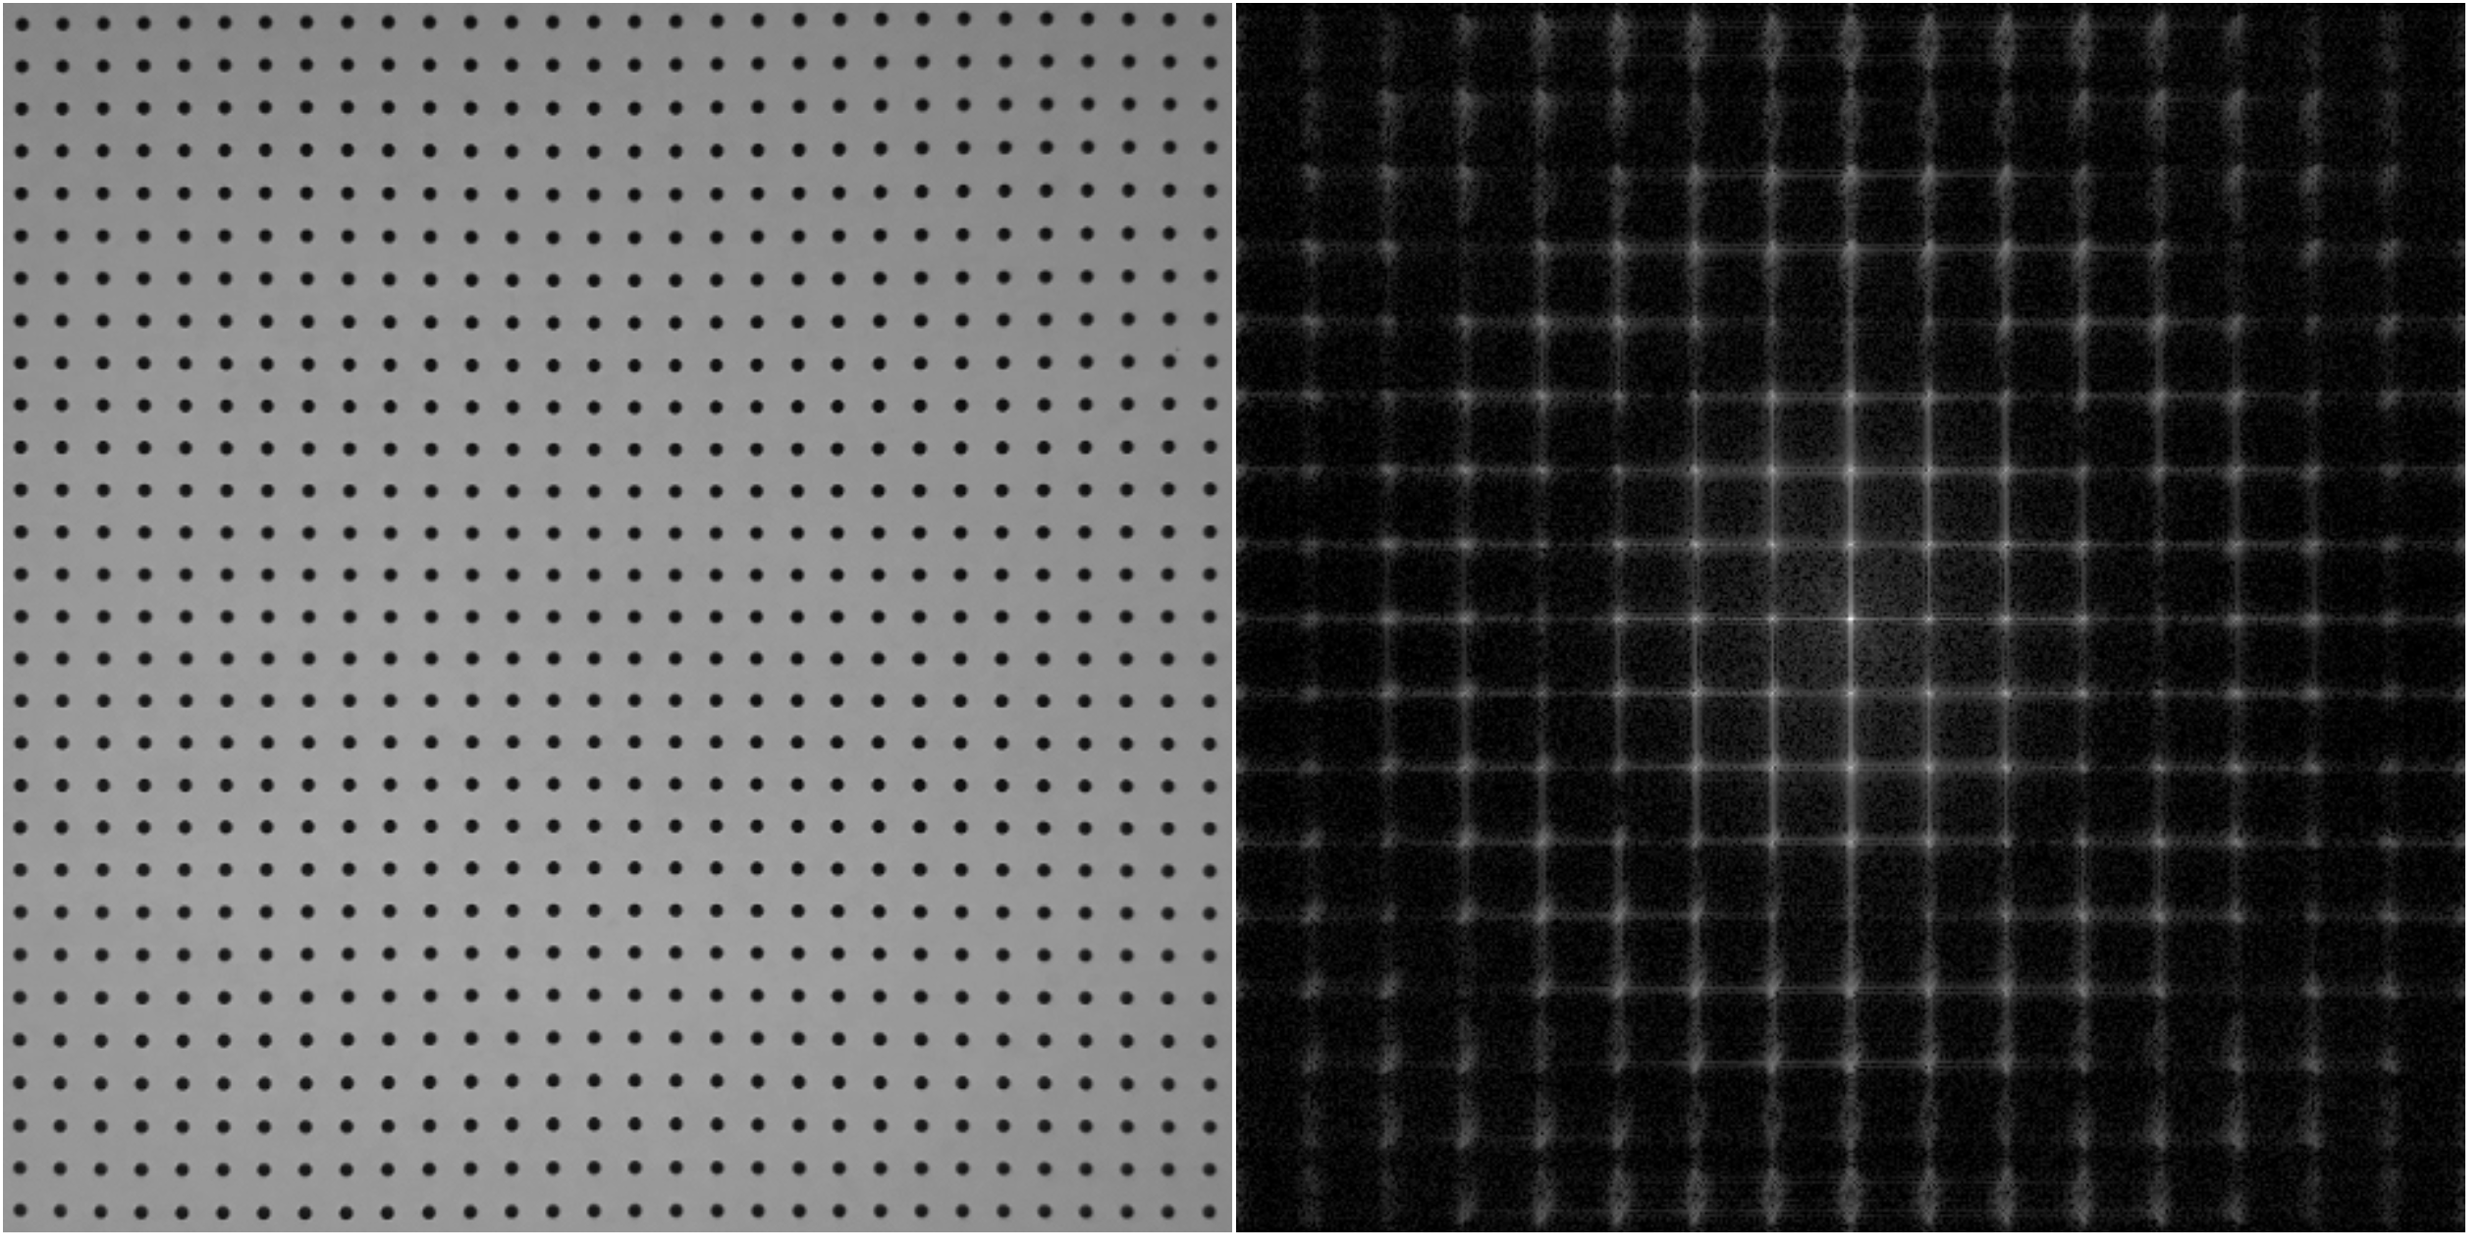
Scattering

Slide 18
real
space
q
space

Slide 19
Fourier transform
$$I(q)\sim \frac{1}{V}{\left|\int{ρ\left(r\right) e^{iqr}}dr\right|}^{2}$$
Scattering intensity is related to the differences in scattering length density distribution, ρ(r)
Intensity ~ Fourier transform² of ρ(r)

Slide 20
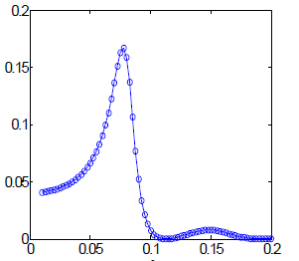
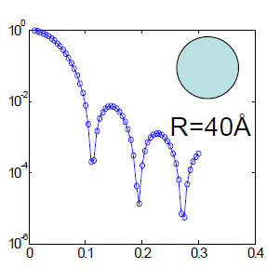
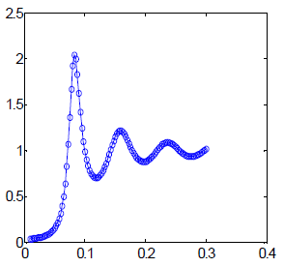
Real space, r (Å)
Positions
Contrast
Shape
=
( - )²
x
x
‘neutron color’
‘intraparticle’
‘inside’
‘interparticle’
Scattering space, q (Å⁻¹)
‘between’
$$I(q)$$
${Δρ}^{2}$
$$P(q)$$
$$S(q)$$
~
x
x
$$3×{10}^{−6}$$
q (Å⁻¹)
q (Å⁻¹)
q (Å⁻¹)
adapted from Y. Liu
‘Colloidal interactions in solution’

Slide 21
Demonstration
Contrast
Size
Shape
Distribution
Interaction
Orientation
Complex shapes
Phase loss
FFT Software:
Brian Maranville: https://ncnr.nist.gov/instruments/magik/calculators/fourier_webcam/
Brian Pauw: https://lookingatnothing.com/

Slide 22
Real space, r (Å)
Positions
Contrast
Shape
=
( - )²
x
x
‘neutron color’
‘intraparticle’
‘inside’
‘interparticle’
Scattering space, q (Å⁻¹)
‘between’
$$I(q)$$
${Δρ}^{2}$
$$P(q)$$
$$S(q)$$
~
x
x
$$3×{10}^{−6}$$
q (Å⁻¹)
q (Å⁻¹)
q (Å⁻¹)
adapted from Y. Liu
‘Colloidal interactions in solution’

Slide 23
coherent
scattering
incoherent
scattering
scattering intensity
$$I(q) \sim φΔρ2P(q)S(q)+B$$
particle volume fraction
scattering length density contrast
form
factor
structure
factor
background
*Useful primarily in simpler colloidal or nanoparticle systems

Slide 24
What is scattering?
Why at small-angle?
Why use neutrons?

Slide 25
“Seeing” collections of atoms
Typical size from 1 nm to 10 µm
www.wichlab.com/research

Slide 26
Small-angle scattering
I(q)
Bragg condition
$$2D\sin\left(\frac{θ}{2}\right)=nλ$$
k_{s}
scattered
$$θ$$
q
k_{i}
$$D$$
transmitted
$$D≌\frac{2π}{q}$$
$$q=\frac{4π}{λ}\sin\left(\frac{θ}{2}\right)$$
$$θ≈\frac{λ}{D}$$
1 nm to 10 µm
1 Å⁻¹ to 0.00003 Å⁻¹
30° to 0.0006°

Slide 27
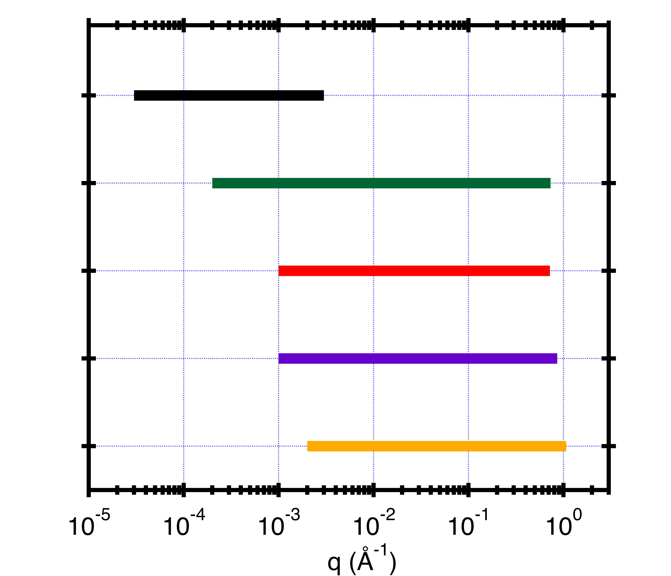
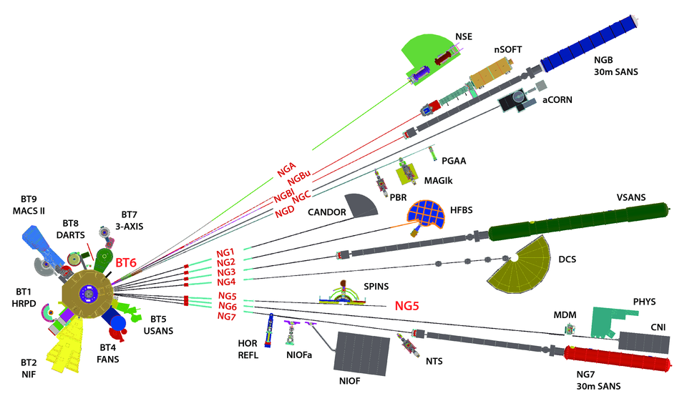
D = 2π/q
6 µm 0.6 µm 600 Å 60 Å 6 Å
USANS λ = 2.4 Å, Δλ/λ = 6%, 0.0006 ° < θ < 0.06 °
vSANS-48m 4.5 < λ < 20 Å, Δλ/λ=1% & 12.5%, 0.017 ° < θ < 30 °
NG7-30m 4.5 < λ < 20 Å, 11% < Δλ/λ < 25%, 0.056 ° < θ < 30 °
NGB-30m 3.0 < λ < 20 Å, 11% < Δλ/λ < 25%, 0.065 ° < θ < 24 °
nSOFT-10m 3.0 < λ < 20 Å, 11% < Δλ/λ < 25%, 0.17 ° < θ < 30 °
80 m

Slide 28
BT5 USANS
NGB-10m SANS
NGB-30m SANS
NG7 SANS
NG3
VSANS

Slide 29
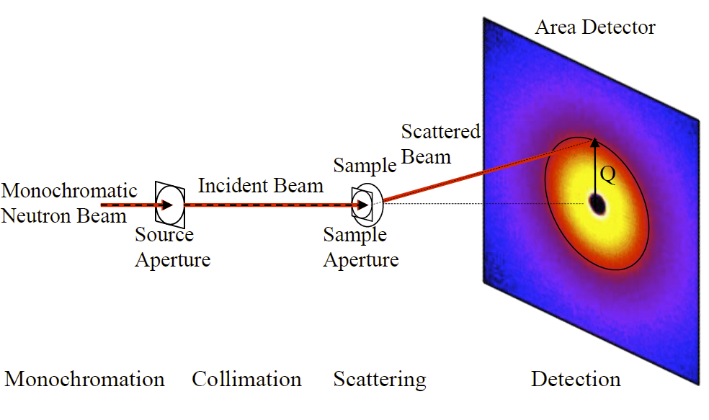
$$q=\frac{4π}{λ}sin\left(\frac{θ}{2}\right)$$
Wavelength
$$λ$$
$$θ$$
$$q_{y}$$
sample
$$q_{x}$$
Hammouda, B. (2016). The SANS Toolbox. Gaithersburg, MD, NIST Center for Neutron Research.

Slide 30
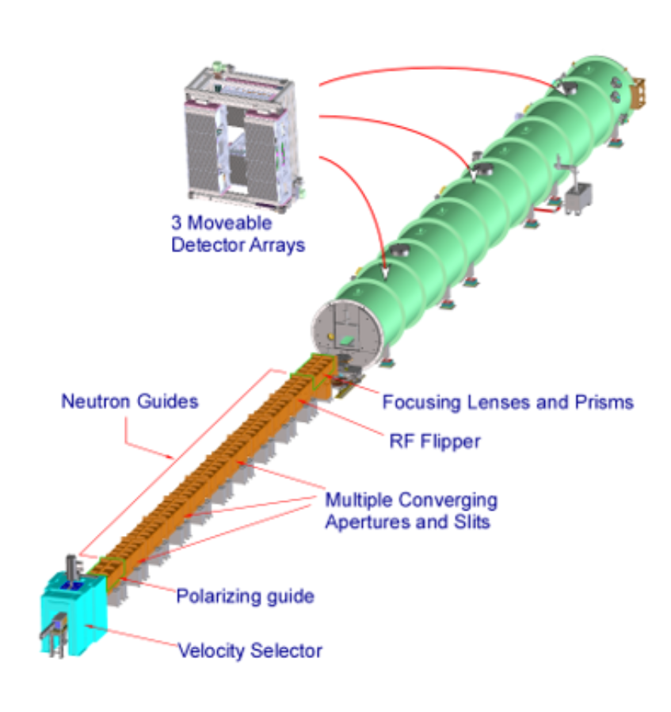
Low-q
Mid-q
High-q
VSANS
Fractal dimensions
Cluster lengths
Second virial coefficients
Radius of gyration
Pore radius
Surface area
Particle radius
Radius distribution

Slide 31
What is scattering?
Why at small-angle?
Why use neutrons?

Slide 32
Neutrons
Photons
Interact with nuclei
SLD differences
Isotope (H/D) variation
Magnetic structure
Non-destructive
Extreme environments
Lower flux
Fewer sources
Interact with electrons
Electron density differences
Ionizing damage (X-rays)
Finer q-resolution
Higher flux
Many sources

Slide 33
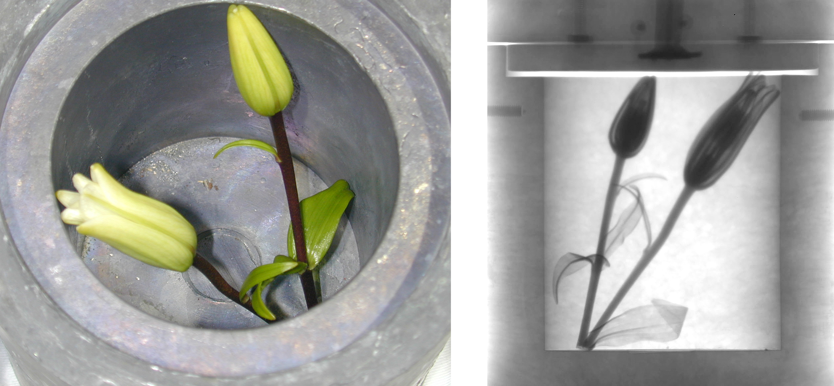
scattering length*
Contrast
neutron
X-ray
H
$$ρ=\frac{\sum{b_{i}}}{V}$$
D
C
O
b_{i} = scattering length
V = molecular volume
Al
Si
scattering length density calculator
https://www.ncnr.nist.gov/resources/activation/
Fe
Neutron image: Daniel Hussey/NIST
*X-ray scale reduced by ~ 1.5X to compare with neutron scale
adapted from presentation by J. D. Copley

Slide 34
Contrast variation
$$Core+Shell$$
$$Shell$$
$$Core$$
ρ_{solvent} ≠ ρ_{core} ≠ ρ_{shell}
core and shell are visible
ρ_{solvent} = ρ_{core}
shell is visible
ρ_{solvent} = ρ_{shell}
core is visible

Slide 35
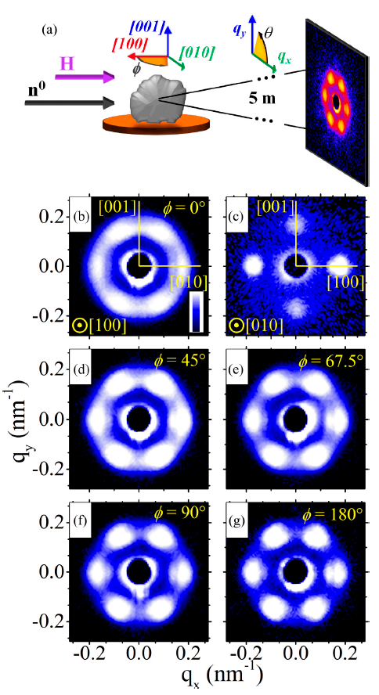
Magnetic structures
Gilbert, D. A., et al. (2019). Physical Review Materials 3(1).

Slide 36
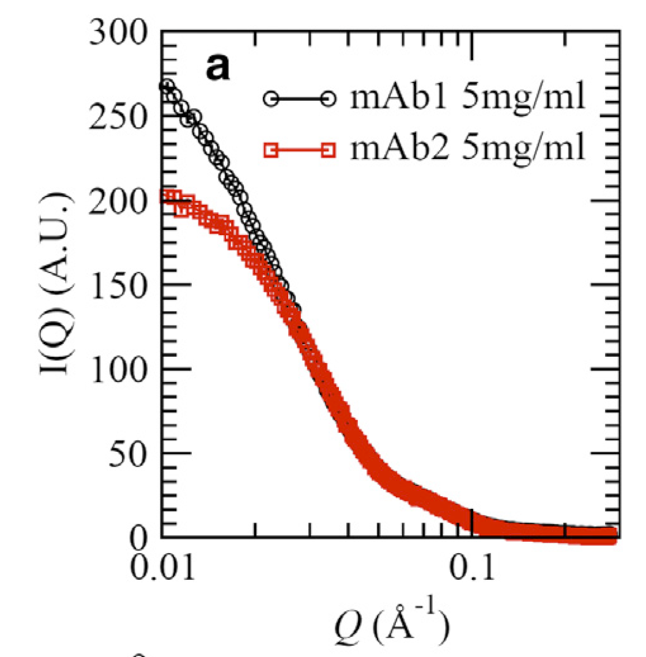
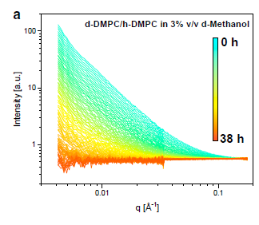
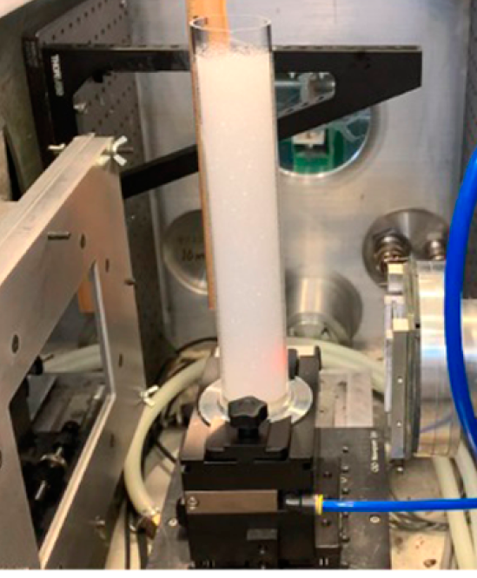
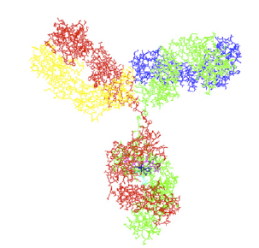
Non-destructive
foams
biologicals
kinetics
Perticaroli, S., et al. (2020). Langmuir 36(48): 14763-14771.
Yearley, E. J., et al. (2014). Biophys J 106(8): 1763-1770.
Nguyen, M. H. L., et al. (2019). Biophys J 116(5): 755-759.

Slide 37
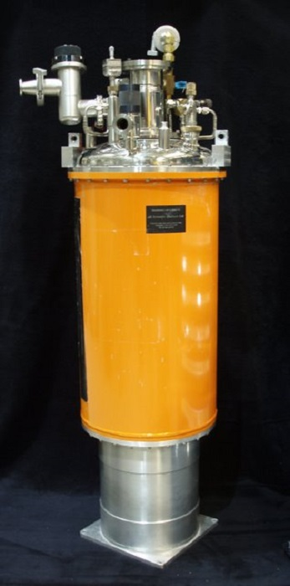
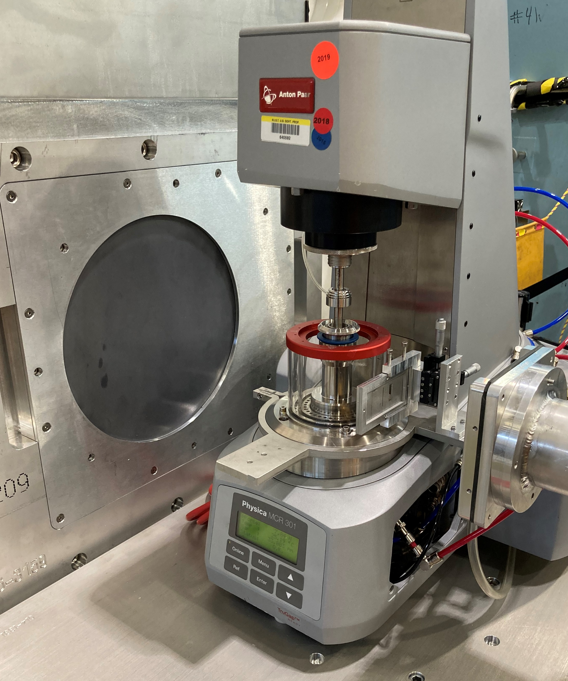
Extreme environments
Shear rates ~ 10⁻³ to 10⁷ s⁻¹
Pressures ~ vacuum to 4400 bar
Temperatures ~ 1.5 K to 800 K
Teixeira, S. C. M., et al. (2018).
Journal of Neutron Research 20(1-2): 13-23.
https://www.nist.gov/ncnr/sample-environment

Slide 38
Summary
What is scattering?
Why at small-angle?
Why use neutrons?
Intensity patterns due to a change in quantum particle momentum (angle), providing a q-space transform of scattering length density differences in real space
Probing length scales : $D=\frac{2π}{q}≈$ 1 nm to 10 um
$q=\frac{4π}{λ}\sin\left(\frac{θ}{2}\right)$ $≈$ 1 Å⁻¹ to 0.00003 Å⁻¹
$θ≈$ 30° to 0.0006°
Unique element contrast, isotope variation, magnetic structure, non-destructive,
extreme and creative sample environments

Slide 39
Looking at everything
(in the beam path)
Sand grains along coastlines on Earth
10¹⁶
https://www.flickr.com/photos/gsfc/

Slide 40
Looking at nothing something?
DNA
0.34 nm
3.4 nm
φ
φ
Rosalind Franklin
Credits: Photo of Rosalind Franklin courtesy of Vittorio Luzzati. Photo of x-ray crystallography
(Exposure 51) courtesy of King's College Archives. King's College London.

Slide 41
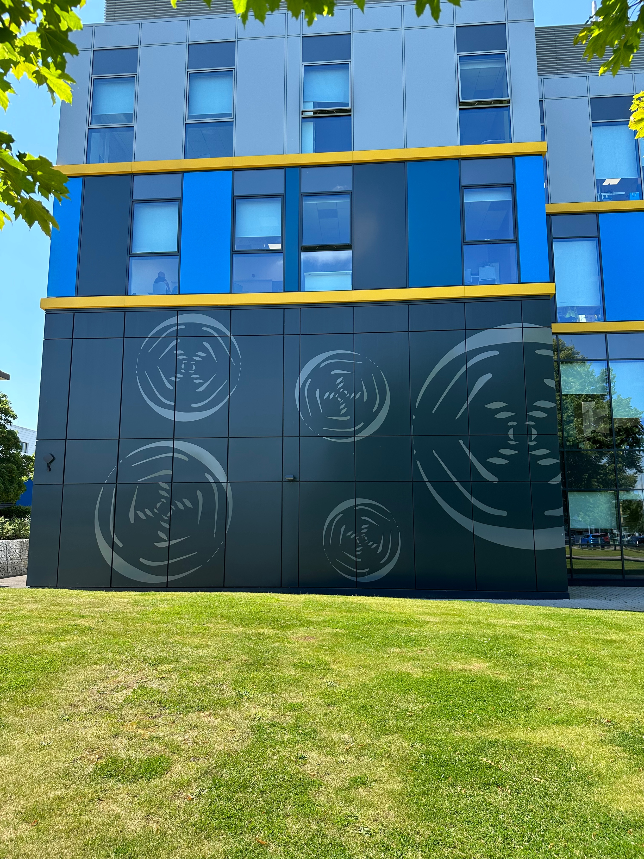
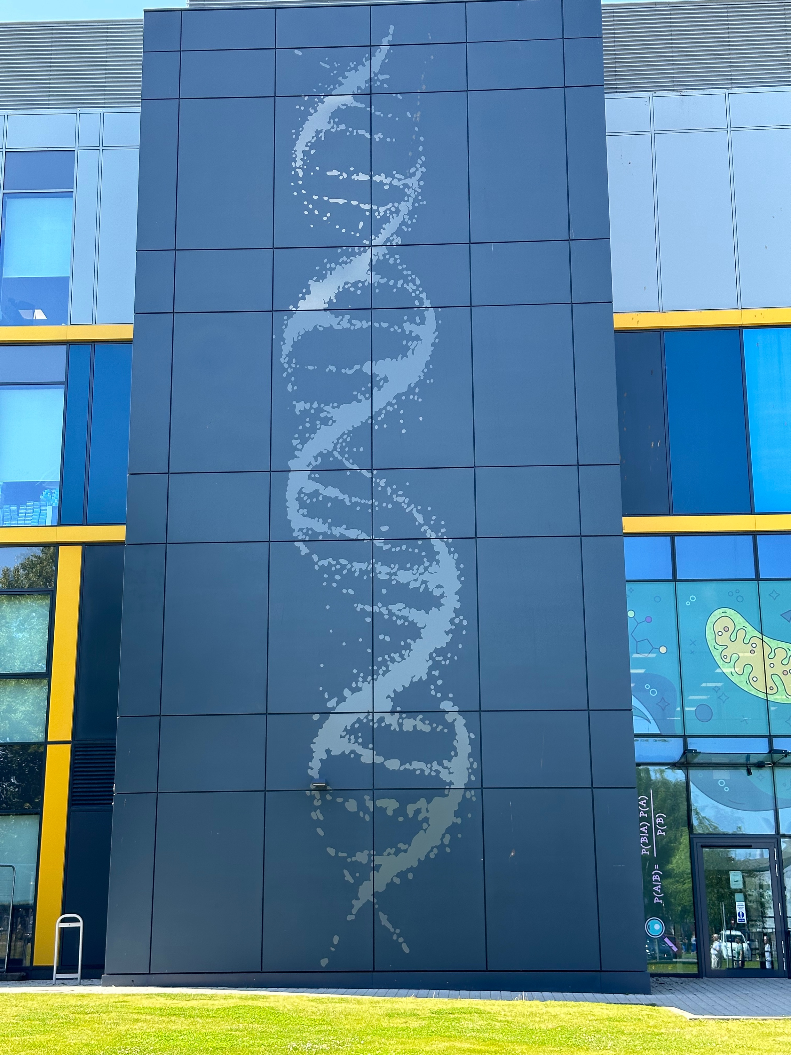
Rosalind Franklin Institute
Rutherford Appleton Laboratory
Didcot, Oxfordshire, UK

Slide 42
Looking at everything while looking at something an Introduction to Small-Angle Neutron Scattering
NIST Center for Neutron Research
Ryan P. Murphy

