Slide 1


Neutron reflectometry of floating lipid bilayers
NIST Center for Neutron Research
CHRNS Neutron School 2024

Slide 2
What are floating bilayers?
Zwitterionic bilayers typically separate 15-20 Å from the nearest surface
Under a narrow range of conditions, they “float” with 40-60 Å separation
Reported based on
  Phase transitions
  Changes in ionic strength

Slide 3
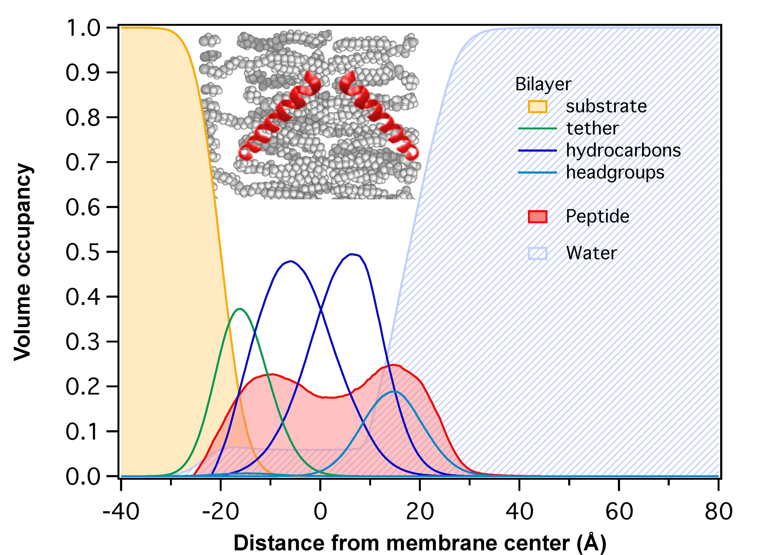
Why are floating bilayers useful?
Therapeutically relevant µM peptide concentrations
How do we distinguish surface association from membrane association?
What about large proteins that stick out of the membrane?
Membrane thickness
Surface peptide
Embedded peptide
Membrane integrity (water content)
Translocated peptide

Slide 4
Solvent-exchange technique

Slide 5
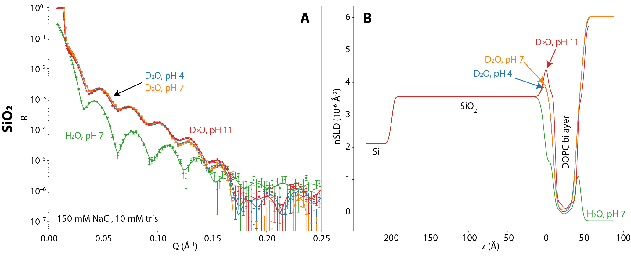
Neutron reflectometry of bilayers on SiO₂

Slide 6
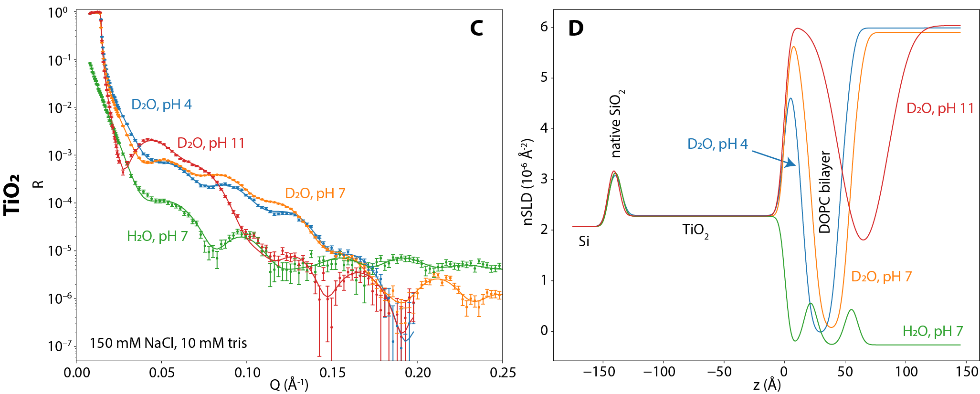
Neutron reflectometry of bilayers on TiO₂

Slide 7
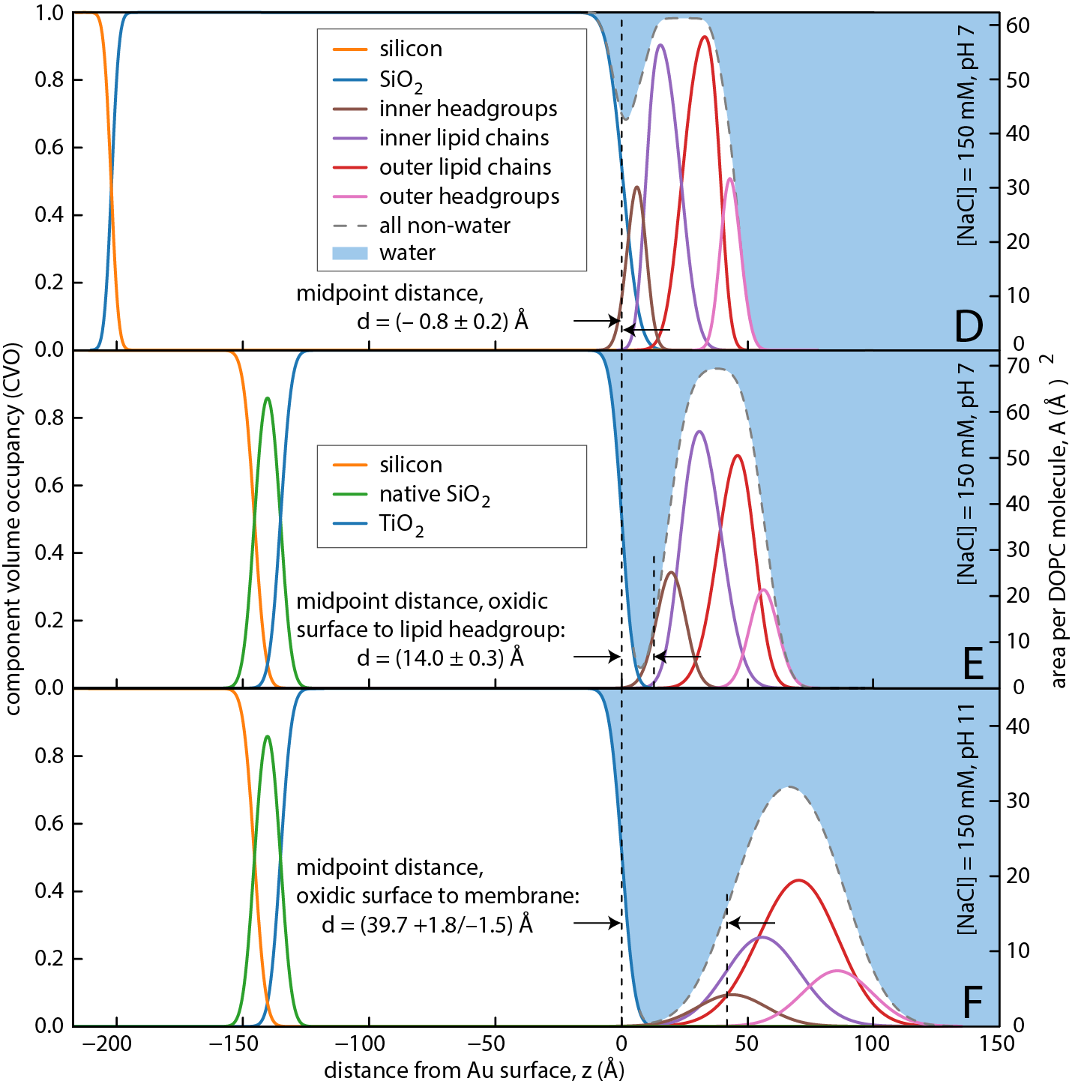
SALB bilayer results
SiO₂: bilayer adheres strongly deforming headgroups
TiO₂ @ pH 7: relatively undistorted bilayer (area per lipid canonical)
TiO₂ @ pH 11: 40 Å separation from surface, large apparent “roughness”

Slide 8
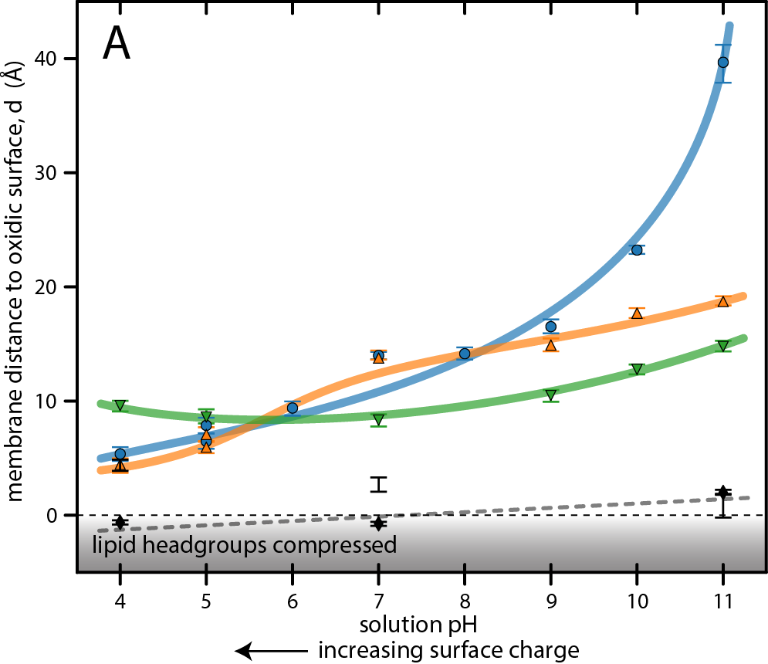
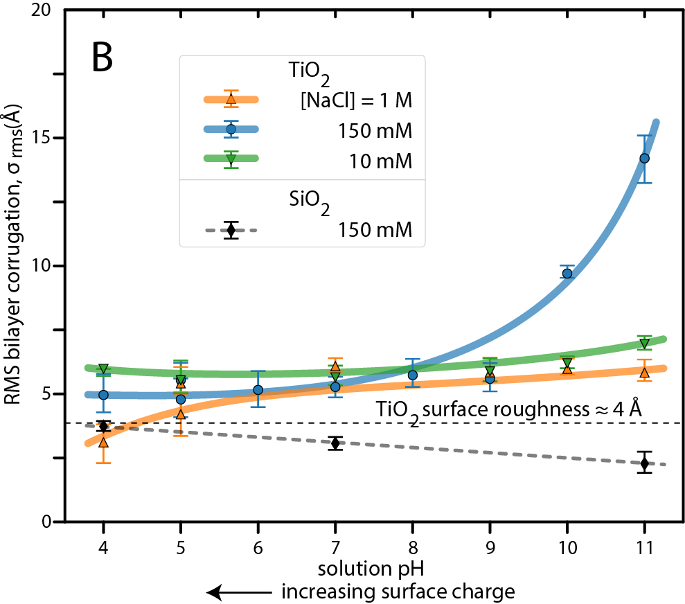
Systematic study

Slide 9
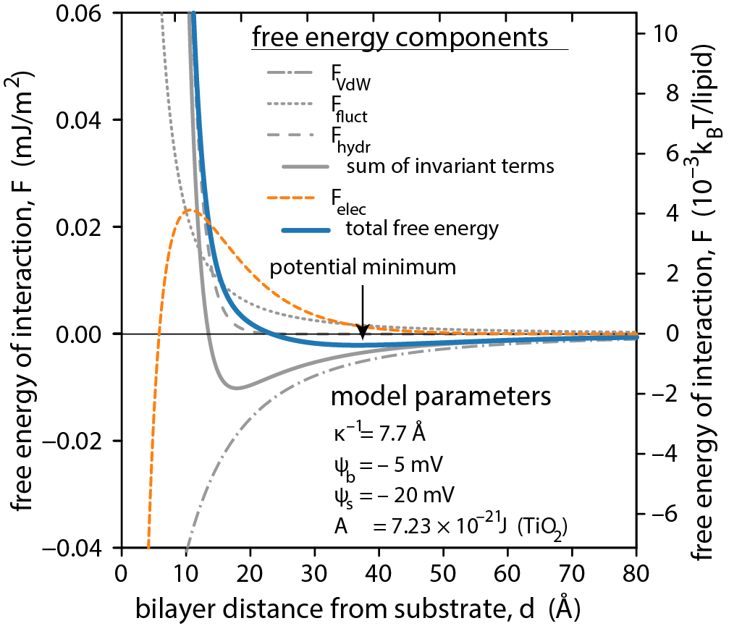
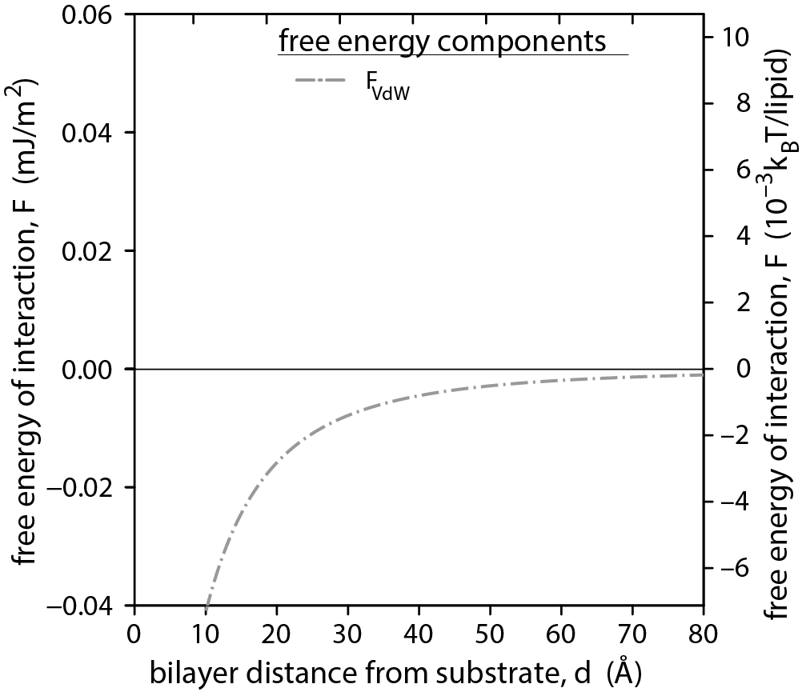
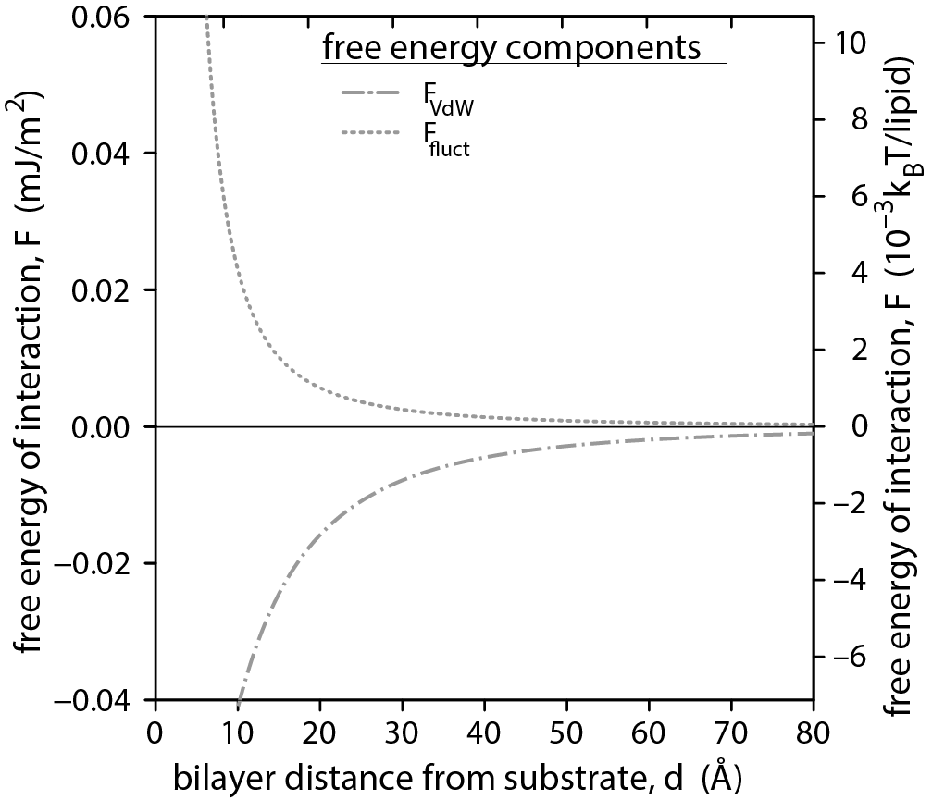
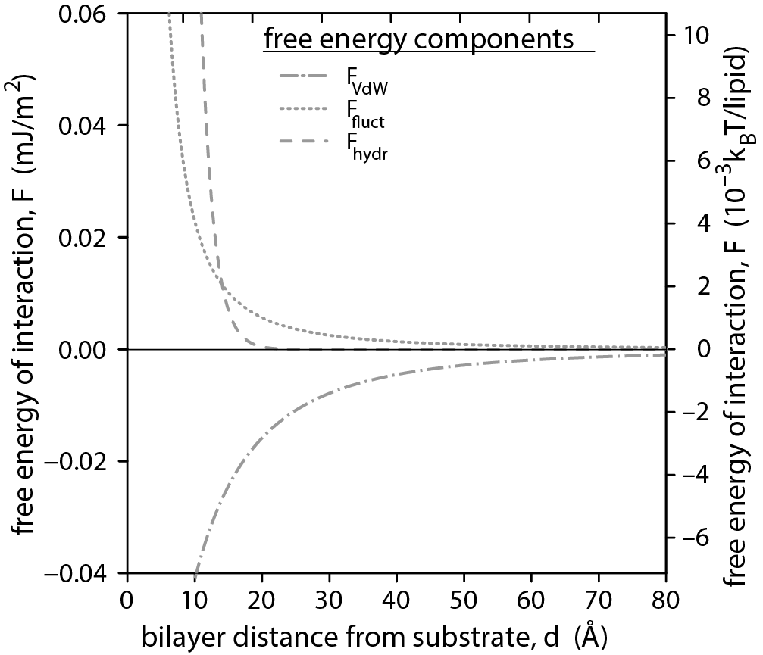
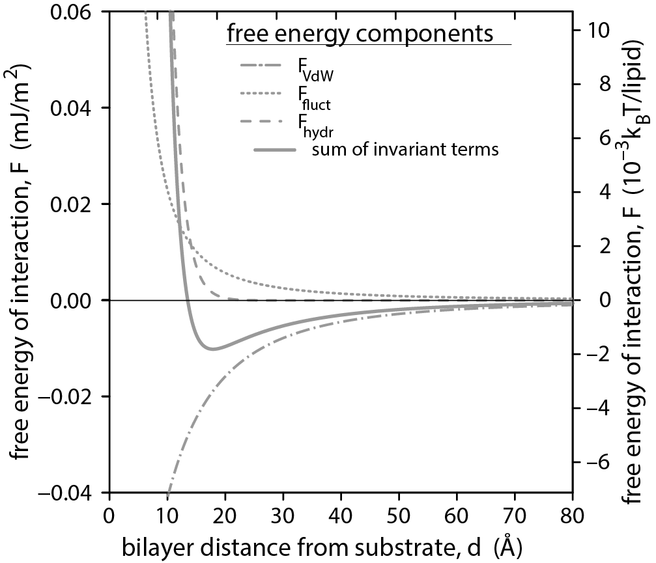
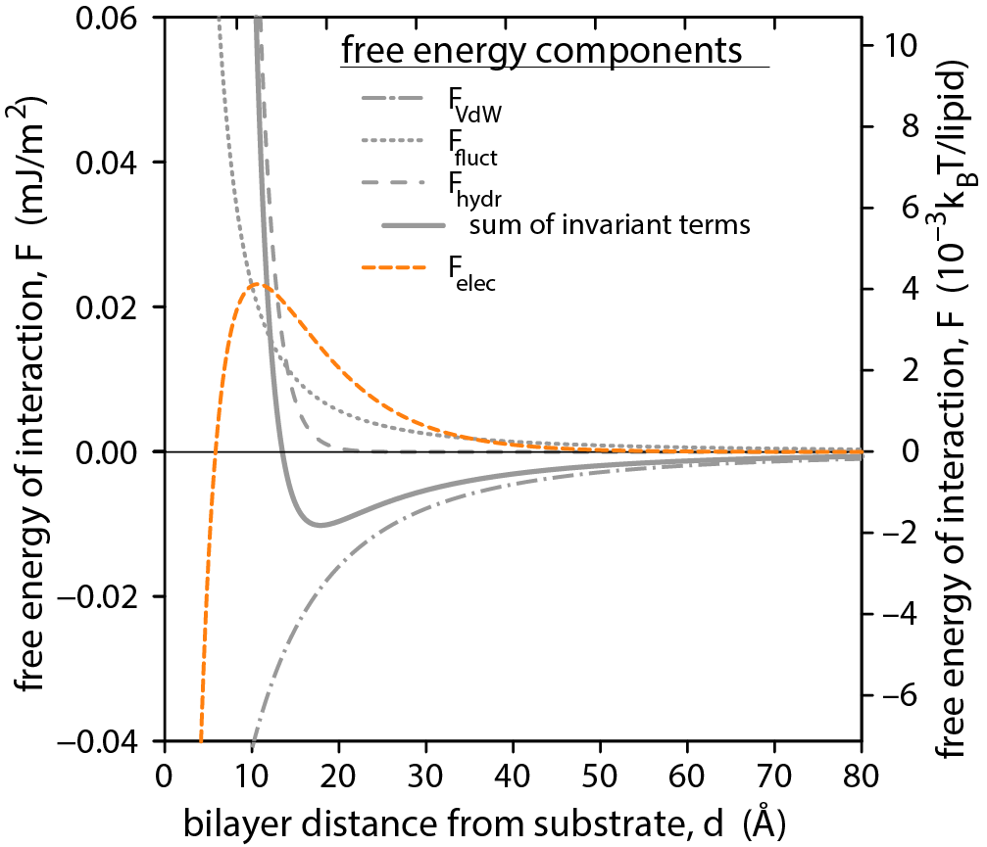

Theory of supported bilayers (DLVO-like)
Free energy terms
van der Waals
Steric/thermal undulation
Hydration/protrusion
Electrostatic
  Tunable via:
  pH / surface charge (magnitude)
  ionic strength (range)
“Invariant” length scale $≈18 Å$

Slide 10
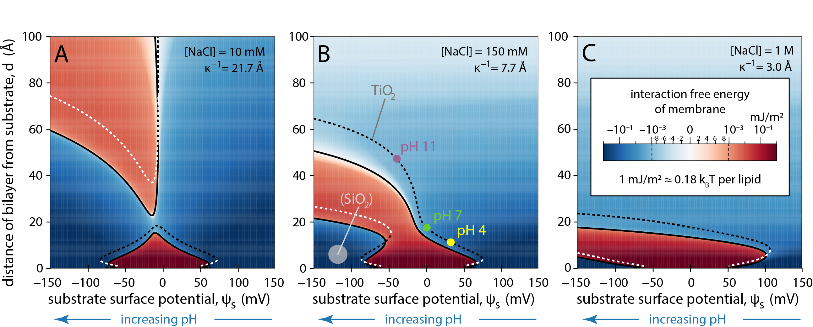

Calculation results
$$ψ_{b}=−5 mV$$
$$A_{132}\left({TiO}_{2}\right)=7.2×{10}^{−21} J$$

Slide 11
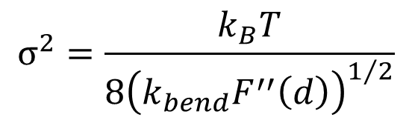
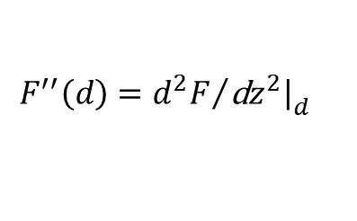
Comparison with experiment
$$σ^{2}=\frac{k_{B}T}{8{\left(k_{bend}F^{′′}\left(d\right)\right)}^{1/2}}$$
$$F^{′′}\left(d\right)={{d^{2}F}/{\left.\text{d}z^{2}\right|}}_{d}$$
No free parameters! (only best guesses)

Slide 12
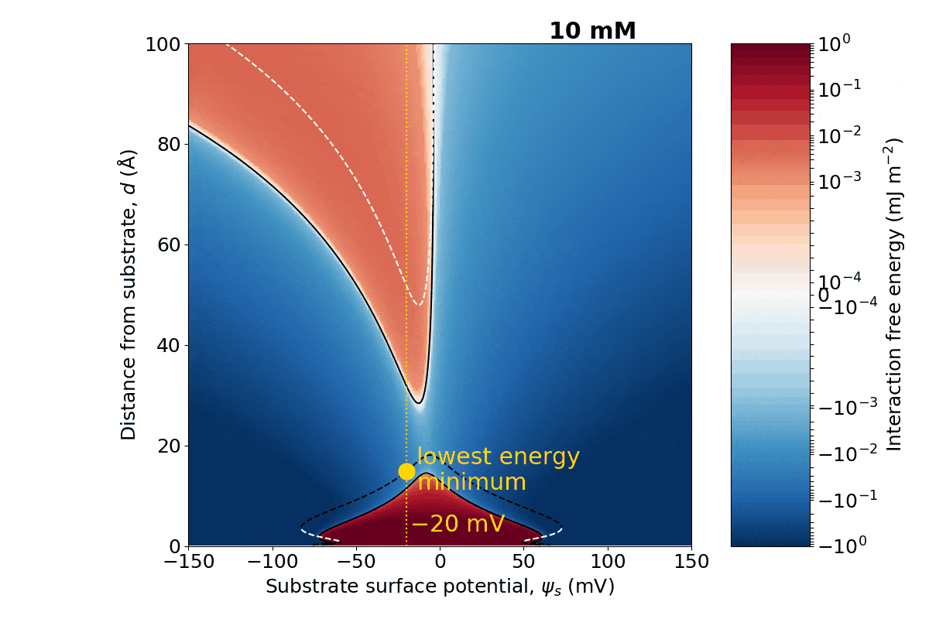
Summary
Floating bilayers are an electrostatic phenomenon
  Zwitterionic bilayers carry a small negative potential
  Balance of van der Waals, Helfrich, and electrostatic effects gives rise to instability
Major free energy components appear to be additive across nanometer length scales

Slide 13


Collaborators and resources
Mathias Lösche (Carnegie Mellon)
  Dennis Michalak
Acknowledgements
  Nanyang Technical U., Singapore: Nam Joon Cho, Joshua Jackman
  NIST: Megan Mitchell, Frank Heinrich, Eric Rus, Joe Dura, Elizabeth Kelley, Katie Weigandt, Steve Hudson
  CMU: Markus Deserno, John Nagle
Computational resources:
XSEDE (Darter Cray XC30, Bridges@PSC)

Slide 14
Aligning a sample

Slide 15
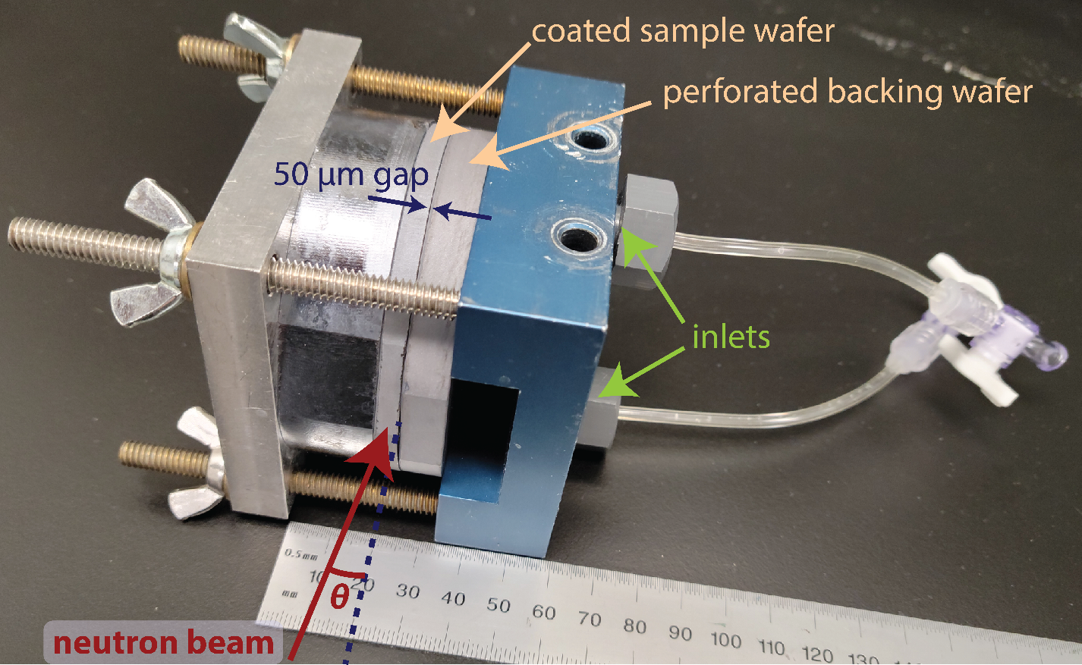
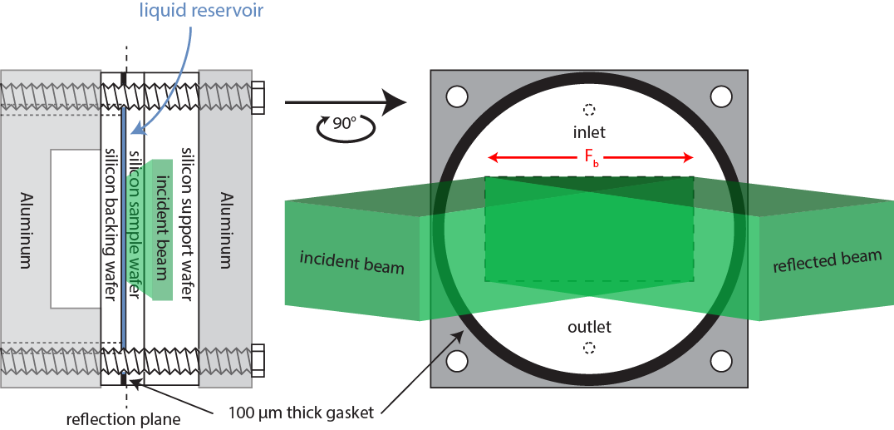
Liquid flow cells
Features:
  Beam only sees silicon and liquid reservoir
  0.4 mL volume for 0.1 mm gap
  Vacuum-tight
  Automated exchange with liquid handling system / syringe pumps

Slide 16
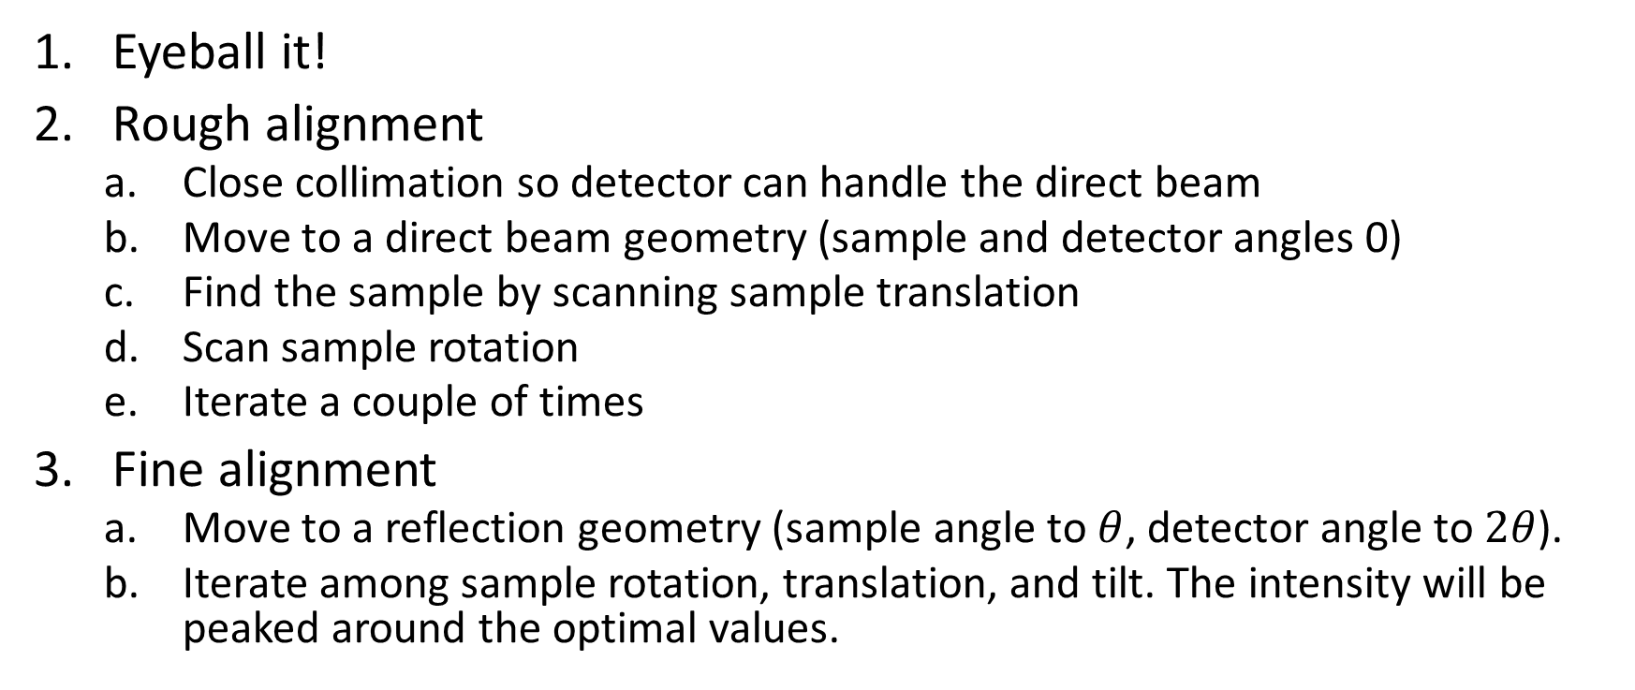
How to align a reflectometry sample
Eyeball it!
Rough alignment
  Close collimation so detector can handle the direct beam
  Move to a direct beam geometry (sample and detector angles 0)
  Find the sample by scanning sample translation
  Scan sample rotation
  Iterate a couple of times
Fine alignment
  Move to a reflection geometry (sample angle to $θ$, detector angle to $2θ$).
  Iterate among sample rotation, translation, and tilt. The intensity will be peaked around the optimal values.
Notes:
I’ll talk briefly here about how to align a reflectometry sample. It’s pretty straightforward. There are three major steps, each of which aligns the sample on a slightly finer scale. The first one is easy: look at it! Typically you can get the sample rotation to within a few degrees and the sample translation within one to two millimeters by doing this. For the second step, we’re going to see how the sample blocks the beam—I’ll discuss this in the next slide. For this we align the detector with the beam, after making sure our beam isn’t too intense for the detector to handle. Then we scan the sample perpendicular to the beam until it blocks it; then we’ll scan the rotation to make sure the beam is skimming right along the surface. Maybe go back and forth a couple of times, and then we’re ready for fine alignment. For fine alignment, we move to a reflection geometry so the detector is looking at the reflected beam. Any misalignment causes a loss of intensity, so we just scan the angles and translations until the intensity is maximized, and that’s it!

Slide 17
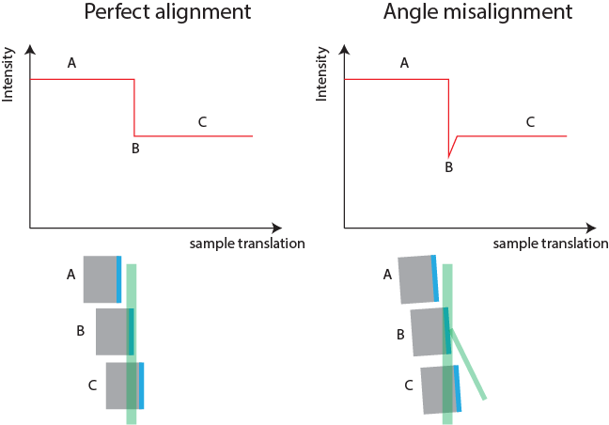
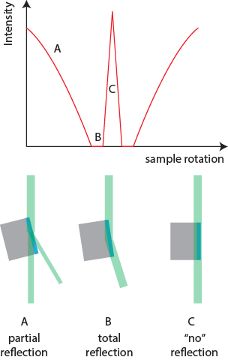
Direct beam alignment
Sample translation
Sample rotation
Notes:
Let’s discuss in a little more detail how to do the rough, direct-beam alignment. Initially you don’t know exactly where your film of interest, shown here in blue is. So we’re going to scan the sample across the beam and look for a dip in intensity where the sample starts to attenuate the beam. If the sample rotation were perfectly aligned, and you had an infinitely thin beam, you’d see the profile on the left. But normally you’ll see something like the right, where the sample rotation is misaligned with the beam and so as it moves into the beam it reflects some of the beam away, causing an even bigger dip.
The sample rotation scan has an interesting shape too. In these pictures the beam is traveling top to bottom; imagine the detector at the bottom where the labels are. If the sample is very misaligned, shown here by the letter A, only a little of the beam is reflected and most of the full beam intensity hits the detector. If the sample is only a little misaligned, as in B, the reflectivity is higher and can even be total, so that no intensity gets to the detector at all. At good alignment, shown in C, the beam skims the top of the surface and typically doesn’t reflect much at all.
Once you’re at point B on the left, and point C on the right, you’re ready to go to a reflection geometry and continue with fine alignment.

Slide 18
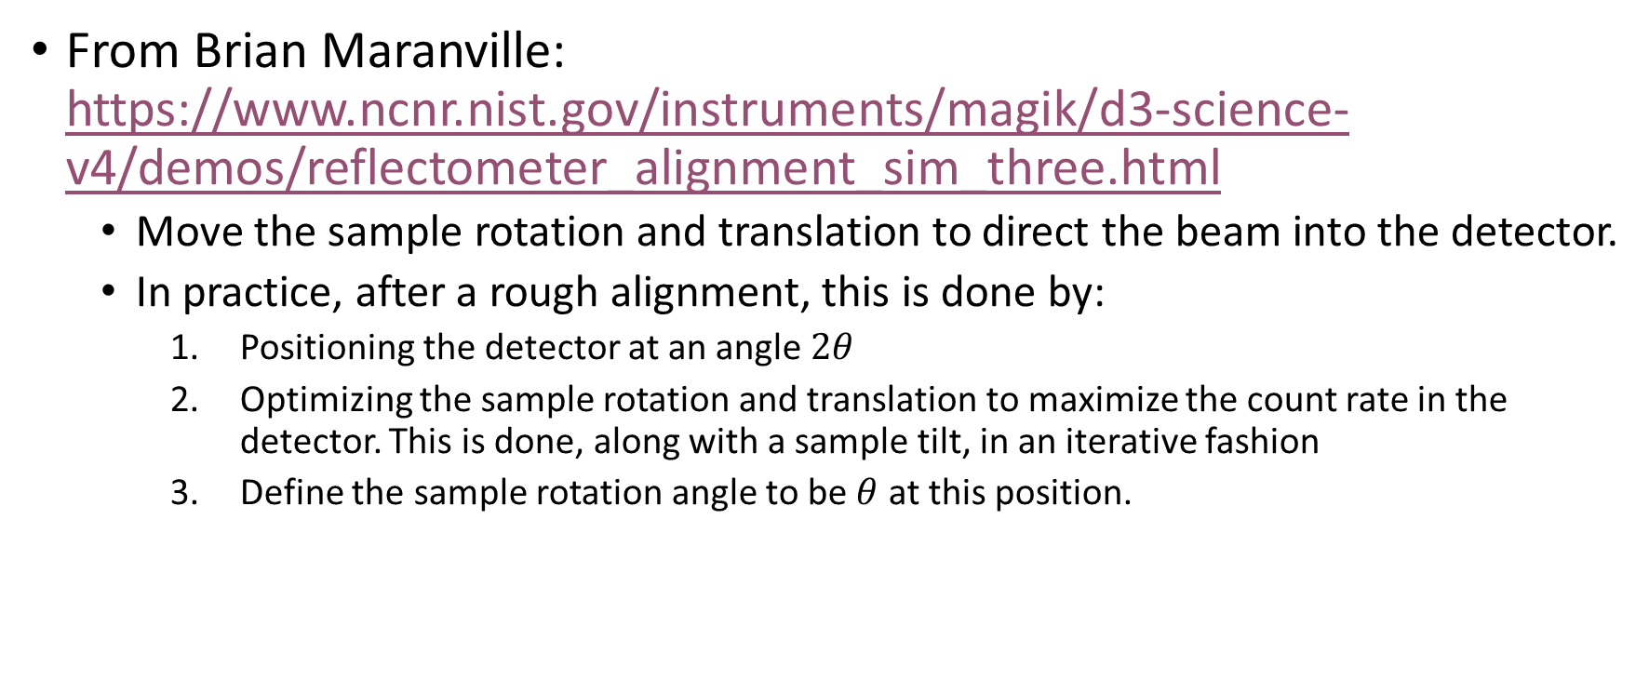
Sample alignment video game
From Brian Maranville: https://www.ncnr.nist.gov/instruments/magik/d3-science-v4/demos/reflectometer_alignment_sim_three.html
  Move the sample rotation and translation to direct the beam into the detector.
  In practice, after a rough alignment, this is done by:
    Positioning the detector at an angle $2θ$
    Optimizing the sample rotation and translation to maximize the count rate in the detector. This is done, along with a sample tilt, in an iterative fashion
    Define the sample rotation angle to be $θ$ at this position.
Notes:
After the sample is mounted and the beam is turned on, you need to align your sample. This is done on three axes: the sample rotation relative to the beam (theta); the sample translation (to ensure the sample is rotating around the interface of interest; and a tilt motion (to make sure the beam ribbon is parallel to the sample surface).
My colleague Brian Maranville has written a fun and briefly addictive simulator for alignment. You can move the detector angle, the collimation, and the sample rotation and translation. Play around with it so you can see the conditions required for aligning the sample. Note that the probability that each neutron reflects is several orders of magnitude higher than it is in reality.
After your sample is aligned, you’re ready to go! Typically there are some preset measurement protocols, and the instrument control software will allow you to estimate how long they’ll take to make sure you can fit your experiment into your allotted beam time. Your instrument scientist can introduce you to these protocols when you’re ready to begin measurement.
Thanks for your attention, and good luck doing neutron reflectometry!

Slide 19
Data collection and reduction

Slide 20
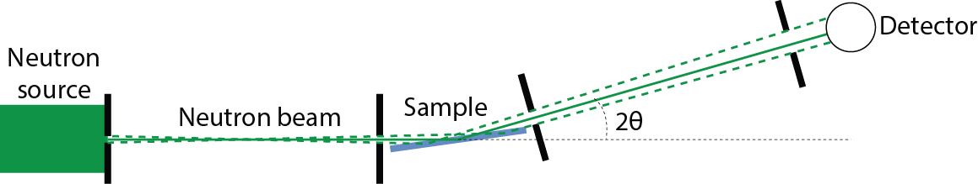
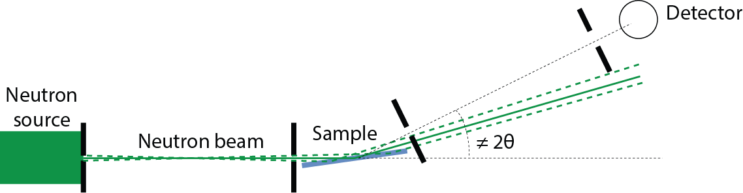

Terms
Specular reflection: sample is at an angle $θ$ relative to the incident beam, and detector is rotated to an angle $2θ$
Offspecular: not specular

Slide 21
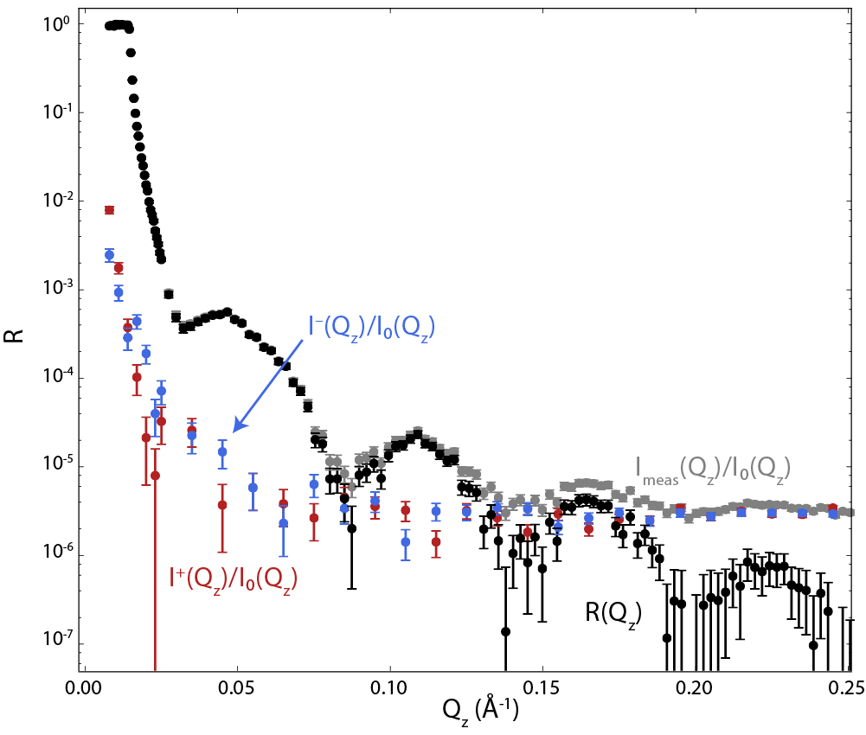

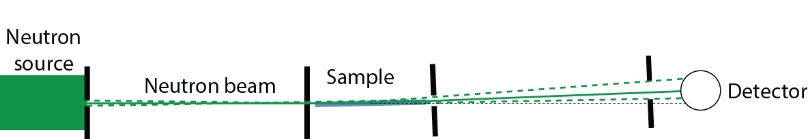

The basic experiment
Measure specular reflection $I_{meas}\left(Q\right)$

Slide 22

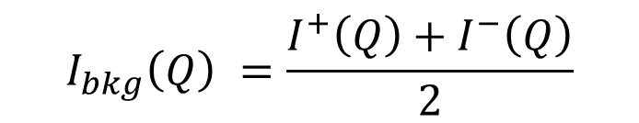
The basic experiment
Measure specular reflection $I_{meas}\left(Q\right)$
Measure background at offspecular positions
$$I_{bkg}\left(Q\right) =\frac{I^{+}\left(Q\right)+I^{−}\left(Q\right)}{2}$$

Slide 23
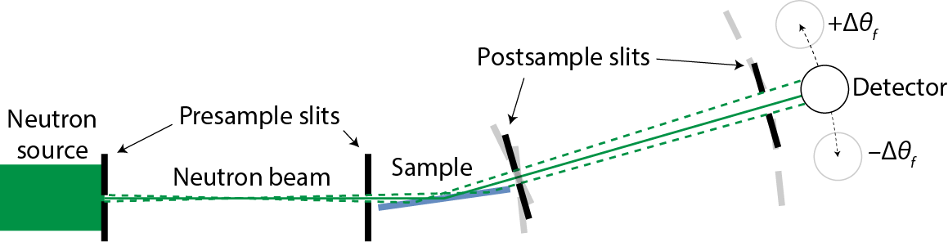
How to measure background
Move detector or sample to offspecular positions that bracket the specular condition
Interpolate to estimate background under the specular signal (discussed further in data reduction module)
Gains no more than a factor of 10 in reflectivity
Notes:
Background is typically assumed to be a smooth field that changes linearly in space. The animation shows isotropic background scattering. In this case, or if the background field changes linearly, you can simply move the detector (or the sample) so the beam isn’t going into the detector. Measure on both sides of the specular reflection condition, and then interpolate the result. This will be discussed further in the data reduction module.
This doesn’t typically give you more than a factor of 10 in reflectivity, and it increases the error bars, so it’s better to think about background before the experiment than to try to measure it and subtract it later.

Slide 24
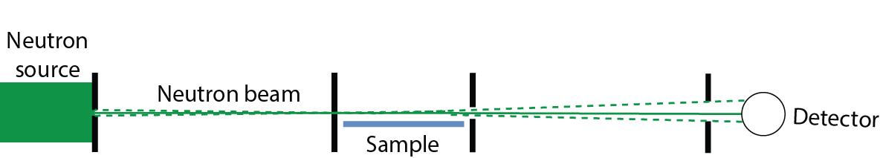
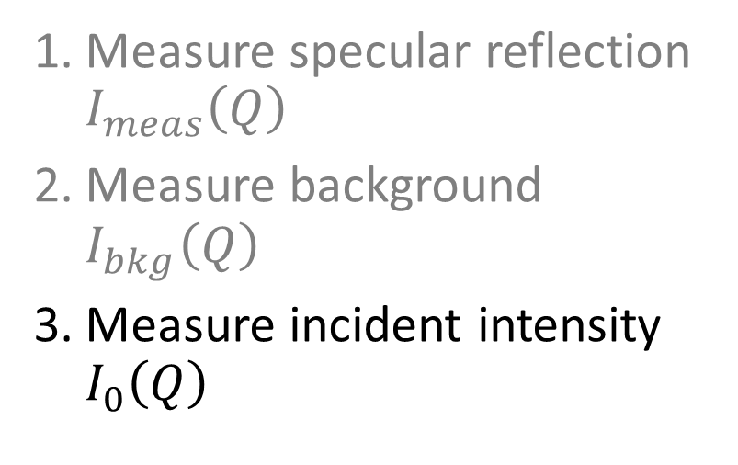
The basic experiment
Measure specular reflection $I_{meas}\left(Q\right)$
Measure background $I_{bkg}\left(Q\right)$
Measure incident intensity $I_{0}\left(Q\right)$

Slide 25
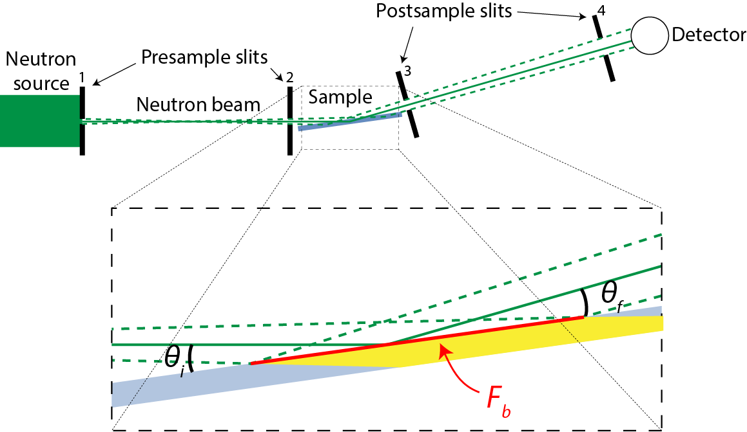
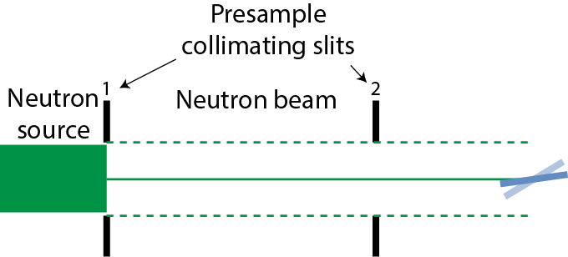
Effect of sample size
Large samples
  constant footprint
  intensity changes with angle
Small samples
  constant beam size
  beam footprint changes with angle
Notes:
Finally, let’s talk about sample size. For the large samples typically used in soft matter and biology applications, where the beam profile is smaller than the sample, the area of the sample that’s illuminated by the beam, or “footprint”, is shown here as the red line, and it changes with angle. As the sample rotates to higher angles, the area decreases. Typically this is compensated by opening the pre-sample slits in such a way that the beam footprint stays constant. This has the advantage of also increasing the beam intensity at higher Q, at the cost of some angular resolution.
For small samples, such as those typically used in magnetism studies (after all, they have to fit inside magnets and cryostats), the opposite is true. The beam is larger than the sample. In this case the fraction of the beam seen by the sample, or the incident intensity, changes with angle, and this has to be corrected for in data reduction.

Slide 26
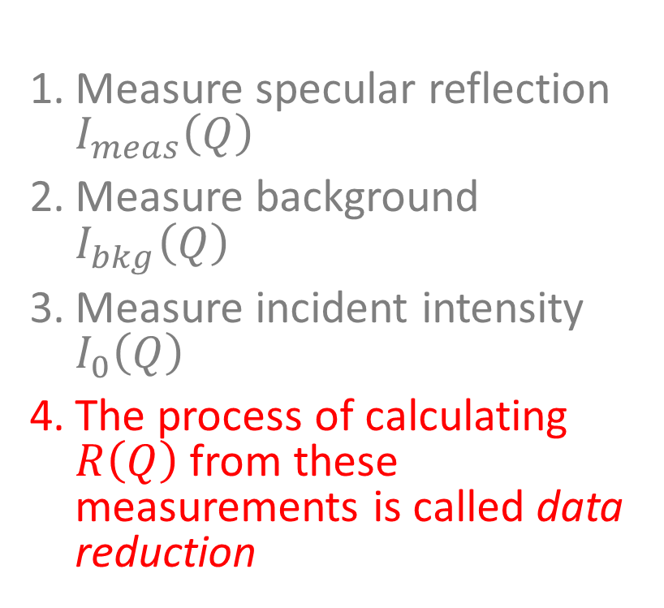
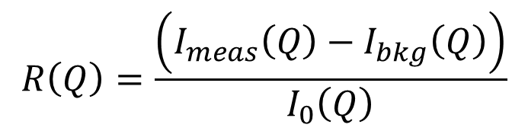
The basic experiment
Measure specular reflection $I_{meas}\left(Q\right)$
Measure background $I_{bkg}\left(Q\right)$
Measure incident intensity $I_{0}\left(Q\right)$
The process of calculating $R\left(Q\right)$ from these measurements is called data reduction
$$R\left(Q\right)=\frac{\left(I_{meas}\left(Q\right)−I_{bkg}\left(Q\right)\right)}{I_{0}\left(Q\right)}$$

Slide 27
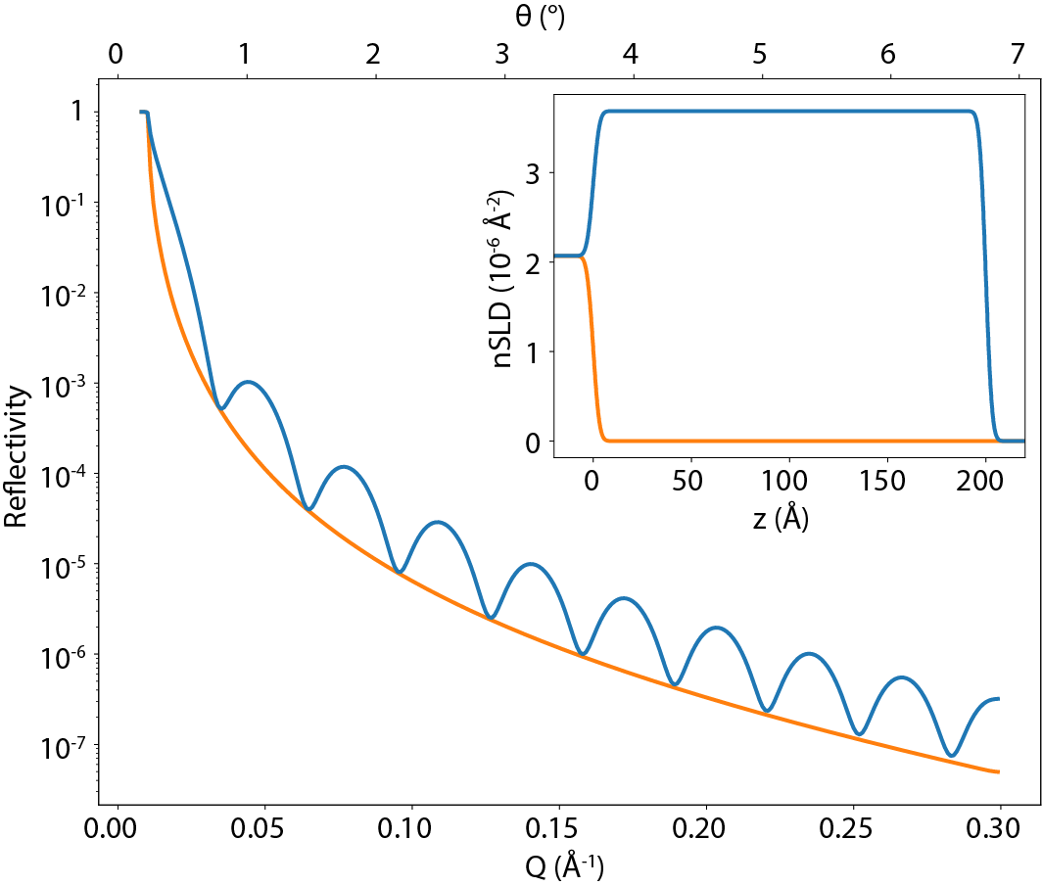
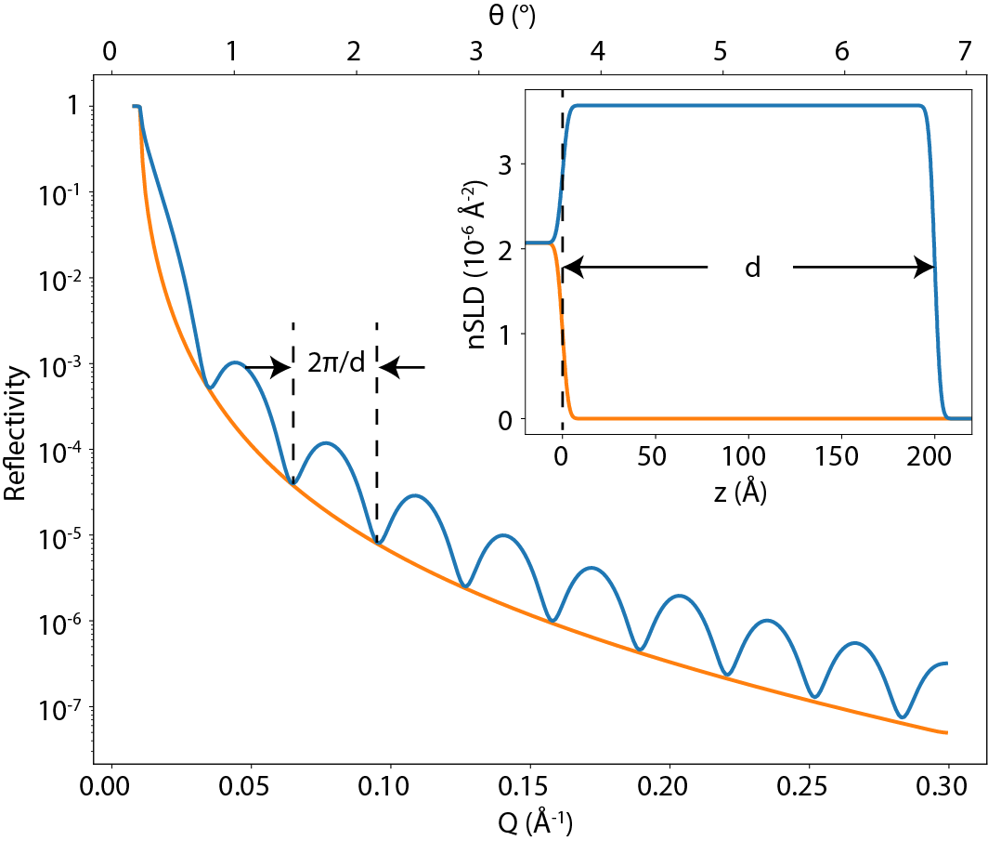
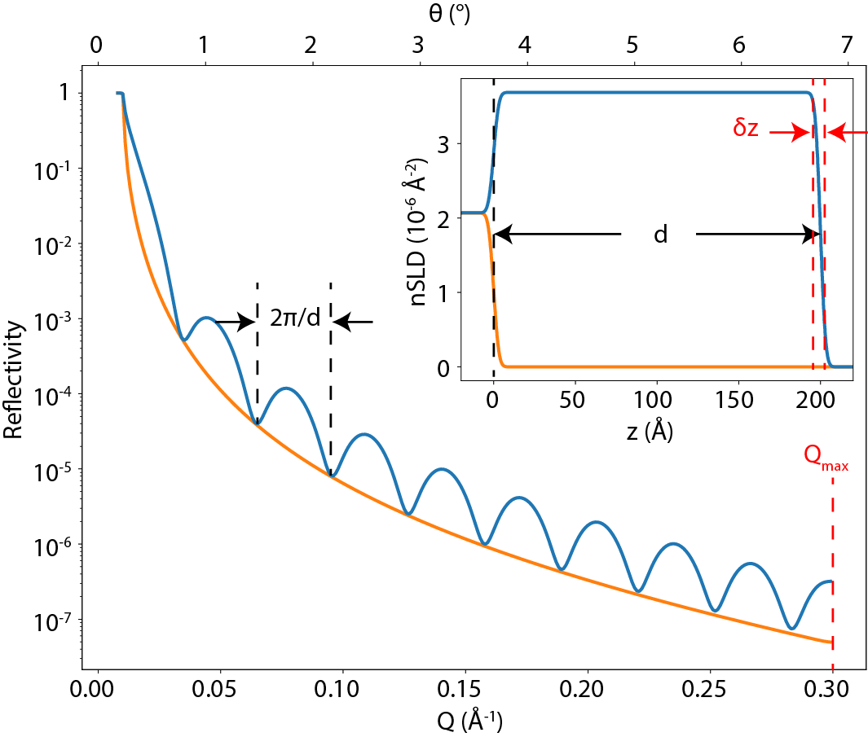
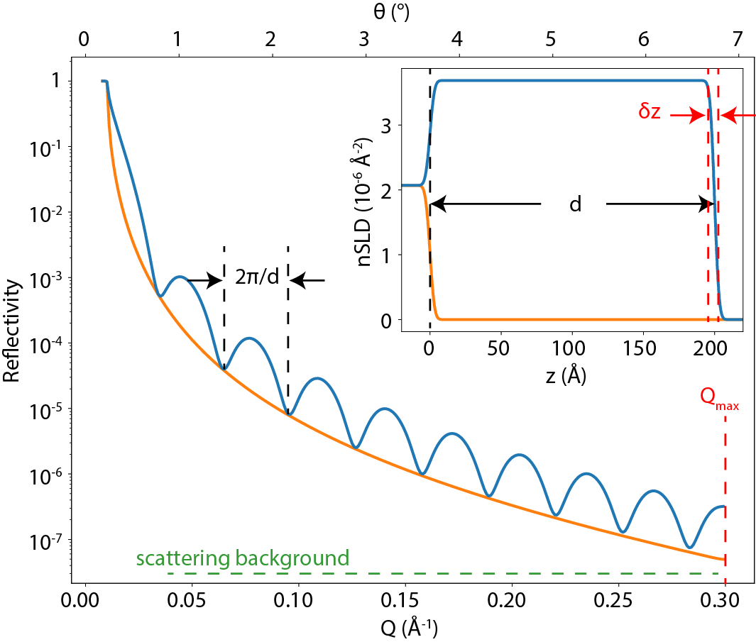
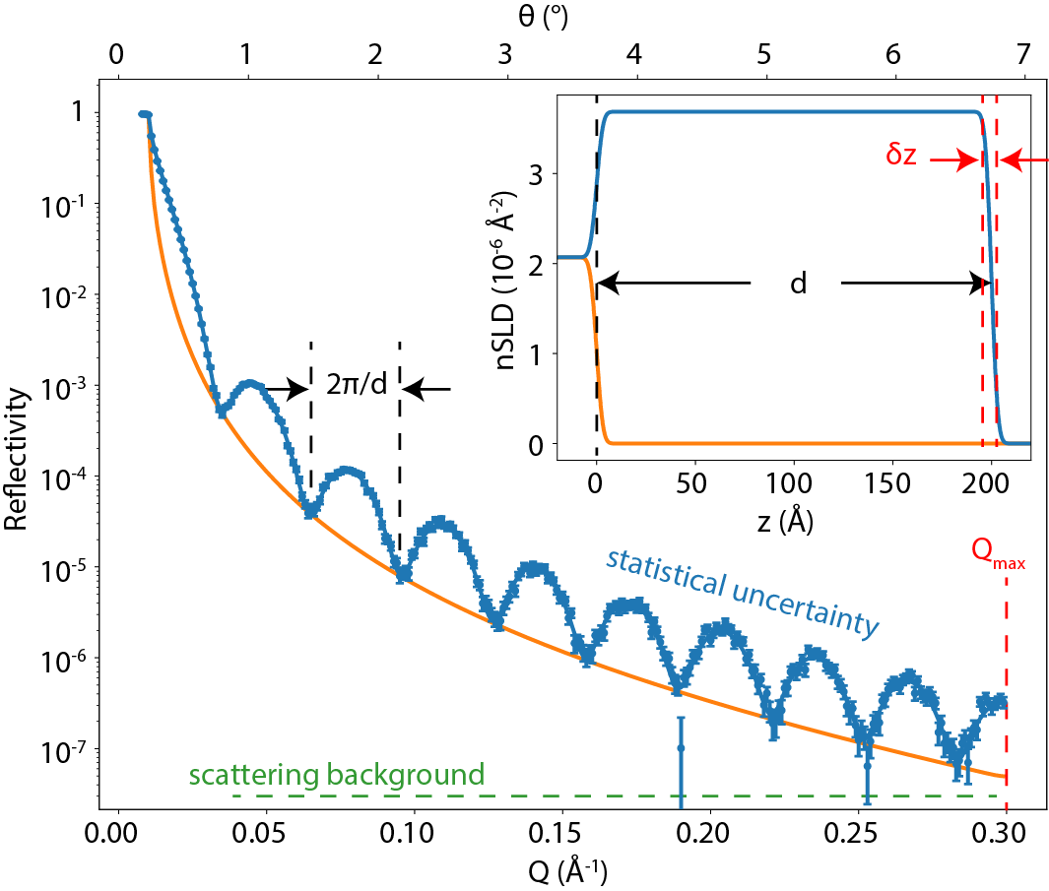
Elements of a reflectivity curve
oscillation period ⬄ film thickness
maximum Q ⬄ real space resolution
Scattering background ⬄ max Q
Statistics ⬄ parameter uncertainty
Notes:
Let’s look a little more closely at the reflectivity pattern for our model thin film. While you can’t usually tell much about your sample from inspection of the curve, it’s important to know how the various film parameters affect it.
First, the period of the wiggles in the reflectivity pattern in Q-space is inversely related to the film thickness. So thicker films give tighter wiggles, and vice versa.
Second, the maximum Q value that you can observe in your experiment is the limit of the real space resolution that you can see. Other things can affect this resolution too, but this is a hard limit (it’s related to the Nyquist theorem).
Third, the scattering background interferes with signals at high Q. As we’ll see, this can limit the maximum Q value that can be observed, or, in the case of magnetic measurements, increase error bars on small magnetic splitting signals.
Fourth, the statistics of the measurement are directly related to the parameter uncertainty. A longer counting time gives you better statistics, but improvement in experimental parameters generally goes as the square root of the counting time, so it’s better to have a bigger signal than to count longer.

Slide 28
Modeling

Slide 29

Slab models (Refl1D Model Builder)
In-plane homogeneity: each slab has a uniform SLD ($ρ$), a thickness, and an interfacial roughness with the next slab
substrate
“slabs”
medium
silicon, sapphire
air, vacuum, buffer

Slide 30
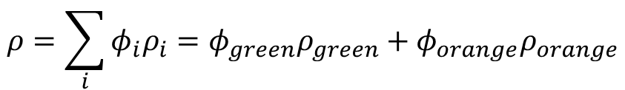

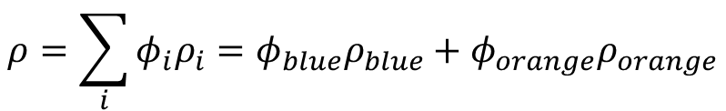
Volume fraction slabs (Refl1D scripts)
$ρ$ of a heterogeneous slab is represented by volume fractions $φ_{i}$ of individual materials ($ρ_{i}$), such that $\sum{φ_{i}}=1$.
substrate
“slabs”
medium
substrate
“slabs”
medium
or
silicon, sapphire
air, vacuum, buffer
silicon, sapphire
air, vacuum, buffer
$$ρ=\sum_{i}{φ_{i}ρ_{i}}=φ_{green}ρ_{green}+φ_{orange}ρ_{orange}$$
$$ρ=\sum_{i}{φ_{i}ρ_{i}}=φ_{blue}ρ_{blue}+φ_{orange}ρ_{orange}$$

Slide 31

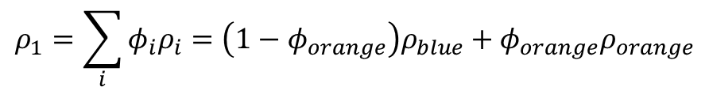
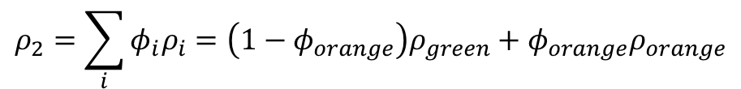
Contrast variation
“Matching” conditions don’t give as much information unless multiple contrasts used
substrate
“slabs”
medium
substrate
“slabs”
medium
substrate
“slabs”
medium
silicon, sapphire
buffer
silicon, sapphire
buffer with “matching” deuteration level
silicon, sapphire
buffer with different deuteration level
$$ρ=ρ_{orange}$$
$$ρ_{1}=\sum_{i}{φ_{i}ρ_{i}}=\left(1−φ_{orange}\right)ρ_{blue}+φ_{orange}ρ_{orange}$$
$$ρ_{2}=\sum_{i}{φ_{i}ρ_{i}}=\left(1−φ_{orange}\right)ρ_{green}+φ_{orange}ρ_{orange}$$
With any two data sets of known $ρ_{buffer}$, can determine $ρ_{orange}$ and $φ_{orange}$: what it is and how much

Slide 32
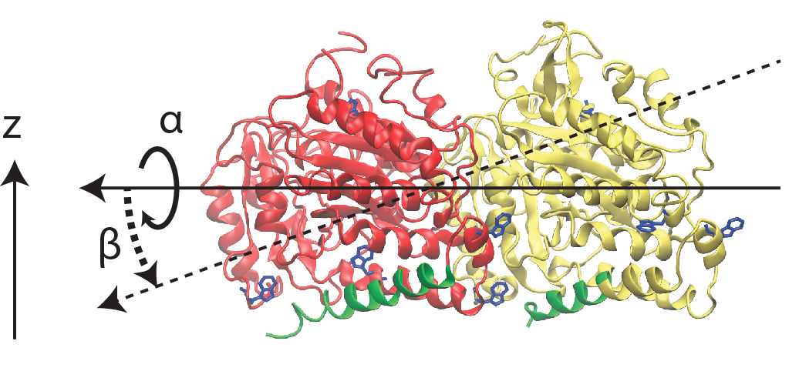
Advanced modeling
Python script is a program; can be arbitrarily complex and use other packages (e.g. MDAnalysis). Generates an SLD profile that is essentially a collection of tiny slabs
Example: tubulin
missing residues!

Slide 33

Modeling tubulin orientation
Apparent thickness of protein “film” on or in bilayer reveals protein orientation

Slide 34

Composition space model

Slide 35


Molgroups: a Refl1D plugin for biomolecules
Bilayers and proteins defined in a few lines of code
Intricate logic (rotations of a PDB file and connections of missing residues)
Arbitrarily complex bilayer/protein complexes (multiple bilayers, multiple proteins)

Slide 36
Contacts
David Hoogerheide: david.hoogerheide@nist.gov
Megan Mitchell: megan.mitchell@nist.gov
Frank Heinrich: frank.heinrich@nist.gov

