Slide 1
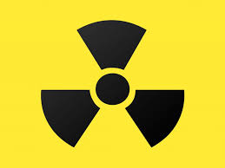
Health Physics An Introduction
Dr. Steven Dewey
Chief, Health Physics

Slide 2
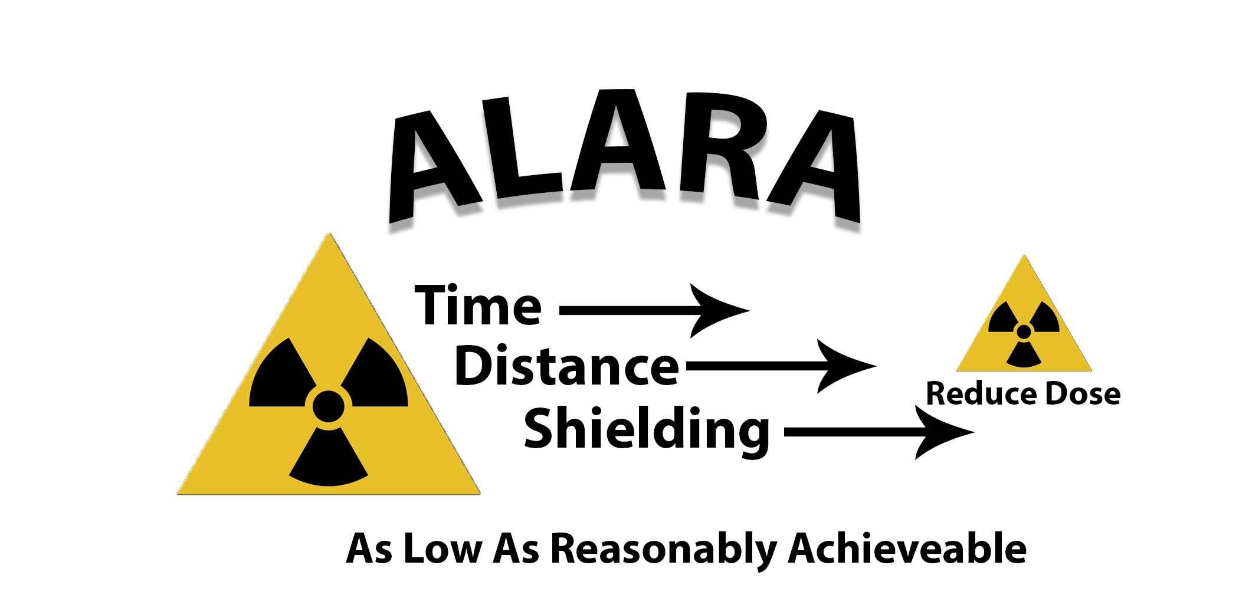
What do we do?
RADIATION SAFETY

Slide 3
Health Physics
Radiation Safety Training
Risks of radiation exposure
How to use radiation meters
How to work safely with radiation
Requirements and procedures at the NCNR
Monitor radiation exposures
Surveys throughout the building
Monitor individuals' exposure
Monitor releases to the environment

Slide 4
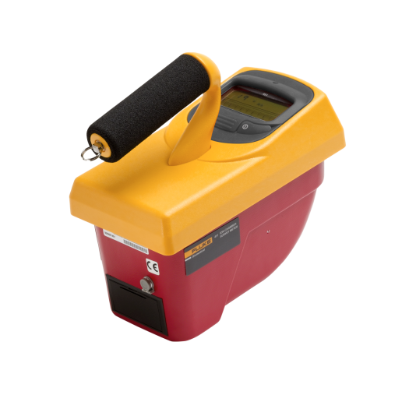
Health Physics
Maintain radiation monitors
Monitor reactor and instrument stations – for radiation concerns
Monitor work with increased radiation risks
Manage radioactive waste
Review new work and develop controls
Monitor contamination throughout the facility
Response to radiological emergencies

Slide 5
The HP Team
One team Chief
Five Health Physicists
One Health Technician Supervisor
Five Health Physics Technicians (two vacancies)

Slide 6
Safety Principles
We want you to understand the risks you are exposed to
Important that you understand how to protect yourself
ALARA – As Low As Reasonably Achievable
Provide you with a safe working environment
Safety Culture is our driving principle
Ask questions! If you don’t understand ask
If something does look, sound, or feel right? Stop ASK
Take personal responsibility for your safety

Slide 7
What can you expect if/when you return?
Training
Online training on radiation safety
What are the risks associated with radiation exposure?
What are the regulatory exposure limits?
What are the requirements at the NCNR
An in-person radiation safety tour of the building
1-2 hours of all the radiation safety features, requirements, and procedures at the NCNR
Hands on Classroom Training
A 1 hour hands on training on using instruments, dosimetry, etc

Slide 8
What can you expect?
Assignment of a radiation dosimeter
Help receiving your samples (if they are radioactive)
Help shipping your samples
Are radioactive after your analysis?
Answer your questions
Respond if you have a spill/incident involving radiation

Slide 9
QUESTIONS?
Steven Dewey, CHP, PhD
Chief, NCNR Health Physics
301-975-5810
Steven.Dewey@nist.gov

