Slide 1
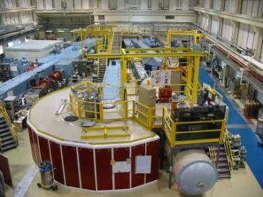
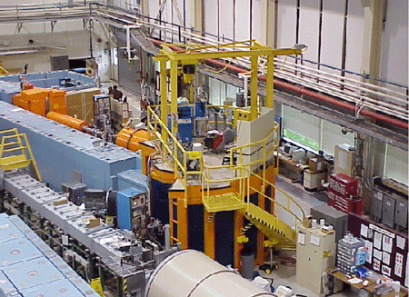
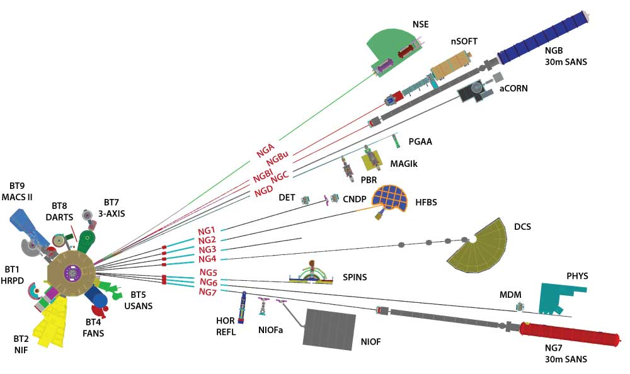
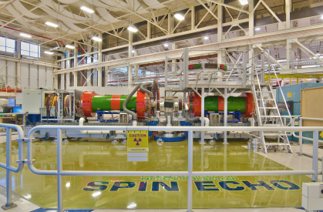
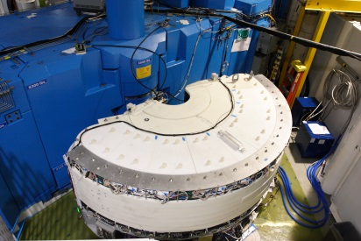
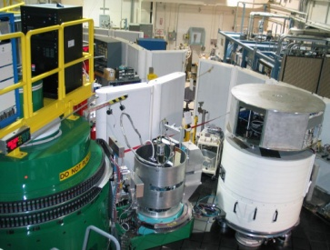

Choosing the Right Spectrometer
Guangyong Xu
NIST Center for Neutron Research
Thanks to Peter Gehring, Jeff Lynn, Dan Neumann, and Jim Ryhne for preparing many of the slides

Slide 2

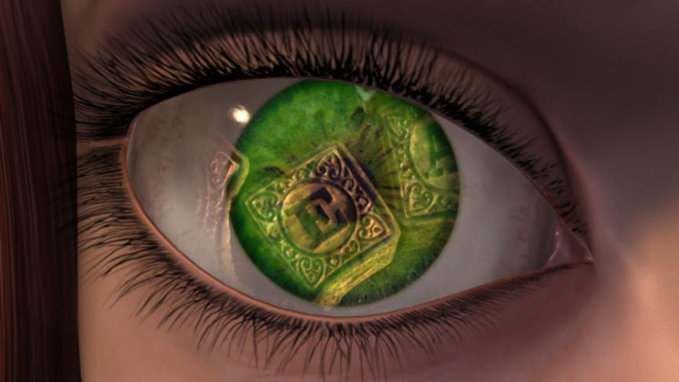

How do we “see”?
We see something when light scatters from it.
Thus scattering conveys information!
Light is composed of electromagnetic waves.
λ ~ 4000 A – 7000 A
However, the details of what we see are ultimately limited by the wavelength.

Slide 3
How do we “see” atomic structures?
we require a probe with the wavelength λ ~ length-scale of interest (angstroms, i.e. 10⁻¹⁰ m), as well as having the correct energy scale (meV).
X-rays
EM - wave
Some candidates …
Electrons
Charged particle
Neutrons
Neutral particle

Slide 4
Some Useful Formulas

Slide 5


How do we study lattice structure/vibrations
Let´s test the net ...
...the principle of scattering experiments

Slide 6
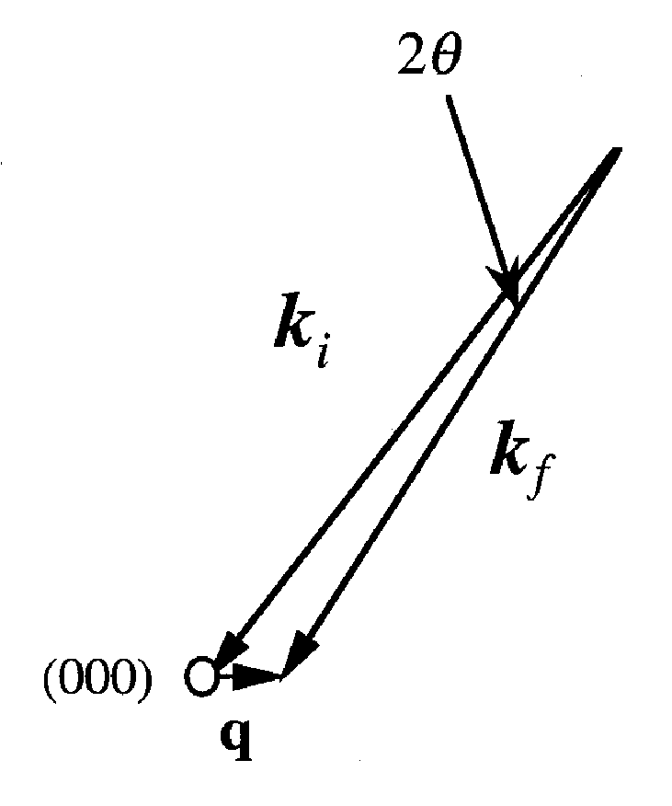
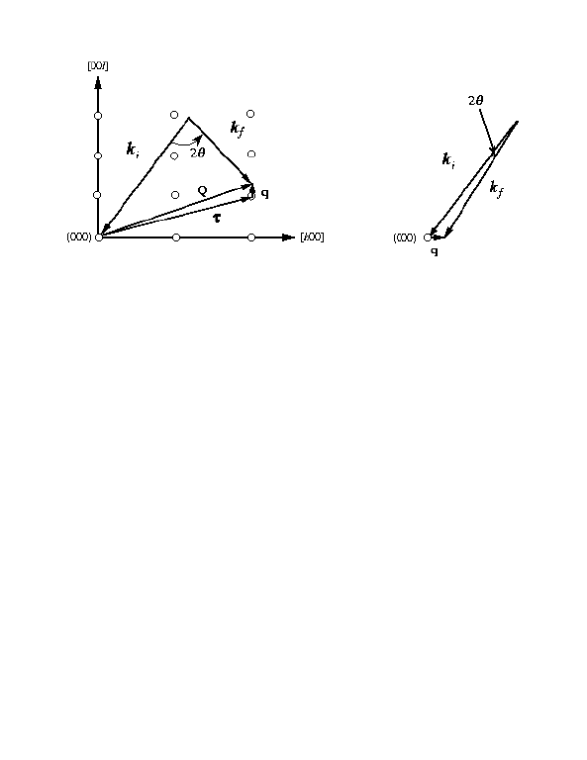
Conservation of Momentum and Energy

Slide 7
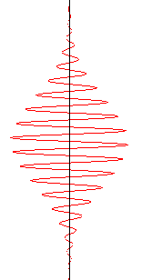
Scattering measurements
Fourier transformation
Space-time (r,t)
Energy-momentum (Q, hw)
Real space
Q-space
Time space
ω-space
Φ_{s}
Φ_{s}
ξ
T
Γ
~1/ξ
~1/Γ
Q
ω
2π/d
2π/T
Bragg peak
time
d
Diffuse scattering
Elastic scattering – static structures
Inelastic scattering – dynamics

Slide 8
Review: Main Messages of the Week
(1) Neutron scattering experiments measure the flux of neutrons scattered by a sample into a detector as a function of the change in neutron wave vector (Q) and energy (hω).
Φ(Q,hω) =
neutrons
Momentum
Energy
sec–cm²
hk_{n} = h(2π/λ_{n})
hω_{n} = h²k_{n}²/2m
hQ = hk_{i} - hk_{f}
hω = hω_{i} - hω_{f}
ϕ
(2) The expressions for the scattered neutron flux Φ depend on the positions and motions of atomic nuclei or unpaired electron spins.
Φ = f{r_{i}(t), r_{j}(t), S_{i}(t), S_{j}(t)}
Φ provides information about all of these quantities!

Slide 9
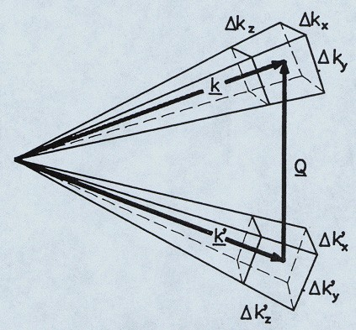
Why So Many Different Spectrometers?
Neutron scattering is an intensity-limited technique where instrumental resolution and signal compete. Different instruments are optimized for different resolution and energy ranges.
Uncertainties in the neutron wavelength and direction imply Q and hω can only be defined with a finite precision.
The total signal in a scattering experiment is proportional to the resolution volume → better resolution leads to lower count rates! Choose carefully …
Courtesy of R. Pynn

Slide 10
Inelastic Spectrometers
Thermal triple-axis instruments (BT-7) (BT-4)
1 meV
Cold neutron triple-axis instrument (MACS) (SPINS)
S(Q,E)
Disk chopper time-of-flight spectrometer (DCS) (FANS)
250 μeV
High flux backscattering spectrometer (HFBS)
1 μeV
S(Q,t)
Spin-echo spectrometer (NSE)
δt → ~50 neV
Remember – Intensity
Resolution
All these different spectrometers are designed differently to optimize intensity and resolution for different measurement requirements

Slide 11
Crystal Spectrometers:
Specifying k_{i} and k_{f}
1. Bragg Diffraction
d
nλ=2dSinθ
BT7, MACS, HFBS
S(Q,E)
SPINS (Cold Triple Axis)
BT-4 (Thermal Triple Axis and Filter Analyzer Spectrometer)
BT-1 (High Resolution Powder Diffractometer)
BT-8 (Residual Stress Diffractometer)

Slide 12
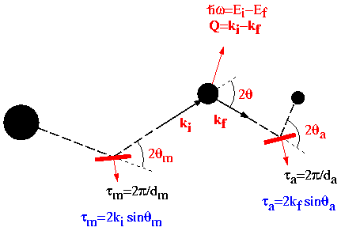
Triple-Axis Spectrometer (BT7, BT4, SPINS, MACS)
Sample
Detector
Neutron Source
Analyzer
Monochromator

Slide 13
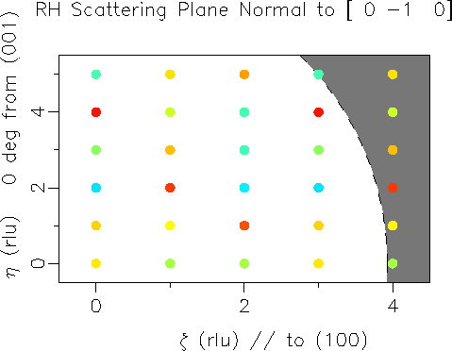
Reciprocal Space for Thermal Neutrons

Slide 14
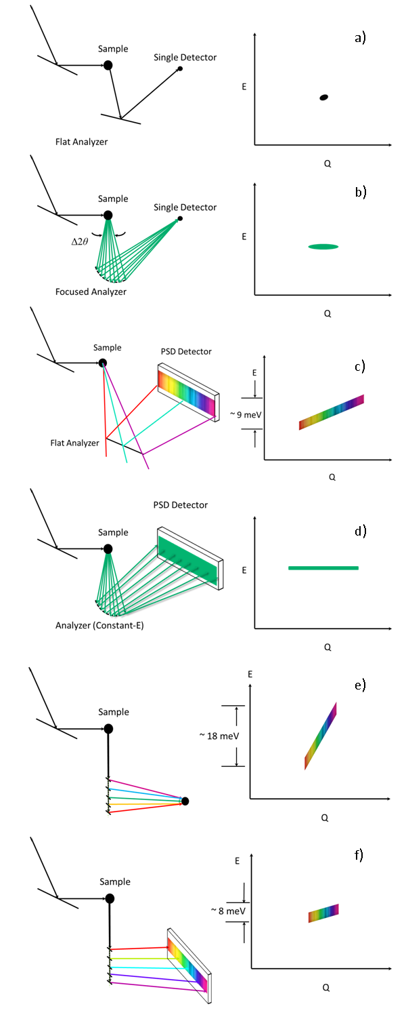
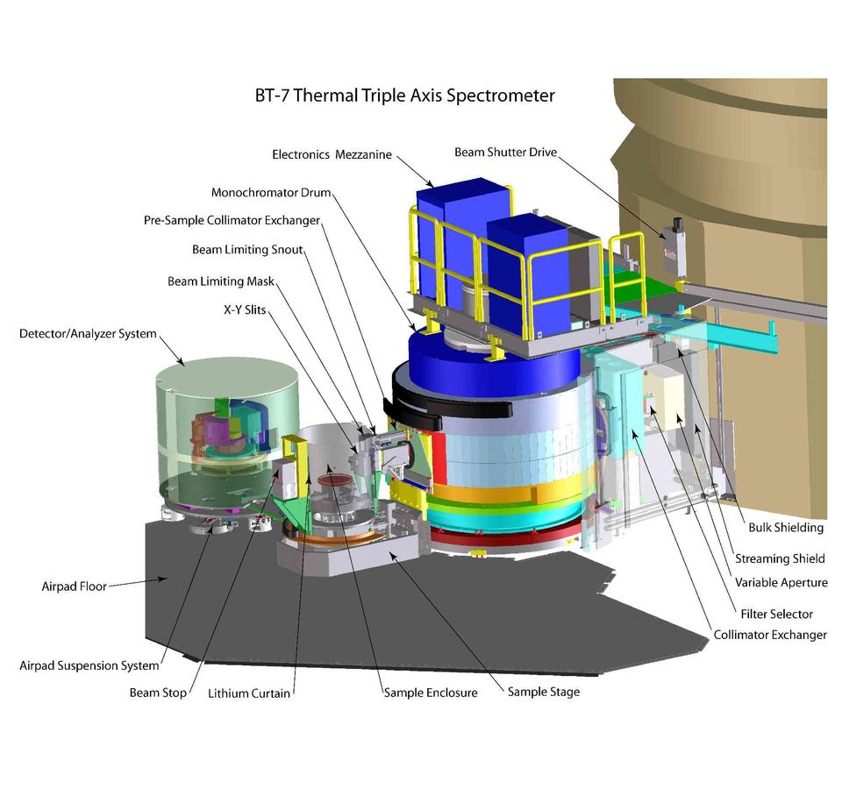
BT-7 Inelastic Scattering
Focusing Analyzer, PSD
Polarized Neutron Measurements
Journal of Research of NIST 117, 61-79 (2012)

Slide 15
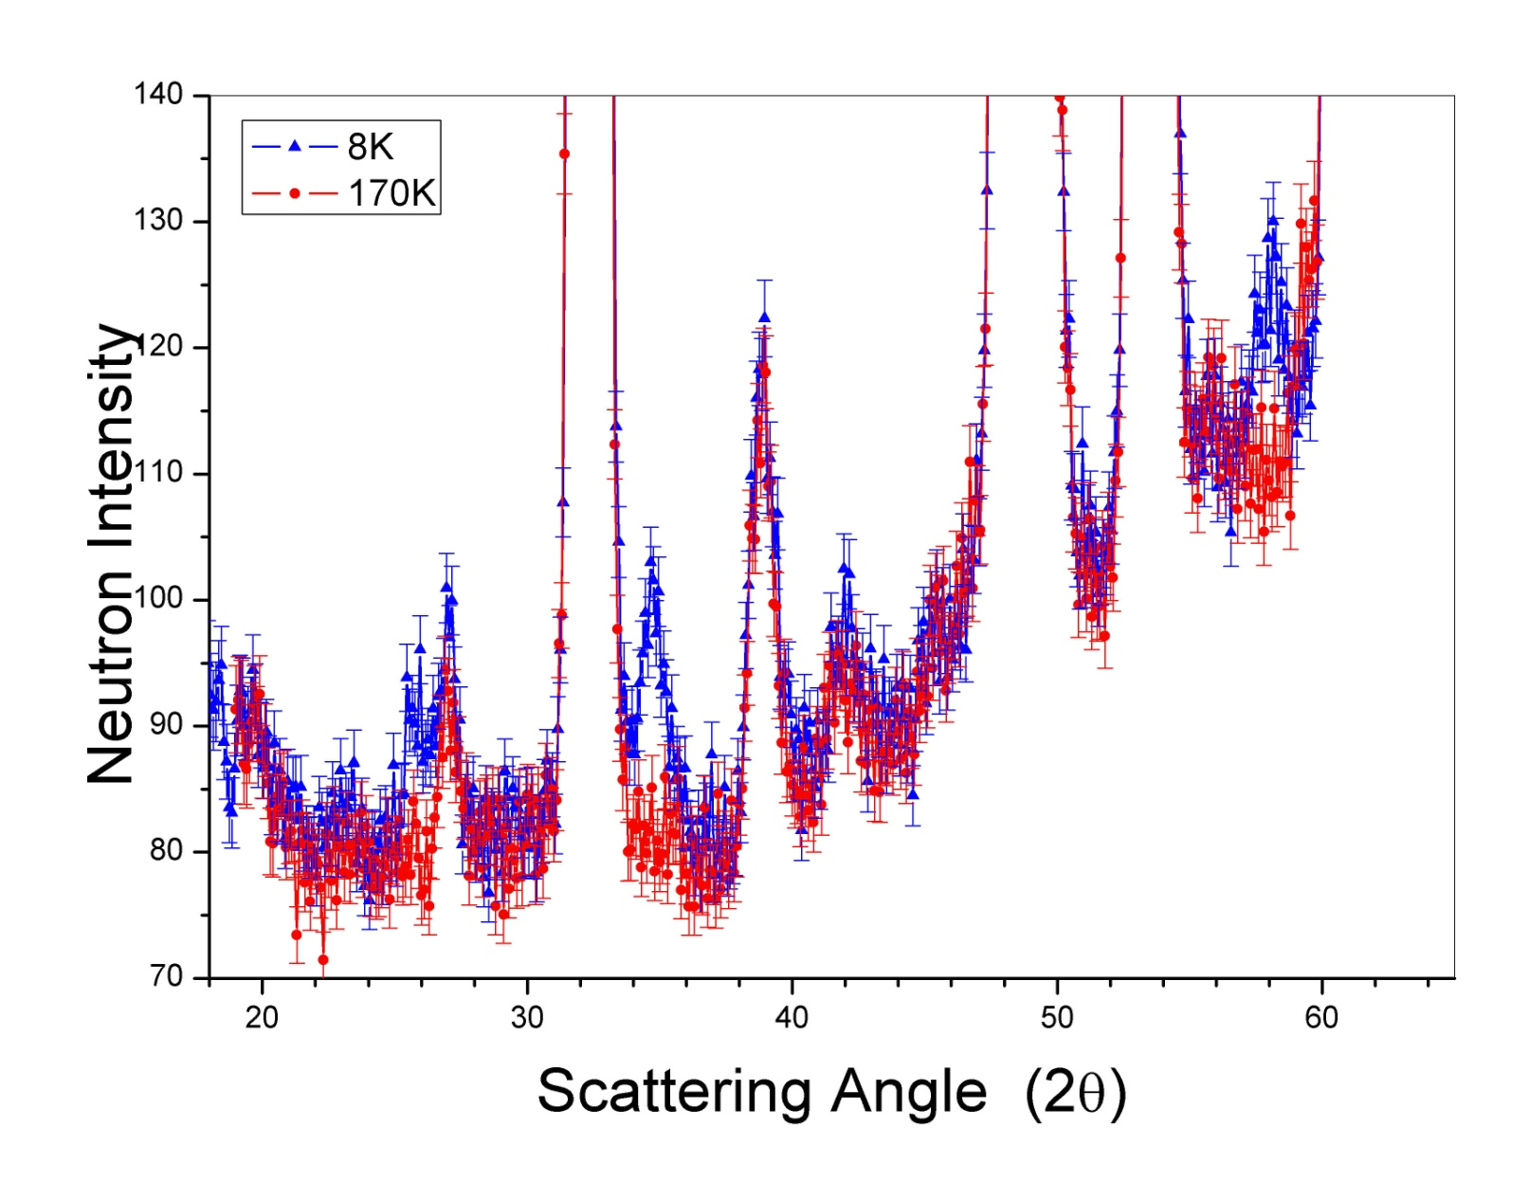
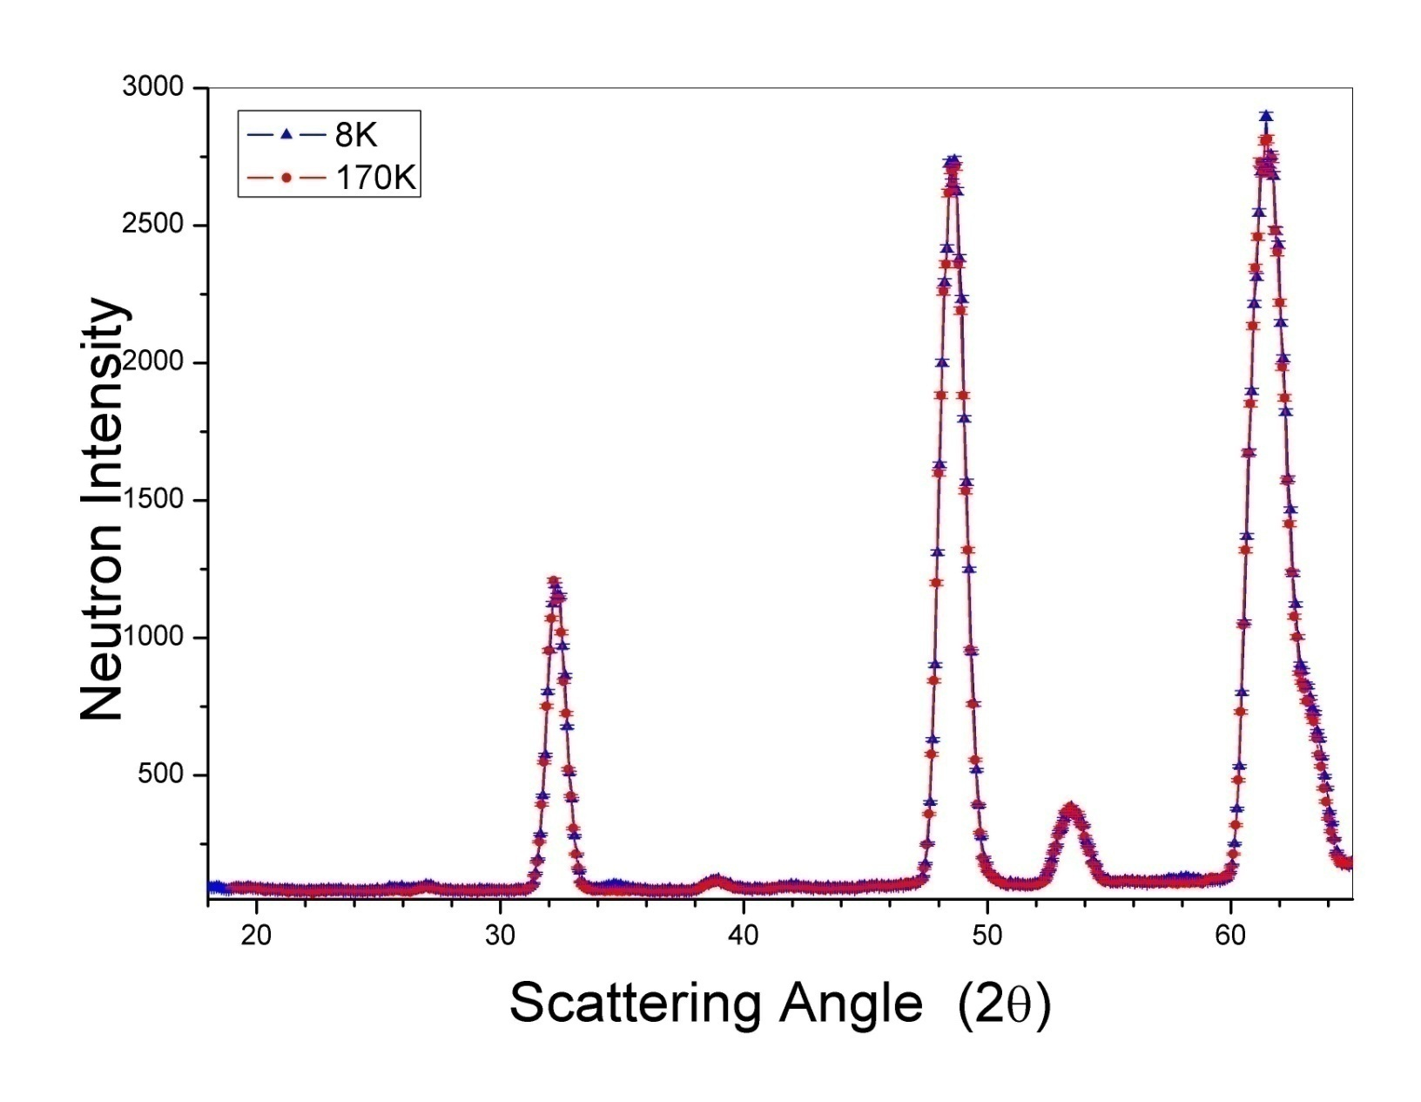
Magnetic Scattering from La(O,F)FeAs
PSD on
BT-7
C. de la Cruz, Q. Huang, J. W. Lynn, J. Li, W. Ratcliff II, J. L. Zarestky, H. A. Mook, G. F. Chen, J. L. Luo, N. L. Wang, and P. Dai,
Nature 453, 899 (2008).

Slide 16
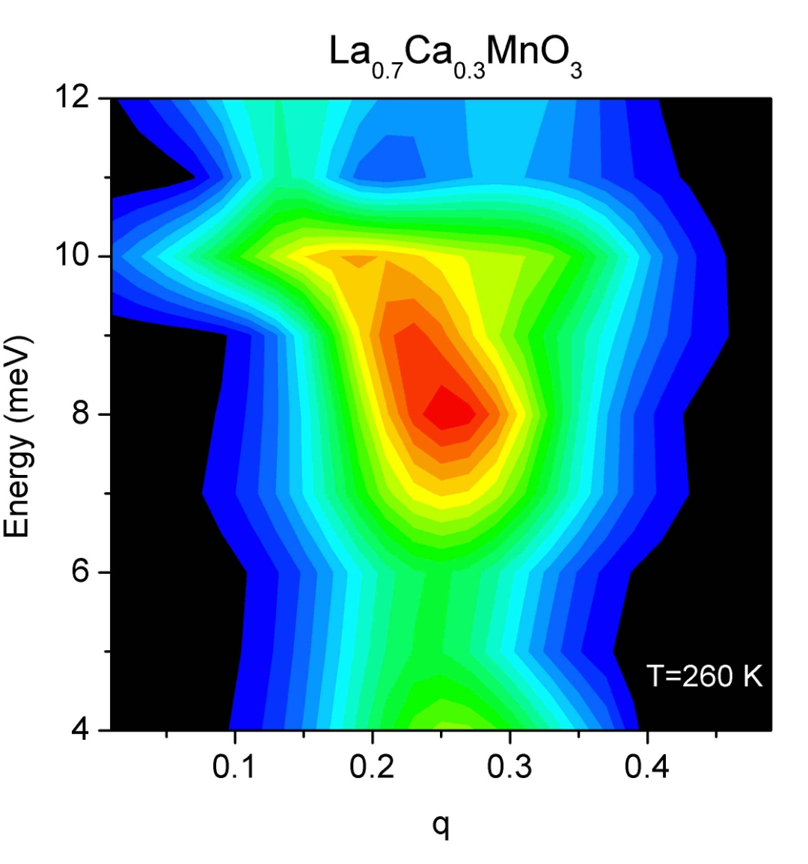
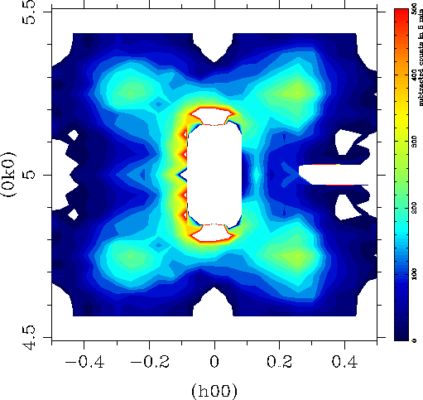
Polaron Dynamics in CMR La_{0.7}Ca_{0.3}MnO₃
J. W. Lynn, D. N. Argyriou, Y. Ren, Y. Chen, Y. M. Mukovskii, and D. A. Shulyatev, Phys. Rev. B76, 014437 (2007)

Slide 17

Energy Resolution for Crystal Spectrometers
E = C (2π/λ)²
ΔE = C´ / λ³δλ
Cold Neutrons →higher resolution
Center for Neutron Research

Slide 18
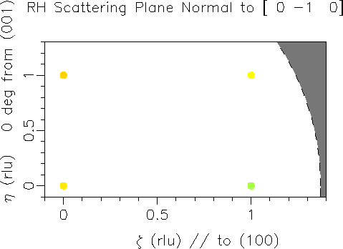
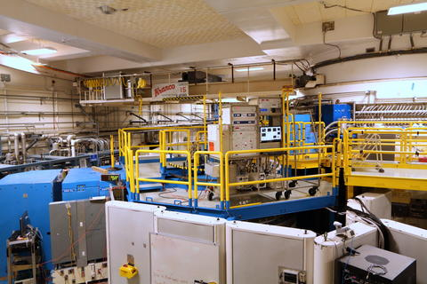
Reciprocal Space for Cold Neutrons
Q
MACS twenty points at a time; high flux horizontal focused monochromator
wide-angle polarization analysis capability

Slide 19
Spin Liquid Scattering in ZnCu₃(OD)₆C_{l2}
6 meV
MACS
T = 1.6 K
2 meV
3/4 meV
Tian-Heng Han, Joel S. Helton, Shaoyan Chu, Daniel G. Nocera, Jose A. Rodriguez-Rivera, Collin Broholm,
and Young S. Lee, Nature 492, 406 (2012).
Notes:
Inelastic neutron scattering from the spin excitations, plotted in reciprocal space. a–c, Measurements were made at T51.6K on a single crystal sample of ZnCu3(OD)6Cl2. The dynamic structure factor, Stot(Q,v), is plotted for Bv56meV (a) and Bv52meV (b) with Ef55.1 meV and Bv50.75 meV (c) with Ef53.0 meV. The background was measured ith an empty sample holder and subtracted. The diffuse scattering is mostly magnetic in origin, because the phonon contribution to the signal is small (except near the (2, 2, 0)-type positions, where the fundamental Bragg peaks are strong). d, The magnetic part of the dynamic structure factor, Smag(Q,v), integrated over 1#Bv#9meV. e, Calculation of the equal-time structure factor, Smag(Q), for a model of uncorrelated nearest-neighbour dimers. The intensity corresponds to 1/8 of the total moment sum rule S(S11) for the spins on the kagome lattice. The data presented in a–c are expressed in barn sr21 eV21 per formula unit, as shown by the left colour bars. The data presented in parts d and e are dimensionless, with the scale given by the right colour bar. The Brillouin zone boundaries are drawn in the figure for clarity; they correspond to the conventional unit cell with parameters a5b56.83A˚ , c514.05A˚ , a5b590u and c5120u.

Slide 20
Perfect Resolution
Backscattering
Note: Scattering angle = 2θ
Thermal TA 1,000 μeV
Cold TA 200 μeV
HFBS 1 μeV

Slide 21
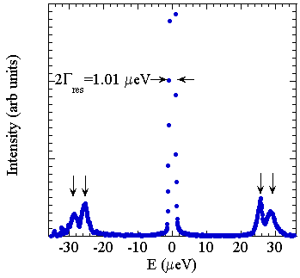
Quantum Rotational Tunneling in Toluene:
A Measurement using HFBS
HFBS
Motion of methyl groups (CH₃) in toluene (C₆H₅CH₃)
Inelastic peaks correspond to tunneling through a potential barrier: a classically forbidden motion!
Tunneling rate ~6 GHz
Presence of two inelastic peaks on the energy loss side and two peaks on the energy gain side indicates two inequivalent sites for molecules in the solid
E (μeV)
Notes:
Find out more about HFBS

Slide 22

Methods of Specifying and Measuring k_{i} and k_{f}
1. Bragg Diffraction (Crystal Spectrometers)
d
nλ=2dSinθ
BT7, MACS, HFBS
S(Q,E)
L
2. Time-of-Flight (TOF)
DCS
S(Q,E)
v = L/t

Slide 23
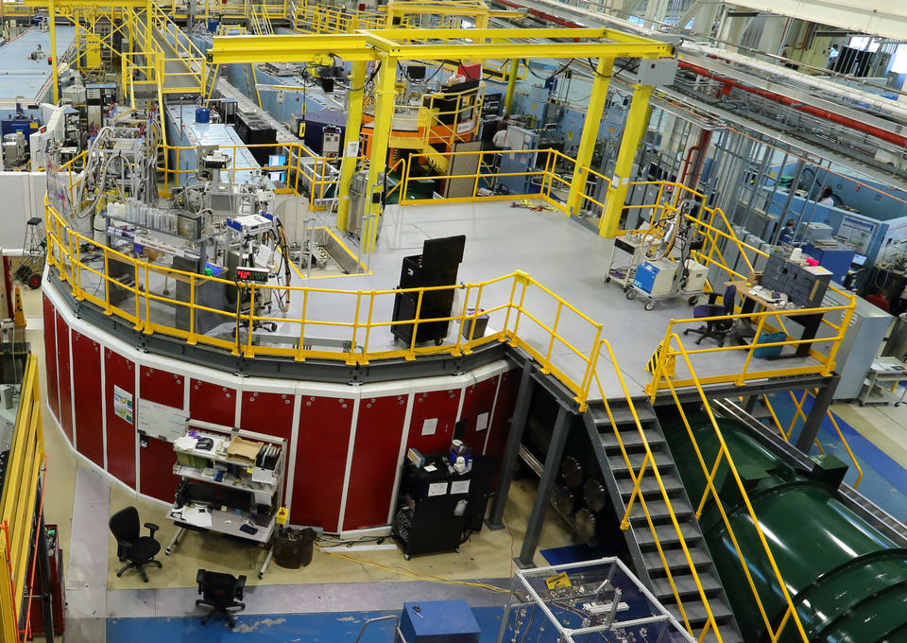
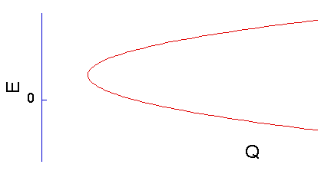
Disk Chopper Spectrometer
k_{f}
k_{i}
Q
k_{f}
Q
Q
k_{f}
Detector
913 Detectors

Slide 24
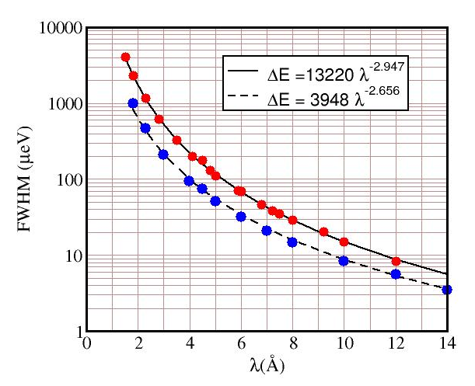
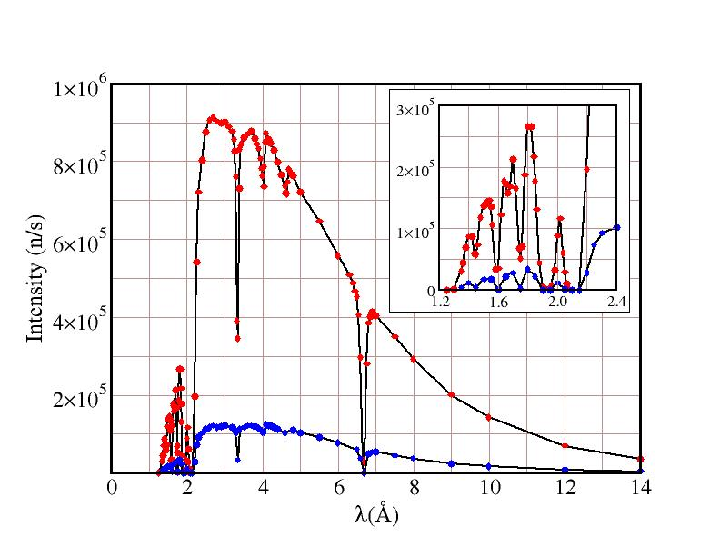
Things to Consider When Choosing DCS
ΔE
I(E)
Quantities varied
wavelength λ
chopper slot widths W
Remember – Intensity
Resolution

Slide 25
Fractional Spin Excitations in Yb₂Pt₂Pb
L. S. Wu, W. J. Gannon, I. A. Zaliznyak, A. M. Tsvelik, M. Brockmann, J.-S. Caux, M. S. Kim, Y. Qiu, J. R. D. Copley, G. Ehlers, A. Podlesnyak, M. C. Aronson, Science 352, 1690 (2016).
Notes:
Orbital-exchange and fractional quantum number excitations in an f-electron metal, Yb₂Pt₂Pb
Fractional spinon excitations in Yb2Pt2Pb. (A) The dispersion of the spectrum of magnetic excitations along the QL direction in reciprocal space of Yb2Pt2Pb at T = 0.1 K, obtained by averaging the scattered neutron intensity over the first Brillouin zone in QHH, along the perpendicular, ðH;H; 0Þ direction. Circles: onset of the excitation continuum determined by fitting the constant-QL data. Solid white lines: lower and upper boundaries of the two-spinon continua. Dashed lines: upper boundaries of the four spinon continua (6). (B) The dispersion of the scattered neutron intensity along the QHH direction for QL ¼ 0:5 T 0:1. (C) The partial static structure factor, MðQÞ, obtained by integrating the scattered intensity from 0.15 to 1.5 meV. MðQÞ depends on the relative orientation of the scattering vector Q ¼ ðH;H; LÞ and the direction of magnetic moment fluctuations (30). (D) At 4 T,MðQÞ (red squares) follows the projection of the (110) sublattice moments on the scattering wave vector (polarization factor Pð4 TÞ ¼ ðLcÞ2 2ðHaÞ2þðLcÞ2, red line), indicating that only magnetic fluctuations along the (110)moments contribute tomagnetic scattering. Both polarizations are present when B ¼ 0 T, consistent with equal longitudinal spinon spectral weight in both (110) and (1-10) sublattices. By subtracting the 4 Tdata from the 0 Tdata (black dots),we can isolate the scattering from fluctuations along the field direction, (1-10), which are always perpendicular to the scattering vector Q and whose polarization factor is constant (black line). The agreement between the polarization factors and our data confirms that only fluctuations of the Ybmoments that lie along the respective (110) or (1-10) direction are seen in our experiment and that there is no measurable transverse component of magnetic moment or excitations. Error bars in all figures represent 1 SD.

Slide 26
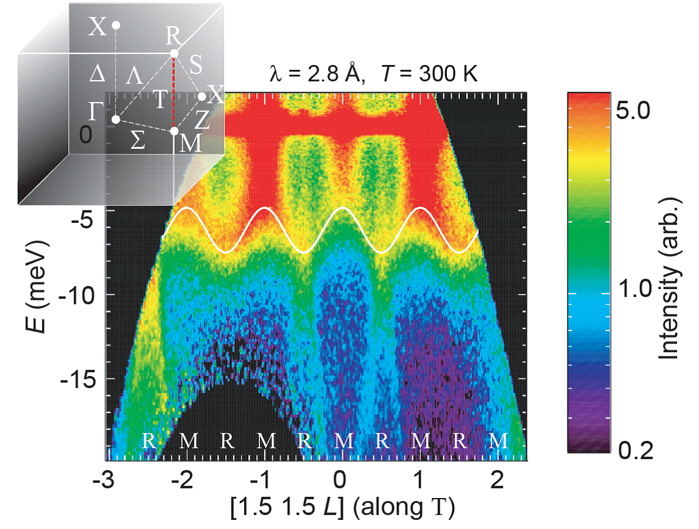
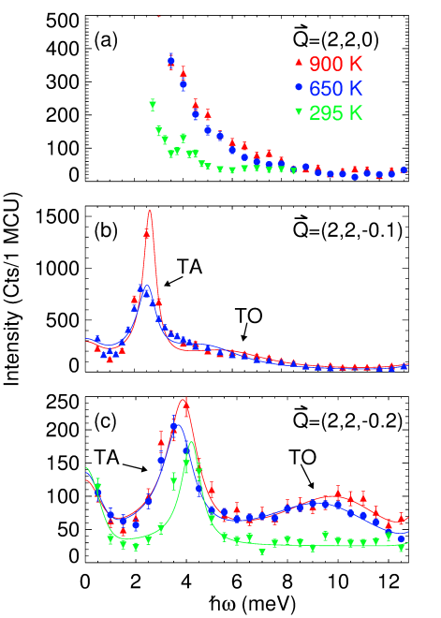
Example: DCS versus BT7
DCS
Broad surveys in Q-ω
BT7
Limited regions in Q-ω
Rules of Thumb: (think carefully before violating)
DCS, MACS – systems requiring resolution < 400 μeV
BT7 – single crystals with specific points of interest

Slide 27
Methods of Specifying and Measuring k_{i} and k_{f}
1. Bragg Diffraction (Crystal Spectrometers)
d
nλ=2dSinθ
BT7, MACS, HFBS
S(Q,E)
L
2. Time-of-Flight (TOF)
DCS, HFBS
S(Q,E)
v = L/t
“TOF” Larmor Precession
NSE
S(Q,t)
B

Slide 28

Spin Echo Spectrometer
Measures I(Q,t) instead of S(Q,ω)
Notes:
Get more info

Slide 29
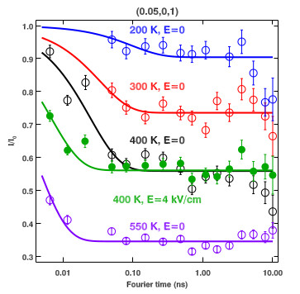
Spin Echo Measurements on Polar Nano Regions in Relaxor Ferroelectric Systems
Zhijun Xu, Jinsheng Wen, Guangyong Xu, Chris Stock, Jason S Gardner, Peter M Gehring, Physical Review B, 82, 134124 (2010)
Notes:
Use my own data

Slide 30
The NCNR Menagerie of Instruments
Cold Neutrons
Thermal Neutrons

Slide 31
How do I Choose the Right Spectrometer?
Two basic considerations:
1. What are the time scales (E) of interest?
2. What are the length scales (Q) of interest?
(Some spectrometers overlap →
the choice may boil down to one of resolution)
Two additional considerations:
1. What energy resolution (ΔE) is required?
2. What momentum resolution (ΔQ [or ΔQ]) is required?

Slide 32
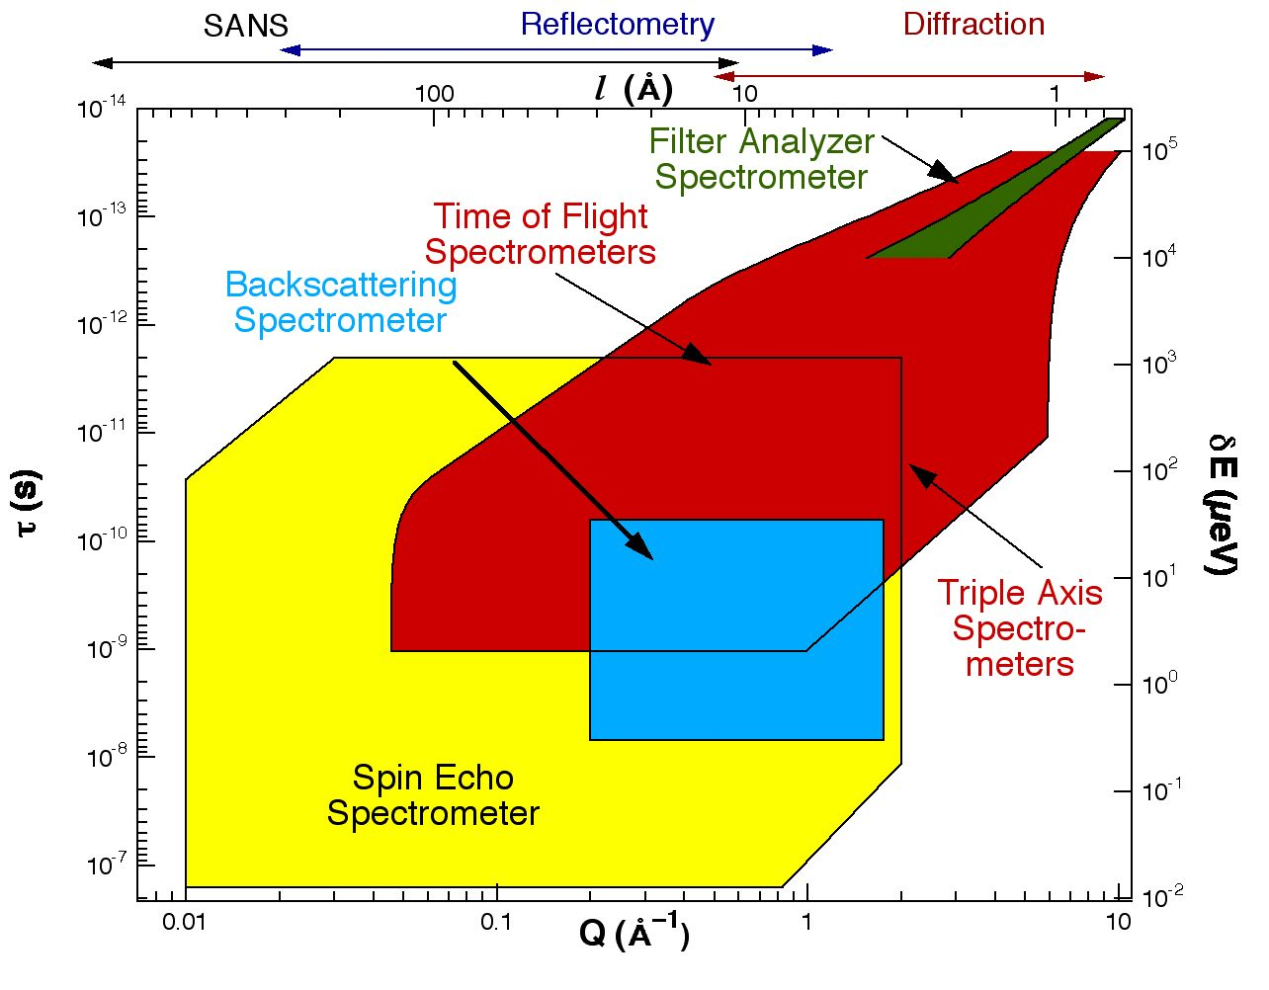
Different Spectrometers Cover Different Regions of Phase Space
Larger “objects” tend to exhibit slower motions.

Slide 33
Rules of Thumb
1. What are the energies (hω), i.e. time scales (Δt ~1/ω), of interest?
hω > 1-100 meV - use a thermal triple-axis spectrometer like BT7.
hω < 30 μeV - use HFBS or NSE.
In between - use MACS or DCS or a cold-neutron triple-axis spectrometer like SPINS.
2. Make sure that the length scales L of the relevant motions lie within the range of the spectrometer. For example, consider the HFBS. (Q ~ 2π/L)
Q_{min} = 0.25 Å⁻¹ → L_{max}~ 25 Å
Q_{max} = 1.75 Å⁻¹ → L_{min}~ 3.5 Å
REMEMBER - Q_{min} and Q_{max} are inversely proportional to the
incident neutron wavelength

Slide 34

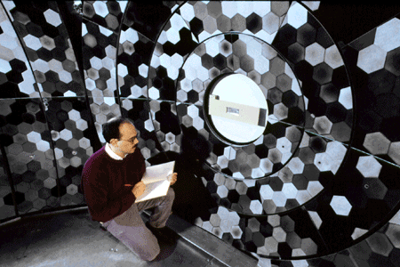
More Rules of Thumb
Is your sample polycrystalline or amorphous?
Does ONLY the magnitude (not the direction) of Q matter?
Is the expected Q-dependence of the scattering weak?
This often means that you want to look at a large region of Q-hω space,
or that you can sum the data over a large region of Q-hω space.
YES? Consider instruments
with large analyzer areas.
NO? Consider using BT7, SPINS, or NSE.
MACS
DCS
HFBS
BT7

Slide 35
General Sample “Design”
Know as much about your sample as possible!!
(Beamtime costs ~ $5000/day!!)
Other considerations:
What’s the structure (in a general sense)?
Are there any phase transitions (or a glass transition)?
What isotopes are present?
Supplementary data from other measurements …
Magnetization vs T
Muon spin relaxation
X-ray data
Specific heat vs T
Raman spectroscopy

Slide 36
General Sample “Design”
Try to avoid isotopes that are strongly absorbing.
⁶Li ¹⁰B ¹¹³Cd ¹⁵⁷Gd
Almost all experiments of collective excitations involve coherent scattering
Avoid isotopes with strong incoherent scattering
If sample contains H it should be deuterated (D).
For a complete listing go to
http://www.ncnr.nist.gov/resources/n-lengths

Slide 37
Sample “Design”
Single crystals yield the most information.
Increase the intensity by increasing the amount of sample.
If you have a powder, use a cylindrical container (rather than flat plate).
Annular may be the best sample geometry.
k_{f}
k_{i}
Almost all experiments of collective excitations involve coherent scattering
→ If sample contains H it should be deuterated (D).

Slide 38
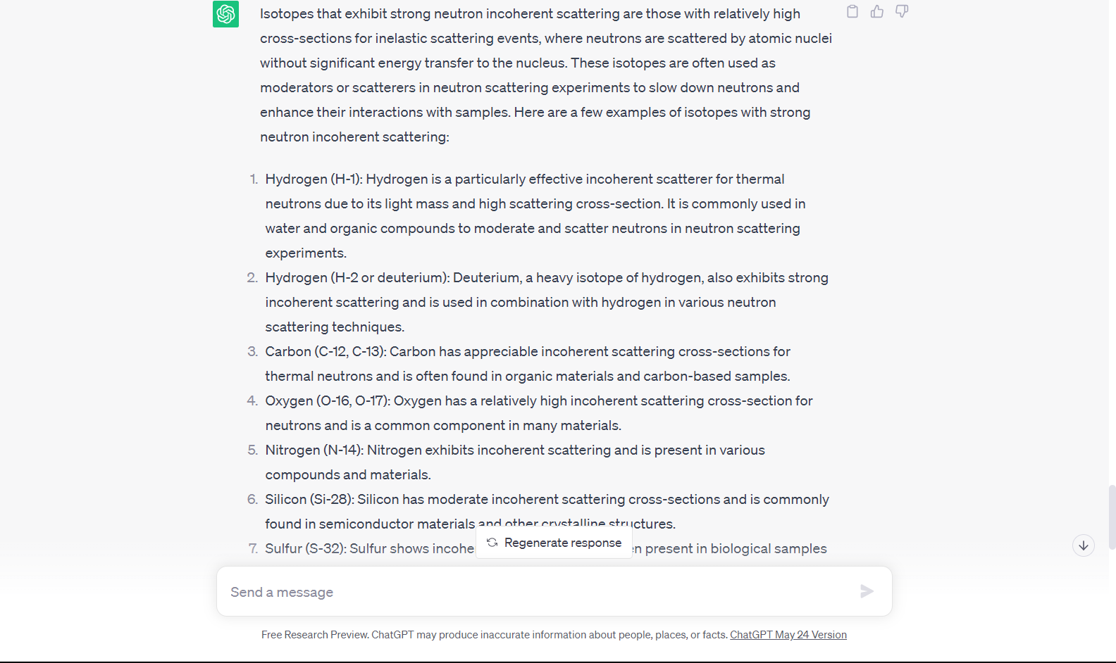
What ChatGPT says

Slide 39

Acknowledgements
Organizers – Leland Harriger and Ryan Murphy
Administrative staff
Experiment teams
Invited speakers
Enjoy the Science!

