Slide 1

Quantum Networking: Experiments, Simulation, and Standards for Scalable Infrastructure
Overview of the DCQ-Net
Sergey V. Polyakov

Slide 2
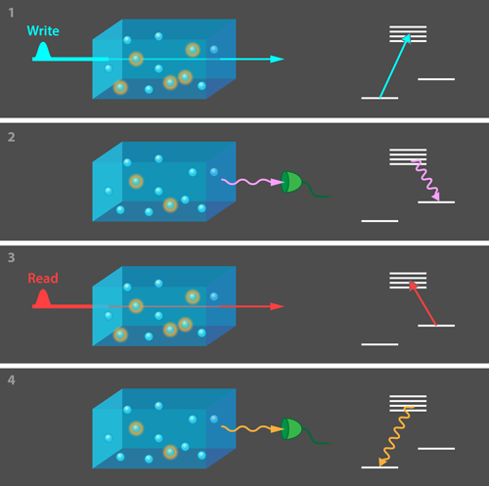
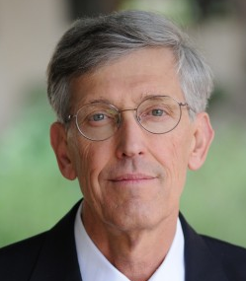
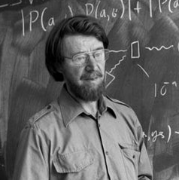
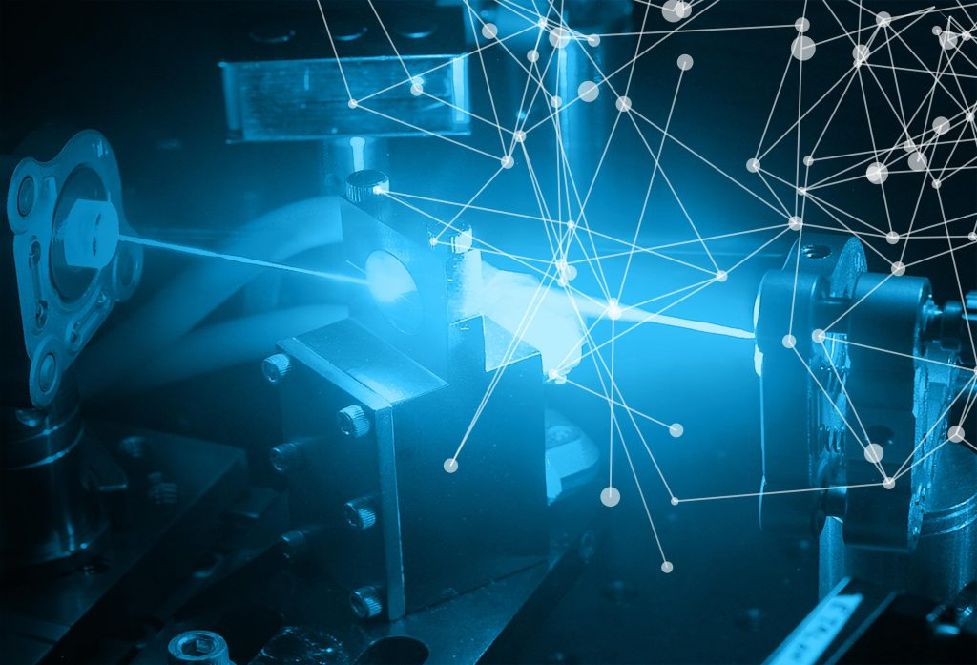
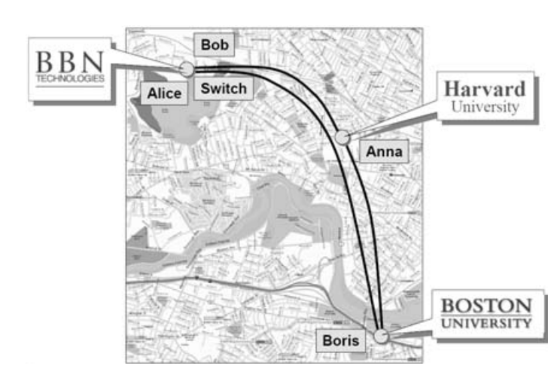
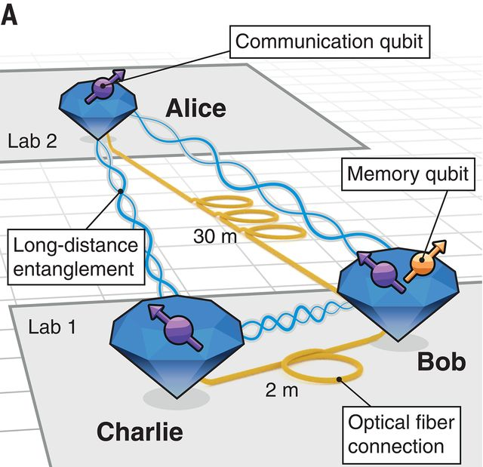
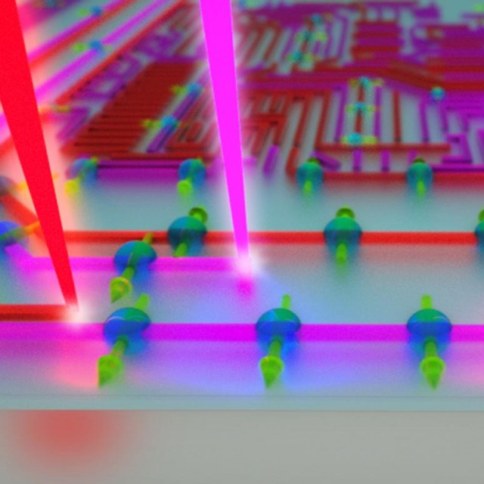
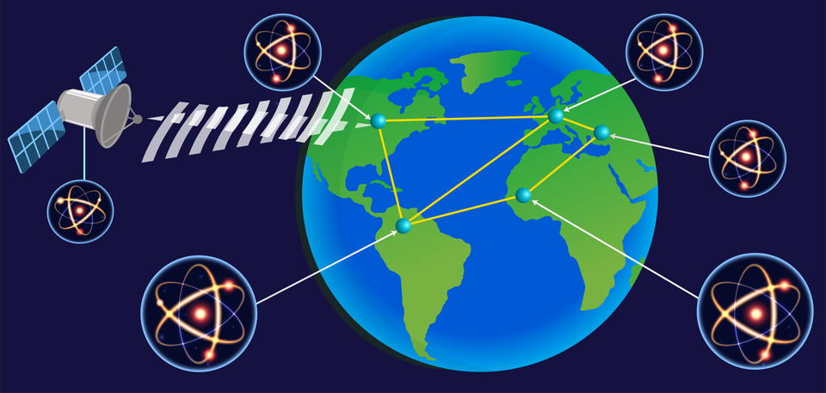
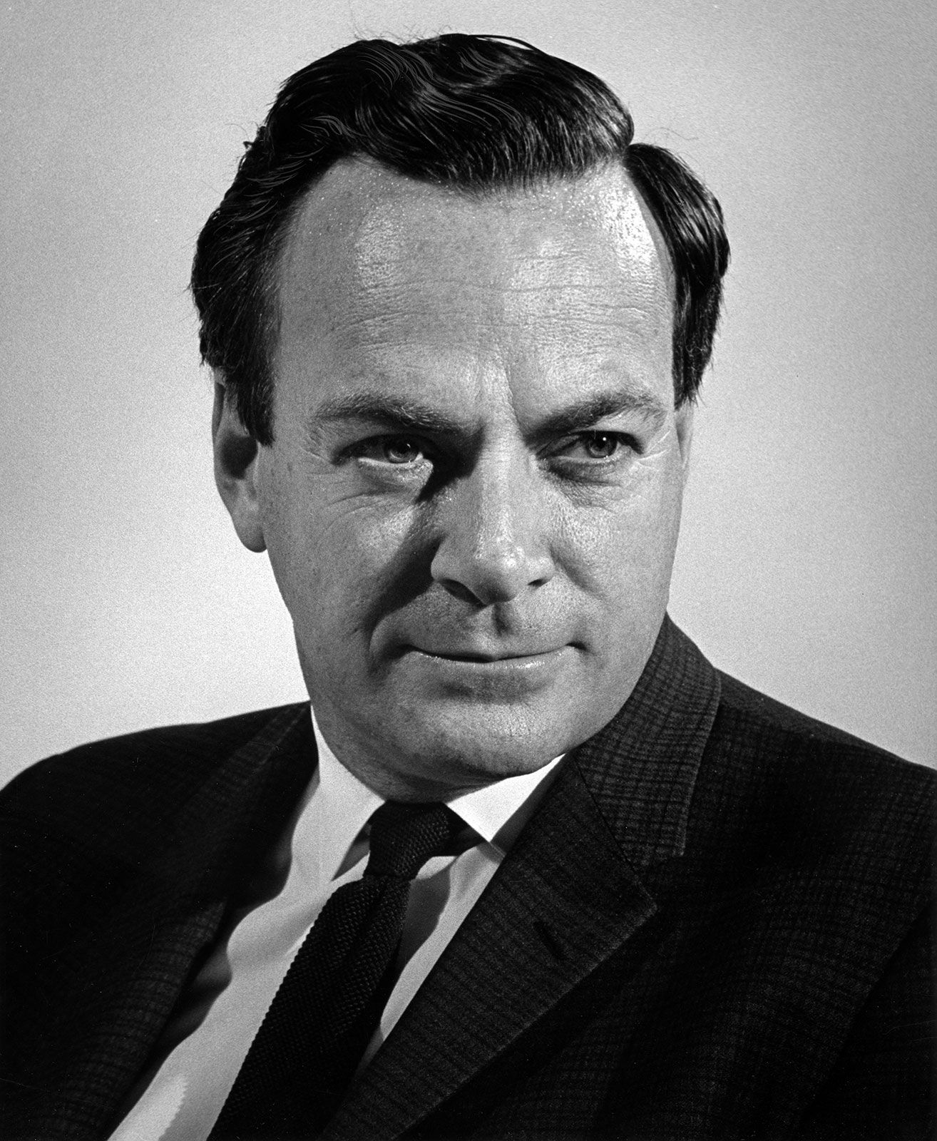
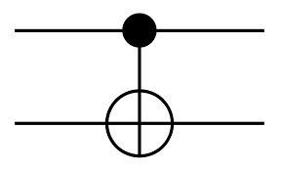
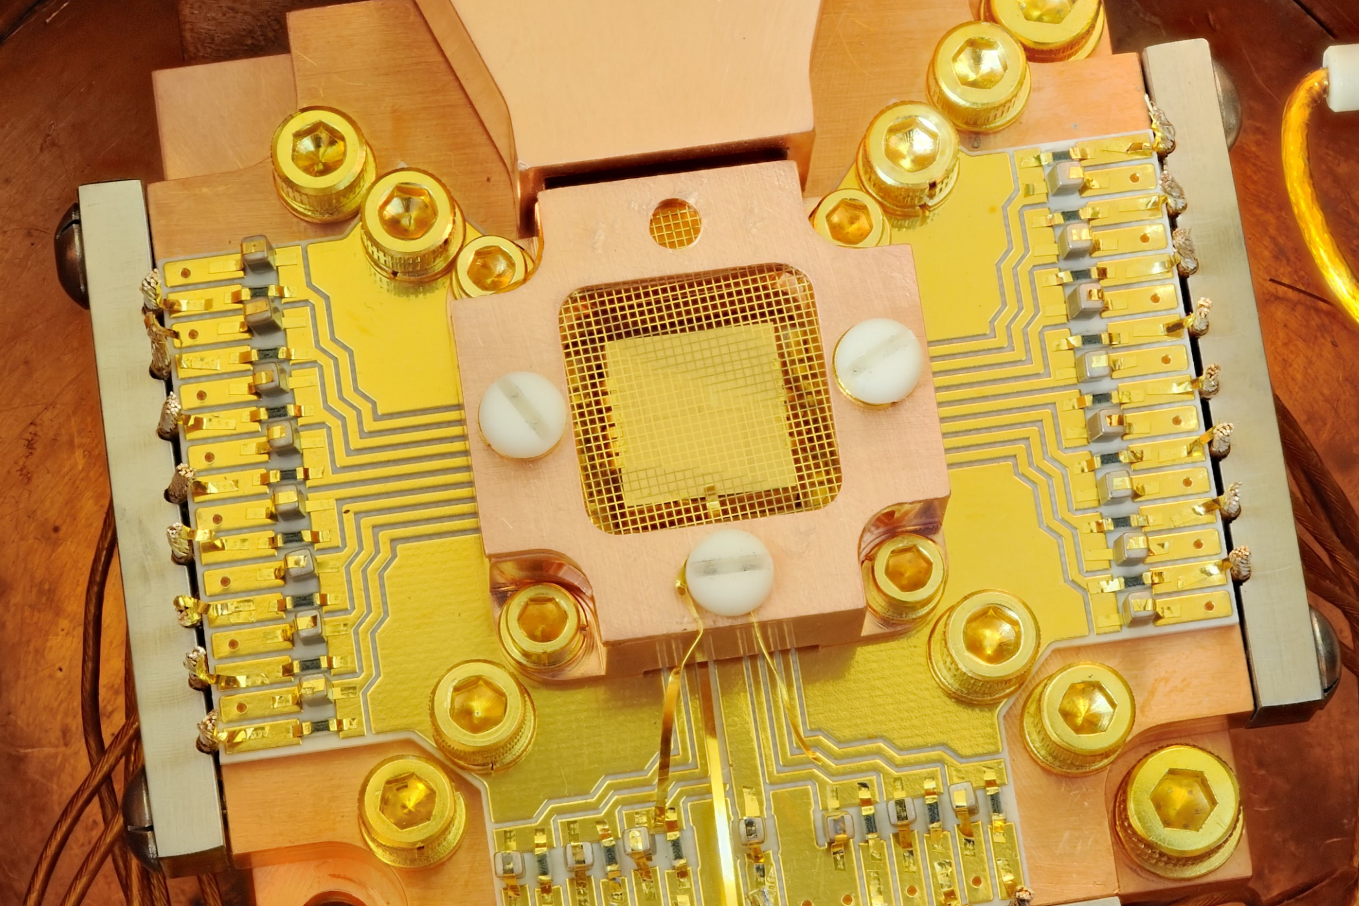
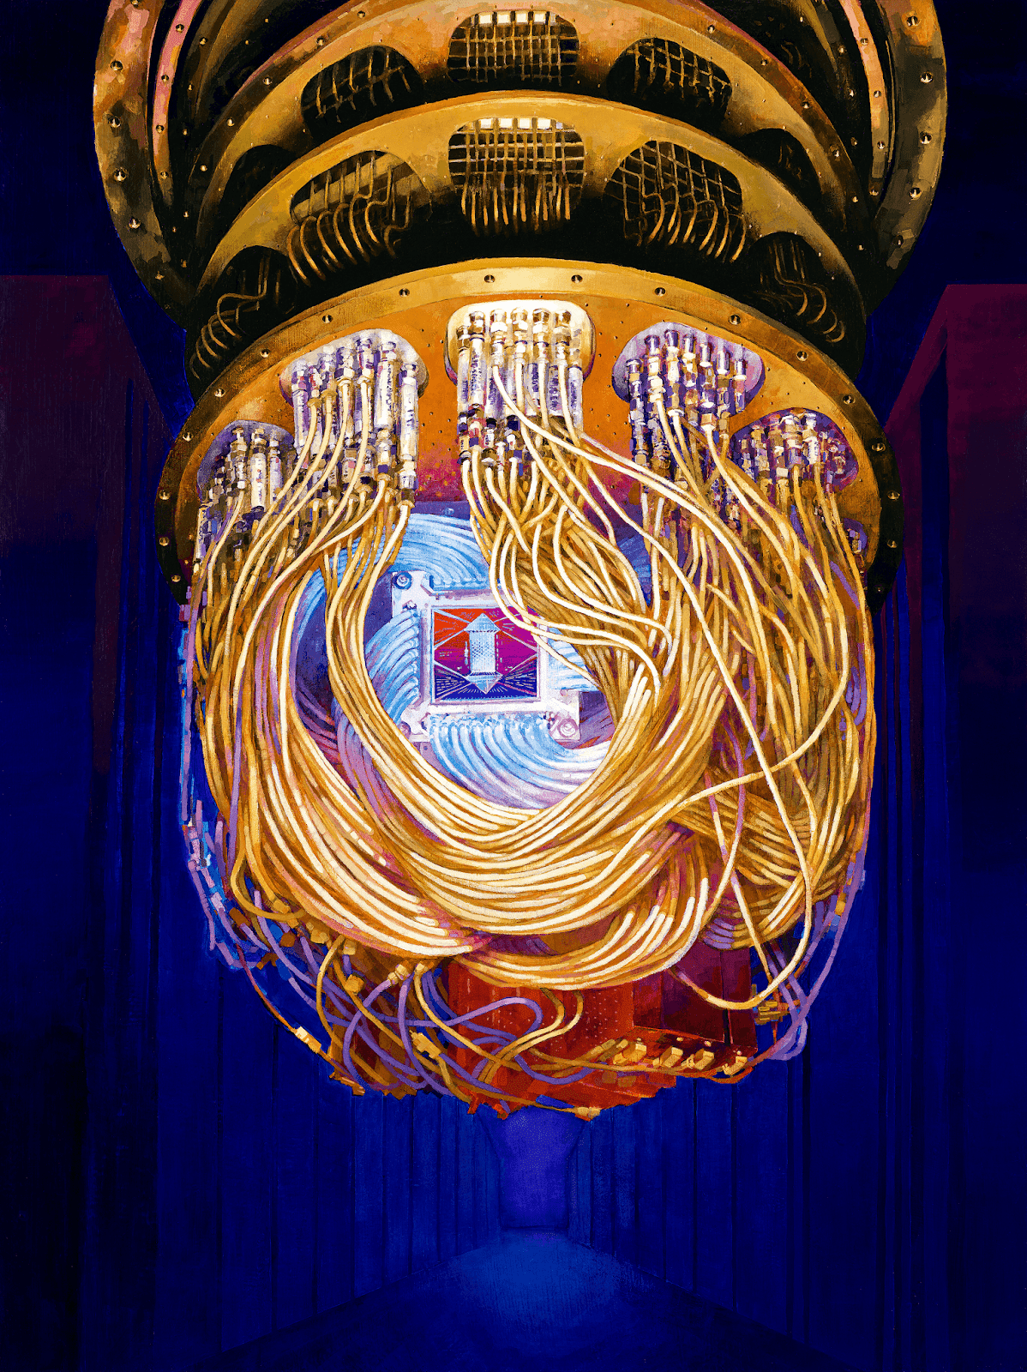
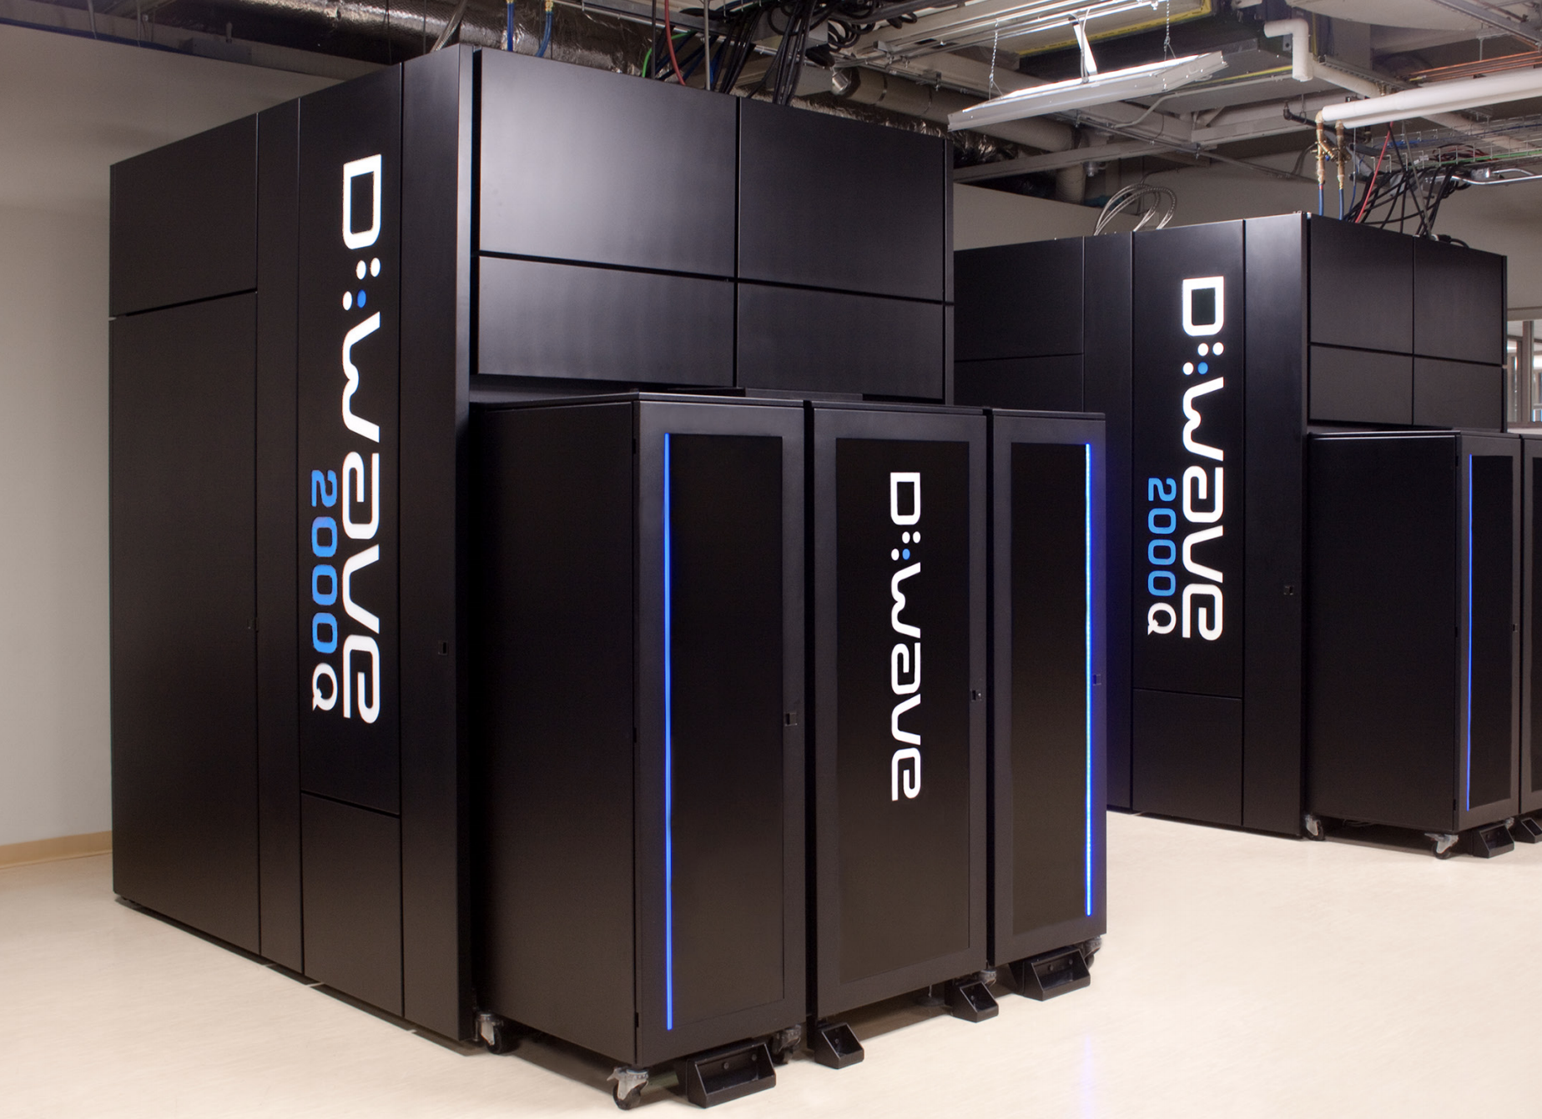
Quantum Computing and Networks
2021: 3-node Q. network with storage claimed
2005 DLCZ
remote entanglement
DOI:10.1038/nature04353
2008: Kimble’s
concept paper
2015: Loophole
free Bell test
2020: The Age of
Metropolitan Quantum Network
Centers
2002 3+ node QKD
DOI: 10.1126/science.abg1919
DOI: 10.1038/nature07127
1986: Feynman’s
Concept paper
2019: Google:
q. supremacy
1995-2005: Gates
2011: D-Wave
128 qbit, annealer
2018: Ions, 20 qbit

Slide 3

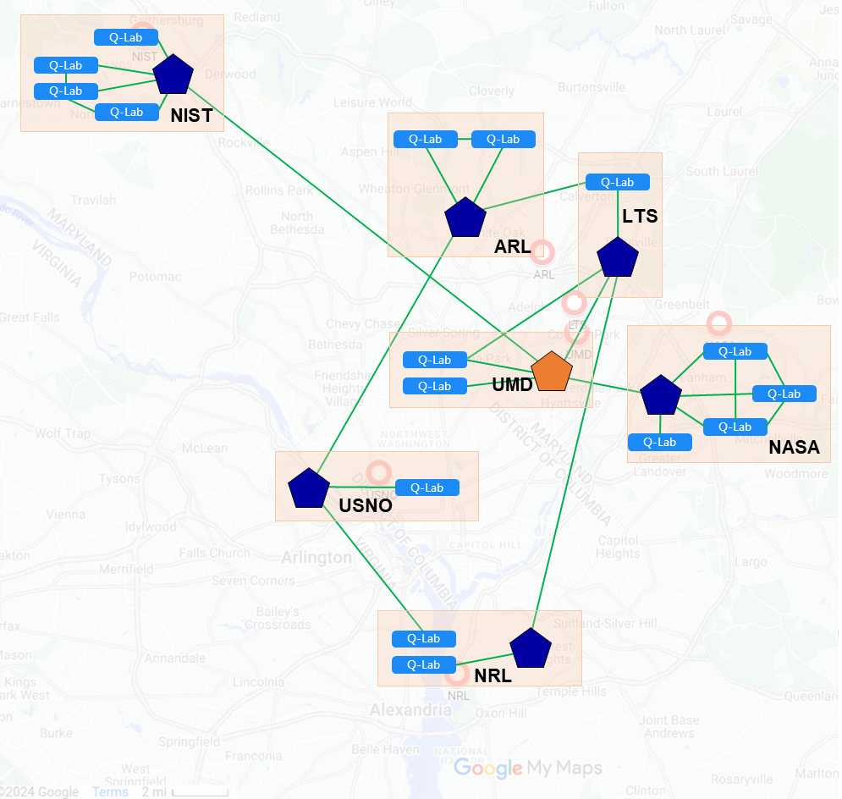
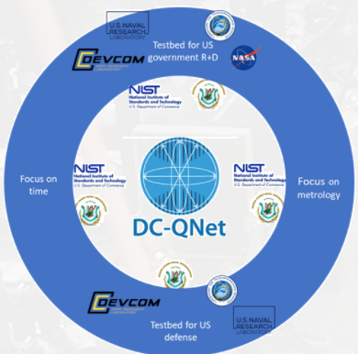






DC-QNet: What, Why, Where and Who?
What is DC-QNet?
A consortium of six DC-area federal agencies stood up to build and operate a real-life regional scale QN testbed.
Formally established as the Washington Metropolitan Quantum Network Research Consortium in May 2022.
Why DC-QNet?
Advance cooperation and enable strategic synergy among agencies in QN research and development.
A non-proprietary environment for test and evaluation of QN concepts, components, protocols and architectures.
Enable cross-cutting agency synergy in sensor development, secure communications, distributed computing and other use cases.
Using unique agency skill sets while targeting unique agency needs.
Where is DC-QNet?
  NQIAC (September 2024): “Quantum networking testbeds, if strategically chosen and properly timed, can play an important role in accelerating U.S. quantum information science leadership.”
Who are the DC-QNet?
3

Slide 4
DC-QNet: Agency Capabilities
NIST
Single-photon and entanglement research-grade sources.
Phase stabilization.
Polarization stabilization.
Detectors (SNSPDs).
Quantum measurement theory.
Single photon level characterization.
Multiverse network controller.
Synchronization: WR and ELSTAB.
….
LTS
SNSPDs
Cs clock
Polarization measurement
Fiber characterization
Entanglement distribution
WR and ELSTAB
ARL
SNSPDs
Polarization EPS
Automated state tomography.
Polarization compensation.
White Rabbit (WR)
OTDR
60 km
NASA
Rb clock
WR
Distributed fiber temp sensing
OTDR
EPS
SPDs
USNO
Ensembled Cs beam, Rb fountain, and H Masers
Electronically stabilized time and frequency transfer (ELSTAB)
13 km
2 km
UMD
Quantum memory (ions, atoms).
QFC for hybrid ion/neutral atom networking.
WR & optical frequency synchronization.
Quantum gates (upcoming).
SNSPDs.
Polarization compensation.
Indistinguishable sources.
68 km
14 km
NRL
H Masers (ensembled)
WR and ELSTAB
Rb quantum memory
Indistinguishable sources
Network management
52 km
4

Slide 5





DC-QNet: Impact
Infrastructure: metropolitan-scale optical connectivity and capabilities to enable scalable, interoperable, and reproducible quantum network development and experimentation
Complimentary capabilities: enable accelerated research and development by leveraging unique capabilities through
inter-agency collaboration
Forward-facing focus: development of next-generation components and protocols with future applications in mind
  Distribution of functional entanglement
  Secure communications
  Distributed sensors
  Quantum computer connectivity
Testbed for pre-standardization: providing a platform for developing requirements for network scalability and interoperability
Testbed for US government R+D
Focus on time
Focus on metrology
Testbed for US defense
Interagency Synergy of the DC-QNET
5

Slide 6
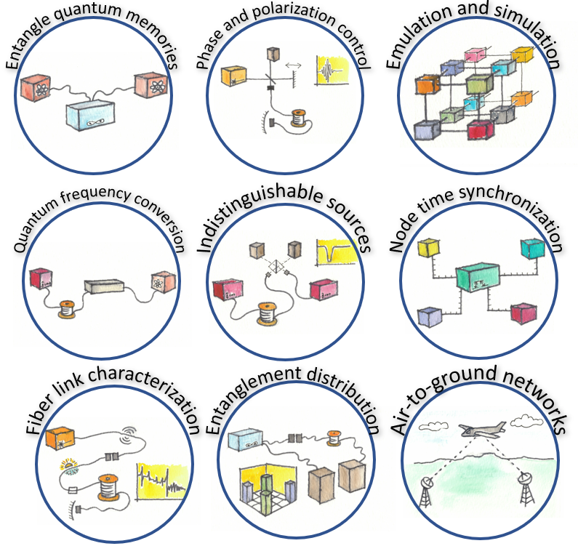
DC-QNet: Experimental Priorities
Executive Steering Committee
Working Groups
Executive Director
S & T Advisors
Experiments
Fiber Infrastructure
Interface Specifications
Security + Operations
6

Slide 7
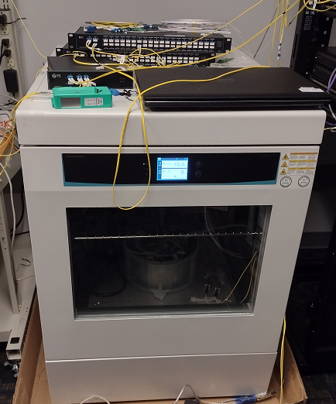
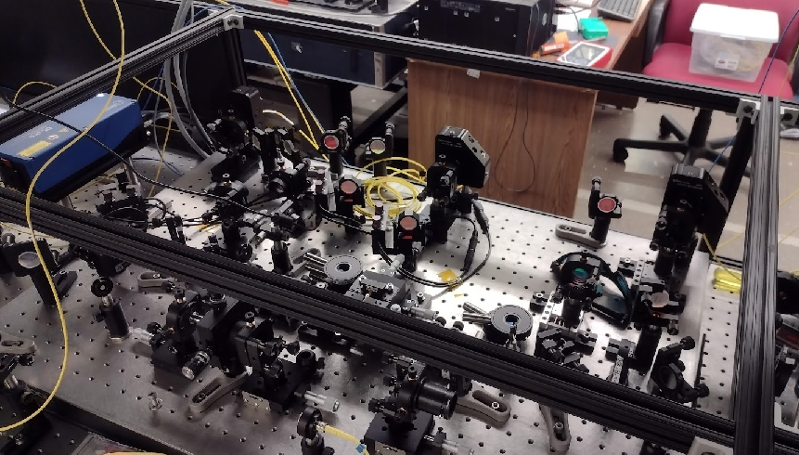
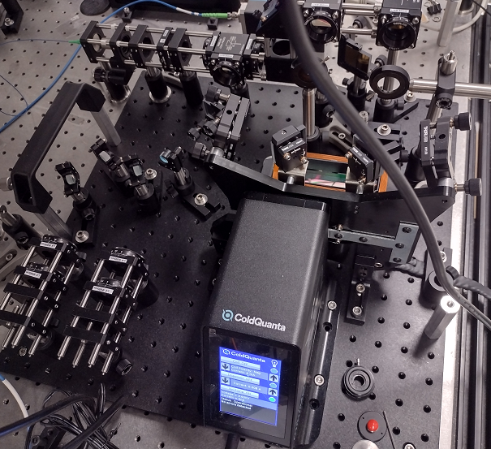
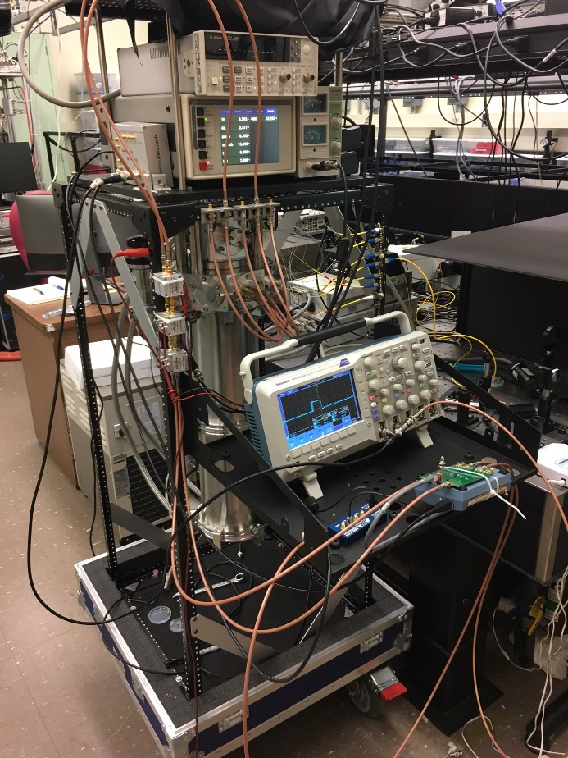
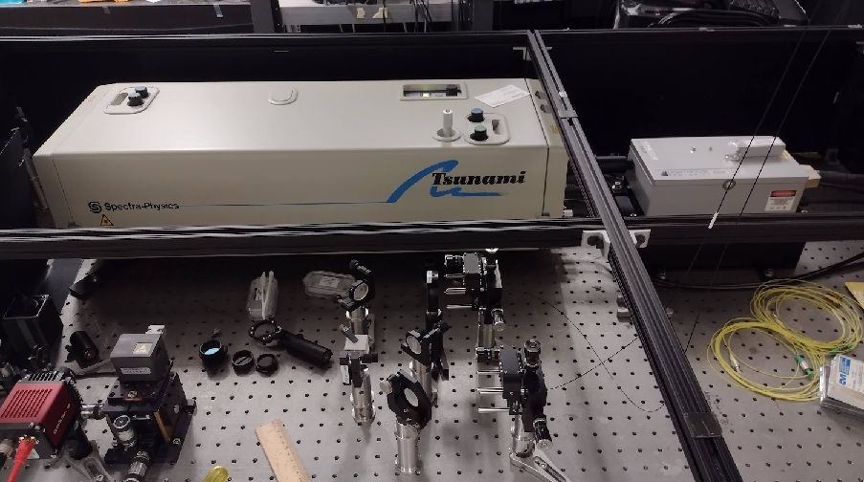
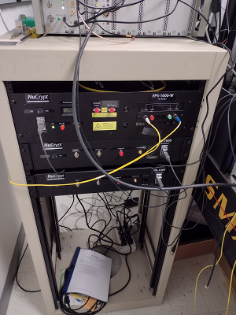
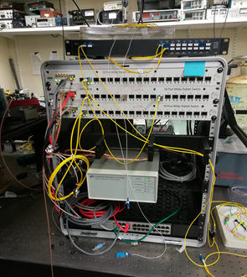
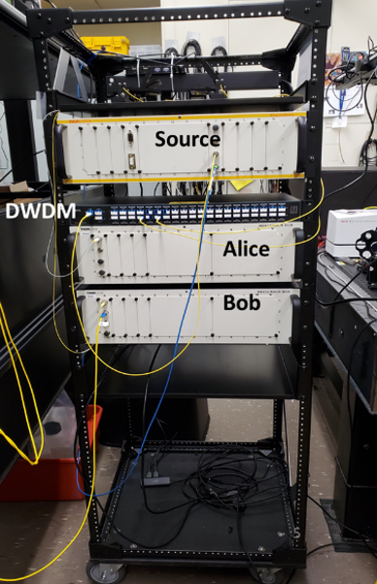
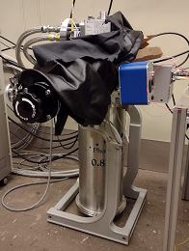
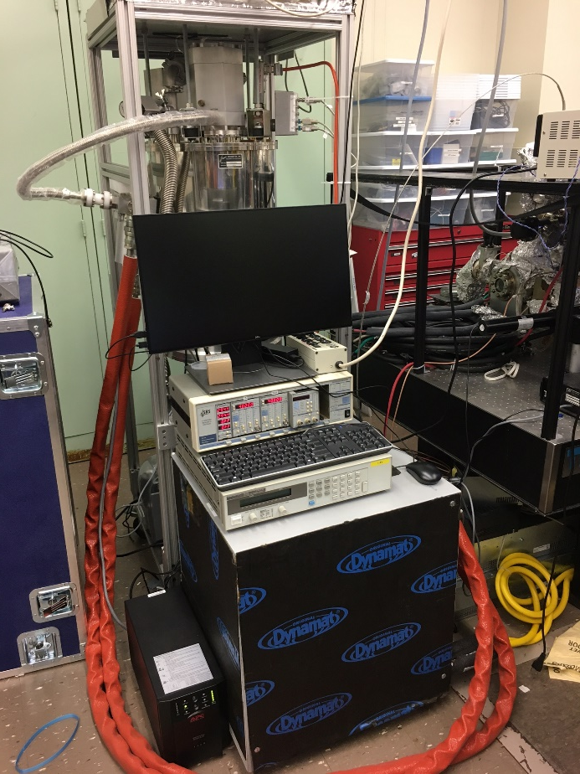
DC-QNet: transformative extension of NIST QN
www
USNO
NASA
ARL
NIST @ UMD
- “Relay station”
- POL EPS / ALZR
- SNSPD
- TCSPC
UMD DC-QNet Switch
NRL
WEB UI
Multiverse Controller
LTS
60 km deployed fiber
Measurement Plane
Control Plane
Mobile EPS
Mobile ALZR
Detector Calibration
www
222 (B205)
‘Control Plane Lab’
-TCSPC
Test Switch
Chamber
Future Lab connection
Future Lab connection
T
T
220 (A224)
‘DC-QNet Lab’
- Metrology grade POL EPS
- HS POL ALZR
- SNSPD (BANK)
-InGaAs / Si (APD)
-TCSPC
- Environmental Chamber
- Switch
T
225
NIST Hub
Switch
222 (B219)
‘QuMem Lab’
- POL EPS / ALZR
- InGaAs / Si (APD)
- TCSPC
222
Local Hub
Switch
T
WRS Leader
T
222 (A224)
‘Fab Lab’
- InGaAs / Si (APD)
- TCSPC
221 (B263)
‘Metrology Lab’
-Metrology grade POL EPS
- HS POL ALZR
- Commercial EPS / ALZR
- SNSPD / TES
- TCSPC
- Baseline DET calibration
221 (A228)
- POL EPS / ALZR
- SNSPD
-InGaAs / Si (APD)
-TCSPC
222 (B227)
- SNSPD
- InGaAs / Si (APD)
-TCSPC
Rb
Clock
T
T
T
Detector Calibration
Mobile EPS
Mobile ALZR
T
7

Slide 8
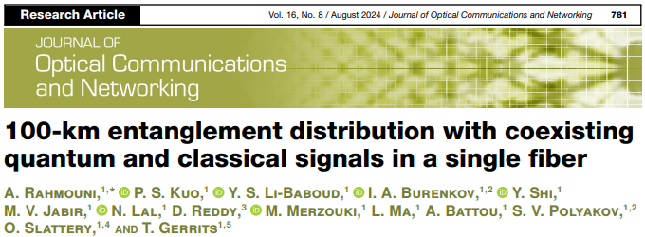
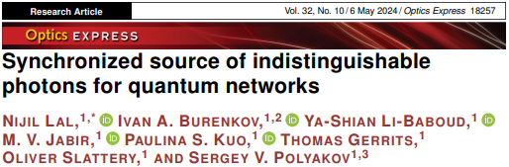
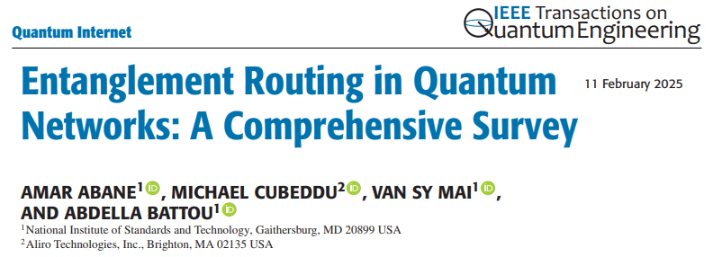
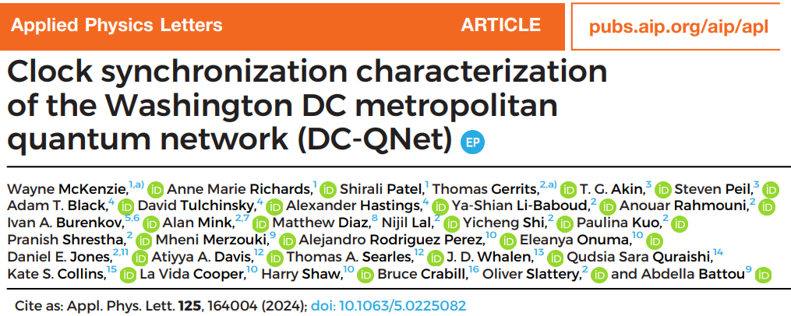
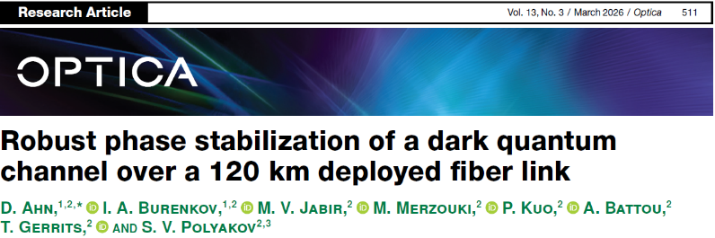
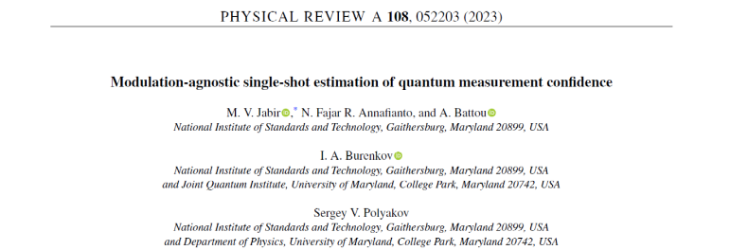
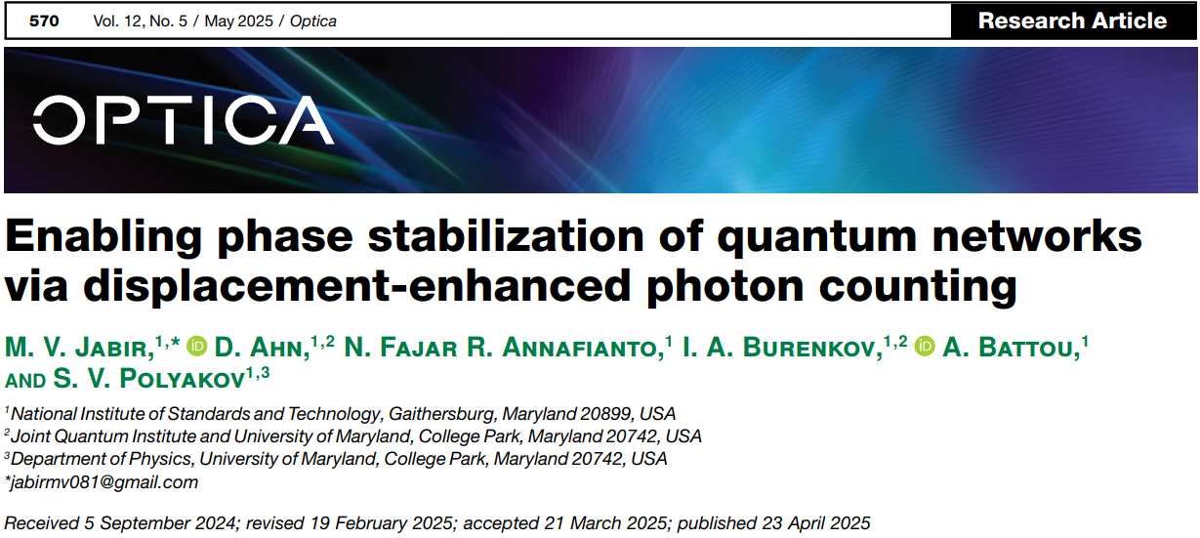
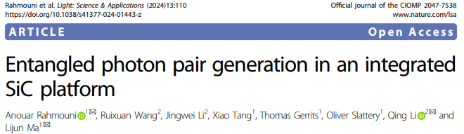
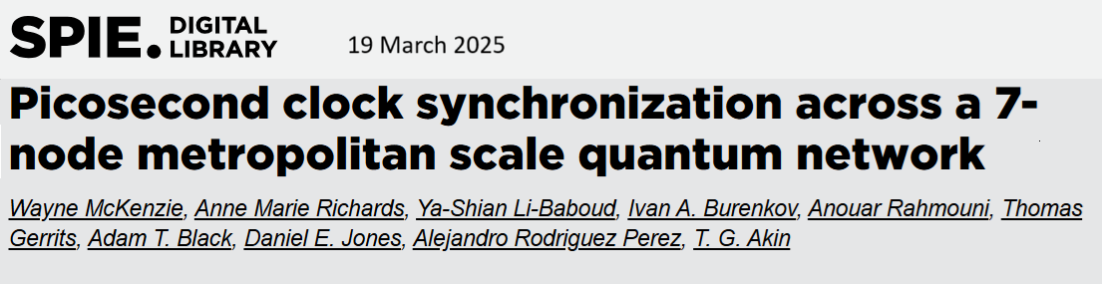
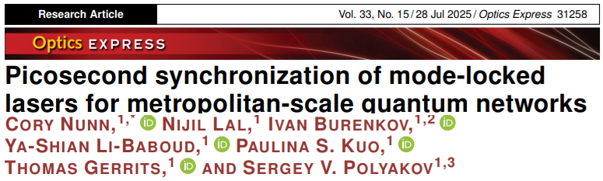
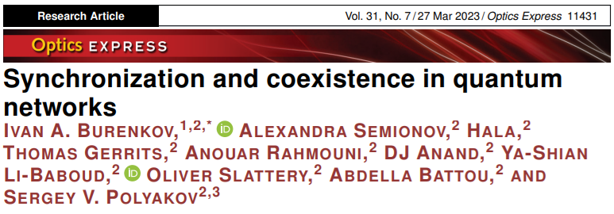
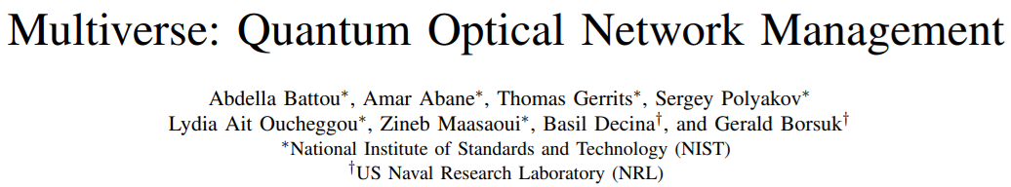
NIST: Some Example Results
8

Slide 9



















U.S. Industry and Government Partners
U.S. Government
DARPA
LTS
NASA
ARL
NRL
USNO
Industry
ADVR
Aliro
Anametric (CRADA)
CERN (White Rabbit Collaboration)
EPB (CRADA)
ISI
Leidos
PhotonSpot (CRADA)
QED-C
QuantumOpus
Qunnect (CRADA)
Safran (France, White Rabbit)
Thorlabs (CRADA)
Xanadu (Canada, CRADA)
MOUs
DC-QNet partners
MAX (Mid-Atlantic crossroads)
NPL (NMI UK)
KRISS (NMI S. Korea)
9

