Slide 1
Assessing and Increasing the Impact of Research at the National Institute of Standards and Technology
Susan Makar, Stacy Bruss, and Amanda Malanowski
NIST Information Services Office
SLA 2013 Annual Conference
The Next Generation Sci-Tech Librarian
June 10, 2013

Slide 2
Presentation Outline
Overview of NIST and ISO
Discussion of impact analyses
  Lab-level
  Institution as a whole
Increasing the impact of NIST research
Note: The identification of any commercial product or trade name does not imply endorsement or recommendation by the National Institute of Standards and Technology.

Slide 3
National Institute of
Standards and Technology
Federal agency made up of about 3,000 science and technology researchers
NIST promotes U.S. innovation and industrial competitiveness by advancing measurement science, standards, and technology
The Information Services Office supports and enhances research activities of the NIST scientific community through a comprehensive program of knowledge management

Slide 4
Assessing Impact
Impact Studies for the Labs
Impact Studies to Assess ISO Impact
Impact Studies for the Institution as a Whole

Slide 5
Impact Studies for the Labs
Quantify impact of a report on its intended audience
Calculate individual h-indexes for promotion packages
Analyze division output over extended time periods for group h-index, citation counts, and more

Slide 6
Quantify Impact of a Report
Technical Report published in 2004 targeted to practitioners in design, construction, and operation and maintenance
Bibliometric analysis of scholarly publications and gray literature, full-text download analysis, and news, trade literature, and blog analysis
Types of Citing Publications

Slide 7
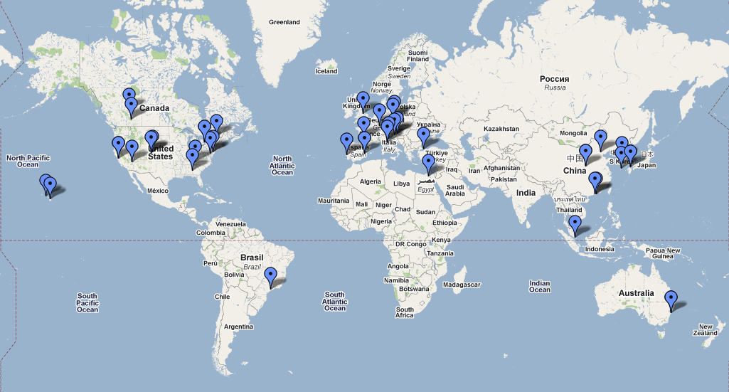
Quantify Impact of a Report
Cited frequently in literature; downloaded even more frequently
Impacted literature in subject fields and geography beyond intended audience
News and trade literature show impact on practitioners in field
Locations of Citing Conference Papers

Slide 8
Analyze Division Outputs
Engineering division wanted h-index values for 44 researchers
H-index values ranged from 2 to 33

Slide 9
Impact Studies for the Institution as a Whole
Identify NIST publications in “top tier” journals using Impact Factor rankings (NIST Balanced Score Card metric)
Analyze outside NIST collaborators on NIST publications to assess NIST’s impact
Study institutions utilizing or citing NIST patents to determine impact of patents
Track detailed bibliometrics of NIST-published journal, Journal of Research of the National Institute of Standards and Technology to help guide editorial decisions

Slide 10
Publishing in
“Top Tier” Journals
Determined number of NIST authored papers published in high impact journals
Used by NIST Management to assess the extent of NIST’s impact
Percentage of NIST Peer Reviewed Journal Articles Published in Top Tier Journals, 2007-2012

Slide 11
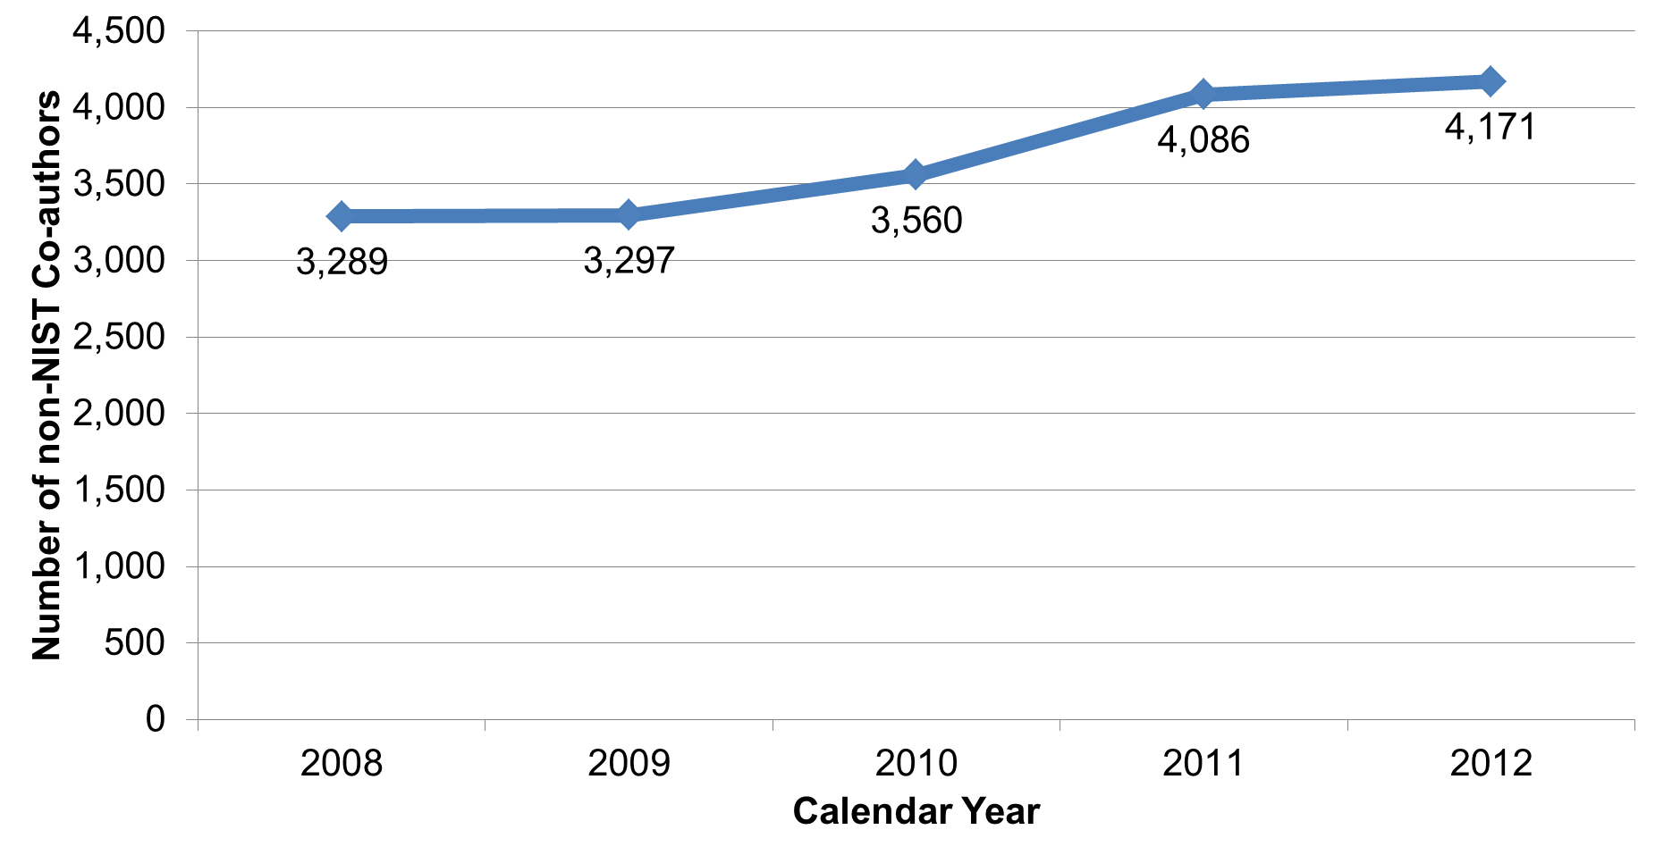
Collaborations with
Outside Organizations
Determined number of unique non-NIST co-authors and number of unique institutions collaborating with NIST
Used by NIST Management to assess the extent of NIST’s impact
Number of Outside Organizations Co-authoring on NIST Publications, 2008-2012

Slide 12
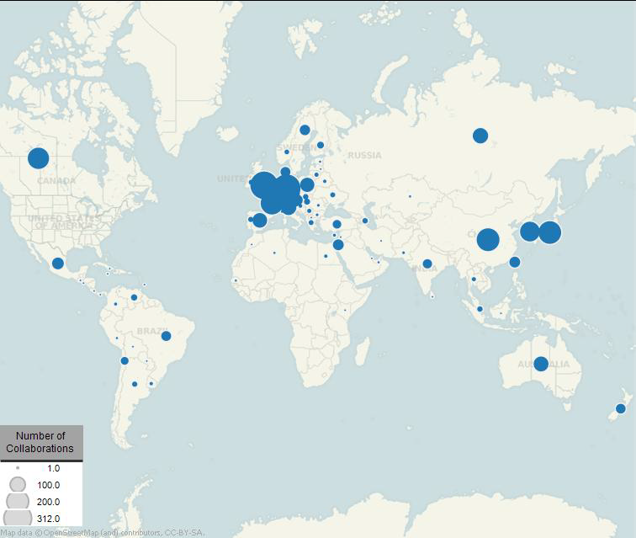
Collaborations with
Outside Organizations
Studied top countries and organizations with whom NIST collaborates
Used data visualization tools to convey and demonstrate impact
Locations of Authors/Institutions Collaborating on NIST Publications, 2008-2011

Slide 13
Increasing the Impact of NIST Research
Help promote NIST conference with bibliometric analysis of past conferences
Recommend journal and conference venues for publishing
  Individual publications
  Proactively for group, program, or division
Highlight NIST research through various venues such as Wikipedia and NIST Digital Archives

Slide 14
Increasing Impact through
Wikipedia
Adding references and links in Wikipedia to Journal of Research of NIST papers
Tracking downloads and citing before and after links added to Wikipedia
Downloads Before and After Linking to Wikipedia

Slide 15
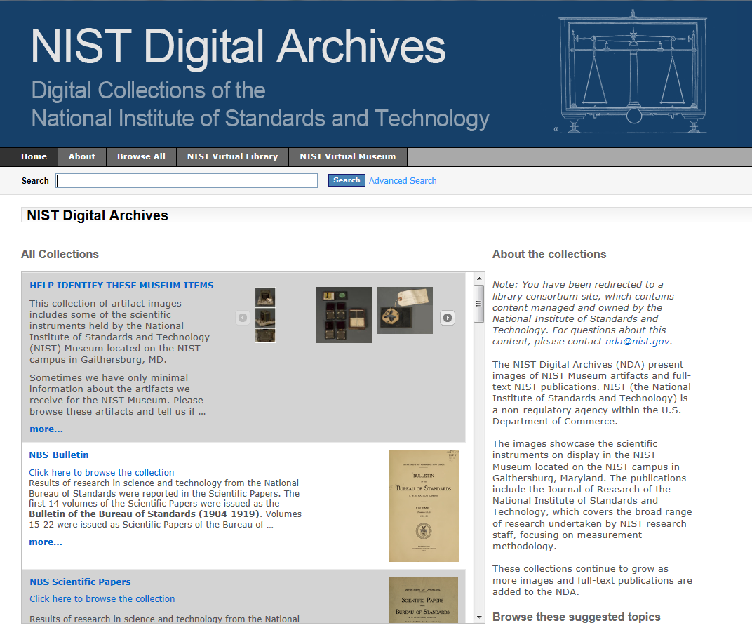
Increasing Impact through the
NIST Digital Archives
Presents images of NIST Museum artifacts and full-text NIST publications
Showcases scientific instruments from the NIST Museum and photos from the NIST Archives
NIST Digital Archives (NDA) web site

Slide 16
Increasing the Impact of NIST Research
Conduct market analysis to help NIST determine future research directions
Identify speakers and attendees for conferences to help increase conference attendance
Conduct benchmark assessments or comparison analyses to assess the value of NIST and to learn from other institutions

Slide 17
Questions?

