Slide 1
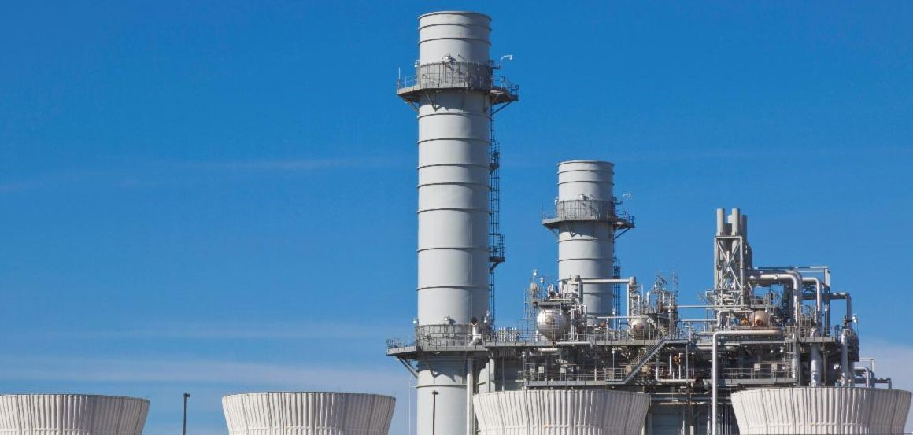

Non-Nulling 3D Velocity Testing for Improving the
Uncertainty of CEMS Flow Measurements
(Evolutions in Measurement Technology)
Source Evaluation Society
September 22, 2021
Presented by Aaron Johnson, NIST
Project Team: Iosif Shinder, Jim Filla, Joey Boyd, Vladimir Khromchenko, John Wright, Michael Moldover, and Rodney Bryant
Tom Martz (EPRI), Sylvio Cardoso (EPRI), Richard M. Himes (EPRI)
Notes:
Today I’ll discuss the work that the NIST has done to improve stack emission measurements from coal-fired powerplants
We have developed what we call “The Non-Nulling Method” to make stack flow measurements faster and more accurate
As I will explain it is important that the NIST method be
accurate
Fast
Robust
In order to be adopted by the electric power industry
The work has been done
by the FMG
NIST staff from other divisions
In cooperation with EPRI – the Electric power research institute

Slide 2
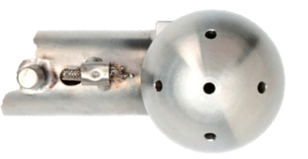

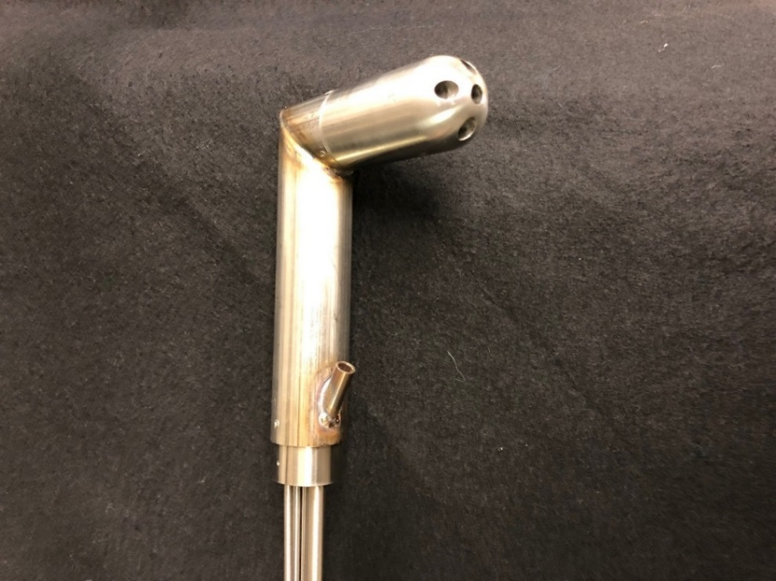
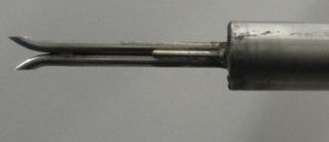
Executive Summary: What NIST has done?
Developed Non-Nulling Method to facilitate fast, accurate, and robust flow RATAs
EPA sanctioned pitot probes can be classified into two categories
Probes with limited accuracy, but fast and robust measurements
Probe with good accuracy, but slow measurements and difficult to use
Probe with good accuracy that provides fast, robust measurements
NIST designed a Non-Nulling Hemispherical Probe
Also developed a Non-Nulling Method for Spherical Probe
Probe Type 1
Probe Type 2
Non-Nulling Probe
Rotate Probe
Non-
Nulling Method
P₂ = P₃
P₂
D = 2.5 cm
D = 2.5 cm
D = 2.5 cm
D = 2.5 cm
P₃
D = 2.5 cm
S-probe (Method 2)
Spherical Probe
Hemispherical Probe
Eliminates need to rotate probe
Non-Nulling is robust, provides 1-3% accuracy & is 4x faster than Nulling Method
Notes:
Probe has 2 large pressure ports that are not probe to being clogged with particulates or that Point velocity
Before we jump into the details of the Non-Nulling Method and Stack Testing let me give an executive summary of what we have NIST has accomplished.
First a few facts
Contrast
Nulling can several minutes to find null condition
Non-Nulling Hemishperical probe measures velocity vector in 5 sec data collection
Hemispherical has larger pressure ports (6 mm) that
Based on results of stack testing

Slide 3
Outline
Explain the Source of Accuracy for the Non-Nulling Method
Review Accuracy of EPA Nulling Method 2F for the Spherical Probe (We assess accuracy of the Non-Nulling Method to EPA Method 2F)
Results of flow RATAs from 4 Coal-Fired Power Plants
Technology Transfer of the Non-Nulling Method to Industry
Conclusions and Future Work

Slide 4
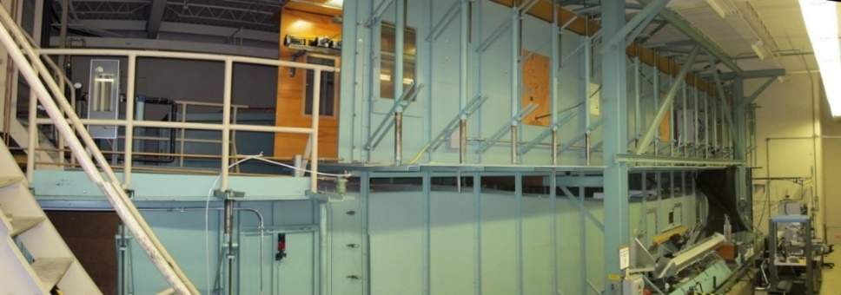
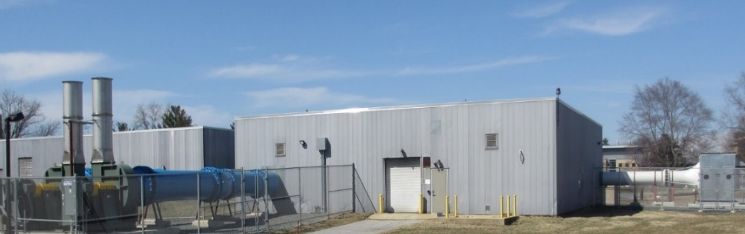
Source of Accuracy of the Non-Nulling Method
Accuracy of NN Method
Method 2F Review
Field Results
Technology Transfer
Conclusions
Non-Nulling & Nulling probes calibrated in NIST WIND TUNNEL
  S-Probe
  Spherical & Prism Probes (Nulling)
  Spherical Probe (Non-Nulling)
  Hemispherical probe (Non-Nulling)
Validated accuracy of probes by performing flow RATA in NIST Stack Simulator
Collaborate with EPRI to apply NIST Non-Nulling Method to industrial stacks
EPA’s
Protocols
NIST WIND TUNNEL
NIST’s
Protocols
Generates smokestack-like flows (i.e., yaw angle 35° & & pitch angle 10°) in a 4 ft Test Section
Facility is equipped with a calibrated reference flow meter with an uncertainty of 0.8 %
Results: Spherical Probe (1 to 2%) & Hemispherical probe (1 to 3%)
Stack Simulator Facility
Notes:
With this in mind we have implemented a 3 Tier Strategy to improve the flow RATA and flow CEMSs
Major

Slide 5

Accuracy of NN Method
Method 2F Review
Field Results
Technology Transfer
Conclusions
How Do We Calibrate Non-Nulling Probes?
LDA
Sensing
Volume
Calibrations are performed in NIST’s Wind Tunnel
  Air Speeds (U_{ꝏ}) 16 ft/s to 100 ft/s measured with LDA Working Std.
  Grid generated Turbulence Intensities 0 % to 10 %
Automated Traverse System Orients Probe
  Range of pitch angles (α) from -20 ⁰ to 20 ⁰
  Range of yaw angles (ꞵ) from -60 ⁰ to 60 ⁰
Calibration Data
  Requires 500 wind tunnel data points
  Data is used to develop curve fits for Dynamic Press. (P_{dyn}), Pitch (α), Yaw (ꞵ), and Static Press. (P_{static})
x
x_{BF}
y_{BF}
y
α
β
Who will perform the 500 point non-nulling calibration for each probe?
Notes:
Efforts are underway to reduce CO2 emissions from coal fired power plants

Slide 6
Accuracy of NN Method
Method 2F Review
Field Results
Technology Transfer
Conclusions
NIST Developed a Universal Curve Fit for the Hemispherical Probe
We procured 6 Hemispherical probes
the 6 probes were manufactured to the same geometrical dimensions
3 different manufacturers, 2 probes made in machine shop, and 4 probes 3D printed
A single universal curve fit characterized the performance of all 6 probes
Dynamic pressure (P_{dyn} ): ± 2 % to 4 % Accuracy
Yaw Null Angle (β_{null}): accuracy ± 1º to 2º
Pitch Angle (α): accuracy ± 1º to 2º
Commercial airspeed labs will confirm the accuracy of universal fit at specified pitch, yaw, and velocity
Work is underway to determine geometric tolerances required to ensure probes are interchangeable (i.e., the universal fit applies to all probes within geometric tolerances)
universal fit can be adjusted for probes slightly out of tolerance based on wind tunnel calibrations (preliminary results indicate a 20 to 30 point calibration)

Slide 7
Accuracy of NN Method
Method 2F Review
Field Results
Technology Transfer
Conclusions
How do you apply Non-Nulling Method in Stack Test?
Measurements are made with P₁ aligned with stack axis (Yaw angle = 0)
(No need to rotate probe to find P₂ – P₃ = 0 at each traverse point)
Dynamic Pressure, Yaw, Pitch, and Static pressure
are curve fits to wind tunnel data fit as a function of differential pressures
Differential pressures are measured for 5 sec at each traverse point and NIST curve fits are used to determine axial velocity (Note density is NOT determined by Non-Nulling)
- Static pressure determined
Hemispherical
Probe
Differential Pressure Notation:
P₁₂ = P₁ – P₂
Notes:
Cos(Yaw) & Cos(Pitch)

Slide 8
Accuracy of NN Method
Method 2F Review
Field Results
Technology Transfer
Conclusions
How do we assess the accuracy of Non-Nulling Method in the field?
Compare Non-Nulling to Method 2F for Spherical Probe
Benefits
Nulling Method 2F is an established protocol and trusted by
industry and EPA
EPRI independently validated the accuracy of the EPA Spherical
Probe Method 2F (1% accuracy) under laboratory conditions (1990’s)
NIST validated the EPA Nulling Method 2F in its stack simulator (1 to 2 % accuracy)
Comparison Nulling vs. Non-Nulling will determine time savings
Challenges
NIST research shows significant errors result if probe is
inadequately nulled, P₂ ≠ P₃
2) Plugging problems: Lab tests showed that the spherical
probe’s ports “plug” in < 2 min in saturated air loaded with
water droplets (Same test did not plug hemispherical probe)
Plugged Pressure Port

Slide 9
Accuracy of NN Method
Method 2F Review
Field Results
Technology Transfer
Conclusions
Review Method 2F & Assess Magnitude of Nulling Errors
Determine calibration factors F₁ and F₂ (measured in wind tunnel at P₂₃ = 0)
Errors in P_{dyn} as a function of yaw angle
No.
Stack Application of Method 2F
Iterate to find β_{null} yaw null angle (i.e., P₂₃ = 0)
Standard M2F
1)
M2F & Theory
(Method 2F does not specify tolerance P₂₃ = 0)
20% Error!
With probe at β_{null} measure F₁ = P₄₅/P₁₂ and use F₁ calibration curve to find pitch angle (α)
± 2%
2)
P_{dyn} / P_{dynCAL}, [%]
P_{dyn} / P_{dynCAL}, [%]
6.6 % spread
(perfect null)
How do we fix the problem?
With probe at β_{null} measure P₁₂ and quantify F₂ using pitch angle (α) and F₂ calibration curve
Low P_{dyn}
3)
P₂₃ > 0
YES!
β_{probe} - β_{null}, [deg]
Are nulling errors significant?
Can you “stack” the deck (i.e., determine sign of P₂₃ to yield smaller P_{dyn})?
Accuracy of theoretically corrected P_{dyn} is ± 2% for probe yaw angles within ±10º of β_{null}
YES!
We applied this correction to Method 2F results to correct for nulling errors

Slide 10
Accuracy of NN Method
Method 2F Review
Field Results
Technology Transfer
Conclusions
Do the proposed nulling error corrections work in the field?
Method 2F (M2F) Iteration 5
M2F Iterations 1 through 4 (P₂₃ ≠ 0)
M2F & Theory
Non-Nulling Algorithm
200
1st
2nd
3rd
4th
5th
74
22.6
150
70
21.3
100
50
66
20.1
P₂₃, [Pa]
0
Axial Velocity, [ft/s]
Axial Velocity, [m/s]
P₂₃ = 0
(Ideal Nulling)
62
18.9
-50
Avg
-100
Actual Nulling Data
58
17.7
-150
-200
54
16.5
1425
1445
1465
1485
0
1
2
3
4
5
6
Time, [sec]
Iterations to optimize P₂₃=0
Non-Nulling gives accurate velocities for all values of P₂₃ providing fast measurement results
1.2
1.1
1.0
0.9
0.8
0
100
200
300
400
500
600
time [min]
Notes:
The correction for nulling errors was based on existing Method 2F & a theoretical correction based on flow around a sphere
Wind tunnel data showed the correction worked well
Now we address How well the correction works in the field
To show the effectiveness of the correction we show a plot of at a single traverse point during a flow RATA where the stack tester attempts to null a spherical probe
X-aixs is time
Y-axis P23

Slide 11
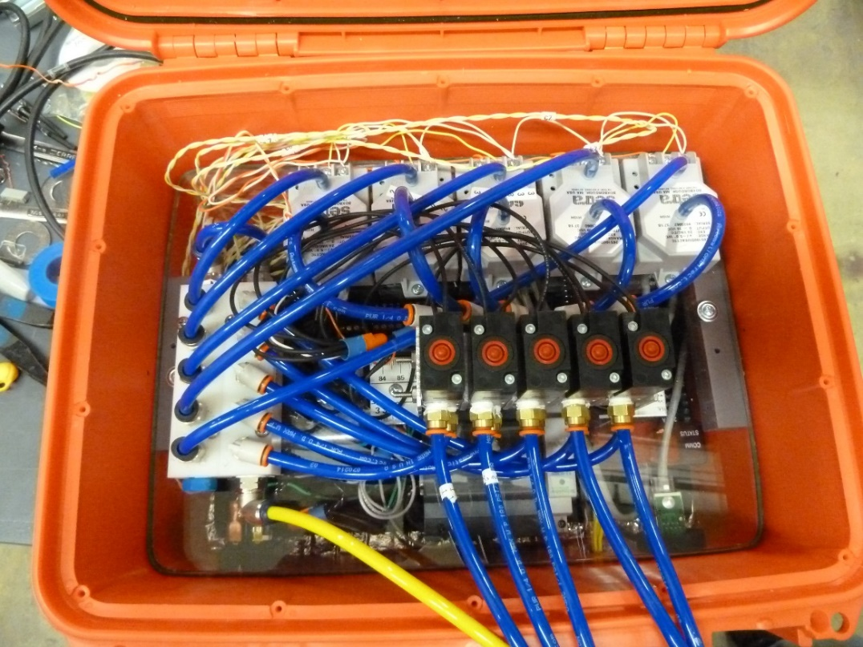
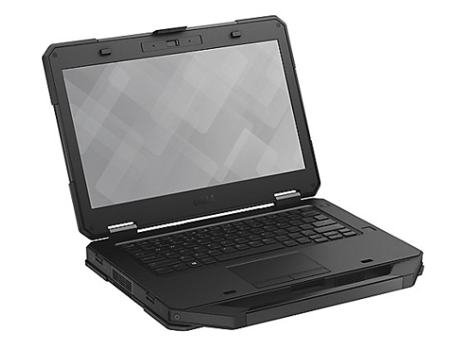
NIST Developed Data Acquisition Box and Software
Accuracy of NN Method
Method 2F Review
Field Results
Technology Transfer
Conclusions
5 DP transducers
Equipment housed in a compact water-proof box
Key Features
  5 Industrial grade differential pressures transducers
  Five 4-way solenoid valves for rapid response, to protect dP sensors during pressure purge
  Weather-proof Laptop
Data Collection & Processing
  LabVIEW data acquisition program
    - Normal sampling rate is 10 Hz for velocity measurements
    - Sample rate is 5 kHz for measuring turbulence
Non-Nulling Algorithm
  Velocity, Yaw, & Pitch calculated using measured dP’s
  Static pressure is also calculated
  Algorithm to troubleshoot for plugging of pressure ports
Reference
Pressure
Manifold
4-way solenoid valves
Laptop

Slide 12
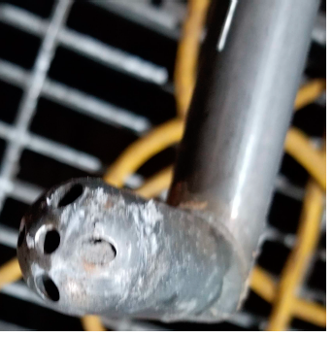
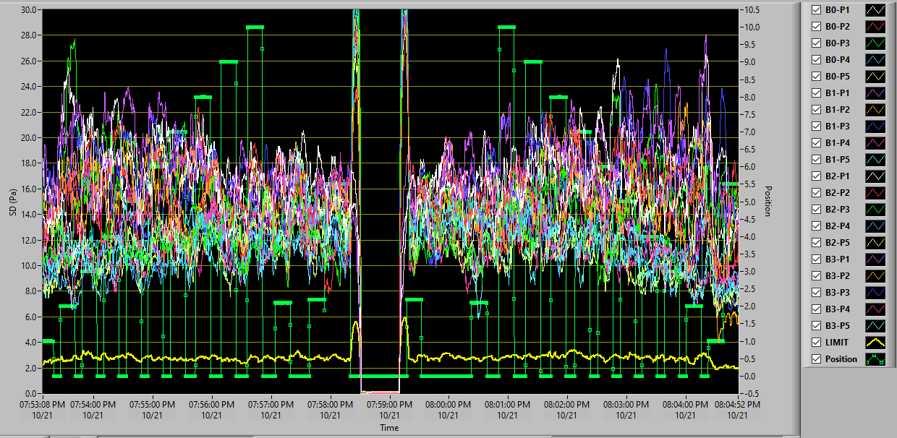
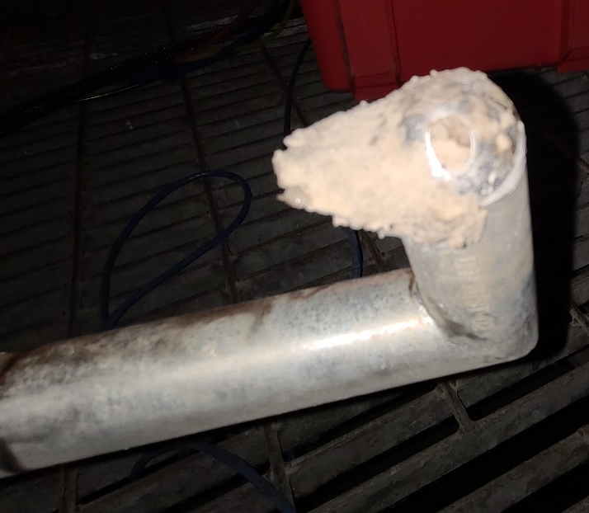
Accuracy of NN Method
Method 2F Review
Field Results
Technology Transfer
Conclusions
Picture of Plugged/Blocked Pressure Ports
Stack testers use high pressure air (100 psi) to periodically purge pitot probe pressure lines
prior testing indicated that purging alone is insufficient to eliminate plugged probes when Nulling Method is implemented using spherical probe
NIST developed software diagnose plugging events
LabVIEW software to identify plugged pressure ports
  Screen shot shows standard deviation of 20 pressure signals (4 spherical probes each with 5 pressure ports) as probes are traversed from point to point
  If stdev falls below empirically determined threshold stack tester is notified
Stdev 20 dP measurements
Empirical threshold to signal plugged data

Slide 13
Results from 4 Coal-Fired Power Plants
Accuracy of NN Method
Method 2F Review
Field Results
Technology Transfer
Conclusions
N/A
Wet Stack 1
Wet Stack 2
Dry Stack 3
Wet Stack 4
Low
Load
High
Load
Low
Load
High
Load
Low
Load
High
Load
High
Load
Probe
(Method)
(7 m/s)
(16 m/s)
(18 m/s)
(27 m/s)
(14 m/s)
(20 m/s)
(13 m/s)
Sphere
(EPA Nulling)
0* %
0* %
0 %
0 %
0 %
0 %
0* %
Taken as
Reference
Sphere
(Non-Nulling)
0.9%
0.0 %
0.9 %
0.5 %
0.5 %
0.1 %
1.2 %
Hemisphere
(Non-Nulling)
-2.5 %
-0.2 %
0 %
1.2 %
0 %
2.6 %
N/A
* Not corrected for stack tester nulling errors
Excellent agreement between Spherical Probe Nulling (EPA) and NIST Non-Nulling Method
Spherical probe: Maximum deviation < 1.2 %
Hemispherical probe: Maximum deviation < 2.6 %
Data indicated that Non-Nulling Method was 4x faster than Nulling Method
No plugging events indicated for Hemispherical probe
Taken as
Reference

Slide 14
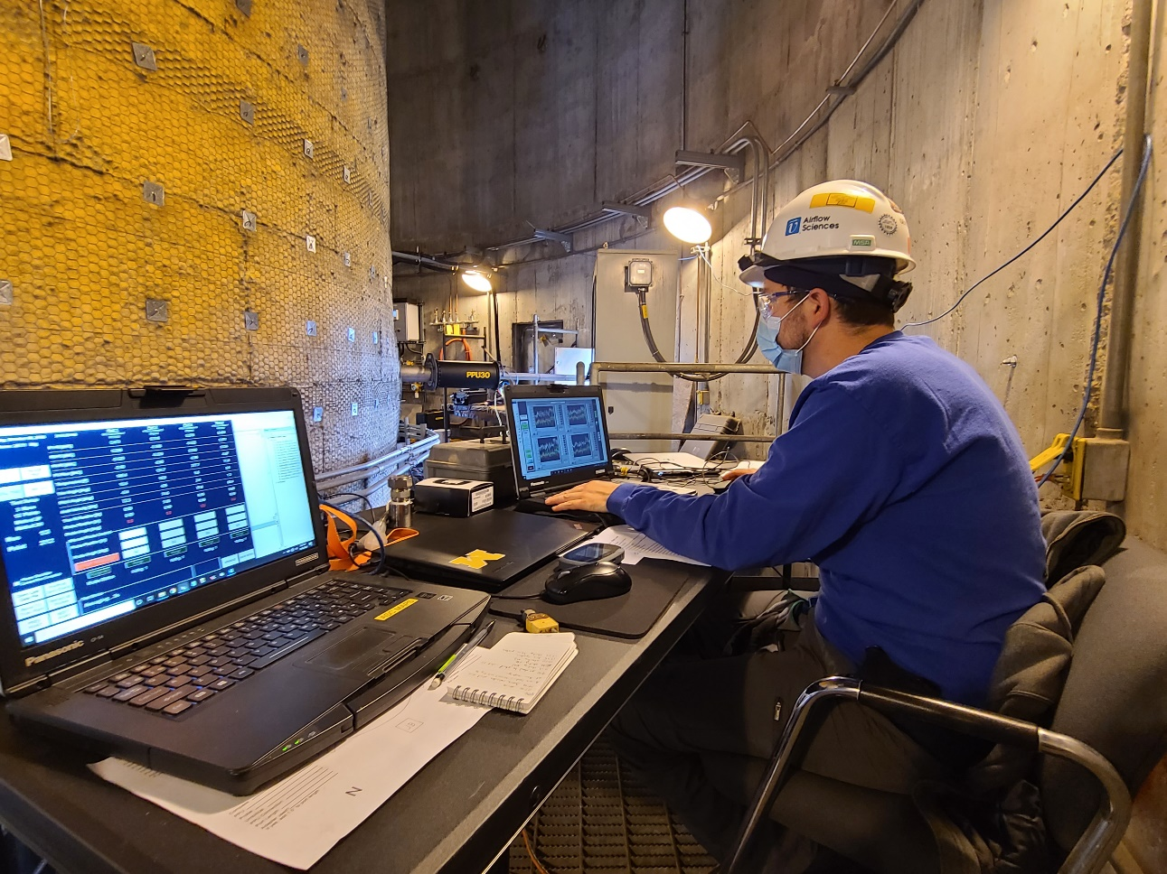
Technology Transfer to Industry in Process
Accuracy of NN Method
Method 2F Review
Field Results
Technology Transfer
Conclusions
Recent test was performed by stack testing company who operated both NIST pressure boxes and software & his own equipment
A Small Business Innovation Research (SBIR) awarded to a stack testing company to develop 1) non-nulling pressure boxes, 2) an automated traverse system, and 3) software to compute velocity
Future testing will use the newly developed industrial non-nulling equipment
Stack tester operating both NIST
and his own equipment

Slide 15
Conclusions
Accuracy of NN Method
Method 2F Review
Field Results
Technology Transfer
Conclusions
NIST Non-Nulling Method
At least 4x faster than nulling methods: EPA Nulling Methods 2G and 2F
Hemispherical probe resistant to plugging problems
Validated Non-Nulling Method in NIST’s Stack Simulator and in 4 Coal-Fired Powerplant Stacks
Accuracy of Non-Nulling velocity measurements 1 to 3 % (Compared to Improved Method 2F)
Complete research on interchangeability and calibration of hemispherical probe shapes
Write the draft of the test method for the Non-Nulling Method to propose to the EPA
Work with EPRI, stack industry, and EPA to make Non-Nulling an approved EPA Method
Future Work

Slide 16
Questions?

