Slide 1
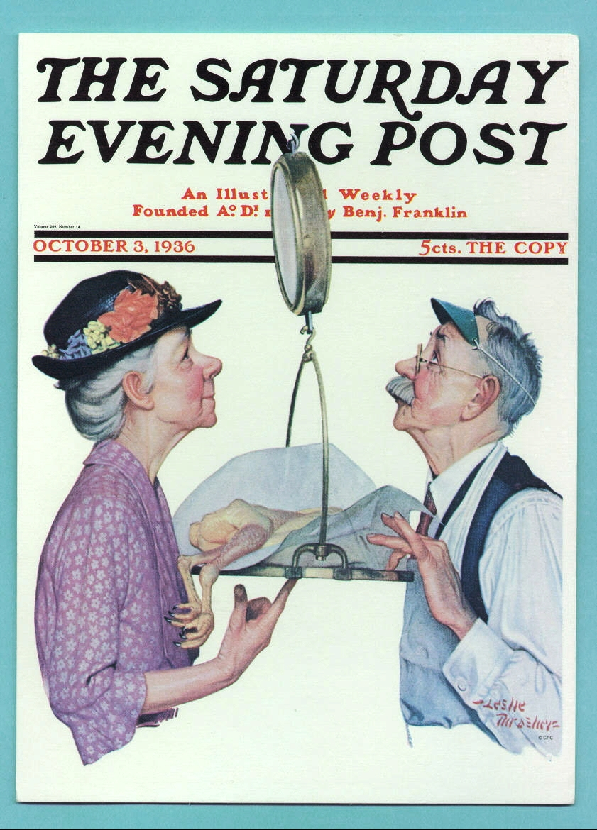
Intro Slide
Good Weighing Practice
It is illegal throughout the world to sell on the basis of gross weight
You must have sound tare procedures and suitable prepackaging and direct sale scales

Slide 2

Good Quantity Control Practices
David Sefcik
Weights & Measures Division
National Institute of Standard & Technology (NIST)

Slide 3
AGENDA
Webinar Protocol and Introductions
HB133 Packaging Requirements
Illustration of a Packaging System
Packer Control
Weighing Accuracy
Tare
Product
12 “Good Quantity Control Practices”
Summary and Handouts

Slide 4
Objectives & Outcomes
Identify the 4 primary components of a packaging system.
Know and recognize the 12 good quantity control practices, as outlined in HB 130.
Know the criteria for evaluating your suppliers quantity control processes and system.
Have the confidence to provide guidance and make improvements to ensure net weight requirements are met.

Slide 5
Introductions
Name
Company
Role
What do you hope to take away from today’s session?

Slide 6
Why Now?
Heightened awareness (investigation).
Limited regulatory oversight has allowed unintentional and intentional fraud to creep into to the marketplace.
Can happen to the best of companies and industries.
See Good Packaging Practices for Dairy Products (by FTC). http://www.ftc.gov/bcp/edu/pubs/business/marketing/bus22.shtm

Slide 7
We Will Not Be Covering…
Ice deglazing procedures.
Field test, audit and sampling procedures.
Focus of states investigation.

Slide 8
NIST is NOT a Regulatory Agency
We cooperate with other Federal Agencies, the States, other countries, standards development organizations, business and industry and the National Conference on Weights and Measures to develop model laws and regulations related to legal metrology.
We support the national and commercial measurement systems primarily by providing traceability, uniform laws, regulations, training, technical and other assistance to administrators, metrologists and field enforcement officials as well as to business and industry.
NIST has a duty under the Fair Packaging and Labeling Act (FPLA): Sec. 1458. Cooperation with State Authorities; Transmittal of Regulations to States;

Slide 9
Questions?
What questions do you have regarding what we will be covering today?

Slide 10
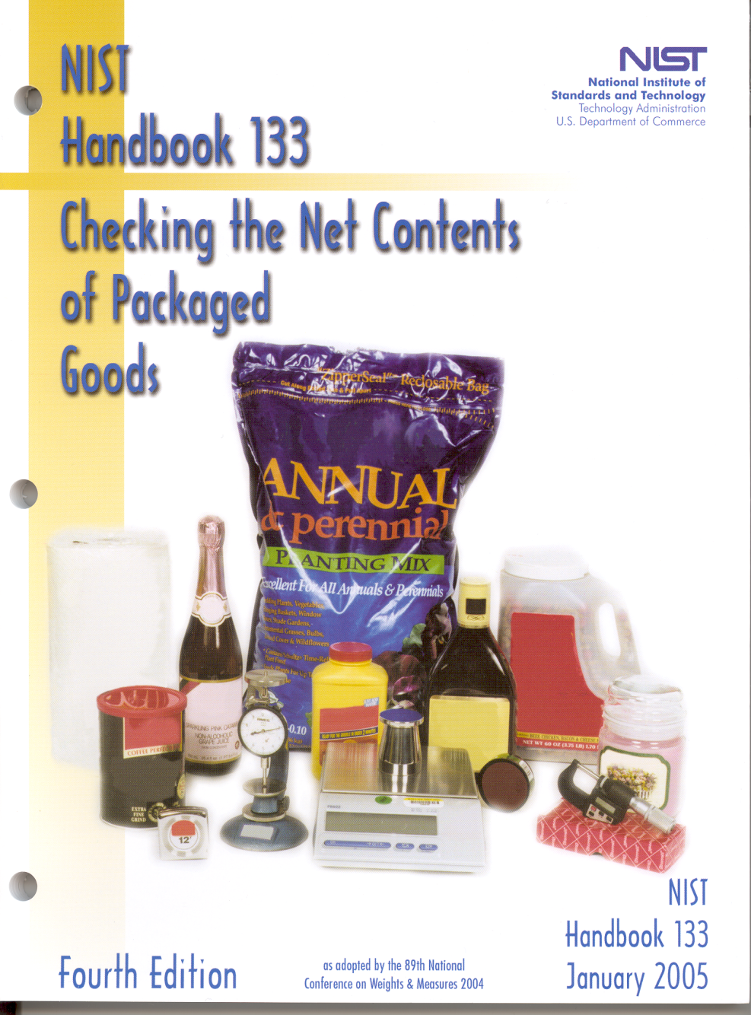
Package Requirements
“How short can my package be?”
“What are the tolerances?”
“What does the net quantity
of contents declaration
represent?”
https://www.nist.gov/system/files/documents/2017/05/09/HB133-05-all.pdf

Slide 11
A Sample Must "Pass" Two Requirements
Average Requirement
A sample "passes" if its average error is equal to or greater than the labeled net quantity of contents.
Individual Package Requirement
Depending on the sample size, no individual package (-) error may be greater than the specified Maximum Allowable Variation (MAV). The MAV varies with the labeled net quantity of contents (See Tables 2-5 to 2-10 in HB 133)

Slide 12
Table 2-5 MAV’s Packages Labeled by Weight
Labeled Quantity MAV
More than 426 g to 489 g 19.9g
More than 0.94 lb to 1.08 lb 0.044lb
More than 15.04 oz to 17.28 oz 11/16oz
More than 489 g to 571 g 21.7g
More than 1.08 lb to 1.26 lb 0.048lb
More than 571 g to 635 g 23.5g
More than 1.26 lb to 1.40 lb 0.052lb

Slide 13
12.1 Packaging Variations
12.1.1. Variations from Declared Net Quantity: "…shall be permitted when caused by unavoidable deviations in weighing, measuring, or counting the contents of individual packages that occur in current good manufacturing practice, but such variations shall not be permitted to such extent that the average of the quantities in the packages of a particular commodity or a lot of the commodity that is kept, offered, or exposed for sale, or sold is below the quantity stated, and no unreasonable shortage in any package shall be permitted even though overages in other packages in the same shipment, delivery, or lot compensate for such shortage….“ (e.g. system)

Slide 14
12.1.2. Variations Resulting from Exposure. - Variations from the declared weight or measure shall be permitted when caused by ordinary and customary exposure to conditions that normally occur in good distribution practice and that unavoidably result in change of weight or measure …. (e.g. moisture)
12.2. Magnitude of Permitted Variations. - The magnitude of variations permitted under this section of this regulation shall be those expressly set forth in this regulation and variations such as those contained in ... NIST Handbook 133, "Checking the Net Contents of Packaged Goods.“

Slide 15
Questions?
What questions do you have about the average and individual package requirements?

Slide 16
Illustration of a Simple Packaging System
shelf life – distribution
unused dry or used dry tare
supplier changes
label size/number of labels
density/volume
variations in wrapping/other items
sample size/minimum load
number & size of soakers
moisture content
environment
handling
material density, solder, adhesives
store or supplier determination
% tare (glaze, individually wrapped items)
Packer
Control
Tare
Weighing Accuracy
Package
Net Wt
2.56 lb
Product
feedback
traceability of weights
intent - fill policy
overfill/moisture loss
data
control
device suitability
accuracy & maintenance
training
static/ dynamic weighing
tolerances
rounding
labeling
economics
supervision
checks & balances
shift
repeatability
sensitivity
knowledge of weighing system

Slide 17
Weighing and Measuring Devices
Retail Computing Scales
Prepackaging Scales
https://www.nist.gov/pml/owm/handbook-44-2009-edition

Slide 18
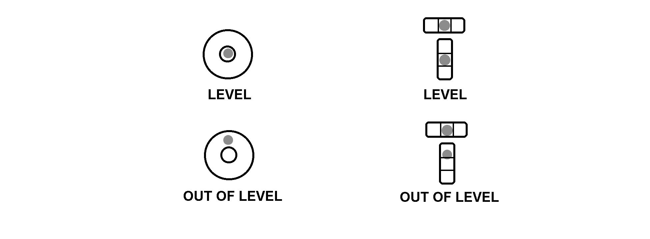
Level Condition
Scales equipped with a level indicator must be maintained in level
H44 Code Reference: UR.4.2.
Notes:
Illustration shows two common types of levels used on portable scales and how the level and out of level conditions of the two types are distinguished.

Slide 19
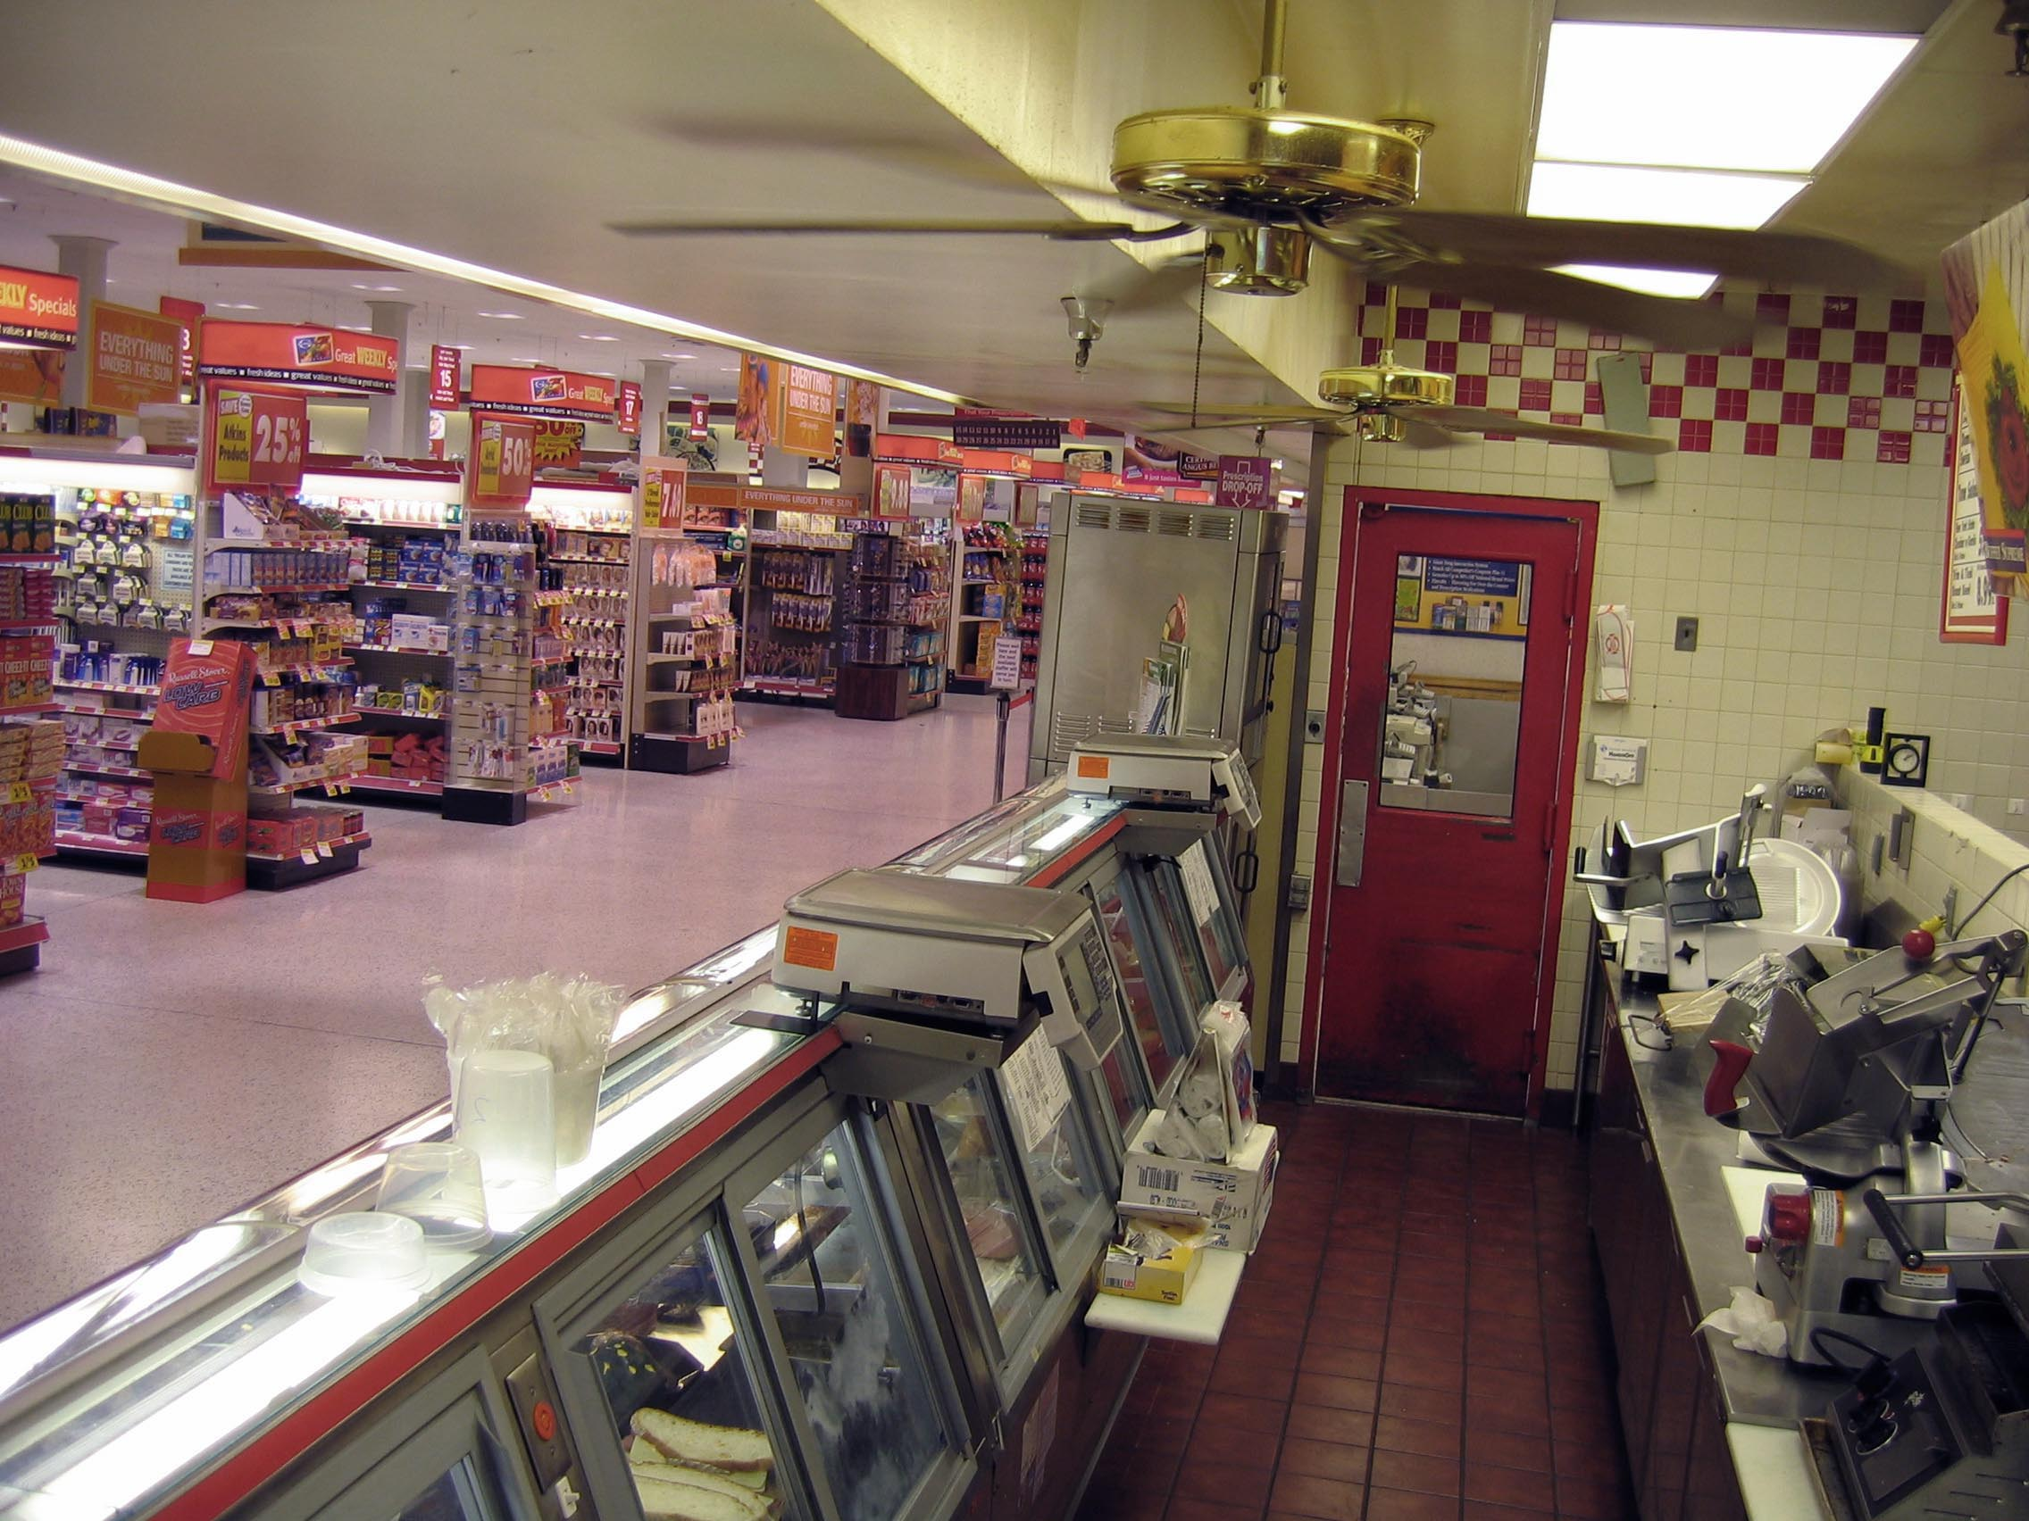
Environmental Concerns
Notes:
Notice the two ceiling fans mounted above the scales in this photograph. By installing these overhead fans near the scales, the device user has likely created an intolerable condition. If either fan generates sufficient draft to affect the weighing performance of either scale then corrective action will be needed.

Slide 20
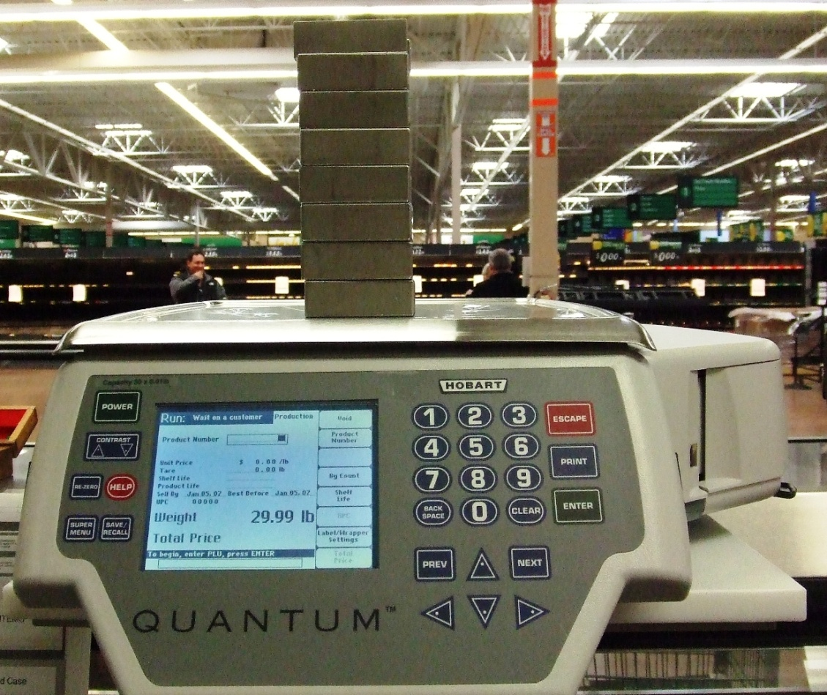
Foundation and Support
Must provide strength, rigidity, and permanence of all components (UR.2.4.)
Notes:
Photo shows scale firmly and securely supported on top of a deli counter. Notice the small stainless steel shelf beneath the scale. This shelf was added to this particular deli counter for the purpose of providing a firm support for the scale. If the foundation under a scale is not firm , the level condition of the scale can change when the platform is loaded and result in inaccurate weight determinations. For this reason, it is necessary to verify that each scale inspected is firmly supported by a firm foundation.

Slide 21
Increasing - Decreasing Load Test
10 lb
15 lb
30 lb
20 lb
10.00 lb
15.00 lb
20.00 lb
30.00 lb
0.00 lb
30.00 lb × .01 lb
Notes:
Test loads specified in N.1.3.

Slide 22
Shift Test Pattern A Test Load of 1/3 Scale Capacity ( 30-35 % )
1st quadrant
2nd
quadrant
10 lb
4th quadrant
3rd quadrant
10.00 lb
0.00 lb
30.00 lb × .01 lb
Notes:
Test loads specified in N.1.3.

Slide 23
Shift Test Agreement
Scale Capacity : 30 lb × 0.01 lb
Shift test load : 10 lb
All test results must agree within the absolute value of the maintenance tolerance even though the scale may be subject to acceptance tolerance
+ 0.01 lb
- 0.01lb
The range of results is 0.03 lb which exceeds the 0.02 lb allowed - this device fails to meet T.N.4.4. Agreement of Indications – Shift Tests
+ 0.02 lb
0.00 lb
30.00 lb × .01 lb
Notes:
Does T.N.4.4. apply to all scales?

Slide 24
Service Agencies
Ensure they are trained on current NIST HB 44 Requirements and that they conduct a W&M type of inspection not just a service test.
Electronic Audit Trails
Licensed or Registered with States where required.
SUPERVISION: ensure that service personnel DO NOT take advantage of tolerances in either direction.
Detailed reports showing as-found and as-left test results and compliance with technical requirements.
Standards must be traceable and used properly.

Slide 25
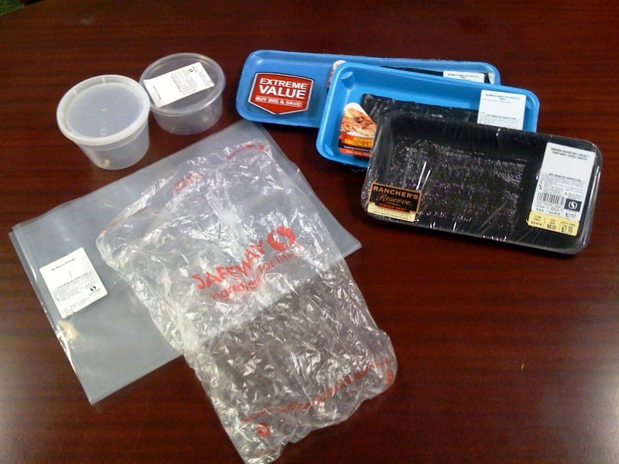
In Store Tare
Stores must deduct the
weight of the ice glaze when
packaging product or selling from bulk.
Suppliers must provide correct percentage tare and notify retailers of changes.
Scales must be capable of doing percentage tare and provisional tare.

Slide 26
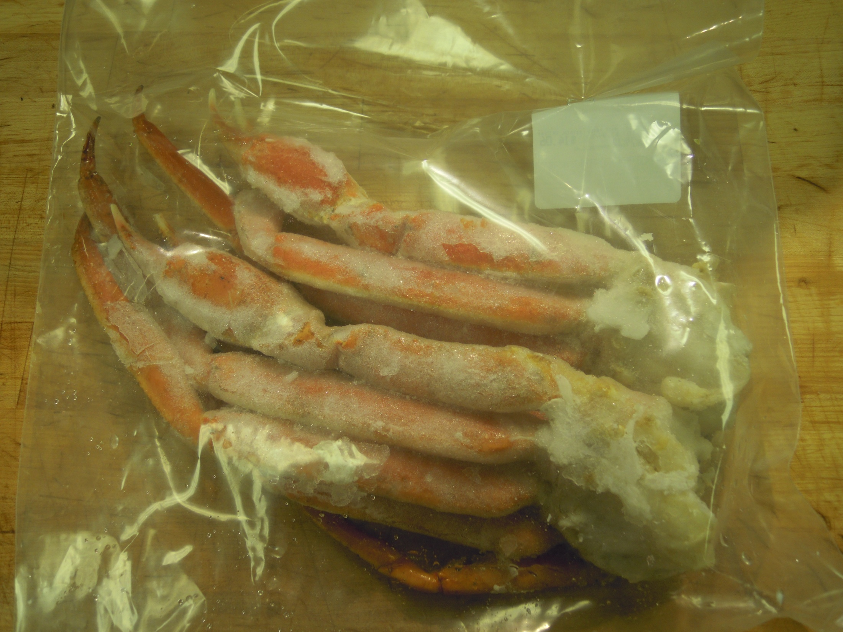
Tare = weight of bag + label + %glaze

Slide 27
Money Value of Weight
Unit Price | 0.001 | 0.002 | 0.005 | 0.01 | 0.02 | 0.03 | 0.05 | 0.25
50 ¢ | 0.05¢ | 0.1¢ | 0.25¢ | 0.5¢ | 1¢ | 1.5¢ | 2.5¢ | 12.5¢
$1.00 | 0.1¢ | 0.2¢ | 0.5¢ | 1¢ | 2¢ | 3¢ | 5¢ | 25¢
$2.00 | 0.2¢ | 0.4¢ | 1¢ | 2¢ | 4¢ | 6¢ | 10¢ | 50¢
$3.00 | 0.3¢ | 0.6¢ | 1.5¢ | 3¢ | 6¢ | 9¢ | 15¢ | 75¢
$4.00 | 0.4¢ | 0.8¢ | 2¢ | 4¢ | 8¢ | 12¢ | 20¢ | $1
$5.00 | 0.5¢ | 1¢ | 2.5¢ | 5¢ | 10¢ | 15¢ | 25¢ | $1.25
$6.00 | 0.6¢ | 1.2¢ | 3¢ | 6¢ | 12¢ | 18¢ | 30¢ | $1.50
$8.00 | 0.8¢ | 1.6¢ | 4¢ | 8¢ | 16¢ | 24¢ | 40¢ | $2
$10.00 | 1¢ | 2¢ | 5¢ | 10¢ | 20¢ | 30¢ | 50¢ | $2.50
$20.00 | 2¢ | 4¢ | 10¢ | 20¢ | 40¢ | 60¢ | $1 | $5

Slide 28

Think of the Numbers
Error-per-Weighment x
Number of Daily Transactions x
7 days per week x
52 weeks per year x
Average price-per-pound =
$ Cost of Error in One Year
Notes:
Error is multiplied by many occurrences

Slide 29
Example of the Accumulation of Errors in 1Year
Assume:
260 transactions per day
$6 lb average unit price
±error of 0.01 lb per transaction
Then: (0.01 lb x $6 lb =) 6 ¢ x 260 (transactions/day) x
7 days per week x 52 weeks per year =
94,640 total weighings/year
$5,678 per year !!!

Slide 30
Questions?
What questions do you have concerning a Packaging System?

Slide 31
Good Quantity Control Practices
HB133 “Interpretations and Guidelines”, Section 2.6.11
These are practiced “everyday”.
“Someone” needs to be held accountable for this function, but at he same time given the tools and authority to get the job done.

Slide 32
Good Quantity Control Practices
1. A formal quantity control function is in place with authority to review production processes and records, investigate possible errors, and approve, control, or reject lots.

Slide 33
Good Quantity Control Practices
2. Adequate facilities (e.g., equipment, standards and work areas) for conducting quantity control functions are provided and maintained.

Slide 34
Good Quantity Control Practices
3. A quantity control program (e.g., a system of statistical process control) is in place and maintained.

Slide 35
Good Quantity Control Practices
4. Sampling is conducted at a frequency appropriate to the product process to ensure that the data obtained is representative of the production lot.

Slide 36
Good Quantity Control Practices
5. Production records are maintained to provide a history of the filling and net content labeling of the product.

Slide 37
Good Quantity Control Practices
6. Each “production lot” contains on the average the labeled quantity and the number of packages exceeding the specified maximum allowable variation (MAV) value in the inspection sample shall be no more than permitted in Tables 2-1 and 2-2 in NIST Handbook 133.

Slide 38
Good Quantity Control Practices
7. Packaging practices are appropriate for specific products and measurement procedures (e.g., quantity sampling, density and tare determinations) and guidelines for recording and maintaining test results are documented.

Slide 39
Good Quantity Control Practices
8. Personnel responsible for quantity control follow written work instructions and are competent to perform their duties (e.g., background, education, experience and training).
Training is conducted at sufficient intervals to ensure good practices.

Slide 40
Good Quantity Control Practices
9. Recognized procedures are used for the selection, maintenance, adjustment, and testing of filling equipment to insure proper fill control.

Slide 41
Good Quantity Control Practices
10. Weighing and measuring devices are suitable for their intended purpose, and measurement standards are suitable and traceable to national standards (test weights).
This includes a system of equipment maintenance and calibration to include recordkeeping procedures.

Slide 42
Good Quantity Control Practices
11. Controls over automated data systems and software used in quantity control ensure that information is accessible, but changeable only by authorized personnel.

Slide 43
Good Quantity Control Practices
12. Tare materials are monitored for variation. Label changes are controlled to ensure net quantity matches labeled declaration.

Slide 44
Additional Resources
American Society for Quality
https://asq.org/
Supplier Quality Page
https://asq.org/quality-resources/supplier-quality

Slide 45
Contacts
David Sefcik - david.sefcik@nist.gov
301-975-4868
Lisa Warfield - lisa.warfield@nist.gov
301-975-3308
www.nist.gov/owm
NIST
National Institute of
Standards and Technology

