Slide 1
Science Afternoon at NIST
Scanning Electron Microscopy (SEM)
Brad Damazo, Prem Kavuri, Bin Ming, Kate Klein and Andras Vladar
Nanometer Scale Metrology Group
Physical Measurement Laboratory
andras@nist.gov

Slide 2
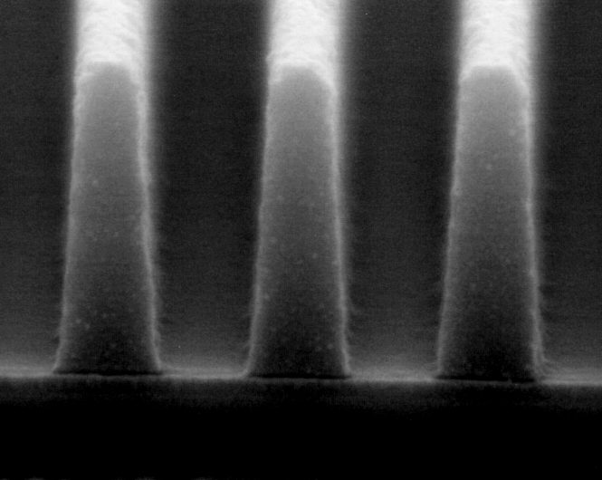
SEM and Imaging System
Frame Grabber
Synchronization
X Y resolution
Temporary frame storage
PCI bus
Fast CPU, lots of RAM, large hard drive
Imaging and measurement software
Number of frames
Time between frames
Vacuum
FE electron gun
Signal detection
Focusing lens
X & Y scan
Sample
Sample positioning stage
Vibration isolation
SEM Computer

Slide 3
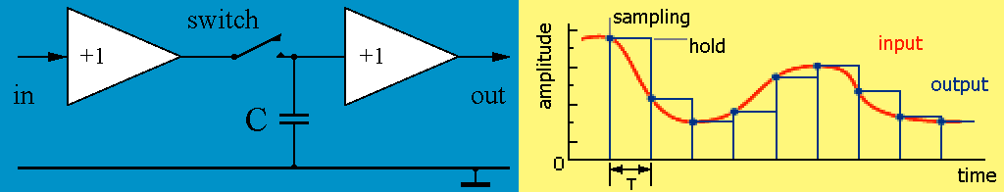
Signal Sampling
Bandwidth (B) : difference between the highest (B₁) and lowest (B₀) frequency
Nyquist (sampling) theorem: an analog signal may be uniquely represented by discrete samples taken at at least twice of the highest frequency (B₁)
Sample and hold circuit keeps signal unchanged for the time of conversion
  spot sampling (cheaper) or gated integrator (more complex, more $)
Example: for audio CDs the 20 Hz - 20 kHz signal is sampled with 44.1 kHz

Slide 4
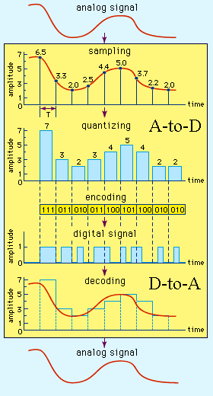
AD and DA Conversion
Analog-to-digital conversion:
sampling, quantizing, encoding
Digital-to-analog conversion:
decoding, filtering
Noise, distortion, non-linearity: resolution dependent for both AD + DA processes
Signal-to-noise ratio (theoretical):
8 bit ADC 48 dB ~250 to 1
12 bit ADC 70 dB ~3100 to 1
Speed of conversion:
100 ksamples/s 12 bit AD converter
0.1 1024x1024 image/s; 25 ns/pixel
10 Msamples/s 12 bit AD converter
10 1024x1024 image/s; 6 ns/pixel

Slide 5
SEM Image Pixel Resolution
512 pixels 4096 pixels
Images with higher pixel density might provide more information, and reveal otherwise not perceivable features

Slide 6
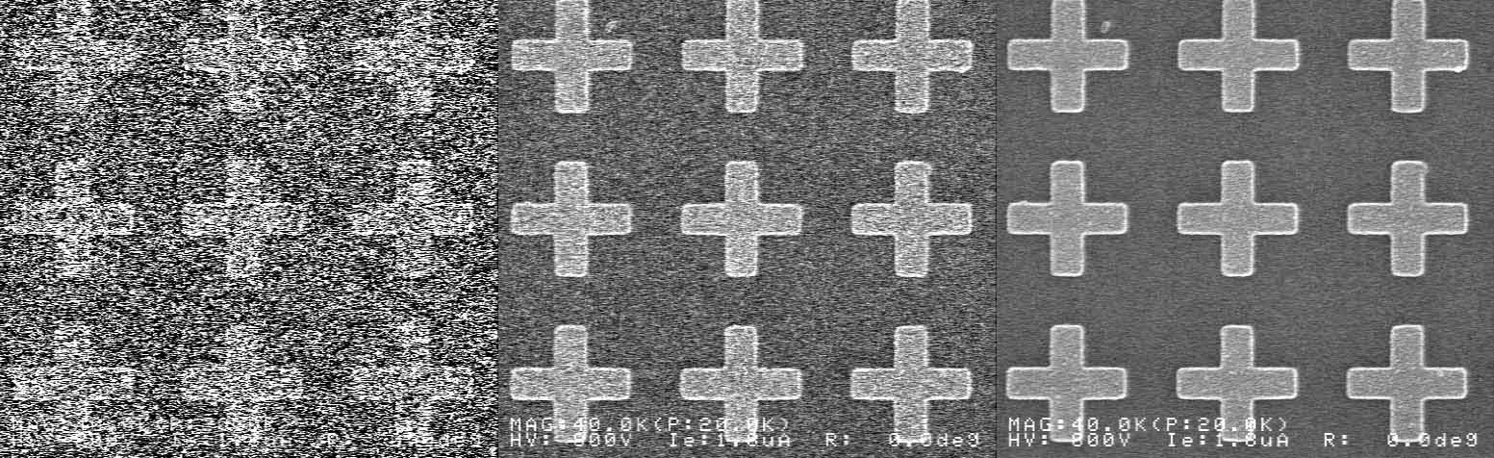
SEM Signal-to-noise Ratio
2 frames 8 frames 32 frames
Acquiring images over longer time can improve the signal-to-noise ratio, and more details can be discerned.

Slide 7
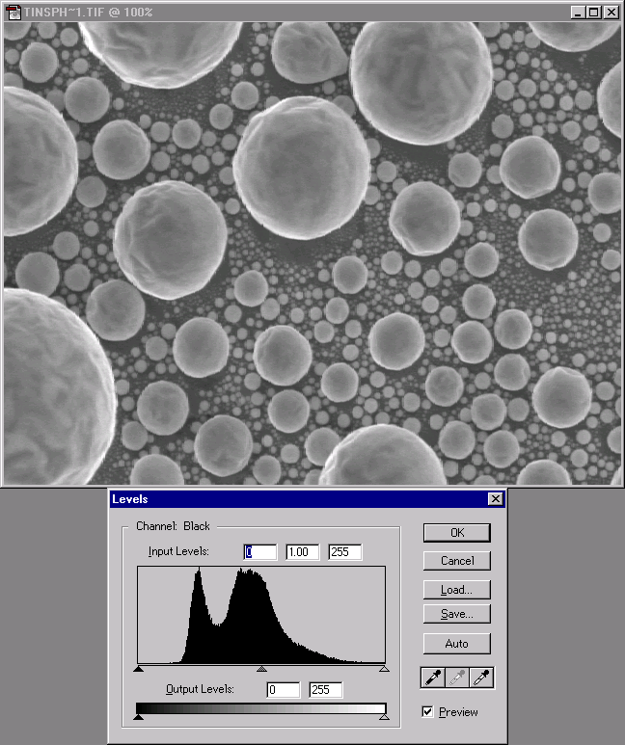
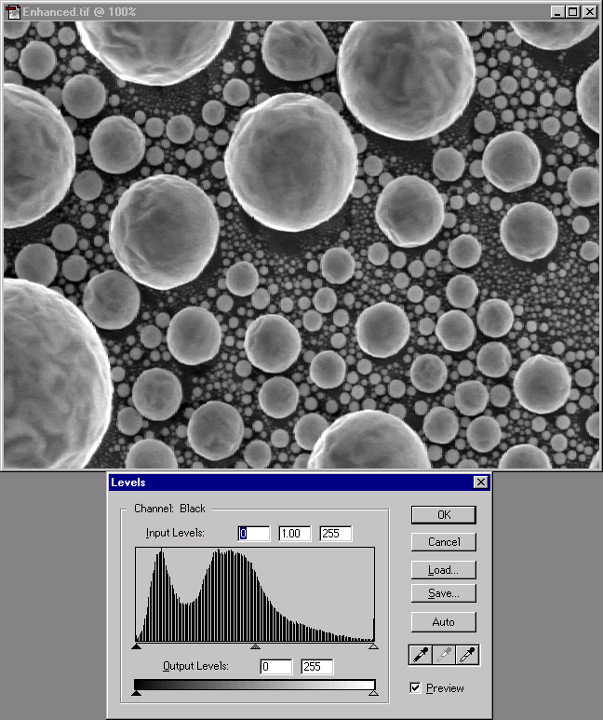
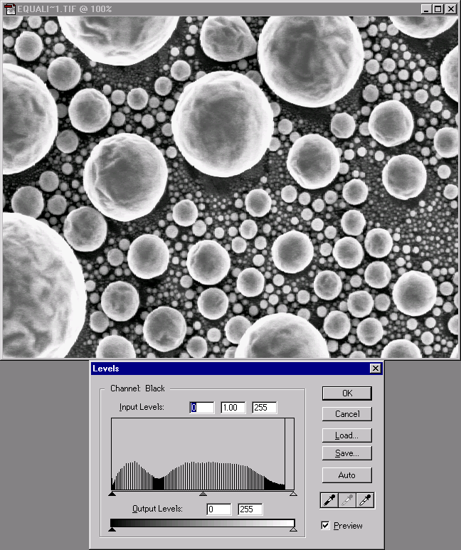
Original Image Histogram Stretched Histogram Equalized
Contrast Adjustment

Slide 8
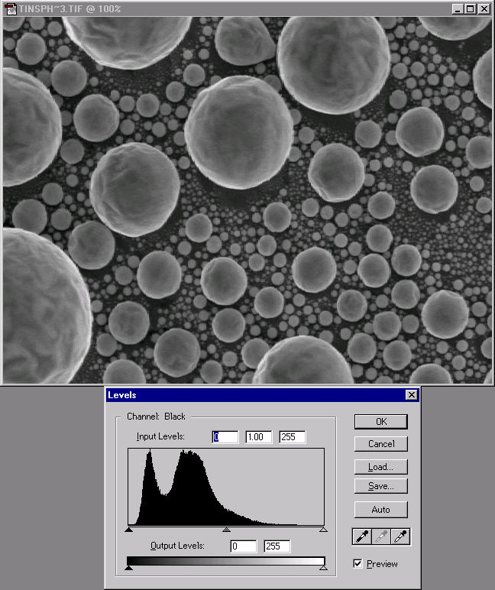
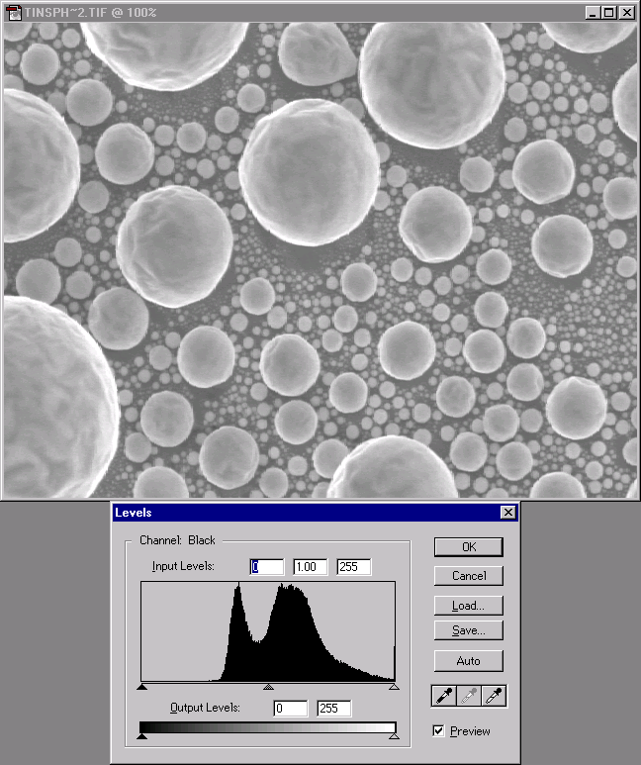
-35 gray levels Original image +35 gray levels
Brightness Adjustment

Slide 9
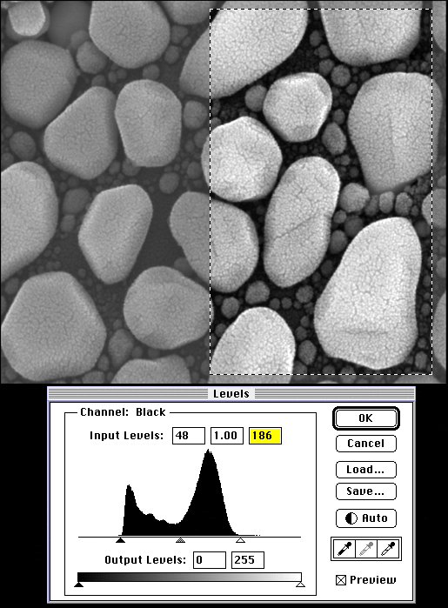
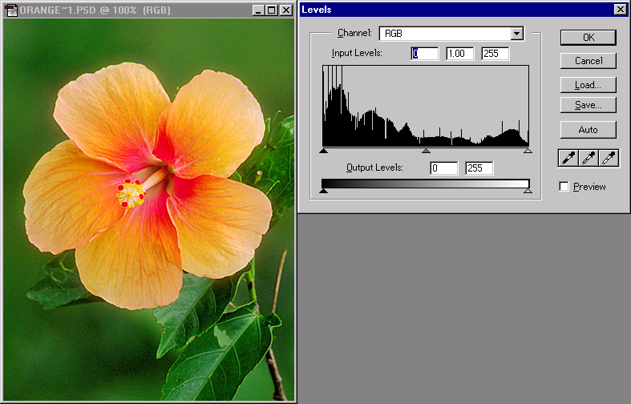
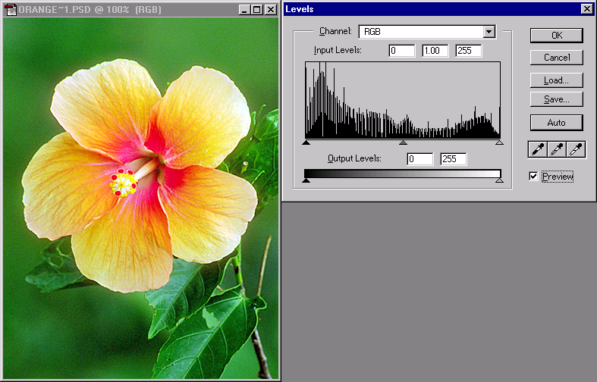
Histogram Stretch

Slide 10
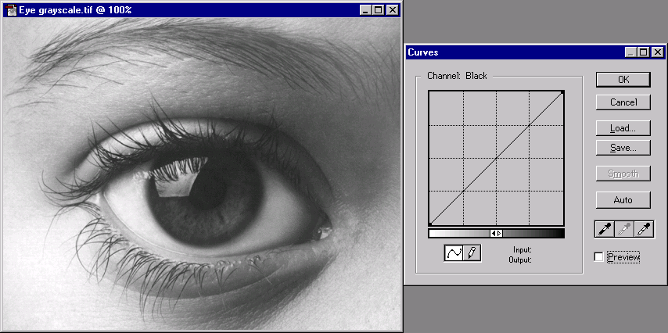
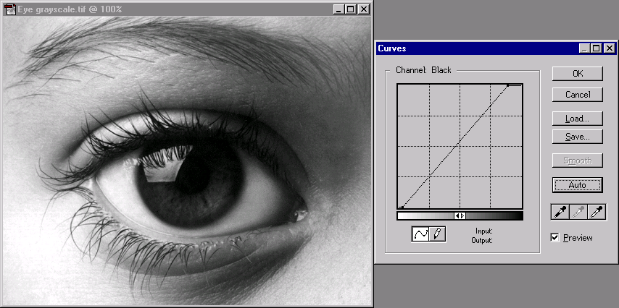
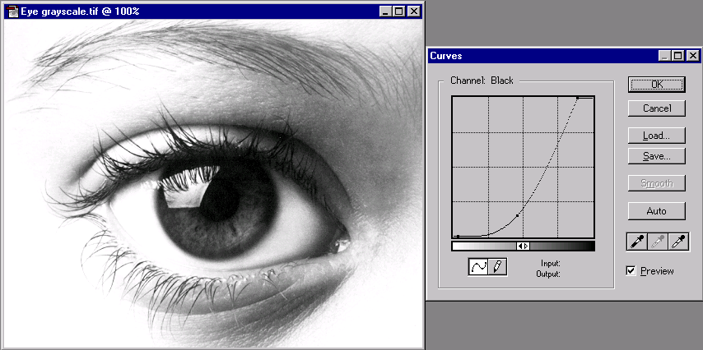
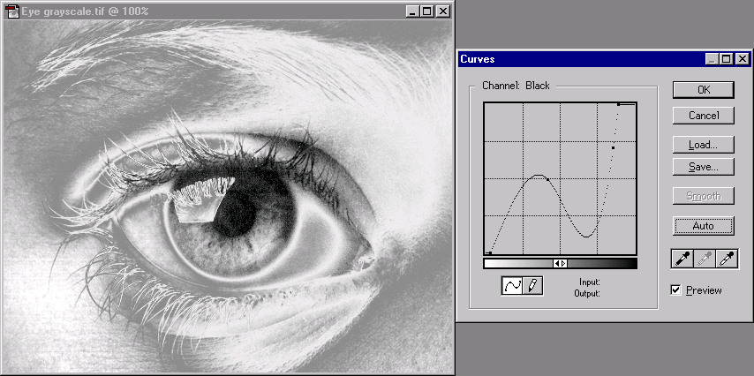
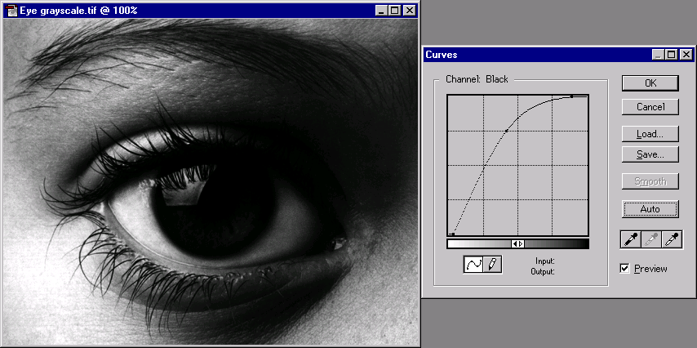
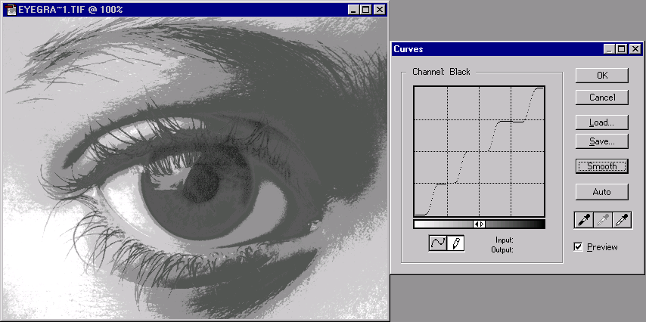
Histogram Adjustment - Transfer Function

Slide 11




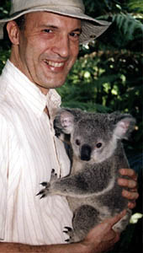
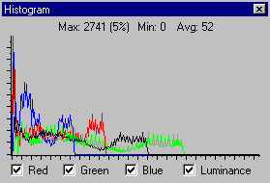
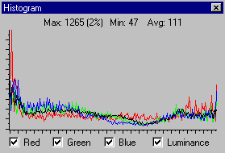
Fixing Colors with Histogram Adjustment
Original RGB images are from David Bright of NIST

Slide 12
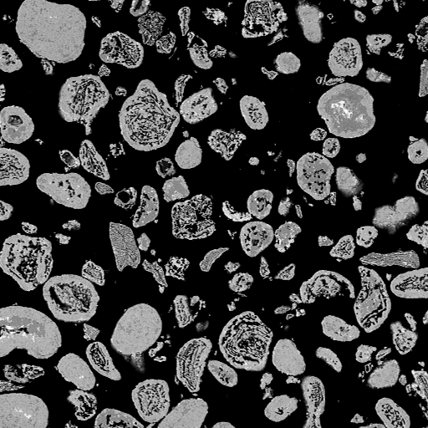
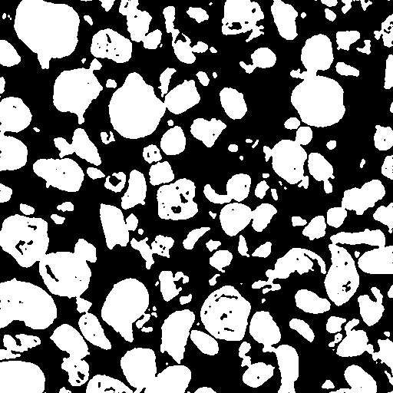
Gray scale image Binary version
From Images to Measured Data

Slide 13
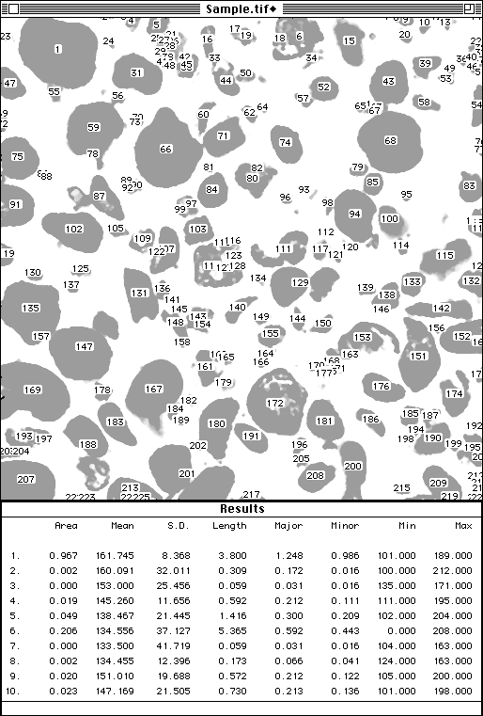
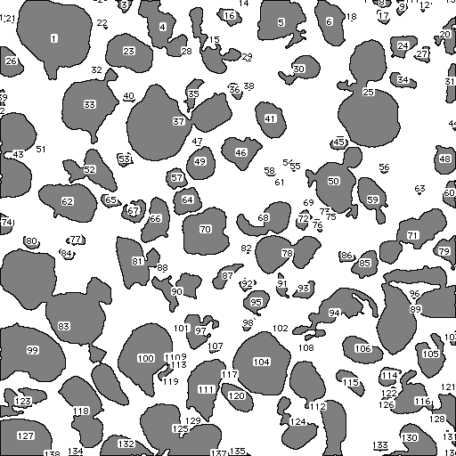
Analysis Result
Particles

Slide 14
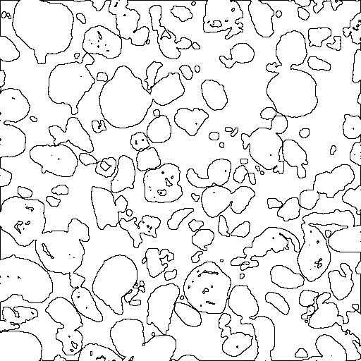
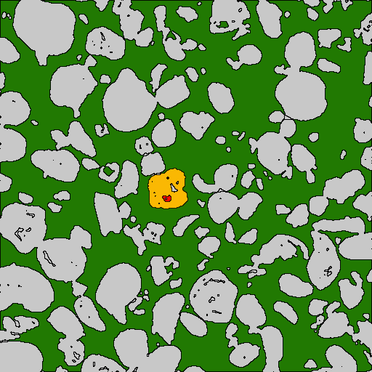
To Interpret Results: Human Mind Needed

Slide 15
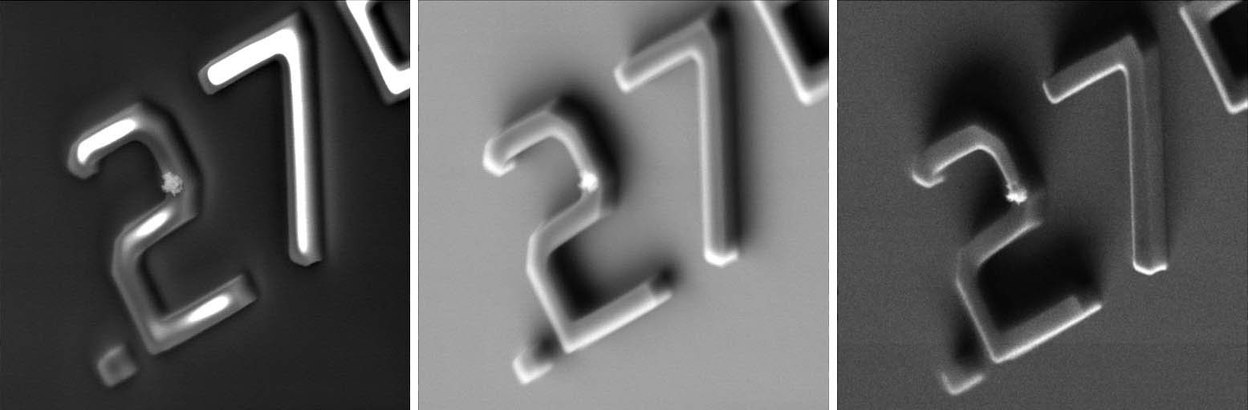
Which one is Right?
Same sample, different electron detectors upper SE, lower SE, low-loss BE

Slide 16
3D SEM? Which is Correct? In or Out?

Slide 17
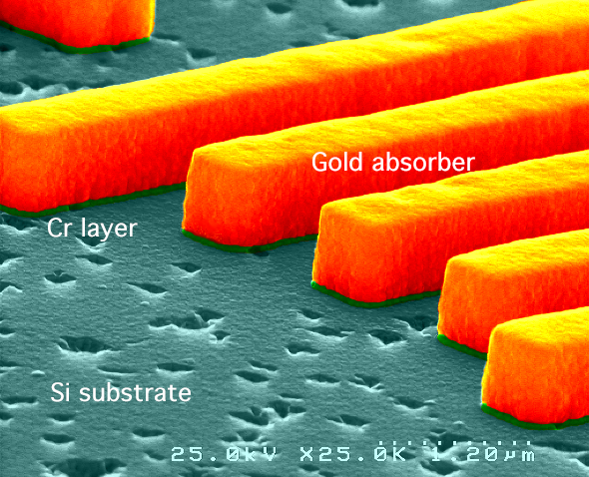
3D SEM? Color SEM?

Slide 18
The Best Way to Interpret the Results
The SEM images are not height maps of the sample
Instead of various fudge factor calculations, it is better put science to work
Monte Carlo modeling and simulation finds the necessary parameters to turn the intensity distribution into real sample geometry information
  compensation for the geometry (edge, height, angle, etc.) and material contrast and charging
  compute yield and trajectory changes of the SE & BE signal due to sample, sample chamber, detector and charging effects. Data Library
  3-D rendering

Slide 19
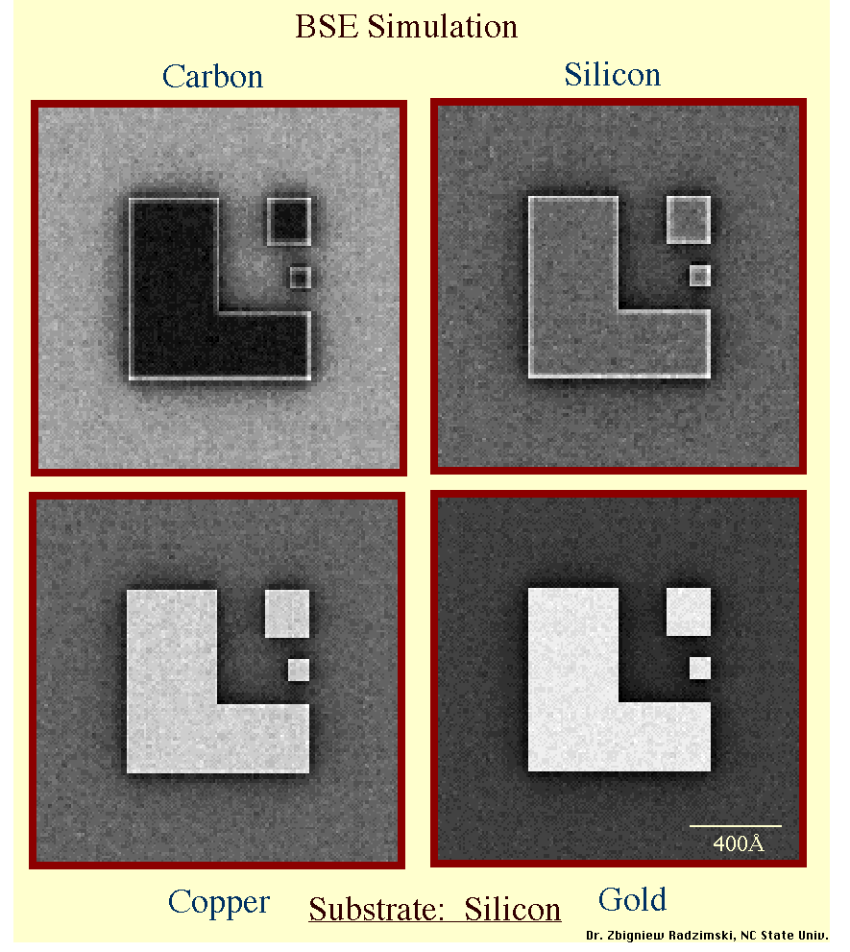

Slide 20
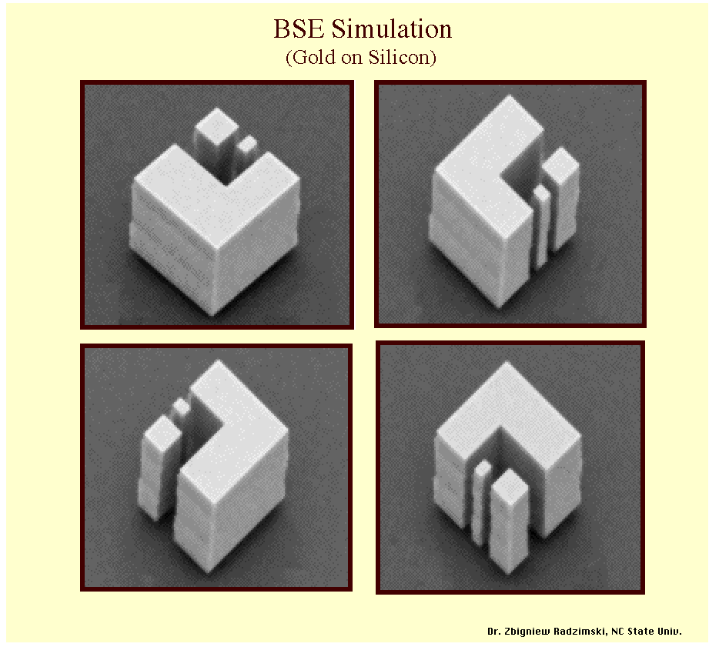

Slide 21
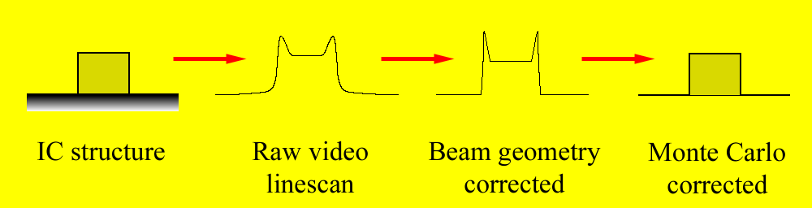
From IC Structures to Correct Dimensions
Correct SEM measurement
De-convolution
Model-based edge criterion

Slide 22
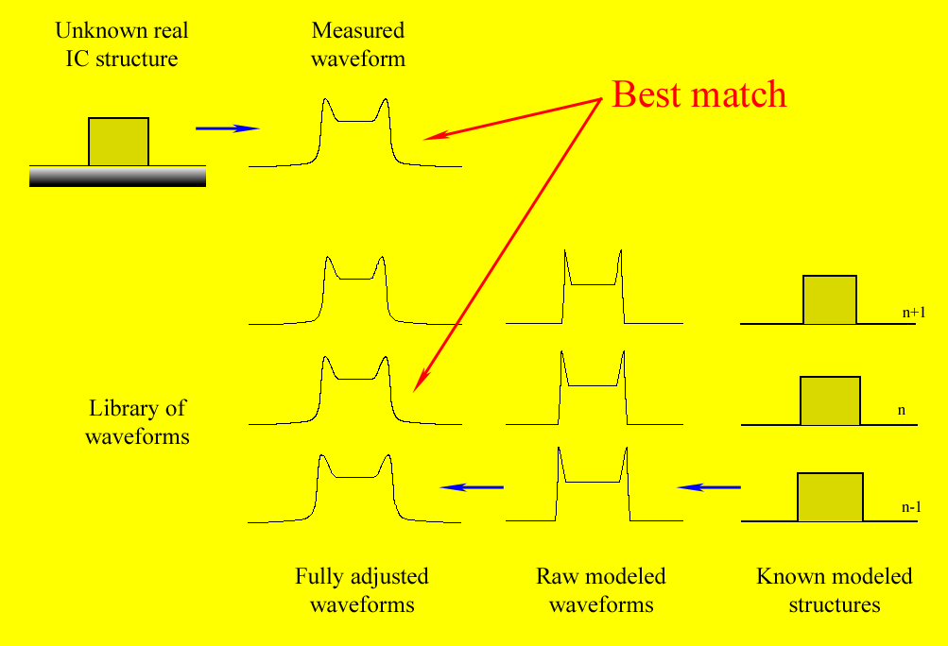
Library-based Dimensional Measurements
The unknown integrated circuit structure can be measured by finding the best match chosen from a modeled library of possible shapes.
This method is superior to any currently known and used algorithm

Slide 23
3-D SEM Imaging
SEM image pair extraction of height and texture information 3-D rendering
http://www.soft-imaging-web.de/

Slide 24
The Best of Scanning Electron Microscopes
The SEM images provide rich information of samples over the millimeter to nanometer scale on a very large and diverse set of samples
Thousands of SEMs are used in research, development and production
3D and super-high resolution imaging and measurements are becoming reality, so are inexpensive SEMs that can do most of the needed work
For the most demanding applications expensive instruments and laboratories and knowledgeable microscopists are needed

