Slide 1
NIST Cybersecurity Framework Threat Profiles
October 26, 2018
Ari Schwartz
Managing Director, Venable LLP
ASchwartz@Venable.com 202.344.4711

Slide 2
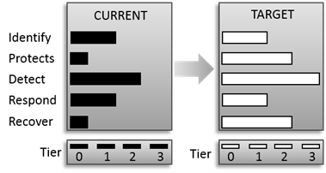
FRAMEWORK PROFILES
The state of your controls today.
Where you want to be, based on risk.
| Cybersecurity Risk Management Services

Slide 3
THREAT PROFILES
Alignment of Functions, Categories, and Subcategories to:
  Guide organizations in implementing controls that will protect from a specific type of attack or prevent compromise.
  Useful as an overlay on existing Framework based risk management programs; a Profile provides a specific lens on how threats and mitigations are being addressed.
  Coalition added Priority levels to ensure resources are spent in an effective order.
  Can tie directly to NIST SP-800 series to emphasize risk controls on threats.

Slide 4
Prioritizing Based on Threat and Industry Profiles
Sectoral
Profile
Threat
Profile
Threat Based
Prioritization
for the Sector

Slide 5
Profiles to Address DDoS and Botnets
DDoS Mitigation:
  40 Subcategories across all 5 Functions
  Guide organizations to implement controls that will protect from DDoS attacks
Botnet Mitigation:
  38 Subcategories across 4 Functions
  Guide organizations to implement controls that will protect technology assets from becoming part of a botnet.
Most useful when used together.

Slide 6

THANK YOU

