Slide 1
A Self-Supervised Approach for Automatic Crystal Structure Classification
Satvik Lolla (Poolesville HS)
Dr. William Ratcliff (NIST NCNR)

Slide 2
Crystals
Repeating unit cell
Examples:
Sugar
Ionic Salts
Ice

Slide 3
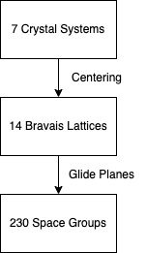
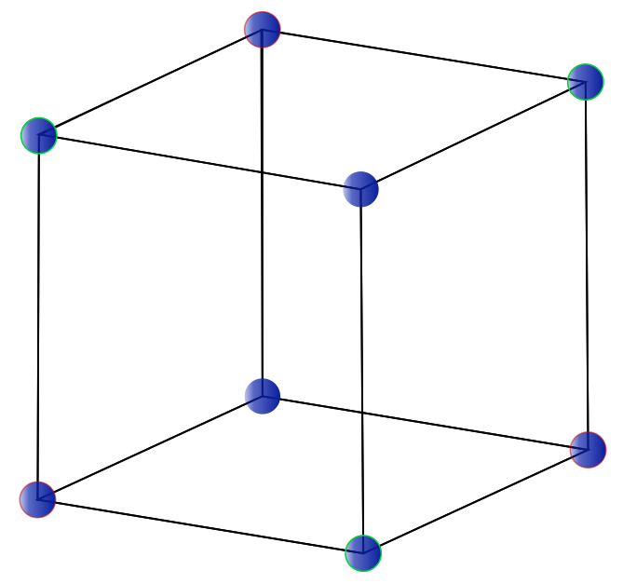
Crystal Structure

Slide 4
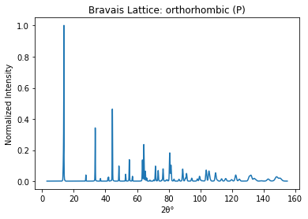
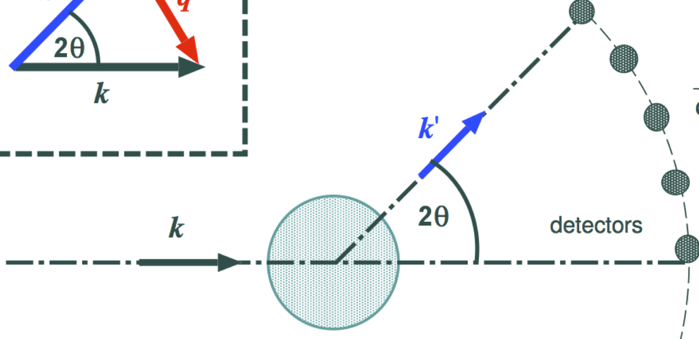
Neutron Diffraction
Neutrons scattered by atoms

Slide 5
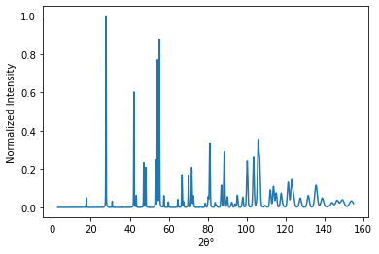
Data
Inorganic Crystal Structure Database
1-D approach
138,000 simulated patterns

Slide 6
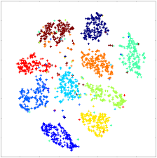
Self-Supervised Learning
Mimics how humans learn
Pretext task & Target task
Pretext task clusters in latent space

Slide 7
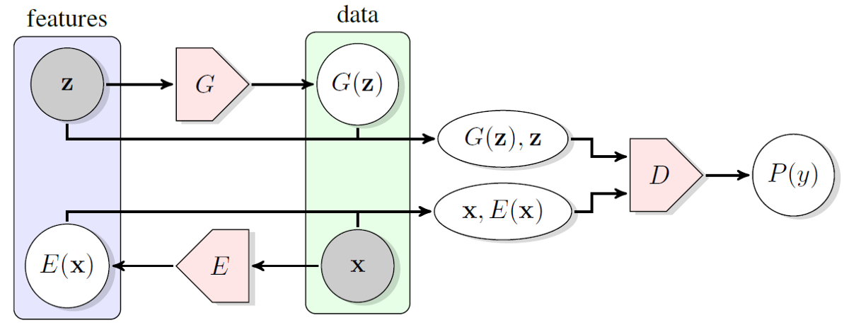
Bidirectional Generative Adversarial Network (BiGAN)
3 models: Generator, Encoder, Discriminator
Encoder maps to latent space
Discriminator clusters in latent space

Slide 8
Challenges with GANs
Zero-sum Equilibrium
Mode collapse
Same generated images
Vanishing Gradients
Models stop learning

Slide 9
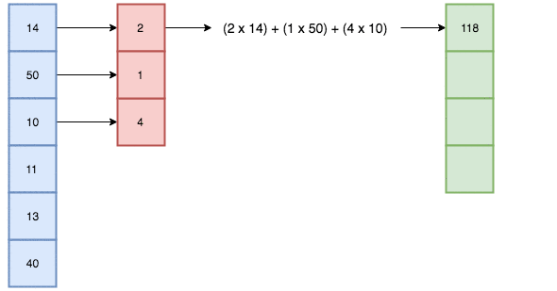
Convolutional Layers
Extract high level features
Reduce dimensionality

Slide 10
Residual Network (ResNet)
Residual/skip connections
Reduce parameters
More generalizable model

Slide 11
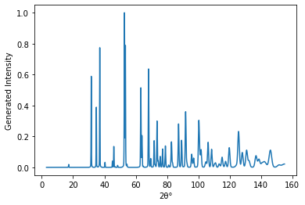
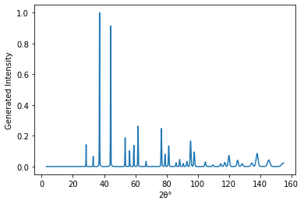
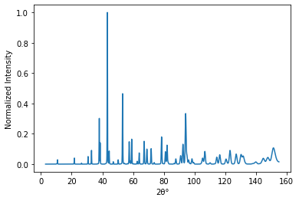
Generated vs Real Patterns

Slide 12
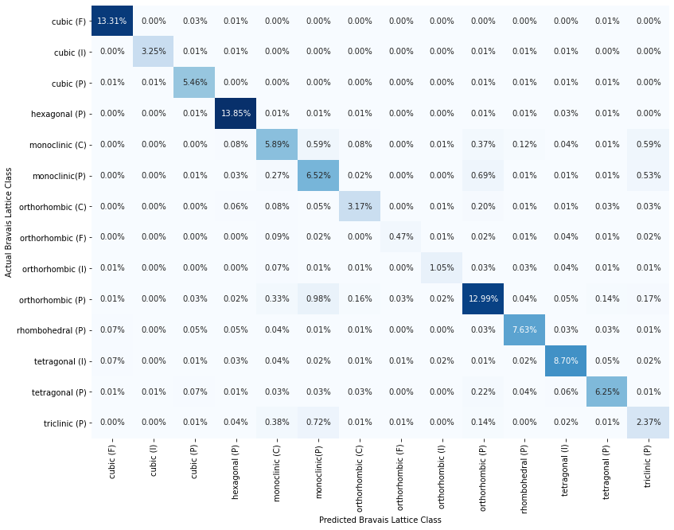
Bravais Lattice Confusion Matrix
Self supervised: 88%

Slide 13
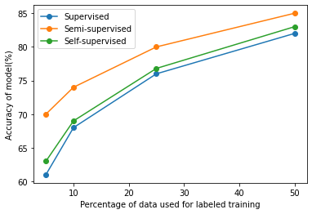
Accuracy Comparison

Slide 14
Conclusion
Self-supervised approach can be used for diffraction classification
No significant difference in accuracy compared to supervised approach

Slide 15
Future Work
Different self supervised techniques
Classify space groups

Slide 16
Acknowledgements
Dr. William Ratcliff (NCNR)
CHRNS/NCNR

