Slide 1


SANS data analysis:
General rules and guidance
Yun Liu
( yunliu@nist.gov, yunliu@udel.edu )
Center for Neutron Research
National Institute of Standards and Technology (NIST)
Chemical and Biomolecular Engineering Department, University of Delaware
CHRNS Virtual Neutron School, February, 2021

Slide 2
Outline
Basic concepts for SANS
General thoughts (or rules?) for the SANS data analysis
1D analysis: Shape independent analysis
1D analysis: Shape dependent analysis (Form factor: P(Q)
1D analysis: Inter-particle structure factor, S(Q) – Understand the interaction between particles
2D data analysis
SANS analysis tools
Summary

Slide 3
Basic concepts of SANS
Even though there are many different scattering techniques, the analysis theories for them are very similar.

Slide 4
Basic concepts of SANS
A typical scattering experiment setup
Scattered particle
Probing particle:
Neutron, photon

Slide 5


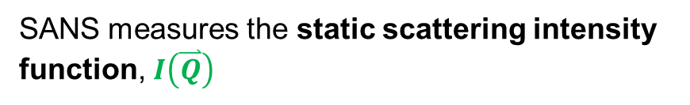


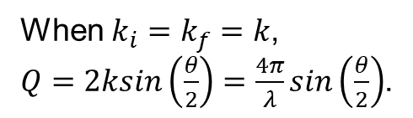


Basic concepts of SANS
A typical scattering experiment setup
Scattered particle
$${\overset{⃑}{k}}_{f}$$
$${\overset{⃑}{k}}_{i}$$
θ
Probing particle
$${\overset{⃑}{k}}_{f}$$
$$\overset{⃑}{Q}$$
Static scattering intensity function
θ
$${\overset{⃑}{k}}_{i}$$
SANS measures the static scattering intensity function, $I\left(\overset{⃑}{Q}\right)$
When $k_{i}=k_{f}=k$,
$Q=2ksin\left(\frac{θ}{2}\right)=\frac{4π}{λ}sin\left(\frac{θ}{2}\right)$.

Slide 6
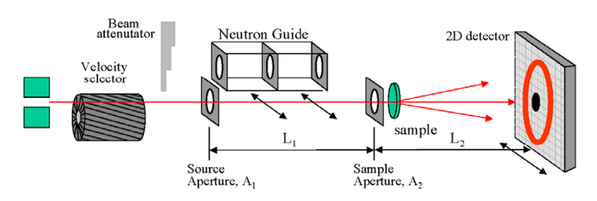
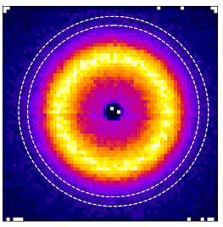
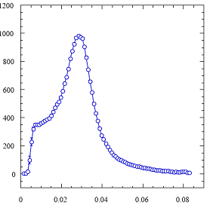







Basic concepts of SANS
2D pattern
$I\left(\overset{⃑}{Q}\right)=I(Q_{x},Q_{y}$, $Q_{z}≈0)$
1D data: $I(Q)$
$$Q_{y}$$
Annulus average
I(Q) (cm⁻¹)
$$Q_{x}$$
Q (Å⁻¹)
$${\overset{⃑}{k}}_{i}$$
$$\overset{⃑}{Q}$$
θ
$${\overset{⃑}{k}}_{i}$$

Slide 7
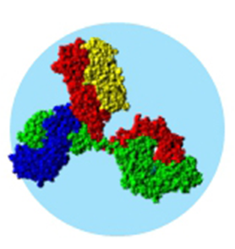

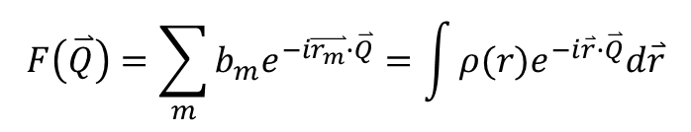
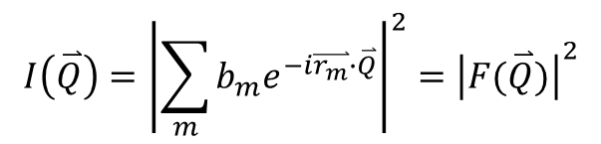

I(Q) (static scattering intensity function)
Basic concepts of SANS
What is the relation between I(Q) and the structure of investigated material?
$$I\left(\overset{⃑}{Q}\right)={\left|\sum_{m}{b_{m}e^{−i\overset{⃑}{r_{m}}∙\overset{⃑}{Q}}}\right|}^{2}={\left|F(\overset{⃑}{Q})\right|}^{2}$$
$$F\left(\overset{⃑}{Q}\right)=\sum_{m}{b_{m}e^{−i\overset{⃑}{r_{m}}∙\overset{⃑}{Q}}}=\int{ρ(r)e^{−i\overset{⃑}{r}∙\overset{⃑}{Q}}d\overset{⃑}{r}}$$
Fourier transformation of the image
$$F(\overset{⃑}{Q})$$
($\overset{⃑}{Q}$: reciprocal space)
Static scattering function is related with the amplitude of the FT of the structure.

Slide 8
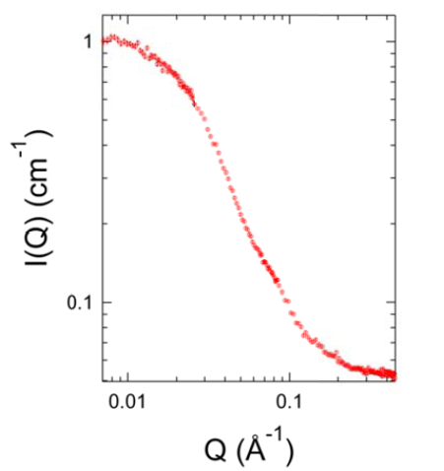
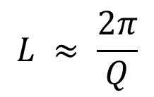
I(Q) (static scattering intensity function)
Basic concepts of SANS
$$L ≈ \frac{2π}{Q}$$
Probed length scale vs. Q:
Small Q
Large L
Overall Size of the protein
Large Q
Small L
Domain structure information

Slide 9
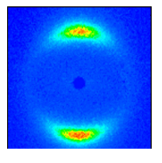




Goals of SANS data analysis
1D data: $I(Q)$
2D pattern
$I\left(\overset{⃑}{Q}\right)=I(Q_{x},Q_{y}$, $Q_{z}≈0)$
$$Q_{y}$$
$$Q_{x}$$

Slide 10
Outline
Basic concepts for SANS
General thoughts (or rules?) for the SANS data analysis
1D analysis: Shape independent analysis
1D analysis: Shape dependent analysis (Form factor: P(Q)
1D analysis: Inter-particle structure factor, S(Q) – Understand the interaction between particles
2D data analysis
SANS analysis tools
Summary

Slide 11
Personal thoughts # 1
1.Making the analysis easier
Avoid multiple scattering effects for the coherent scattering.
Coherent scattering contribution should be less than 10% of incident neutrons.
Single scattering event
Multiple scattering effect

Slide 12
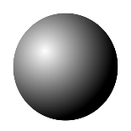
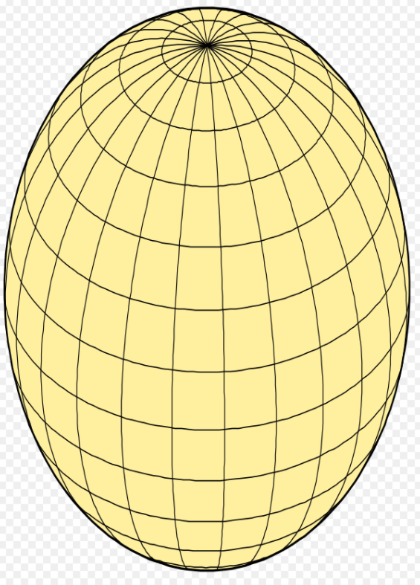
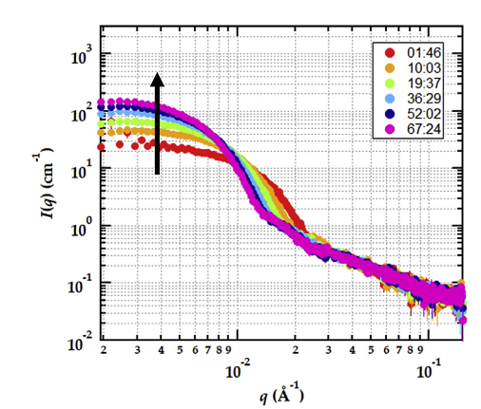
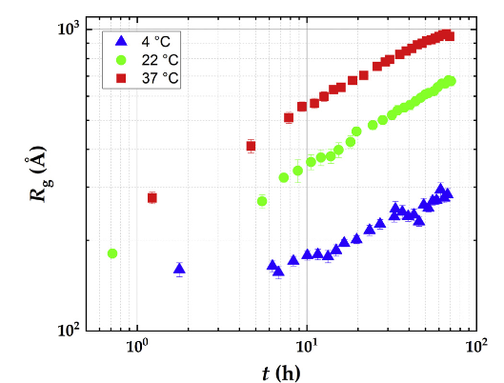
Personal thoughts # 2
2. Understand what you need to know.
Choose the right model.
You may NOT need to fit everything of the SANS patterns
P. H. Gilbert, et al. Jour of Pharmaceutical Science, 2021

Slide 13
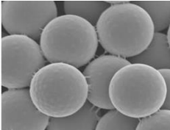
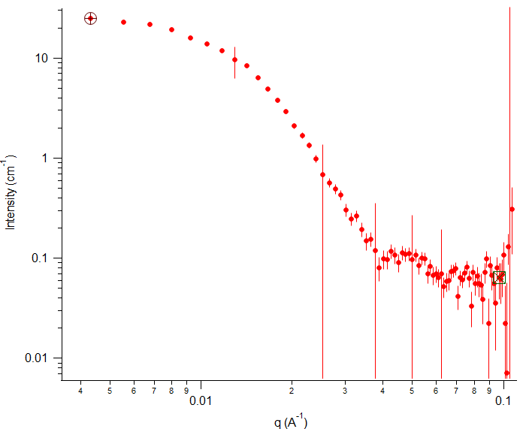
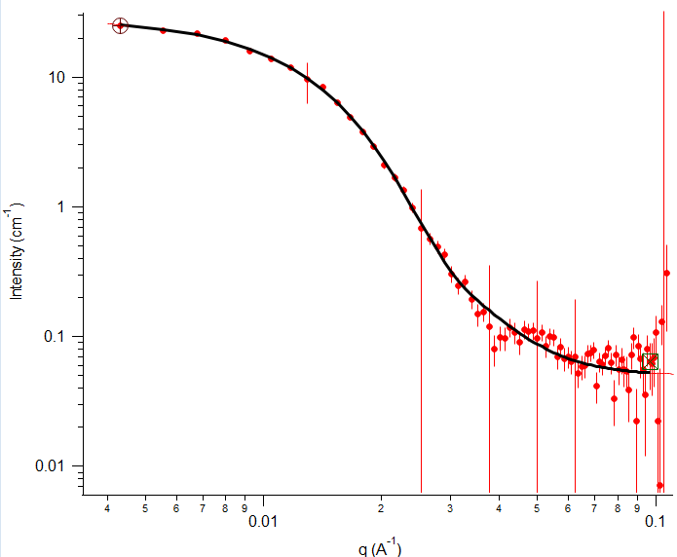
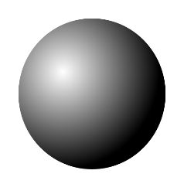

Personal thoughts # 3
3. For many cases, use other methods to find a model, and use SANS to find the values of the parameters for the model
$$χ^{2}=1.0$$
Spherical particles with polydispersity
12.5 nm

Slide 14
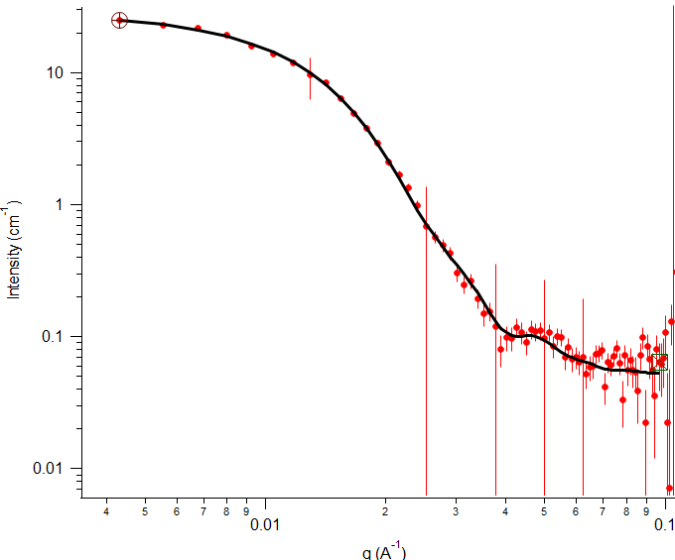

Personal thoughts # 4
4. There may be multiple models that can fit the data equally well
$$χ^{2}=0.9$$
Prolate sphere
20 x 10 x 10 nm
$$χ^{2}=1.0$$
Spherical particles with polydispersity
12.5 nm

Slide 15
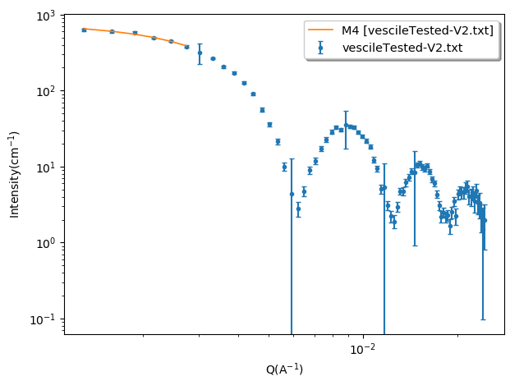
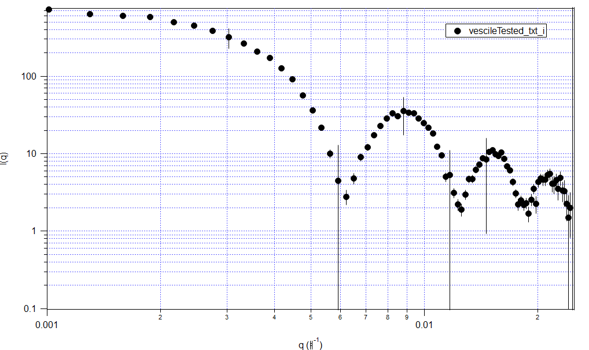
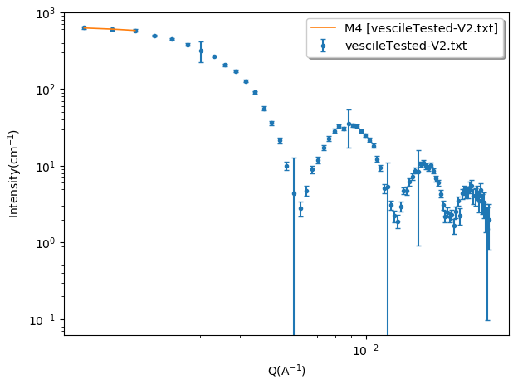
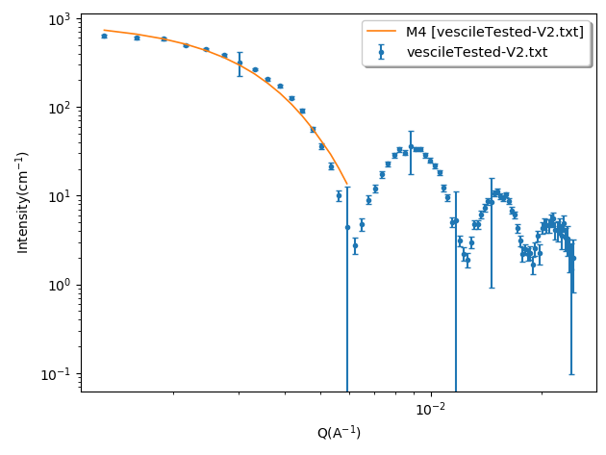
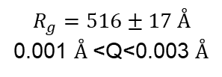

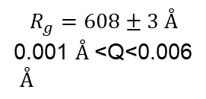
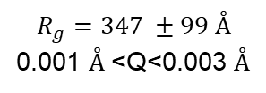
Personal thoughts # 5
5. Understand the limitations of the data and theoretical models
For a Guinier analysis, $QR_{g}<1$
$$R_{g}=516±17 Å$$
0.001 $Å$<Q<0.003 $Å$
$$R_{g}=347 ±99 Å$$
0.001 $Å$<Q<0.003 $Å$
$$R_{g}=608±3 Å$$
0.001 $Å$<Q<0.006
$Å$

Slide 16
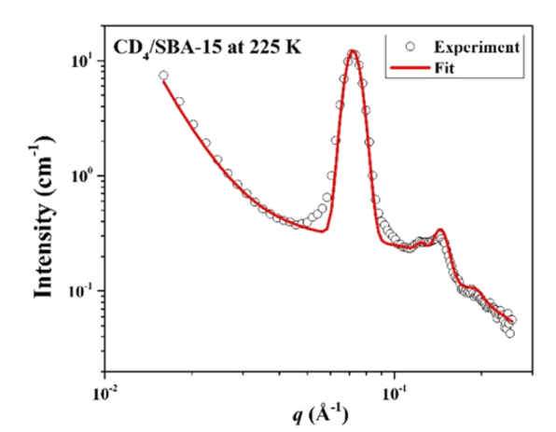
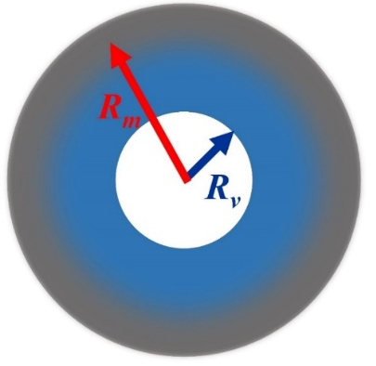
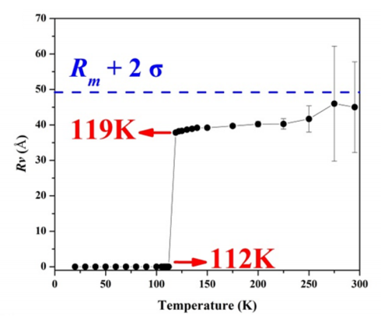
Personal thoughts # 6
6. Evaluate the sensitivity of the fitting parameters.
All fittings are model biased.
(Use the Error bar analysis, and systematic error evaluation.)
Methane gas adsorption in cylinder pores with the diameter about 7 nm.
W. S. Chiang, et al. J. Phys. Chem. C 120, 4354(2016)

Slide 17
Our goal
7. Best fitting to the data may not be the right answer!
8. More parameters usually make the fitting better, but not necessarily a better approach
…
Our goal:
Understand the structure and dynamics of a sample by analyzing and fitting the data.
Our goal is NOT to have the best fitting for our SANS data.

Slide 18
Outline
Basic concepts for SANS
General thoughts (or rules?) for the SANS data analysis
1D analysis: Shape independent analysis
1D analysis: Shape dependent analysis (Form factor: P(Q)
1D analysis: Inter-particle structure factor, S(Q) – Understand the interaction between particles
2D data analysis
SANS analysis tools
Summary

Slide 19
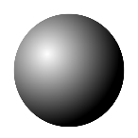

1. Guinier analysis – Radius of gyration
n: number density
v: volume of a colloidal particle
Δρ: scattering length density difference
Q range for the Guinier plot:
Slope:
R=40Å
I(Q)
ln(I(Q))
Guinier plot
Q (Å⁻¹)
Q²(Å⁻²)

Slide 20
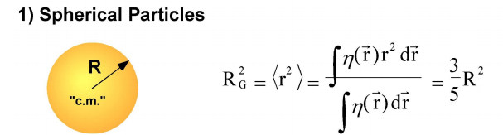
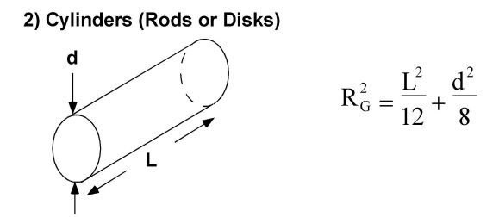
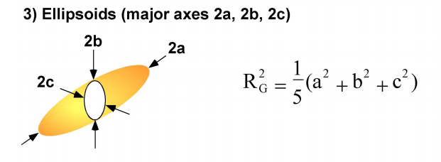
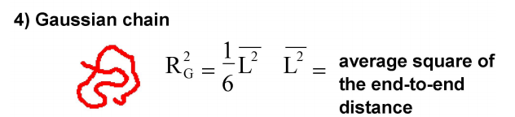
1. Guinier analysis – Radius of gyration
Radius of Gyration
View graph from Charles Glinka
http://www.ncnr.nist.gov/programs/sans/pdf/SANS_dilute_particles.pdf

Slide 21
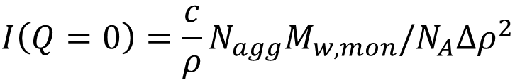
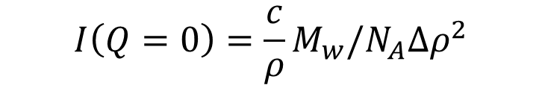

1. Guinier analysis – Molecular Mass
$$I\left(Q=0\right)=nv^{2}{Δρ}^{2}$$
$$I\left(Q=0\right)=\frac{c}{ρ}M_{w}/N_{A}{Δρ}^{2}$$
$c$: mass concentration $ρ$: mass density
$N_{A}$: Avogadro number$M_{w}$: molecular mass
$$I\left(Q=0\right)=\frac{c}{ρ}N_{agg}M_{w,mon}/N_{A}{Δρ}^{2}$$
For a micelle system,
For the same concentration, large intensity means large molecular mass.

Slide 22
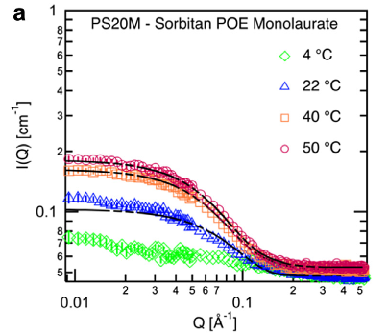
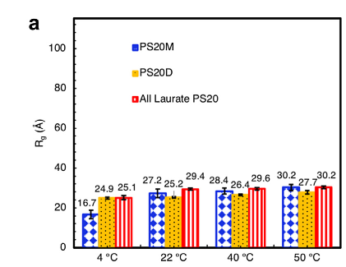
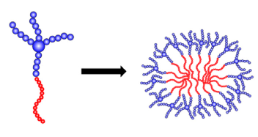
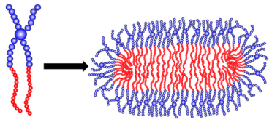
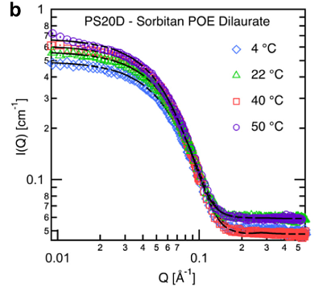
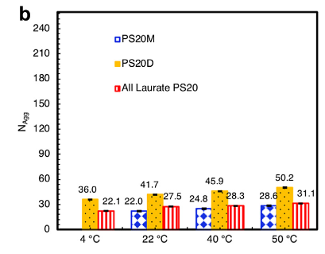
1. Guinier analysis – Example
Jannatun Nayem, Zhenhuan Zhang, Anthony Thomlinson, Isidro E. Zarraga, Norman J. Wagner, Yun Liu, Journal of Pharmaceutical Sciences, 109(4), 1498-1508 (2019)

Slide 23

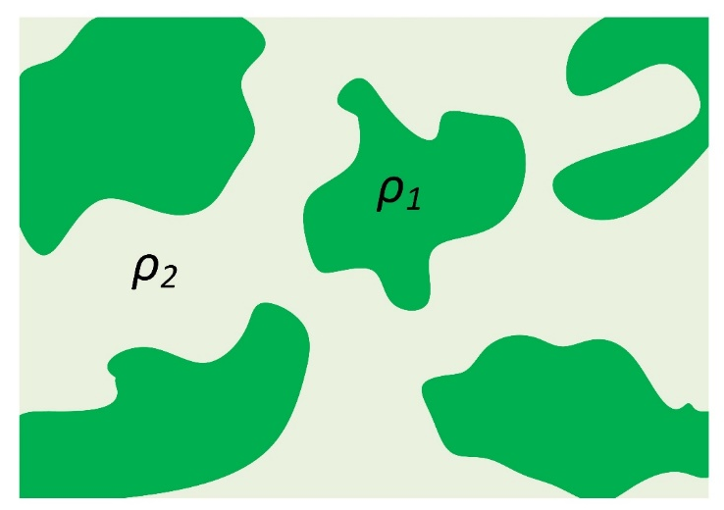
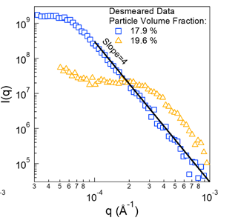
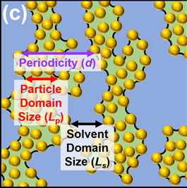
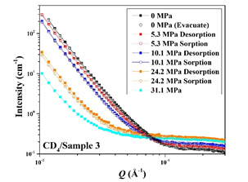
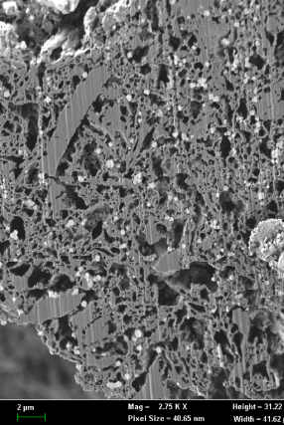


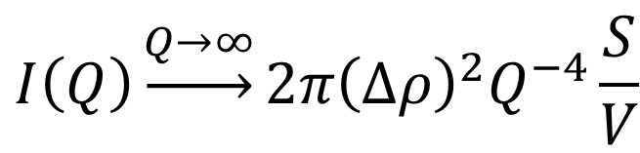
2. Porod’s Law Scattering: two phases
For Two-Phase systems with smooth interfaces:
$$I\left(Q\right)\underset{→}{Q→∞}2π{\left(∆ρ\right)}^{2}Q^{−4}\frac{S}{V}$$
$$∆ρ=ρ_{1}−ρ_{2}$$
Porod G., Kolloid Zeit., 124 (1951) 83; 125 (1951) 51
SLD (Scattering Length Density) is only determined by element composition and material density.
$$Q^{−4}$$
Porous materials
Particle domains
Wei-Shan Chiang et al., Energy & Fuel (2020)
Yuyin Xi et al., Langmuir (2021)
Notes:
Protein aggregation is a common problem in bio-processing operations such as drying, reconstitution, and storage
Soluble aggregates may decrease effectiveness of pharmaceuticals or cause unwanted side-effects
Protein aggregation has also been implicated in a variety of debilitating diseases
Recent evidence suggests that soluble aggregate precursors rather than mature, insoluble fibrils are the primary cytotoxic species in a number of cases
Protein aggregation is a common issue encountered during manufacture of pharmaceuticals.
For protein therapeutics, the presence of aggregates of any type is typically considered to be undesirable because of the concern that the aggregates may lead to an immunogenic reaction or may cause adverse effects on administration.
Therefore, care should be taken when developing a process to monitor the compatibility of the equipment and process with the protein to ensure that potential aggregation is minimized.
It is possible to influence the amount of aggregate produced during the cell culture and purification process by carefully controlling the environment and implementing appropriate strategies to minimize the extent of aggregation.
Steps to remove aggregates have been successfully used at a manufacturing scale.
23

Slide 24
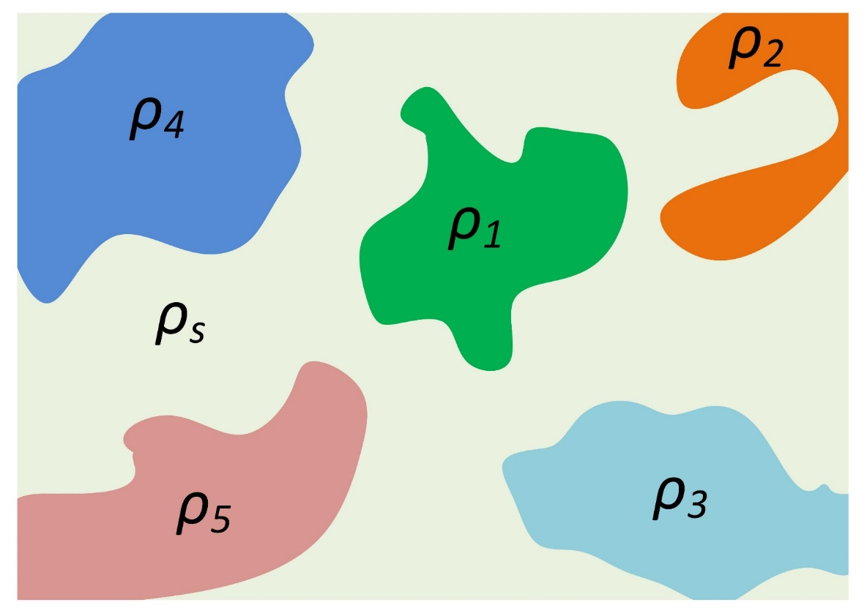





2. Porod’s law scattering: multiple phases
SLD (Scattering Length Density) is only determined by element composition and material density.
pores
Matrix 4
Matrix 2
$$I\left(Q\right)\underset{→}{Q→∞}2π {〈{∆ρ}^{2}〉}_{s} Q^{−4}\frac{S_{T}}{V}$$
pores
Matrix 1
pores
$${〈{∆ρ}^{2}〉}_{s}≡\frac{1}{S_{T}}\int{{\left(ρ\left(S\right)−ρ_{s}\right)}^{2} dS}$$
pores
$$Q^{−4}$$
Matrix 3
Matrix 5
W. S. Chiang, D. Georgi, T. Yildirim, J. Chen, Y. Liu, Nat Commun. 9(1), 784 (2018).
Notes:
Protein aggregation is a common problem in bio-processing operations such as drying, reconstitution, and storage
Soluble aggregates may decrease effectiveness of pharmaceuticals or cause unwanted side-effects
Protein aggregation has also been implicated in a variety of debilitating diseases
Recent evidence suggests that soluble aggregate precursors rather than mature, insoluble fibrils are the primary cytotoxic species in a number of cases
Protein aggregation is a common issue encountered during manufacture of pharmaceuticals.
For protein therapeutics, the presence of aggregates of any type is typically considered to be undesirable because of the concern that the aggregates may lead to an immunogenic reaction or may cause adverse effects on administration.
Therefore, care should be taken when developing a process to monitor the compatibility of the equipment and process with the protein to ensure that potential aggregation is minimized.
It is possible to influence the amount of aggregate produced during the cell culture and purification process by carefully controlling the environment and implementing appropriate strategies to minimize the extent of aggregation.
Steps to remove aggregates have been successfully used at a manufacturing scale.
24

Slide 25





3. Power law dependence: Mass fractal analysis
$$I\left(Q\right)=\frac{A}{Q^{d_{f}}}$$
J. E. Martin, and A. J. Hurd, J. App. Cryst. 20, 61-78 (1987)
More complete version
T. Freltoft, J. K. Kjems, and S. K. Sinha, Phys. Rev. B 33, 269 (1986)
Mass fractal analysis:
$$d_{f}≤3$$

Slide 26






3. Power law dependence: Surface fractal analysis
Smooth Surface
$$I\left(Q\right)→A{/Q}^{4}$$
Surface fractal scattering
Rough surface
$$I\left(Q\right)→A{/Q}^{6−d_{f}}$$
$$3<6−d_{f}<4$$
${2<d}_{f}$<3
J. E. Martin, and A. J. Hurd, J. App. Cryst. 20, 61-78 (1987)
More complete version
$$I\left(Q\right)={\left(∆ρ\right)}^{2}\frac{S}{V}l^{D_{f}−2}\frac{\left.πΓ(5−D_{f})sin{(}\frac{π\left(3−D_{f}\right)}{2}\right)}{3−D_{f}}\frac{1}{Q^{6−D_{f}}}$$
Wong, P. Z.; Bray, A. J.,. Journal of Applied Crystallography 1988, 21, 786-794

Slide 27



4. Invariant calculations
Invariant:
I(Q) (cm⁻¹)
$$Q^{∗}≡\int{I\left(\overset{⃑}{Q}\right)d\overset{⃑}{Q}}=\int{I(Q)Q^{2}dQ}$$
$Q^{∗}$ is a constant if the constituent components are incompressible no matter what structures are formed in this system.
Q (Å⁻¹)
For a two-phase system:
P. H. Gilbert, et al. Jour of Pharmaceutical Science, 2021

Slide 28




4. Invariant calculations: examples
P. H. Gilbert, et al. Jour of Pharmaceutical Science, 2021

Slide 29


5. SasView
Website: https://www.sasview.org/

Slide 30
Outline
Basic concepts for SANS
General thoughts (or rules?) for the SANS data analysis
1D analysis: Shape independent analysis
1D analysis: Shape dependent analysis (Form factor: P(Q)
1D analysis: Inter-particle structure factor, S(Q) – Understand the interaction between particles
2D data analysis
SANS analysis tools
Summary

Slide 31

Different models in SasView
Website: https://www.sasview.org/

Slide 32





Cylindrical objects
$$Q_{y}$$
$$α$$
$$Q_{x}$$
$$Q_{z}$$
$$P\left(Q\right)=n{v^{2}Δρ}^{2}\frac{1}{2}\int_{0}^{π}{\frac{\sin^{2}\left(Q\frac{L}{2}\cos{α}\right)}{{\left(Q\frac{L}{2}cos{α}\right)}^{2}}\frac{{\left[2J_{1}\left(Q\sin{α}\frac{d}{2}\right)\right]}^{2}}{{\left(Q\frac{d}{2}\sin{α}\right)}^{2}}\sin{α}dα}$$

Slide 33
Form factor: Cylinders
1) QL << 1 (Guinier region)
2) QL >> 1 & Qd << 1
View graph from Charles Glinka
3) Qd >> 1
http://www.ncnr.nist.gov/programs/sans/pdf/SANS_dilute_particles.pdf
(Porod law: Q⁻⁴ decay)

Slide 34




Form factor: Disks
1) QD << 1 (Guinier region)
$$R_{G}^{2}=\frac{t^{2}}{12}+\frac{D^{2}}{8}$$
2) QL >> 1 & Qd << 1
View graph from Charles Glinka
3) Qd >> 1
http://www.ncnr.nist.gov/programs/sans/pdf/SANS_dilute_particles.pdf
(Porod law: Q⁻⁴ decay)

Slide 35





Vesical objects
https://en.wikipedia.org/wiki/Vesicle_(biology_and_chemistry)
R=50nm
Thickness=5nm
R=50nm
Thickness=2nm

Slide 36


Vesical objects
$$Q^{−2}$$
$$Q^{−2}$$
R=50nm
Thickness=5nm
R=50nm
Thickness=2nm
1. Size of the vesicle (low Q)
2. Thickness of the vesicle (high Q)
3. Power law decay (middle Q)

Slide 37



Proteins with the PDB structures
Monoclonal antibody protein
$$I\left(Q\right)=n\sum_{i}{\sum_{j}{b_{i}b_{j}\frac{Sin(Q\left|{\overset{⃑}{r}}_{i}−{\overset{⃑}{r}}_{j}\right|)}{Q\left|{\overset{⃑}{r}}_{i}−{\overset{⃑}{r}}_{j}\right|}}}$$
Maria Monica Castellanos et al. Analytical and Bioanalytical Chemistry (2018) 410:2141–2159

Slide 38

Proteins with the PDB structures
SASSIE Program
http://www.smallangles.net/sassie/SASSIE_HOME.html
Website: https://www.sasview.org/
CRYSON and CRYSOL in ATSAS
https://www.embl-hamburg.de/biosaxs/cryson.html

Slide 39

Add multiple models together
A system with two different objects:
Create your own models in SASView

Slide 40



Any arbitrary shapes
$$I\left(\overset{⃑}{Q}\right)={\left|\sum_{m}{b_{m}e^{−i\overset{⃑}{r_{m}}∙\overset{⃑}{Q}}}\right|}^{2}={\left|F(\overset{⃑}{Q})\right|}^{2}$$
$$F\left(\overset{⃑}{Q}\right)=\sum_{m}{b_{m}e^{−i\overset{⃑}{r_{m}}∙\overset{⃑}{Q}}}=\int{ρ(r)e^{−i\overset{⃑}{r}∙\overset{⃑}{Q}}d\overset{⃑}{r}}$$
https://en.wikipedia.org/wiki/Pyramid

Slide 41
Outline
Basic concepts for SANS
General thoughts (or rules?) for the SANS data analysis
1D analysis: Shape independent analysis
1D analysis: Shape dependent analysis (Form factor: P(Q)
1D analysis: Inter-particle structure factor, S(Q) – Understand the interaction between particles
2D data analysis
SANS analysis tools
Summary

Slide 42




I(Q) (static scattering intensity function)
Inter-particle structure factor
(
-
)
×
I(Q)
=
A
×
×
P(Q)
S(Q)
Static scattering function
prefactor
Normalized form factor
Inter-particle structure factor

Slide 43
I(Q) (static scattering intensity function)
Inter-particle structure factor
(
-
)
×
I(Q)
=
A
×
×
P(Q)
S(Q)
Molecular mass
Aggregate mass
Aggregation number
Particle size
Particle shape
Polydispersity
Aggregate size
Relative locations of particles:
Protein-protein interaction
Phase transition
Fractal structure

Slide 44



Particle-particle interactions vs. S(Q)
M.Broccio, D.Costa, Y.Liu, S.H. Chen, JCP 124, 084501 (2006)

Slide 45
Particle-particle interactions vs. S(Q)
Ornstein-Zernike equation
Ornstein-Zernike equation:
Closures (approximations): link pair interaction potential with h(r) and c(r).
MSA closure (Mean Spherical Approximation)
PY closure (Percus-Yevic)
HNC closure (Hypernetted-Chain)
RY closure (Rogers-Young)
Other closures: Zerah-Hansen, SMSA, SCOZA, HMSA, …
Reference: C. Caccamo, Integral Equation Theory Description of Phase Equilibria in Classical Fluids, Physics Report 274, 1-105 (1996).
J. P. Hansen, I. R. McDonald, Theory of Simple Liquids (Academic Press, London) 1976
Colloidal interaction in solutions by Yun Liu. Website link:
https://cpb-us-w2.wpmucdn.com/sites.udel.edu/dist/4/1563/files/2014/03/ColloidsTutorial_final-283hizw.pdf

Slide 46

Models for S(Q) in SasView
I(Q) = A × P(Q) × S(Q)
Four different type of interaction models:
Hardsphere
Hayter_MSA
Squarewell
Stickyhardsphere

Slide 47

S(Q) in SasView: Hardsphere
I(Q) = A × P(Q) × S(Q)
Four different type of interaction models:
Hardsphere
Hayter_MSA
Squarewell
Stickyhardsphere
Spherical particles in solutions. (PY closure)
Colloidal Interactions in solution
https://cpb-us-w2.wpmucdn.com/sites.udel.edu/dist/4/1563/files/2014/03/ColloidsTutorial_final-283hizw.pdf

Slide 48


S(Q) in SasView: Hayter_MSA
I(Q) = A × P(Q) × S(Q)
Four different type of interaction models:
Hardsphere
Hayter_MSA
Squarewell
Stickyhardsphere
Colloidal particles with charge interactions.
(MSA closure)
J. B. Hayter and J. Penfold, Mol. Phys. 46, 651 (1981).
Colloidal Interactions in solution
https://cpb-us-w2.wpmucdn.com/sites.udel.edu/dist/4/1563/files/2014/03/ColloidsTutorial_final-283hizw.pdf

Slide 49




S(Q) in SasView: Squrewell
I(Q) = A × P(Q) × S(Q)
Four different type of interaction models:
Hardsphere
Hayter_MSA
Squarewell
Stickyhardsphere
Colloidal particles with short-range attraction.
(PY closure)
$$V\left(r\right)=\left\{\begin{aligned}&+∞, r<σ \\ &−εk_{B}T, σ<r<λσ=a \\ &0, r>λσ=a\end{aligned}\right.$$
$$τ=\frac{1}{\left.4(λ^{3}−1)(e^{ε}−1\right)}$$
Colloidal Interactions in solution
https://cpb-us-w2.wpmucdn.com/sites.udel.edu/dist/4/1563/files/2014/03/ColloidsTutorial_final-283hizw.pdf

Slide 50

Other interaction models
Two Yukawa Hard-Core Potential
Y. Liu, W. R. Chen, S. H. Chen, J. Chem. Phys. 122, 044507 (2005)
It is useful for system with complicated potential.
1. Charge colloidal particles with a short-range
attraction.
2. Charge colloidal particles with a soft-core.
3. Simulate the Lennard-Jones potential.
structure factor
M.Broccio, D.Costa, Y.Liu, S.H. Chen, JCP 124, 084501 (2006)

Slide 51
Effect of polydispersity and anisotropic shape
β-approximation
I(Q) = A × P(Q) × S(Q)
Decoupling approximation: one component system with spherical particles
Given the know information of inter-particle potential, S(Q) can be
obtained by solving OZ equation: isotropic interaction
β-approximation
I(Q) =
can be approximated with one component structure factor.
S.-H. Chen Ann. Rev. Phy. Chem. 37 351 1986

Slide 52
Outline
Basic concepts for SANS
General thoughts (or rules?) for the SANS data analysis
1D analysis: Shape independent analysis
1D analysis: Shape dependent analysis (Form factor: P(Q)
1D analysis: Inter-particle structure factor, S(Q) – Understand the interaction between particles
2D data analysis
SANS analysis tools
Summary

Slide 53





Anisotropic 2D SANS patterns
Crystal formation of spherical micelles
Smectic phase of rod objects
Carlos R Lopez-Barron, et al., PRL 108,258301(2012)
Satoshi Kajiyama, et al., Nanoscale 12, 11468(2020)
Polymer deformations under stretching
Structures of shear banding materials
Matthew E. Helgeson, et al., J. of Rheology 53, 727(2009)
Zhe Wang et al., PRX 7, 031003 (2017)

Slide 54








Alignment factor for rod like systems
Wormlike micelles
$$φ$$
$$φ$$
Alignment factor:
$$A_{f}=1$$
Perfectly aligned
$$A_{f}=0$$
Randomly distributed
Structures of shear banding materials
Matthew E. Helgeson, et al., J. of Rheology 53, 727(2009)

Slide 55





Orientation distribution of a rod
Katie M. Weigandt et al. Soft Matter 7,9992(2011)
Alignment of fibrin clot.

Slide 56


Spherical Harmonic Expansion
Polymer deformations under stretching
Zhe Wang et al., PRX 7, 031003 (2017)

Slide 57
Outline
Basic concepts for SANS
General thoughts (or rules?) for the SANS data analysis
1D analysis: Shape independent analysis
1D analysis: Shape dependent analysis (Form factor: P(Q)
1D analysis: Inter-particle structure factor, S(Q) – Understand the interaction between particles
2D data analysis
SANS analysis tools
Summary

Slide 58

7. Existing resources
SASView
I(Q) = A × P(Q) × S(Q)
SASView. (Free software)
It is a data analysis software for small angle scattering that was partially funded by NSF initially.
Website: http://www.sasview.org/index.html
It includes of the calculation of form factor (many models) and structure factor for some simple cases.

Slide 59

7. Existing resources
IGOR SANS package
I(Q) = A × P(Q) × S(Q)
2. IGOR SANS package. (Free software) (Developed and maintained at NCNR)
It is a comprehensive data reduction, treatment, and analysis software for small angle neutron scattering. But the package can be used to calculate the form factor and structure factor too.
Website: https://www.ncnr.nist.gov/programs/sans/data/red_anal.html
It has most form factors included in SASView and has a few structure factor models.
There are many useful help files for it.

Slide 60

7. Existing resources
Form factor for protein structure: SASSIE
I(Q) = A × P(Q) × S(Q)
4. SASSIE (Free software) (Developed and maintained people at NCNR)
SASSIE is a software to create atomistic models of molecular systems and calculate the scattering intensity. It can calculate the form factor using the protein PDB file and fit experimental SANS /SAXS data to extract the conformation of proteins in solutions.
Website: http://www.smallangles.net/sassie/SASSIE/SASSIE_HOME.html

Slide 61

7. Existing resources
ATSAS
I(Q) = A × P(Q) × S(Q)
5. ATSAS (Free software)
ATSAS is a software developed for small angle scattering data analysis for biological macromolecules. It includes cyrson (crysol) to calculate the form factor of a protein from the PDB files.
Website: http://www.embl-hamburg.de/biosaxs/software.html

Slide 62
Final words
Some of my personal thoughts for achieving a good data analysis:
Have a good understanding of the limitations of the experimental data.
Have a good understanding of the limitations of the models.
Our goal is to understand the structure of our samples by analyzing and fitting the data using a model to approximate a real and complex system.
Our goal is NOT to have the best fit of the data.
Analysis method development for scattering data itself is a scientific field that needs the inputs from everyone. There are many existing methods and models. However, more need to be developed for new scientific problems.

